Slide 1

Software Engineering
Fundamentals
Svetlin Nakov
National Academy for Software Development
academy.devbg.org

Slide 2

Agenda
Software engineering overview
  Requirements
  Design
  Construction
  Testing
  Project management
Development methodologies overview
  The Waterfall development process
  Heavyweight methodologies
  Agile methodologies and XP

Slide 3

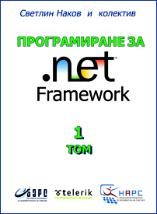


About The Speaker
Svetlin Nakov
  Founder and Chairman of BASD
  Director training and consulting activities, National Academy for Software Development (NASD)
  15 years of developer experience
    8 year as a professional software engineer, trainer and consultant
  Author of 4 books, 20 articles, and 50 seminar lectures
  Lecturer in Sofia University and NBU

Slide 4
Software Engineering
Requirements, Design, Construction, Testing

Slide 5
What is Software Engineering?
Software engineering is the application of a systematic, disciplined, quantifiable approach to the development, operation, and maintenance of software
Definition by IEEE

Slide 6
Software Engineering
Software engineering is:
  An engineering discipline that provides knowledge, tools, and methods for:
    Defining software requirements
    Performing software design
    Software construction
    Software testing
    Software maintenance tasks
    Software project management

Slide 7
Software Development Activities
Software development always includes the following activities (to some extent):
  Requirements analysis
  Design
  Construction
  Testing (sometimes)
These activities do not follow strictly one after another!
  Often overlap and interact
Software Project Management

Slide 8
Software Requirements
Functional, Non-functional Requirements, SRS

Slide 9
Software Requirements
Software requirements define the functionality of the system
  Answer the question "what?", not "how?"
  Define constraints on the system
Two kinds of requirements
    Functional requirements
    Non-functional requirements

Slide 10
Requirements Analysis
Requirements analysis starts from a vision about the system
  Customers don't know what they need!
  Requirements come roughly and are specified and extended iteratively
Prototyping is often used, especially for the user interface
The outcome is the Software Requirements Specification (SRS)

Slide 11
Software Requirements Specification (SRS)
The Software Requirements Specification (SRS) is a formal requirements document
It describes in details:
  Functional requirements
    Business processes
    Actors and use-cases
  Non-functional requirements
    E.g. performance, scalability, etc.

Slide 12
Software Requirements
It is always hard to describe and document the requirements in comprehensive and not ambiguous way
  Good requirements save time and money
Requirements always change during the project!
  Good software requirements specification reduces the changes
  Prototypes significantly reduce changes

Slide 13
Software Requirements Specification and UI Prototype – Examples

Slide 14
Software Architecture and Software Design

Slide 15
Software Architecture and Software Design
Software design is a technical description about how the system will implement the requirements
The system architecture describes:
  How the system will be decomposed into subsystems (modules)
  Responsibilities of each module
  Interaction between modules
  Platforms and technologies

Slide 16
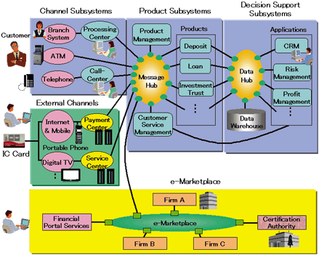
System Architecture Diagram – Example

Slide 17
Software Design
Detailed Design
  Describes the internal module structure
  Interfaces, data design, process design
Object-Oriented Design
  Describes the classes, their responsibilities, relationships, dependencies, and interactions
Internal Class Design
  Methods, responsibilities, algorithms and interactions between them

Slide 18
Software Design Document (SDD)
The Software Design Document (SDD) is a formal description of the architecture and design of the system
It contains:
  Architecture design
    Modules and their interaction (diagram)
  For each module
    Process design (diagrams)
    Data design (E/R diagram)
    Interfaces design (class diagram)

Slide 19
Software Design Document – Example

Slide 20
Software Construction
Implementation, Unit Testing, Debugging, Integration

Slide 21
Software Construction
During the software construction phase developers create the software
  Sometimes called implementation phase
It includes:
  Internal method design
  Writing code
  Writing unit tests (sometimes)
  Testing and debugging
  Integration

Slide 22
Writing the Code
Coding is the process of writing the programming code (the source code)
  The code strictly follows the design
  Developers perform internal method design as part of coding
The source code is the output of the software construction process
  Written by developers
  Can include unit tests

Slide 23
Testing the Code
Testing checks whether the developed software conforms to the requirements
  Aims to identify defects (bugs)
Developers test the code after write it
  At least run it to see the results
  Unit testing is even better
    Units tests can be repeated many times
System testing is done by QA engineers
  Unit testing is done by developers

Slide 24
Debugging
Debugging aims to find the source of already identified defect and to fix it
  Performed by developers
Steps in debugging:
  Find the defect in the code
    Identify the source of the problem
    Identify the exact place in code causing it
  Fix the defect
  Test to check if the fix is correct

Slide 25
Integration
Integration is putting all pieces together
  Compile, run and deploy the modules as single system
  Test to identify defects
Integration strategies
  Big bang, top-down and bottom-up
  Continuous integration

Slide 26
Coding != Software Engineering
Inexperienced developers consider coding the core of development
  In most projects coding is only 20% of the project activities!
  The important decisions are taken during the requirements analysis and design
  Documentation, testing, integration, maintenance, etc. are often disparaged
Software engineering is not just coding!
  Programmer != software engineer

Slide 27
Software Verification and Testing

Slide 28
Software Verification
What is software verification?
  It checks whether the developed software conforms to the requirements
  Performed by the Software Quality Assurance Engineers (QA)
Two approaches:
  Formal reviews and inspections
  Different kinds of testing
Cannot certify absence of defects!
  Can only decrease their rates

Slide 29
Software Testing
Testing checks whether the developed software conforms to the requirements
Testing aims to find defects (bugs)
  Black-box and white-box tests
  Unit tests, integration tests, system tests, acceptance tests
  Stress tests, load tests, regression tests
  Tester engineers can use automated test tools to record and execute tests

Slide 30
Software Testing Process
Test planning
  Establish test strategy and test plan
  During requirements and design phases
Test development
  Test procedures, test scenarios, test cases, test scripts
Test execution
Test reporting
Retesting the defects

Slide 31
Test Plan and Test Cases
The test plan is a formal document that describes how tests will be performed
  List of test activities to be performed to ensure meeting the requirements
  Features to be tested, testing approach, schedule, acceptance criteria
Test scenarios and test cases
  Test scenarios – stories to be tested
  Test cases – tests of single function

Slide 32
Test Plans and Test Cases – Example

Slide 33
Software Project Management

Slide 34
What is Project Management?
Project management is the discipline of organizing and managing resources in order to successfully complete a project
Successfully means within defined scope, quality, time and cost constraints
Project constraints:
Scope
Project Success
Quality
Cost
Time

Slide 35
What is Software Project Management?
Software project management
  Management discipline about planning, monitoring and controlling software projects
Project planning
  Identify the scope, estimate the work involved, and create a project schedule
Project monitoring and control
  Keep the team up to date on the project's progress and handle problems

Slide 36
What is Project Plan?
The project plan is a document that describes how the work on the project will be organized
  Contains tasks, resources, schedule, milestones, etc.
  Tasks have start, end, assigned resources (team members), % complete, dependencies, nested tasks, etc.
Project management tools simplify creating and monitoring project plans

Slide 37
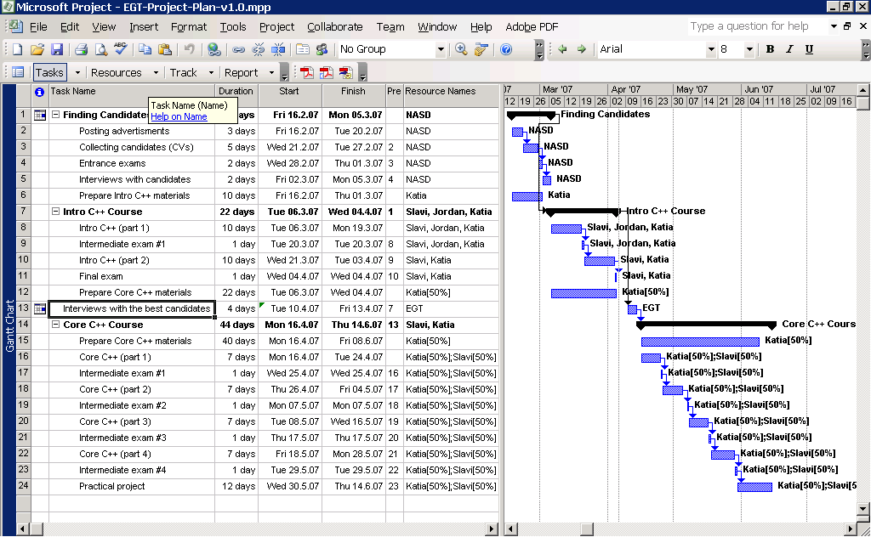
Project Plan – Example

Slide 38
Development Methodologies

Slide 39
What is a Development Methodology?
A development methodology is a set of practices and procedures for creating software
  A set of rules that developers have to follow
  A set of conventions the organization decides to follow
  A systematical, engineering approach for organizing software projects

Slide 40
Development Methodologies
The "Waterfall" Process
  Old-fashioned, not used today
Rational Unified Process (RUP)
  Very formal, lots of documentation
Microsoft Solutions Framework (MSF)
  Formal heavyweight approach
Agile Development Processes
  E.g. Extreme Programming

Slide 41



The Waterfall Development Process

Slide 42
The Waterfall Process
The waterfall development process:
Software
Requirements
Software
Design
Implementation
(Coding)
Verification
(Testing)
Operation
(Maintenance)
Notes:
<number>##
<footer>*
<header>*
11/07/2607/16/96
It’s only in testing that your design is tested against reality. At this point you always learn something about your design (usually that it is wrong!), and that tells you something about your requirements (ditto!)

Slide 43
Formal Methodologies
Formal methodologies are heavyweight!
Requirements
Lots of documents,
diagrams, etc.
System
Requirements
Design
Analysis
Software
Requirements
Detailed
Design
Preliminary
Design
Coding
Software
Requirements
Specification
Integration
Analysis
Testing
Prelim.
Review
Usage
Program
Design
Preliminary
Design
Document
Operating
Instructions
Coding
Design Review
Testing
UI Design Document
Final
Design
Code Review
Test
Plan
Operations

Slide 44

Agile Development

Slide 45
The Agile Manifesto
  “Our highest priority is to satisfy the
  customer through early and continuous
  delivery of valuable software“
  Manifesto for Agile

Slide 46
The Agile Spirit
Incremental
  Working software over comprehensive documentation
Cooperation
  Customer collaboration over contract negotiation
Straightforward
  Individuals and interactions over processes and tools
Adaptive
  Responding to change over following a plan

Slide 47
Agile Methodologies
eXtreme Programming (XP)
Scrum
Crystal family of methodologies
Feature-Driven Development (FDD)
Adaptive Software Development (ASD)
Dynamic System Development Model (DSDM)
Agile Unified Process (AUP)

Slide 48
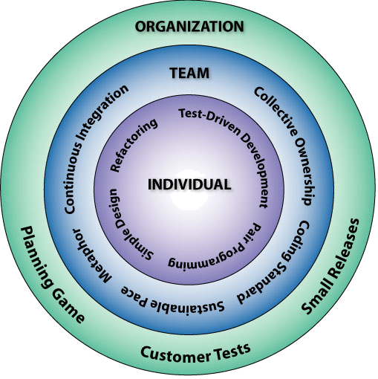
Extreme Programming:
The 12 Key Practices
The Planning Game
Small Releases
Metaphor
Simple Design
Test-Driven Development
Refactoring
Pair Programming
Collective Ownership
Continuous Integration
40-Hour Workweek
On-site Customer
Coding Standards

Slide 49
Software Engineering Fundamentals
Questions?

