Slide 1
Quickstart HTML, Javascript, CSS, and DOM

Slide 2
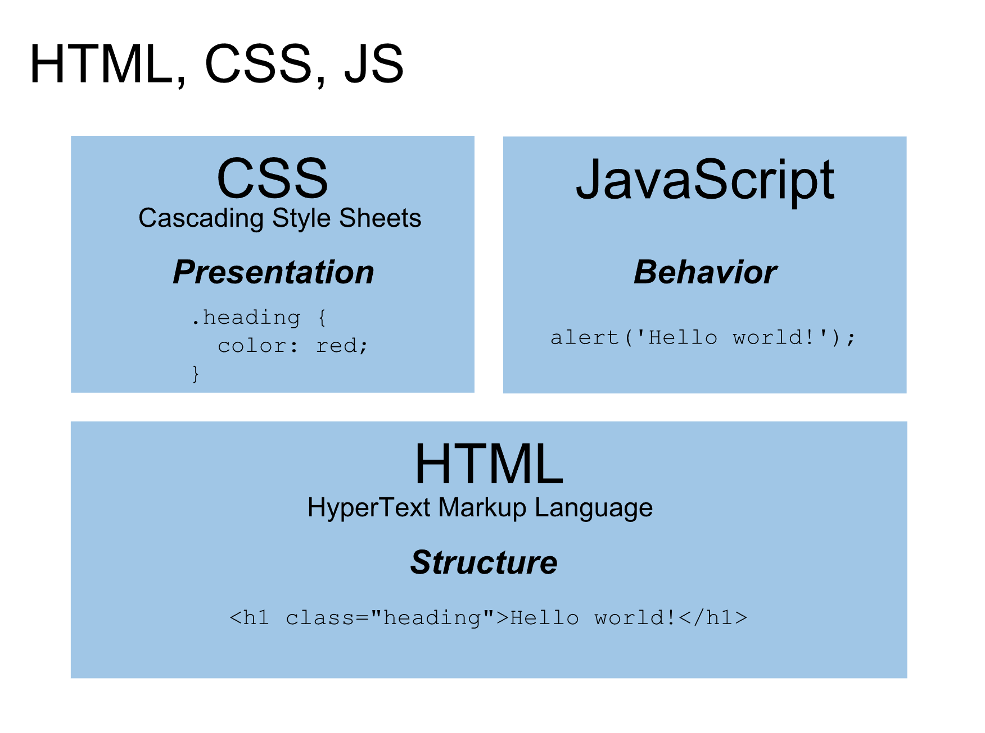

Slide 3
http://sta.mn/w96
Notes:
HTML intro, then build HTML for to-do demo

Slide 4
Make a to-do list
Start with blank block: http://sta.mn/x3fd
Notes:
Final for this: http://blockbuilder.org/loganwilliams/90b5ac0ede7349f83208136e2d5f5021

Slide 5
http://sta.mn/sc4
Notes:
CSS intro, then style it a little bit

Slide 6
Make the to-do list prettier
Notes:
http://blockbuilder.org/loganwilliams/a5e487d989097924d93e83393f24b6c0

Slide 7
http://sta.mn/6xw
Notes:
Intro to Javascript, variables and functions.

Slide 8
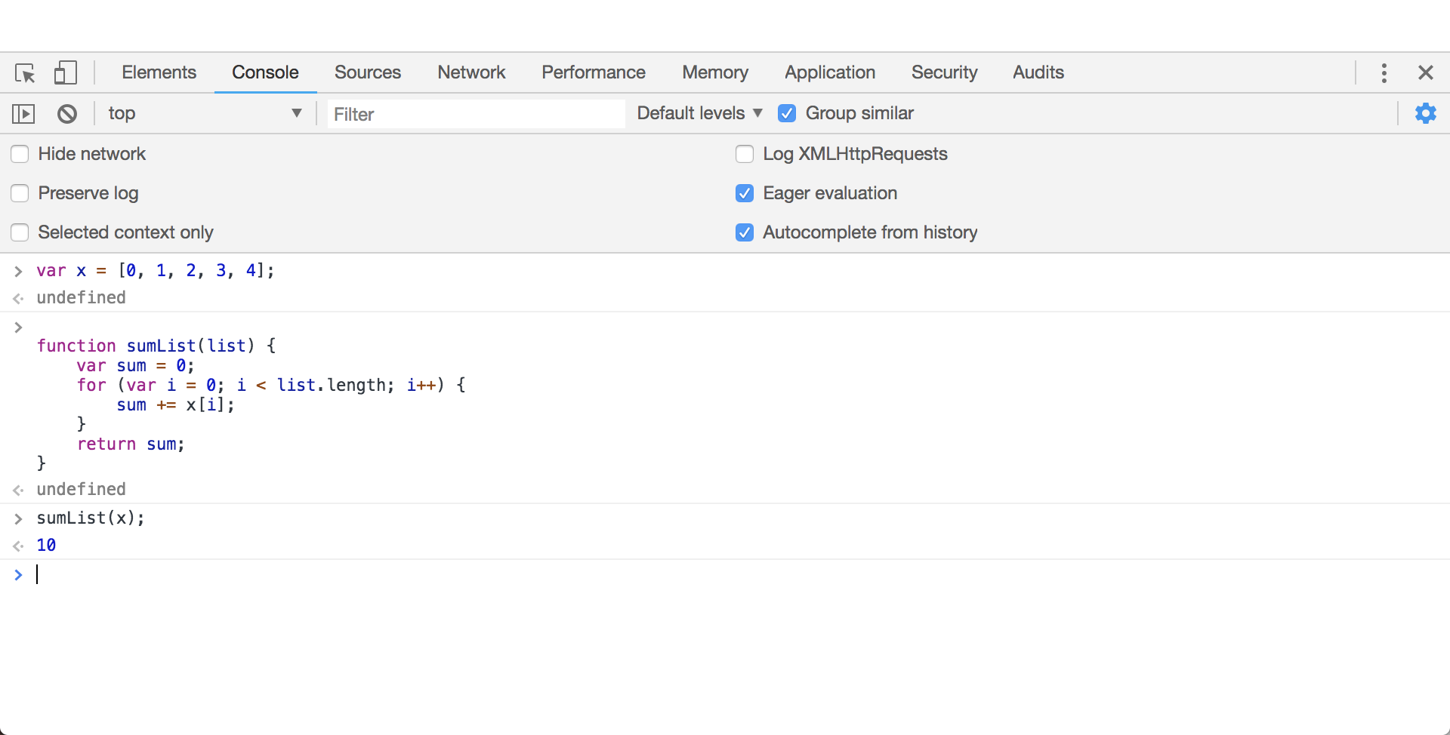
Javascript console

Slide 9
http://sta.mn/jrg
Notes:
Intro to Javascript: objects

Slide 10
Function chaining
Function chaining is a pattern where a function on an object returns a modified copy of that object.
This lets us combine multiple actions into one line!
Example: var account = {}; account.checkedOut = []; account.checkout = function(book) { account.checkedOut.push(book); return account; }
account.checkout(‘Das Kapital’).checkout(‘This Changes Everything’);
Notes:
filter/map example?

Slide 11
Anonymous functions
Not every function needs a name!
This is especially helpful for functions that are special purpose and short.
Example: var books = [‘Das Kapital’, ‘An Inconvenient Truth’, ‘This Changes Everything’, ‘Drawdown’]; function isTitleLong(title) { return (title.length > 12); } var long_books = books.filter(isTitleLong);

Slide 12
Anonymous functions
Not every function needs a name!
This is especially helpful for functions that are special purpose and short.
Example: var books = [‘Das Kapital’, ‘An Inconvenient Truth’, ‘This Changes Everything’, ‘Drawdown’]; var long_books = books.filter(function(title) { return (title.length > 12); });

Slide 13
ES6 syntax
A new version of Javascript introduced slightly prettier syntax for functions. (“arrow syntax”)
It works exactly the same though!
Example: var books = [‘Das Kapital’, ‘An Inconvenient Truth’, ‘This Changes Everything’, ‘’]; var long_books = books.filter((title) => { return (title.length > 10); });

Slide 14
ES6 syntax
A new version of Javascript introduced slightly prettier syntax for functions. (“arrow syntax”)
It works exactly the same though!
Example: var books = [‘Das Kapital’, ‘An Inconvenient Truth’, ‘This Changes Everything’, ‘’]; var long_books = books.filter((title) => title.length > 10);

Slide 15
http://sta.mn/f8h
Notes:
DOM manipulation. Final example: http://blockbuilder.org/loganwilliams/245decde7c775eac820711ad4ffc4121

Slide 16
