Slide 1


Reduction of Radar Processing Latency
01-June-2015 to 16-Dec-2015
Master thesis presentation by
Tamilselvan Shanmugam
Matrik #: 367975
Date: 21-Apr-2016

Slide 2
Agenda
Background
Existing analysis by Airbus DS
Testbed
Implementation
Summary & Conclusion

Slide 3
Agenda
Background
Existing analysis by Airbus DS
Testbed
Implementation
Summary & Conclusion

Slide 4
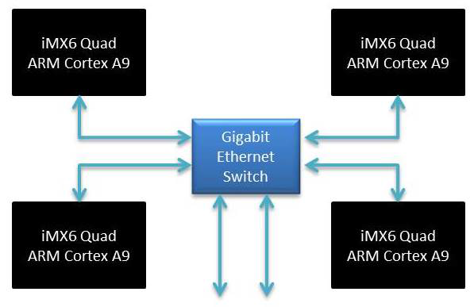
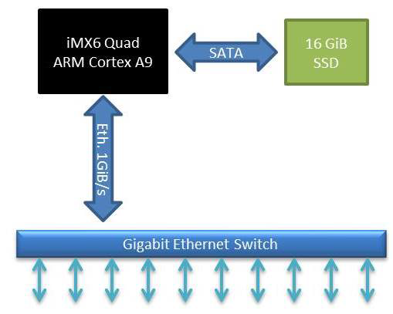
Background
Minimize SWaP, Cost – ARM Cortex A9
Integrated Modular Avionics(IMA)
Core #1
Core #2
Core #3
Core #4
Data Graphics Processing Module
(DGPM)
Platform Support Module
(PSM)

Slide 5
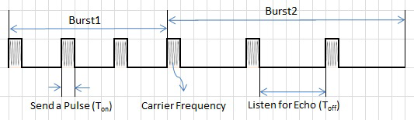
Terminologies
Pulse
Burst
Dwell

Slide 6
Requirements
2x Dwell time latency
50% Utilization
CPU
Memory
Memory transfer band-width

Slide 7
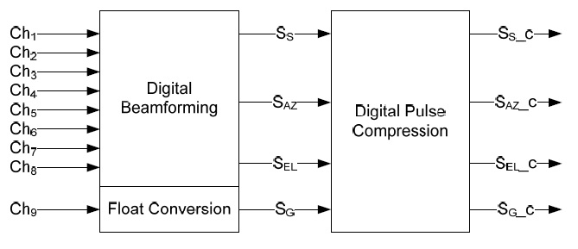
A/A Mode Processing Chain
Time Domain Processing

Slide 8
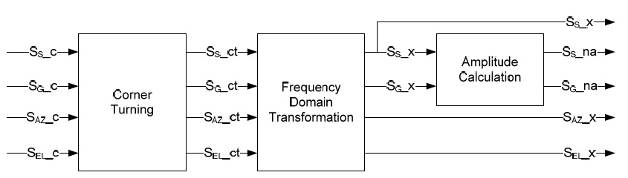
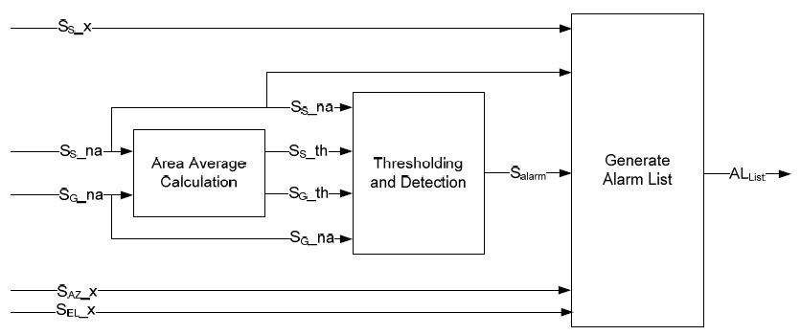
A/A Mode Processing Chain
Frequency Domain Processing
Detection Processing

Slide 9
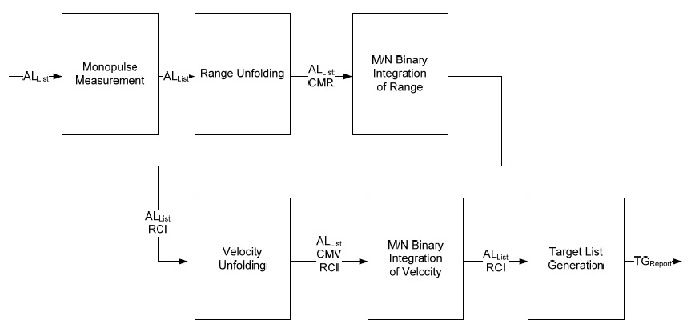
A/A Mode Processing Chain
Correlation Processing

Slide 10
Agenda
Background
Existing analysis by Airbus DS
Testbed
Implementation
Summary & Conclusion
Notes:
Only excel estimation.
Based on single-core results.

Slide 11
Functional Blocks
Raw data in
3x
CMYACC
4x
RMY
4x
CONV
4x
COT
4x
RMY
4x
FFT
2x
MAG
2x
AVG
2x
CMPR
1x
DET
Processed data out
Notes:
Single core measurements

Slide 12
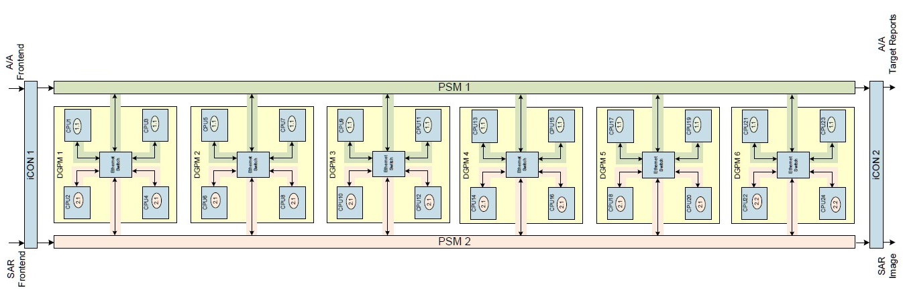
Scheme-1, Space Partitioning
12 A/A Mode CPUs
12 A/G Mode CPUs
1 Dwell(8-bursts) per CPU
1 |  | 2 |  | 3 |  | 4 |  | 5 |  | 6 |  | 7 |  | 8

Slide 13
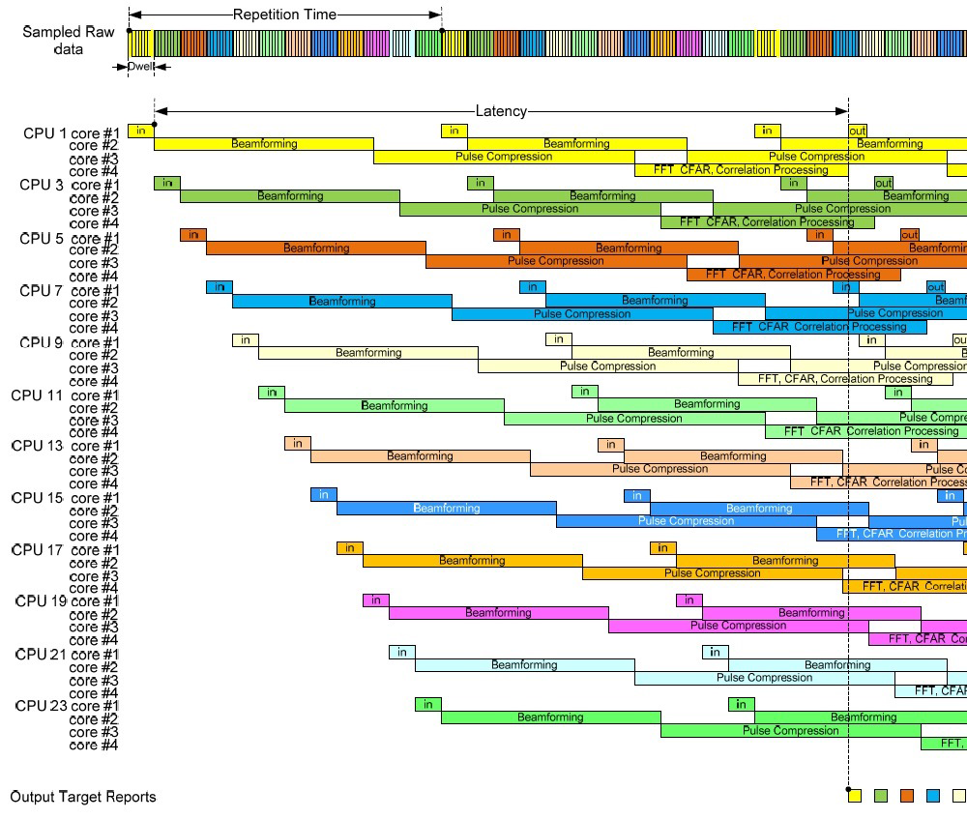
Scheme-1, Data Distribution

Slide 14
Scheme-1, Processing Latency
Data fetch
SDRAM Buffer to SDRAM
SDRAM to L2 cache
Execute
Store back
L2 Cache to SDRAM
SDRAM to SDRAM Buffer

Slide 15
Scheme-1, Results
CPU Util: 75.58%
Memory Util: 7% of 1GB
Interface Util: 72% of 100MB/s
Processing Latency: 333.67ms (12x dwell time)

Slide 16
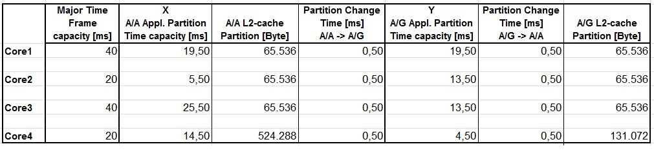
Scheme-2, Time Partitioning
24 CPUs for A/A Mode and A/G Mode

Slide 17
Scheme-2, Results
CPU Util: 71%
Memory Util: 9% of 1GB
Interface Util: 72% of 100MB/s
Processing Latency: 640ms (23x dwell time)

Slide 18
Agenda
Background
Existing analysis by Airbus DS
Testbed
Implementation
Summary & Conclusion

Slide 19
Testbed
Memory Transfer Bandwidth
STREAM Benchmark, 4threads – 1048MiB/s
Memory Utilization
Monitor ‘top’ output
Processing Latency
4 threads to 4 cores, 1000 runs
CPU Load

Slide 20
Agenda
Background
Existing analysis by Airbus DS
Testbed
Implementation
Summary & Conclusion

Slide 21
Design Decisions
Space Partition
Data in
Data out
PSM1
cpu1
cpu2
DGPM
cpu3
cpu4

Slide 22
Scheme-3
Correlation Processing – Data Dependent
4 Bursts per CPU
1 |  | 2 |  | 3 |  | 4
Data in
PSM1
Data out
Dwell1
cpu1
cpu2
Dwell3
cpu5
cpu6
Dwell2
cpu3
cpu4
cpu7
Correlation processing

Slide 23
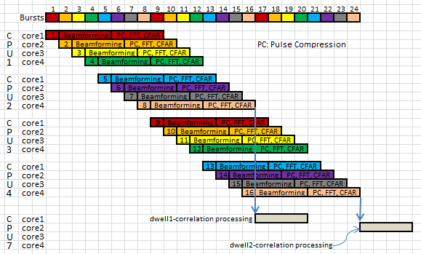
Scheme-3, Data Distribution
CPU7 – 1 dwell per core

Slide 24
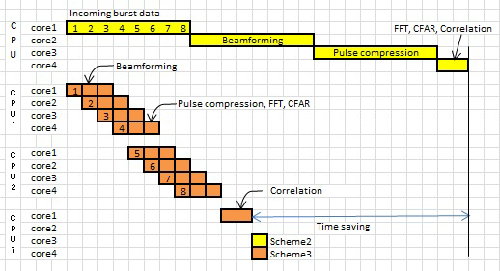
Scheme-3, Time Saving

Slide 25
Scheme-3, Results
CPU Util: 66%
Memory Transfer BW: 39.4% of 1048MiB/s
Memory Util: 0.9% of 879MiB
Processing Latency: 167ms (4x dwell time)

Slide 26
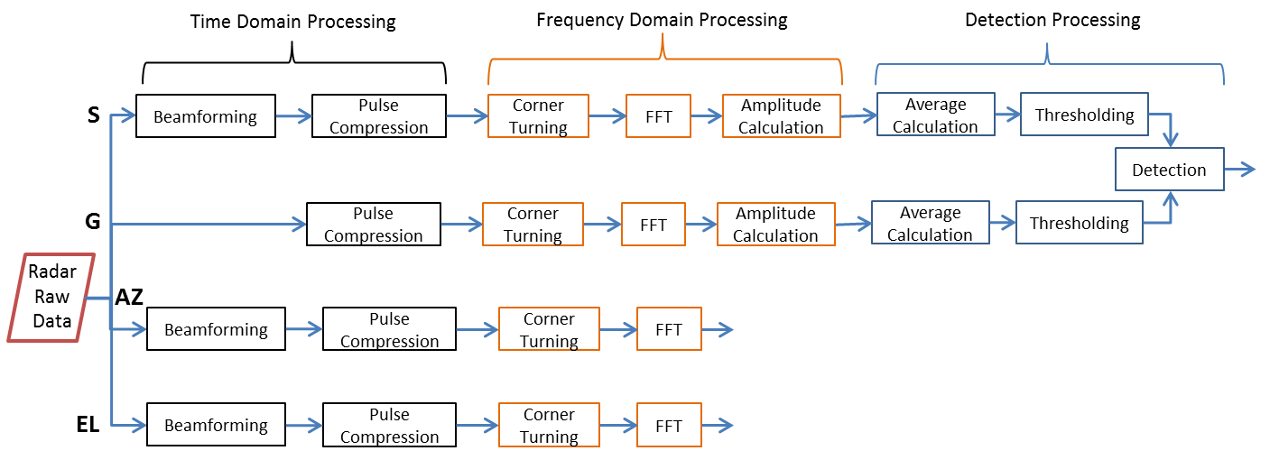
Scheme-4

Slide 27
Scheme-4
Dwell1-Burst1
Dwell1-Burst2
Dwell1-Burst5
Dwell1-Burst6
cpu1
cpu2
cpu5
cpu6
1
cpu3
cpu4
cpu7
cpu8
Data in
Dwell1-Burst7
Dwell1-Burst3
Dwell1-Burst4
Dwell1-Burst8
PSM1
Dwell2-Burst1
Dwell2-Burst2
cpu9
cpu10
Data out
cpu13
cpu14
cpu11
cpu12
Correlation processing
Dwell2-Burst3
Dwell2-Burst4

Slide 28
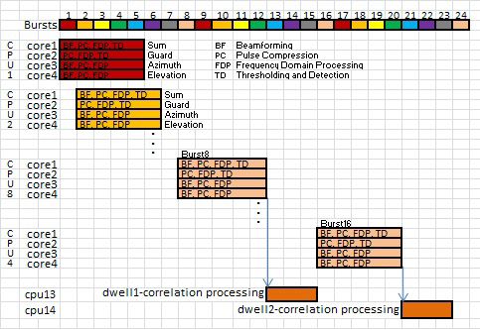
Scheme-4, Data Distribution

Slide 29
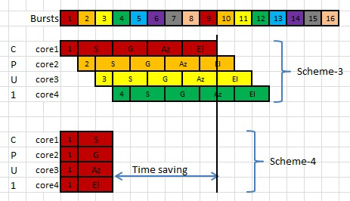
Scheme-4, Time Saving

Slide 30
Correlation Processing
Execution time = 43.34ms = 1.5x dwell time

Slide 31
Scheme-4, Correlation Processing
core1
Monopulse measurement
Range unfolding
M/N range integration
Velocity unfolding
M/N velocity integration
core2
M/N velocity integration
Burst processed data
core3
M/N velocity integration
core4
M/N velocity integration
Target list generation

Slide 32
Scheme-4, Results
CPU Util: 50.8%
Memory Transfer BW: 30.3% of 1048MiB/s
Memory Util: 0.5% of 879MiB
Processing Latency: 54.7ms (1.9x
dwell time)

Slide 33
Agenda
Background
Existing analysis by Airbus DS
Testbed
Implementation
Summary & Conclusion

Slide 34
Summary
Objective
Real-time processing
Less SWaP and Cost
Contributions
Single core to Multicore
Optimized Scheduling

Slide 35
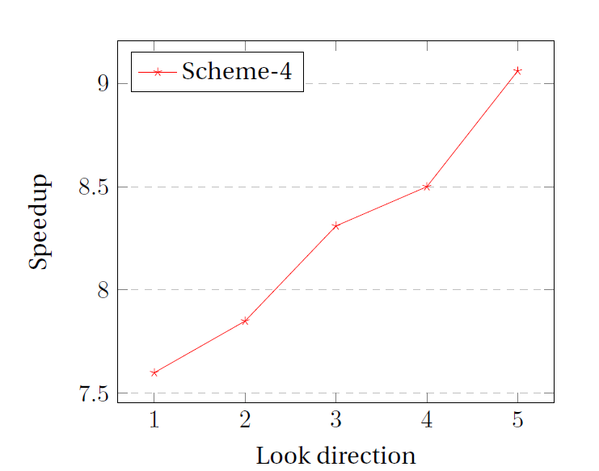
Conclusion

Slide 36


Slide 37
Backup Slides
1-Cores is active
Benchmark | Execution time[cycles]
CMYACC8 | 79
RMY50 | 15
CONV128 | 24100
COT50 | 12
FFT256 | 29700
MAG256 | 20
AVG256 | 20
CMPR256 | 7
DET256 | 10

Slide 38
Benchmark | Old value [cycles] | Measured value [cycles]
CMYACC8 | 79 | 287
RMY50 | 15 | 68
CONV128 | 24100 | 27300
COT50 | 12 | 98
FFT256 | 29700 | 37490
MAG256 | 20 | 41
AVG256 | 20 | 51
CMPR256 | 7 | 55
DET256 | 10 | 97
Measurements
Nitrogen6X board, 1 core is active
1GHz to 800MHz

Slide 39
Multicore Performance
1-Core < 2-Cores < 3-Cores < 4-Cores

Slide 40
Related Work
Zeng Y & team - Velocity Measurement System
ARM Processor
1.5km range, 5km/h to 250km/h
Cheng C & team
Real-time scheduling on PRSP
Notes:
2.h/w, s/w systems constraints r identified. Priority of tasks are assigned.
Workload is balanced by scheduling them

Slide 41


Requirements
±3Mach
5 look directions
2x dwell time latency
50% Utilization
40nm
120°

