Slide 1

Bacchus Winery
Database Implementation & Management Reports
A Case Study Analysis by Group C:
Neosha Allen, Prince Hubbard, and Nicholas Zankl
Notes:
Hello everyone, and welcome to our finalized presentation for Bacchus Winery. We are Group C, which includes myself, Nicholas, along with my colleagues Neosha and Prince. Today, we are going to walk you through our comprehensive database solution for the Bacchus Winery case study. Over the past few weeks, our team has worked collaboratively to design, build, and test a robust relational database tailored specifically to the operational needs of a growing winery. We will be taking you step-by-step through our journey: from our initial understanding of Bacchus Winery's core business bottlenecks, through our strategic assumptions, all the way to our finalized Entity-Relationship Diagram and the automated Python reporting scripts we developed. Let’s go ahead and dive right into the case study to understand exactly what problem we were tasked with solving.

Slide 2
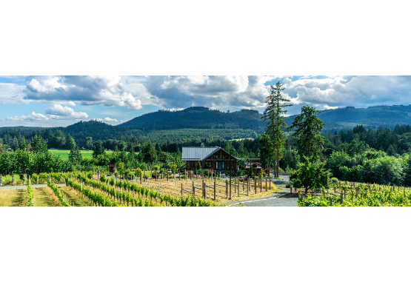
The Challenge
•
Client Identity: Bacchus Winery, a prominent regional wine producer looking to scale operations.
•
The Core Problem: Their supply chain tracking was severely disconnected, leading to unclear distributor sales volume and inconsistent auditing of labor hours.
•
Call to Action: The winery required a centralized, structured database architecture to capture operational data across production, logistics, and sales.
•
Our Objective: Architect a robust database and deliver actionable management reports to eliminate operational bottlenecks.
Notes:
To set the stage, let's briefly review the core problem Bacchus Winery is facing. Bacchus is a successful, expanding vineyard, but their growth has completely outpaced their data management capabilities. Currently, they are relying on fragmented, manual tracking systems that make it incredibly difficult for management to get a clear picture of their day-to-day operations. Their primary call to action for our team was to eliminate these data silos and design a centralized, relational database system. Specifically, they needed a way to accurately track their supply chain, monitor distribution and sales, and manage their internal employee labor hours across different departments. Without a unified system, Bacchus cannot make informed business decisions regarding purchasing, distribution, or staffing. Our goal was to step in as database consultants, analyze their specific workflow requirements, and build a streamlined infrastructure that not only stores their data securely but also allows them to easily pull actionable business intelligence whenever they need it.

Slide 3



Design Assumptions & Constraints
Standardized Quarters
Localized Hosting
Active Records Only
We assumed standard 3-month
reporting intervals. This constraint
ensures consistency when generating
labor and sales comparative reports.
Because of current infrastructure limits,
we assumed the database operates on local MySQL instances, prioritizing local
integrity over cloud scale initially.
To reduce query complexity and
maintain performance, we assumed only active staff and current suppliers need real-time tracking in primary tables.
Notes:
Before we could start drawing tables and relationships, we had to establish a few guiding assumptions about how Bacchus Winery operates. These assumptions heavily informed our design decisions. First, we assumed that supply orders and deliveries are tracked on a per-order basis, meaning a single supplier could have multiple pending or completed orders, and we needed to measure the gap between expected and actual delivery dates to track reliability. Second, regarding distribution, we assumed distributors handle shipments of various wines in cases, so our database needed to link specific shipment items and case quantities to calculate distribution volume accurately. Third, for employee tracking, we assumed that labor is measured in quarterly timesheets, which allowed us to aggregate hours by department and quarter. Finally, from a technical perspective, we designed the Python reporting script assuming a standardized local database environment with secure password prompts for database connections to ensure smooth execution among our development team.

Slide 4
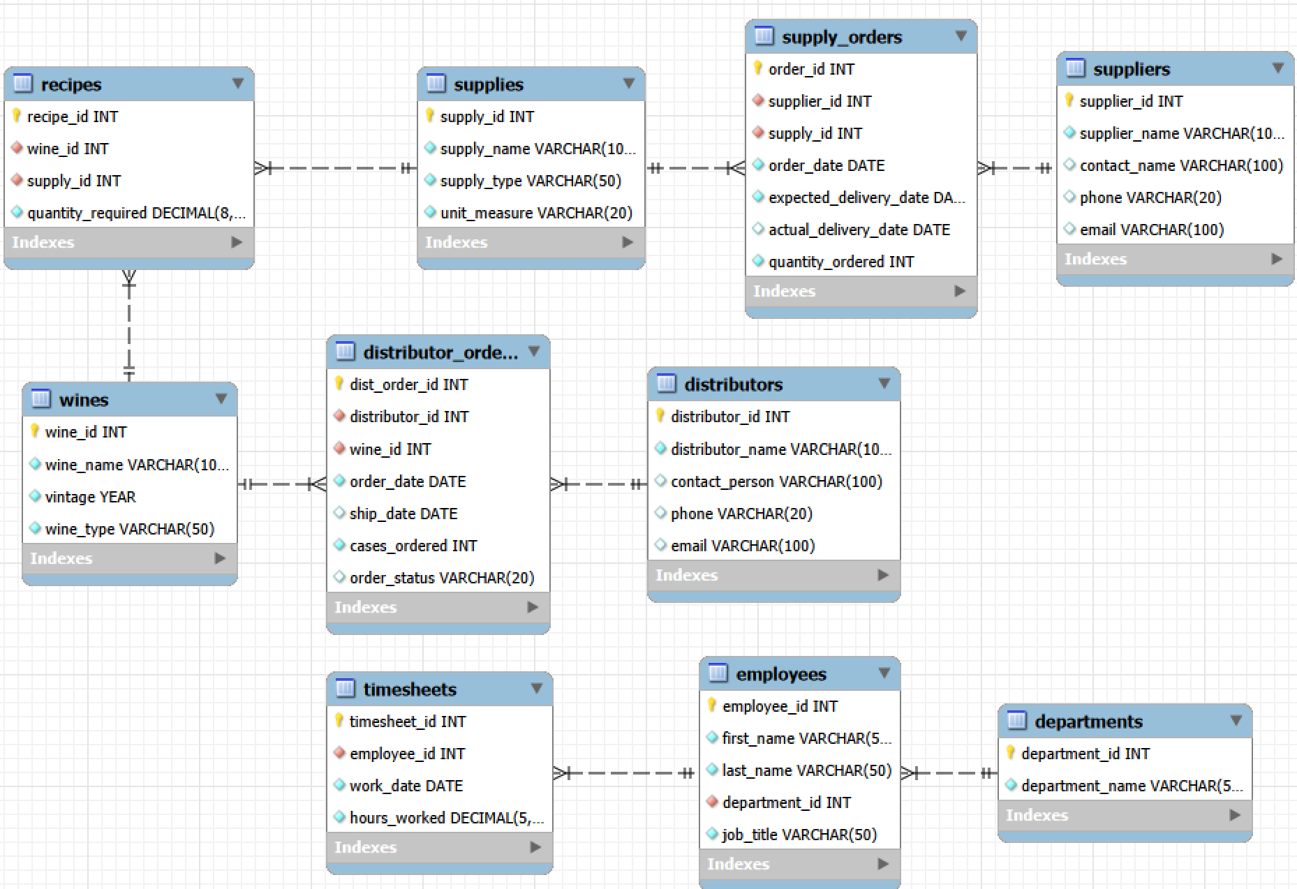
Database Design & ERD
Building the Schema
Our process began with drafting an Entity Relationship Diagram (ERD) to map the flow between Suppliers, Production, Distributors, and Staff.
We normalized the tables to the Third Normal Form (3NF) to eliminate data redundancy. Foreign keys were strictly implemented to ensure referential integrity between operational departments and external partners. We also extracted department attributes from EMPLOYEES into a dedicated DEPARTMENTS lookup table to achieve full 3NF compliance and eliminate redundancy.
This structural foundation allows complex reporting queries to run efficiently without data duplication or anomalous update errors.
Notes:
Here you can see our finalized Entity-Relationship Diagram, which serves as the structural blueprint for our entire solution. Neosha spearheaded the initial schema design, where our process began by identifying core entities, including Suppliers, Distributors, Employees, Wines, and Orders. We established primary and foreign key relationships to link these tables logically, translating the visual diagram into actual MySQL data definition language. Based on feedback during the peer review phase, we iteratively refined this model to achieve strict Third Normal Form (3NF) compliance by decoupling department attributes from the Employees table into a dedicated Departments lookup table. We also standardized relationship notation across both subsystems so foreign keys point directly to parent primary keys. As noted below the diagram, Wines and Supplies function as shared bridge entities that connect procurement, production, and distribution workflows seamlessly. This solid relational foundation was absolutely critical, allowing us to run complex management reports efficiently without risking data duplication or anomaly errors.

Slide 5
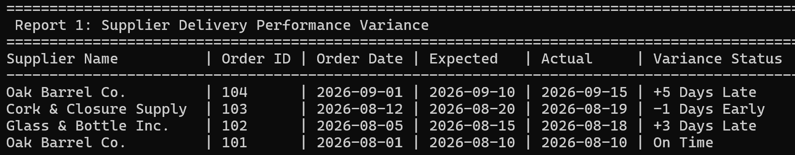
Generated Report 1: Supplier Fulfillment
Supply Chain Reliability
50%
We tested database reliability by tracking fulfillment variance across supply_orders. Delivery dates revealed delays for Oak Barrel Co. (+5 days) and Glass & Bottle Inc. (+3 days), alongside on-time and early deliveries from Cork & Closure (-1 day). Automating these variance metrics eliminates ambiguity and provides actionable data for vendor evaluations.
On-Time Delivery Rate
Notes:
For our first management report, we tackled supply chain reliability by evaluating vendor fulfillment performance. The query calculates delivery variance across our supply_orders table, translating dates into clear status indicators. As shown in the terminal output, we can immediately identify specific performance trends: Oak Barrel Co. logged both an on-time delivery and a five-day delay on order 104, Cork & Closure arrived a day early, and Glass & Bottle Inc. experienced a three-day delay. This gives leadership the exact visibility needed to monitor vendor compliance and tighten supply chain bottlenecks before they impact our production lines.

Slide 6

Visual Analytics: Supplier Fulfillment Variance
Addressing feedback by visualizing vendor delivery timelines across Q3 orders.
Oak Barrel Co. (#104)
+5 Days Late
Glass & Bottle Inc. (#102)
+3 Days Late
Oak Barrel Co. (#101)
On Time
Cork & Closure (#103)
-1 Day Early
Visual metric breakdown highlights vendor risk, giving supply management clear data for upcoming contract negotiations.
Notes:
To directly address peer review feedback, we translated our SQL terminal query into an intuitive visual metric breakdown for leadership. Taking the raw data from Report 1, where only half of our orders arrived schedule-compliant to result in that 50% on-time delivery rate, this visual bar chart instantly isolates vendor reliability risks. Oak Barrel Company’s 5-day delay on order 104 and Glass & Bottle’s 3-day delay stand out immediately in red and orange, while Cork & Closure’s early arrival and Oak Barrel’s on-time order show optimal performance in blue and green. Presenting fulfillment variance visually allows management to identify supply chain bottlenecks in seconds, giving supply managers clear, undeniable data for upcoming vendor contract negotiations.

Slide 7
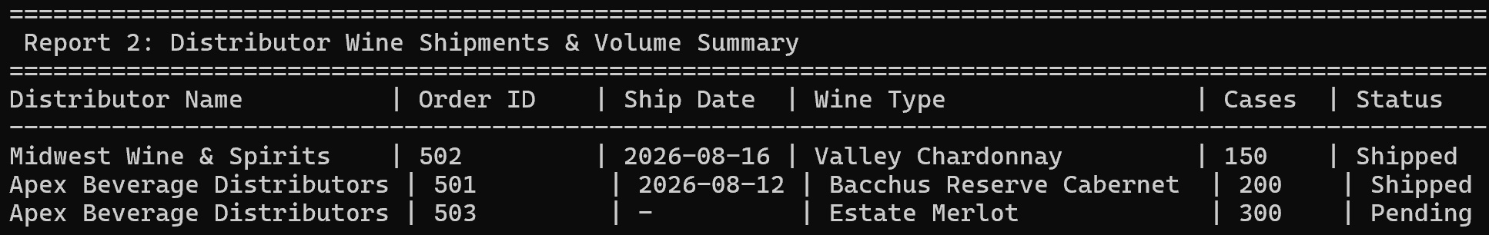
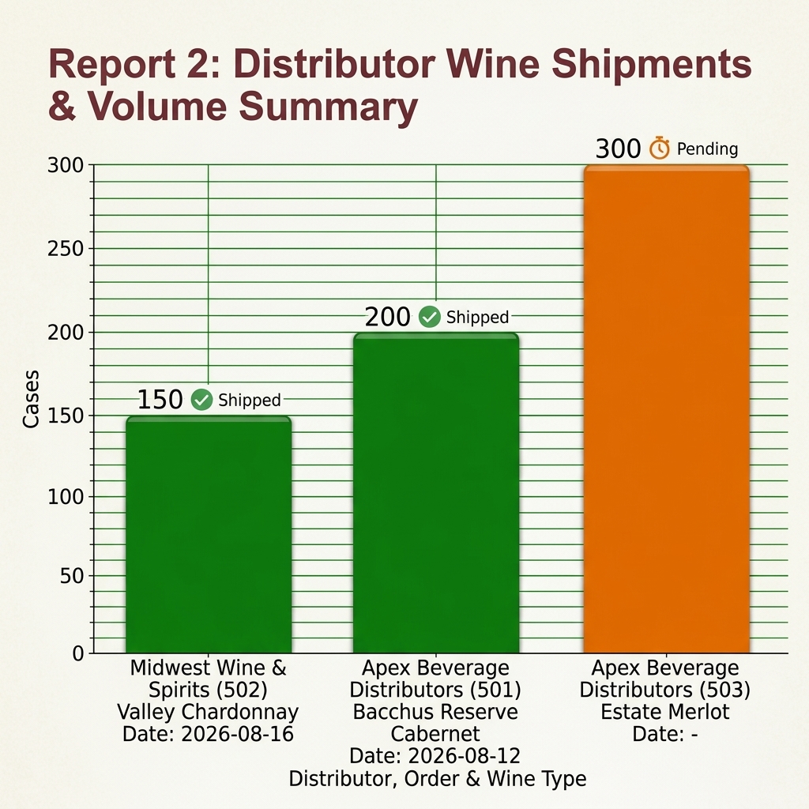
Generated Reports 2: Distributor Sales
Multi-table JOINs across distributors, orders, and products deliver immediate regional wholesale visibility. The output captures completed deliveries, including 150 cases of Valley Chardonnay for Midwest Wine & Spirits, while flagging outstanding volume like 300 pending cases of Estate Merlot for Apex Beverage Distributors.
Notes:
Moving to our second management report, we shift focus from supply chain logistics to outward-facing sales and distribution. To help Bacchus monitor order status and case volume, our Python script executes multi-table JOINs connecting distributors, orders, and product lines. As shown in the terminal output, the query provides itemized visibility into each order: it captures completed deliveries like 150 cases of Valley Chardonnay for Midwest Wine & Spirits and 200 cases of Bacchus Reserve Cabernet for Apex Beverage Distributors, while displaying a clean dash for unfulfilled orders like the 300 cases of Estate Merlot still marked as pending. Prince synthesized the business logic for this report, ensuring management can instantly track real-time fulfillment and verify case quantities across key accounts.

Slide 8
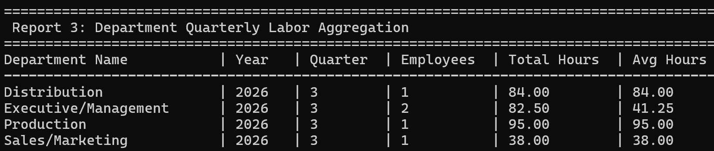
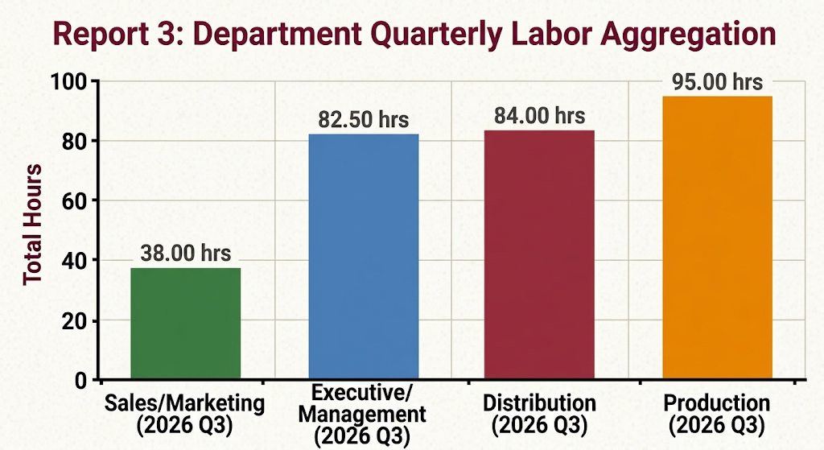
Generated Report 3: Department Quarterly Labor Aggregation
Multi-table JOINs across timesheet and employee data evaluate Q3 2026 labor allocation. Calculating distinct headcount and aggregated hours demonstrates seamless 3NF aggregate operations, identifying key workload concentrations in Production (95.00 hrs) and Distribution (84.00 hrs) compared to Executive (82.50 hrs) and Sales (38.00 hrs).
Notes:
Transitioning to our third management report, we analyzed Q3 2026 employee labor allocation across departments to evaluate operational efficiency. Translating our SQL GROUP BY aggregation into a visual bar chart highlights where labor demand was heaviest during the third quarter. Production emerged as the highest total labor expenditure at 95 hours for a single employee, directly reflecting harvesting and bottling line demands. Distribution followed closely at 84 hours. While Executive and Management accumulated 82.5 total hours, splitting that across two headcount results in an average of 41.25 hours per manager. Visualizing departmental labor distribution gives leadership immediate oversight to adjust staffing levels and optimize workforce planning before peak operational periods.

Slide 9
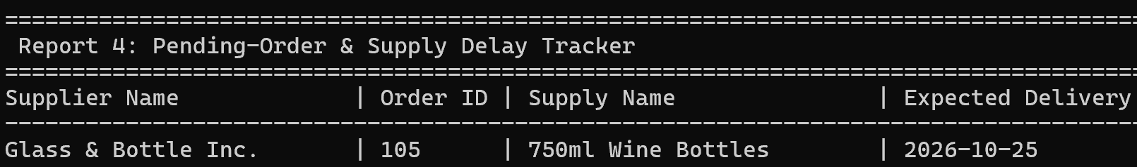
Generated Report 4: Pending-Order & Supply Delay Tracker
This report monitors outstanding supplier fulfillments by tracking active purchase orders where the actual delivery date remains unrecorded. By isolating pending shipments, such as Order #105 for 750ml Wine Bottles from Glass & Bottle Inc., the report provides real-time visibility into incoming supply chains. This enables production managers to anticipate potential raw material shortages, hold vendors accountable to expected delivery dates, and prevent operational delays on the bottling floor.
Notes:
Our fourth and final report tackles a major operational blind spot: our supply chain delay and pending-order tracker. By pulling from our supply_orders and suppliers tables, it automatically flags any raw material orders that are still sitting in a pending status, specifically looking for entries where the actual delivery date hasn't been logged yet. This catches active items like Order #105, tracking 750ml wine bottles from Glass & Bottle Inc. that are expected on October 25th, 2026. Instead of finding out we're out of bottles after the production line has already stalled, this gives management real-time visibility into incoming shipments. It’s all about holding vendors accountable and staying ahead of bottlenecks so our bottling floor never skips a beat.

Slide 10
How Our Solution Resolves The Issues
Supply Chain Connectivity: The relational schema natively links raw material intakes to final case shipments, providing end-to-end traceability that previously didn't exist.
Transparent Sales Volume: Automated JOIN queries now instantly calculate total shipment volume and order status per distributor, eliminating manual spreadsheet errors.
Consistent Labor Auditing: Centralized timesheet records group total and average hours by department and quarter, allowing management to track seasonal labor distribution across fiscal periods.
Centralized Truth: Bacchus Winery now operates from a single, unified database instance, preventing departmental data silos.
Notes:
So, how does our deliverable actually solve the Bacchus Winery case study problem? The core issue was a lack of unified data preventing informed decision-making. By implementing a fully normalized relational database, we completely eliminated their fragmented tracking methods. The data is now centralized, secure, and easily accessible. Furthermore, we provided a production-ready Python automation script that bridges the gap between raw database storage and actionable business intelligence. Instead of manually tallying up spreadsheets, management can execute a single script to generate perfectly formatted ASCII tables detailing supply chain reliability, distributor case volumes, and departmental labor distribution. Our solution transforms their raw operational data into strategic assets. The combination of Neosha’s schema foundation, Prince’s business logic, and my backend error handling ensures that Bacchus Winery now has a scalable, reliable infrastructure that can easily grow alongside their expanding business.

Slide 11
Summary
Unified Data Architecture: Replaced fragmented spreadsheets with a single, secure MySQL instance covering Procurement, Production, Labor, and Distribution.
Automated Business Intelligence: Engineered a Python reporting CLI that dynamically generates real-time management tracking for supplier delays, distributor volume, and quarterly labor distribution.
Operational Impact: Restored end-to-end supply chain visibility, preventing bottling line delays and empowering data-driven executive decision-making.
Notes:
To summarize: We believe that we have successfully modernized Bacchus Winery's data management systems. We identified their need for a centralized system, mapped out the logical architecture through our Entity-Relationship Diagram, and established key assumptions about their business rules to guide our design. We then physically built the MySQL database and populated it. Finally, we engineered a secure, Python-based reporting tool that automatically generates four critical management reports focusing on supplier delivery performance, distributor case volumes, and quarterly employee labor hours. This project was a highly collaborative effort that utilized each of our strengths to deliver a comprehensive, enterprise-ready database solution.

Slide 12
Questions?
Thank you for your time and attention.
Group C | Bacchus Winery Project Team
Notes:
Any questions? Thank you for your time and attention as we walked through our design process. We are really proud of the final system we built, and we look forward to reviewing everyone else's presentations on the project forum this week!

Slide 13


Image Sources
https://www.tourismvictoria.com/_next/image?url=https%3A%2F%2Fadmin.tourismvictoria.com%2Fcontent%2Fuploads%2F2018%2F03%2FBlue-Grouse-Winery.gif&w=1920&q=75
Source: www.tourismvictoria.com
https://media.istockphoto.com/id/2245833272/photo/digital-database-schema-showing-finance-and-accounting-data-structure-representing-financial.jpg?s=612x612&w=0&k=20&c=reK5QoEjKes-mD2ybzeRN6InFnV4CRQjqXaTxxuaxKI=
Source: www.istockphoto.com

