Slide 1
Supply Chain with Blockchain
Suresh Tamminiedi

Slide 2
Problem Statement
Having highest levels of trust and verifiability of processes taking place in supply chain process is a challenge.

Slide 3
Approach
Record the key transactions in supply chain on public blockchain
Provide the functionality to quickly track / verify the transactions
Technologies Used
Ethereum Blockchain
Ganache Network
Java Script, JQuery
HTML, CSS
Truffle, Remix

Slide 4
Roles in Supply Chain
Producer
Distributor
Retailer
Consumer

Slide 5
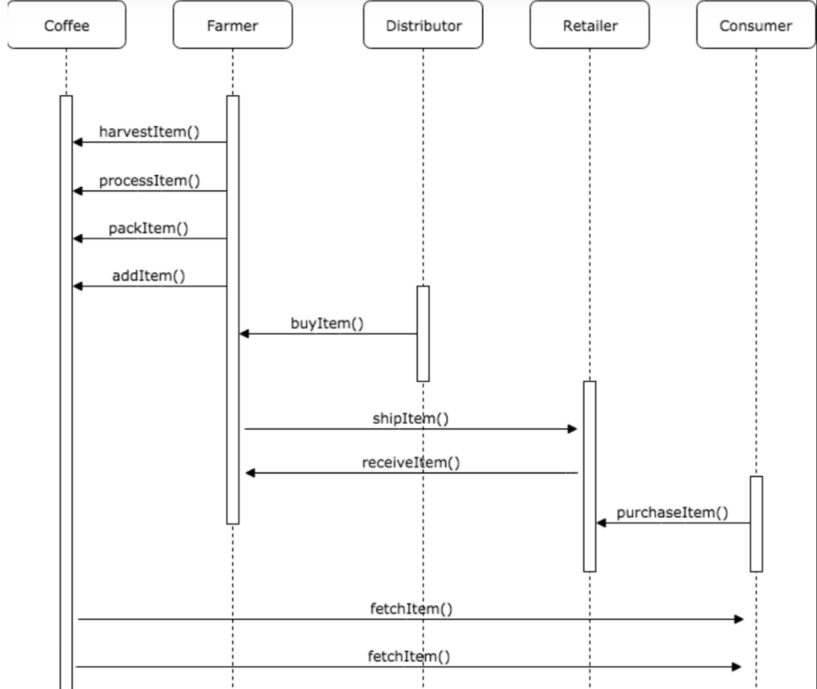
Process Flow: Coffee Farming

Slide 6
Demo

Slide 7
Learning Points
Benefits of using Truffle have been very minimal
Some of the limitations within Solidity/Ethereum resulted to additional code
Once we get hold of Solidity/Ethereum, development is relatively straight forward

Slide 8
Conclusion
Using Blockchain for processes involved in supply chain improves trust and verifiability of transactions
Further enhanced functionalities can be built around this

Slide 9
Q & A

