Slide 1

C++ STL Tutorial
Ratchadaporn Kanawong
Silpakorn University

Slide 2
STL components overview
Data storage, data access and algorithms are separated
Containers hold data
Iterators access data
Algorithms, function objects manipulate data
Allocators... allocate data (mostly, we ignore them)
Container
Container
Algorithm
Container

Slide 3
Sequence Containers
vector<T> – dynamic array
Offers random access, back insertion
Should be your default choice, but choose wisely
Backward compatible with C : &v[0] points to the first element
deque<T> – double-ended queue (usually array of arrays)
Offers random access, back and front insertion
Slower than vectors, no C compatibility
list<T> – 'traditional' doubly linked list
Don't expect random access, you can insert anywhere though
string – yes, it is a STL container (a typedef actually)
Nonstandard containers : slist, rope...

Slide 4
Associative Containers
Offer O(log n) insertion, suppression and access
Store only weakly strict ordered types (eg. numeric types)
Must have operator<() and operator==() defined and !(a<b) && !(b<a) ≡ (a==b)
The sorting criterion is also a template parameter
set<T> – the item stored act as key, no duplicates
multiset<T> – set allowing duplicate items
map<K,V> – separate key and value, no duplicates
multimap<K,V> – map allowing duplicate keys
hashed associative containers may be available
Dinkumware and SGI did things differently though

Slide 5
Container Adaptors
There are a few classes acting as wrappers around other containers, adapting them to a specific interface
stack – ordinary LIFO
queue – single-ended FIFO
priority_queue – the sorting criterion can be specified
Programmers can specify the underlying data type
usually a deque

Slide 6
Tip : vector<bool>
Meyers: "As an STL container, there are really only two things wrong with vector<bool>. First it's not an STL containers. Second it doesn't hold bools. Other than that, there's not much to object to." (Effective STL, p79)
vector<bool> does not conform to STL requirements
it stores bools in a packed representation (e.g. bitfield)
Accessing it returns proxy objects to bools, not true bools
Use a deque<bool> or a bitset to store bools
You won't get C compatibility (but C doesn't have bools anyways)

Slide 7
Tip : size() and empty()
You may check whether a container is empty by writing c.size() == 0 or c.empty()
However, with lists, which have a splice() function, if splice() is O(1), size() must be O(n) and conversely.
Therefore, while empty() will always run in O(1), size() may not. You should thus prefer calling empty() to checking size() against zero.

Slide 8

Template
Template เป็นพื้นฐานสำหรับการเขียนโปรแกรมเพื่อใช้งานโดยไม่ยึดติดกับชนิดข้อมูล เช่นการเรียงลำดับข้อมูล จะเรียงตัวเลข หรือตัวอักษรก็สามารถทำได้ เรียกว่า generic programming
Template เป็นเหมือนแม่แบบสำหรับสร้าง generic class หรือ generic function

Slide 9
ตัวอย่าง container
vector เราสามารถกำหนดชนิดข้อมูลที่จะสร้างเป็นเวกเตอร์ได้
list เราสามารถสร้างลิสต์ของชนิดข้อมูลใดก็ได้
definition | meaning
vector<int> | เวกเตอร์จำนวนเต็ม
vector<String> | เวกเตอร์เก็บข้อความ
definition | meaning
list<int> | ลิสต์จำนวนเต็ม
list<float> | ลิสต์จำนวนจริง

Slide 10
Example of the vector container
#include <iostream>
#include <vector>
using namespace std;
int main() {
// create a vector to store int
vector<int> vec;
int i;
// display the original size of vec
cout << "vector size = " << vec.size() << endl;
// push 5 values into the vector
for(i = 0; i < 5; i++){
vec.push_back(i);
}
// display extended size of vec
cout << "extended vector size = " << vec.size() << endl;
// access 5 values from the vector
for(i = 0; i < 5; i++){
cout << "value of vec [" << i << "] = " << vec[i]
<< endl;
}
// use iterator to access the values
vector<int>::iterator v = vec.begin();
while( v != vec.end()) {
cout << "value of v = " << *v << endl;
v++;
}
return 0;
}

Slide 11
Example of constructing lists
#include <iostream>
#include <list>
void main (){
// constructors used in the same order as described above:
std::list<int> first; // empty list of ints
std::list<int> second (4,100); // four ints with value 100
std::list<int> third (second.begin(),second.end()); // iterating through second
std::list<int> fourth (third); // a copy of third
// the iterator constructor can also be used to construct from arrays:
int myints[] = {16,2,77,29};
std::list<int> fifth (myints, myints + sizeof(myints) / sizeof(int) );
std::cout << "The contents of fifth are: ";
for (std::list<int>::iterator it = fifth.begin(); it != fifth.end(); it++)
std::cout << *it << ' ';
std::cout << '\n';}

Slide 12
ตัวอย่าง container
vector เราสามารถกำหนดชนิดข้อมูลที่จะสร้างเป็นเวกเตอร์ได้
list เราสามารถสร้างลิสต์ของชนิดข้อมูลใดก็ได้
definition | meaning
vector<int> | เวกเตอร์จำนวนเต็ม
vector<String> | เวกเตอร์เก็บข้อความ
definition | meaning
list<int> | ลิสต์จำนวนเต็ม
list<float> | ลิสต์จำนวนจริง

Slide 13
Function Template
สร้างฟังก์ชันเทมเพลตได้ด้วยรูปแบบนี้
เราจะต้องกำหนดชื่อใดๆ แทนคำว่า type สำหรับแทนชนิดข้อมูลที่เราจะอ้างในฟังก์ชัน
template <class type> re-type func-name(parameter list){
// body of function
}

Slide 14
Example of function template
#include <iostream>
#include <string>
using namespace std;
template <typename T>
inline T const& Max (T const& a, T const& b) {
return a < b ? b:a;
}
int main () {
int i = 39;
int j = 20;
cout << "Max(i, j): " << Max(i, j) << endl;
string s1 = "Hello";
string s2 = "World";
cout << "Max(s1, s2): " << Max(s1, s2) << endl;
return 0;}

Slide 15
Class Template
สร้างคลาสเทมเพลตได้ด้วยรูปแบบนี้
เราจะต้องกำหนดชื่อใดๆ แทนคำว่า type สำหรับแทนชนิดข้อมูลที่เราจะอ้างในคลาส
template <class type> class class-name{
// body of class
}

Slide 16
Example of class Stack<>
#include <iostream>
#include <vector>
#include <cstdlib>
#include <string>
#include <stdexcept>
using namespace std;
template <class T>
class Stack {
private:
vector<T> elems; // elements
public:
void push(T const&); // push element
void pop(); // pop element
T top() const; // return top element
bool empty() const{ // return true if empty.
return elems.empty();
}
};

Slide 17
Example of class Stack<> (cont’)
template <class T>
void Stack<T>::push (T const& elem) {
// append copy of passed element
elems.push_back(elem);
}
template <class T>
void Stack<T>::pop () {
if (elems.empty()) {
throw out_of_range("Stack<>::pop(): empty stack");
}
// remove last element
elems.pop_back();
}
template <class T>
T Stack<T>::top () const {
if (elems.empty()) {
throw out_of_range("Stack<>::top(): empty stack");
}
// return copy of last element
return elems.back();
}

Slide 18
Example of class Stack<> (cont’)
int main() {
try {
Stack<int> intStack; // stack of ints
Stack<string> stringStack; // stack of strings
// manipulate int stack
intStack.push(7);
cout << intStack.top() <<endl;
// manipulate string stack
stringStack.push("hello");
cout << stringStack.top() << std::endl;
stringStack.pop();
stringStack.pop();
}catch (exception const& ex) {
cerr << "Exception: " << ex.what() <<endl;
return -1; }
}
7
hello
Exception: Stack<>::pop(): empty stack

Slide 19
Map Container
สร้างความสัมพันธ์ระหว่างคีย์หลักกับค่าข้อมูล
เราสามารถใช้คีย์หลักในการหาค่าที่สัมพันธ์กับคีย์หลัก
ตัวอย่าง คีย์หลักเป็นรหัสชิ้นส่วนอิเล็กทรอนิกส์ สัมพันธ์กับราคา 8.75 ดอลล่าร์ ผลิตโดยบริษัท Martin
A22-56
A23-57
A24-57
A24-57 | 8.75 | Martin
A22-56 | 12.50 | Calloway
A23-57 | 4.95 | Mirage

Slide 20
STL map – Associative Arrays
STL map class เป็นการกำหนดคีย์กับข้อมูล โดยคีย์เป็นข้อมูลที่ไม่ซ้ำกันเลย เช่น เลขบัตรประชาชนกับชื่อสกุล เป็นต้น
STL map class สามารถใช้ชนิดข้อมูลใดๆ ก็ได้เป็นคีย์หรือเป็นข้อมูล
1 to 1 mapping (หนึ่งคีย์สัมพันธ์กับข้อมูลหนึ่งข้อมูล)
การใช้ STL map class จะต้อง #include <map>

Slide 21
STL map – Associative Arrays
รูปแบบการกำหนดคือ
หมายเหตุ comparison_function ถ้าไม่ระบุจะใช้ค่า default เป็น less <
ตัวอย่าง
std::map <key_type, data_type, [comparison_function]>
map(char,int> m; // keys of type char, values of type int
// less than is already defined for char

Slide 22
STL Maps: Constructors
map<char,int> m;
map<char,int> m2(m);
Standard constructor
Note that allocator, cmpfn are constructed automatically if not passed in
(2) Copy constructor
map<template,fields> mapName(const Comp &cmp = Comp(),
const Allocator &a = Allocator());
map<template,fields> mapName(const map<Key, T, Comp, Allocator> &anotherMap);

Slide 23
STL Maps: Data Storage
An STL map is implemented as a tree-structure, where each node holds a “pair”
Most important to know when retrieving data from the table
Some functions return the pair, not just the value
A pair has two fields, first (holding the key) and second (holding the value)

Slide 24
STL Map: Data Storage
If you have a pair object, you can use the following code to print the key and value:
cout << myPairObject.first << “ “ << myPairObject.second;
If you have a pointer to the pair object, use the arrow operator instead
cout << myPairObject->first << “ “ << myPairObject->second;

Slide 25
STL Map: Data Storage
Any time a function returns an iterator, the iterator is a pointer to the pair [so you’ll use the -> operation most frequently].
Tree structure
logarithmic time inserts, finds, deletes

Slide 26
Example of map class
#include <map>
int main() {
std::map <string, char> grade_list;
grade_list["John"] = 'A';
// Should be John
std::cout<<grade_list.begin()->first<<endl;
// Should be A
std::cout<<grade_list.begin()->second<<endl;
if(grade_list.find("Tim") == grade_list.end()){
std::cout<<"Tim is not in the map!"<<endl;
}
}

Slide 27
STL Map: Available Methods
Methods | description
void clear() | remove all elements
bool empty() | Returns true if empty, false otherwise
size_type max_size() | returns max number of elements map can hold (usually an integer returned) [capacity]
size_type size() | return the number of elements currently in the map (usually an integer returned) [actual size]
iterator begin() | returns an iterator to the first element in the map (the first when sorted, due to storage mechanism)
iterator end() | returns an iterator to the last element in the map (the last when sorted)
reverse_iterator rbegin() | returns a reverse iterator to the end of the map
reverse_iterator rend() | returns a reverse iterator to the start of the map

Slide 28
STL Map: Available Methods
pair<iterator,bool> insert(const value_type &val)
Insert val into the map, if it’s not already there. Return pair<iterator,true> if successful, pair<iterator,false> if fails.
iterator insert(iterator i, const value_type &val)
Insert val into the map, after the value specified by i. Iterator to inserted element is returned.
template <class InIter> void insert(InIter start, InIter end)
Insert a range of elements

Slide 29
STL Map: Available Methods
void erase (iterator i)
Remove the element pointed to by i.
size_type erase(const key_type & k)
Remove from the map elements that have keys with the value k.
void erase(iterator start, iterator end)
Remove the elements in the range start to end

Slide 30
STL Map: Available Methods
iterator find(const key_type &k)
Returns an iterator to the specified key. If the key is not found, an iterator to the end of the map is returned.
size_type count(const key_type &k) const
Returns the number of times a key k occurs in the map (0 or 1)
reference operator[](const key_type &k)
Returns a reference to the value associated with the key k.
If the key is not found in the map, the key and a default constructed instance of the value type is inserted in the amp.

Slide 31
STL Map: Available Methods
iterator lower_bound(const key_type &k)
Returns an iterator to the first element in the map with a key >= k
iterator upper_bound(const key_type &k) const
Returns an iterator to the first element in the map with a key strictly > k
pair<iterator, iterator> equal_range(const key_type &k)
Returns a pair of iterators that point to the upper bound and the lower bound in the map for the specified key

Slide 32
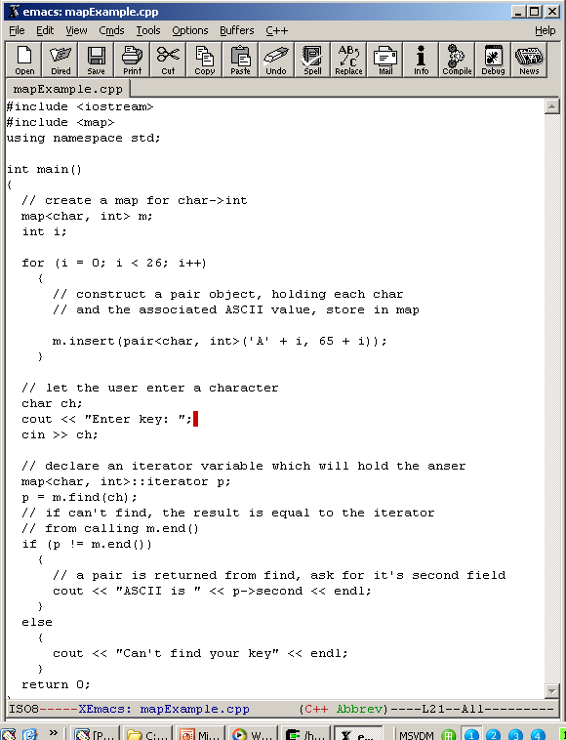
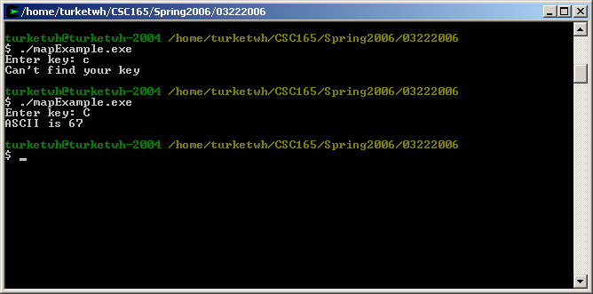
STL Map: Example Programs
Map between characters and ASCII representations

Slide 33
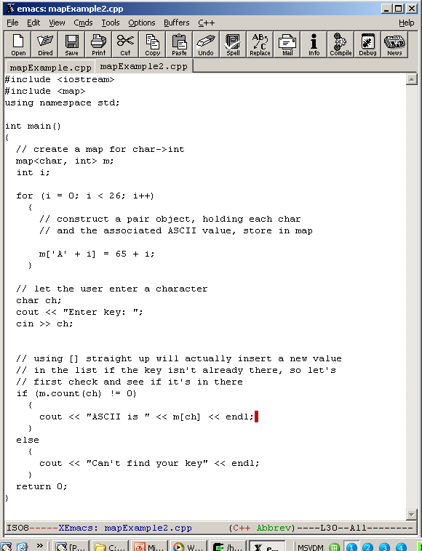

STL Map: Example Programs
Same program, exploiting []

Slide 34
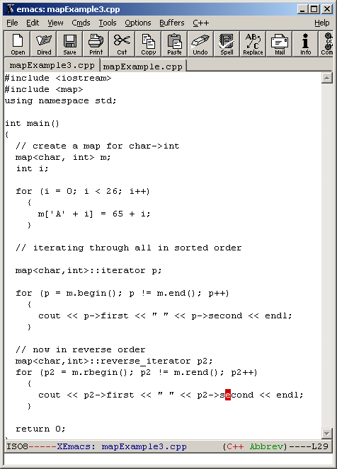
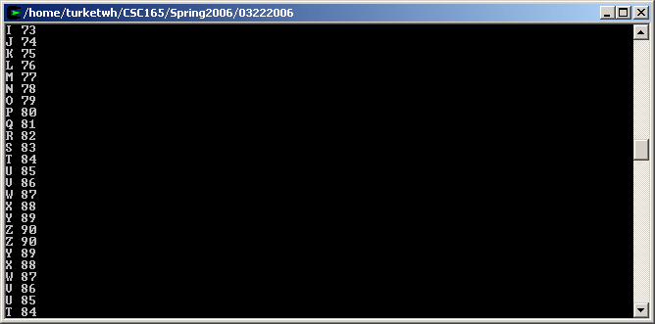
STL Map: Example Programs
Print all entries in map in forward and reverse order

Slide 35
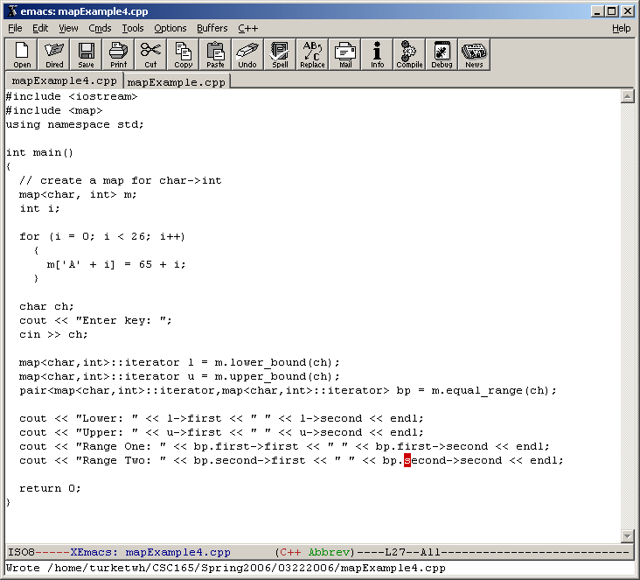
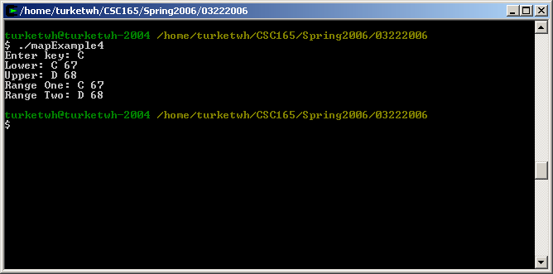
STL Map: Example Programs
Print lower bound, upper bound, and equal range given a char typed in

Slide 36
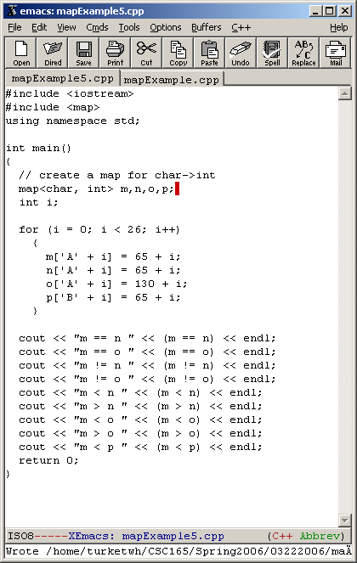
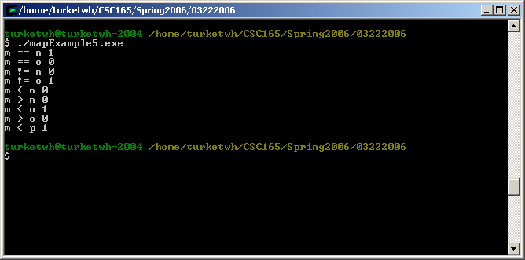
STL Map: Example Programs
Using the <,>, ==, != functions on map objects

Slide 37
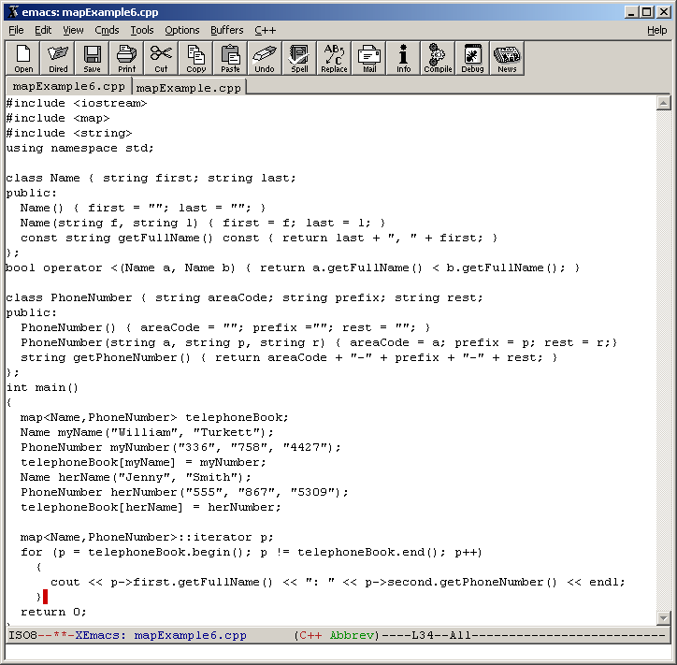
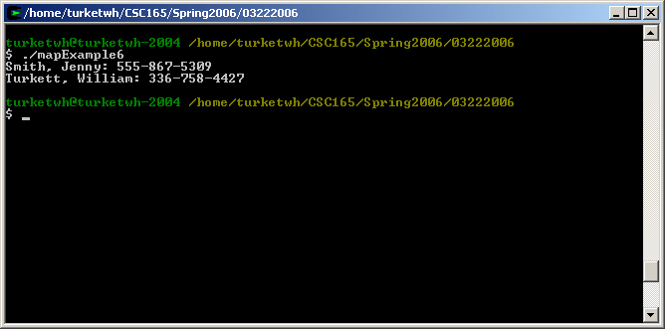
STL Map: Example Programs
Storing objects, requiring an overload of the < operator for the key type

Slide 38
Multi-map Container
Similar to a map container
Multi-map container allows duplicates
Sorted Associative Container
Multiple Associative Container, there is no limit on the number of elements with the same key.

Slide 39
Example inserting
int main () {
std::multimap<char,int> mymultimap;
std::multimap<char,int>::iterator it;
// first insert function version (single parameter):
mymultimap.insert ( std::pair<char,int>('a',100) );
mymultimap.insert ( std::pair<char,int>('z',150) );
it=mymultimap.insert ( std::pair<char,int>('b',75) );
// second insert function version (with hint position):
mymultimap.insert (it, std::pair<char,int>('c',300)); //max efficiency
mymultimap.insert (it, std::pair<char,int>('z',400)); //no max efficiency
mymultimap contains:
a => 100
b => 75
c => 300
z => 400
z => 150
anothermultimap contains:
a => 100
b => 75

Slide 40
Example inserting con’t
// third insert function version (range insertion):
std::multimap<char,int> anothermultimap;
anothermultimap.insert(mymultimap.begin(),mymultimap.find('c'));
// showing contents:
std::cout << "mymultimap contains:\n";
for (it=mymultimap.begin(); it!=mymultimap.end(); ++it)
std::cout << (*it).first << " => " << (*it).second << '\n';
std::cout << "anothermultimap contains:\n";
for (it=anothermultimap.begin(); it!=anothermultimap.end(); ++it)
std::cout << (*it).first << " => " << (*it).second << '\n';
return 0;
}

Slide 41
Example finding
int main () { std::multimap<char,int> mymm;
mymm.insert (std::make_pair('x',10));
mymm.insert (std::make_pair('y',20));
mymm.insert (std::make_pair('z',30));
mymm.insert (std::make_pair('z',40));
std::multimap<char,int>::iterator it = mymm.find('x');
mymm.erase (it);
mymm.erase (mymm.find('z'));
// print content:
std::cout << "elements in mymm:" << '\n';
std::cout << "y => " << mymm.find('y')->second << '\n';
std::cout << "z => " << mymm.find('z')->second << '\n';
return 0; }
Elements in mymm:
y => 20
z => 40

Slide 42
Example erasing
int main (){
std::multimap<char,int> mymultimap;
// insert some values:
mymultimap.insert(std::pair<char,int>('a',10));
mymultimap.insert(std::pair<char,int>('b',20));
mymultimap.insert(std::pair<char,int>('b',30));
mymultimap.insert(std::pair<char,int>('c',40));
mymultimap.insert(std::pair<char,int>('d',50));
mymultimap.insert(std::pair<char,int>('d',60));
mymultimap.insert(std::pair<char,int>('e',70));
mymultimap.insert(std::pair<char,int>('f',80));
std::multimap<char,int>::iterator it = mymultimap.find('b');
mymultimap.erase (it); // erasing by iterator (1 element)
mymultimap.erase ('d'); // erasing by key (2 elements)
it=mymultimap.find ('e');
mymultimap.erase ( it, mymultimap.end() ); // erasing by range
// show content:
for (it=mymultimap.begin(); it!=mymultimap.end(); ++it)
std::cout << (*it).first << " => " << (*it).second << '\n';
return 0;
}
Edit & Run
a => 10
b => 30
c => 40

Slide 43
Example erasing con’t
std::multimap<char,int>::iterator it = mymultimap.find('b');
mymultimap.erase (it); // erasing by iterator (1 element)
mymultimap.erase ('d'); // erasing by key (2 elements)
it=mymultimap.find ('e');
mymultimap.erase ( it, mymultimap.end() ); // erasing by range
// show content:
for (it=mymultimap.begin(); it!=mymultimap.end(); ++it)
std::cout << (*it).first << " => " << (*it).second << '\n';
return 0;
}

Slide 44
Question

