Slide 1
BCS701 (Information and Network Security)
CCA: Security Breach Analysis
Application Title: SignGate
Stopping the Codecov (2021) Supply-Chain Attack with a Cryptographic Verify-Before-Execute Gate
Presented By
<Student Name 1> – <USN>
<Student Name 2> – <USN>
<Student Name 3> – <USN>
Under the guidance of
Prof. Sonnegowda K
Assistant Professor, Dept. of ISE, BMSIT&M
Notes:
Good morning. Our CCA case study is the 2021 Codecov supply-chain attack. We will show how one leaked key let an attacker steal secrets from thousands of CI pipelines, and present SignGate, a small cryptographic gate we built that would have stopped it. (~20 s)

Slide 2
Content
Title of the application
Abstract
Introduction: The Codecov Incident
Problem Statement
Objectives
Requirements
Methodology
Design and Implementation
Security Analysis
Results (System Testing)
Innovation and Relevance
Conclusion
References : (IEEE format)
Notes:
This is the flow of our presentation. (~5 s)

Slide 3
Abstract
Incident: In 2021 an HMAC key leaked from a Docker image let an attacker modify the Codecov Bash Uploader. Thousands of CI/CD pipelines ran it and leaked their secrets for about 2 months.
Solution: SignGate, a verify-before-execute gate. SHA-256 + Ed25519 signed releases, a root-certified key hierarchy with revocation, a hash-chained transparency log, anti-rollback, and least-privilege execution.
Result: Python prototype blocked the real attack and 5 stronger variants, cut exposed secrets from 8 to 1, and adds only ~0.6 ms per build.
~2 months
6 checks
8 → 1
0.56 ms
attack went undetected
before any code runs
CI secrets exposed
verification cost
Notes:
In one line: an attacker modified a trusted tool that thousands of companies ran automatically, and nobody noticed for two months. We analysed why this worked and built SignGate, which signs every release and verifies it inside CI before running anything. We tested it against seven attack scenarios and all malicious ones were blocked. (~30 s)

Slide 4
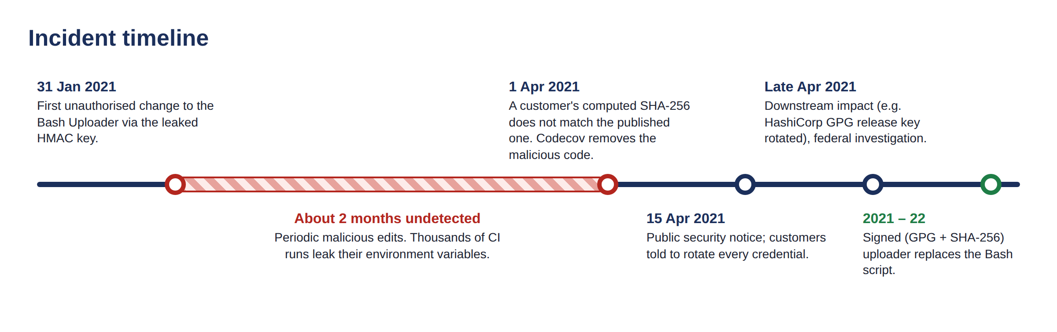
Introduction: The Codecov Incident
Organisation
Codecov: SaaS code-coverage tool, 29,000+ customers
Sector
DevOps / CI-CD, software supply chain
Date
31 Jan to 1 Apr 2021 (disclosed 15 Apr)
Security requirements violated:
Integrity (primary)
Authentication
Confidentiality
Key management
Notes:
Codecov is a code-coverage SaaS. Customers ran its Bash Uploader inside CI with curl piped to bash, so it ran next to all their secrets. From 31 January 2021 the attacker kept modifying it. On 1 April a customer noticed the SHA-256 did not match. The main violation is integrity and authenticity, and confidentiality was lost as a result. (~40 s)

Slide 5
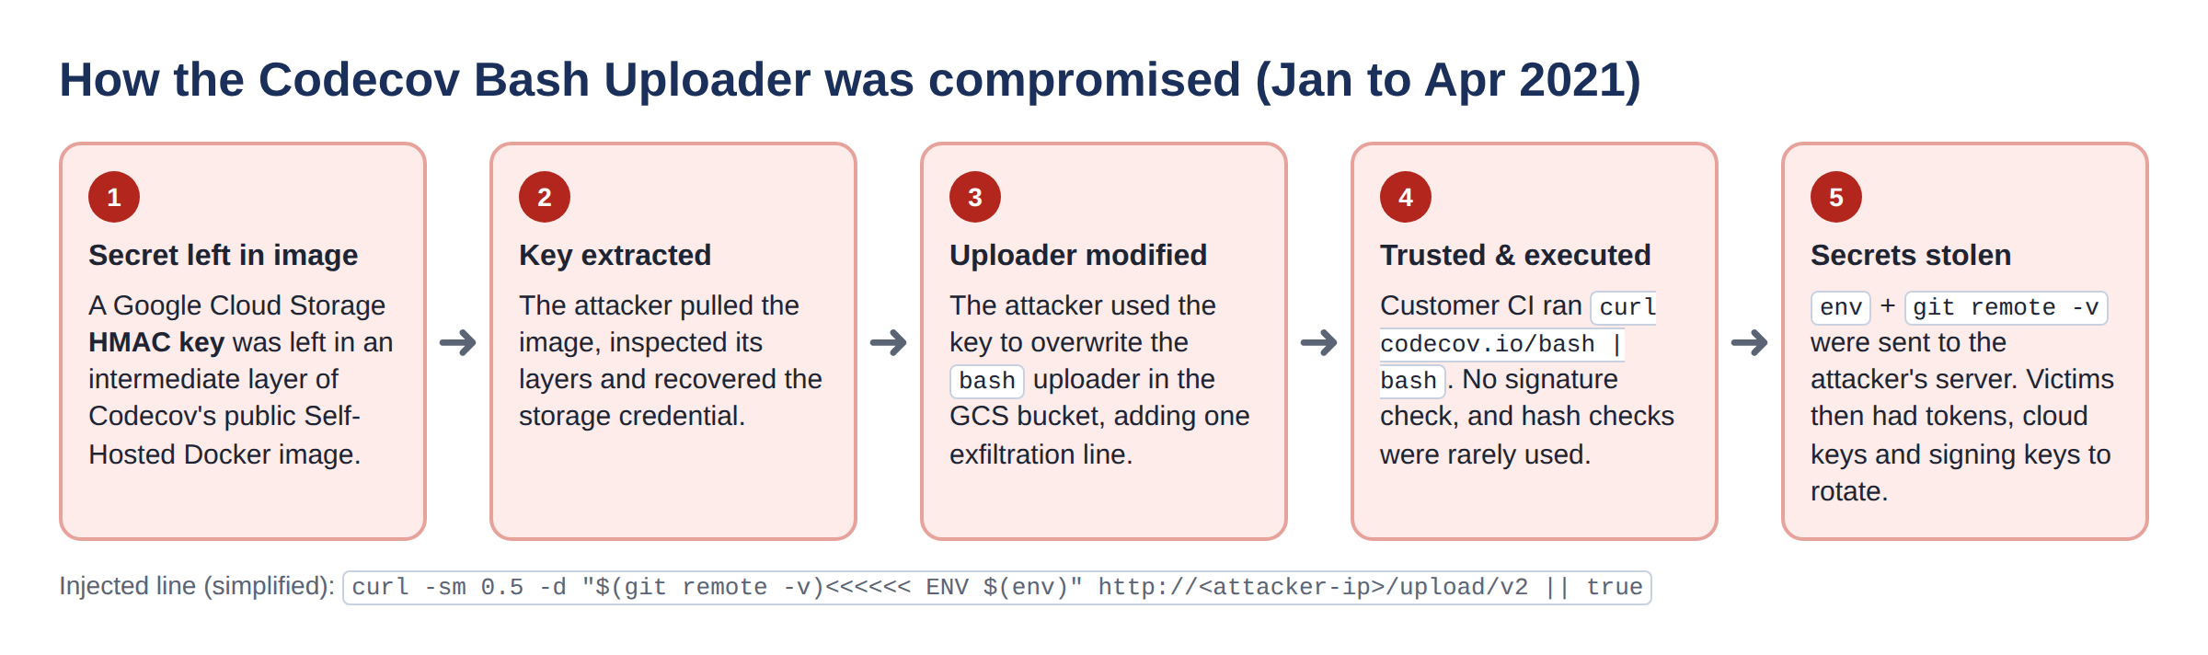
Problem Statement
CI/CD pipelines download and execute third-party tools with full access to secrets, but have no enforced way to verify the tool is authentic and unmodified before running it.
V1 Secret left in public Docker image layer
V2 Static, over-privileged storage HMAC key
V3 Uploader not signed; SHA-256 not enforced
V4 'curl | bash' runs whatever is served
V5 Every CI step can read every secret
V6 No monitoring → ~2 months dwell time
Notes:
Here is the attack chain. A GCS HMAC key was left inside a Docker image layer. The attacker used it to overwrite the uploader, and every pipeline that ran it sent env and git remote to the attacker. Six weaknesses made this possible: V1 to V6. Our problem: CI runs third-party code with full secrets but has no enforced way to verify it first. (~45 s)

Slide 6
Objectives
O1
O2
O3
Integrity
Authenticity
Key management
Detect any modification of the uploader before it executes
Accept only software signed by the genuine publisher key, even if the bucket and hash are attacker-controlled
Protected keys, 90-day rotation, instant revocation without changing customer pipelines
O4
O5
O6
Misuse & rollback
Least privilege
Simple & cheap
Expose silent use of a stolen key; block downgrade to old vulnerable versions
If malicious code ever runs, it sees only the one token it needs
Standard algorithms, ~1 ms overhead, one-line CI change
Notes:
Six objectives, each mapped to a weakness. Integrity and authenticity are the core. Key management and misuse detection handle a stronger attacker who steals a key. Least privilege limits damage. And it must be simple and cheap enough to be adopted. (~25 s)

Slide 7
Requirements
Functional
Security
Hardware / Software
FR1 Sign release manifest
FR2 Root certifies keys + revocation list
FR3 Append every release to a transparency log
FR4 Six-check verification in CI
FR5 Execute with env allowlist
FR6 Monitor served artifact
SR1 Detect any 1-bit change (SHA-256)
SR2 Unforgeable signature (Ed25519)
SR3 Pinned trust anchor
SR4 Keys in HSM/KMS, AES-256 at rest
SR5 Fail-closed
SR6 < 50 ms overhead
Any x86/ARM machine, 2 GB RAM
Python 3.9+, pyca/cryptography
Bash, Git, GitHub Actions
Production: Cloud KMS / HSM
Object storage / CDN over TLS 1.3
Notes:
Functional requirements describe what the system does: sign, certify, log, verify, restrict and monitor. Security requirements are measurable: any bit flip detected, unforgeable signatures, pinned trust anchor, protected keys, fail-closed, under 50 ms. The prototype needs only Python and one crypto library. (~30 s)

Slide 8
Methodology
1. Study incident
2. Analyse
3. Design
Codecov security update, post-mortem, Reuters, HashiCorp bulletin
Attack chain, vulnerabilities V1–V6, STRIDE threat model
Map each weakness to a crypto / security control
4. Implement
5. Attack & test
6. Evaluate
Python + pyca/cryptography prototype (~500 lines)
7 attack scenarios, assume-breach test, 13 unit tests, timing
Compare with standard fix; cost and feasibility
Tools: Python 3, pyca/cryptography (Ed25519, AES), Bash, unittest, GitHub Actions
Notes:
We followed six steps: study the incident from primary sources, find vulnerabilities and model threats with STRIDE, design cryptographic controls for each one, implement them in Python, attack our own implementation, and compare it with the standard fix. (~25 s)

Slide 9
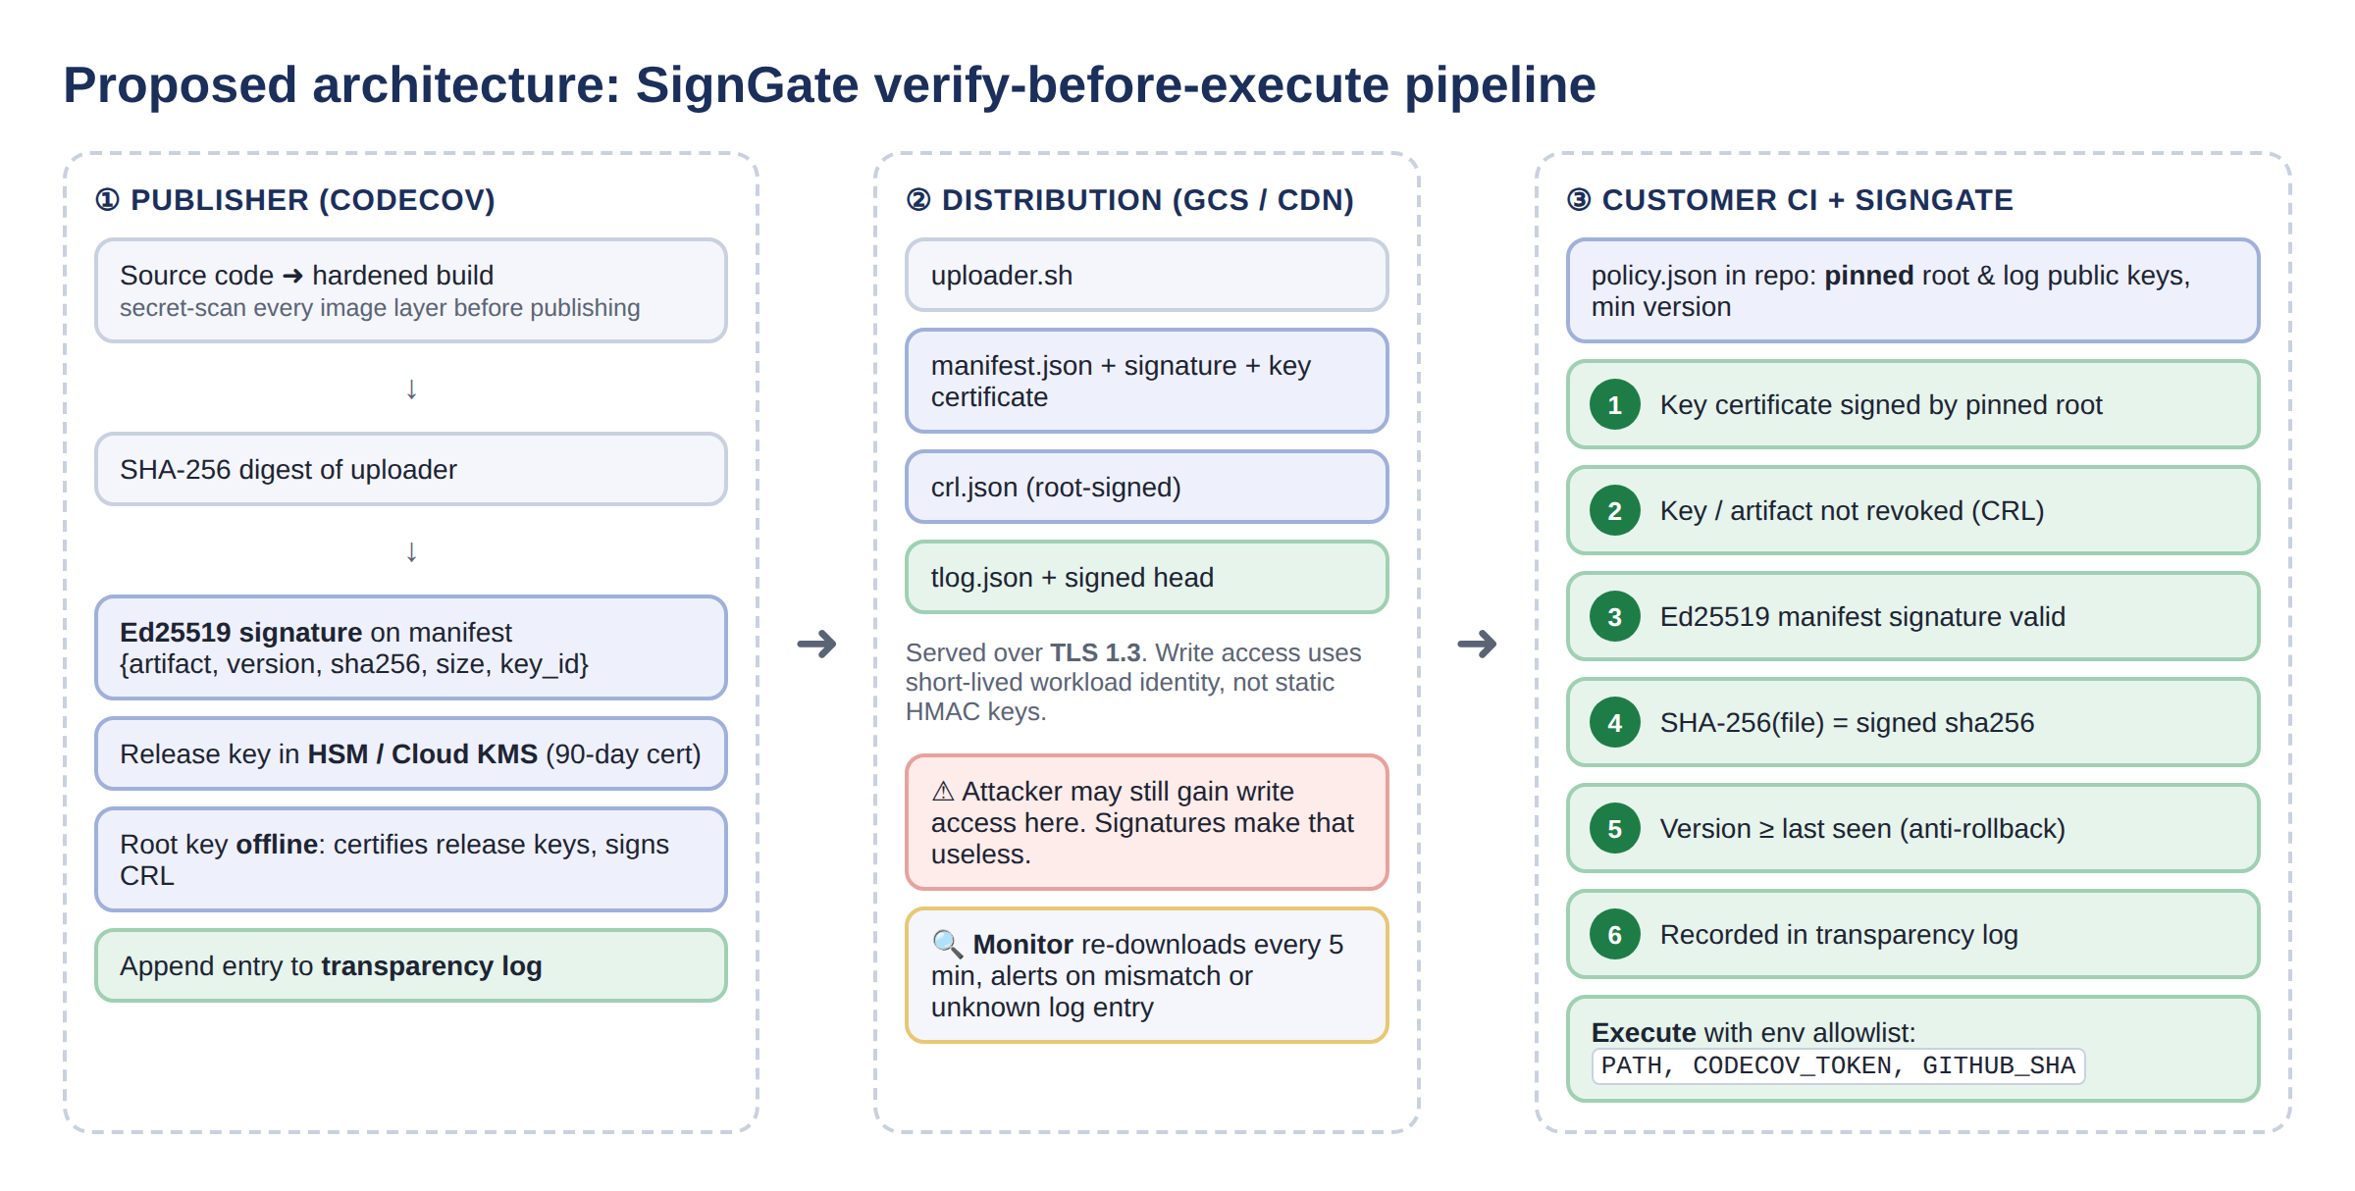
Design: SignGate Architecture
Idea: move trust from the storage bucket to cryptographic keys
Notes:
The key idea is to move trust from where the file is stored to who signed it. The publisher hashes and signs each release with a KMS-held key certified by an offline root and logs it. The bucket may be attacker-controlled; that no longer matters. In the customer's CI, SignGate runs six checks against keys pinned in the customer's own repo, then runs the tool with only the variables it needs. (~50 s)

Slide 10
Design: Cryptographic Building Blocks
Mechanism | Standard | Role in SignGate
SHA-256 | FIPS 180-4 | Fingerprint of uploader; log hash chain
Ed25519 signature | RFC 8032 / FIPS 186-5 | Signs manifest, key certs, CRL, log head
Mini-PKI (root → release key) | NIST SP 800-57 | 90-day certified keys; rotation
Signed revocation list | X.509-CRL style | Blocks stolen keys / bad artifacts
Hash-chained transparency log | RFC 6962 (CT) idea | Makes silent key misuse visible
AES-256 PKCS#8, HSM/KMS | FIPS 197 | Private keys never in plain text
TLS 1.3 + workload identity | RFC 8446, OIDC | Transport; replaces static HMAC key
Why a signature, not just a hash? An attacker who can edit the file can also edit the published hash. σ = Sign(SK_release, SHA-256 manifest) can only be produced with the private key, and it is verified with a public key pinned in the customer's repo.
Notes:
These are the primitives and why each fits. SHA-256 detects change. Ed25519 proves who signed it, and it is fast and deterministic. The mini-PKI and revocation list handle key theft. The transparency log makes misuse visible. The important point: a hash alone is not enough, because whoever can change the file can change the published hash. A signature binds the hash to a key the attacker does not have. (~45 s)

Slide 11
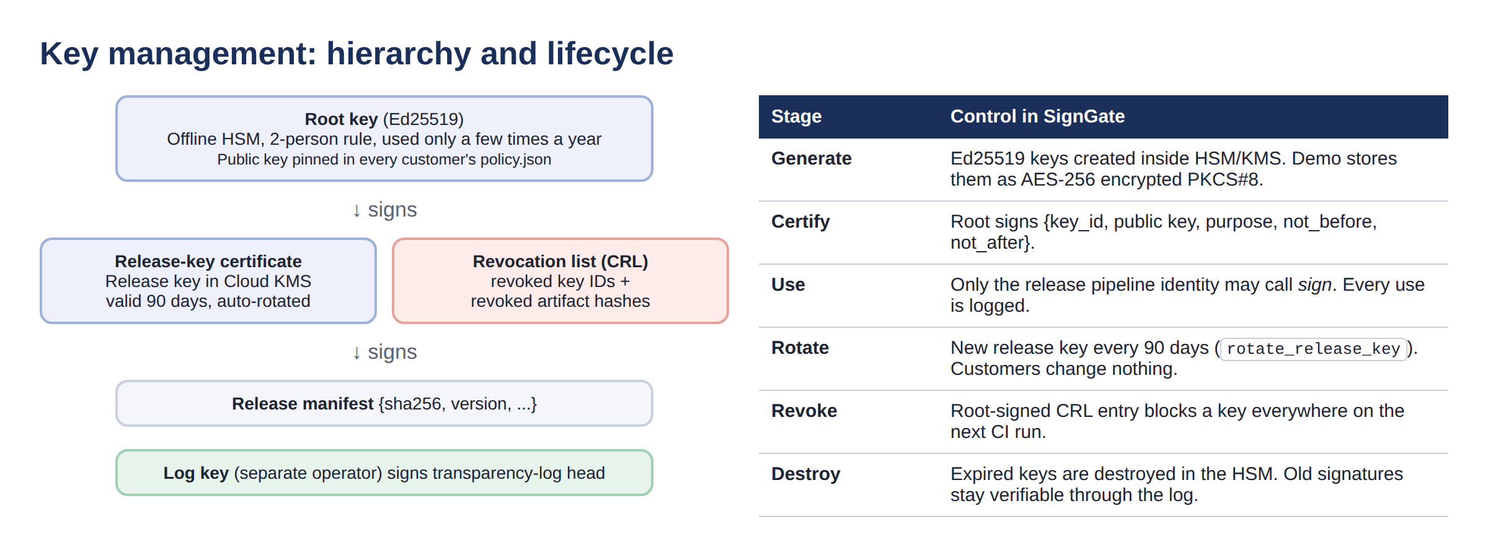
Design: Key Management
Separation of duties: root (offline HSM), release (KMS), log (separate operator)
Rotation: new release key every 90 days; customers change nothing
Revocation: root-signed CRL blocks a leaked key on every CI run immediately
Root cause fixed: no long-lived secret inside build images; secret-scan every layer
Notes:
Key management is exactly where Codecov failed. Our root key is offline and only certifies release keys and signs the revocation list. Its public key is pinned by customers. Release keys live in KMS for 90 days and rotate automatically. If one leaks, the root signs a new CRL and every pipeline rejects it on the next run, with no customer changes. (~40 s)

Slide 12
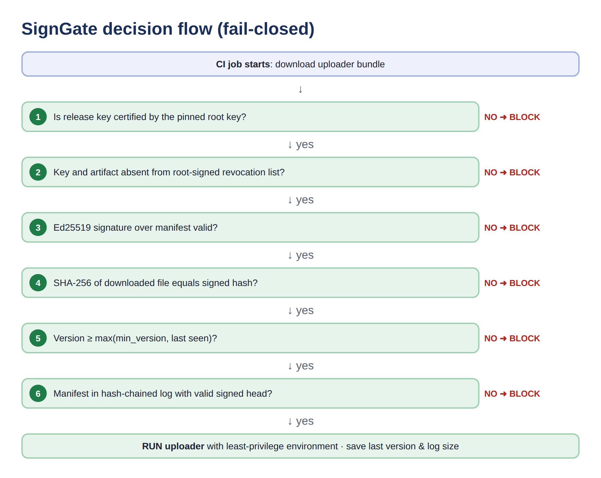
Implementation: Verify-Before-Execute Gate
Module | Does
crypto_utils | SHA-256, Ed25519, AES keys
pki | Key certs, revocation
tlog | Hash-chained log
publisher | Hash → sign → log → publish
gate | 6 checks + env allowlist
monitor | Tamper alerts
Before
bash <(curl -s codecov.io/bash)
After
python -m signgate.cli run --bucket b/ --policy policy.json
Notes:
This is the gate's decision flow. The checks are ordered and fail-closed, so the first failure blocks execution. The code is split into small modules, as listed on the right. For a customer, adopting it is a one-line change: replace curl pipe bash with signgate run. (~45 s)

Slide 13
Security Analysis: STRIDE Threat Model
STRIDE | Threat | SignGate control | Check
Spoofing | Fake 'Codecov' key | Cert must chain to pinned root | 1
Tampering | Edit uploader (2021 attack) | SHA-256 bound by Ed25519 | 3, 4
Tampering | Replay old signed version | Signed version ≥ last seen | 5
Repudiation | Hidden / denied release | Append-only signed log | 6
Info. disclosure | Read all CI secrets | Env allowlist | exec
DoS | Corrupt files to break builds | Fail-closed + mirrors | -
Elevation | Stolen release key | Log + monitor + CRL | 2, 6
Original attack vector: attacker has bucket write access, no signing key → hash mismatch (check 4). Also rewrites the hash → signature invalid (check 3). Blocked before a single line runs. Residual risk: compromised build server (future: SLSA).
Notes:
In 2021 the attacker had bucket write access but no signing key. With SignGate, the edited file fails the hash check. Rewriting the hash breaks the signature. Using their own key fails the certificate check. Each STRIDE threat maps to a check. The residual risk is a compromised build server that signs malware legitimately; the log makes that visible, and SLSA provenance is the future fix. (~45 s)

Slide 14
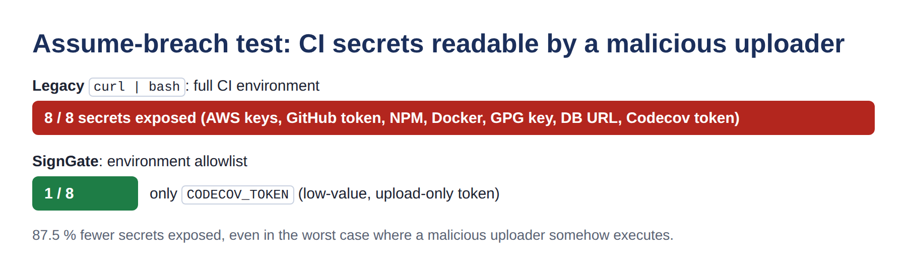
Results: System Testing
ID | Scenario | Expected | Result | Stopped at
S1 | Legitimate signed release | ALLOW | ALLOWED | -
S2 | 2021 attack: uploader edited in bucket | BLOCK | BLOCKED | 4. SHA-256 integrity
S3 | Attacker also rewrites published SHA-256 | BLOCK | BLOCKED | 3. Ed25519 signature
S4 | Attacker signs with own key + fake cert | BLOCK | BLOCKED | 1. Key certificate (PKI)
S5 | Stolen release key, release not logged | BLOCK | BLOCKED | 6. Transparency log
S6 | Stolen key detected by monitor and revoked | BLOCK | BLOCKED | 2. Revocation list
S7 | Rollback to older signed version | BLOCK | BLOCKED | 5. Anti-rollback
0.56 ms
13 / 13
avg verification
unit tests pass
Notes:
We attacked our own system. The legitimate release is allowed. The exact 2021 attack is blocked at the hash check, and each stronger variant is blocked at a different check, so every layer does something. In the assume-breach test, where we run the malicious script anyway, the allowlist cut exposed secrets from 8 to 1. Verification costs about half a millisecond. (~50 s)

Slide 15
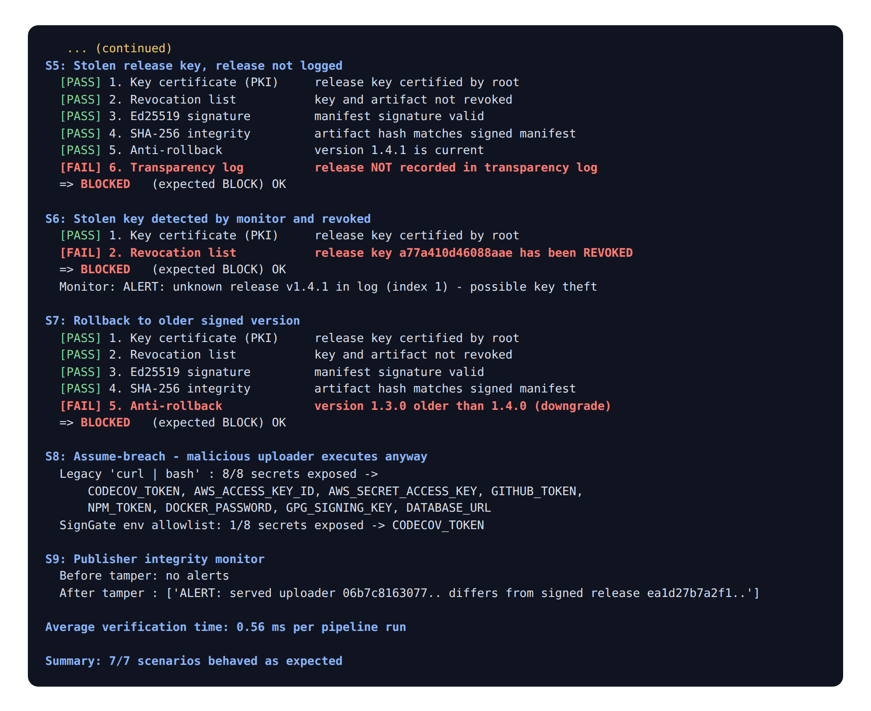
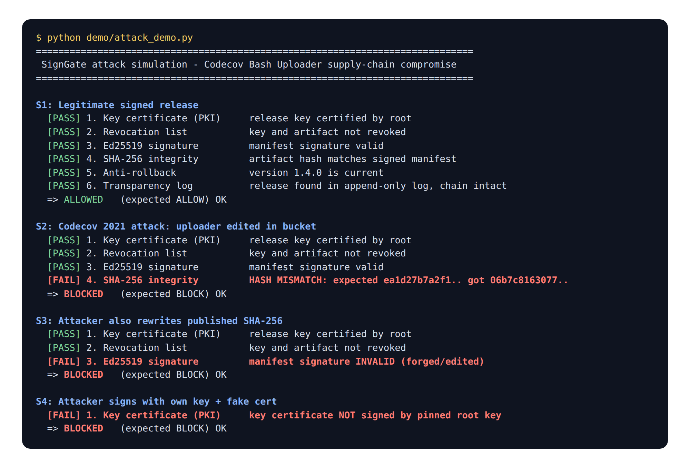
Results: Demo Output
Notes:
This is the actual console output of our attack simulation. Green PASS and red FAIL show exactly which check stopped each attack. The monitor also flags a tampered file immediately; in 2021 that took two months. If time permits, we run this live: python demo/attack_demo.py. (~20 s)

Slide 16
Innovation and Application Relevance
Aspect | Standard fix (signed + SHA) | SignGate
Verification | Optional, manual | Enforced, fail-closed
Trust anchor | Fetched from same site | Pinned in customer repo
Leaked signing key | Every user must update | Root-signed CRL, automatic
Silent key misuse | Undetectable | Transparency log + monitor
Rollback | Not addressed | Signed version + state
If malicious code runs | All secrets exposed | 1 of 8 secrets (allowlist)
Detection time | ~2 months | Minutes
Industry
Cost
Feasibility
SLSA · NIST SSDF · EO 14028
Open source; KMS ≈ US$1/month
1 CI line; ~0.6 ms per build
Notes:
After the incident Codecov published a signed uploader, but verification stayed optional and manual. Our contribution is not a new algorithm. It combines standard primitives into an enforced gate that also handles key theft, rollback and blast radius. It matches SLSA, NIST SSDF and Executive Order 14028, and costs about a dollar a month for a KMS key. The same pattern applies to GitHub Actions, npm and container images, as the 2025 tj-actions incident showed. (~45 s)

Slide 17
Conclusion
Root cause: integrity + authenticity failure (unsigned uploader, leaked static key) → confidentiality breach.
SignGate: SHA-256 + Ed25519 signatures, root-certified rotatable keys with CRL, transparency log, anti-rollback and least-privilege execution in one fail-closed gate.
Evidence: 7/7 scenarios correct, 2021 attack blocked before execution, secrets exposed 8 → 1, ~0.6 ms.
Lesson: trust keys, not locations. Verify before you execute.
Future work: Sigstore keyless (OIDC) signing · SLSA build provenance for compromised build servers · witness co-signed log · package as a reusable GitHub Action
Notes:
To conclude: Codecov was an integrity and authenticity failure that became a confidentiality breach. SignGate fixes that with standard cryptography and good key management, and our tests show it blocks the real attack and stronger variants cheaply. Next steps are Sigstore keyless signing, SLSA provenance and packaging it as a GitHub Action. (~30 s)

Slide 18
References (IEEE)
[1] Codecov, "Bash Uploader Security Update," Apr. 15, 2021. about.codecov.io/security-update
[2] Codecov, "Post-Mortem / Root Cause Analysis (April 2021)." about.codecov.io/apr-2021-post-mortem
[3] J. Menn and R. Satter, "Codecov hackers breached hundreds of restricted customer sites," Reuters, Apr. 2021.
[4] HashiCorp, "HCSEC-2021-12: Codecov Security Event and HashiCorp GPG Key Exposure," Apr. 2021.
[5] S. Josefsson and I. Liusvaara, "Edwards-Curve Digital Signature Algorithm (EdDSA)," RFC 8032, 2017.
[6] NIST, "Secure Hash Standard (SHS)," FIPS 180-4, 2015; "Digital Signature Standard," FIPS 186-5, 2023.
[7] E. Barker, "Recommendation for Key Management," NIST SP 800-57 Pt. 1 Rev. 5, 2020.
[8] B. Laurie, A. Langley and E. Kasper, "Certificate Transparency," RFC 6962, 2013.
[9] Z. Newman et al., "Sigstore: Software Signing for Everybody," ACM CCS, 2022.
[10] OpenSSF, "SLSA v1.0," 2023; NIST SP 800-218 (SSDF), 2022; Executive Order 14028, 2021.
Notes:
Our main sources are Codecov's own security update and post-mortem, plus Reuters and HashiCorp for impact. The standards cited are for the algorithms we used. (~5 s)

Slide 19
Thank You
Questions?
Trust keys, not locations. Verify before you execute.
Notes:
Thank you. We are happy to take questions or run the demo live.

