Slide 1


Market Analysis
Appropriate locations for coffee shops in Toronto, Canada
Recommendations

Slide 2
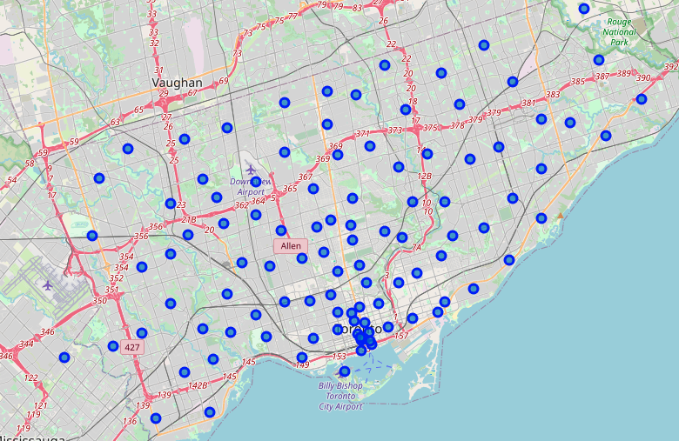
Map of Toronto Neighbourhoods

Slide 3
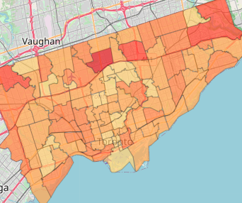
Chloropleth map of population density.
Data sourced from the 2016 Canada census

Slide 4
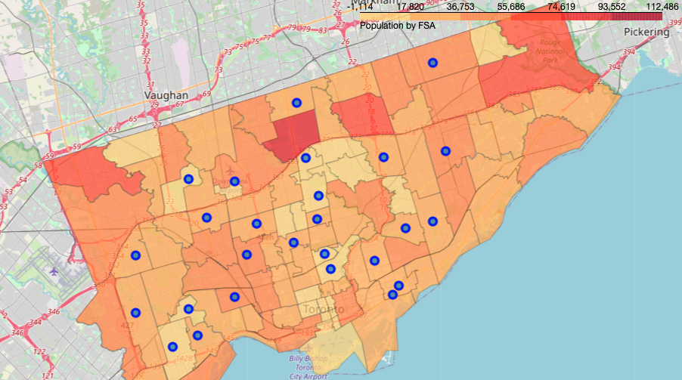
Selected Neighbourhoods from Data Analysis overlayed with the population density map.

Slide 5
Highlighted Neighbourhoods

Slide 6
Highest Population
Recommendations:
Milliken, Agincourt North, Steeles East, L'Amoreaux East
Dorset Park, Wexford Heights, Scarborough Town Centre

Slide 7
Best neighbouring locations
Enclave of M4L
Top 10 locations
Light Rail Station | Park | Spa | Skate Park | Auto Workshop | Burrito Place | Fast Food | Farmers Market | Garden | Garden Center

