Slide 1
Context
The customer was relying on two content management systems (DMS and CMS) that were built on outdated and unsupported technologies, both at the operating system and software levels. This posed significant risks to critical business processes. To mitigate these risks, the project was initiated to consolidate and replace the two systems with a unified, modern content management platform.

Slide 2
Initiating the Transition
Requirements analysis (Understand current systems)
Define goals
Assemble team
Create project plan

Slide 3
Main Areas of Work
Document & data migration (SL)
Document capture (TP)
User interface (DW, Stan)
Web APIs and utilities (Stan)

Slide 4
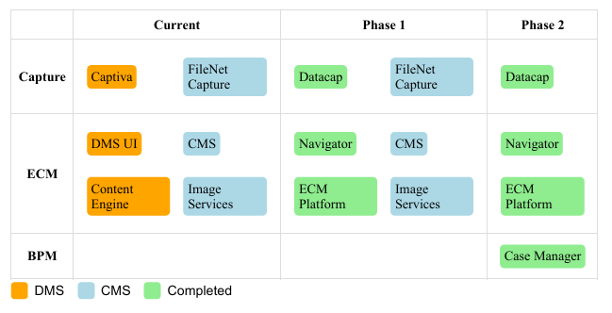
Implementation Phases

Slide 5
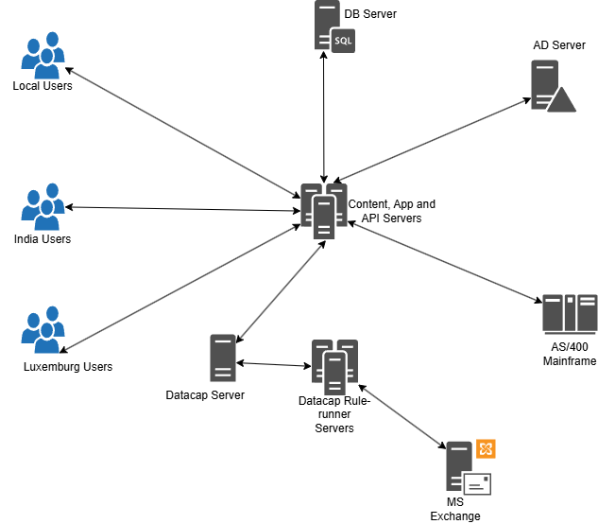
Architecture

Slide 6
Phase 1
Install and configure ECM platform, migrate DMS documents and data using built-in P8 Sweep. (SL)
Replace Captiva capture software with Datacap (TP)
Configure document security and implement search functionality (DW)
Build the web services, create custom UI components and actions (Stan)

Slide 7
Phase 1- Stan’s tasks
Create Reference DB - SQL Server
Create API that exposes Reference DB – .net
Create API that returns indexing info from their host DB – .net
Create External Data Service - Java
Create UI components (audit viewer, bulk-indexing, document comments) for Navigator – JS and Java
Create Web UI to manage Reference Data – .net

Slide 8
Phase 2
Migrate CMS documents and data using content federation services (SL)
Replace FileNet Capture capture software with Datacap (TP)
Configure document security (DW)
Modify web services and custom UI components, create Case Manger UI components (Stan).

Slide 9
Phase 2 - Stan’s tasks
Make External Data Service more generic/configurable (Java)
Deliver custom ICM components to manage letters, emails and case notes (JS and Java)
Build command line utility to help export/imprt lookup lists from UAT -> PRE-PROD -> PROD (c#)

