Slide 1

Why we need Biostatistics
Stan Pounds

Slide 2
Statistics in Science
Statistics is the scientific discipline that develops, evaluates, and applies methods to collect and interpret incomplete information to gain new knowledge.
Science endeavors to systematically interpret incomplete information obtained through observation and experimentation in order to gain new knowledge about nature.
Scientific research is an intrinsically statistical process because it always relies upon incomplete information.

Slide 3







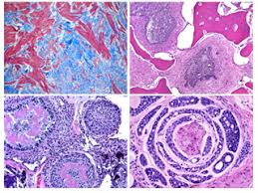





Select an incomplete subcohort of the all persons of scientific interest for research evaluations.
From each person, we obtain incomplete subsets of tissue for study …
from which, we obtain incomplete subsets of molecules for study …
dentistry.tamhsc.edu
during an incomplete subset of a lifetime.

Slide 4
Statistics are Intrinsic to Research
As of June 17, 2019, 62 of the 100 articles most recently appearing in PubMed Central had some explicit reference to formal statistical tests, methods, or results identified by simplistic computational scans of the full text.
Most of the other articles were literature reviews or case reports.
The top 100 cited scientific papers include 12 on statistics (https://www.nature.com/news/the-top-100-papers-1.16224).
“Statistics is the grammar of science.” - Pearson

Slide 5
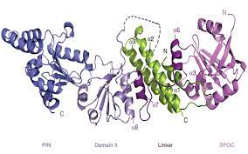
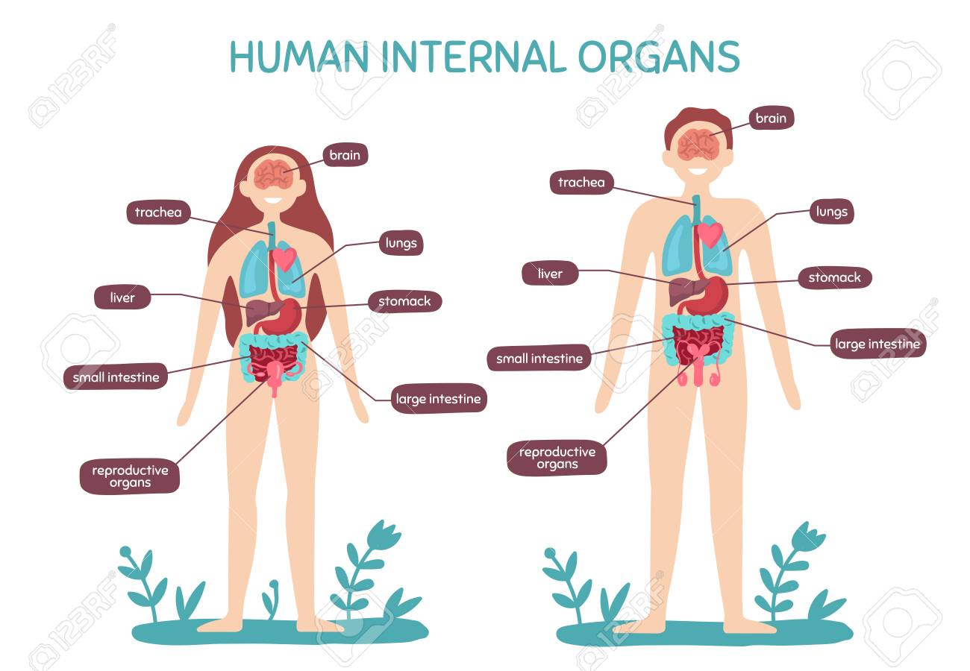
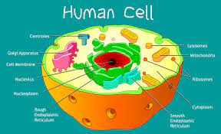
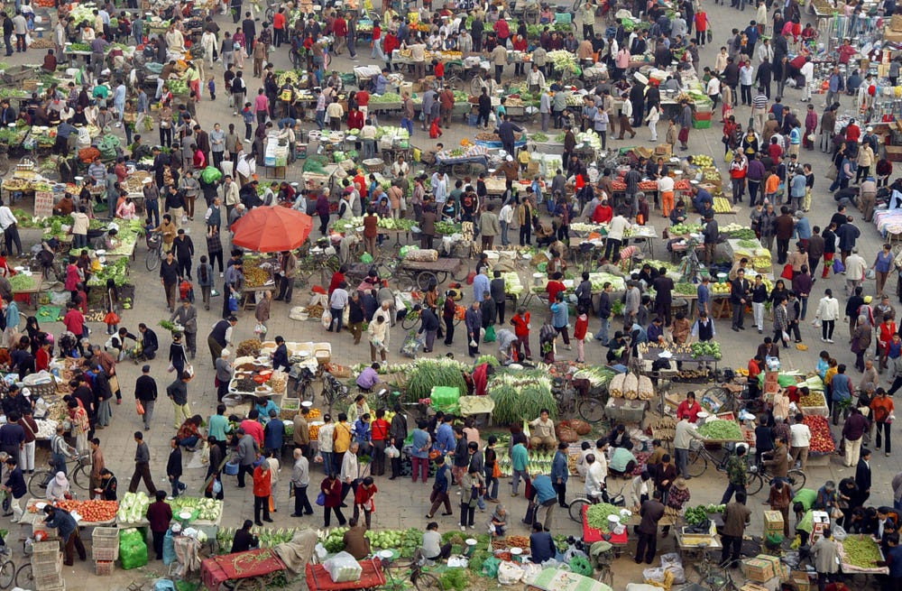


We don’t have a movie of
every molecule
of every organ
in every cell
in every person
in the world
at every moment.

Slide 6


Thus, we collect and interpret incomplete information (i.e., use statistics) to gain new knowledge.
We are not all-knowing;
therefore,
statistics are unavoidable.

Slide 7
How can we learn from incomplete info?
Statistics works because incomplete information is a subset of the complete information.
Subsets follow enumerable patterns.
Those patterns are used to quantify how accurately the subset represents the whole.

Slide 8
1
2
3
4
5
Mean = 3.00
All Subsets of 2
All Subsets of 3
All Subsets of 4
Subset | Mean
1,2 | 1.50
1,3 | 2.00
1,4 | 2.50
2,3 | 2.50
1,5 | 3.00
2,4 | 3.00
2,5 | 3.50
3,4 | 3.50
3,5 | 4.00
4,5 | 4.50
Subset | Mean
1,2,3 | 2.00
1,2,4 | 2.33
1,2,5 | 2.67
1,3,4 | 2.67
1,3,5 | 3.00
1,4,5 | 3.33
2,3,4 | 3.00
2,3,5 | 3.67
2,4,5 | 4.00
3,4,5 | 4.00
Subset | Mean
1,2,3,4 | 2.50
1,2,3,5 | 2.75
1,2,4,5 | 3.00
1,3,4,5 | 3.25
2,3,4,5 | 3.50
Mean of Subset Means: 3.0
Range of Means: 2.5-3.5
For most subsets, the subset mean is close to the overall mean.
As the number in the subset grows, the means of subsets get closer to the overall mean.
Mean of Subset Means: 3.0
Range of Means: 1.5 - 4.5
Mean of Subset Means: 3.0
Range of Means: 2.0-4.0

Slide 9
Summary
Statistics is the scientific discipline that develops, evaluates, and applies methods to collect and interpret incomplete information to gain new knowledge.
It is impossible to obtain complete information; therefore, we make the best use of the incomplete information we can obtain by using statistics.
Statistics relies on the mathematical patterns of subsets to quantitatively characterize how well a conclusion can be supported with available information.

