Slide 1
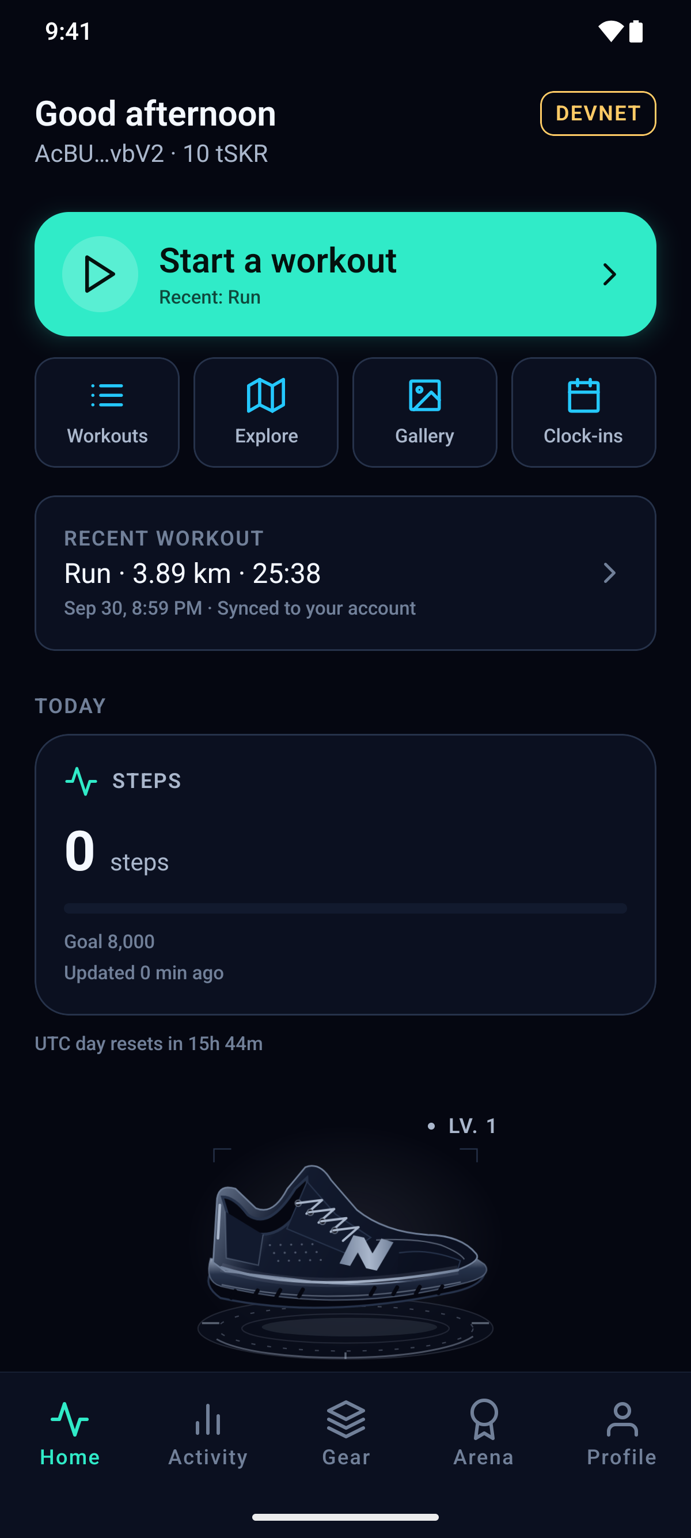
NEONSHIFT / A
01 / 11
Daily movement.
Visible progress.
A reason to return, every day.
MOVE / GROW / COLLECT
DEVICE CAPTURE · OCT 02 · APK CODE 14
REAL DATA · NO DEMO OVERRIDE
Notes:
What keeps us moving after the first few days? NeonShift turns everyday movement into visible progress, wildlife-inspired shoes, and a reason to return.

Slide 2
NEONSHIFT / A
02 / 11
Built for
Solana Mobile.
01
PHONE WORKOUTS
02
Phone-based workouts.
Health summaries. Wallet approval.
HEALTH SUMMARY
03
WALLET APPROVAL
MOBILE-FIRST FITNESS
PRODUCT OVERVIEW
Notes:
Built for Solana Mobile, it connects daily activity with achievements you can collect and verify.

Slide 3
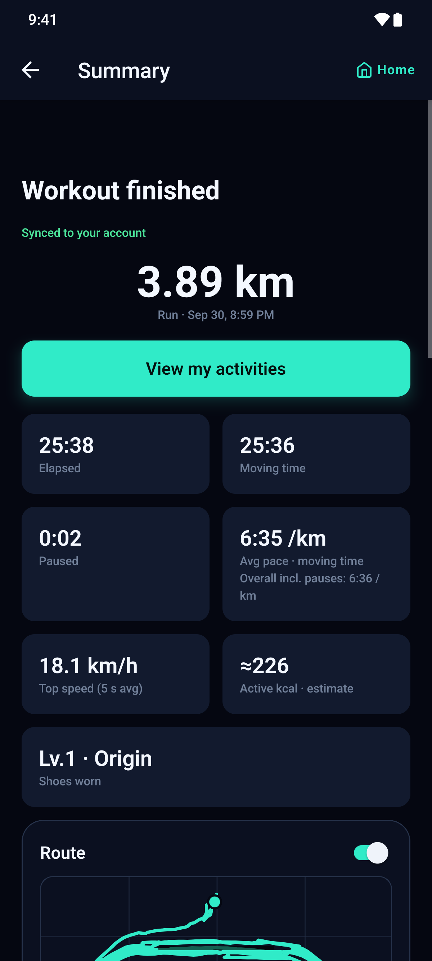
NEONSHIFT / B
03 / 11
Walk. Run.
See your progress.
Record → Save → Review
YOUR ACTIVITY JOURNAL
DEVICE CAPTURE · OCT 02 · APK CODE 14
REAL DATA · NO DEMO OVERRIDE
Notes:
Start with a walk or a run. Record your workout, save it on your phone, and review your progress in the Activity journal.

Slide 4
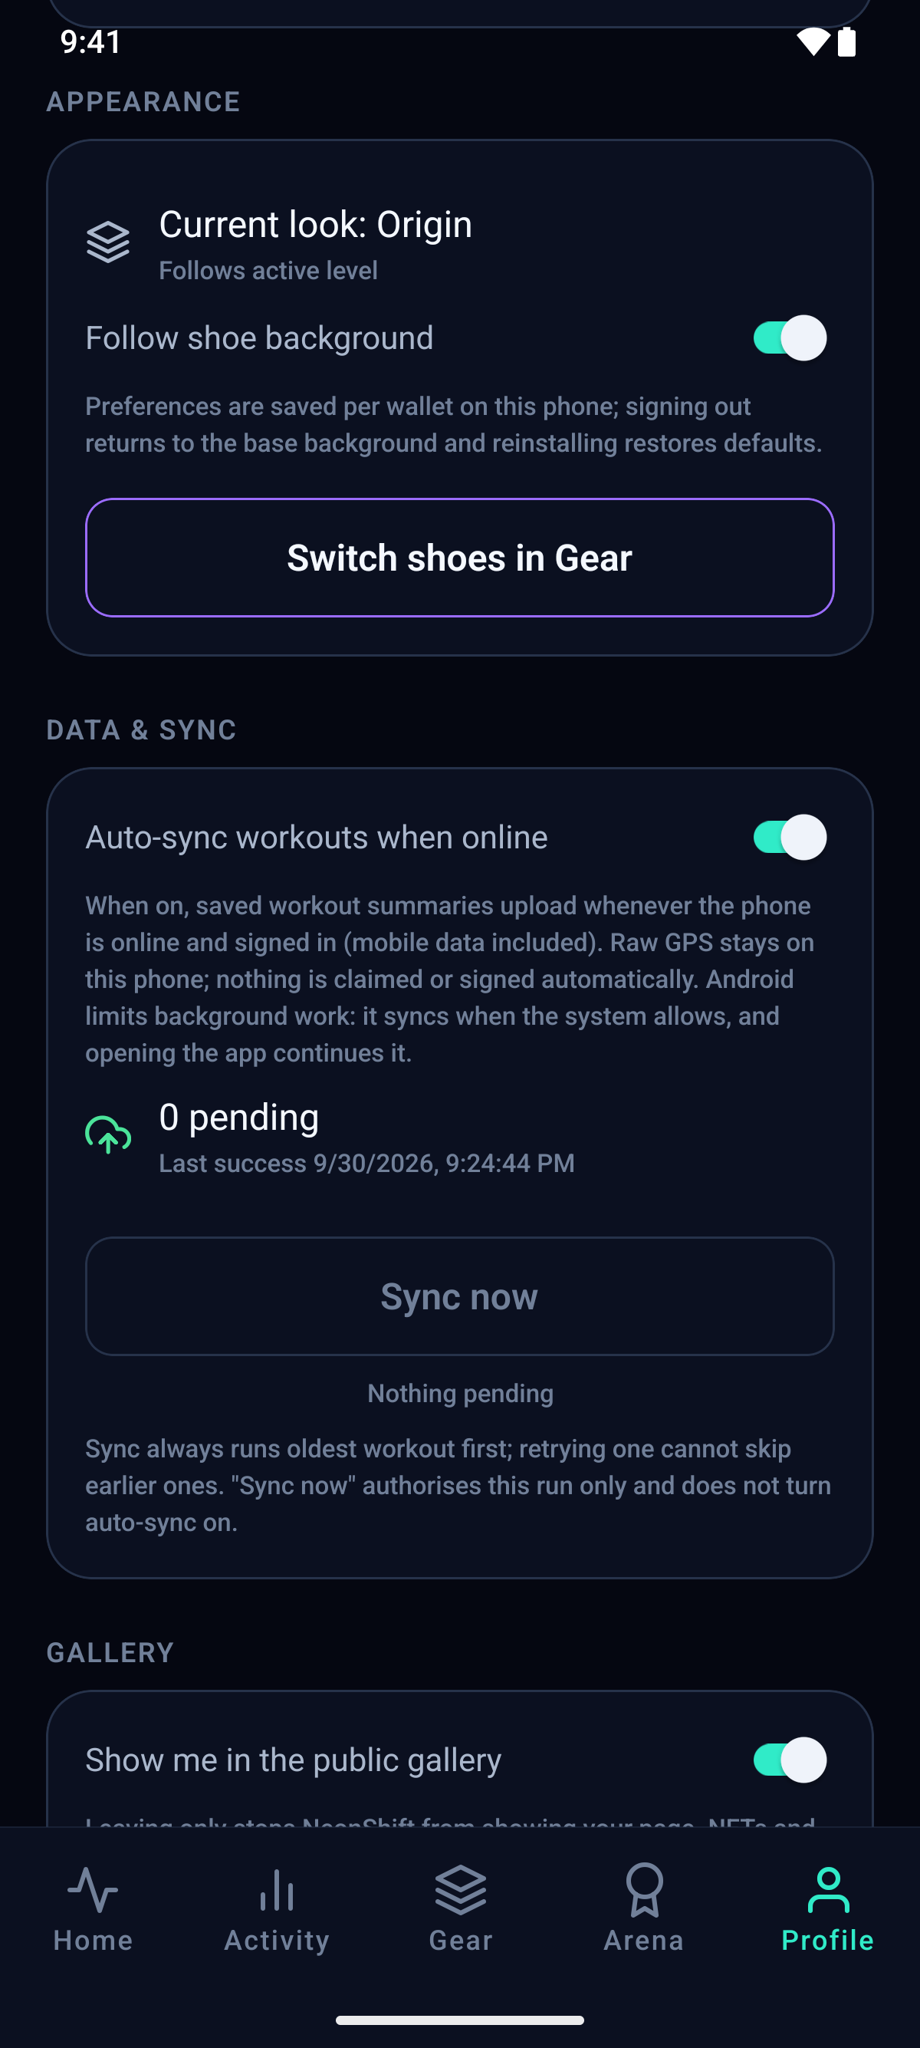
NEONSHIFT / B
04 / 11
Sync when
you are ready.
Optional online sync.
Oldest workout first.
STARTER SHOES + UPGRADES: FREE
DEVICE CAPTURE · OCT 02 · APK CODE 14
REAL DATA · NO DEMO OVERRIDE
Notes:
Choose automatic sync when online, with saved workouts processed oldest first. Starter shoes and level upgrades remain free. Recording a workout does not automatically qualify you for a reward.

Slide 5
NEONSHIFT / C
05 / 11
Your approval.
An onchain claim.
01
QUALIFYING SUMMARY
02
Qualifying summary
→ Wallet approval → Explorer
WALLET APPROVAL
03
DEVNET EXPLORER
SOLANA DEVNET
WORKFLOW OVERVIEW
Notes:
Qualifying activity connects to a claim on Solana devnet. For daily steps, an Android Health Connect summary is checked before wallet approval. View the resulting transaction in the explorer.

Slide 6
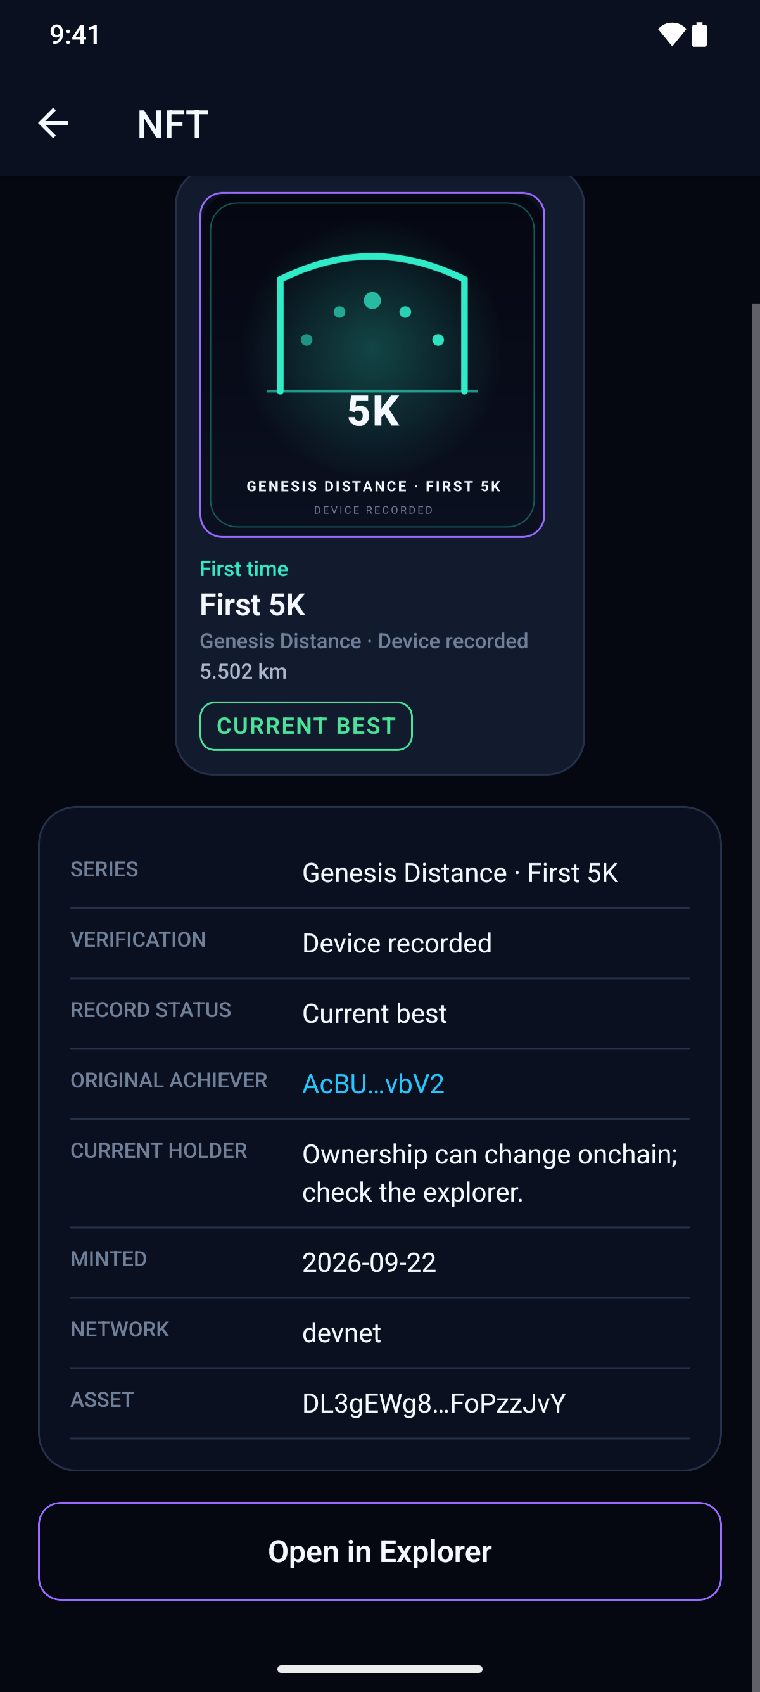
NEONSHIFT / C
06 / 11
Collect milestones.
Keep the meaning.
Achievements have their own
requirements and approval.
RAW HEALTH RECORDS: NOT ONCHAIN
DEVICE CAPTURE · OCT 02 · APK CODE 14
REAL DATA · NO DEMO OVERRIDE
Notes:
Raw health records are not published onchain. Achievement collectibles have their own requirements and approval process. The blockchain records the claim, not every step.

Slide 7
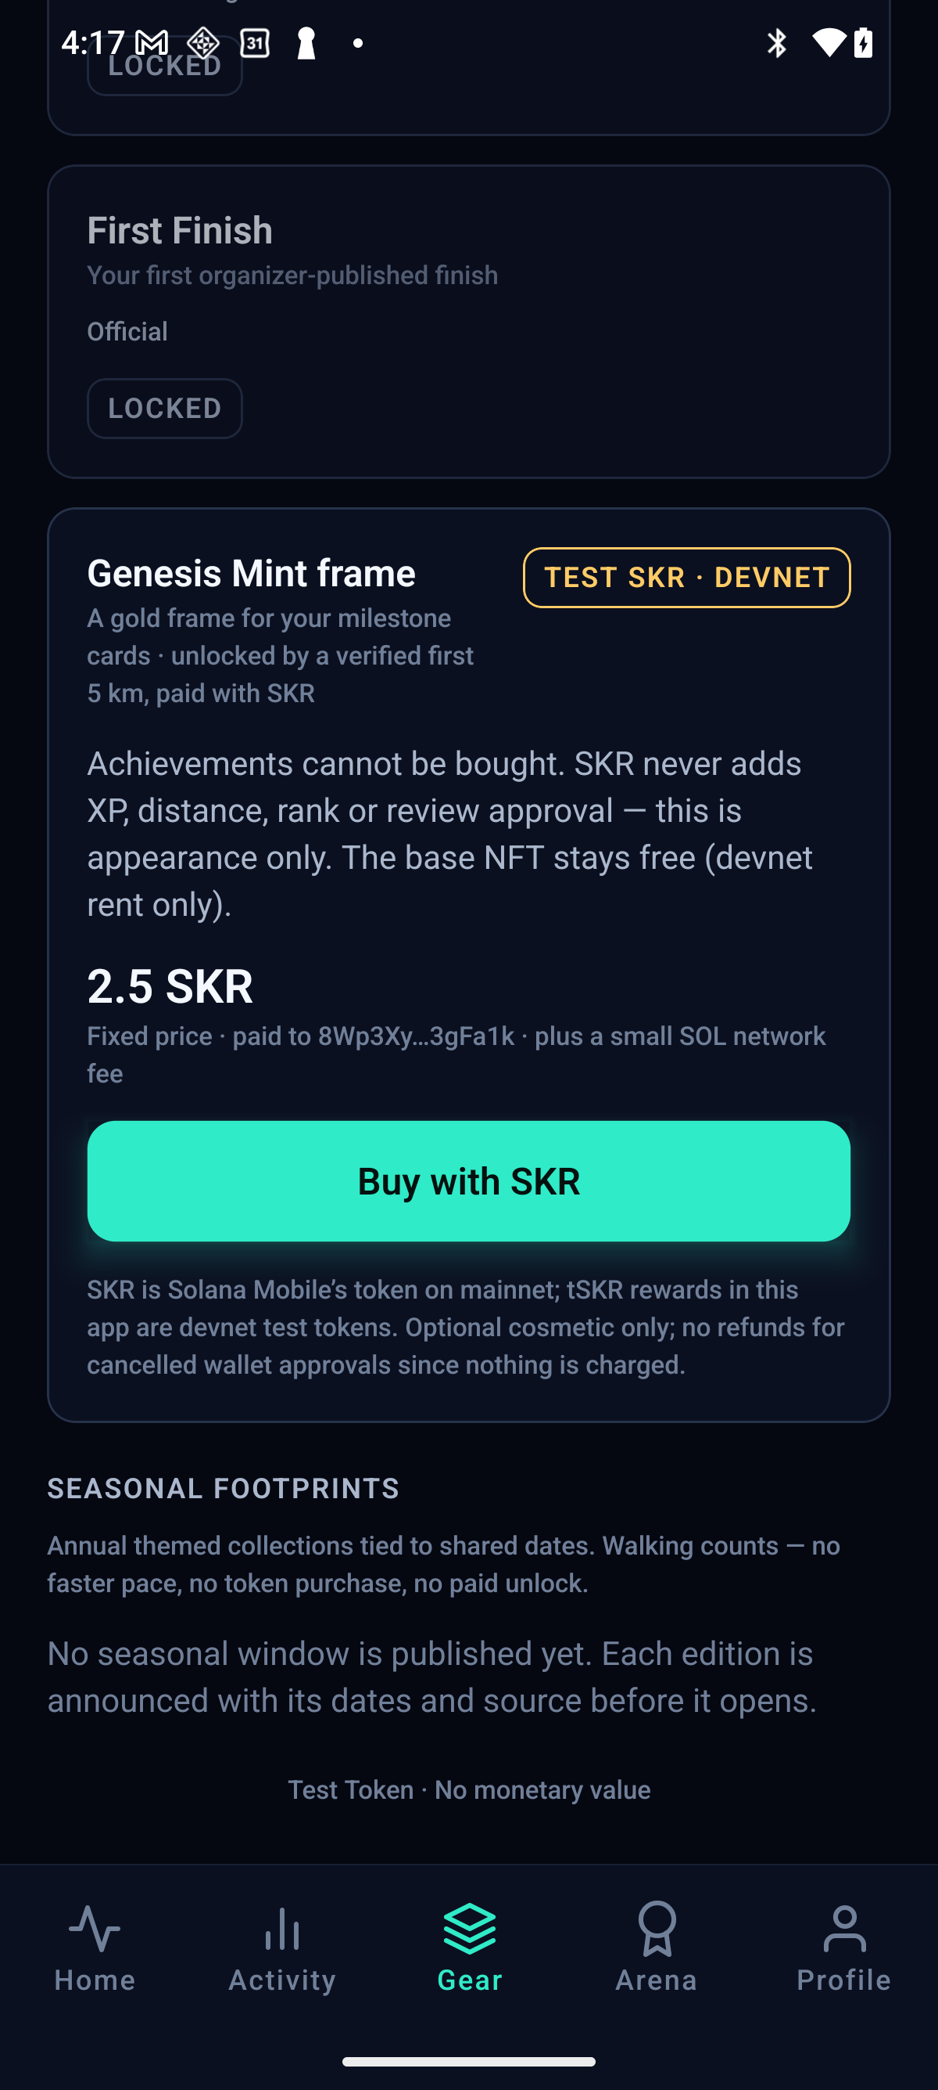
NEONSHIFT / D
07 / 11
Earn eligibility.
Unlock your frame.
Verified first 5K eligibility.
Server-set order, price, recipient.
COSMETIC PAYMENT
DEVICE CAPTURE · OCT 01 · APK CODE 11
TEST SKR · DEVNET · NOT OFFICIAL SKR
Notes:
NeonShift gives token payments a cosmetic purpose. Eligible first-five-kilometer runners can unlock a Genesis Mint frame, paid with a test token on devnet. The server sets the order, price, and recipient.

Slide 8
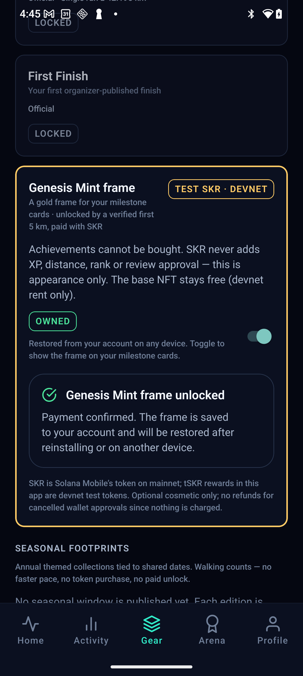
NEONSHIFT / D
08 / 11
Confirmed payment.
Unlocked frame.
Wallet approval → Onchain check
→ Cosmetic unlock
NO XP, RECORDS OR ACHIEVEMENTS BOUGHT
DEVICE CAPTURE · OCT 01 · APK CODE 11
TEST SKR · DEVNET · NOT OFFICIAL SKR
Notes:
Review the details, then approve in your wallet. After the server verifies the confirmed transfer onchain, the frame unlocks for that wallet. This payment uses test tokens, not official SKR. It buys no experience points, records, or achievements.

Slide 9
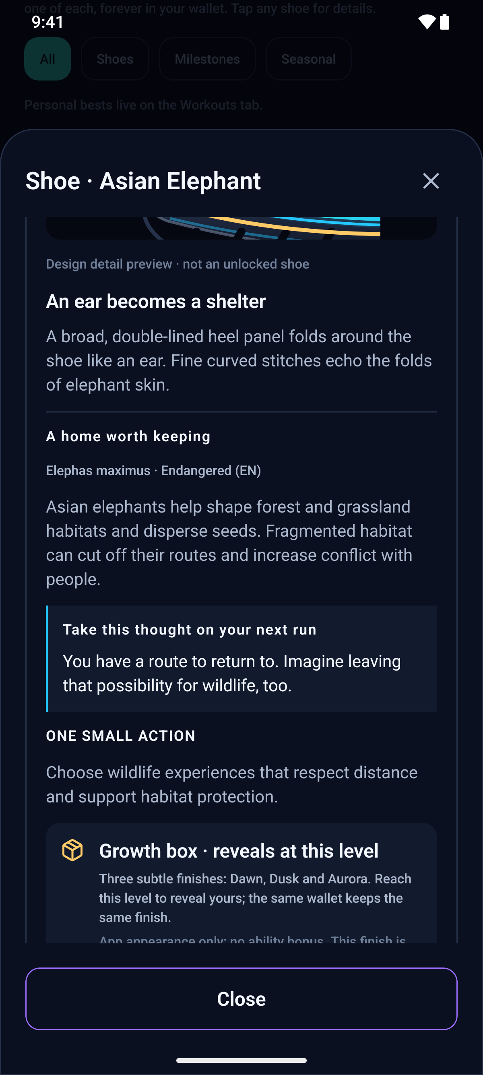
NEONSHIFT / E
09 / 11
Progress with
a wildlife story.
Conservation learning today.
Community pilots are planned.
NEXT: LOCAL PILOTS
DEVICE CAPTURE · OCT 02 · APK CODE 14
IN-APP STORY CARD · PILOTS PLANNED
Notes:
Wild Guardians connect your progress with conservation learning. Local community pilots are planned. No partnership or donation is claimed.

Slide 10
NEONSHIFT / E
10 / 11
STAKING BOOST (ILLUSTRATIVE)
Next: stake SKR.
Boost by level.
LV.1 ORIGIN
+5%
LV.2
+10%
LV.3
+15%
Higher shoe levels earn higher boosts.
A fixed share of staking rewards
funds wildlife conservation.
LV.4
+20%
LV.5
+25%
ROADMAP · NOT LIVE · RATES NOT FINAL
CONSERVATION SHARE
10% of staking rewards
PLANNED · NOT IMPLEMENTED
Notes:
Next, stake SKR to boost mission rewards, with higher boosts at higher shoe levels. A fixed share of staking rewards will fund a separately tracked wildlife conservation pool. Rates are not final.

Slide 11
NEONSHIFT / E
11 / 11
Move for yourself.
Move together
for nature.
Explore NeonShift.
ANDROID APP / SOURCE / REVIEWER GUIDE
NEONSHIFT · SOLANA MOBILE
Notes:
Explore the Android app, source code, and reviewer guide through the submission links. Move for yourself. Move together for nature.

