Slide 1
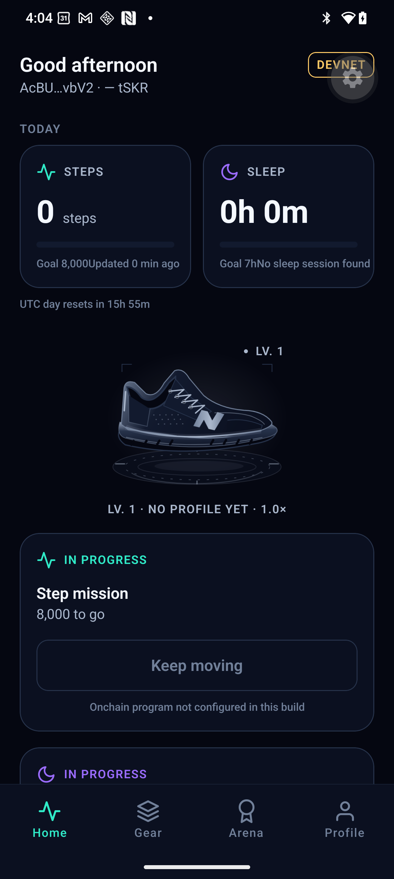
NEONSHIFT / MOVE WITH PURPOSE
Daily movement.
Visible progress.
A fitness experience built
for Solana Mobile.
MOVE / LEVEL UP / DISCOVER
A reason to return, every day.
EARLY BUILD · SEP 14, 2026
SOLANA MOBILE / HACKATHON PRODUCT INTRO
01 / 06
Notes:
0:00–0:18
ENGLISH VOICEOVER
What keeps us moving after the first few days? NeonShift turns everyday movement into visible progress, wildlife-inspired shoes, and a reason to return. Built for Solana Mobile, it connects personal achievement with a wider purpose.
PRODUCTION NOTES
目前為 2026-09-14 早期實機截圖，含尚未配置鏈上程式的狀態；不是交易證據。正式影片以提交 APK 首頁錄影替換。前 2 秒可加戶外起步，包含在 18 秒內。

Slide 2
NEONSHIFT / SEE YOUR PROGRESS
Your movement. Your history.
NEXT DESIGN · ACTIVITY + OPTIONAL AUTO-SYNC
ACTIVITY
AUTO-SYNC WHEN ONLINE
Month view · Filters · Workout details
Your choice: OFF / ON
SEP 17 RUN 5.00 km 30:00
Oldest workout first
SEP 18 WALK 2.40 km 28:00
SEP 17 > SEP 18 > SEP 19
SEP 19 RUN 3.00 km 19:00
Retry safely. Keep records in order.
DESIGN PREVIEW · SAMPLE DATA · IMPLEMENTATION PENDING
SOLANA MOBILE / HACKATHON PRODUCT INTRO
02 / 06
Notes:
0:18–0:43
ENGLISH VOICEOVER
Start with a walk or a run. Our next design adds a personal Activity journal with monthly views and workout details. Choose automatic sync when online, with saved workouts processed oldest first. Starter shoes and level upgrades remain free.
PRODUCTION NOTES
設計預覽與示例資料，非實機。Activity 月份／篩選／詳情；連網自動同步預設關閉，開啟後依運動開始時間由舊到新。補拍 17→18→19 與較早失敗阻擋後續；不得把摘要同步當成 Health Connect 打卡或自動錢包簽署。

Slide 3
NEONSHIFT / VERIFY A MILESTONE
Your milestone.
An onchain record.
Raw health records stay on your phone.
01
02
03
04
HEALTH SUMMARY
>
VALIDATION
>
WALLET APPROVAL
>
ONCHAIN CLAIM
Android Health
Connect
Qualifying activity
is checked
You approve
the claim
View the transaction
on Solana devnet
WORKFLOW PREVIEW · DEVICE VALIDATION PENDING
tSKR: devnet test token · No monetary value · Not official SKR
SOLANA MOBILE / HACKATHON PRODUCT INTRO
03 / 06
Notes:
0:43–1:29
ENGLISH VOICEOVER
NeonShift connects qualifying daily activity with a claim on Solana devnet. An activity summary from Android Health Connect is checked before you approve the claim in your wallet. The resulting transaction can be viewed in the explorer. Raw health records stay on your phone; they are not published onchain. The prototype uses test tokens with no monetary value. The blockchain records the claim, not every step of your run.
PRODUCTION NOTES
本頁為流程圖，非已成功交易。正式影片以合格摘要 → 打卡 → 錢包確認 → 成功 → 同筆 Explorer 實錄覆蓋中間流程區。僅證據完成後改為 REAL DEVICE · DEVNET；縮短等待需標 Wait time shortened。

Slide 4
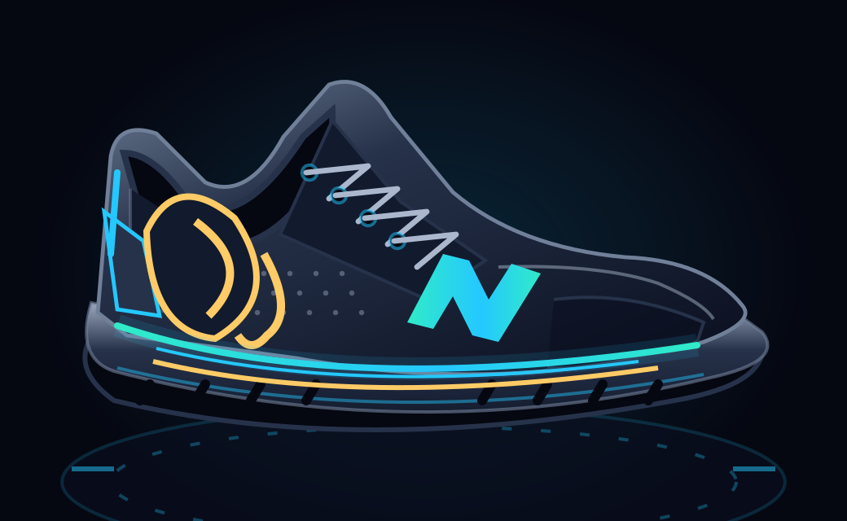
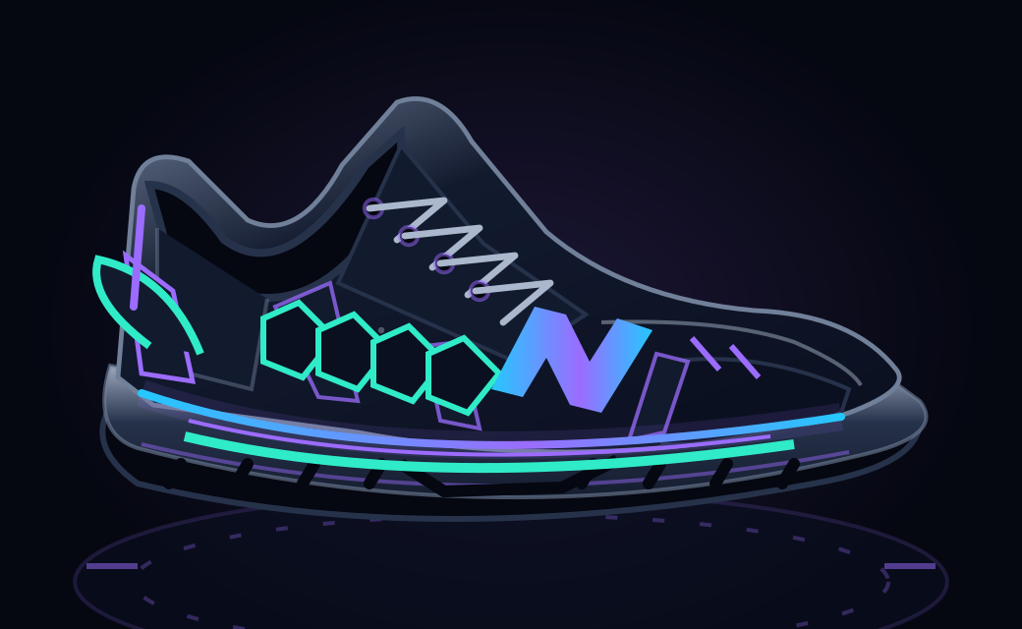
NEONSHIFT / DISCOVER WILD GUARDIANS
Progress with a story.
NEXT DESIGN · SWITCH EARNED SHOES + MATCHING BACKGROUNDS
ASIAN ELEPHANT
HAWKSBILL TURTLE
Forest theme · Earned shoe selection
Ocean theme · Background ON / OFF
DESIGN PREVIEW · COSMETIC ONLY · ACTIVE LEVEL CONTROLS ELIGIBILITY
SOLANA MOBILE / HACKATHON PRODUCT INTRO
04 / 06
Notes:
1:29–2:03
ENGLISH VOICEOVER
As you level up, discover Wild Guardians, inspired by threatened wildlife. Our next design lets you switch between shoes you have earned, with matching forest or ocean backgrounds. Prefer a simpler view? Turn the background off. These choices are cosmetic; your active level still controls eligibility. Each shoe connects your progress with conservation learning.
PRODUCTION NOTES
本頁使用專案既有鞋款素材；多鞋切換、森林／海洋背景與關閉開關為待實作設計。正式影片補切兩雙已取得鞋→關背景→故事卡；圖不可冒充實機。使用試拆時標 DEMO PREVIEW，切帳號標 Prepared demo account。不稱隨機 NFT、付費抽獎或保育收益權。

Slide 5
NEONSHIFT / CONNECT WITH COMMUNITY
From daily movement
to shared experiences.
EVENT PROTOTYPE · WORKFLOW PREVIEW
PARTICIPANT
AUTHORIZED STAFF
Discover an event
Register and show a code
Enter the participant code
Confirm attendance
NEXT: local community and conservation pilots.
Device validation pending. Partnerships are planned.
SOLANA MOBILE / HACKATHON PRODUCT INTRO
05 / 06
Notes:
2:03–2:29
ENGLISH VOICEOVER
The journey also reaches beyond solo exercise. This event prototype previews registration and staff-confirmed check-in. Participants show a code; authorized staff confirm attendance. Event participation connects back to your personal journey. Our next step is to test this experience with local communities and conservation partners.
PRODUCTION NOTES
雙角色流程示意。完成提交 APK 端到端驗收後替換為報名 → 出示代碼 → 授權 staff 輸入 → 狀態確認，保留 TEST DATA 標示。不可改成 staff 相機掃碼或暗示 NFC 為出席證明；活動報到不等同每日鏈上打卡。

Slide 6
NEONSHIFT / BUILD WHAT COMES NEXT
Move for yourself.
Move together
for nature.
THE EXPERIENCE
NEXT: LOCAL PILOTS
Movement · Progress
Conservation learning
Planned: paid event services
Separate conservation reporting
NEONSHIFT
SOLANA MOBILE / HACKATHON PRODUCT INTRO
06 / 06
Notes:
2:29–2:50
ENGLISH VOICEOVER
Our direction is simple: move for yourself, move together for nature. We plan to fund useful event services through paying partners, with conservation contributions tracked separately. NeonShift brings movement, meaningful progress, and conservation learning into one mobile experience.
PRODUCTION NOTES
最後至少靜止 2 秒。正式發布 APK、原始碼與評審指南後，才在影片說明欄與片尾加可點連結／QR。現有投影片不放未發布連結或佔位網址；尚無已確認合作、捐款或減碳實績。

Slide 7
NEONSHIFT / PERSONAL ACHIEVEMENT NFT
A personal record, a collectible identity.
GENESIS DISTANCE
GENESIS DISTANCE
GENESIS DISTANCE
GENESIS DISTANCE
5
10
21.0975
42.195
km / FIRST DISTANCE
km / FIRST DISTANCE
km / HALF MARATHON
km / MARATHON
DEVICE RECORDED
DEVICE RECORDED
DEVICE RECORDED
DEVICE RECORDED
SAMPLE / NO OWNER DATA
SAMPLE / NO OWNER DATA
SAMPLE / NO OWNER DATA
SAMPLE / NO OWNER DATA
VISUAL SYSTEM
Distance first. A distinct color per milestone. Source labels stay visible.
Other series: PB / First Finish / Event Memory. Organizer and device records remain distinct.
JUDGE APPENDIX 1/3 / DESIGN PREVIEW - NOT A MINT RECEIPT
Notes:
中文講稿：這是個人成就 NFT 的資訊版式提案，不是已鑄造證明。距離是主角，來源標籤不能省略。既有正式 SVG 圖樣請看同目錄 preview.html。首次距離與 First Finish 可從 Lv1 開始；PB 仍依達成時 Lv3 等資格規則。裝置來源上線狀態以 App 實際資格頁為準。

Slide 8
NEONSHIFT / PERSONAL ACHIEVEMENT NFT
From verified achievement to wallet ownership.
01 / RECORD
02 / VERIFY
03 / PREVIEW
04 / APPROVE
Complete a qualifying run.
Sync it to NeonShift.
Check source and eligibility.
Wait for registry approval.
Choose public details.
Review metadata and SOL fee.
Approve in your wallet.
Wait for chain confirmation.
CLAIM = USER-INITIATED MINT
Reaching a target does not automatically mint an NFT.
No tSKR spend. Review the current SOL estimate before approving.
Public blockchain ownership remains visible; optional detail sharing is not anonymity.
Raw GPS, heart rate and weight are not included in the achievement NFT.
JUDGE APPENDIX 2/3 / DESIGN PREVIEW - NOT A MINT RECEIPT
Notes:
中文講稿：完成運動只是開始。系統驗證來源、門檻和唯一性，registry 核准後才可鑄造。使用者選擇公開內容、查看 metadata 與當次 SOL 費用，再到錢包核准。首次距離的領取就是主動發起鑄造，不是先自動鑄造後再空投。依據 Milestones.tsx 與 AchievementService.ts；此頁是流程圖，尚未附上真實交易。

Slide 9
NEONSHIFT / PERSONAL ACHIEVEMENT NFT
Claim once. Keep the story. Show the evidence.
ELIGIBLE IS NOT MINTED
Locked / under review / pending approval stay separate from claimed.
CONFIRMED AND COLLECTED
Show the reveal, then open the collection and inspect the asset.
RETRIES DO NOT CREATE DUPLICATES
An existing on-chain receipt returns the existing asset instead of minting again.
LIVE DEMO CHECKLIST
Eligibility -> privacy + fee preview -> wallet approval -> confirmation -> collection
Show the actual asset and transaction on Devnet. Never replace them with sample IDs.
JUDGE APPENDIX 3/3 / DESIGN PREVIEW - NOT A MINT RECEIPT
Notes:
中文講稿：評審應看到可領取、待核准、已領取是不同狀態。拒簽不發成功动画；重試先查 receipt，避免重複鑄造。實錄需補上提交版本的資格畫面、公開內容與費用、錢包核准、成功收藏及真實 Devnet asset／交易。此附件沒有執行鑄造，也沒有捏造交易網址。

