Slide 1
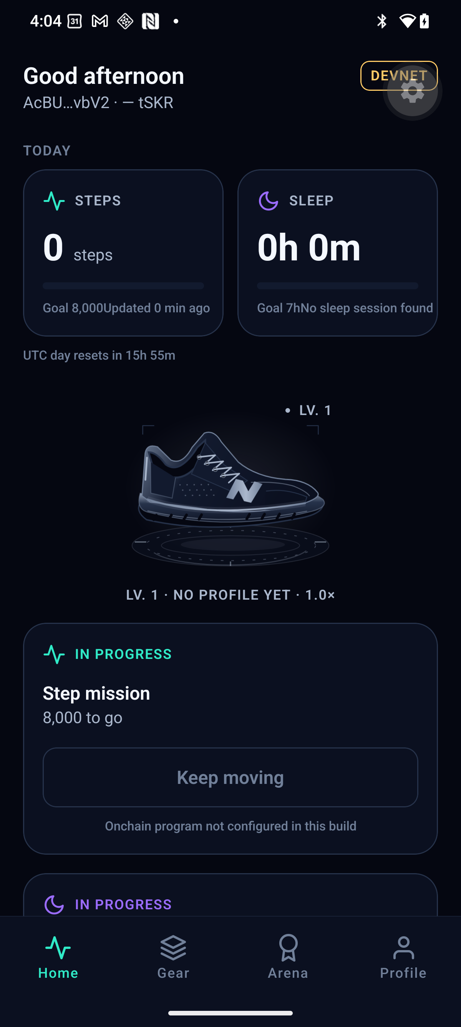
NEONSHIFT / MOVE WITH PURPOSE
Daily movement.
Visible progress.
A fitness experience built
for Solana Mobile.
MOVE / LEVEL UP / DISCOVER
A reason to return, every day.
EARLY BUILD · SEP 14, 2026
SOLANA MOBILE / HACKATHON PRODUCT INTRO
01 / 06
Notes:
0:00–0:18
ENGLISH VOICEOVER
What keeps us moving after the first few days? NeonShift turns everyday movement into visible progress, wildlife-inspired shoes, and a reason to return. Built for Solana Mobile, it connects personal achievement with a wider purpose.
PRODUCTION NOTES
目前為 2026-09-14 早期實機截圖，含尚未配置鏈上程式的狀態；不是交易證據。正式影片以提交 APK 首頁錄影替換。前 2 秒可加戶外起步，包含在 18 秒內。

Slide 2
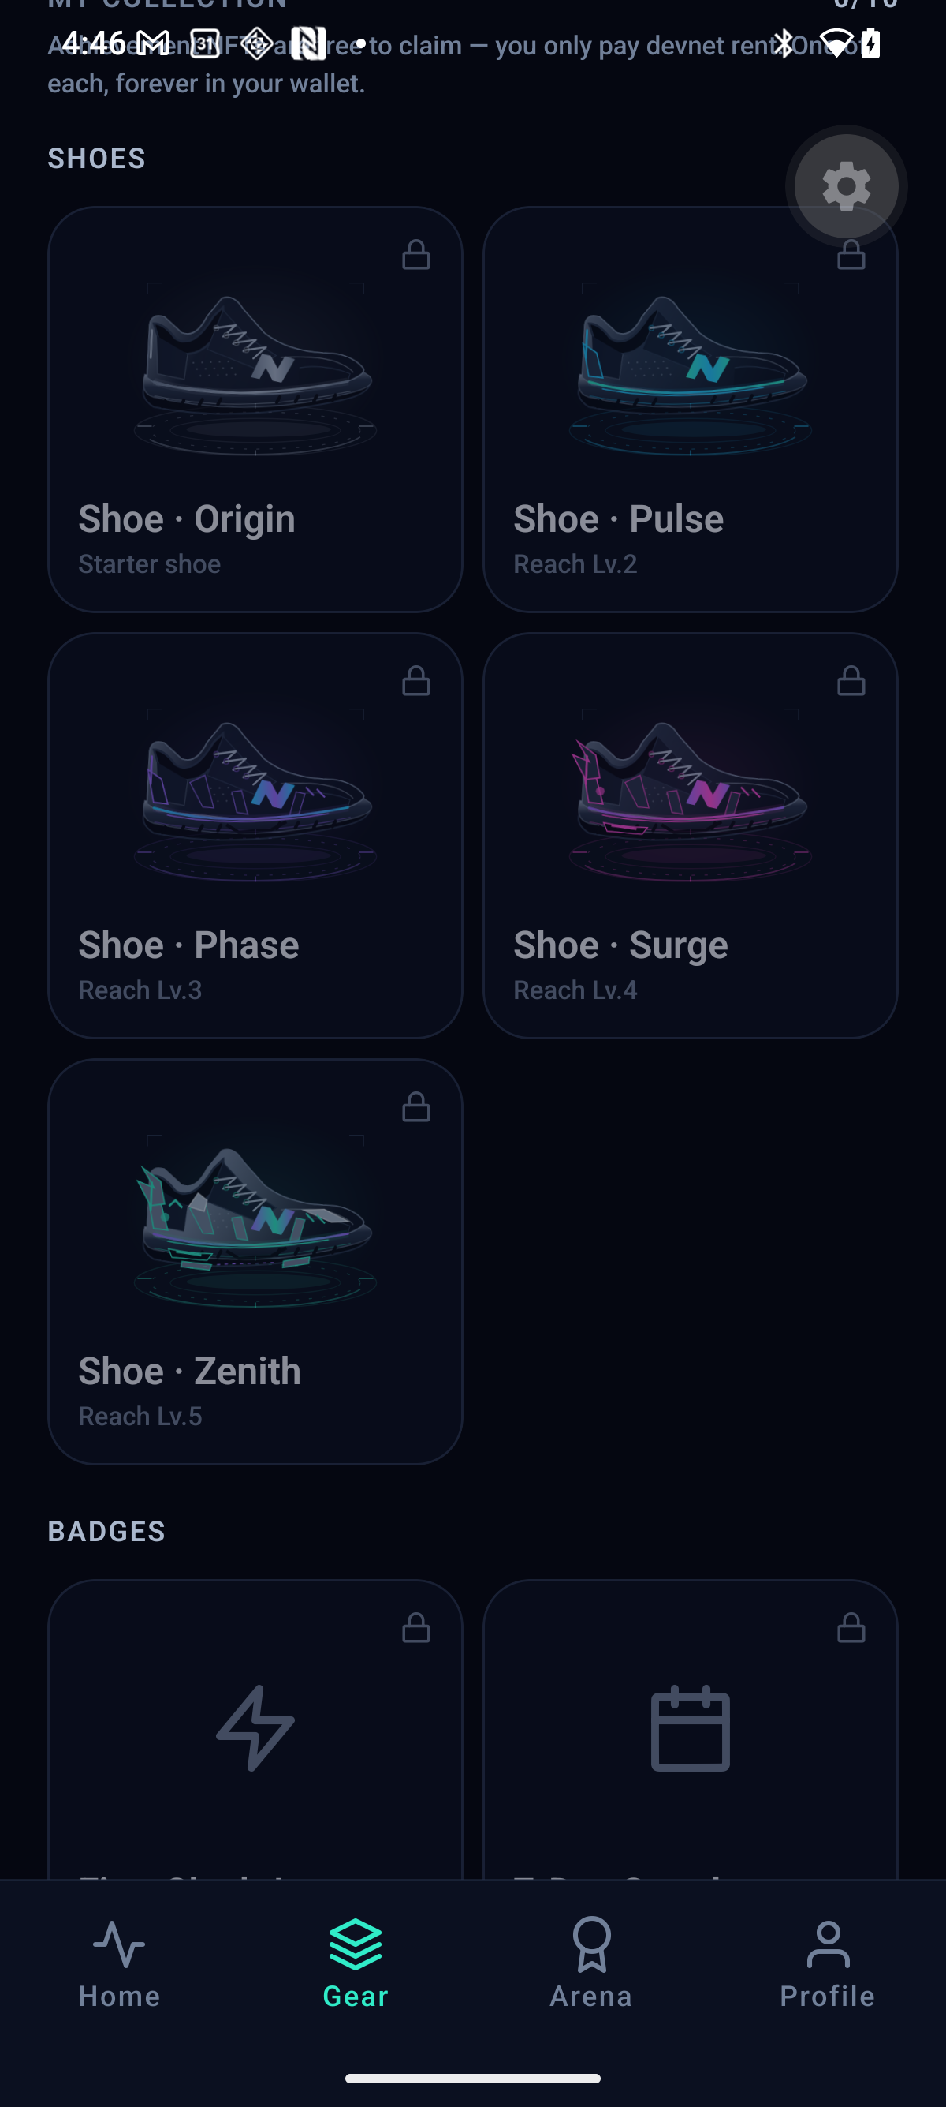
NEONSHIFT / SEE YOUR PROGRESS
Every session
moves you forward.
01 WALK OR RUN
Start with everyday movement.
02 COMPLETE DAILY GOALS
Build a habit you can see.
03 LEVEL UP YOUR SHOES
Free starter shoes. Free level upgrades.
EARLY GEAR UI · SEP 14, 2026
SOLANA MOBILE / HACKATHON PRODUCT INTRO
02 / 06
Notes:
0:18–0:43
ENGLISH VOICEOVER
Start with a walk or a run. Follow your pace, complete daily goals, and build your progress over time. Your starter shoes and level upgrades are free. Each session adds to a journey you can see, rather than another number to forget.
PRODUCTION NOTES
右側為舊版 Gear UI，尚非 Wild Guardians 系列。正式影片替換為本次提交版本：運動頁 → 每日目標 → 等級進度。GPS 運動追蹤不等同 Health Connect 申領依據。

Slide 3
NEONSHIFT / VERIFY A MILESTONE
Your milestone.
An onchain record.
Raw health records stay on your phone.
01
02
03
04
HEALTH SUMMARY
>
VALIDATION
>
WALLET APPROVAL
>
ONCHAIN CLAIM
Android Health
Connect
Qualifying activity
is checked
You approve
the claim
View the transaction
on Solana devnet
WORKFLOW PREVIEW · DEVICE VALIDATION PENDING
tSKR: devnet test token · No monetary value · Not official SKR
SOLANA MOBILE / HACKATHON PRODUCT INTRO
03 / 06
Notes:
0:43–1:29
ENGLISH VOICEOVER
NeonShift connects qualifying daily activity with a claim on Solana devnet. An activity summary from Android Health Connect is checked before you approve the claim in your wallet. The resulting transaction can be viewed in the explorer. Raw health records stay on your phone; they are not published onchain. The prototype uses test tokens with no monetary value. The blockchain records the claim, not every step of your run.
PRODUCTION NOTES
本頁為流程圖，非已成功交易。正式影片以合格摘要 → 打卡 → 錢包確認 → 成功 → 同筆 Explorer 實錄覆蓋中間流程區。僅證據完成後改為 REAL DEVICE · DEVNET；縮短等待需標 Wait time shortened。

Slide 4
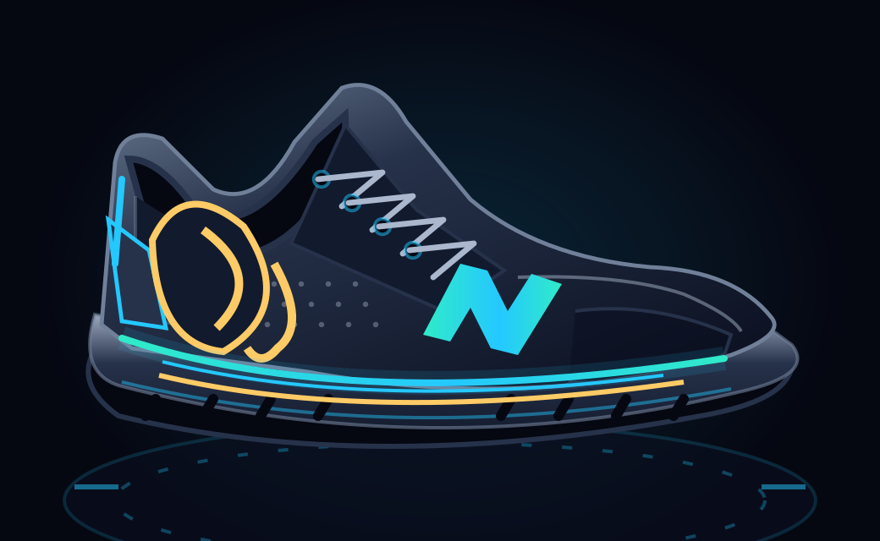
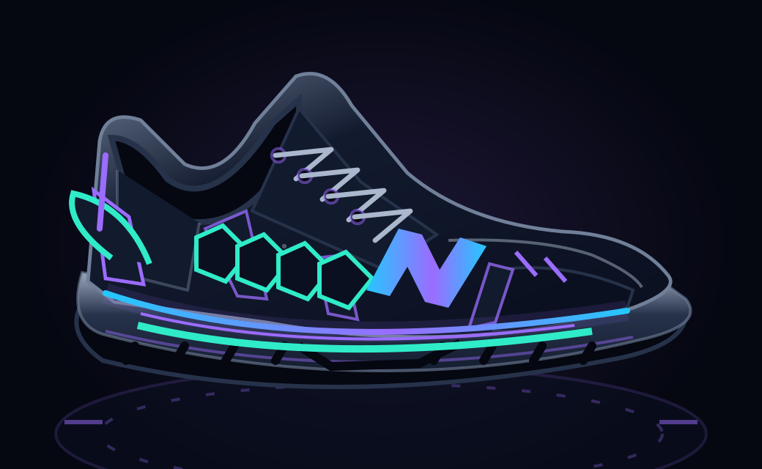
NEONSHIFT / DISCOVER WILD GUARDIANS
Progress with a story.
Wildlife-inspired shoes. Conservation learning.
ASIAN ELEPHANT
HAWKSBILL TURTLE
Learn about habitat fragmentation.
Learn about threats to coastal habitats.
COSMETIC SHOE DESIGNS · DESIGN ASSETS, NOT DEVICE CAPTURES
SOLANA MOBILE / HACKATHON PRODUCT INTRO
04 / 06
Notes:
1:29–2:03
ENGLISH VOICEOVER
As you level up, discover Wild Guardians: shoes inspired by threatened wildlife, from the Asian elephant to the hawksbill turtle. Each design introduces an animal, the pressures on its habitat, and a small action you can take. These personal finishes are cosmetic. They connect your progress with a story worth remembering, and a world worth caring about.
PRODUCTION NOTES
本頁使用專案既有設計圖。正式影片補已解鎖鞋款、鞋面特寫與物種故事卡；圖不可冒充實機。使用試拆時標 DEMO PREVIEW，切帳號標 Prepared demo account。不稱隨機 NFT、付費抽獎或保育收益權。

Slide 5
NEONSHIFT / CONNECT WITH COMMUNITY
From daily movement
to shared experiences.
EVENT PROTOTYPE · WORKFLOW PREVIEW
PARTICIPANT
AUTHORIZED STAFF
Discover an event
Register and show a code
Enter the participant code
Confirm attendance
NEXT: local community and conservation pilots.
Device validation pending. Partnerships are planned.
SOLANA MOBILE / HACKATHON PRODUCT INTRO
05 / 06
Notes:
2:03–2:29
ENGLISH VOICEOVER
The journey also reaches beyond solo exercise. This event prototype previews registration and staff-confirmed check-in. Participants show a code; authorized staff confirm attendance. Event participation connects back to your personal journey. Our next step is to test this experience with local communities and conservation partners.
PRODUCTION NOTES
雙角色流程示意。完成提交 APK 端到端驗收後替換為報名 → 出示代碼 → 授權 staff 輸入 → 狀態確認，保留 TEST DATA 標示。不可改成 staff 相機掃碼或暗示 NFC 為出席證明；活動報到不等同每日鏈上打卡。

Slide 6
NEONSHIFT / BUILD WHAT COMES NEXT
Move for yourself.
Move together
for nature.
THE EXPERIENCE
NEXT: LOCAL PILOTS
Movement · Progress
Conservation learning
Planned: paid event services
Separate conservation reporting
NEONSHIFT
SOLANA MOBILE / HACKATHON PRODUCT INTRO
06 / 06
Notes:
2:29–2:50
ENGLISH VOICEOVER
Our direction is simple: move for yourself, move together for nature. We plan to fund useful event services through paying partners, with conservation contributions tracked separately. NeonShift brings movement, meaningful progress, and conservation learning into one mobile experience.
PRODUCTION NOTES
最後至少靜止 2 秒。正式發布 APK、原始碼與評審指南後，才在影片說明欄與片尾加可點連結／QR。現有投影片不放未發布連結或佔位網址；尚無已確認合作、捐款或減碳實績。

