Slide 1
HEALTH & DEMOGRAPHIC ANALYTICS REPORT
Smoking Demographics Dashboard
Cholesterol and heart-rate patterns across smoking status, age, and gender
Data Analysis • Demographic & Cardiovascular Overview

Slide 2
EXECUTIVE SUMMARY
Non-Smoker
Smoker
Four Patterns Shape the Findings
↑
Cholesterol Climbs With Age — Non-Smokers
↓
An Early Peak, Then Decline — Smokers
Among non-smokers, average cholesterol rises steadily with age, reaching its highest point between 50 and 60 years.
Among smokers, cholesterol peaks much earlier — around age 40 — then trends downward through later age groups.
♀
Females Run a Faster Heart Rate
+1.36
Smokers Beat Faster
Across the study population, female patients show a higher average heart rate than male patients.
Current smokers average 1.36 more heartbeats per minute than non-smokers — a measurable cardiovascular difference.
02 / 10

Slide 3
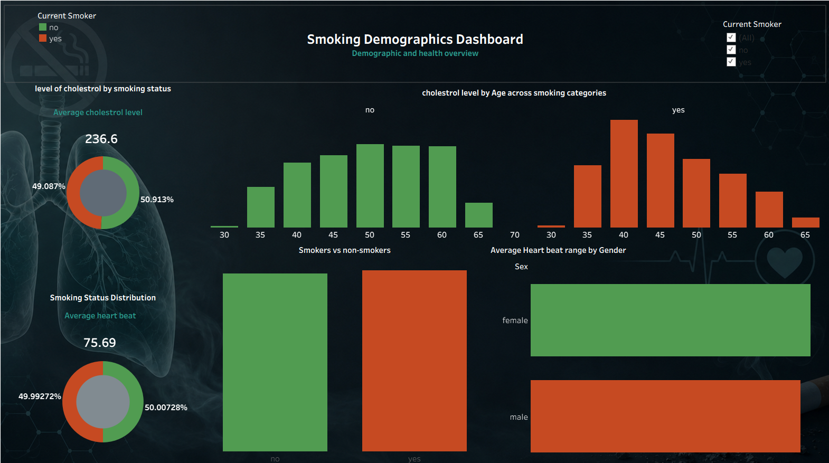
FULL-POPULATION OVERVIEW
Non-Smoker
Smoker
The Complete Dashboard View
236.6
Average cholesterol level (mg/dL) — all patients
75.69
Average heart rate (bpm) — all patients
49% / 51%
Non-smoker / smoker split across the study sample
03 / 10

Slide 4
GROUP COMPARISON
Non-Smoker
Smoker
Average Cholesterol, By Group
236.6
238.6
234.5
mg/dL average
mg/dL average
mg/dL average
All Patients
Non-Smokers
Smokers
Reading the numbers
Overall averages sit close together — but that similarity hides two very different stories underneath. Non-smokers and smokers follow opposite cholesterol trends as age increases, explored on the following slides.
04 / 10

Slide 5
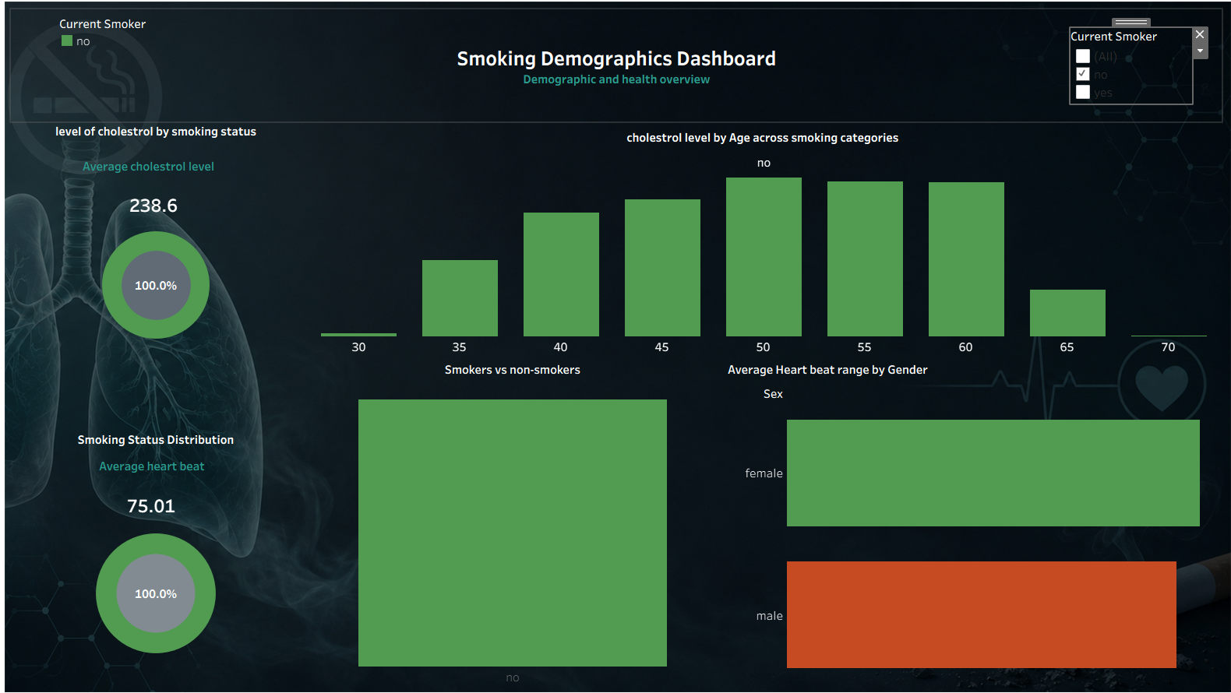
SEGMENT PROFILE — NON-SMOKERS
Non-Smoker
Smoker
Non-Smoker Population
238.6
Average cholesterol level (mg/dL)
75.01
Average heart rate (bpm)
Key pattern
Cholesterol rises steadily across age groups, reaching its highest average between 50 and 60 years before tapering slightly.
05 / 10

Slide 6
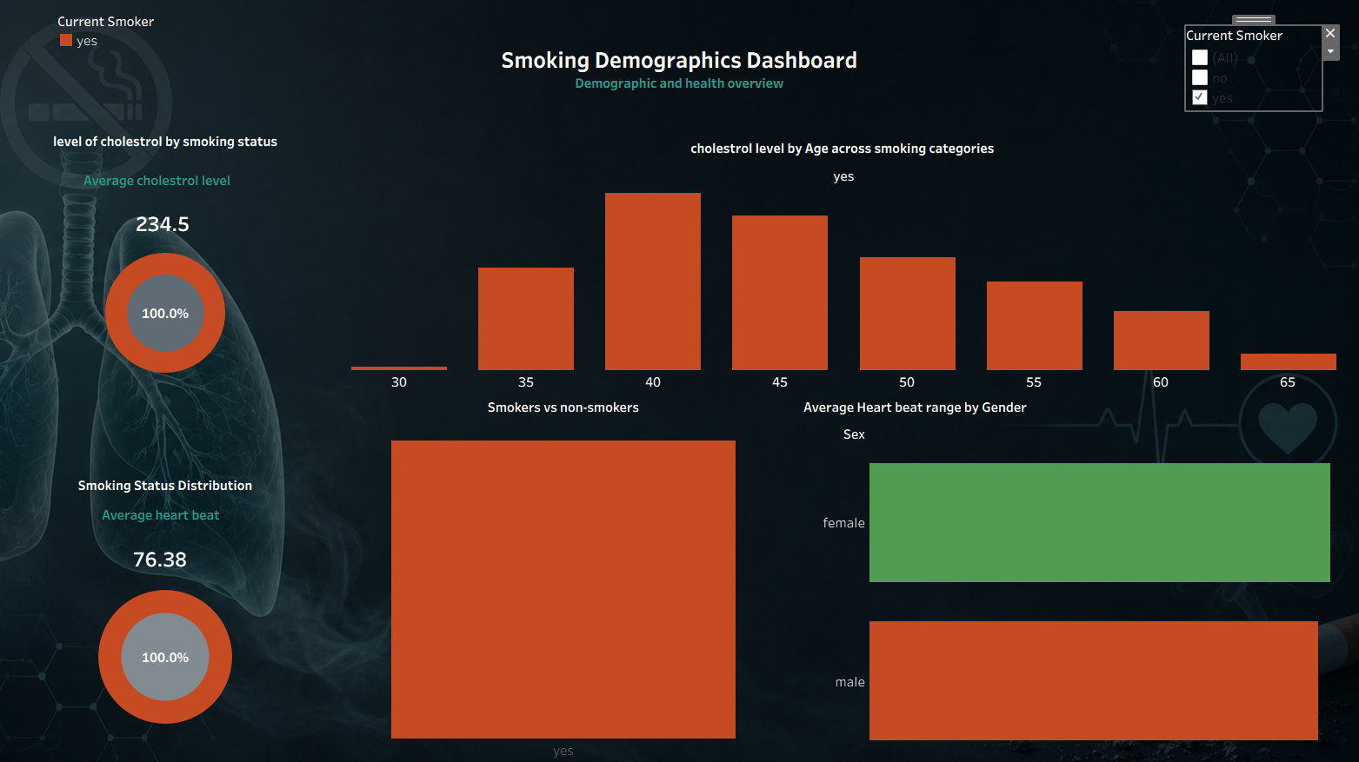
SEGMENT PROFILE — SMOKERS
Non-Smoker
Smoker
Smoker Population
234.5
Average cholesterol level (mg/dL)
76.38
Average heart rate (bpm)
Key pattern
Cholesterol peaks early — around age 40 — then declines through the remaining age groups, the reverse of the non-smoker trend.
06 / 10

Slide 7
KEY INSIGHT
Non-Smoker
Smoker
Cholesterol Trends Diverge With Age
Non-smokers
Cholesterol builds gradually across the lifespan, peaking at 50–60 years — consistent with typical age-related lipid increases.
Smokers
Cholesterol peaks far earlier, around age 40, then declines — a markedly different trajectory from the non-smoking group.
Chart shape reconstructed from the source dashboard visualization to illustrate the trend; treat exact values as approximate.
07 / 10

Slide 8
KEY INSIGHT
Non-Smoker
Smoker
Smokers Run a Faster Heart Rate
+1.36
beats per minute higher, on average, for smokers
Why it matters
On average, current smokers show an increase in heart rate compared to non-smokers, a difference of 1.36 beats per minute — consistent with nicotine's known stimulant effect on the cardiovascular system.
08 / 10

Slide 9
KEY INSIGHT
Non-Smoker
Smoker
Heart Rate Also Varies By Gender
F
M
Female
Male
Higher average heart rate
Lower average heart rate
Observation
Across the study population, female patients recorded a higher average heart rate than male patients — a consistent gender-level pattern worth accounting for alongside smoking status.
09 / 10

Slide 10
CONCLUSION
What the Data Tells Us
Non-smoker cholesterol rises with age, peaking at 50–60 years — a pattern typical of natural, age-related lipid increases.
Smoker cholesterol peaks earlier, around age 40, then declines — suggesting a different, front-loaded risk window for younger smokers.
Female patients show a higher average heart rate than male patients across the sample.
Smokers average 1.36 more heartbeats per minute than non-smokers, a measurable cardiovascular effect of smoking.
Recommendations
Prioritize cardiovascular screening for smokers under 45.
Track cholesterol by age cohort, not smoking status alone.
Apply gender-aware baseline heart-rate ranges.
Support smoking cessation to reduce early-onset lipid risk.
Thank you
10 / 10

