Slide 1
AUTOMATIC STANCE DETECTION
By: Abhinav Kumar Jha
Amish Gupta

Slide 2
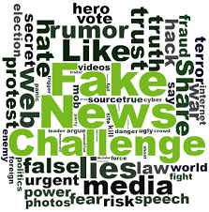

Slide 3
Problem Statement
The problem is about “stance detection,” which involves comparing a headline with a
body of text from a news article to determine what relationship (if any) exists between the
two. There are 4 possible classifications:
• The article text agrees with the headline.
• The article text disagrees with the headline.
• The article text is a discussion of the headline, without taking a position on it.
• The article text is unrelated to the headline (i.e. it doesn’t address the same topic).

Slide 4
Dataset Overview
The datasets for our task are provided by the Fake News Challenge organization. The complete
training set consists of 50,000 “stance” tuples, with each tuple consisting of:
A headline (word count 2-40)
The (integer) ID of an article.
Article Body. Length range from 2 to nearly 5000 words.
• The true stance of the headline with respect to the article. (This is one of the four classes
outlined earlier: agree, disagree, discuss, and unrelated.)
https://github.com/FakeNewsChallenge/fnc-1

Slide 5

Text Summarization using SeqToSeq Attention Model
The tokens of the article wi are fed one-by-one into the encoder (a single-layer bidirectional LSTM), producing a sequence of encoder hidden states hi.
On each step t, the decoder (a single-layer unidirectional LSTM) receives the word embedding of the previous word (while training, this is the previous word of the reference summary; at test time it is the previous word emitted by the decoder), and has decoder state st . The attention distribution at is calculated as in Bahdanau et al. (2015):

Slide 6
- The attention distribution is used
to produce a weighted sum of the encoder hidden
states, known as the context vector.
- The context vector, is concatenated with the decoder state st and fed through two linear layers to produce the vocabulary distribution Pvocab and provides us with our final distribution from which to predict words w: P(w) = Pvocab(w)

Slide 7
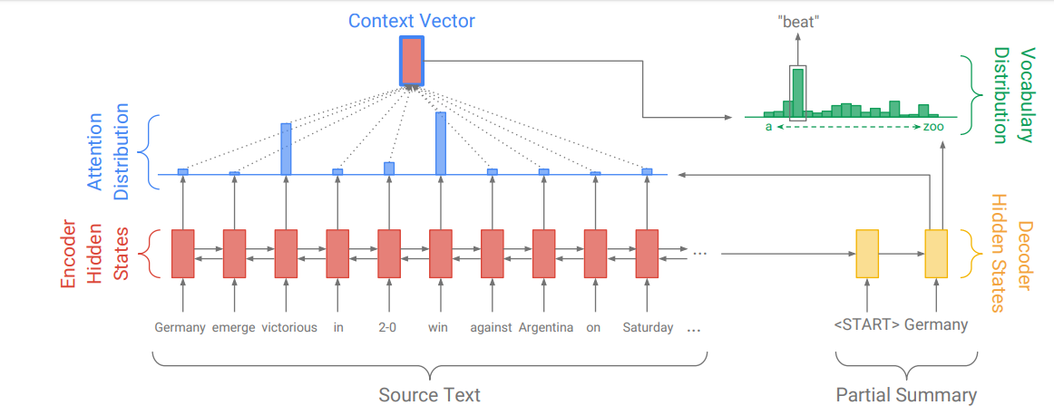

Slide 8
Model Parameters:
--number of hidden nodes: 120
--nubers of layers: 2
--learning rate: 1e-3
Dataset
Datset is HarvardNLP gigaword Dataset containg 40K
Articles bodies and their respective Headlnes.

Slide 9

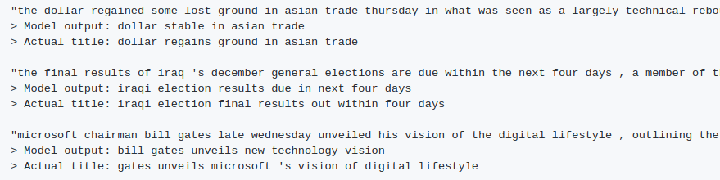

Slide 10
Representation and Features for MLP
We use two simple bag-of-words (BOW) representations for the text inputs: term frequency (TF) and term frequency-inverse document frequency (TF-IDF) .
TF measures the number of times a term (word) occurs in a document
TF-IDF helps in weighing down the effects of too frequently occurring terms. Also the terms that occur less in the document can be more relevant. TF-IDF helps weighing up the effects of less frequently occurring terms.

Slide 11


Slide 12
The representations and feature extracted from the headline and body pairs consist of only the following:
• The TF vector of the headline
• The TF vector of the body
• The cosine similarity between the TF-IDF vectors of the headline and body
The TF vectors and the TF-IDF cosine similarity are concatenated in a feature vector

Slide 13
Classifier
The classifier is a MLP with one hidden layer of 100 units and a softmax on the output of the final linear layer.
We use the rectified linear unit (ReLU) activation function as non-linearity for the hidden layer.
The system predicts with the highest scoring label (‘agree’, ‘disagree’, ‘discuss’, or ‘unrelated’).

Slide 14
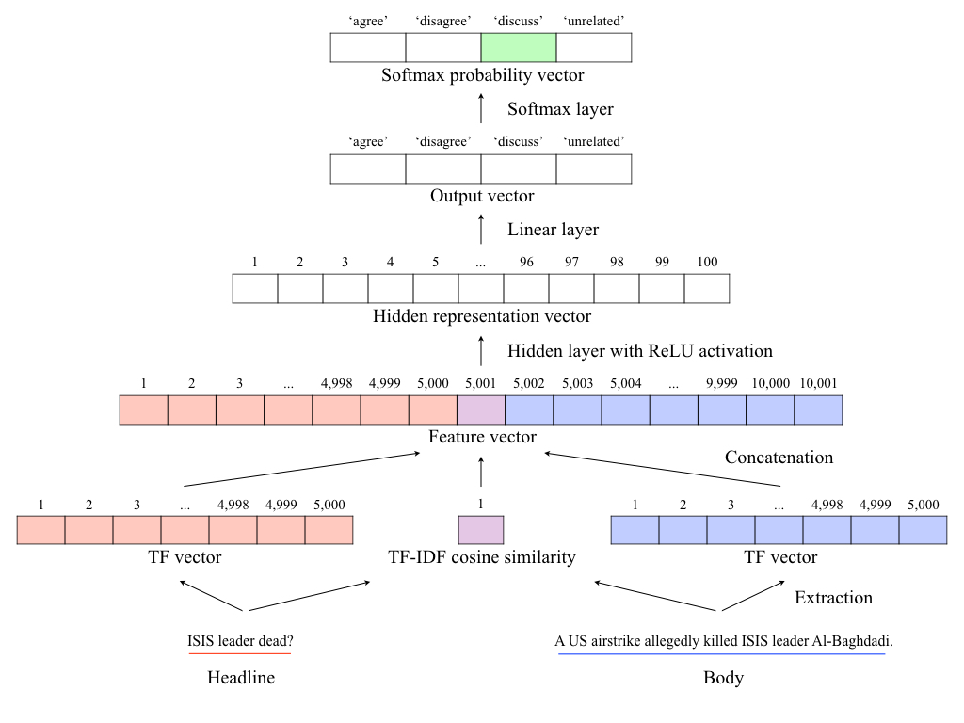

Slide 15
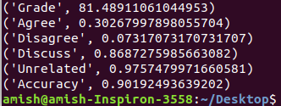
Training Results

Slide 16
Additional Features Extracted from text
1.Cosine Similarity
2.KL Divergence Score
3.Google News Cue Words Embedding
4.Google Word 2 Vec word embeddings
5.N Gram Model
5.1 Unigram
5.2 Bigram
5.3 Trigram
6. Word Weightage scorers
6.1 TF -IDF
6.2 Skip Gram Model
6.3 Common Bag of Words

Slide 17
Vector Representation
GloVe: Global Vectors for Word Representation -:
Then, to make these tf-idf representations comparable, we used GLoVe pre-trained word vectors (https://nlp.stanford.edu/projects/glove/) to convert these tf-idf representations to fixed-length vectors based on the learned ‘meaning’ of each word.
GLoVe provides a mapping of six billion English words to a 50-dimensional vector, trained on Wikipedia and Gigaword.

Slide 18

converting a document to a GLoVe vector -:
To convert a document to a GLoVe vector, the (scalar) tf-idf value of each word in the document is multiplied by the GLoVe vector associated with the word, which is summed together and normalised for document length:

Slide 19

Computing cosine similarity of GLoVe vectors for all headline-body pairs -:
The GLoVe vector representation of documents is used as a feature by calculating the cosine similarity of the GLoVe vector representation of each article’s headline and body.
The cosine similarity of two similar-length vectors are computed with:
Where H = GLoVe vector representation of headline,
B = GLoVe vector representation of body, and len(glove) is the dimensionality of the GLoVe vector representation used (in this case 50).

Slide 20
Return values of Cosine Similarity -:
This feature returns a real value between -1.0 and 1.0 .
higher = words in headline and body are more similar
lower = words in headline and body are more different.

Slide 21
Language Model Representation (KL-Divergence) -:
Another feature that we are using is the KL-Divergence of the language model representations of the headline and the article body.
This is a measure of how divergent (i.e. different) are the language (i.e. words) being used in the headline and the body.
To convert a document to a (simple, unigram) language model, we compute the probability of each word occurring in the document, by using the occurrence of the word:
Whereas eps is a small value ( 0.1) used to ‘smoothen’ the language model

Slide 22
Computing the KL-Divergence of language model (LM) representations of the headline and the body
KL-divergence is a measure of how different two probability distributions are. In this case, KL-divergence is used to measure the divergence between the language model of each article’s headline and body.
This formula is defined as:
This feature returns a positive real value (in practice between 0.0 and ~3.0, but in theory uncapped), where the higher the value is, the more divergent the language model (i.e. words used) in the article’s headline and body are.

Slide 23

Additional Features (N-gram overlap) -:
N-gram overlap is a measure of how many times n-grams that occur on the article’s headline re-occur on the article’s body.
For each article (headline-body pair), I counted n-gram overlaps up to 3-grams (i.e. count no. of words in headline that re-occur on body + no. of sequence of 2-words in the headline that re-occur in body + no. of sequence of 3-words in the headline that re-occur in body).
N-gram overlap returns a real value between 0.0 and 1.0 (higher = words in headline and body are more similar, lower = words are more different).

Slide 24

MLP Result

Slide 25
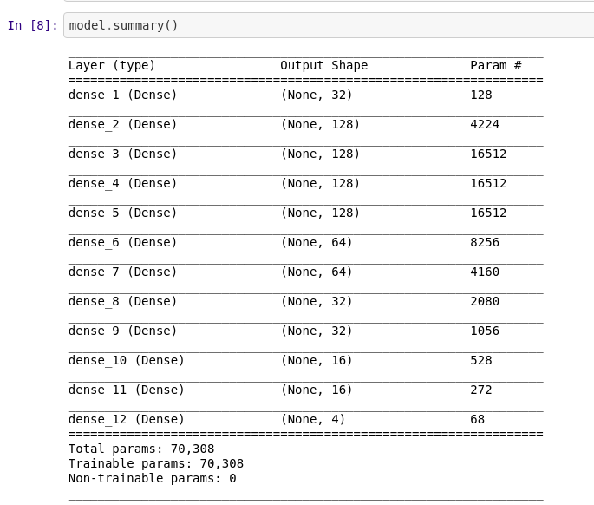
Dense layer Model architecture

Slide 26
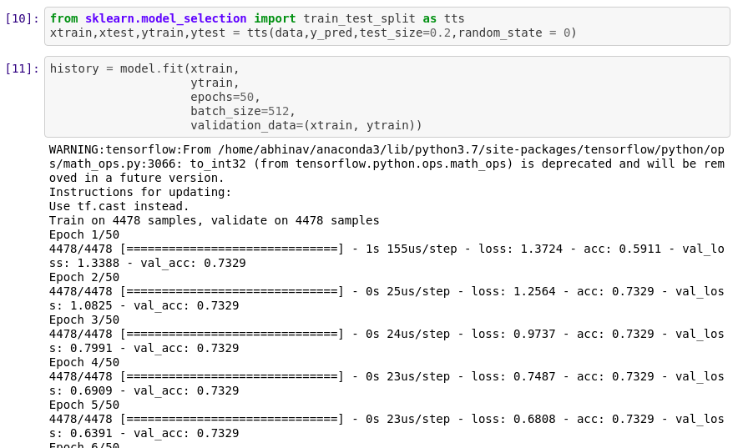

Slide 27
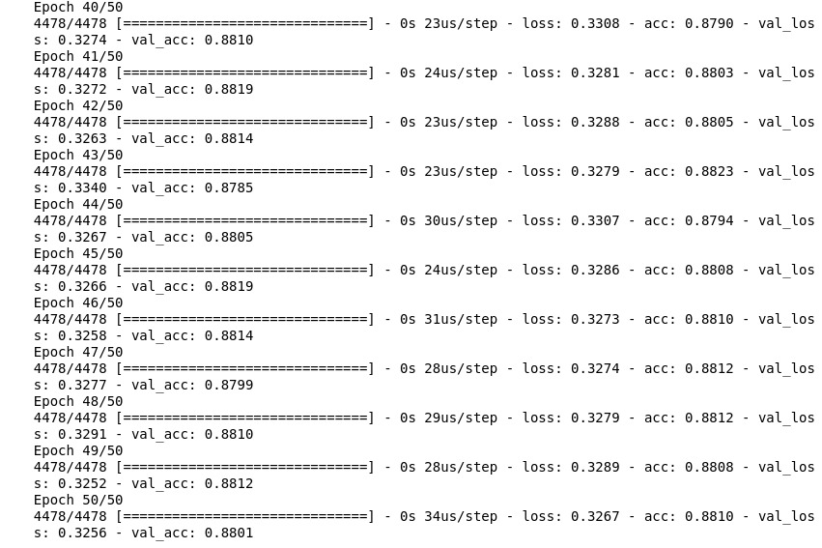

Slide 28
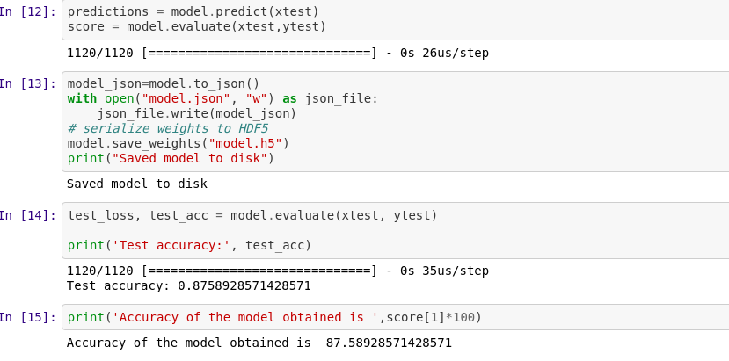

Slide 29
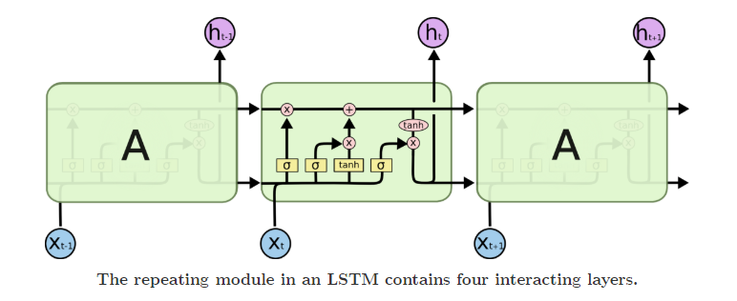
LSTM architecture

Slide 30
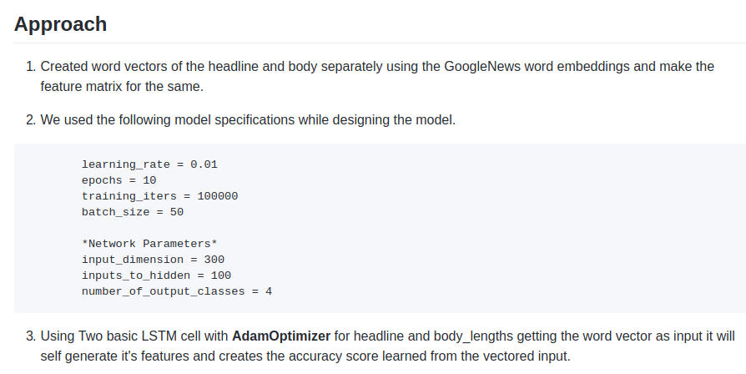

Slide 31
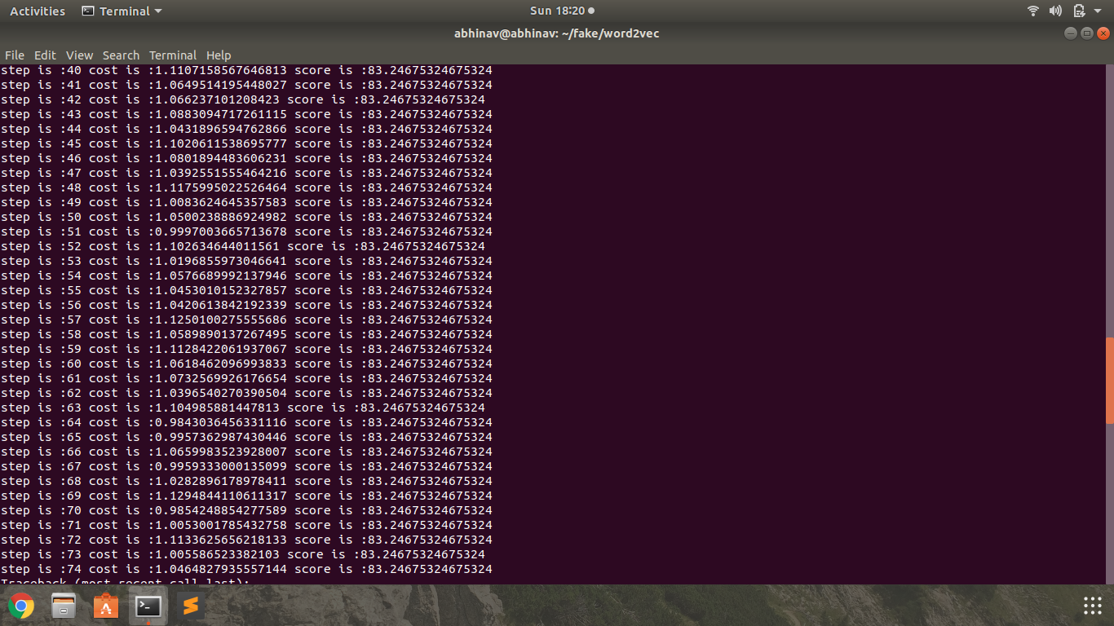
LSTM RESULT

Slide 32
Previous Works
Ferreira and Vlachos [5] used the “Emergent” dataset and applied Logistic Regression to identify compare rumored claims against news articles that had been previously labeled by journalists with the goal of predicting the stance of the article towards the rumor.
This team summarized each article into a headline and used a logistic regression model with features representing the article and claim to classify the combination of article and claim as either “for,” “against,” or “observing,” with a final accuracy level of 73%.

Slide 33
References
TensorFlow: Large-scale machine learning on heterogeneous systems, 2015. URL http://tensorflow.org/.
A. Agrawal, D. Chin, and K. Chen. Cosine siamese models for stance detection, 2017. URL http://web.stanford.edu/class/cs224n/reports/2759862.pdf
B. Galbraith, H. Iqbal, H. van Veen, D. Rao, J. Thorne, and Y. Pan. A baseline implementation for FNC-1, 2017. URL https://github.com/FakeNewsChallenge/fnc-1-baseline.
N. Srivastava, G. Hinton, A. Krizhevsky, I. Sutskever, and R. Salakhutdinov. Dropout: A simple way to prevent neural networks from overfitting. Journal of Machine Learning Research, 2014.
Stance Detection in Fake News: A Combined Feature Representation.Bilal Ghanem,Paulo Rasom

