Slide 1
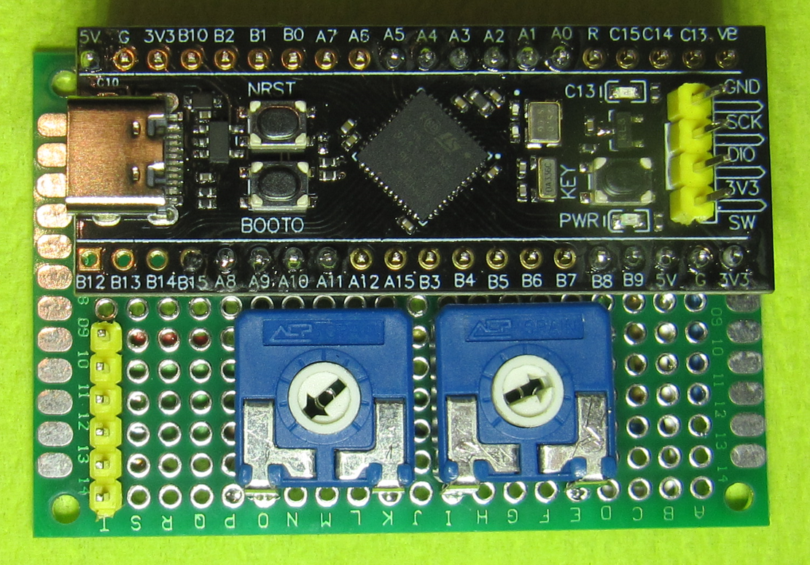
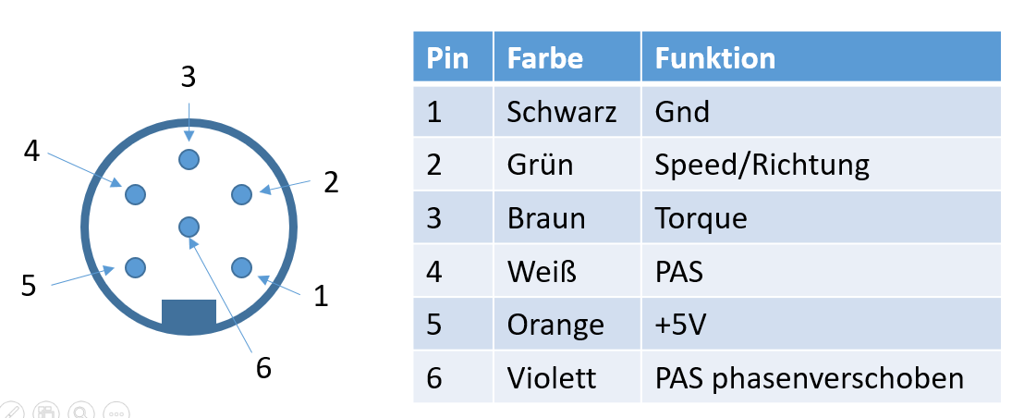
Kadenz LED
USB-C für digitatle Ausgabe der Parameter
3_torque
Start/Stop Button
2_speed/dir
Power LED
6_quad. PAS2
4_quad. PAS1
5_+5V
1_GND
Poti für Torque
Poti für Kadenz

Slide 2
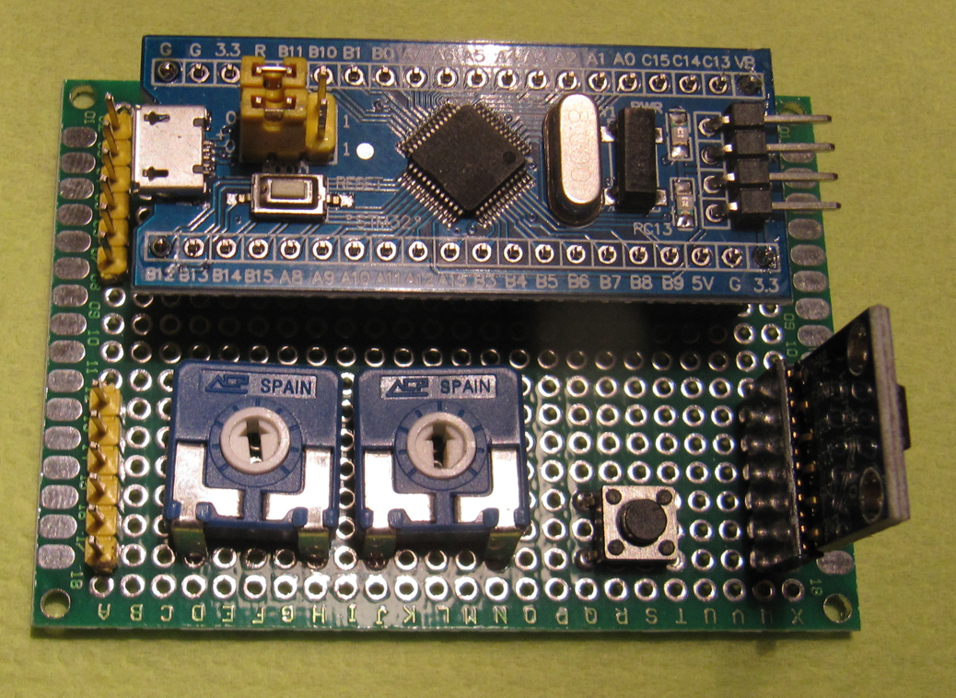
„Bluepill“ board
Power LED
Header for
CAN sensor
4_CAN-H
2_CAN-L
6_quad. PAS2
3_quad. PAS1
1_+5V
5_GND
Cadence LED
5_torque
4_speed/dir
6_quad. PAS2
2_quad. PAS1
CAN Transceiver board
1_+5V
3_GND
Header for
analogue sensor
Start/Stop button
Poti for torque
Poti for cadence

Slide 3
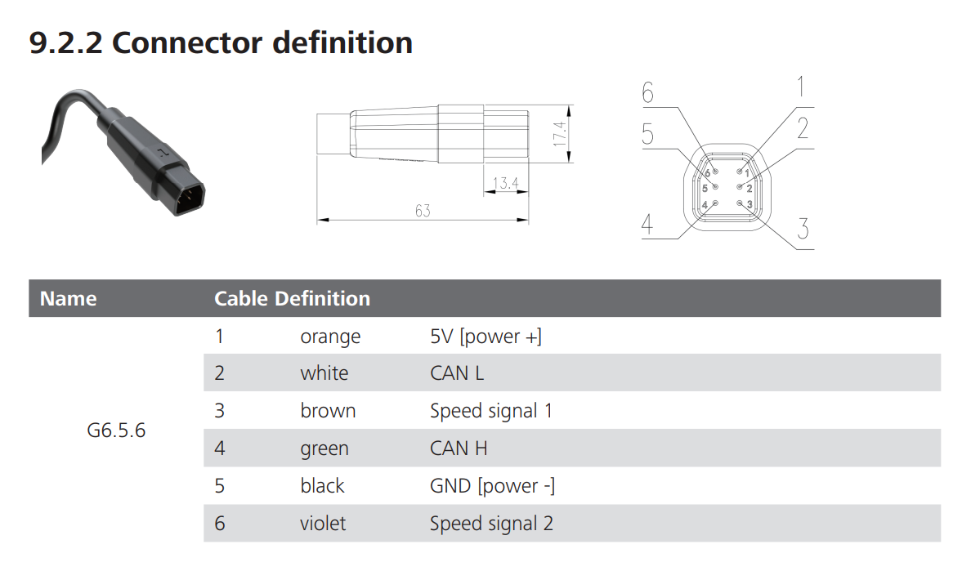

Slide 4
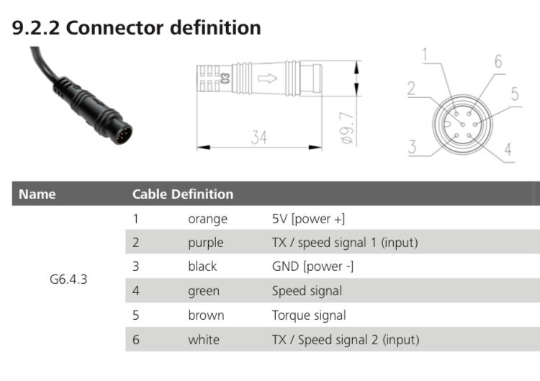

Slide 5
