Slide 1

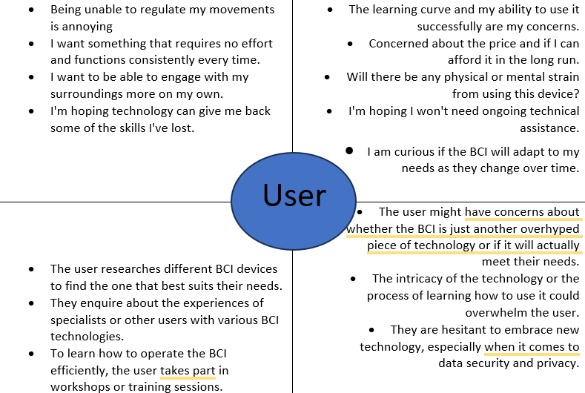
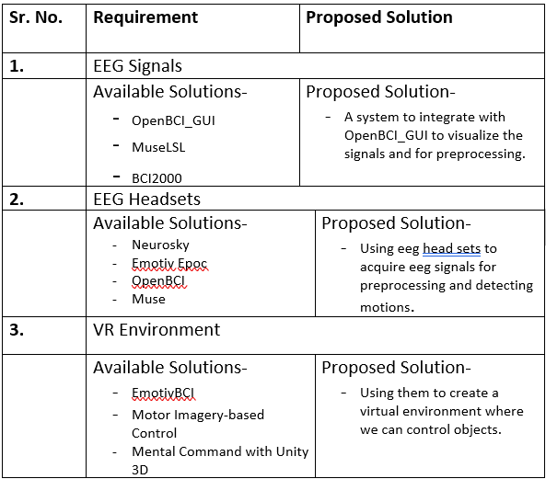
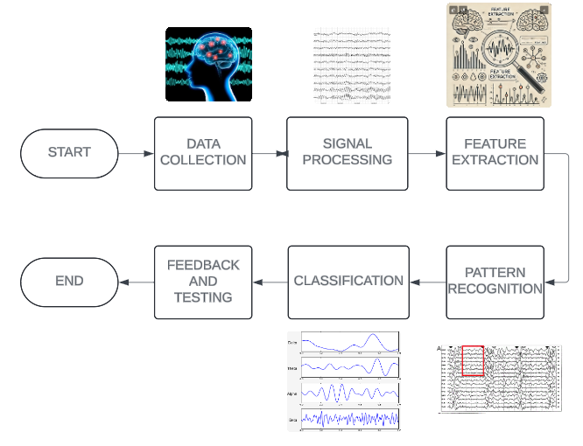
Proposed Architecture/ Diagram:
MIT SCHOOL OF COMPUTING
Class : LY-AIA2
Group Id: LYAIA203
DEPARTMENT OF COMPUTER SCIENCE & ENGINEERING
BRAIN COMPUTER INTERFACE
A collaboration between the brain and a device that permits the brain to send impulses that control an external action.
Nishith Jain, Om Thorve, Sudhamsu Rawlo
Faculty Guide:
Dr. Nagesh Jadhav
Problem statement
Many people with severe physical disabilities have a difficult time connecting and communicating with others and their surroundings. Current assistive technologies frequently fall short in offering dependable and reachable solutions. A BCI will enable impaired people to communicate and engage with their environment in a more natural and seamless way
Proposed Solution
Provide an EEG-based Brain-Computer Interface (BCI) that reads brain signals to enable people with disabilities to carry out everyday tasks. Adaptive algorithms will be used by this BCI to continuously learn from and adjust to each user's distinct brain patterns, increasing accuracy and efficiency over time.
Scope and Feasibility
Cloud-based shared learning can be utilised which is both scaleable and workable, offering customised support and improving in accuracy over time. Because the adaptive EEG-based BCI is constantly learning from the user's brain patterns, it allows impaired people to carry out everyday tasks independently.

