Slide 1

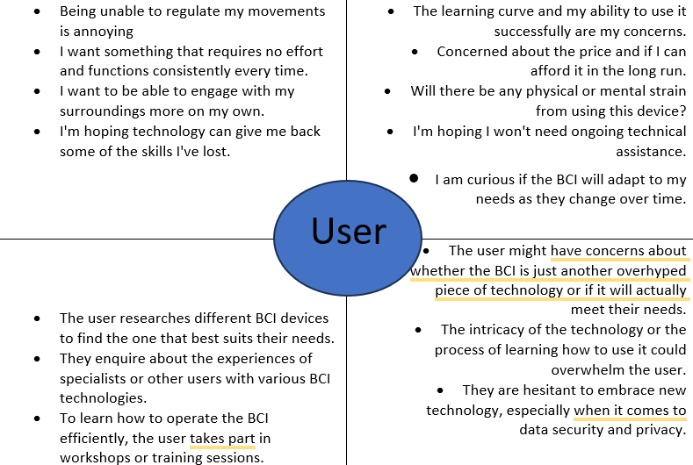
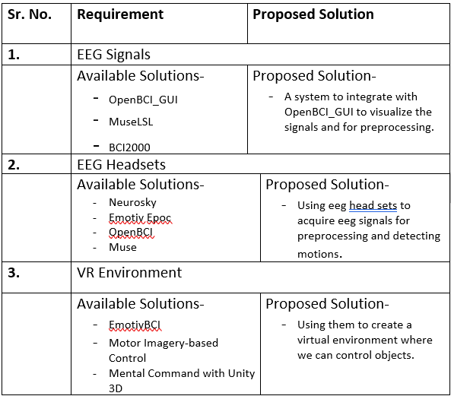
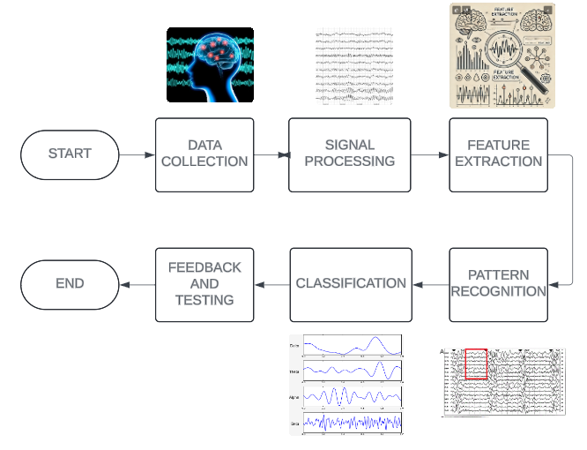
Proposed Architecture/ Diagram:
MIT SCHOOL OF COMPUTING
Class : LY-AIA2
Group Id: LYAIA203
DEPARTMENT OF COMPUTER SCIENCE & ENGINEERING
BRAIN COMPUTER INTERFACE
A collaboration between the brain and a device that permits the brain to send impulses that control an external action.
Nishith Jain, Om Thorve, Sudhamsu Rawlo
Faculty Guide:
Dr. Nagesh Jadhav
Problem statement
Many people with severe physical disabilities have a difficult time connecting and communicating with others and their surroundings. Current assistive technologies frequently fall short in offering dependable and reachable solutions. A BCI will enable impaired people to communicate and engage with their environment in a more natural and seamless way
Proposed Solution
Scope and Feasibility

