Slide 1
Delving deep into rectifiers:
Surpassing human-level performance on imagenet classification
He, Kaiming, et al.
경상국립대학교 석사과정 오서영

Slide 2
Abstract
we study rectifier neural networks for image classification from two aspects.
1. we propose a Parametric Rectified Linear Unit (PReLU) that generalizes the traditional rectified unit.
-> improves model fitting with nearly zero extra computational cost and little overfitting risk.
2. we derive a robust initialization method that particularly considers the rectifier nonlinearities.
-> enables us to train extremely deep rectified models directly from scratch and to investigate deeper or wider network architectures
Our result is the first1 to surpass the reported human-level performance
(5.1%, [26]) on this dataset.

Slide 3
Introduction
Rectified Linear Unit (ReLU), is one of several keys to the recent success of deep networks.
-> It expedites convergence of the training procedure and leads to better solutions than conventional sigmoid like units
Unlike traditional sigmoid-like units, ReLU is not a symmetric function.
-> the mean response of ReLU is always no smaller than zero
- Even assuming the inputs/weights are subject to symmetric distributions, the distributions of responses can still be asymmetric because of the behavior of ReLU.

Slide 4
Introduction
We investigate neural networks from two aspects
1. we propose a new extension of ReLU, which we call Parametric Rectified Linear Unit (PReLU)
2. we study the difficulty of training rectified models that are very deep.
By explicitly modeling the nonlinearity of rectifiers (ReLU/PReLU),
we derive a theoretically sound initialization method, which helps with convergence of very deep models

Slide 5
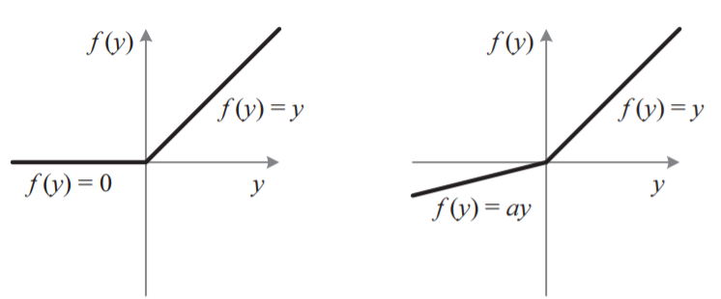
Introduction
ReLU vs PReLU
If a = 0.01:
Leaky ReLU

Slide 6
Parametric Rectifiers
We show that replacing the parameter-free ReLU by a learned activation unit improves classification accuracy.
PReLU introduces a very small number of extra parameters.
The number of extra parameters is equal to the total number of channels, which is negligible when considering the total number of weights.
-> we expect no extra risk of overfitting.

Slide 7
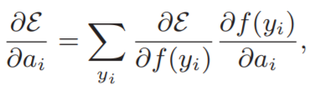
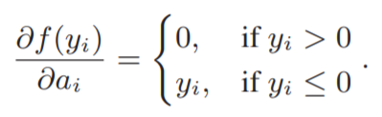
Parametric Rectifiers
The gradient of $a_{i}$for one layer is:
The time complexity due to PReLU is negligible for both forward and backward propagation

Slide 8
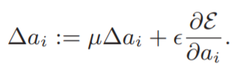

Parametric Rectifiers
We adopt the momentum method
when updating $a_{i}$:
Initialization : $a_{i}$=0.25
Momentum
Learning rate
we do not use weight decay when updating $a_{i}$.
A weight decay tends to push $a_{i}$ to zero, and thus biases PReLU toward ReLU.

Slide 9
Initialization of Filter Weights for Rectifiers
Rectifier networks are easier to train,
But a bad initialization can still hamper the learning of a highly non-linear system
-> we propose a robust initialization method that removes an obstacle of training extremely deep rectifier networks.
Xavier initialization
Glorot and Bengio [8] proposed to adopt a properly scaled uniform distribution for initialization.
-> Its derivation is based on the assumption that the activations are linear.
→ This assumption is invalid for ReLU and PReLU.

Slide 10

Initialization of Filter Weights for Rectifiers
Rectifier networks are easier to train,
But a bad initialization can still hamper the learning of
a highly non-linear system
-> we propose a robust initialization method that removes an obstacle of training extremely deep rectifier networks.
Xavier initialization
Glorot and Bengio [8] proposed to adopt a properly scaled uniform distribution for initialization.
-> Its derivation is based on the assumption that the activations are linear.
This assumption is invalid for ReLU and PReLU.
“He” initialization
$$Var{(W}_{i})= \frac{2}{n_{in}+n_{out}}$$

Slide 11

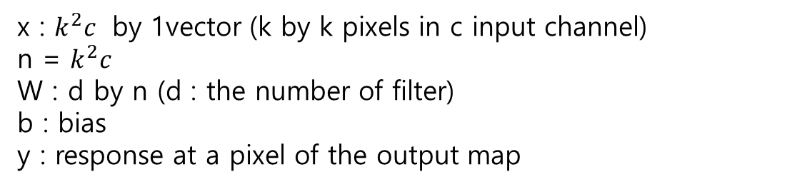
Initialization of Filter Weights for Rectifiers
Forward Propagation Case
The central idea is to investigate the variance of the responses in each layer.
For a conv layer, a response is:
x : $k^{2}c$ by 1vector (k by k pixels in c input channel)
n = $k^{2}c$
W : d by n (d : the number of filter)
b : bias
y : response at a pixel of the output map

Slide 12


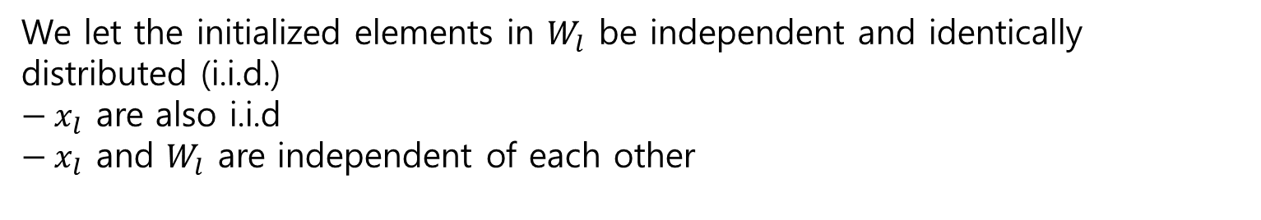
Initialization of Filter Weights for Rectifiers
We let the initialized elements in $W_{l}$ be independent and identically distributed (i.i.d.)
${− x}_{l}$ are also i.i.d
${− x}_{l}$ and $W_{l}$ are independent of each other
n the variance of the product of independent variables gives us

Slide 13


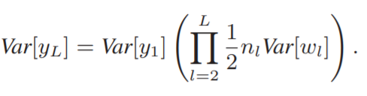

Initialization of Filter Weights for Rectifiers
let $W_{l−1}$ have a symmetric distribution around zero and $b_{l−1}$ = 0,
then $y_{l−1}$ has zero mean and has a symmetric distribution around zero
when f is ReLU
Key to the initialization design
Sufficient condition
zero-mean Gaussian distribution whose standard deviation (std) is $\sqrt{2/n_{l}}$

Slide 14


Initialization of Filter Weights for Rectifiers
Backward Propagation Case
The gradient of a conv layer is computed by:
Note that
$W_{l}$ and ∆$y_{l}$ are independent of each other, then ∆$x_{l}$ has zero mean for all l, when $W_{l}$ is initialized by a symmetric distribution around zero

Slide 15


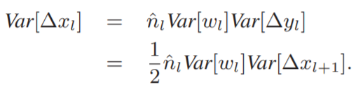

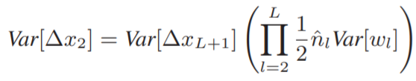
Initialization of Filter Weights for Rectifiers
We assume that f ′ ($y_{l}$) and ∆$x_{l+1}$ are independent of each other
Sufficient condition

Slide 16
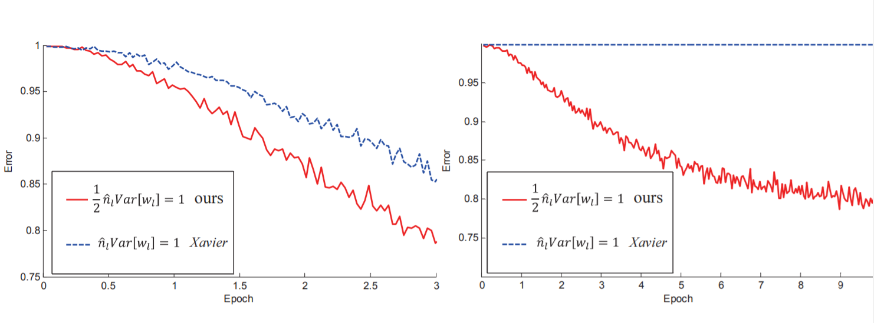
Initialization of Filter Weights for Rectifiers
We use ReLU in both figures
He initialization is able to make the extremely deep model converge.
On the contrary, the Xavier method completely stalls the learning, and the gradients are diminishing as monitored in the experiments.

Slide 17
Initialization of Filter Weights for Rectifiers
We found that this degradation is because of the increase of training error when the model is deeper. Such a degradation is still an open problem
Though our attempts of extremely deep models have not shown benefits on accuracy, our initialization paves a foundation for further study on increasing depth. We hope this will be helpful in understanding deep networks.

Slide 18
Experiments on ImageNet
We perform the experiments on the 1000-class ImageNet 2012 dataset
- 1.2 million training images
-> 50,000 validation images, and 100,000 test images
- top1/top-5 error rates

Slide 19
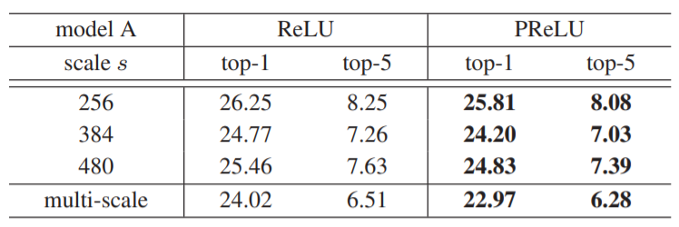
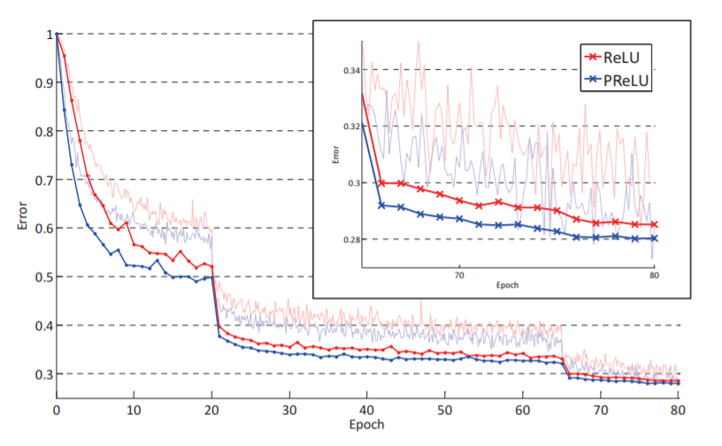
Experiments on ImageNet
Comparisons between ReLU and PReLU
PReLU converges faster than ReLU.
Moreover, PReLU has lower train error and val error than ReLU throughout the training procedure.

Slide 20
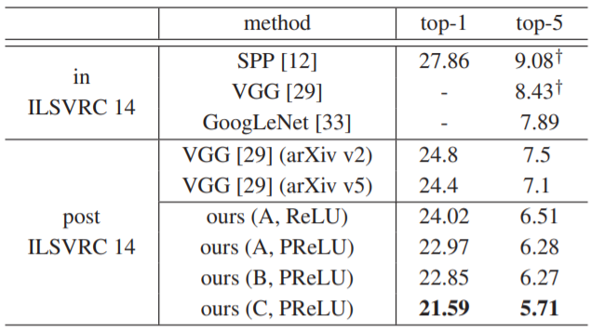
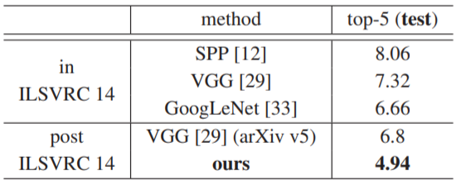
Experiments on ImageNet
Multi-model results for ImageNet test set
Single-model results evaluated from test set
Combine six models

Slide 21
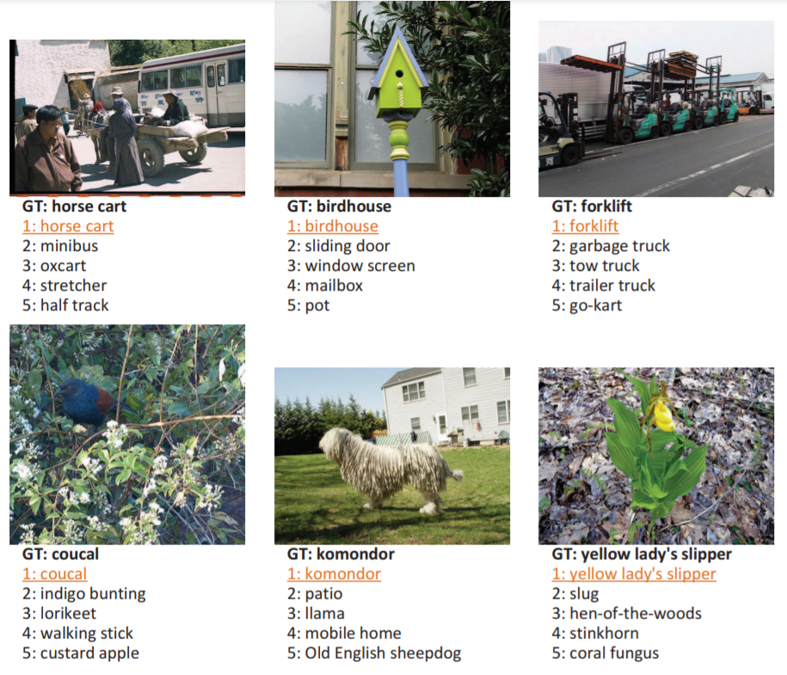
Experiments on ImageNet
Human performance yields a 5.1% top-5 error
on the ImageNet dataset.
-> Our result (4.94%) exceeds
the reported human-level performance
Comparisons with Human Performance

