Slide 1

Professional Certificate in Coding
Office Hour: Puneet Saraswat
February 12th 2021

Slide 2
Agenda
01 | New Learnings Big O Notation/ Complexity FAQs Data Structures/Algorithms
02 | Let’s Code A very common question
03 | Q/A

Slide 3
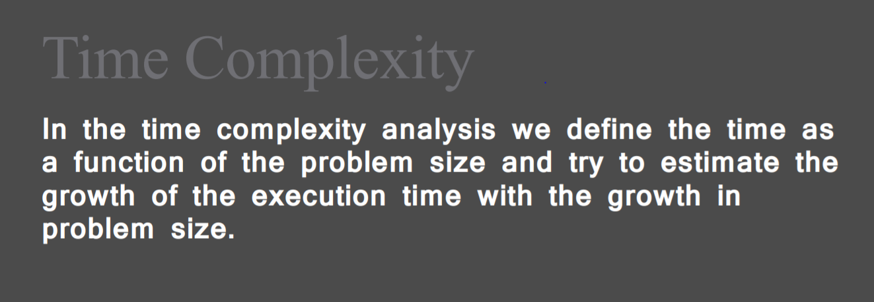

Slide 4
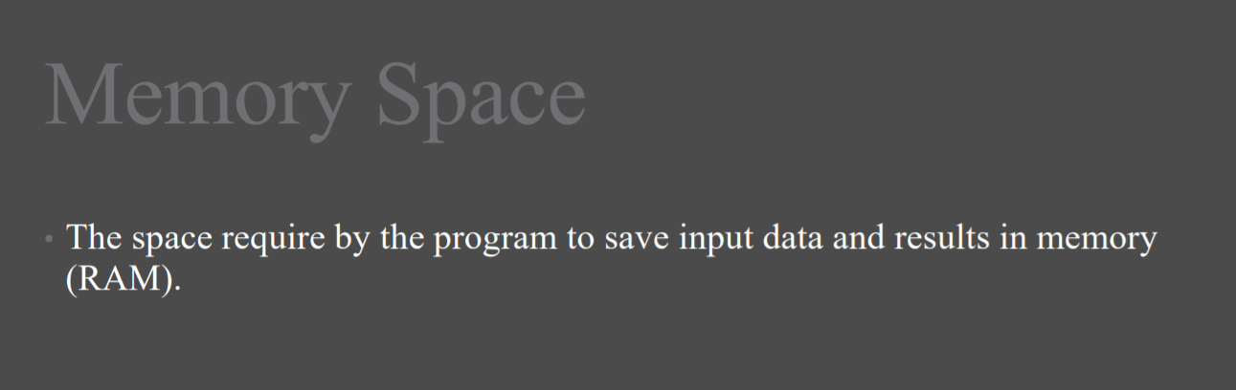

Slide 5
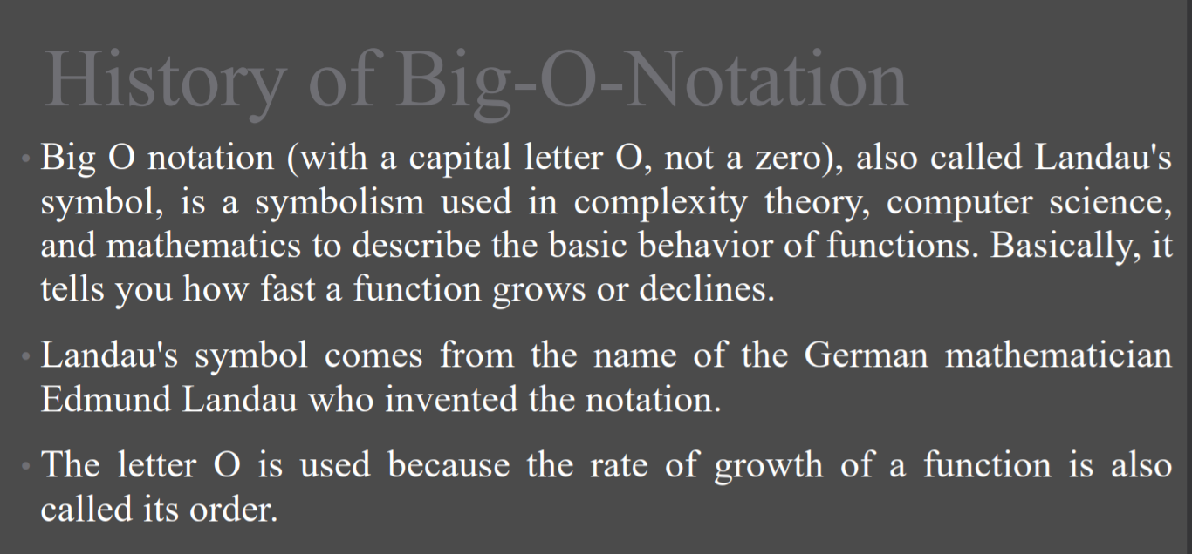

Slide 6
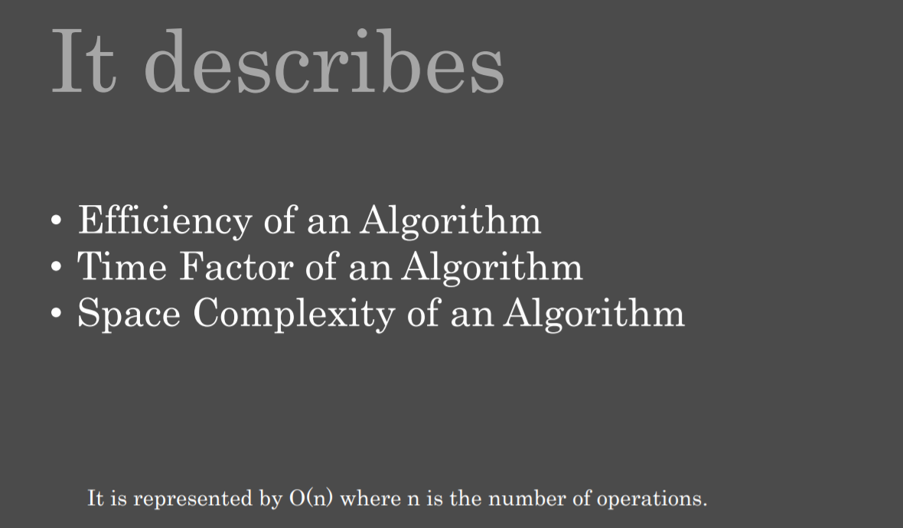

Slide 7
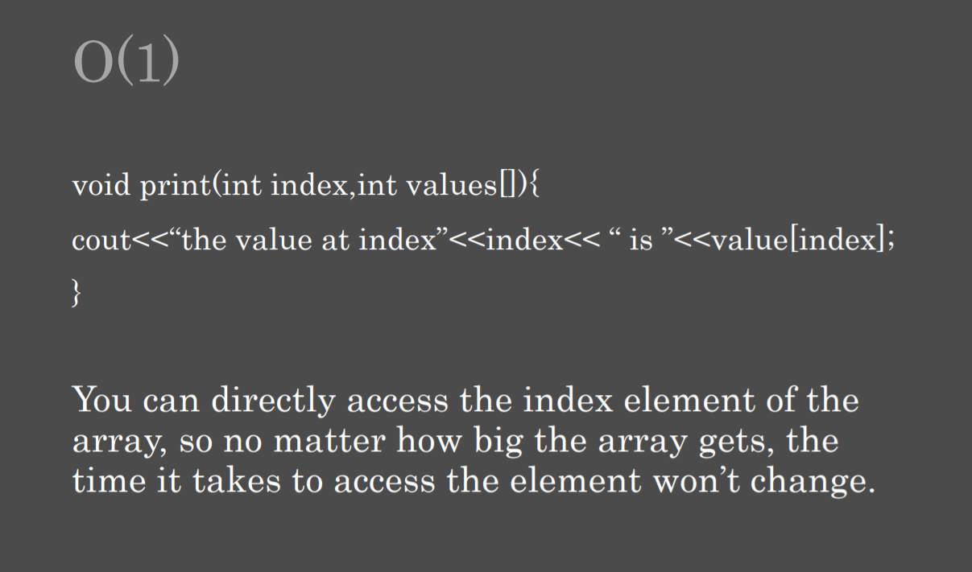

Slide 8
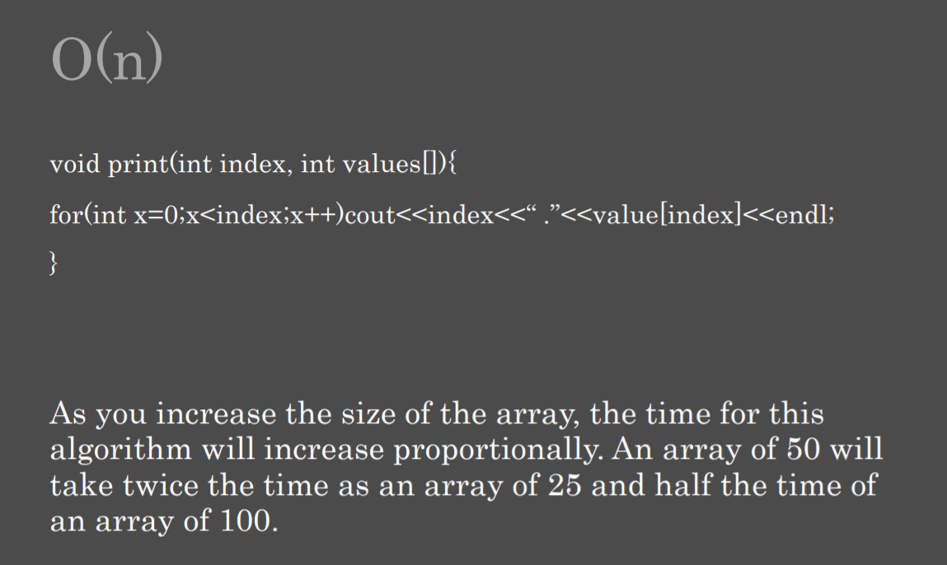

Slide 9
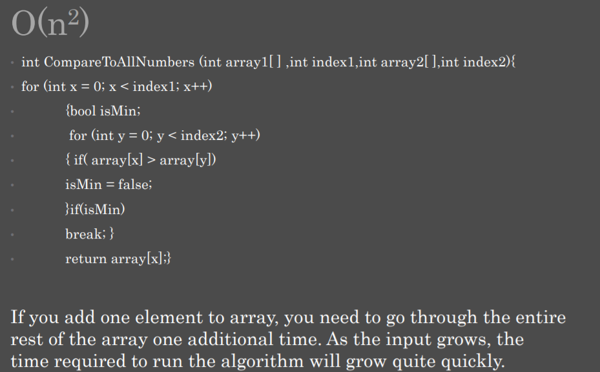

Slide 10
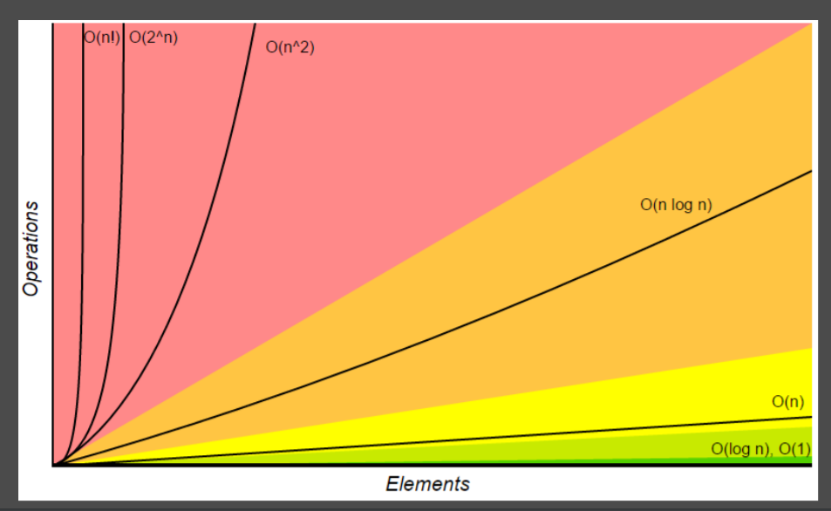

Slide 11
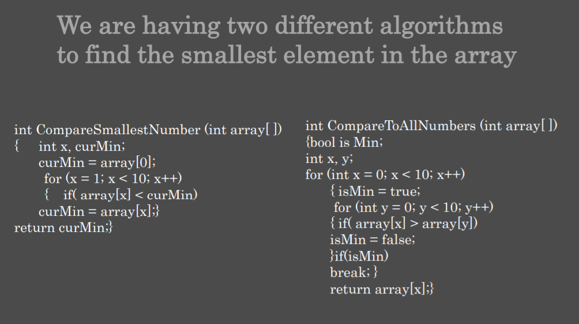

Slide 12
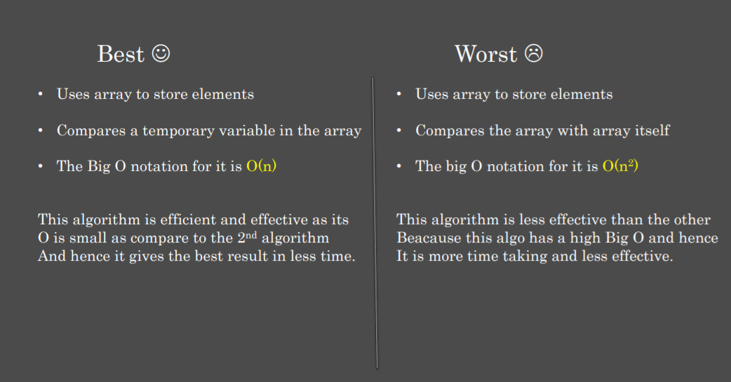

Slide 13
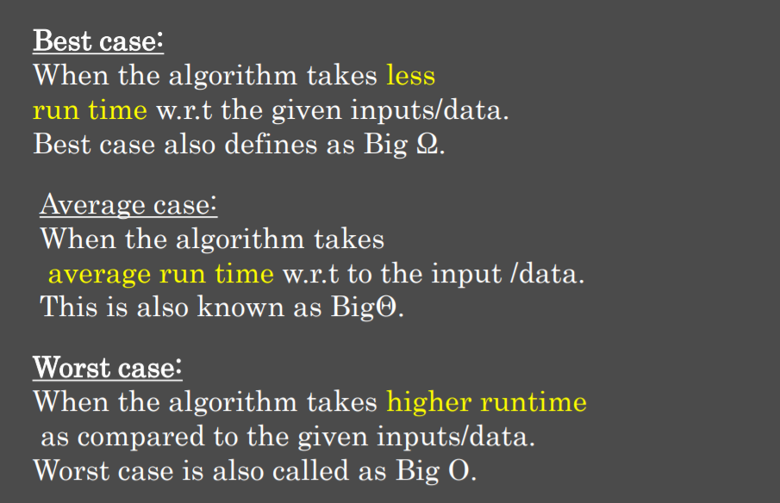

Slide 14
General Questions Interviewers Ask
https://github.com/sudheerj/javascript-interview-questions

Slide 15
Data Structures and Algorithms: very important to have our fundamentals clear
https://github.com/trekhleb/javascript-algorithms

Slide 16
02
Let’s Code

Slide 17
Implement the myAtoi(string s) function, which converts a string to a 32-bit signed integer (similar to C/C++'s atoi function).
https://leetcode.com/problems/string-to-integer-atoi/

Slide 18
03
Q/A

