Slide 1
MAT-311 Final Project
Samuel Andreson

Slide 2
Problem Statement
Diabetes affects over 400 million people worldwide
Correct diagnosis is crucial, especially for people that develop diabetes later in life. It can prevent complications or even death.
ML can help health providers flag at risk people for further testing.

Slide 3
Dataset Overview
Sourced from Kaggle
Originally created by the National Institute of Diabetes and Digestive and Kidney Diseases (NIH)
Data was taken from Indian women who were screened for diabetes
CSV file includes 768 Observations and 8 features
Target: 1 = diabetic, 0 = non-diabetic

Slide 4
Features
Feature | Type | Description
Pregnancies | Integer | Number of times pregnant
Glucose | Integer | Plasma glucose concentration
BloodPressure | Integer | Diastolic blood pressure (mm Hg)
SkinThickness | Integer | Triceps skinfold thickness (mm)
Insulin | Integer | 2-hour serum insulin (mu U/ml)
BMI | Float | Body Mass Index (kg/m²)
DiabetesPedigreeFunction | Float | Diabetes risk score from family history
Age | Integer | Age in years

Slide 5
EDA
Checked for missing values (none)
Decision Tree used for feature importance (entropy)
Kept top 5 most influential features

Slide 6
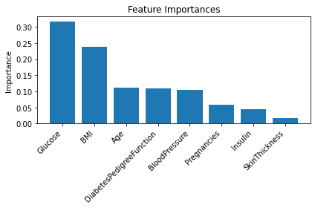
Bar Chart of Features ordered by importance

Slide 7
Data Splitting
Used test_train_split to split dataset
Split based on
70% Training
20%Validation
10% Testing
Same training and validation data were used for each classification method
Held test set until final evaluation

Slide 8
KNN Classification
Tested with K values of 1,3,5,7,9
Best performance with K=9 with an accuracy of 0.7727
K=9 had a:
Precision of 0.85
Recall of 0.84
f-1 of 0.84

Slide 9
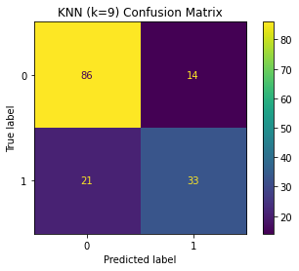
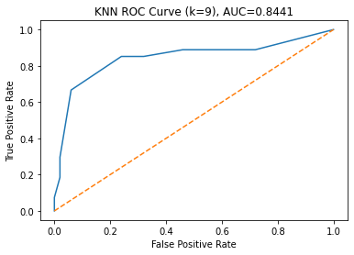
KNN graphs

Slide 10
Naïve-Bayes Classification
Naïve Bayes had a:
precision of 0.78
recall of 0.79
f1-score of 0.78

Slide 11
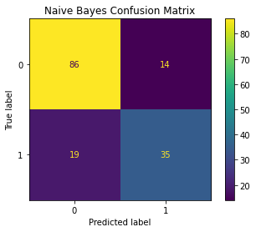
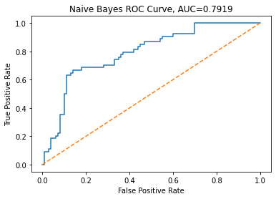
Naïve Bayes graphs

Slide 12
Decision Tree Classification
The Decision Tree had a:
precision of 0.73
recall of 0.72
f1-score of 0.73

Slide 13
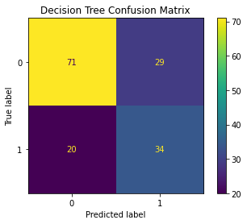
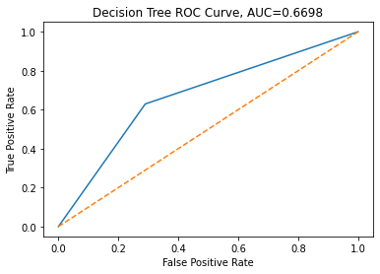
Decision Tree Graphs

Slide 14
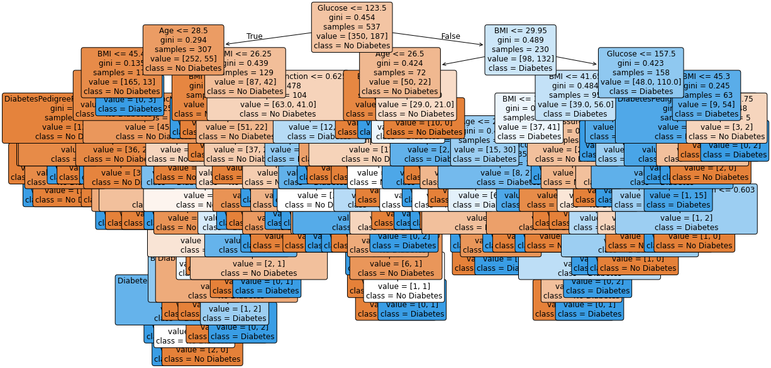
The decision tree in question

Slide 15
Which Model is best? KNN had the best ROC curve at 0.8441

Slide 16
Which model is best?
As you can see, they are all similar in performance
Naïve bayes is the winner because it had the least amount of False Negatives, which is important when flagging people for potential diseases.
It also had the second highest AUC at 0.7919

Slide 17
Naïve Bayes on Testing data
naïve bayes on the testing data resulted in these scores:
Precision of 0.84
Recall of 0.84
f1-score of 0.84

Slide 18
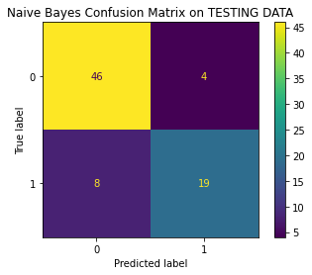
Validation vs. Testing Confusion Matrix

Slide 19
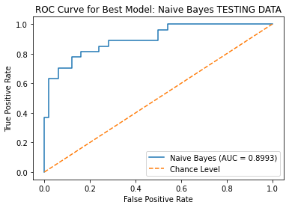
As you can see, Naïve Bayes outperformed itself on the testing data by quite a bit

Slide 20
Impact and Limitations
Impact
All models scored very well
Good starting point for flagging patients who might be at risk, and then testing from there
Limitations
Bias towards one gender and ethnicity
Still a small dataset at just over 750 rows

Slide 21
Thank You!
Questions?

