Slide 1

Machine learning
Neural Networks
Wouter Gevaert

Slide 2
Content
Introduction
The artificial neural network
Getting started with Keras and Tensorflow

Slide 3
Introduction

Slide 4
What is a neural network?
Definition
According to Simon Haykin, Neural Networks - a comprehensive Foundation, Prentice Hall, New Jersey, 2nd edition.
A neural network (NN) is a massively parallel distributed processor that has a natural propensity for malfunctioning experimental knowledge and making it available for use.
It resembles the brain in two aspects:
Knowledge is acquired through the network through a learning process.
Interneuron connection strengths known as synaptic weights are used to store the knowledge.

Slide 5
What is a neural network?
Inspired by the human brain
The human brain excels in tasks such as pattern recognition, speech recognition, perception, and so on.
As the brain learns more, it learns faster.
The brain is very strong in parallel processing, a classic computer in serial processing.

Slide 6
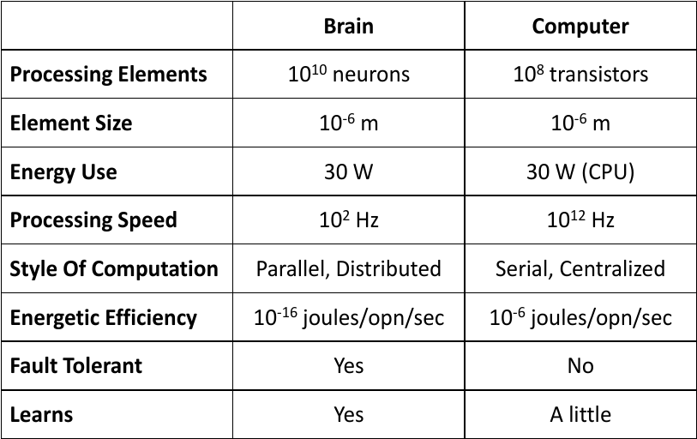
Human brain vs computer

Slide 7
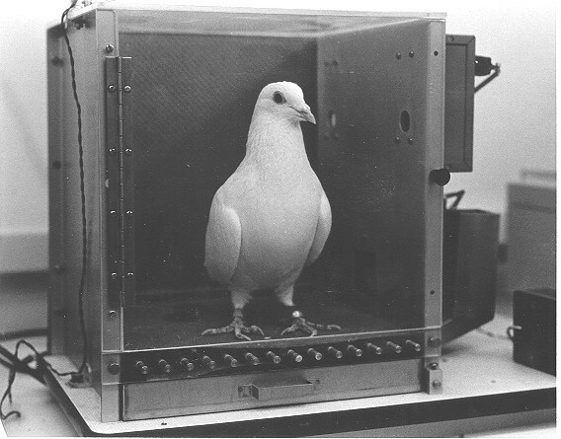
Biological model
Pigeons as art experts (Watanabe et al. 1995)
Pigeon in Skinner box.
Show paintings by two painters (Chagall and Van Gogh).
Give pigeon a reward for paintings by a certain painter.

Slide 8
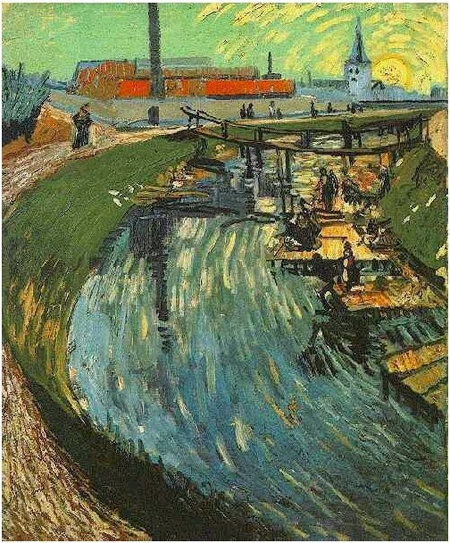
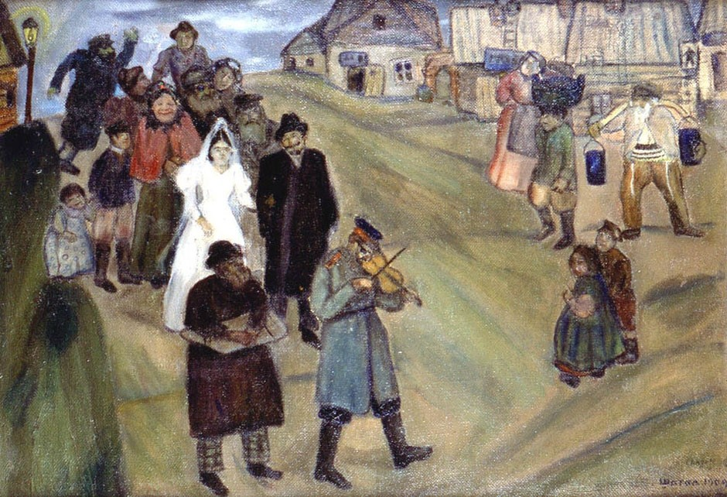
Biological model
Pigeons as art experts (Watanabe et al. 1995)

Slide 9
Biological model
Pigeons as art experts (Watanabe et al. 1995)
The pigeons were able to correctly classify the training set with 95%.
On the test set with unseen paintings they achieved an accuracy score of 85%.
Pigeons not only memorize images, they recognize patterns.
They generalize already seen information to base predictions on.

Slide 10
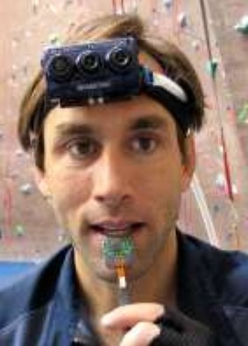
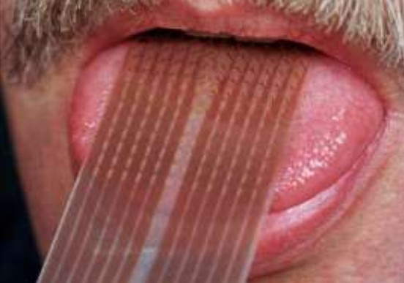
Biological model
See with the tongue

Slide 11
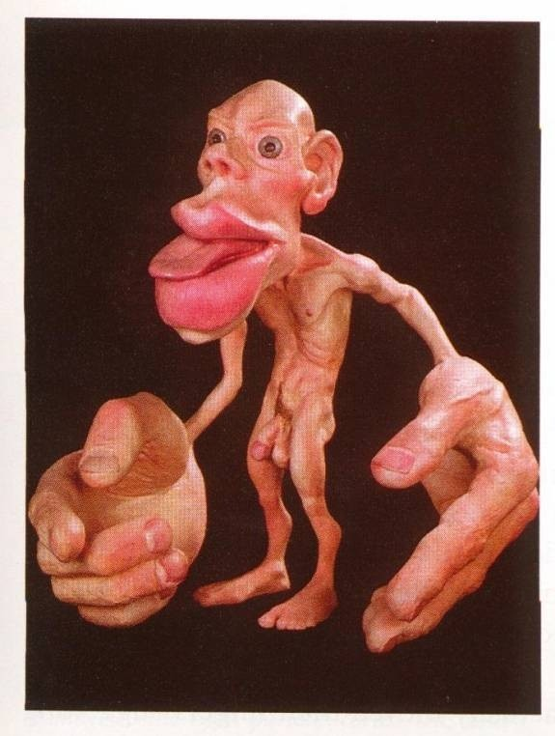
Human body scaled to allocated volume of brain
Biological model

Slide 12
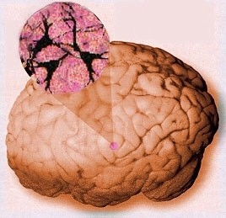
Biological model
The human brain

Slide 13
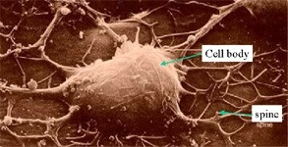
Biological model
The biological neuron

Slide 14
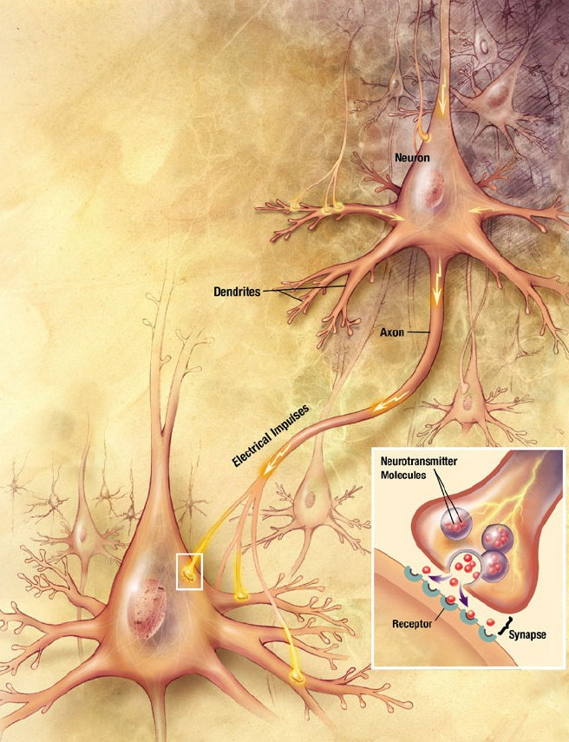
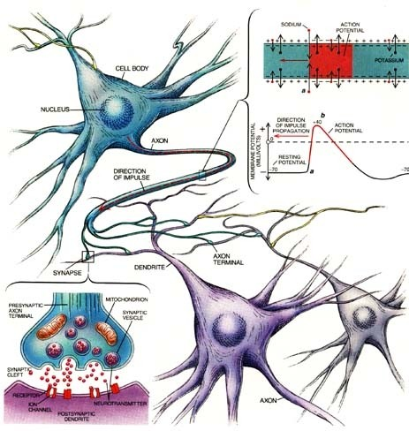
Biological model
The biological neuron

Slide 15
The artificial neural network

Slide 16
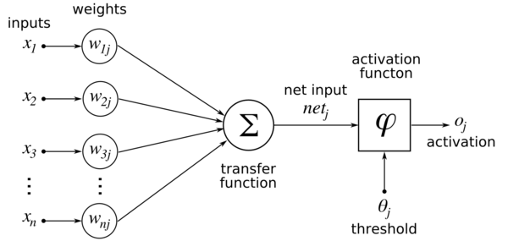
The artificial neural network Perceptron

Slide 17
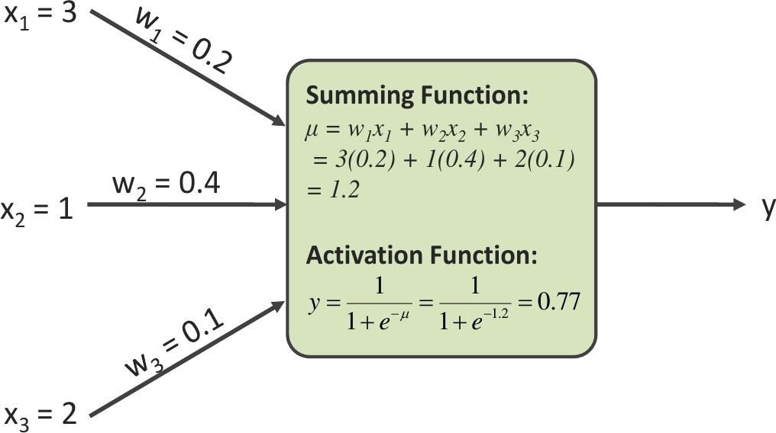
The artificial neural network Perceptron

Slide 18
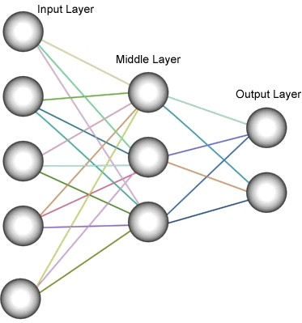
Characteristics of a neural network
Network architecture
Learning algorithm
Activation functions

Slide 19
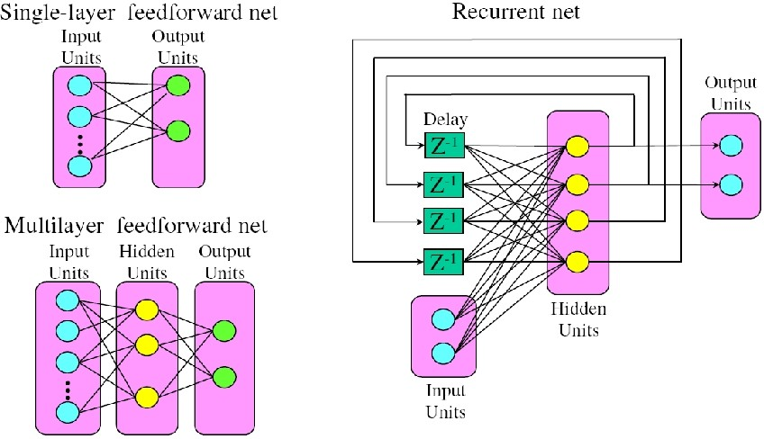
Network architecture
Overview
Meer info: http://www.asimovinstitute.org/neural-network-zoo/
17

Slide 20
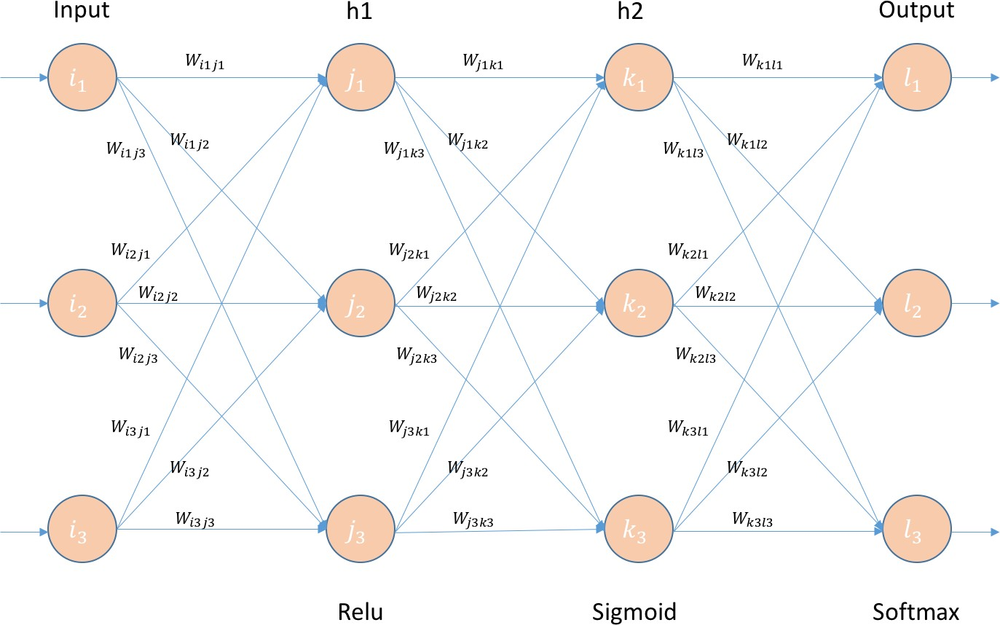
Feedforward neural network
Structure
The information flows one way from input to output.

Slide 21
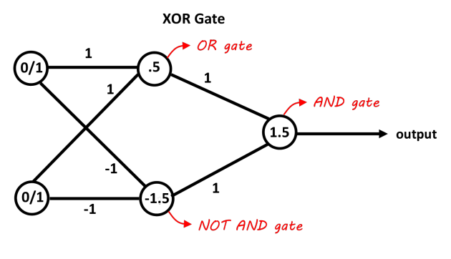
Feedforward neural network
Example: XOR function

Slide 22
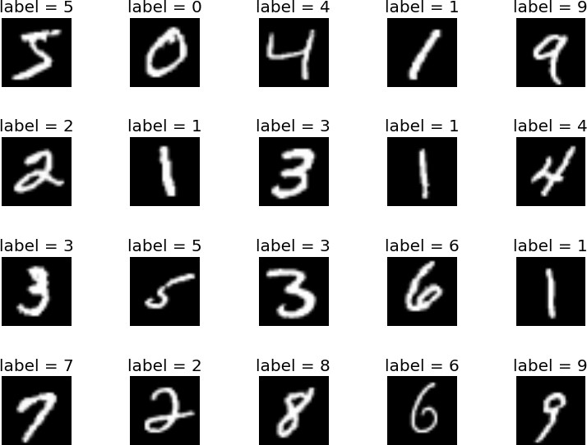
Feedforward neural network
Example MNIST

Slide 23
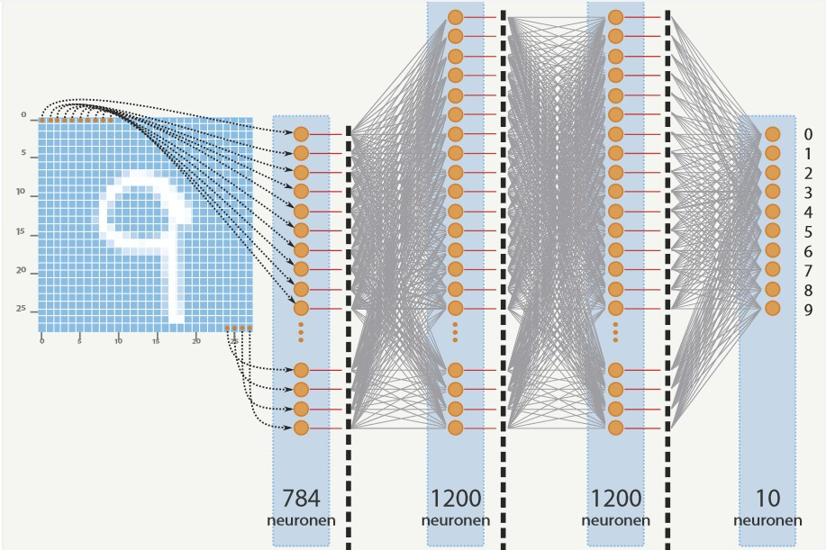
Feedforward neural network
Example MNIST

Slide 24
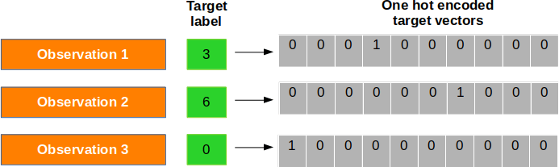
Feedforward neural network
One-hot encoding
One-hot encoding is a way to transform categorical features / targets to a more suitable format.
The index of 1 in a column vector (with only zeros) corresponds to the category of the feature / target.

Slide 25
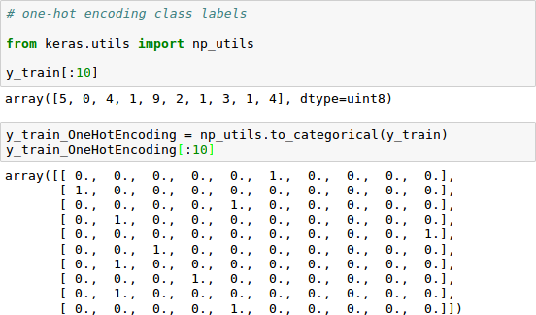
Feedforward neural network
One-hot encoding

Slide 26
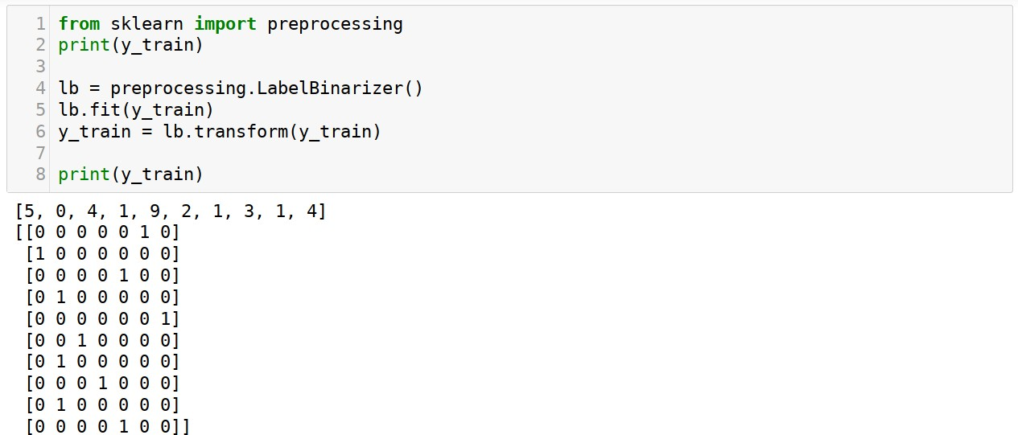
Feedforward neural network
One-hot encoding

Slide 27
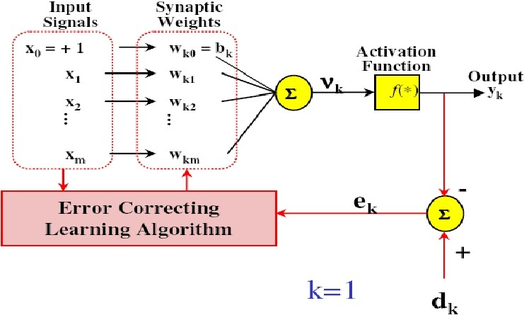
Feedforward neural network
Backpropagation learning
Error: e_{k} (n) = d_{k} (n) − y_{k} (n)
Minimize the cost based on the current error e_{k} (n)
1
Σ
ε(n) =
2
e (n)
2
k
k
∆W_{kj} (n) = ηe_{k} (n)x_{j} (n) with η the learning rate
η is the learning rate
0 < m η < 1 with m number of inputs
Adjust the weight according to :
∆W_{kj} (n + 1) = W_{kj} (n) + ∆W_{kj} (n)
Meer info: https://becominghuman.ai/back-propagation-is-very-simple-who-made-it-complicated-97b794c97e5c

Slide 28
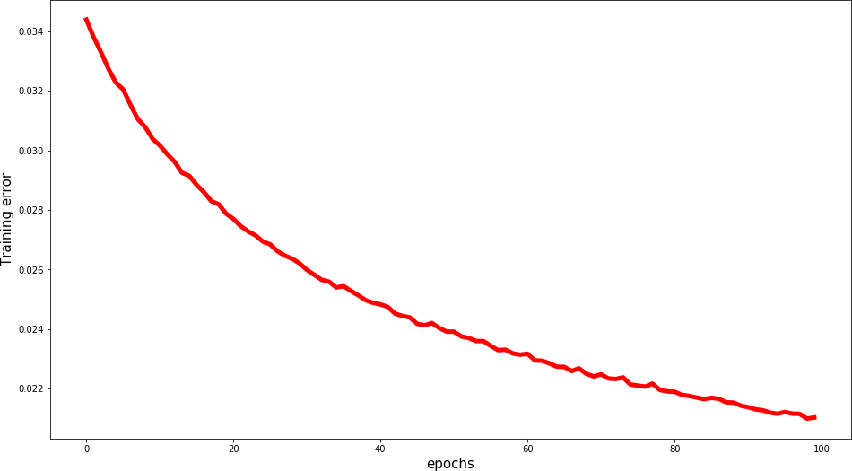
Feedforward neural network
Backpropagation learning
Error function (= loss) in function of number of training epochs

Slide 29
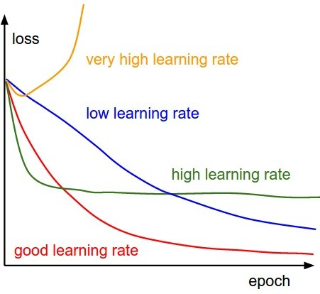
Feedforward neural network
Backpropagation learning
Influence/Impact of the learning rate on the training

Slide 30
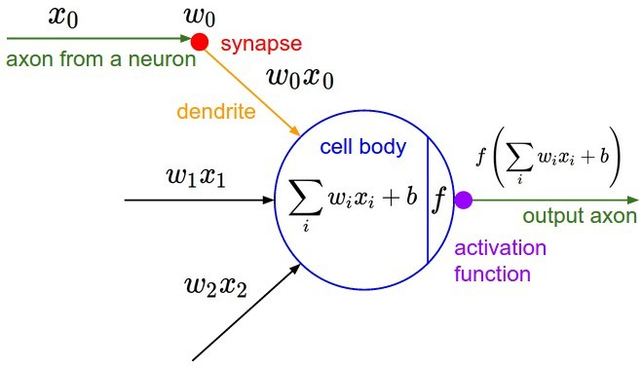
Feedforward neural network
Activation function

Slide 31
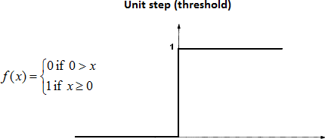
Activation functions
Step function
Output is 1 when the value > 0
Output is 0 when the value < 0 Disadvantage:
Can only say yes or no (100% or 0%)
Problems with multiple classes.
What if multiple classes are on 1?
Backpropagation does not work. The derivative = 0
29

Slide 32
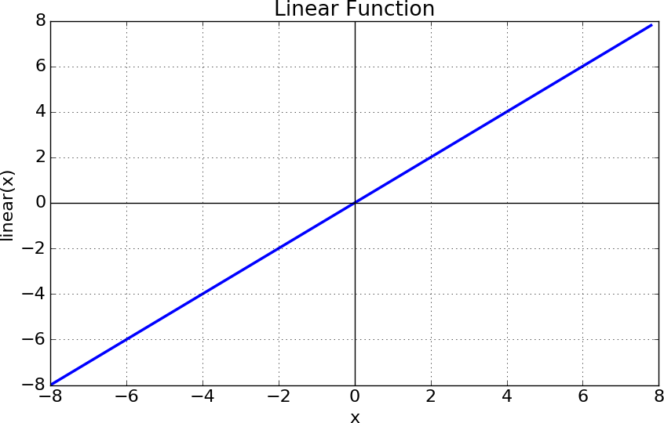
Activation functions
Linear function (Adaline)
Output is proportional to the input
Disadvantages:
No matter how many layers you use, the final activation will remain linear.
The derivative is constant and has no relation with the entrance.
Use:
Input layer
Output layer in regression
30

Slide 33
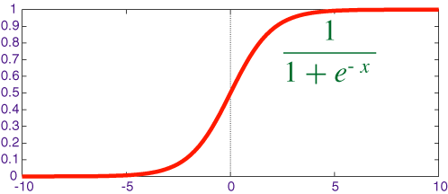
Activation functions
Sigmoid
Non-linear
The output is always between 0 and +1
Disadvantages
Vanishing gradient problem.
Problematic with neural networks with many hidden layers.
Use:
Not often used anymore.
Sometimes for output layer at classification problems.

Slide 34
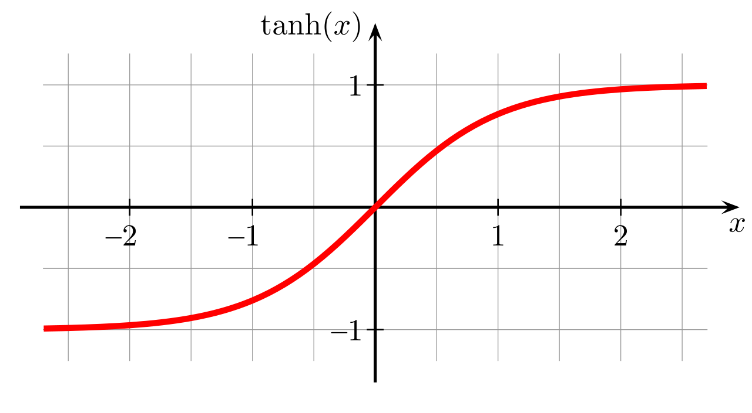
Activation functions
Hyperbolic tangent (tanh)
Non-linear
The output is always between -1 and +1
Centered around 0
Disadvantages
Vanishing gradient problem remains.
Use:
Not often used anymore.
32

Slide 35
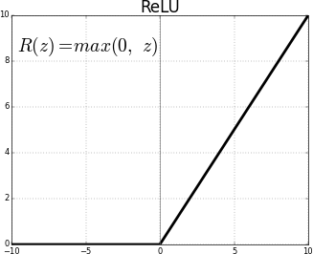
Activation functions
Relu = Rectified Linear Unit
ReLu is non-linear and each function can be approached by combining relay functions.
Very efficient to computing power.
Sparse activation. Many activations become 0.
Disadvantages:
Dead neurons can no longer be activated.
Use:
For hidden layers
33

Slide 36
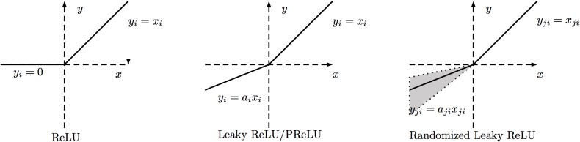
Activation functions
Leaky Relu
Variant on ReLu.
Do not die.
Disadvantages:
More parameters to train.
Use:
For hidden layers.
34

Slide 37
Activation functions
Conclusions
Hidden layers:
First use ReLu.
Try Leaky ReLu.
Do not use Sigmoid or Tanh.
Output layer:
Linear in regression.
Softmax / Sigmoid at classification.
Sofmax is a generalization of the Sigmoid :
σ(z) =
_{e}z_{j}
j
Σ
.
K
k=1
_{e}z_{k}
Works with mult-class classification.
35

Slide 38
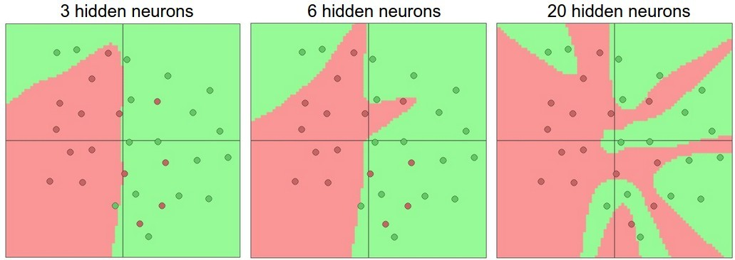
Underfitting and overfitting
Number and size of the layers
Too large neural network: overfitting.
Too small neural network: underfitting.

Slide 39
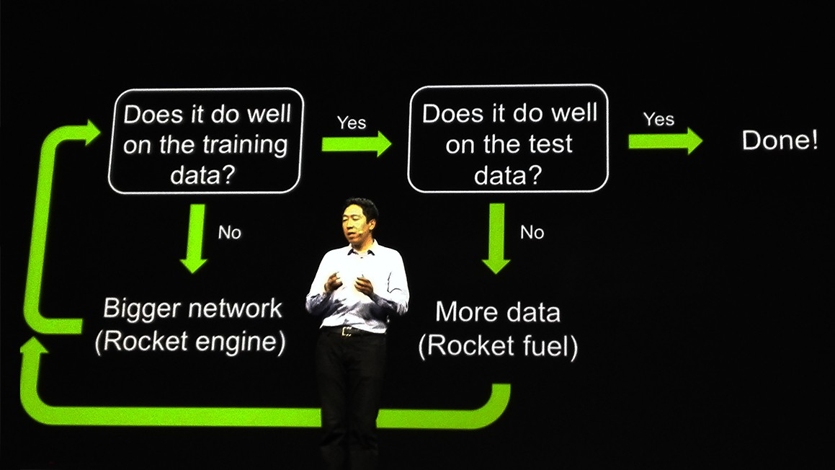
Underfitting and overfitting
Regularization of a neural network

Slide 40
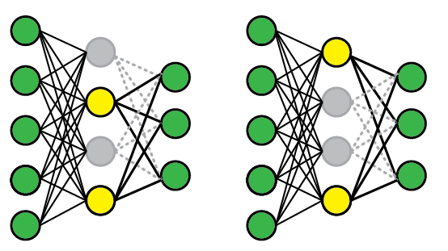
Underfitting and overfitting
Dropout
Technique to prevent overfitting.
Switch off a certain percentage of the neurons in a layer.
Other neurons have to indent for neurons that are off.
38

Slide 41
Getting started with Keras and Tensorflow

Slide 42
Getting started with Keras and Tensorflow
What is Keras?
https://keras.io/
Neural Network library written in Python.
Built on top of Tensorflow and Theano.
Easy to use.Modular and expandable.
Allows to build complex (deep learning) neural networks.

Slide 43
Getting started with Keras and Tensorflow
Install Keras and Tensorflow
pip install tensorflow
pip install keras

Slide 44
Getting started with Keras and Tensorflow
The sequential model
Allows to stack different layers of a neural network
https://keras.io/#getting-started-30-seconds-to-keras
Construction of the sequential model:
from k e r a s . models i m p o r t S e q u e n t i a l
model = S e q u e n t i a l ( )
from k e r a s . l a y e r s i m p o r t Dense , A c t i v a t i o n
model . add ( Dense ( u n i t s = 3 0 , i n p u t _ d i m = 1 0 ) ) model . add ( A c t i v a t i o n ( ’ r e l u ’ ) )
model . add ( Dense ( u n i t s = 5 ) )
model . add ( A c t i v a t i o n ( ’ s o f t m a x ’ ) )
10 inputs | 30 hidden layer ReLu units | 5 softmax uitgangen

Slide 45
Getting started with Keras and Tensorflow
The sequential model
Compile and train the sequential model + predictions
model . c o m p i l e ( l o s s = ’ c a t e g o r i c a l _ c r o s s e n t r o p y ’ ,
o p t i m i z e r = ’ sgd ’ ,
m e t r i c s = [ ’ a c c u r a c y ’ ] )
model . c o m p i l e ( l o s s = k e r a s . l o s s e s . c a t e g o r i c a l _ c r o s s e n t r o p y , o p t i m i z e r = k e r a s . o p t i m i z e r s . SGD ( l r = 0 . 0 1 , momentum = 0 . 9 ,
n e s t e r o v = T r u e ) )
model . f i t ( x _ t r a i n , y _ t r a i n , epochs = 5 , b a t c h _ s i z e = 3 2 ) c l a s s e s = model . p r e d i c t ( x _ t e s t , b a t c h _ s i z e = 1 2 8 )

Slide 46
Parameters of the sequential model
Activation functions
https://keras.io/activations/
Available activation functions:
softmax
relu
sigmoid
tanh
linear
https://keras.io/layers/advanced-activations/

Slide 47
Parameters of the sequential model
Learning rate optimizers
https://keras.io/optimizers/
SGD + Nesterov (Stochastic Gradient Descent)
RMSProp: more suitable for recurrent networks
Adagrad
Adam
Adamax

Slide 48
Parameters of the sequential model
Epochs - batch size – iterations
Epochs: the number of times the neural network sees the complete training set.
Iterations: The number of times the weights are adjusted. Is equal to the number of epochs times the number of batches.
Batch size: The number of samples that the neural network will see before it updates the weights. Updating of the weights is based on the average error of a batch.
Batch mode: The batch size is equal to the number of training samples.
Mini-batch mode: The batches are larger than 1 and smaller than the number of training samples.
Stochastic mode: The batch size = 1. After each training sample there is an update of the weights.

Slide 49
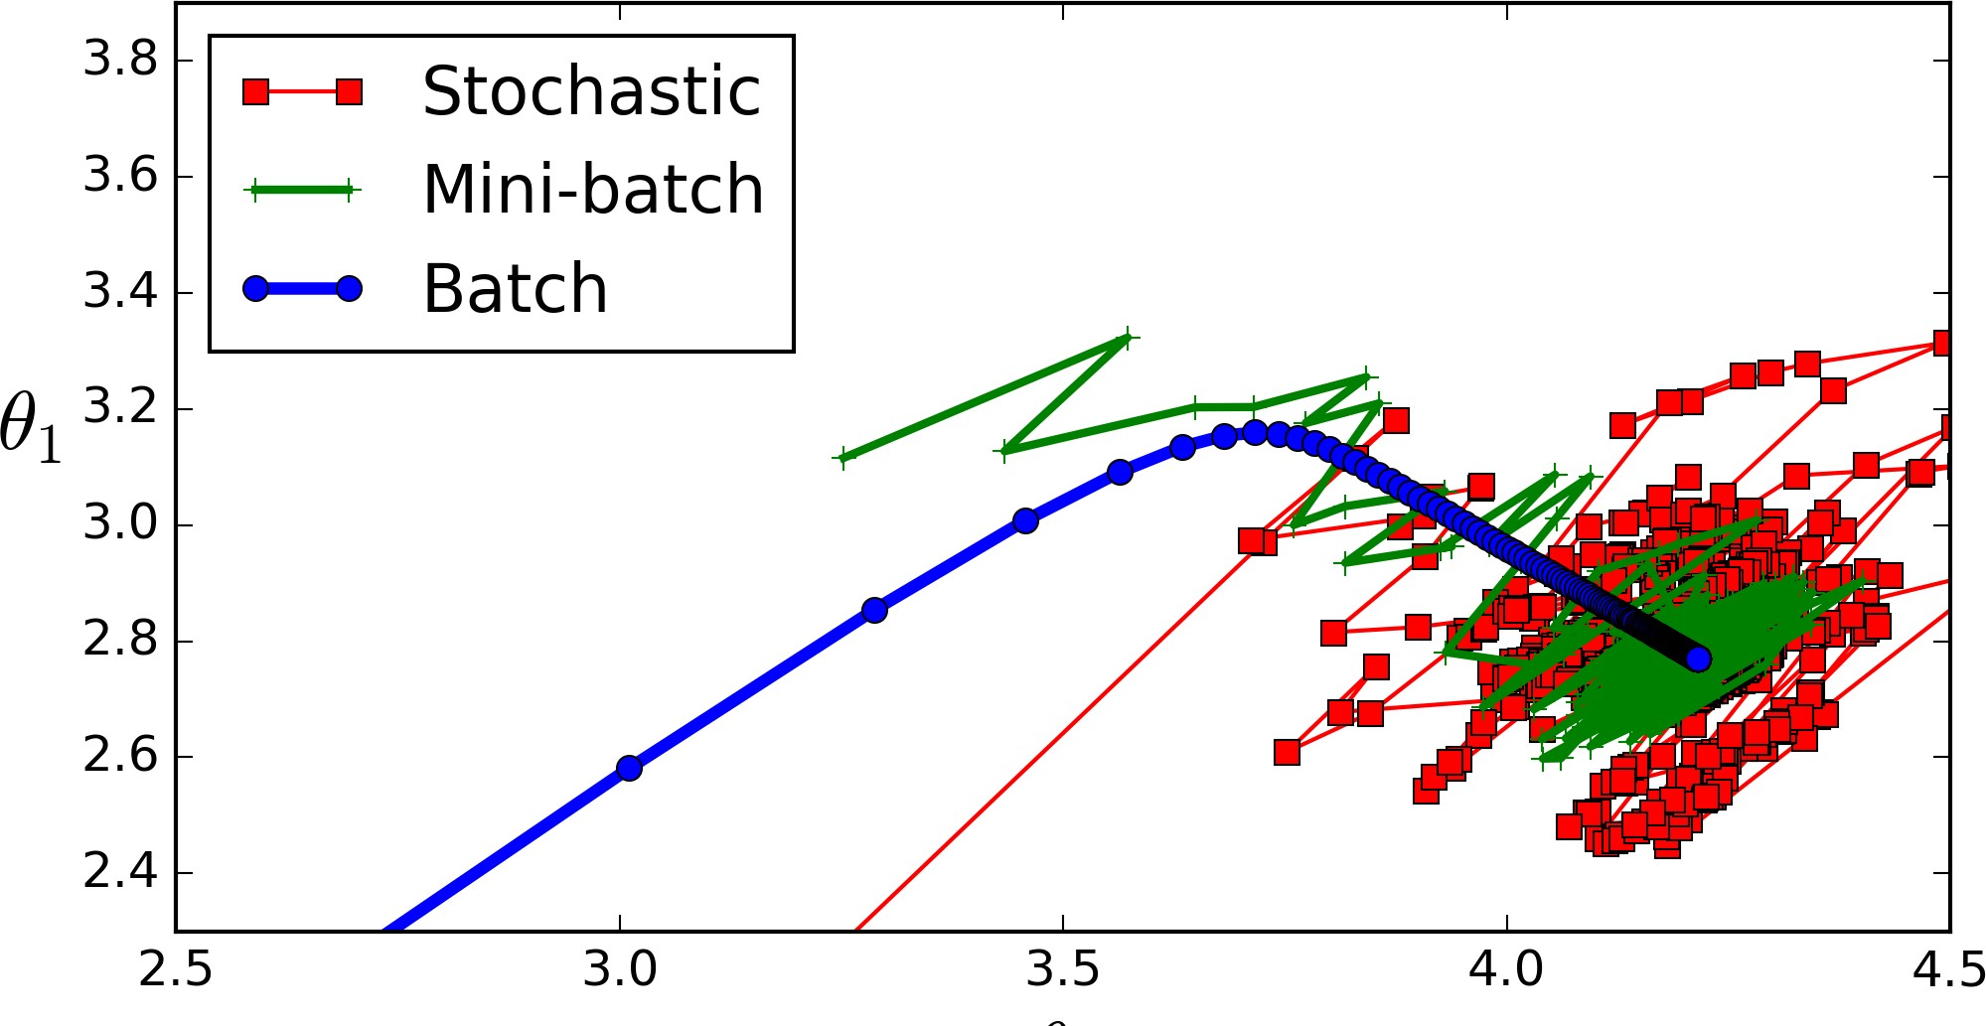
Parameters of the sequential model
Batch size
Advantages and disadvantages of a small batch size
Small batches take up less memory.
The network usually trains faster in small batches.
Smaller batches give quicker feedback.
Disadvantage of small batches: less accurate estimation of the gradient. Network stabilizes on the basis of the last training samples.

Slide 50
Parameters of the sequential model
Loss function
https://keras.io/losses/#available-loss-functions
The cost function to be minimized during training.
Error losses: usually used in regressionmean_squared_error(y_true, y_pred)
mean_absolute_error(y_true, y_pred)
mean_absolute_percentage_error(y_true, y_pred)
mean_squared_logarithmic_error(y_true, y_pred)

Slide 51
Parameters of the sequential model
Loss function
https://keras.io/losses/#available-loss-functions
Hinge losses: usually used with Support Vector Machines.
squared_hinge(y_true, y_pred)
hinge(y_true, y_pred)
categorical_hinge(y_true, y_pred)

Slide 52
Parameters of the sequential model
Loss function
https://keras.io/losses/#available-loss-functions
Class losses: used in classification.
binary_crossentropy (y_true, y_pred)
For binary classification or multilabel classification: problems where multiple labels can be assigned to a training sample (with sigmoid output layer).
Example a photo contains both a dog and a cat.
categorical_crossentropy (y_true, y_pred)
With multiclass classification with softmax where you want to predict one particular class with high certainty.
Example with the MNIST classification.

Slide 53
Parameters of the sequential model
Metrics
Used to assess the performance of the model.
Regression metrics:
Mean Squared Error: mean_squared_error of mse
Mean Absolute Error: mean_absolute_error, mae
Mean Absolute Percentage Error: mean_absolute_percentage_error, mape
Cosine Proximity: cosine

Slide 54
Parameters of the sequential model
Metrics
Classification metrics:
Binary Accuracy: binary_accuracy, acc
Categorical Accuracy: categorical_accuracy, acc
Top k Categorical Accuracy: top_k_categorical_accuracy
Cosine Proximity

Slide 55
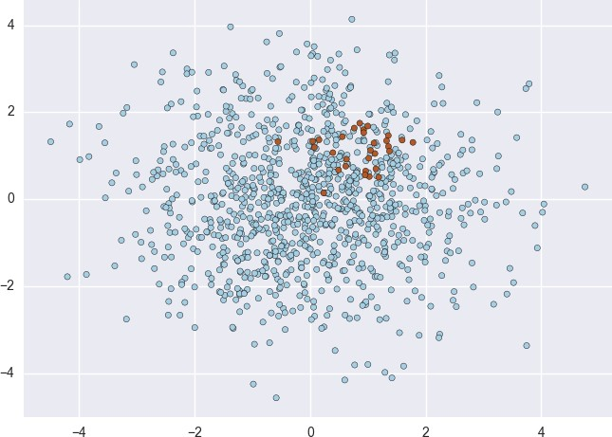
Parameters of the sequential model
Other parameters
validation_split: fraction of training data used for validation.
sample_weight_mode: for unbalanced data: some classes are more common in the training set than others.

