Slide 1
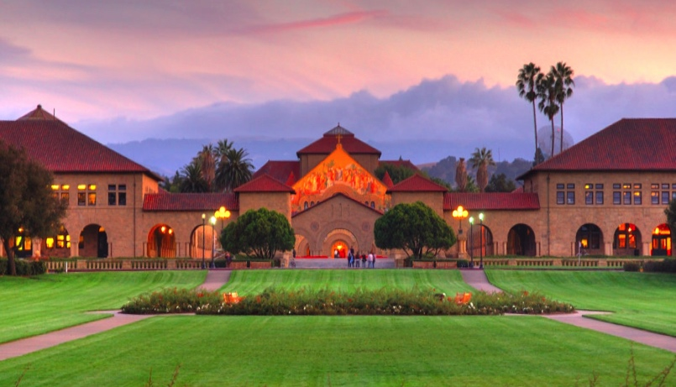

Foundation Models
for Healthcare
Akshay Chaudhari
Tanveer Syeda-Mahmood
James Zou
Notes:
2023 year of model released – language, vision, mix
Models driving discussion of impact on humans, capabiltiies, health, law, ethics, etc
How are some of these models trained, what are their capabilities, how might it affect a field like health
Multiple stakeholders: initially doctors, now patients, pharma, healthcare providers, payers, etc
Goal: Not to make you an expert in FM, but start asking the questions towards that path

Slide 2
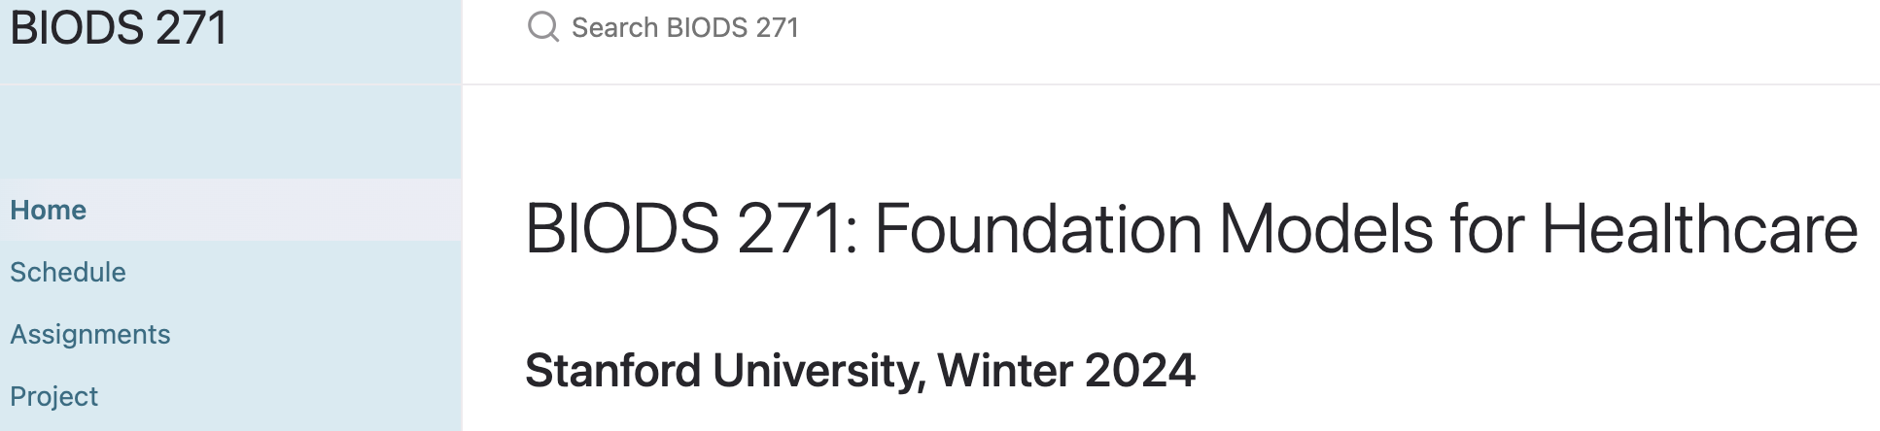

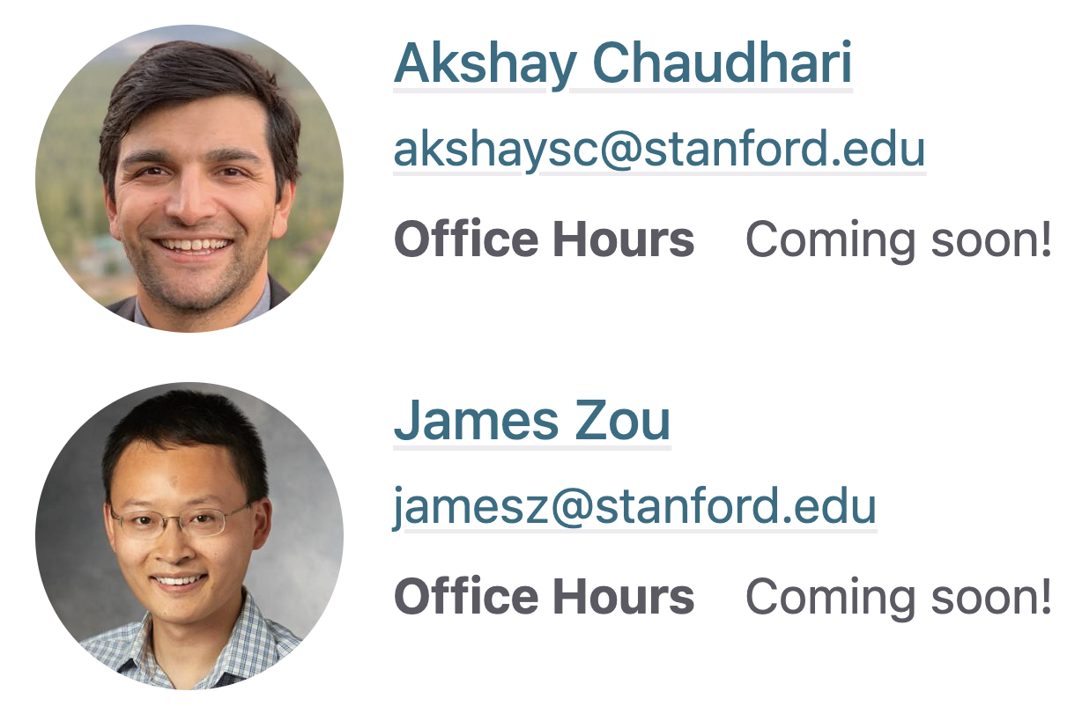
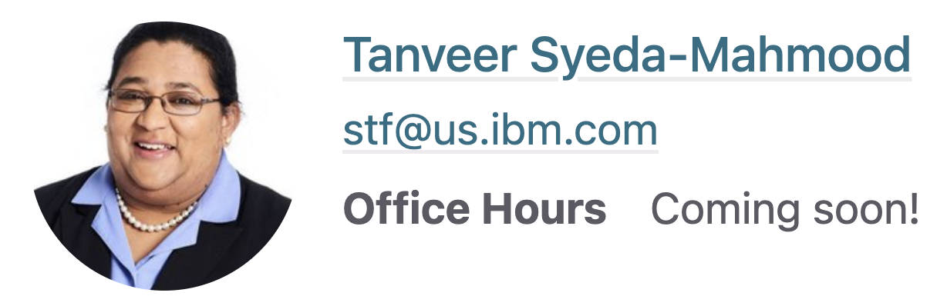
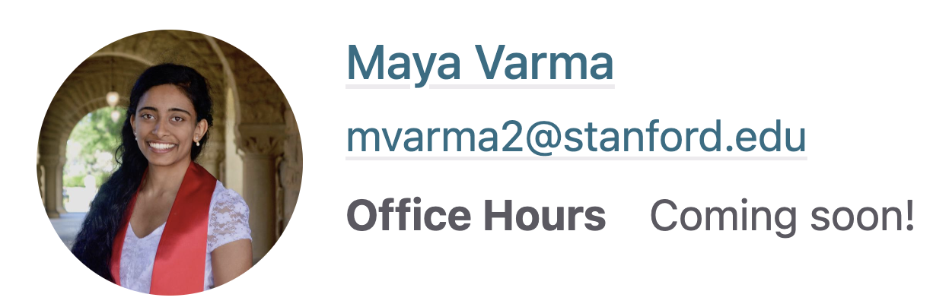
https://stanford-biods271.github.io/
Notes:
Website is public facing for broader access to course materials
Lectures will be found via canvas/Panopto
Ed discussion platform

Slide 3
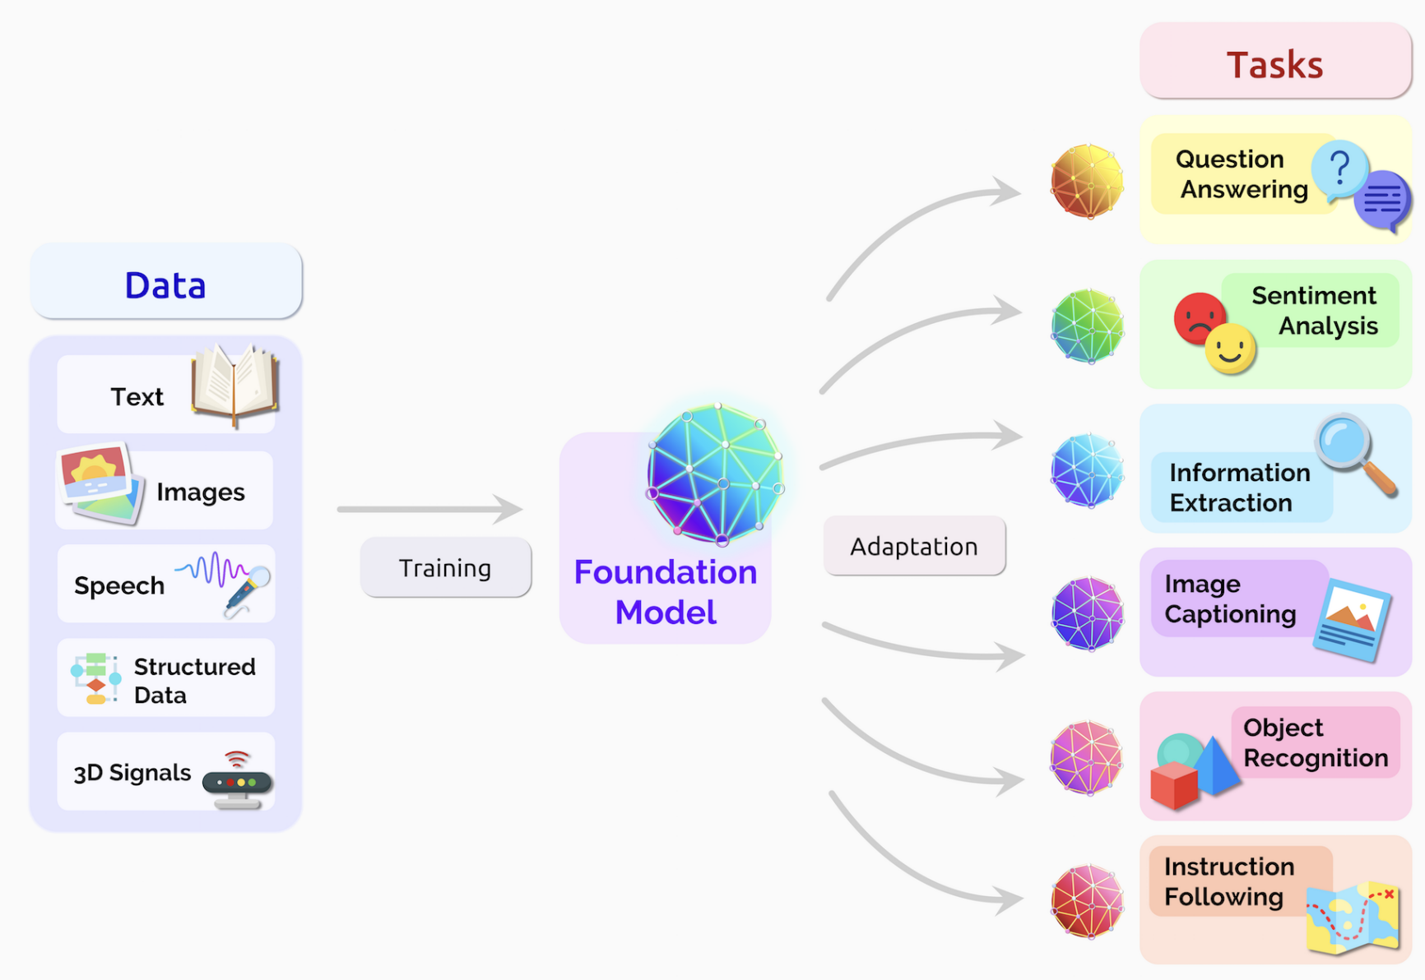
Foundation Models
Bommasani et al. On the Opportunities and Risks of Foundation Models. arXiv 2021.

Slide 4
What to Expect from Course
Provide background and discussion of (some) of the latest large-scale foundation models
Discuss applications, exciting opportunities, and challenges for adaptation to healthcare
Educate in this rapidly moving area and help enable high-quality research and applications
Notes:
Educate to build and evaluate

Slide 5
What to Expect from Students
Active participation in course content - discussions, readings, and assignment
Working towards a high-quality final project
Flexibility to adapt to a fast-changing field!!
Notes:
10% participation, 30% HW, 60% project
HW – 2 for now subject to change. Ability to meaningfully interact with models
Familiarity with DL models highly encouraged

Slide 6
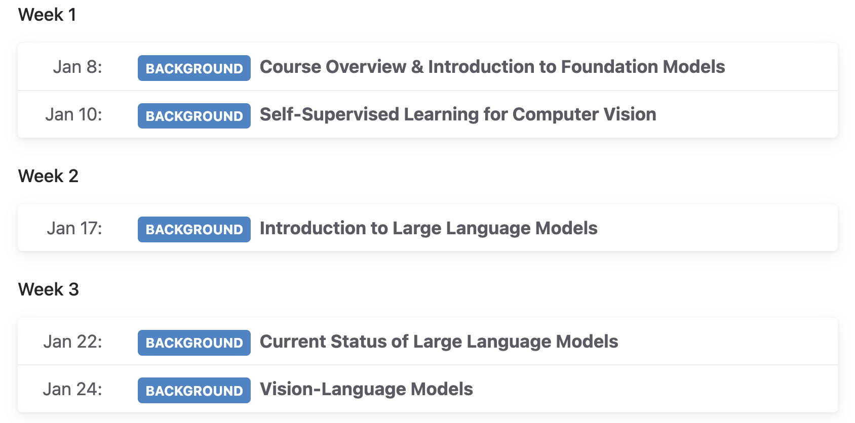
(Rough) Course Outline

Slide 7
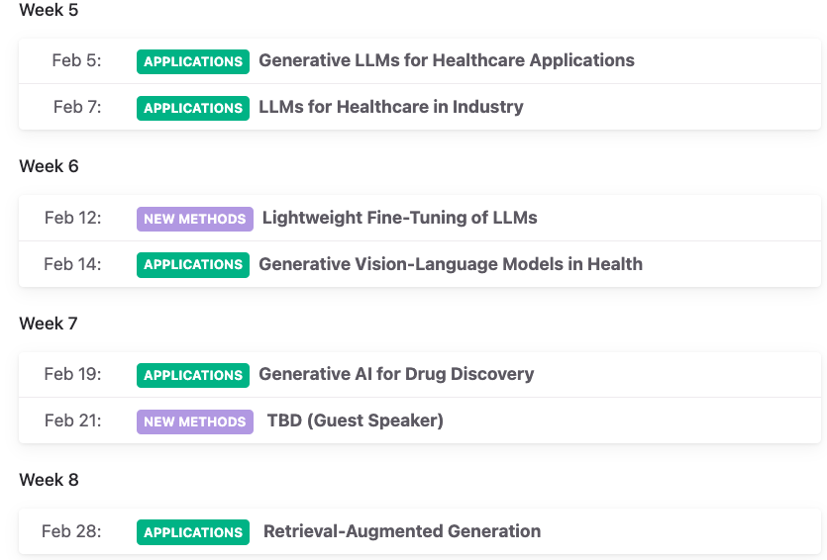
(Rough) Course Outline

Slide 8
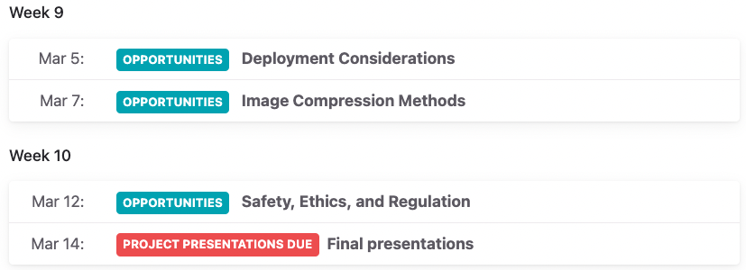
(Rough) Course Outline

Slide 9
ML Models
Input
Output
ML Model
Input | Output | Function | Tasks | Application
Clustering
Classification
Prediction
Regression
Synthesis
Recognition
Detection
Segmentation
Captioning
Image/text/synthesis
Audio/Video/multimodal synthesis
Question answering
Text generation
Autocompletion
Translation
Summarization
Sentiment analysis
Navigation
Search/IR
Recommendation
….
Customer service
Social Media
Marketing
Code generation
Automated reporting
Domain-specific
Structured
Time series
Text
Image
Audio
Video
Table
Domain-specific
Multi-D
Multimodal
Label
Regression
Text
Image
Audio
Video
Table
Domain-specific

Slide 10
Foundation Model
Input
s
Output
Foundation Model
Input | Output | Function | Tasks | Application
Trained on a variety of data input
Different types of output based on downstream use
Defined based on the scope of ability, range of uses, breadth of tasks or types of output and input
Encoder
Decoder
Encoder-Decoder
A single model can accomplish multiple tasks:
Sentence completion
Sentiment classification
Summarization
….
Works for arbitrary input
Can be fine-tuned
Same model can serve multiple applications
Customer service
Code generation
…

Slide 11
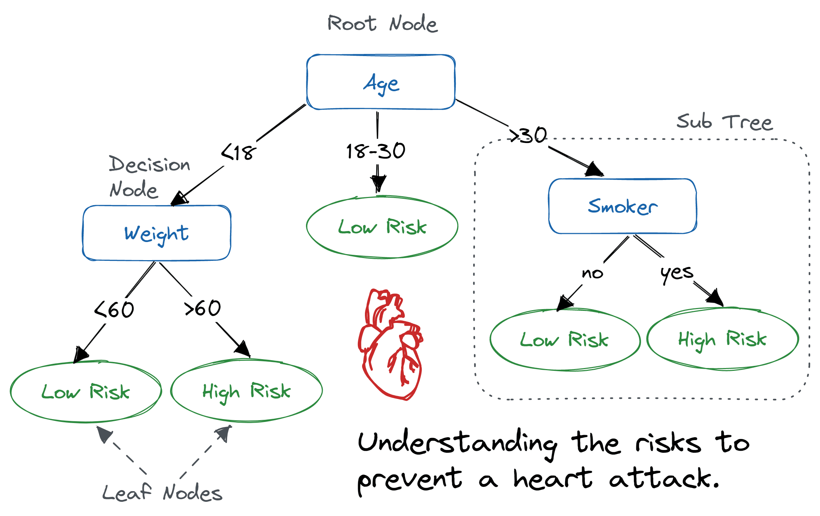
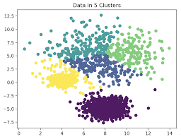
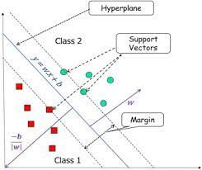
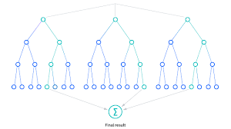
Are these Foundational Models?
Decision Trees
Clustering
Support Vector Machines
Random Forests
https://www.datacamp.com/tutorial/decision-tree-classification-python
https://www.ml-science.com/k-means-clustering
https://www.ibm.com/topics/random-forest
https://www.sciencedirect.com/topics/computer-science/support-vector-machine

Slide 12
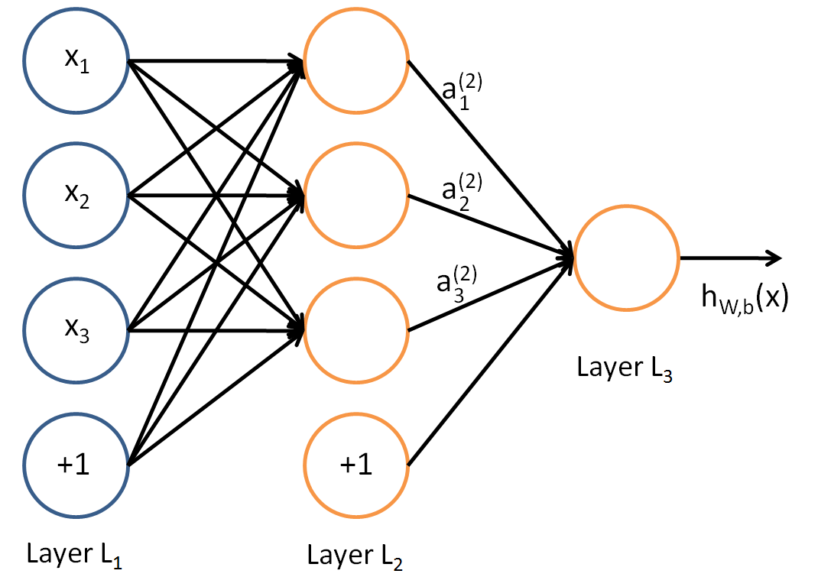
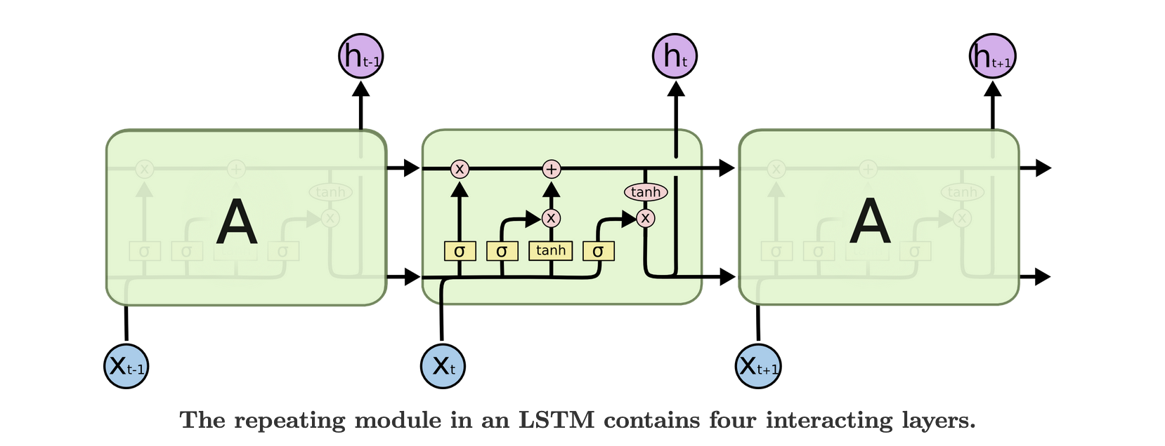
Are these Foundational Models?
Multi-layer perceptron
RNN
LSTM
https://colah.github.io/posts/2015-08-Understanding-LSTMs/
http://deeplearning.stanford.edu/tutorial/supervised/MultiLayerNeuralNetworks/

Slide 13
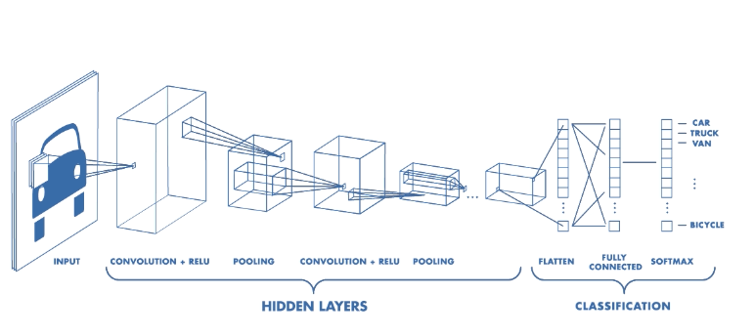
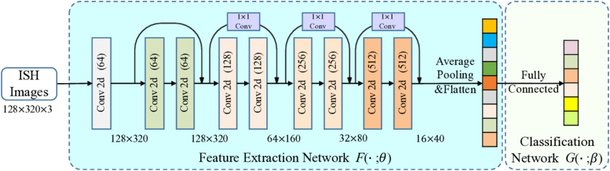
Are these Foundational Models?
Convolutional neural networks
ResNet
DNN
https://www.linkedin.com/pulse/deep-residual-networks-resnet-ayoub-kirouane/
https://towardsdatascience.com/convolutional-neural-networks-explained-9cc5188c4939

Slide 14
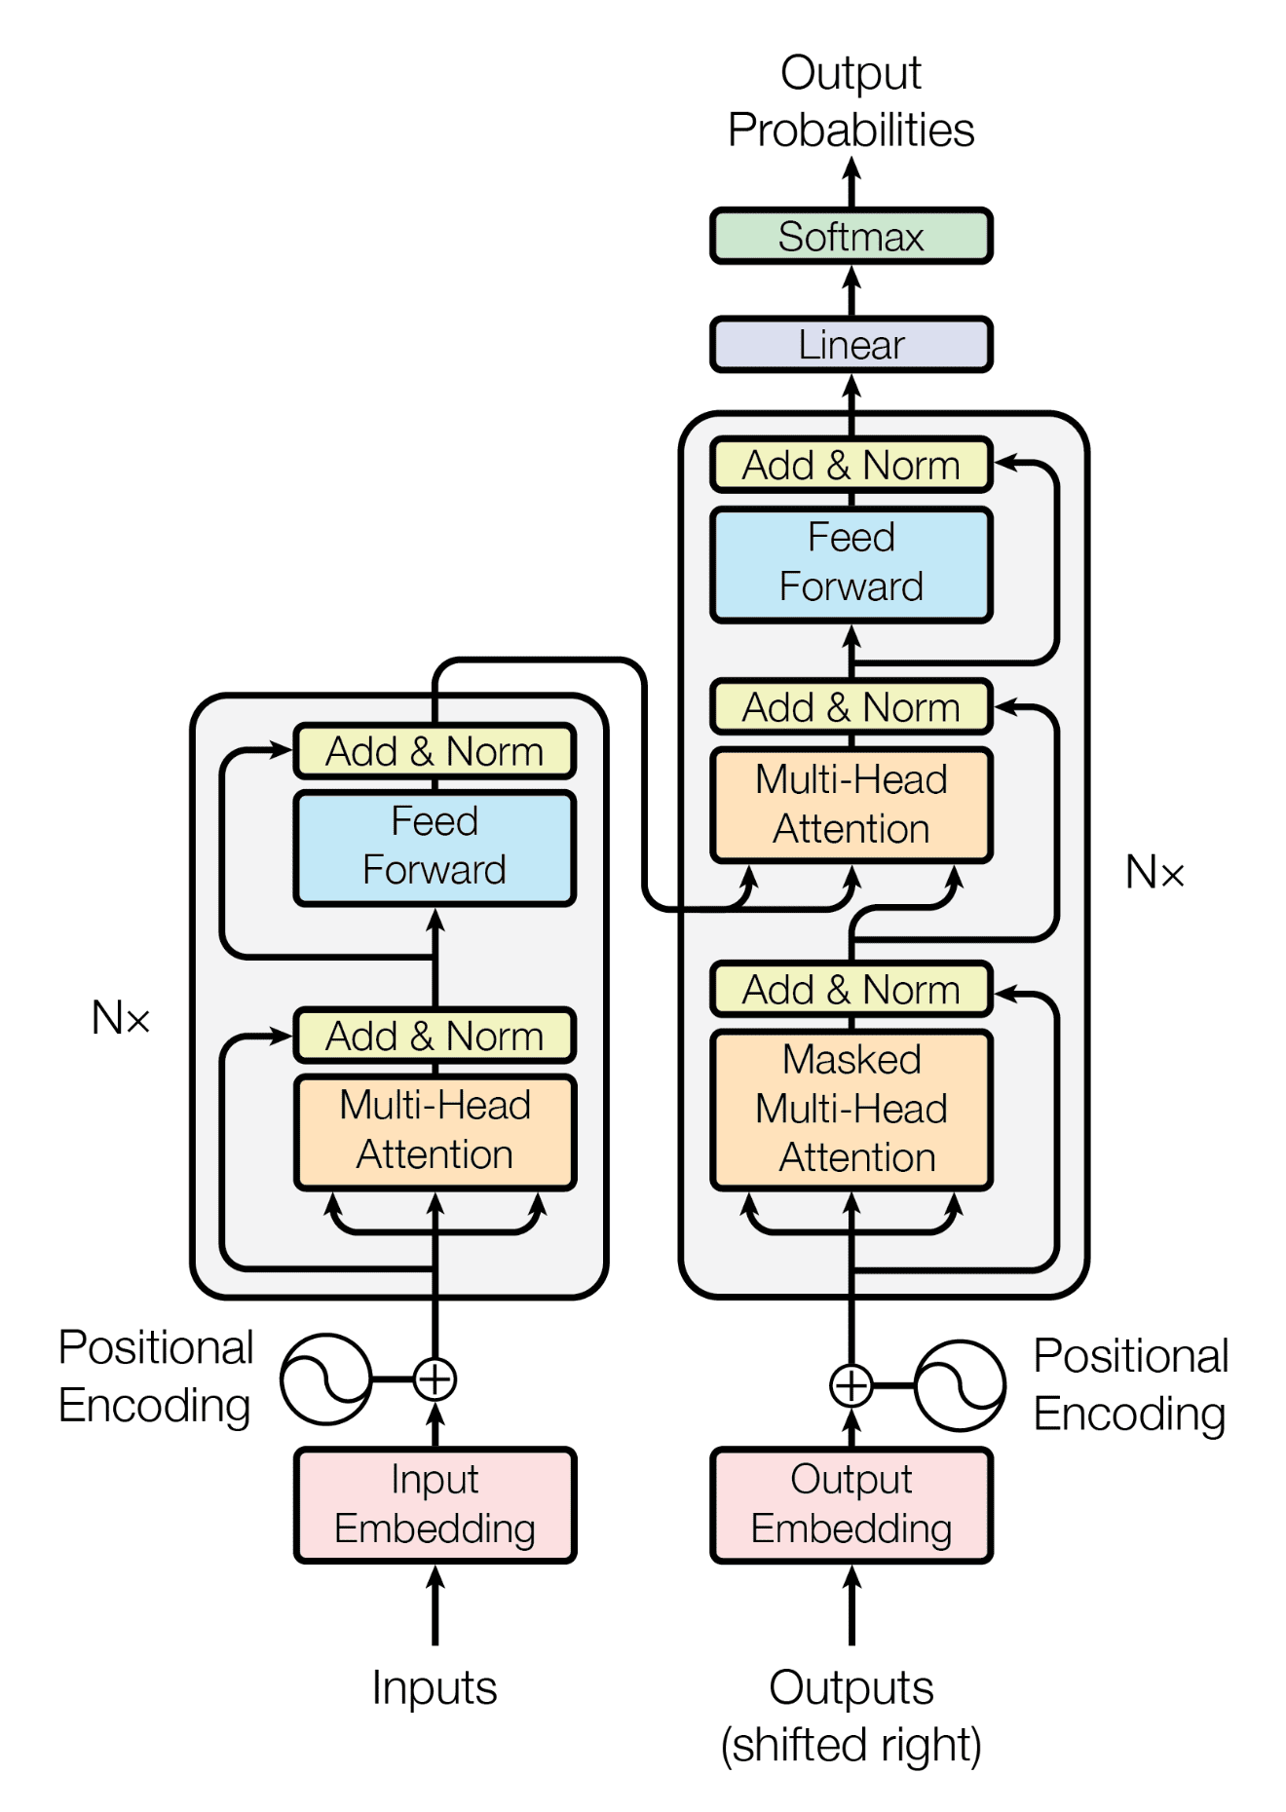
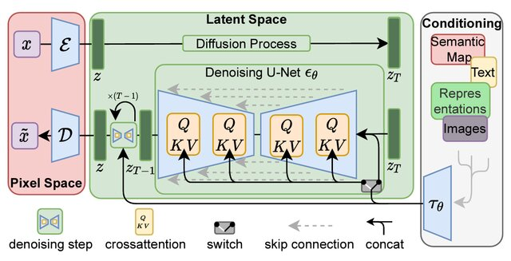
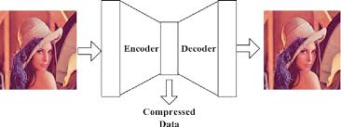
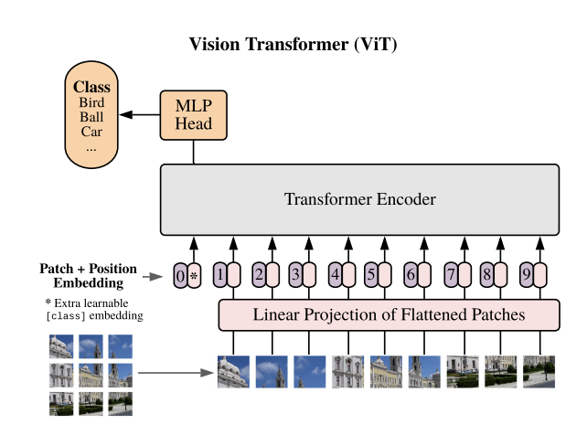
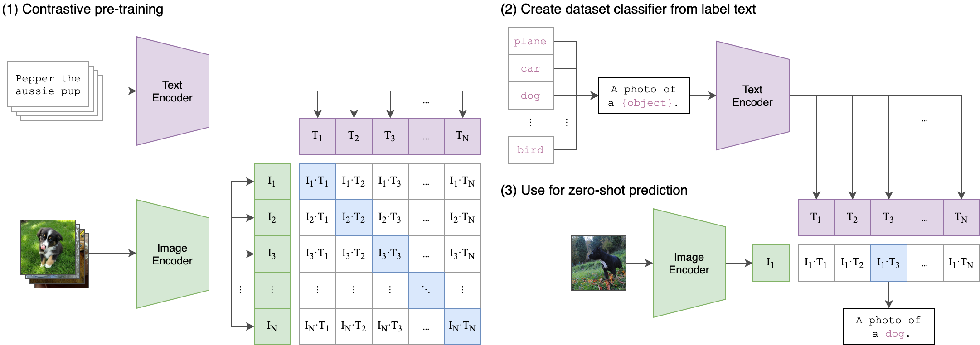
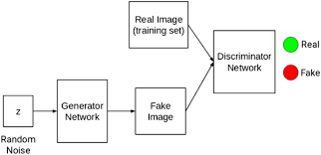
Are these Foundational Models?
Auto-encoders
GANs
Transformers
GPT
CLIP
Diffusion models
https://www.semanticscholar.org/paper/A-Better-Autoencoder-for-Image%3A-Convolutional-Zhang/b1786e74e233ac21f503f59d03f6af19a3699024
https://www.nature.com/articles/s41598-022-09929-9
https://paperswithcode.com/method/vision-transformer
https://openaccess.thecvf.com/content/CVPR2022/papers/Rombach_High-Resolution_Image_Synthesis_With_Latent_Diffusion_Models_CVPR_2022_paper.pdf
https://github.com/openai/CLIP
https://arxiv.org/abs/1706.03762

