Slide 1
Online Experiments
Causality, Decision Making, and Data Science
Lecture 5

Slide 2
Announcements
HW1 part 2 due Monday 10/13!

Slide 3
Agenda
Recap: Randomized Experiments
Today: Online Experiments

Slide 4
Recap

Slide 5
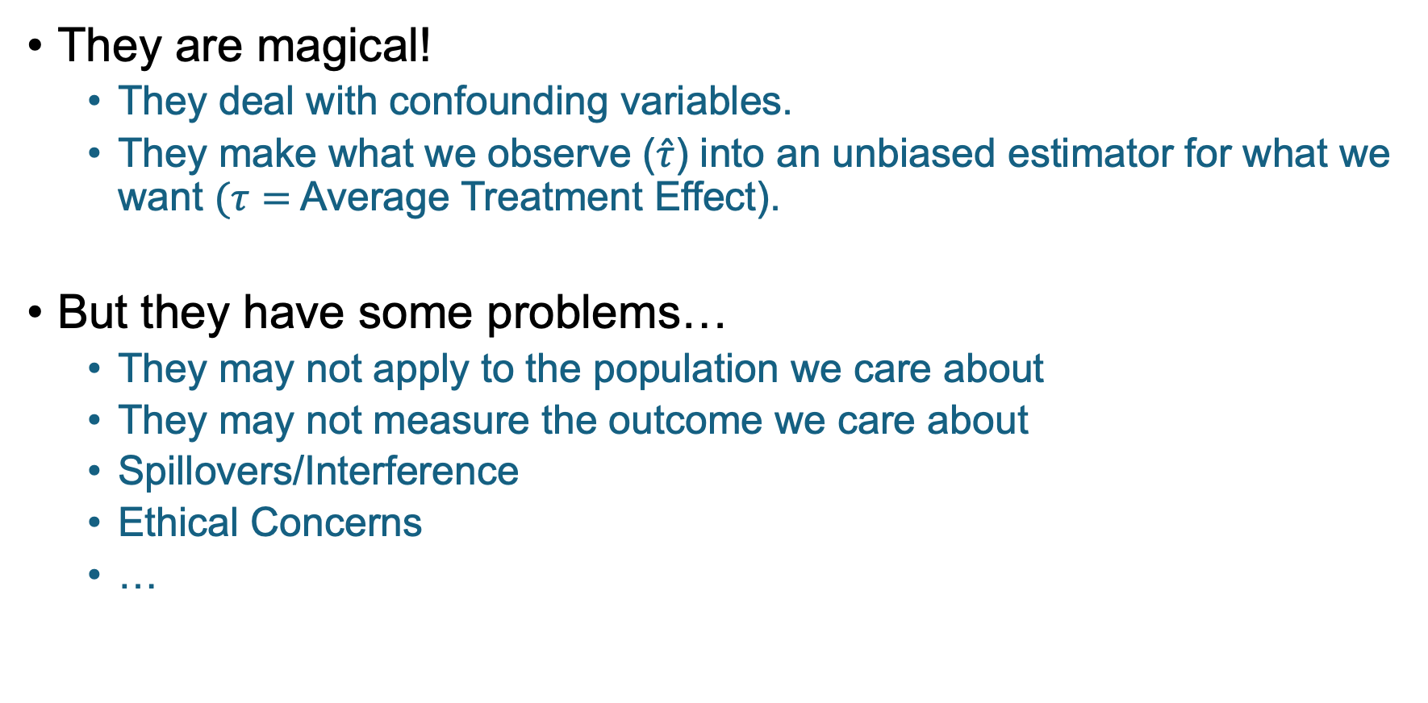
Randomized Experiments
They are magical!
They deal with confounding variables.
They make what we observe ($\hat{τ}$) into an unbiased estimator for what we want $(τ=$ Average Treatment Effect).
But they have some problems…
They may not apply to the population we care about
They may not measure the outcome we care about
Spillovers/Interference
Ethical Concerns
…

Slide 6
What more could we ask for?

Slide 7

Lots of ways to do “advanced” experiments!
Multi-Armed Bandits and Online Experiments
Stratified Experiments
Matched Pair Experiments
Clustered Experiments
Cross-Over Experiments
Multiple-Randomization Experiments
Bipartite Graph Experiments
Latin Squares
Equilibrium Experiments
…
That’s a lot! We can’t cover all of these, so we’ll just pick one.
But feel free to ask us (or the internet) about these other buzzwords!

Slide 8
Motivation
For online experiments

Slide 9
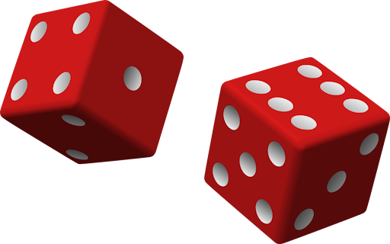
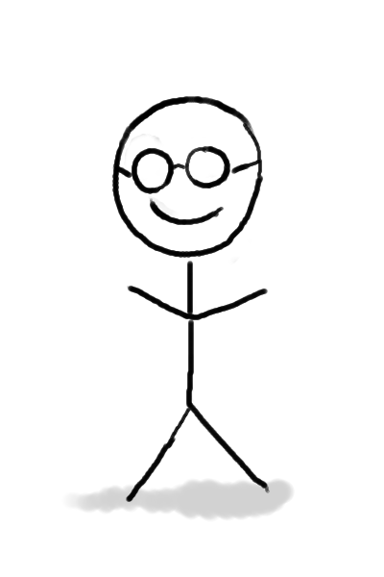
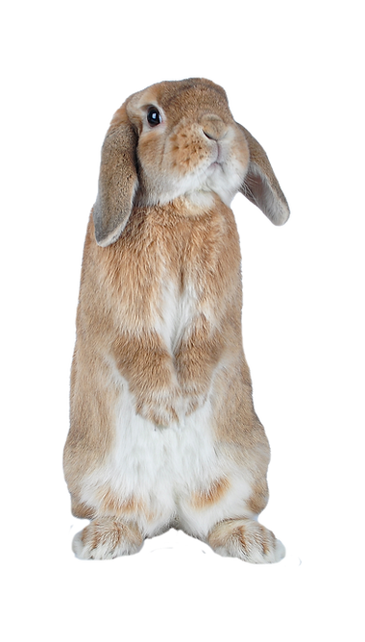
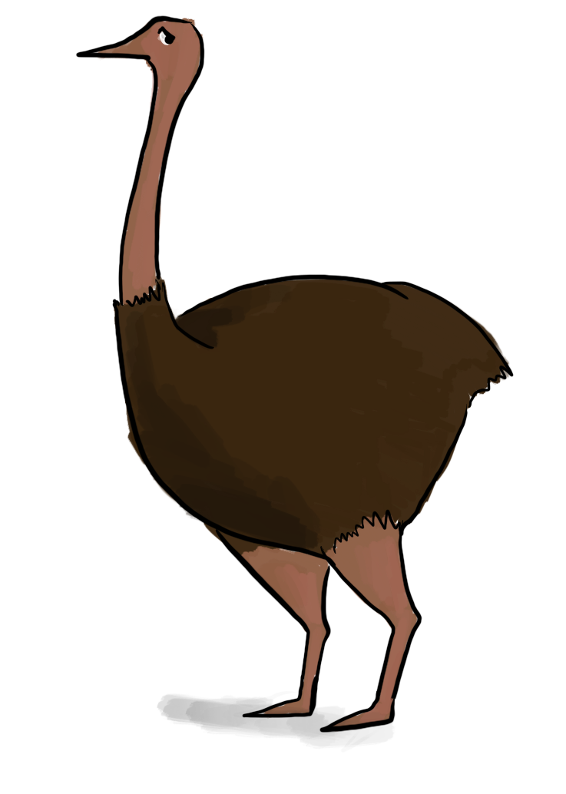
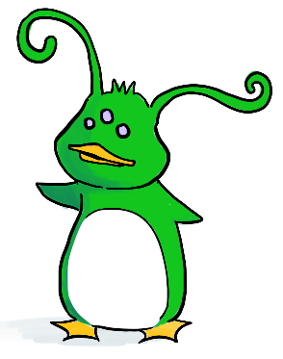
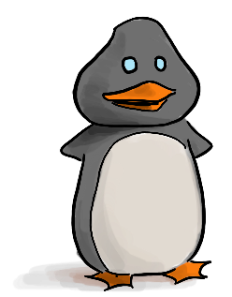
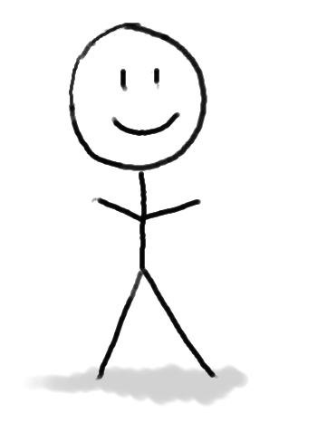
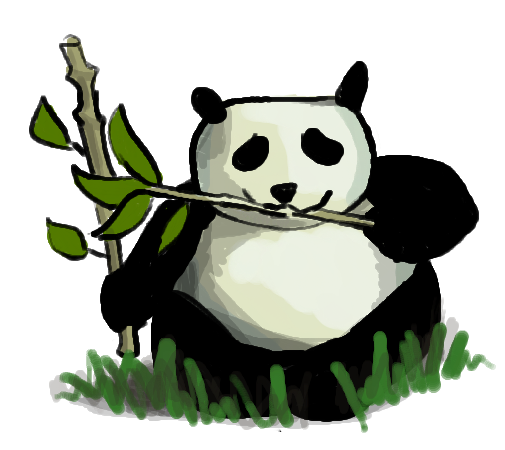

From your pre-lecture response
RCT to study a drug
See the outcome for person $i$ before assigning person $i+1$to control/treatment.
Treatment!
Treatment!
Control!
Control!
…
🙂
🤕
🙂
🤕

Slide 10
From your pre-lecture response
RCT to study a drug
See the outcome for person $i$ before assigning person $i+1$to control/treatment.
Treatment!
Treatment!
Control!
Control!
…
🙂
🤕
🙂
🤕
At some point, should we stop the study? Or adapt in some other way?

Slide 11
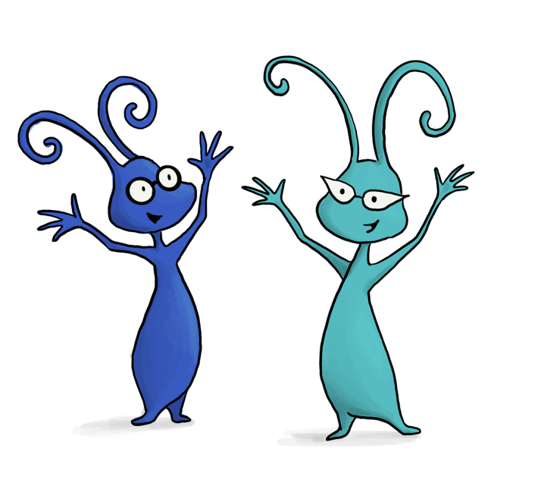
More generally What does adaptivity buy us?
Suppose our goal is to help as many people as possible.
Can we do better with an adaptive/online experiment?
You thought about this in your pre-lecture response – share your answer with your neighbors!
Discuss!
Don’t try to figure out a particular algorithm -- we’ll do that later. Just try to think about the big ideas that might be involved.

Slide 12
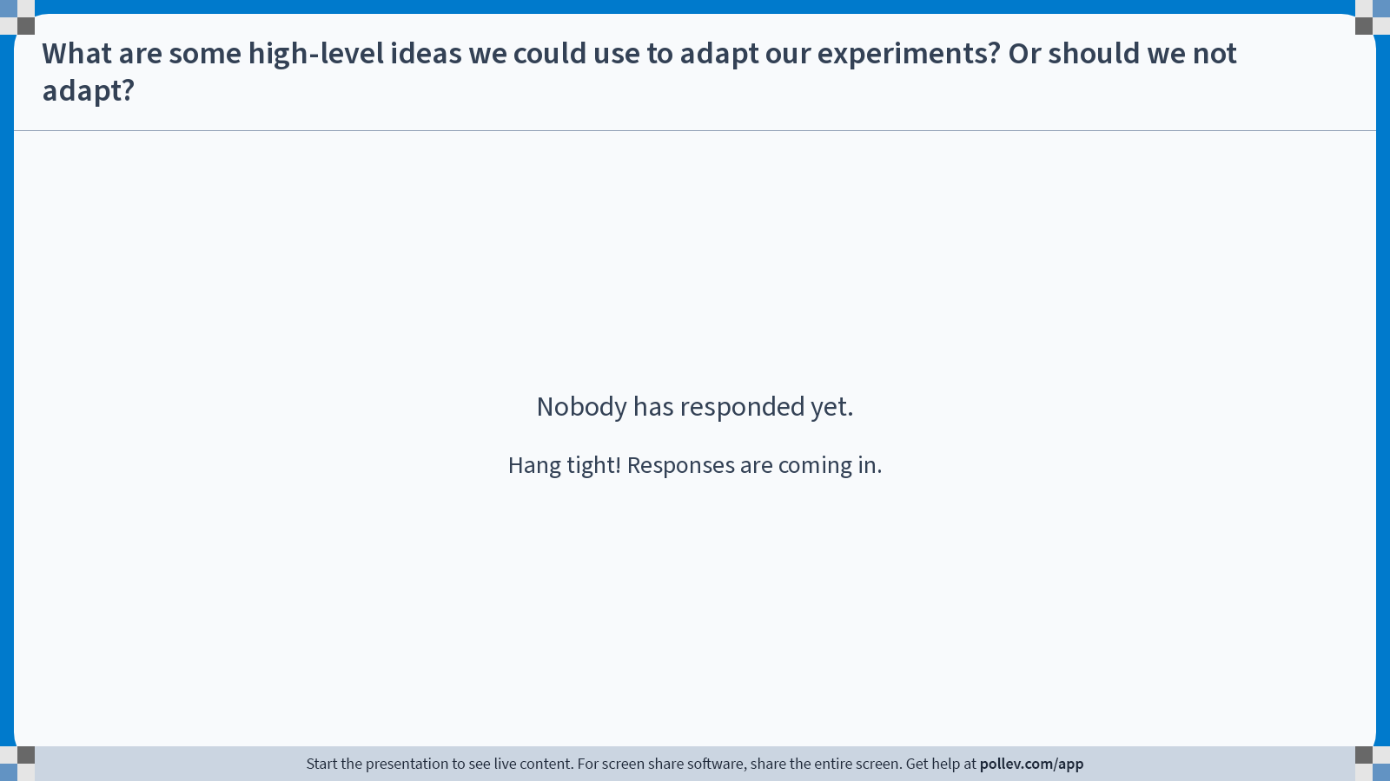
Notes:
Do not modify the notes in this section to avoid tampering with the Poll Everywhere activity. More info at polleverywhere.com/support What are some high-level ideas we could use to adapt our experiments? Or should we not adapt?
https://www.polleverywhere.com/discourses/da5De1uIDV4lc6I29UNL8

Slide 13
Some reasonable ideas
Run the RCT as normal, but stop once your experiment has a small enough p-value or something like that.
Over time, change the probability that someone is assigned to treatment vs control.
As ”treatment” seems better and better, assign people to “treatment” with higher probability.
We’ll come back to good ways to do this later today! But first…

Slide 14
Online Experiments and where they show up

Slide 15
Where else could online experiments show up?
Key criterion: past outcomes can influence future decisions.
Discuss!

Slide 16
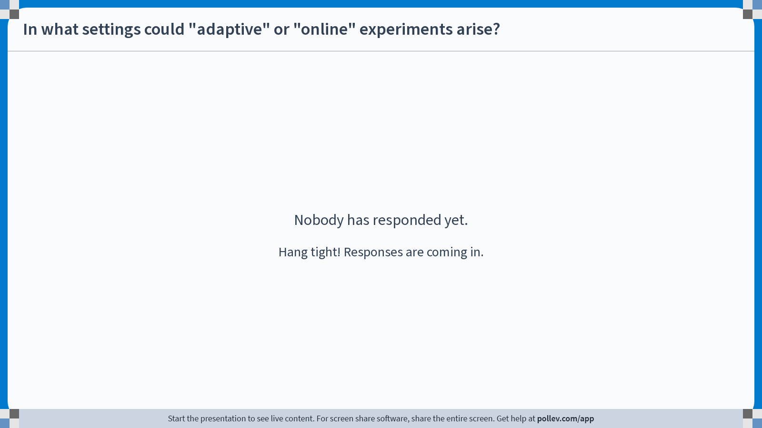
Notes:
Do not modify the notes in this section to avoid tampering with the Poll Everywhere activity. More info at polleverywhere.com/support In what settings could "adaptive" or "online" experiments arise?
https://www.polleverywhere.com/free_text_polls/6BMOjJhjMHvAXOpDrKCAZ

Slide 17
A few of many many examples
Adaptive Clinical trials (our earlier example)
Fundraising: which solicitation leads to the most donations?
Advertising: which ad yields the most clicks?
Robotics: which action leads to the desired result?
Website design: which design choice do users like best?
Education (or any) policy: which interventions are most effective?
Digital health apps: which nudges are most effective?
Video games: which difficulty level / rewards maximize player engagement?
Online learning: which calculus exercises are most helpful for students?
Etc…

Slide 18
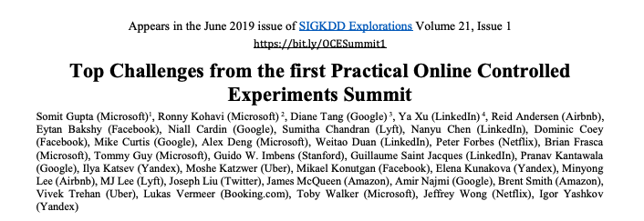
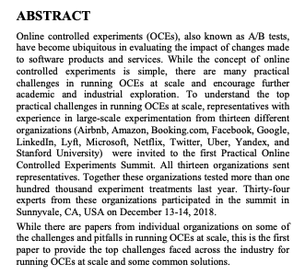
Tech companies do this a lot
“Together these organizations tested more than 100,000 experiment treatments last year”

Slide 19
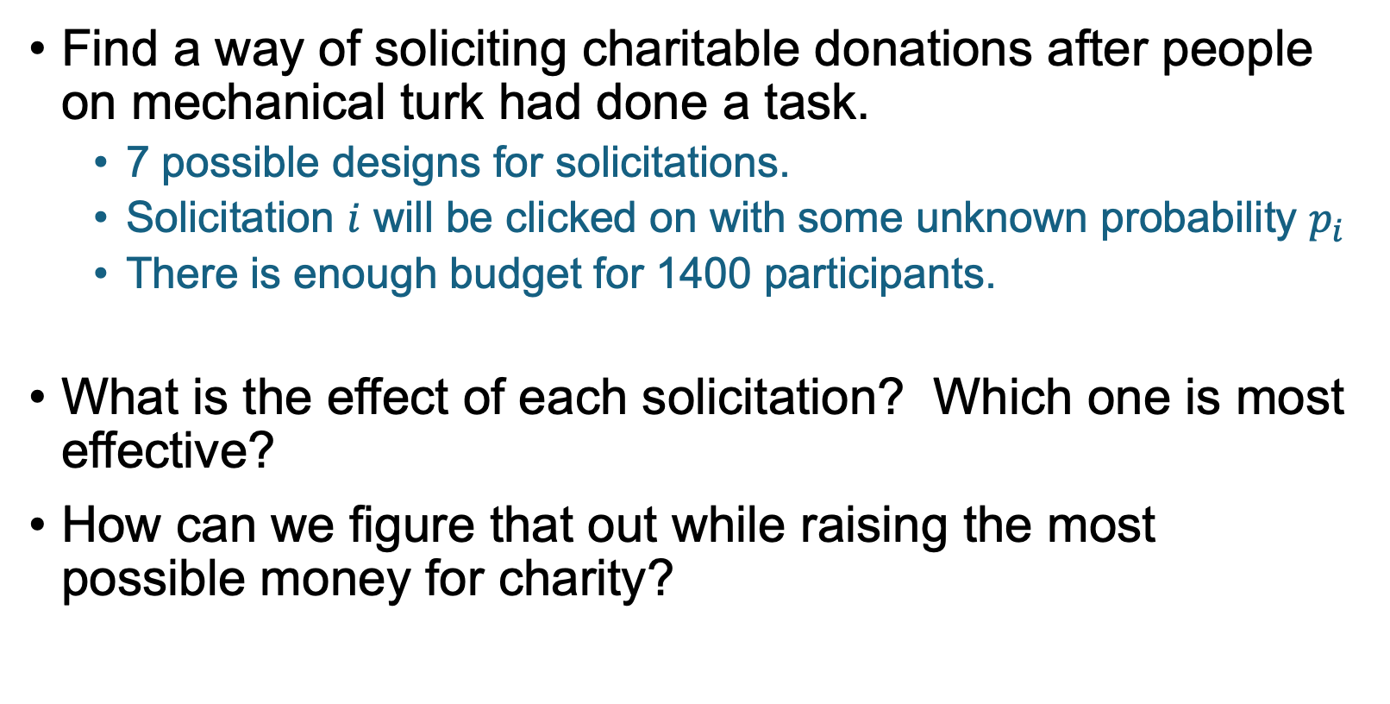
Example (from an MBA class Guido taught)
Find a way of soliciting charitable donations after people on mechanical turk had done a task.
7 possible designs for solicitations.
Solicitation $i$ will be clicked on with some unknown probability $p_{i}$
There is enough budget for 1400 participants.
What is the effect of each solicitation? Which one is most effective?
How can we figure that out while raising the most possible money for charity?

Slide 20
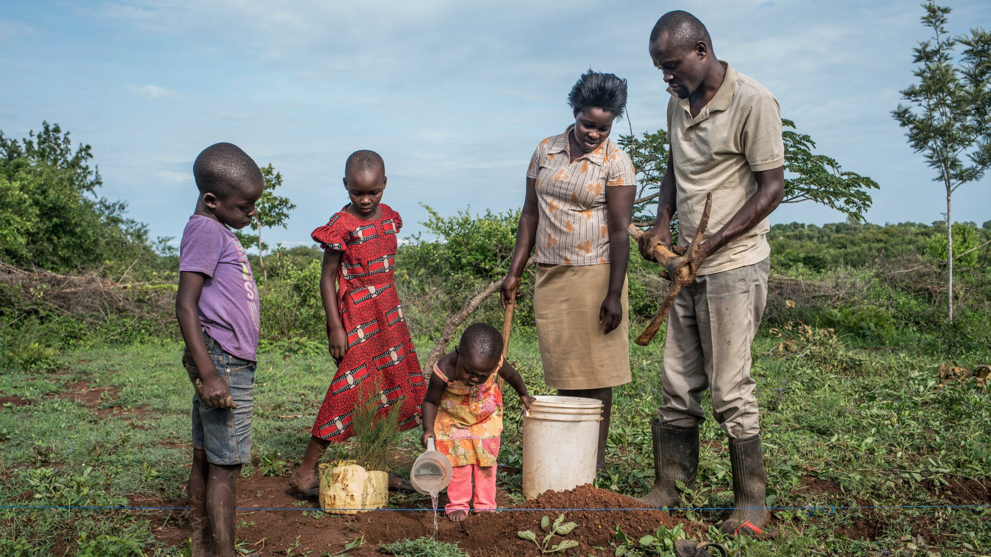
Example: One of the 7 solicitations
4 out of 5 survey respondents donate their bonus to GiveDirectly - join them in providing support to families in extreme poverty.
GiveDirectly, a top-rated charity, works tirelessly to provide aid to vulnerable people worldwide, and expands access to food, medicine, water, education, and more. GiveDirectly is recommended by leading global aid organizations such as USAID, Google.org, and the Global Innovation Fund. Any contribution will go a long way.
Yes, donate my bonus (approximately 1.4 meals).
No, keep my $0.35 bonus.

Slide 21
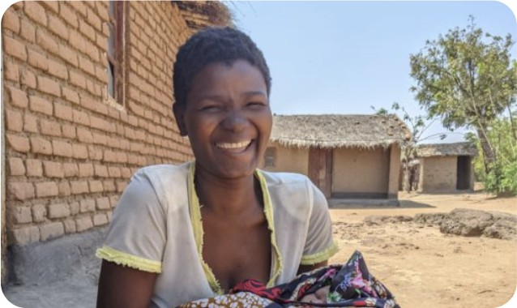
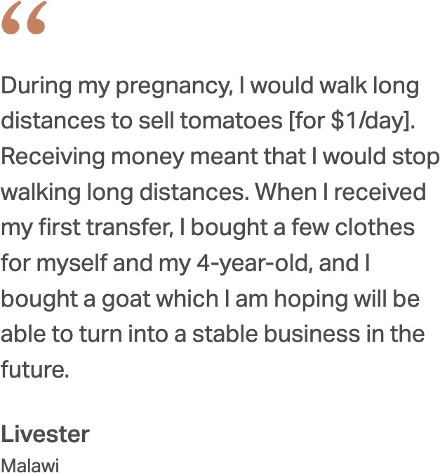
Another one
Thank you very much for completing this survey! We are working with GiveDirectly, a charity, to help raise money for impoverished parents in sub-Saharan Africa. To that end, you have been granted a supplement of $0.35 which you can give to mothers like Livester.
Would you like to pass on the $0.35 supplement to help moms like Livester?
Pass it on to charity (80% of survey participants have chosen this)
Take the supplement for yourself
Based on extensive field research and on GiveDirectly’s own experience, people use cash on what they need the most: medicine; cows and goats and chickens; school fees; water; solar lights; tin roofs; irrigation; motorcycles to jumpstart taxi services; businesses to generate income; and more.

Slide 22
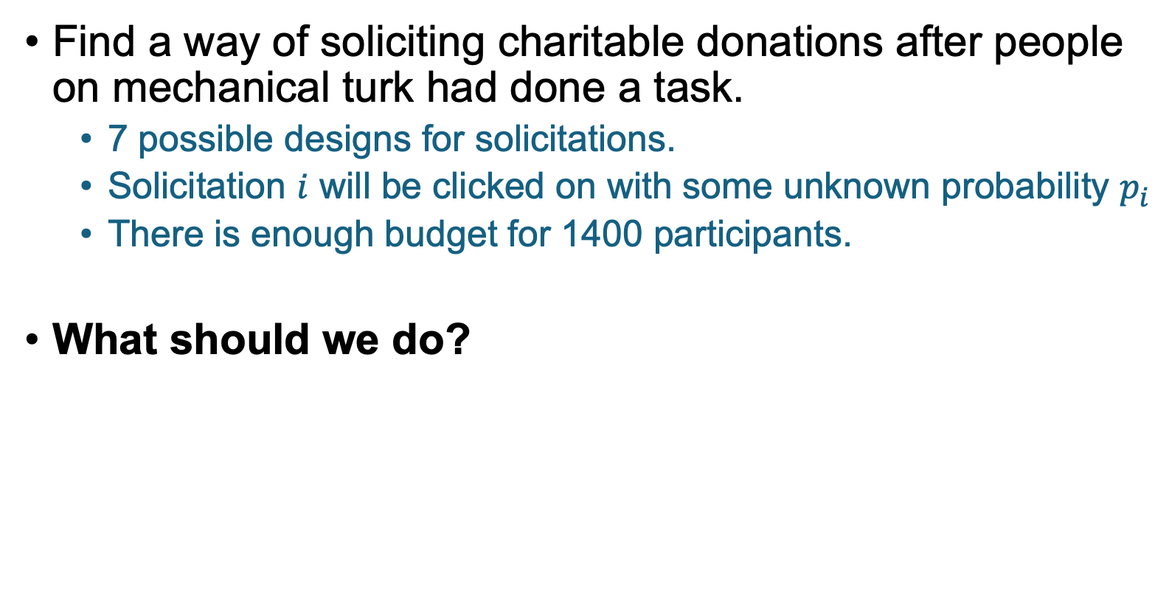
Example (from an MBA class Guido taught)
Find a way of soliciting charitable donations after people on mechanical turk had done a task.
7 possible designs for solicitations.
Solicitation $i$ will be clicked on with some unknown probability $p_{i}$
There is enough budget for 1400 participants.
What should we do?
Discuss: Come up with a candidate algorithm!

Slide 23
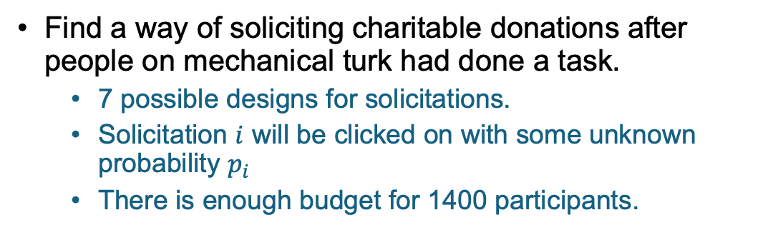
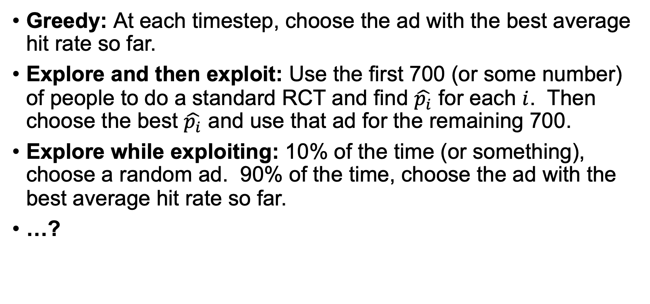
Some ideas
Find a way of soliciting charitable donations after people on mechanical turk had done a task.
7 possible designs for solicitations.
Solicitation $i$ will be clicked on with some unknown probability $p_{i}$
There is enough budget for 1400 participants.
Greedy: At each timestep, choose the ad with the best average hit rate so far.
Explore and then exploit: Use the first 700 (or some number) of people to do a standard RCT and find $\hat{p_{i}}$ for each $i$. Then choose the best $\hat{p_{i}}$ and use that ad for the remaining 700.
Explore while exploiting: 10% of the time (or something), choose a random ad. 90% of the time, choose the ad with the best average hit rate so far.
…?

Slide 24
Multi-Armed Bandits

Slide 25
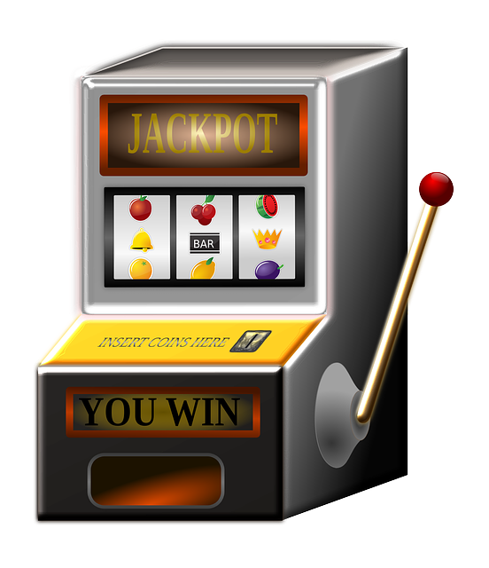
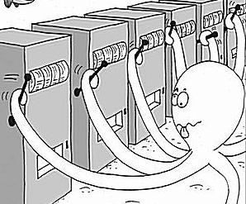
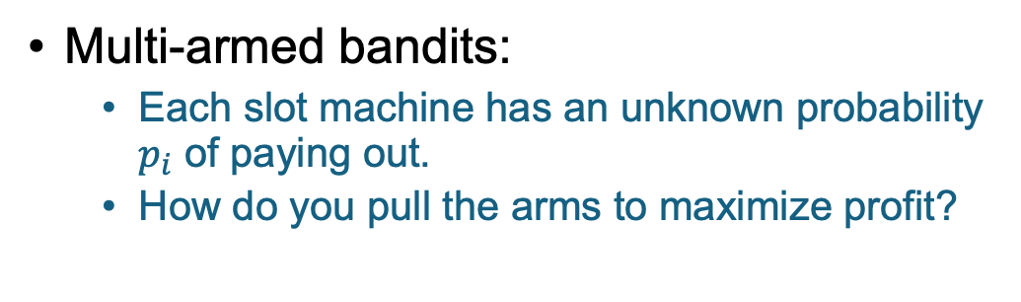
What does this have to do with “bandits”?
“One-armed bandit” is slang for a slot machine.
Multi-armed bandits:
Each slot machine has an unknown probability $p_{i}$ of paying out.
How do you pull the arms to maximize profit?

Slide 26
What does this have to do with “bandits”?
There’s a trade-off between exploring (learning the probabilities) and exploiting (pulling the best arm)
“One-armed bandit” is slang for a slot machine.
Multi-armed bandits:
Each slot machine has an unknown probability $p_{i}$ of paying out.
How do you pull the arms to maximize profit?

Slide 27
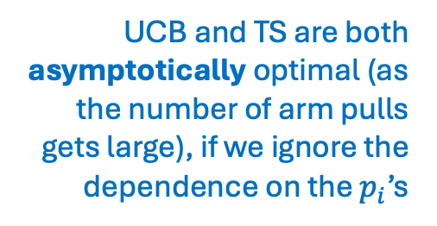
Algorithms for Multi-Armed Bandits
We’ll discuss three:
Greedy (as a straw man)
Upper Confidence Bounds (UCB)
Thompson Sampling (TS)
Greedy isn’t a great idea
Both UCB and TS are (probably) pretty good.
UCB and TS are both asymptotically optimal (as the number of arm pulls gets large), if we ignore the dependence on the $p_{i}$’s

Slide 28
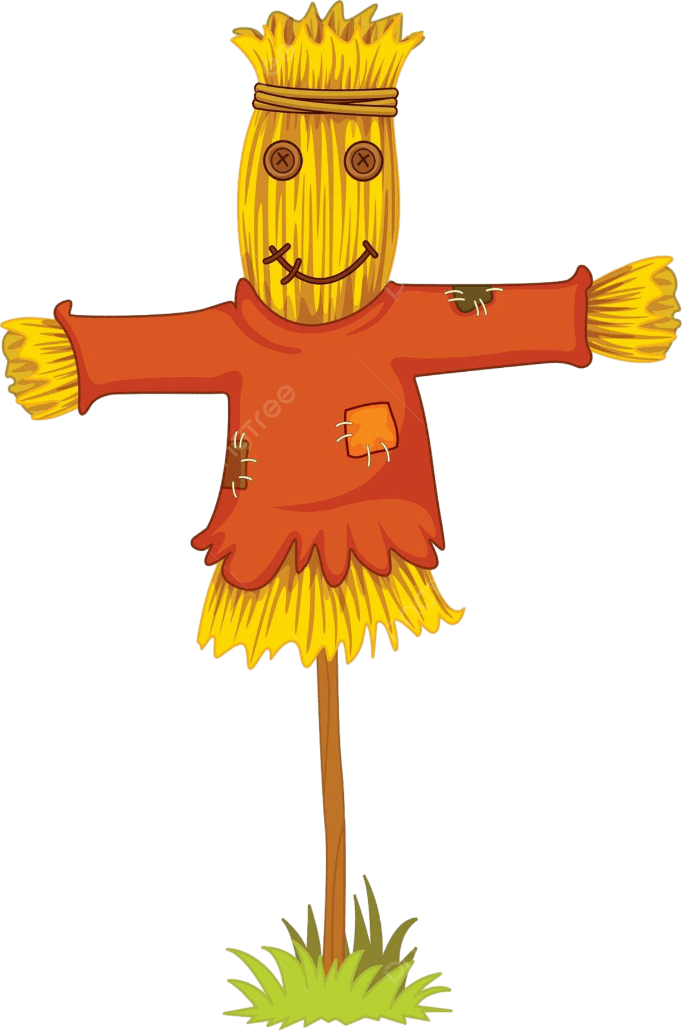
Straw-Man: Greedy Algorithm
“Straw-man” here means “easy baseline that we can compare to.”

Slide 29
Greedy Algorithm
Pull each arm once to get started.
Then choose the arm with the best average so far.

Slide 30



Greedy Algorithm
Show each ad once to get started.
Each time after that, choose the ad with the best average so far.
Example:
$$p_{1}=\frac{2}{3}$$
$$p_{2}=\frac{1}{2}$$
$$p_{3}=\frac{1}{3}$$
What could go wrong with this strategy?

Slide 31
Greedy Algorithm
Show each ad once to get started.
Each time after that, choose the ad with the best average so far.
Example:
$$p_{1}=\frac{2}{3}$$
$$p_{2}=\frac{1}{2}$$
$$p_{3}=\frac{1}{3}$$
What could go wrong with this strategy?
About 1/3 of the time, when we first show Ad 1, we get zero reward.
Then we’ll likely never show Ad 1 again.

Slide 32
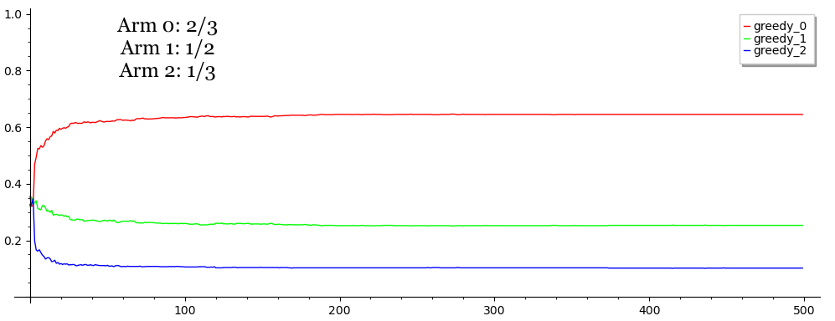

Let’s try it!
$$p_{1}=\frac{2}{3}$$
$$p_{2}=\frac{1}{2}$$
$$p_{3}=\frac{1}{3}$$
Run the greedy algorithm 1000 times, with a budget of 500 ads.
In what fraction of the 1000 runs does the algorithm show the best ad (Ad 1) at any particular time t?
No matter how long the algorithm runs for, the probability that it chooses the Ad 1 is less than 0.62…
Fraction of the time each ad is used
Ad 1
Ad 2
Ad 3
Time $t$

Slide 33
Upper Confidence Bound Algorithm (UCB)

Slide 34

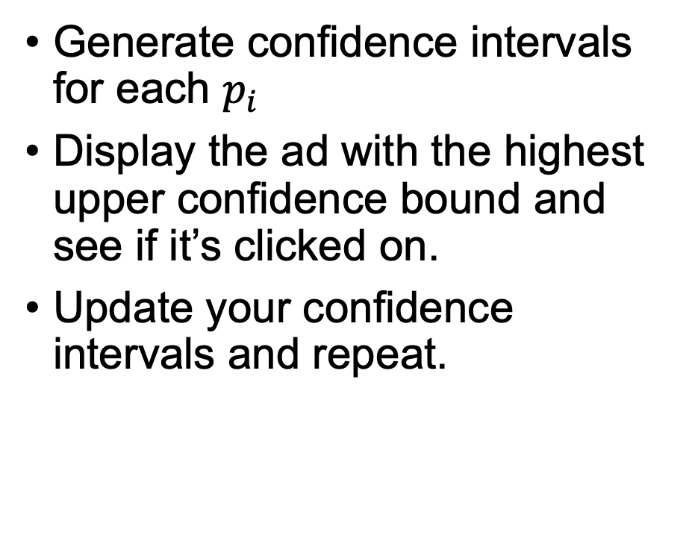




Upper Confidence Bound (UCB) Basic idea
0
1
Generate confidence intervals for each $p_{i}$
Display the ad with the highest upper confidence bound and see if it’s clicked on.
Update your confidence intervals and repeat.
$$p_{1}$$
0
1
$$p_{2}$$
0
1
$$p_{3}$$
0
1
$$p_{4}$$
0
1
$$p_{5}$$

Slide 35



UCB Example
$$p_{1}=\frac{2}{3}$$
$$p_{2}=\frac{1}{2}$$
$$p_{3}=\frac{1}{3}$$
Say there are three ads:

Slide 36
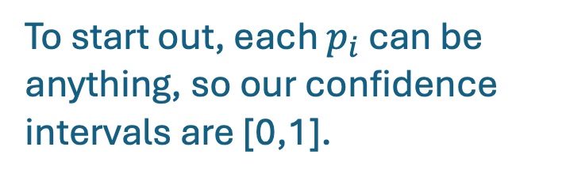



UCB Example
$$p_{1}=\frac{2}{3}$$
$$p_{2}=\frac{1}{2}$$
$$p_{3}=\frac{1}{3}$$
Say there are three ads:
0
1
$$p_{1}$$
To start out, each $p_{i}$ can be anything, so our confidence intervals are [0,1].
0
1
$$p_{2}$$
0
1
$$p_{3}$$
* To start, it’s a good idea to try each arm once or a few times, but we’ll ignore that for this example.

Slide 37
UCB Example
$$p_{1}=\frac{2}{3}$$
$$p_{2}=\frac{1}{2}$$
$$p_{3}=\frac{1}{3}$$
Say there are three ads:
0
1
Show Ad 1.
Let’s say that the user doesn’t donate.
$$p_{1}$$
0
1
$$p_{2}$$
0
1
$$p_{3}$$

Slide 38
UCB Example
$$p_{1}=\frac{2}{3}$$
$$p_{2}=\frac{1}{2}$$
$$p_{3}=\frac{1}{3}$$
Say there are three ads:
0
1
Show Ad 1.
Let’s say that the user doesn’t donate.
$$p_{1}$$
0
1
$$p_{2}$$
Update Ad 1’s confidence interval.
0
1
$$p_{3}$$

Slide 39
UCB Example
$$p_{1}=\frac{2}{3}$$
$$p_{2}=\frac{1}{2}$$
$$p_{3}=\frac{1}{3}$$
Say there are three ads:
0
1
Show an ad with the highest upper confidence bound, say Ad 2.
Say the user does donate.
$$p_{1}$$
0
1
$$p_{2}$$
0
1
$$p_{3}$$

Slide 40
UCB Example
$$p_{1}=\frac{2}{3}$$
$$p_{2}=\frac{1}{2}$$
$$p_{3}=\frac{1}{3}$$
Say there are three ads:
0
1
Show an ad with the highest upper confidence bound, say Ad 2.
Say the user does donate.
$$p_{1}$$
0
1
$$p_{2}$$
Update Ad 2’s confidence interval.
0
1
$$p_{3}$$

Slide 41
UCB Example
$$p_{1}=\frac{2}{3}$$
$$p_{2}=\frac{1}{2}$$
$$p_{3}=\frac{1}{3}$$
Say there are three ads:
0
1
Show an ad with the highest upper confidence bound, say Ad 2 again.
Say the user doesn’t donate.
$$p_{1}$$
0
1
$$p_{2}$$
0
1
$$p_{3}$$

Slide 42
UCB Example
$$p_{1}=\frac{2}{3}$$
$$p_{2}=\frac{1}{2}$$
$$p_{3}=\frac{1}{3}$$
Say there are three ads:
0
1
Show an ad with the highest upper confidence bound, say Ad 2 again.
Say the user doesn’t donate.
$$p_{1}$$
0
1
$$p_{2}$$
Update Ad 2’s confidence interval.
0
1
$$p_{3}$$

Slide 43
UCB Example
$$p_{1}=\frac{2}{3}$$
$$p_{2}=\frac{1}{2}$$
$$p_{3}=\frac{1}{3}$$
Say there are three ads:
(etc…)

Slide 44
UCB Example
$$p_{1}=\frac{2}{3}$$
$$p_{2}=\frac{1}{2}$$
$$p_{3}=\frac{1}{3}$$
Say there are three ads:
We’re pretty sure Ad 1’s average is about 2/3.
0
1
$$p_{1}$$
Eventually, the confidence intervals shrink enough that we’ll always choose the best ad (Ad 1).
0
1
$$p_{2}$$
0
1
$$p_{3}$$
We’ve tried Ads 2 and 3 enough times to be pretty sure that their average is below 2/3.

Slide 45

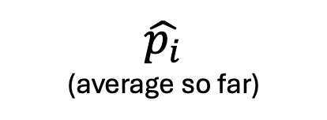

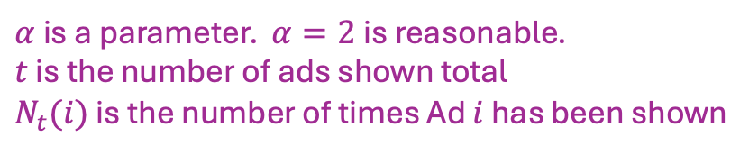
Aside: How do we compute the confidence intervals?
Don’t worry too much about the details, this slide is just here in case you want to implement UCB.
One way:
0
1
$\hat{p_{i}}$
(average so far)
Fact: there is $≈t^{−α}$ mass in the tails
So this is a $\left(1 −t^{−α}\right)$ confidence interval for $\hat{p_{i}}$.
$$\hat{p_{i}}±\sqrt{\frac{α⋅log\left(t\right)}{2 N_{t}(i)}}$$
Confidence interval:
$α$ is a parameter. $α=2$ is reasonable.
$t$ is the number of ads shown total
$N_{t}(i)$ is the number of times Ad $i$ has been shown

Slide 46
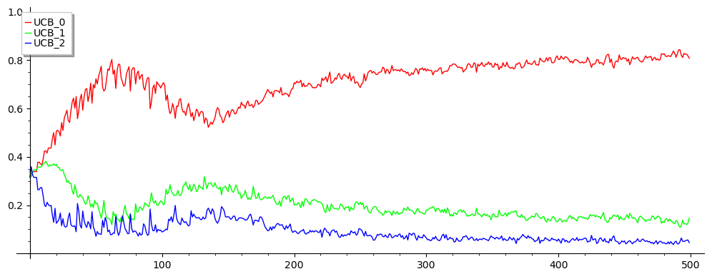


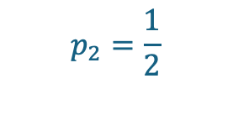
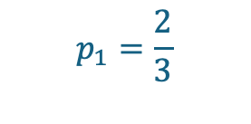
Let’s try it!
Greedy algorithm from before:
Ad 1
Ad 2
Ad 3
Same exercise as before…
1000 runs of UCB; how often is each arm picked?
$$p_{1}=\frac{2}{3}$$
$$p_{2}=\frac{1}{2}$$
$$p_{3}=\frac{1}{3}$$
Ad 1
Fraction of the time each ad is used
This is better! After 500 ads, UCB picks Ad 1 about 82% of the time, better than about 62% for greedy.
Ad 2
Ad 3
Time $t$

Slide 47
Thompson Sampling

Slide 48


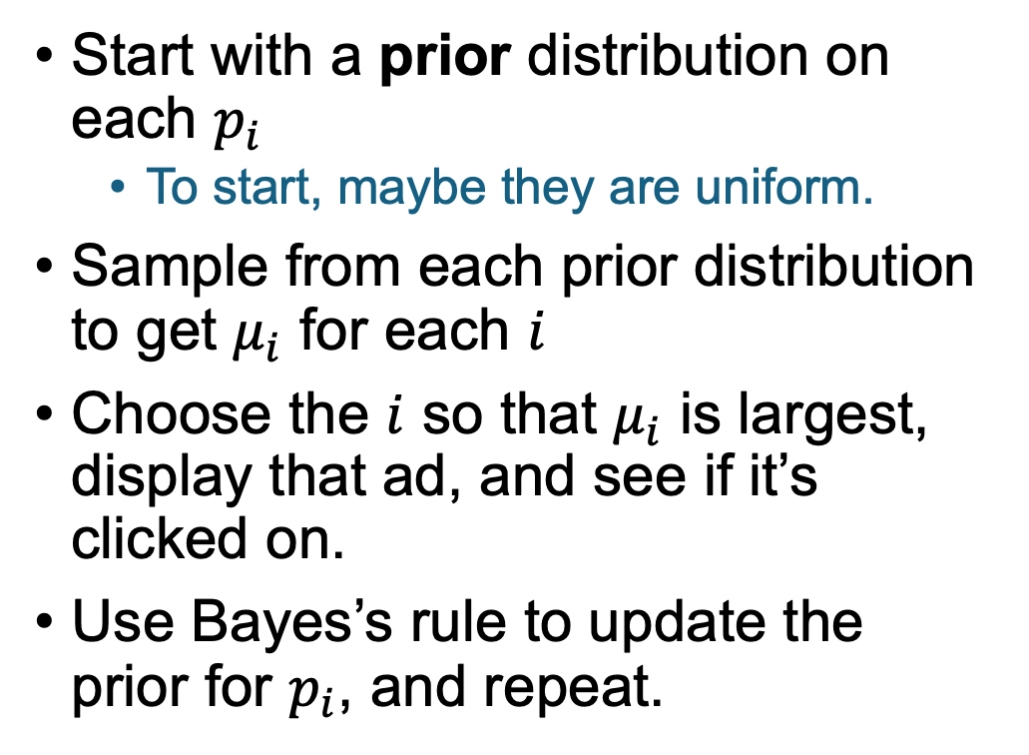








Thompson Sampling Basic idea
$$p_{1}$$
0
$$μ_{1}$$
1
Start with a prior distribution on each $p_{i}$
To start, maybe they are uniform.
Sample from each prior distribution to get $μ_{i}$ for each $i$
Choose the $i$ so that $μ_{i}$ is largest, display that ad, and see if it’s clicked on.
Use Bayes’s rule to update the prior for $p_{i}$, and repeat.
$$p_{2}$$
0
$$μ_{2}$$
1
$$p_{3}$$
0
$$μ_{3}$$
1
$$p_{4}$$
0
$$μ_{4}$$
1
$$p_{5}$$
0
$$μ_{5}$$
1

Slide 49
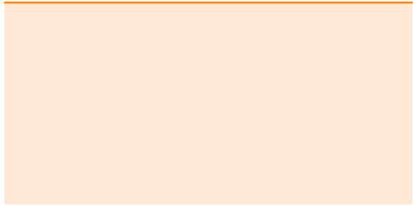






Thompson Sampling Example
$$p_{1}=\frac{2}{3}$$
$$p_{2}=\frac{1}{2}$$
$$p_{3}=\frac{1}{3}$$
Say there are three ads:
Start with the uniform distribution for each ad.
$$p_{1}$$
0
1
$$p_{2}$$
0
1
$$p_{3}$$
0
1

Slide 50
Thompson Sampling Example
$$p_{1}=\frac{2}{3}$$
$$p_{2}=\frac{1}{2}$$
$$p_{3}=\frac{1}{3}$$
Say there are three ads:
Now draw from each distribution and choose the largest.
$$p_{1}$$
0
1
$$p_{2}$$
0
1
$$p_{3}$$
0
1

Slide 51
Thompson Sampling Example
$$p_{1}=\frac{2}{3}$$
$$p_{2}=\frac{1}{2}$$
$$p_{3}=\frac{1}{3}$$
Say there are three ads:
Now draw from each distribution and choose the largest.
$$p_{1}$$
0
1
$$p_{2}$$
Say the user does not donate on Ad 3.
0
1
$$p_{3}$$
0
1

Slide 52
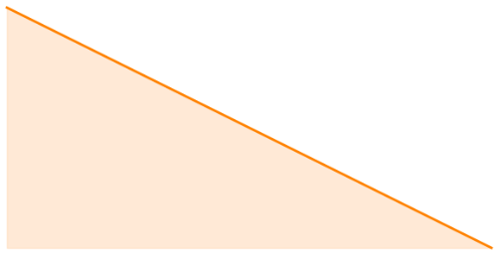
Thompson Sampling Example
$$p_{1}=\frac{2}{3}$$
$$p_{2}=\frac{1}{2}$$
$$p_{3}=\frac{1}{3}$$
Say there are three ads:
Now draw from each distribution and choose the largest.
$$p_{1}$$
0
1
$$p_{2}$$
Say the user does not donate on Ad 3.
0
1
Update Ad 3’s prior distribution.
$$p_{3}$$
0
1

Slide 53
Thompson Sampling Example
$$p_{1}=\frac{2}{3}$$
$$p_{2}=\frac{1}{2}$$
$$p_{3}=\frac{1}{3}$$
Say there are three ads:
Draw from each distribution and choose the largest.
$$p_{1}$$
0
1
$$p_{2}$$
0
1
$$p_{3}$$
0
1

Slide 54
Thompson Sampling Example
$$p_{1}=\frac{2}{3}$$
$$p_{2}=\frac{1}{2}$$
$$p_{3}=\frac{1}{3}$$
Say there are three ads:
Draw from each distribution and choose the largest.
$$p_{1}$$
0
1
Say the user does donate on Ad 1.
$$p_{2}$$
0
1
$$p_{3}$$
0
1

Slide 55
Thompson Sampling Example
$$p_{1}=\frac{2}{3}$$
$$p_{2}=\frac{1}{2}$$
$$p_{3}=\frac{1}{3}$$
Say there are three ads:
Draw from each distribution and choose the largest.
$$p_{1}$$
0
1
Say the user does donate on Ad 1.
$$p_{2}$$
0
1
Update Ad 1’s prior distribution.
$$p_{3}$$
0
1

Slide 56
Thompson Sampling Example
$$p_{1}=\frac{2}{3}$$
$$p_{2}=\frac{1}{2}$$
$$p_{3}=\frac{1}{3}$$
Say there are three ads:
Draw from each distribution and choose the largest.
$$p_{1}$$
0
1
$$p_{2}$$
0
1
$$p_{3}$$
0
1

Slide 57

Thompson Sampling Example
$$p_{1}=\frac{2}{3}$$
$$p_{2}=\frac{1}{2}$$
$$p_{3}=\frac{1}{3}$$
Say there are three ads:
Draw from each distribution and choose the largest.
$$p_{1}$$
0
1
Say the user does not donate on Ad 1.
$$p_{2}$$
0
1
Update Ad 1’s prior distribution.
$$p_{3}$$
0
1

Slide 58
Thompson Sampling Example
$$p_{1}=\frac{2}{3}$$
$$p_{2}=\frac{1}{2}$$
$$p_{3}=\frac{1}{3}$$
Say there are three ads:
(etc…)

Slide 59



Thompson Sampling Example
$$p_{1}=\frac{2}{3}$$
$$p_{2}=\frac{1}{2}$$
$$p_{3}=\frac{1}{3}$$
Say there are three ads:
Eventually, our priors are somewhat concentrated around the actual values.
$$p_{1}$$
0
1
$$p_{2}$$
0
1
As time goes on, we are more likely to choose the arm that we think is better.
$$p_{3}$$
0
1
*Note: these distributions are what I got on one run of TS, after running for t=500 total ads.

Slide 60






Aside: How do we update the distributions?
Don’t worry too much about the details, this slide is just here in case you want to implement TS.
$$(α=6,β=8)$$
Short answer: Bayes rule!
Longer answer: we still need to make some assumptions about the form of the distribution.
It is mathematically convenient to choose a Beta distribution.
Has two parameters, $α$ and $β$.
Suppose that Ad $i$’s prior is $(α,β)$
If Ad $i$ is successful, the prior becomes $(α+1,β)$
Otherwise, the prior becomes $(α,β+1)$
$$(α=6,β=9)$$
$$β($$
$$(α=7,β=8)$$

Slide 61

Let’s try it!
Greedy:
Ad 1
Ad 2
Ad 3
Same exercise as before…
1000 runs of UCB; how often is each arm picked?
$$p_{1}=\frac{2}{3}$$
$$p_{2}=\frac{1}{2}$$
$$p_{3}=\frac{1}{3}$$
Ad 1
Fraction of the time each ad is used
This is even better! After 500 ads, Thompson Sampling picks Ad 1 almost all the time!
Ad 2
Ad 3
Time $t$

Slide 62
But wait, there’s more!

Slide 63

Lots fancier bandits!
Generative AI’s take on “fancy bandit”
(Apparently fancy bandits can levitate teacups)
Real-Valued payoffs
In our examples, the outcomes are binary (donate or not)
This is called “Bernoulli Bandits”
In lots of situations, the rewards are real-valued.
Contextual Bandits
Multi-armed bandits where the reward from each arm differs over time, related to some context the experimenter can see.
Combinatorial Bandits
Each round, we choose a subset of arms, instead of a single arm.
Continuum-Armed Bandits
Instead of just 3 or 7 or 10000 arms, there is a continuum of arms to choose from.
Etc…
(Want to learn more? Take MS&E 237A: Bandit Learning!)
Notes:
Both UCB and TS generalize to real-valued payoffs: with UCB you need some sort of concentration on the rewards to make confidence intervals; and with TS you define your prior for the reward distribution.
Both generalize to contextual bandits to some extent: UCB can extend to linear contextual bandits (where rewards are linear functions of the context + noise). TS extends naturally, your priors are parameterized by the context.

Slide 64
Recap and Looking Ahead

Slide 65
Recap
Sometimes, we get to do experiments “adaptively” or “online.”
This lets us do better than we can non-adaptively/offline.
In clinical trials, don’t give people medicine that probably won’t work
In advertising/fundraising, don’t waste ad budget on ineffective ads
… all while efficiently learning which medicines/ads/etc do work!
UCB and Thompson Sampling:
Two algorithms that (near-)optimally balance exploration and exploitation.

Slide 66
Looking ahead
Next week we’ll start Module 2: The effects of Universal Basic Income!

Slide 67


Exit ticket
Don’t forget to fill out the exit ticket before you leave class!

