Slide 1
The Magic of Randomized Control Trials
Causality, Decision Making, and Data Science
Lecture 3

Slide 2
Announcements
Part 1 of HW1 is due on Monday Oct 6, 11:59pm
Part 2 is HW1 due on Monday Oct 13, 11:59pm
Don’t forget to fill out the exit ticket before you leave class!

Slide 3
Agenda
Quick Recap
The Magic of Randomized Control Trials (RCTs)
Example: Laptops in classrooms
Analyzing RCTs

Slide 4
Quick Recap!

Slide 5
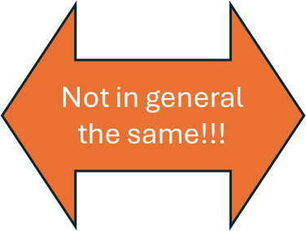
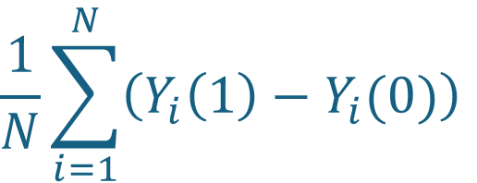
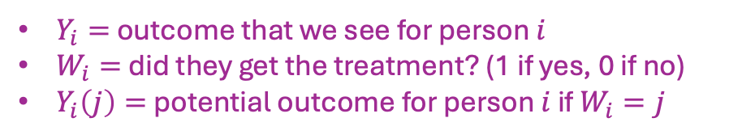
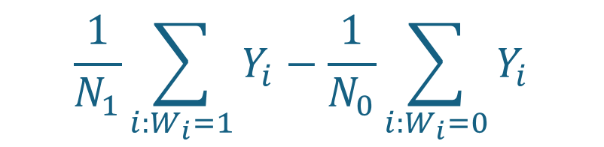
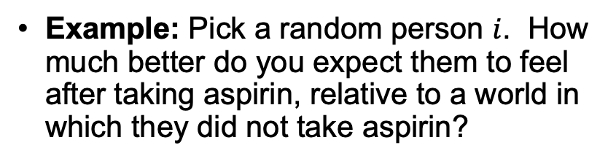
Recap from last time
$Y_{i}=$ outcome that we see for person $i$
$W_{i}=$ did they get the treatment? (1 if yes, 0 if no)
$Y_{i}\left(j\right)=$ potential outcome for person $i$ if $W_{i}=j$
What we want: Average Treatment Effect (ATE) ``causal’’
What we have: Observational Comparison ``correlation’’
$$\frac{1}{N}\sum_{i=1}^{N}{\left(Y_{i}\left(1\right)−Y_{i}(0)\right)}$$
$$\frac{1}{N_{1}}\sum_{i:W_{i}=1}{Y_{i}}−\frac{1}{N_{0}}\sum_{i:W_{i}=0}{Y_{i}}$$
Example: Pick a random person $i$. How much better do you expect them to feel after taking aspirin, relative to a world in which they did not take aspirin?
Example: Pick a random aspirin-taker and a random non-aspirin-taker. What’s the expected difference in how they feel?

Slide 6
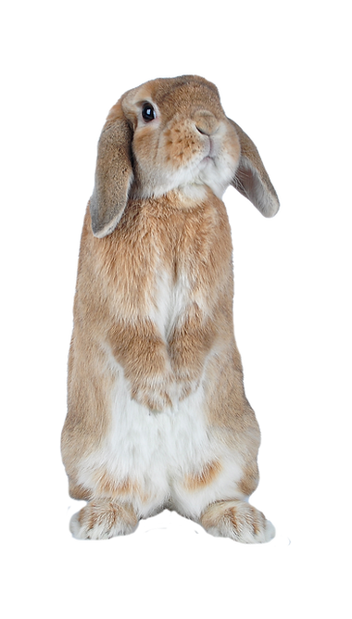
Recap from last time
Why might Observational Comparison be different from ATE?
Confounding Variables:
Some other variable affects both who is in the treatment group and also the outcome.
(Also called “Selection Effects”)
I’m the sort of person who is conscious of my health. I take aspirin, but I also eat healthy and get lots of sleep…
Taking medicine when sick
Being health-conscious
Recovering from illness faster
Getting lots of sleep

Slide 7
(The Magic of) Randomized Control Trials (RCTs)

Slide 8
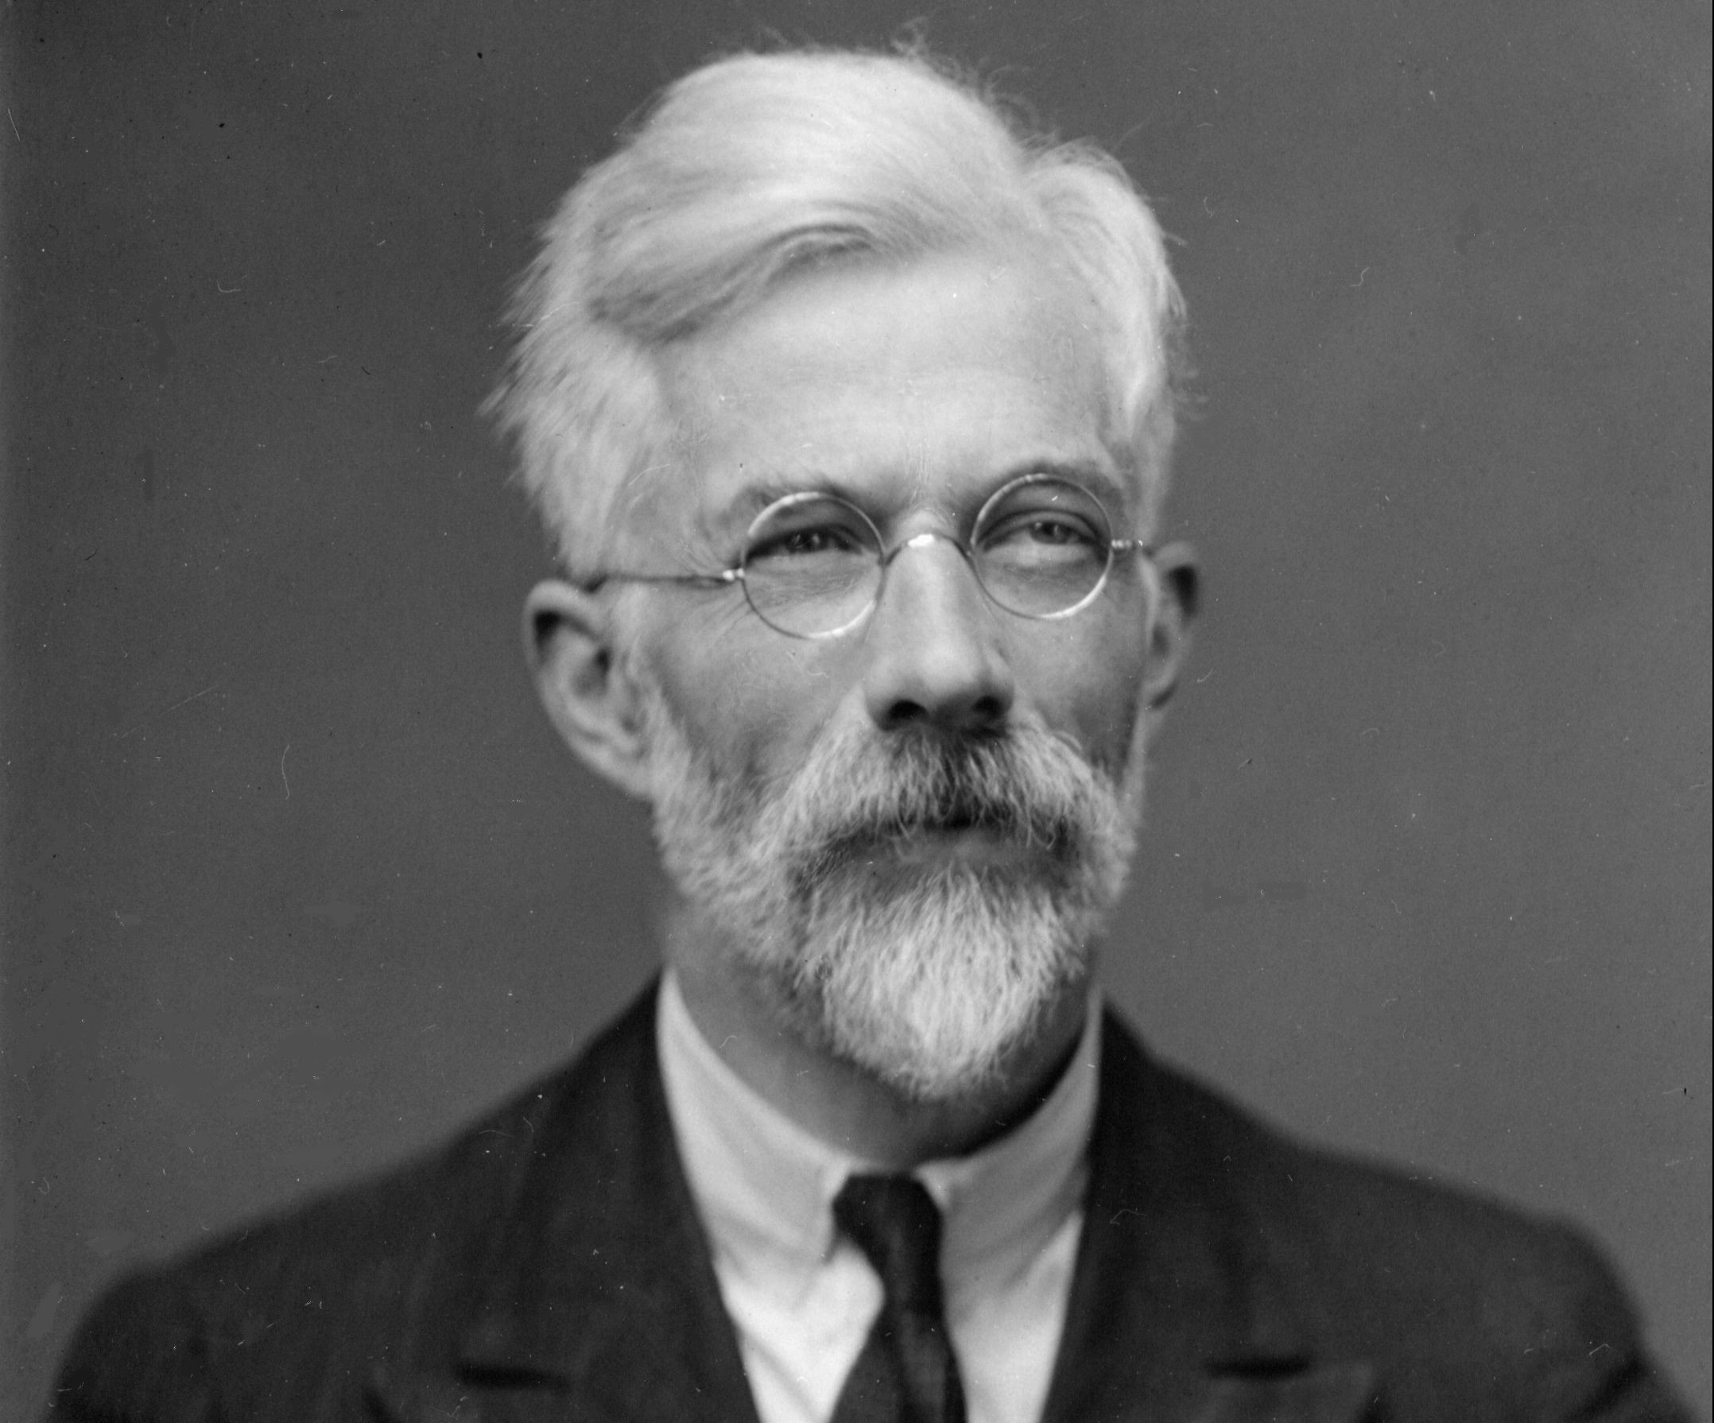
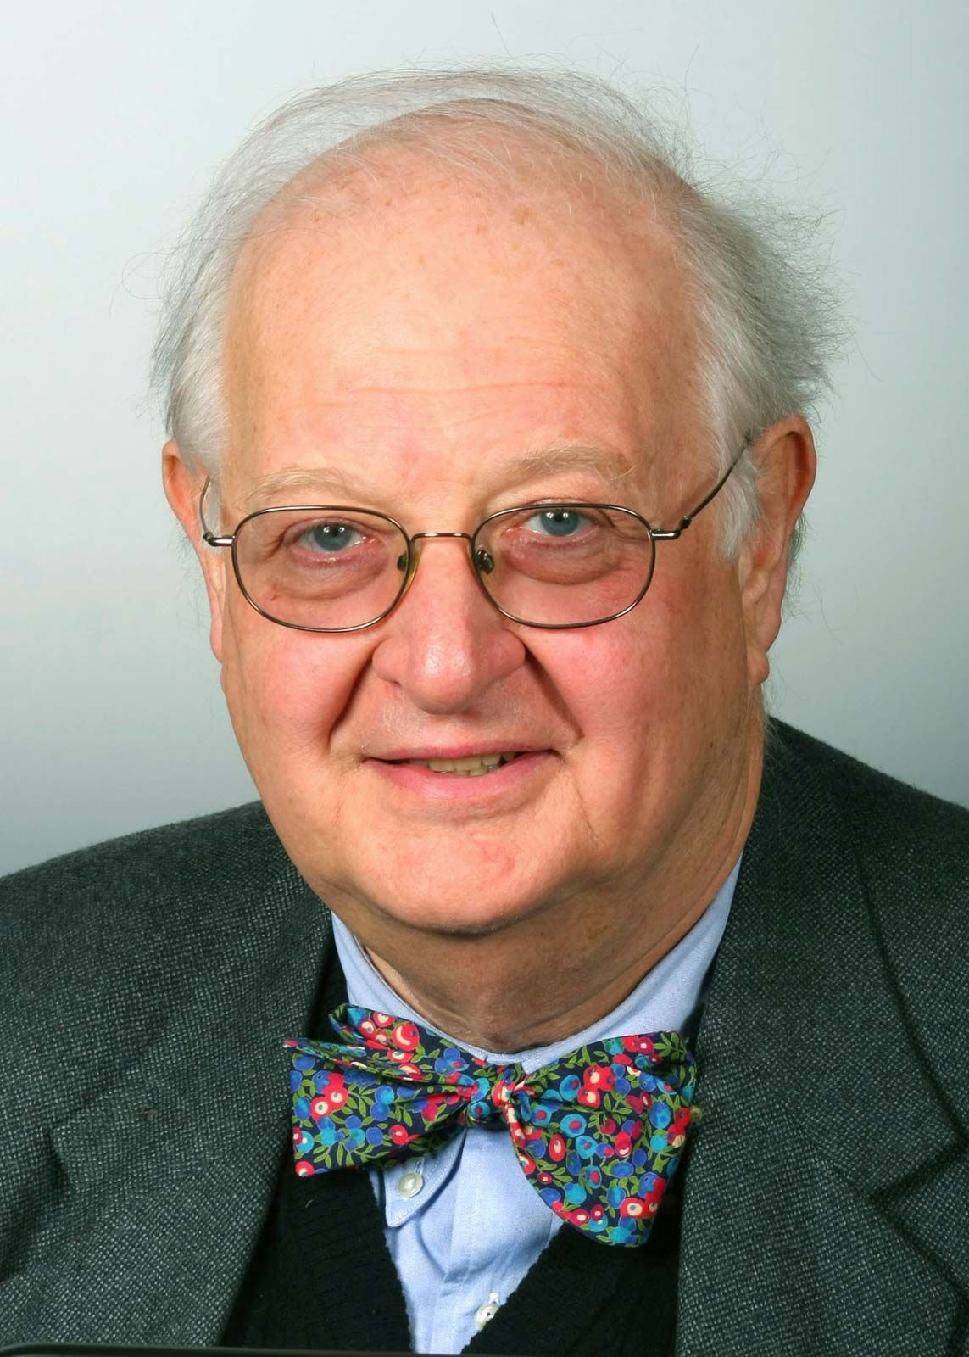
Pre-Class Reading: To Randomize or not to Randomize?
What’s needed is a "full procedure of randomization, by which the validity of the test of significance may be guaranteed against corruption by the causes of disturbance which have not been eliminated."
Ronald A. Fisher, 1890-1962
(According to Wikipedia, “the single most important figure in 20th century statistics”)
“Randomized controlled trials cannot automatically trump other evidence, they do not occupy any special place in some hierarchy of evidence, nor does it make sense to refer to them as ‘hard’ while other methods are ‘soft.’ ”
Angus Deaton
(2015 Nobel Laureate in Econ)

Slide 9
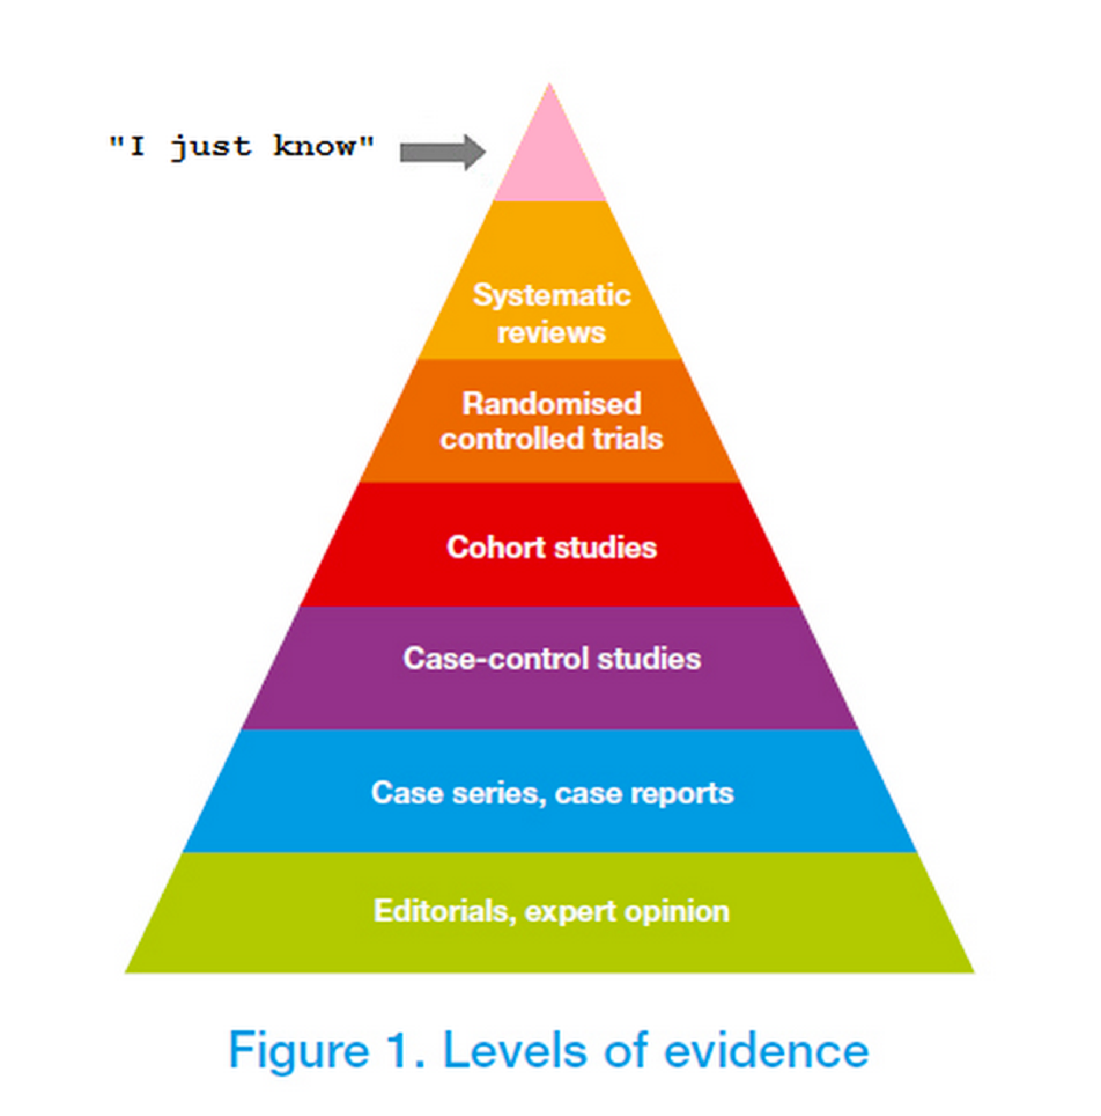
Pre-Class Reading: To Randomize or not to Randomize?
What’s needed is a "full procedure of randomization, by which the validity of the test of significance may be guaranteed against corruption by the causes of disturbance which have not been eliminated."
Ronald A. Fisher, 1890-1962
(According to Wikipedia, “the single most important figure in 20th century statistics”)
“Randomized controlled trials cannot automatically trump other evidence, they do not occupy any special place in some hierarchy of evidence, nor does it make sense to refer to them as ‘hard’ while other methods are ‘soft.’ ”
Angus Deaton
(2015 Nobel Laureate in Econ)

Slide 10
What do you think?
Randomization is not a good idea. It limits us from taking advantage of our own knowledge/intuition.
Randomization (or some approximation of it) is the only way we can make causal statements!
Meh.

Slide 11
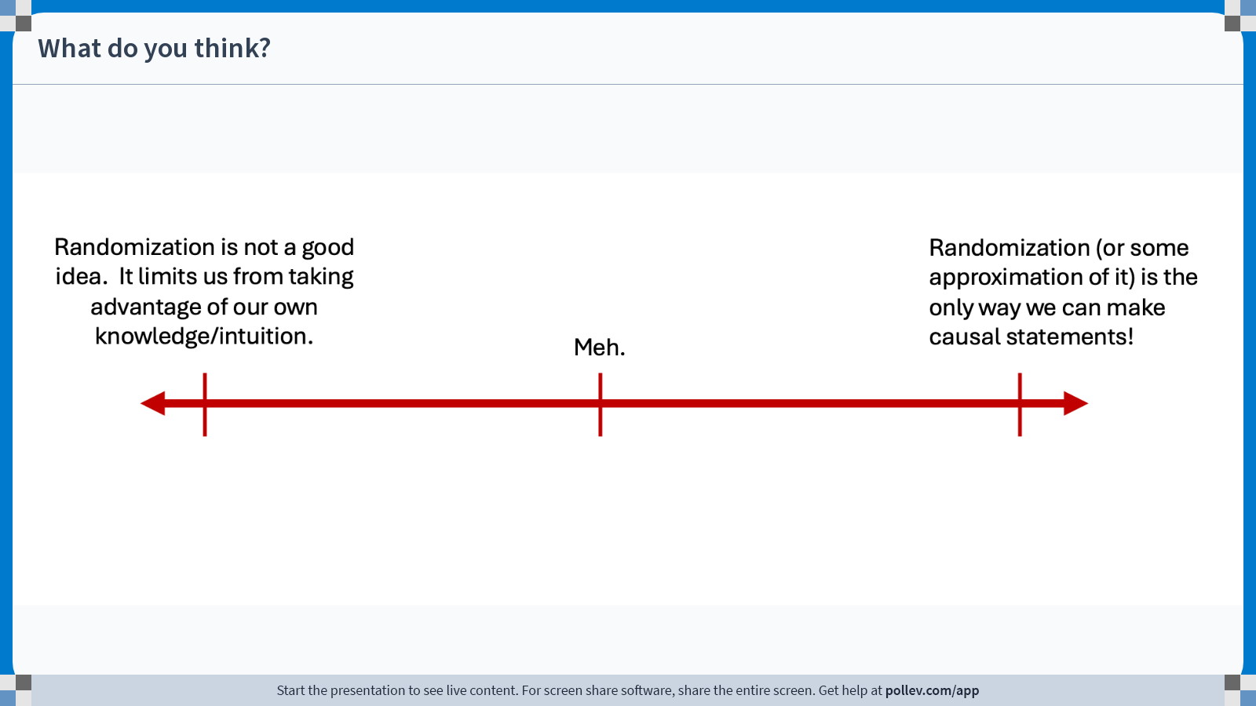
Notes:
Do not modify the notes in this section to avoid tampering with the Poll Everywhere activity. More info at polleverywhere.com/support What do you think?
https://www.polleverywhere.com/clickable_images/pzoXCXhdbaDKqmdbnYvQX

Slide 12
Our approach in this class
Randomization is good.
Today, we’ll formalize why!
But there are legitimate concerns about randomized experiments.
Next time, we’ll talk about those!

Slide 13
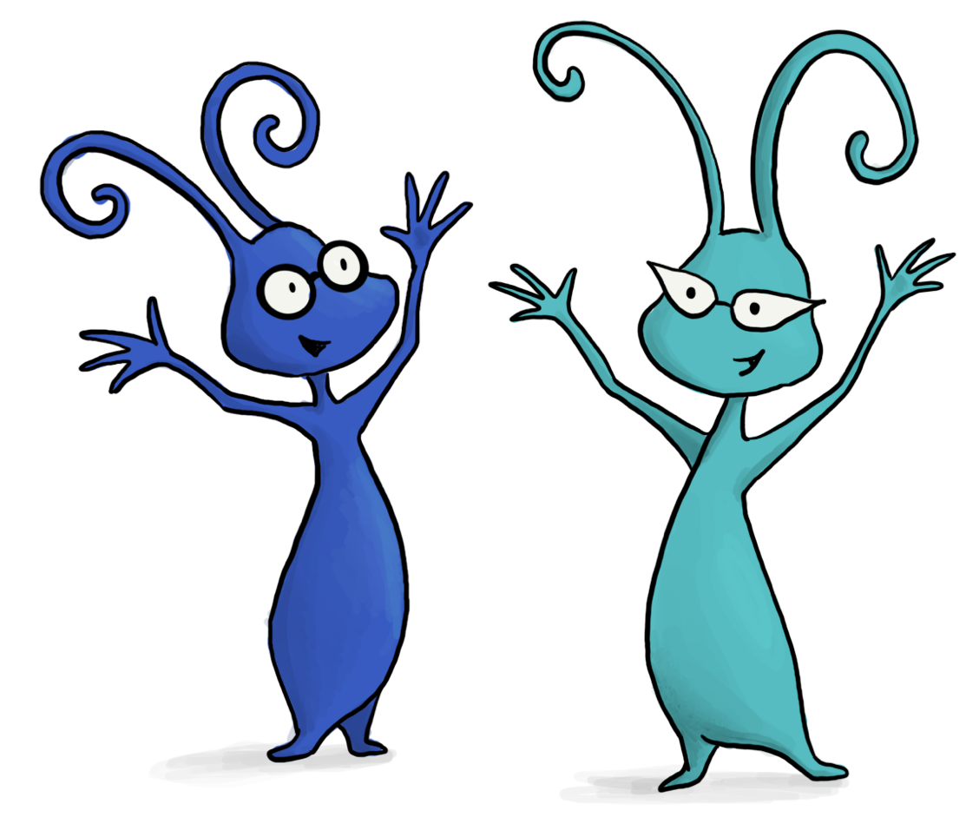
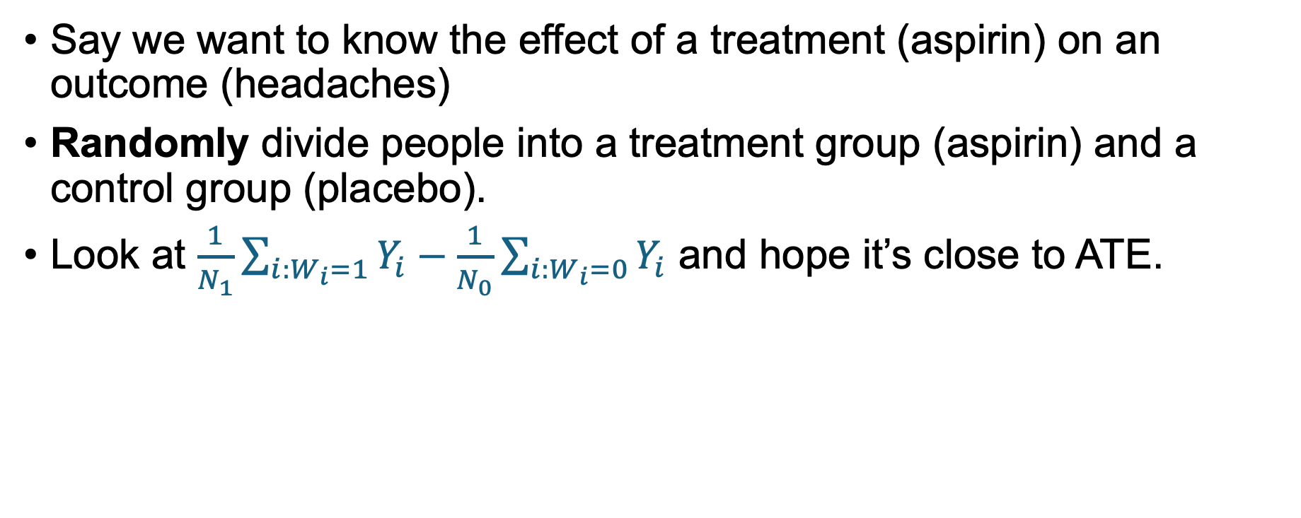
Randomized Control Trials
Say we want to know the effect of a treatment (aspirin) on an outcome (headaches)
Randomly divide people into a treatment group (aspirin) and a control group (placebo).
Look at $\frac{1}{N_{1}}\sum_{i:W_{i}=1}{Y_{i}}−\frac{1}{N_{0}}\sum_{i:W_{i}=0}{Y_{i}}$ and hope it’s close to ATE.
Discuss: Intuitively, why should randomizing help with confounding variables / selection effects?

Slide 14

From a “confounding variables” point of view
The “confounders” no longer have a causal link with the treatment!
Note: other causal links may be harder to cut.
Taking medicine when sick
Being health-conscious
Recovering from illness faster
Getting lots of sleep

Slide 15
From a “selection effects” point of view
The problem was that “people in the treatment group” are systematically different than “people in the control group.”
If the “selection” is done at random, this is not the case!
I’m the sort of person who is conscious of my health. I take aspirin, but I also eat healthy and get lots of sleep…

Slide 16
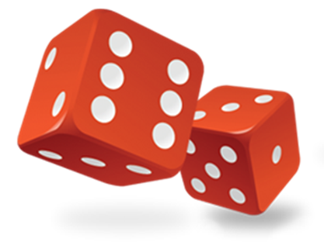
From a “selection effects” point of view
The problem was that “people in the treatment group” are systematically different than “people in the control group.”
If the “selection” is done at random, this is not the case!
…but (in an rct) that has nothing to do with my decision to take aspirin or not.
I’m the sort of person who is conscious of my health. I take aspirin, but I also eat healthy and get lots of sleep…

Slide 17
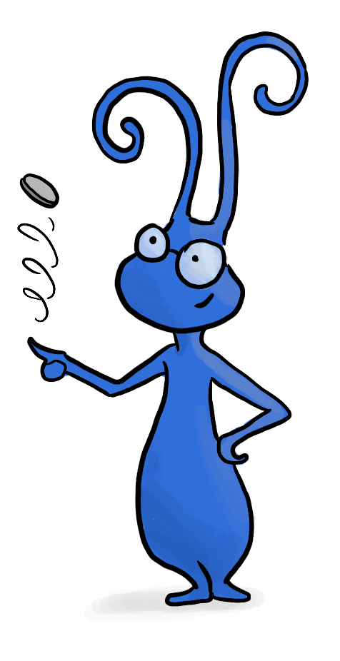
Another way to say it
Consider the group of “people who care about their health”
This group will be split approximately in half by our random design!
So will the group of “people on whom aspirin works better than average”
So will the group of “people who have a weird birthmark”
…And all the other groups that we can’t even think of!
Yay randomization!

Slide 18
RCTs are powerful
They are the best sort of evidence we can get for a causal effect.
They can have big effects on policy decisions.
With great power comes great responsibility…
We need to analyze RCTs carefully
We need to think carefully about how to interpret RCTs

Slide 19
Example: Use of Laptops in Classrooms

Slide 20
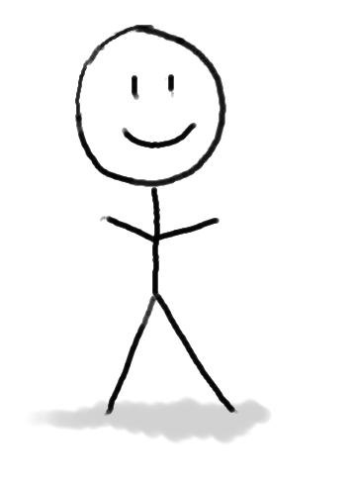
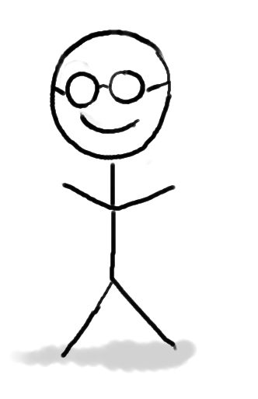
Should laptops be allowed in class?
We don’t allow them in this class. Why not?
We are capricious dictators on a power trip!
Guido and Mary

Slide 21
Should laptops be allowed in class?
We don’t allow them in this class. Why not?
We are capricious dictators on a power trip!
Guido and Mary

Slide 22
Should laptops be allowed in class?
We don’t allow them in this class. Why not?
We are compelled by evidence from an RCT!
Guido and Mary

Slide 23
What is the effect on student learning of having laptops in class?
Discuss:
How would you design an RCT to measure the effects of laptops in class?

Slide 24
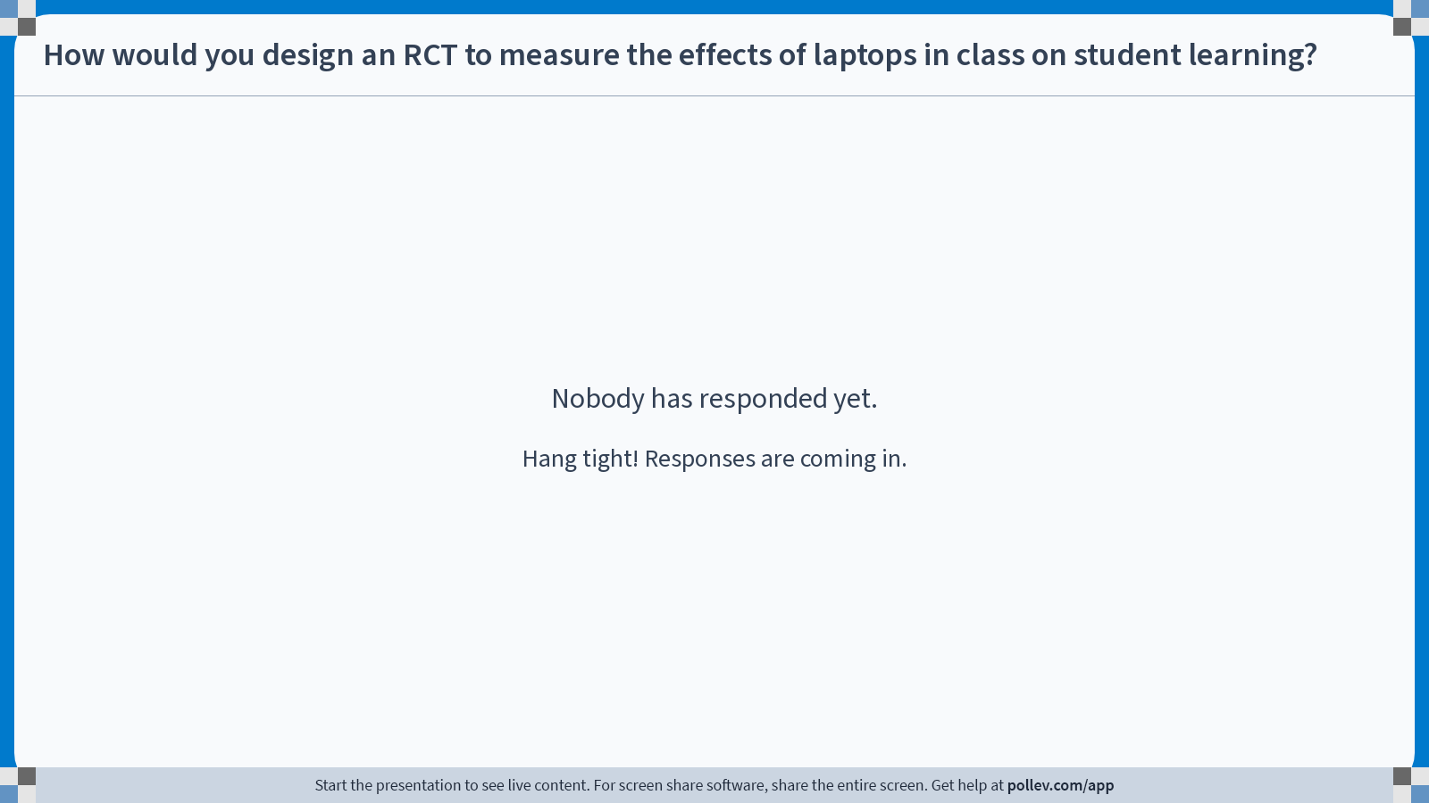
Notes:
Do not modify the notes in this section to avoid tampering with the Poll Everywhere activity. More info at polleverywhere.com/support How would you design an RCT to measure the effects of laptops in class on student learning?
https://www.polleverywhere.com/discourses/AVhAULrUL1WBH9J5PAT39

Slide 25
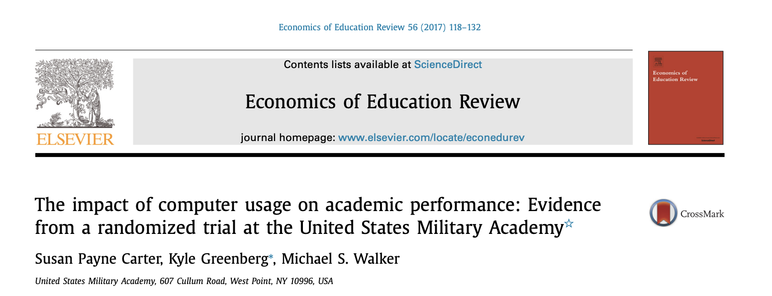
Here’s one study that did this already! You’ll read and think more about it before next class!

Slide 26
RCT on Laptops in Class
Population: 726 students at West Point from 2014-2016
Students were spread across 50 sections of Intro Econ.
Note: Intro Econ is required at West Point.
All sections have same syllabus, textbook, and exam
Classrooms were randomly split into three treatment groups:
Treatment 1: Anything goes (17 classrooms, 248 students)
Treatment 2: Tablets, but only for note-taking (15 classrooms, 208 students)
Control: No tablets/computers (18 classrooms, 270 students)
Students/Professors don’t get to choose their group.
Outcome:
Measured on common final exam

Slide 27
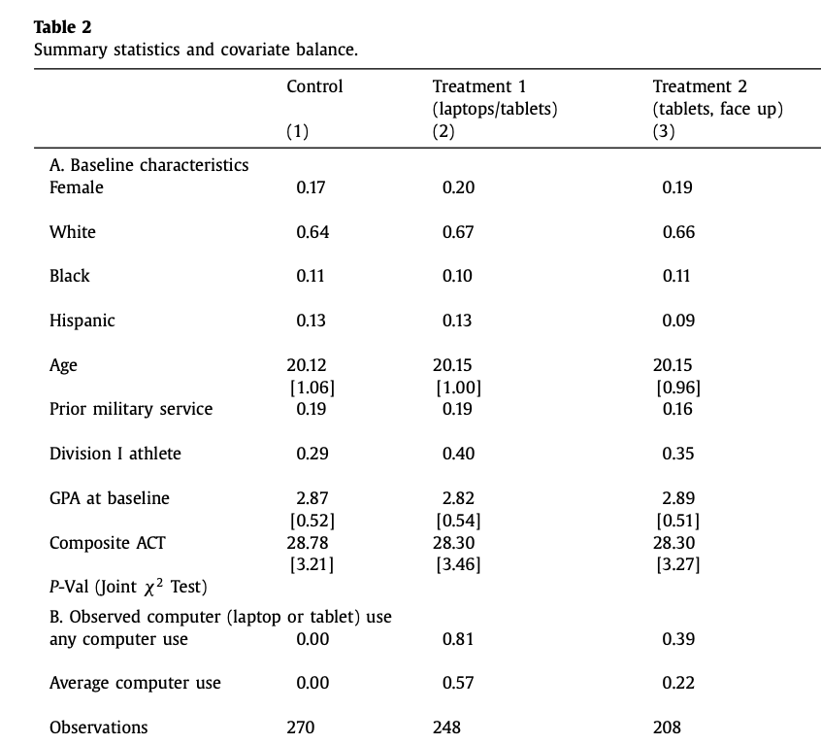
Are the observables “balanced”?
Table* from laptop paper:
We want all groups that we can identify to be about “equally split” between treatment(s) and control.
It’s good practice to check this! (what would you do if there was imbalance??)
*They also include more evidence that things are fairly balanced, but it involves regression which we haven’t covered yet.

Slide 28

What do you think the results were?
Is there an effect?
Is the effect the same for:
Women vs men
High-ACT vs low-ACT
White vs non-white
…

Slide 29
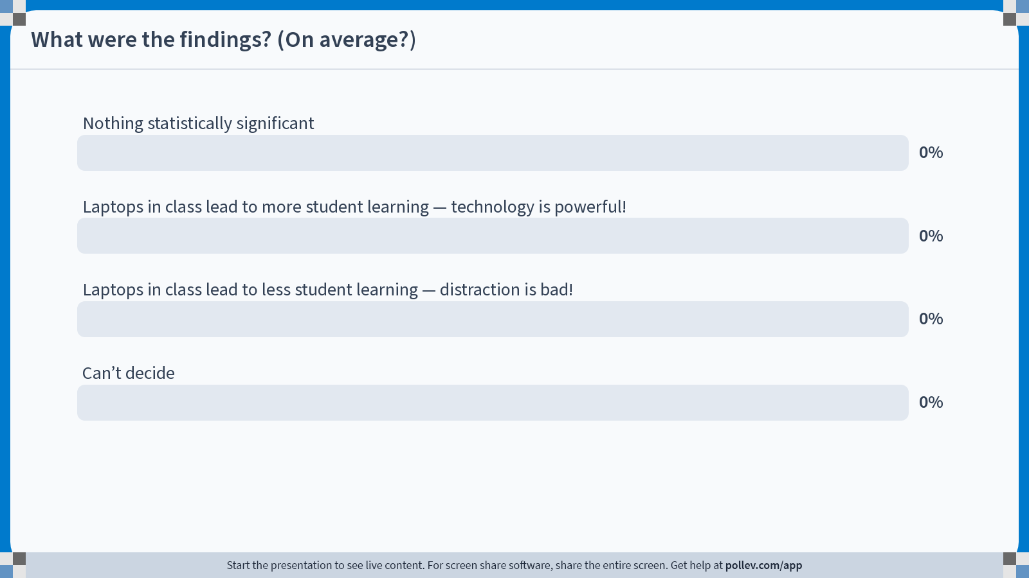
Notes:
Do not modify the notes in this section to avoid tampering with the Poll Everywhere activity. More info at polleverywhere.com/support What were the findings? (On average?)
https://www.polleverywhere.com/multiple_choice_polls/cXZcgLIWFjh425Ey9XcE1?state=opened&flow=Default&onscreen=persist

Slide 30
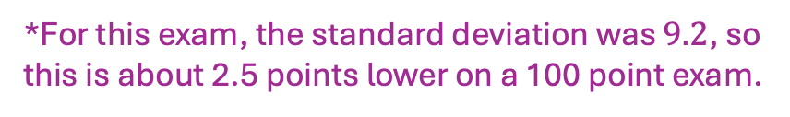
Outcomes*
*For this exam, the standard deviation was $9.2$, so this is about 2.5 points lower on a 100 point exam.
Standard Error
(aka, estimate of std. deviation of the estimated effect)
p-value
To reject the null that the treatment had no effect
Estimated average treatment effect
Anything goes group:
-0.28
<0.01
(0.10)
Scores for laptop-users were 0.28 standard deviations lower than the control group.*
If there were no real effect, seeing something as extreme as “-0.28” would happen with probability <0.01
The estimated standard deviation of the
result “-0.28” is 0.10
Modified-tablet group:
-0.17
<0.1
(0.10)
*Simplified, see paper for much more detail!

Slide 31
Outcomes*
Don’t worry about how we “control for demographics” for now… we’ll come back to this when we talk about regression ☺
Standard Error
(aka, estimate of std. deviation of the estimated effect)
p-value
To reject the null that the treatment had no effect
Estimated average treatment effect
Anything goes group:
-0.28
<0.01
(0.10)
-0.18
<0.01
(0.07)
Controlling for demographics:
Modified-tablet group:
-0.17
<0.1
(0.10)
Controlling for demographics:
-0.17
<0.05
(0.07)
*Simplified, see paper for much more detail!

Slide 32
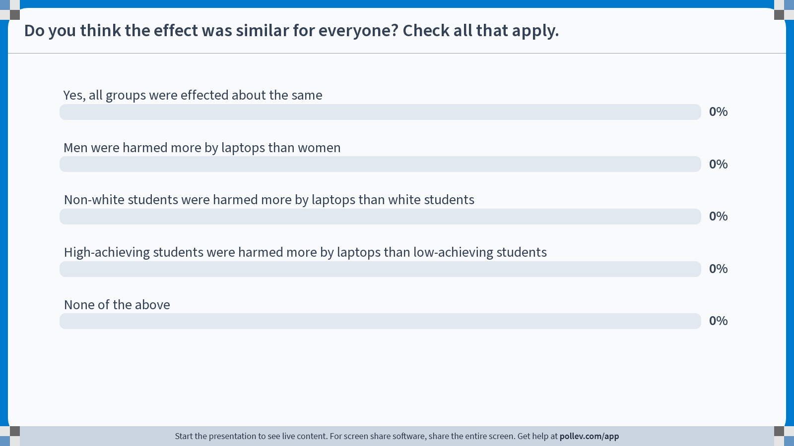
Notes:
Do not modify the notes in this section to avoid tampering with the Poll Everywhere activity. More info at polleverywhere.com/support Do you think the effect was similar for everyone? Check all that apply.
https://www.polleverywhere.com/multiple_choice_polls/BGCGIR6QDV4H25MzVP0it?state=opened&flow=Default&onscreen=persist

Slide 33
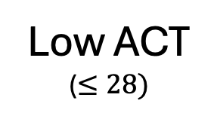
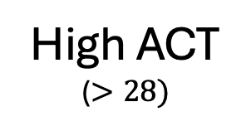
Heterogeneous effects of laptop use
Low ACT
($≤28)$
High ACT
($>28)$
Women
Men
Non-white
White
+0.02
(0.14)
131 total
-0.21***
(0.06)
580 total
-0.22*
(0.10)
244 total
-0.18*
(0.07)
476 total
-0.07
(0.08)
351 total
-0.27***
(0.08)
360 total
*** = p-value <0.01
** = p-value < 0.05
* = p-value < 0.1

Slide 34

We had to make a decision! Are we right to act on the basis of this study?
Discuss:
What are some weaknesses with the study?
Are you compelled by these findings?
We’ll talk a lot more about this in the next class!
Are we just capricious dictators on a power trip?
Guido and Mary

Slide 35
The Statistical Analysis of RCTs

Slide 36
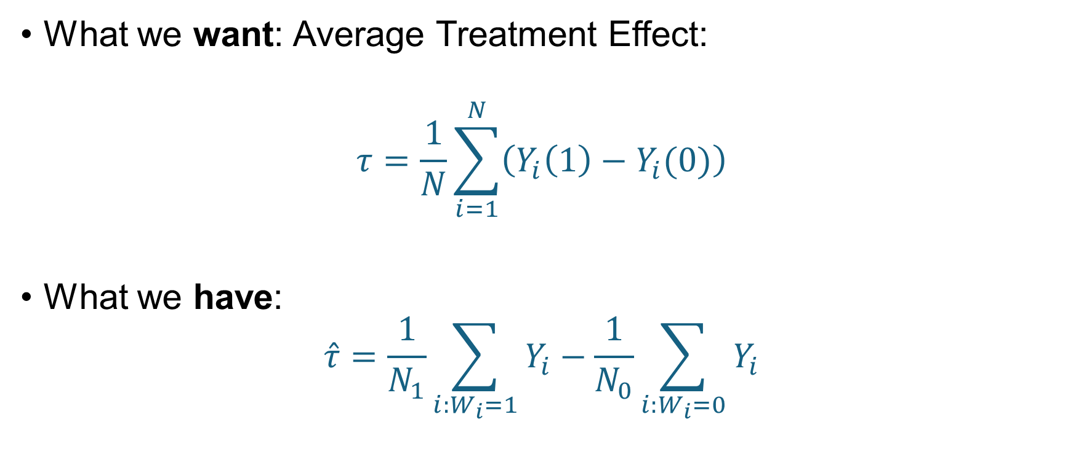
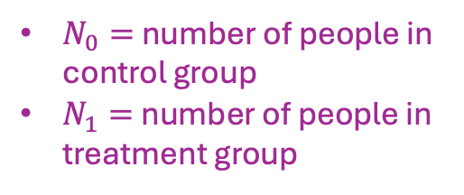
In the RCT context, our “Observational Comparison” from last class is an estimator
What we want: Average Treatment Effect:
$$τ=\frac{1}{N}\sum_{i=1}^{N}{\left(Y_{i}\left(1\right)−Y_{i}(0)\right)}$$
What we have:
$$\hat{τ}=\frac{1}{N_{1}}\sum_{i:W_{i}=1}{Y_{i}}−\frac{1}{N_{0}}\sum_{i:W_{i}=0}{Y_{i}}$$
$N_{0}=$ number of people in control group
$N_{1}=$ number of people in treatment group

Slide 37
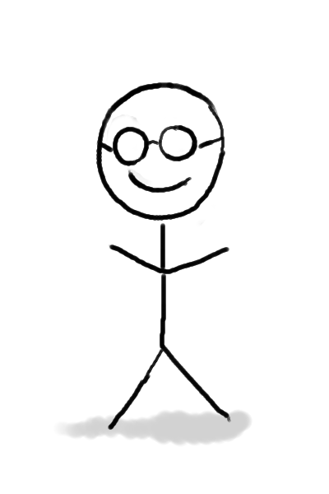
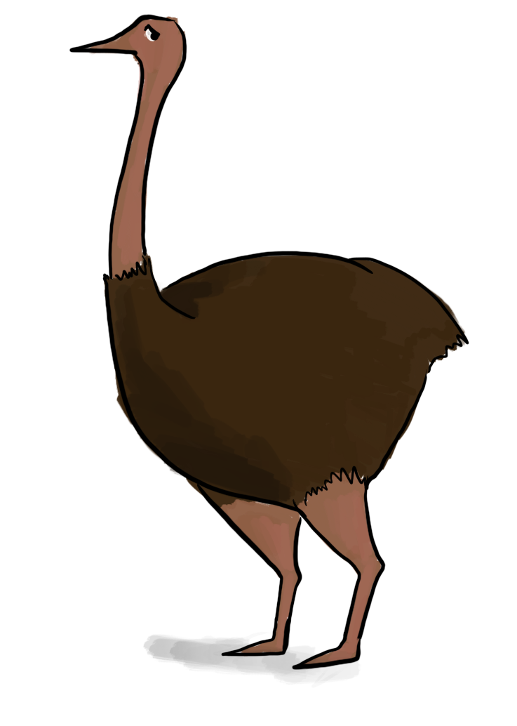

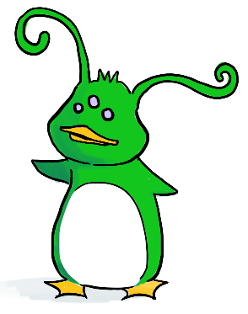


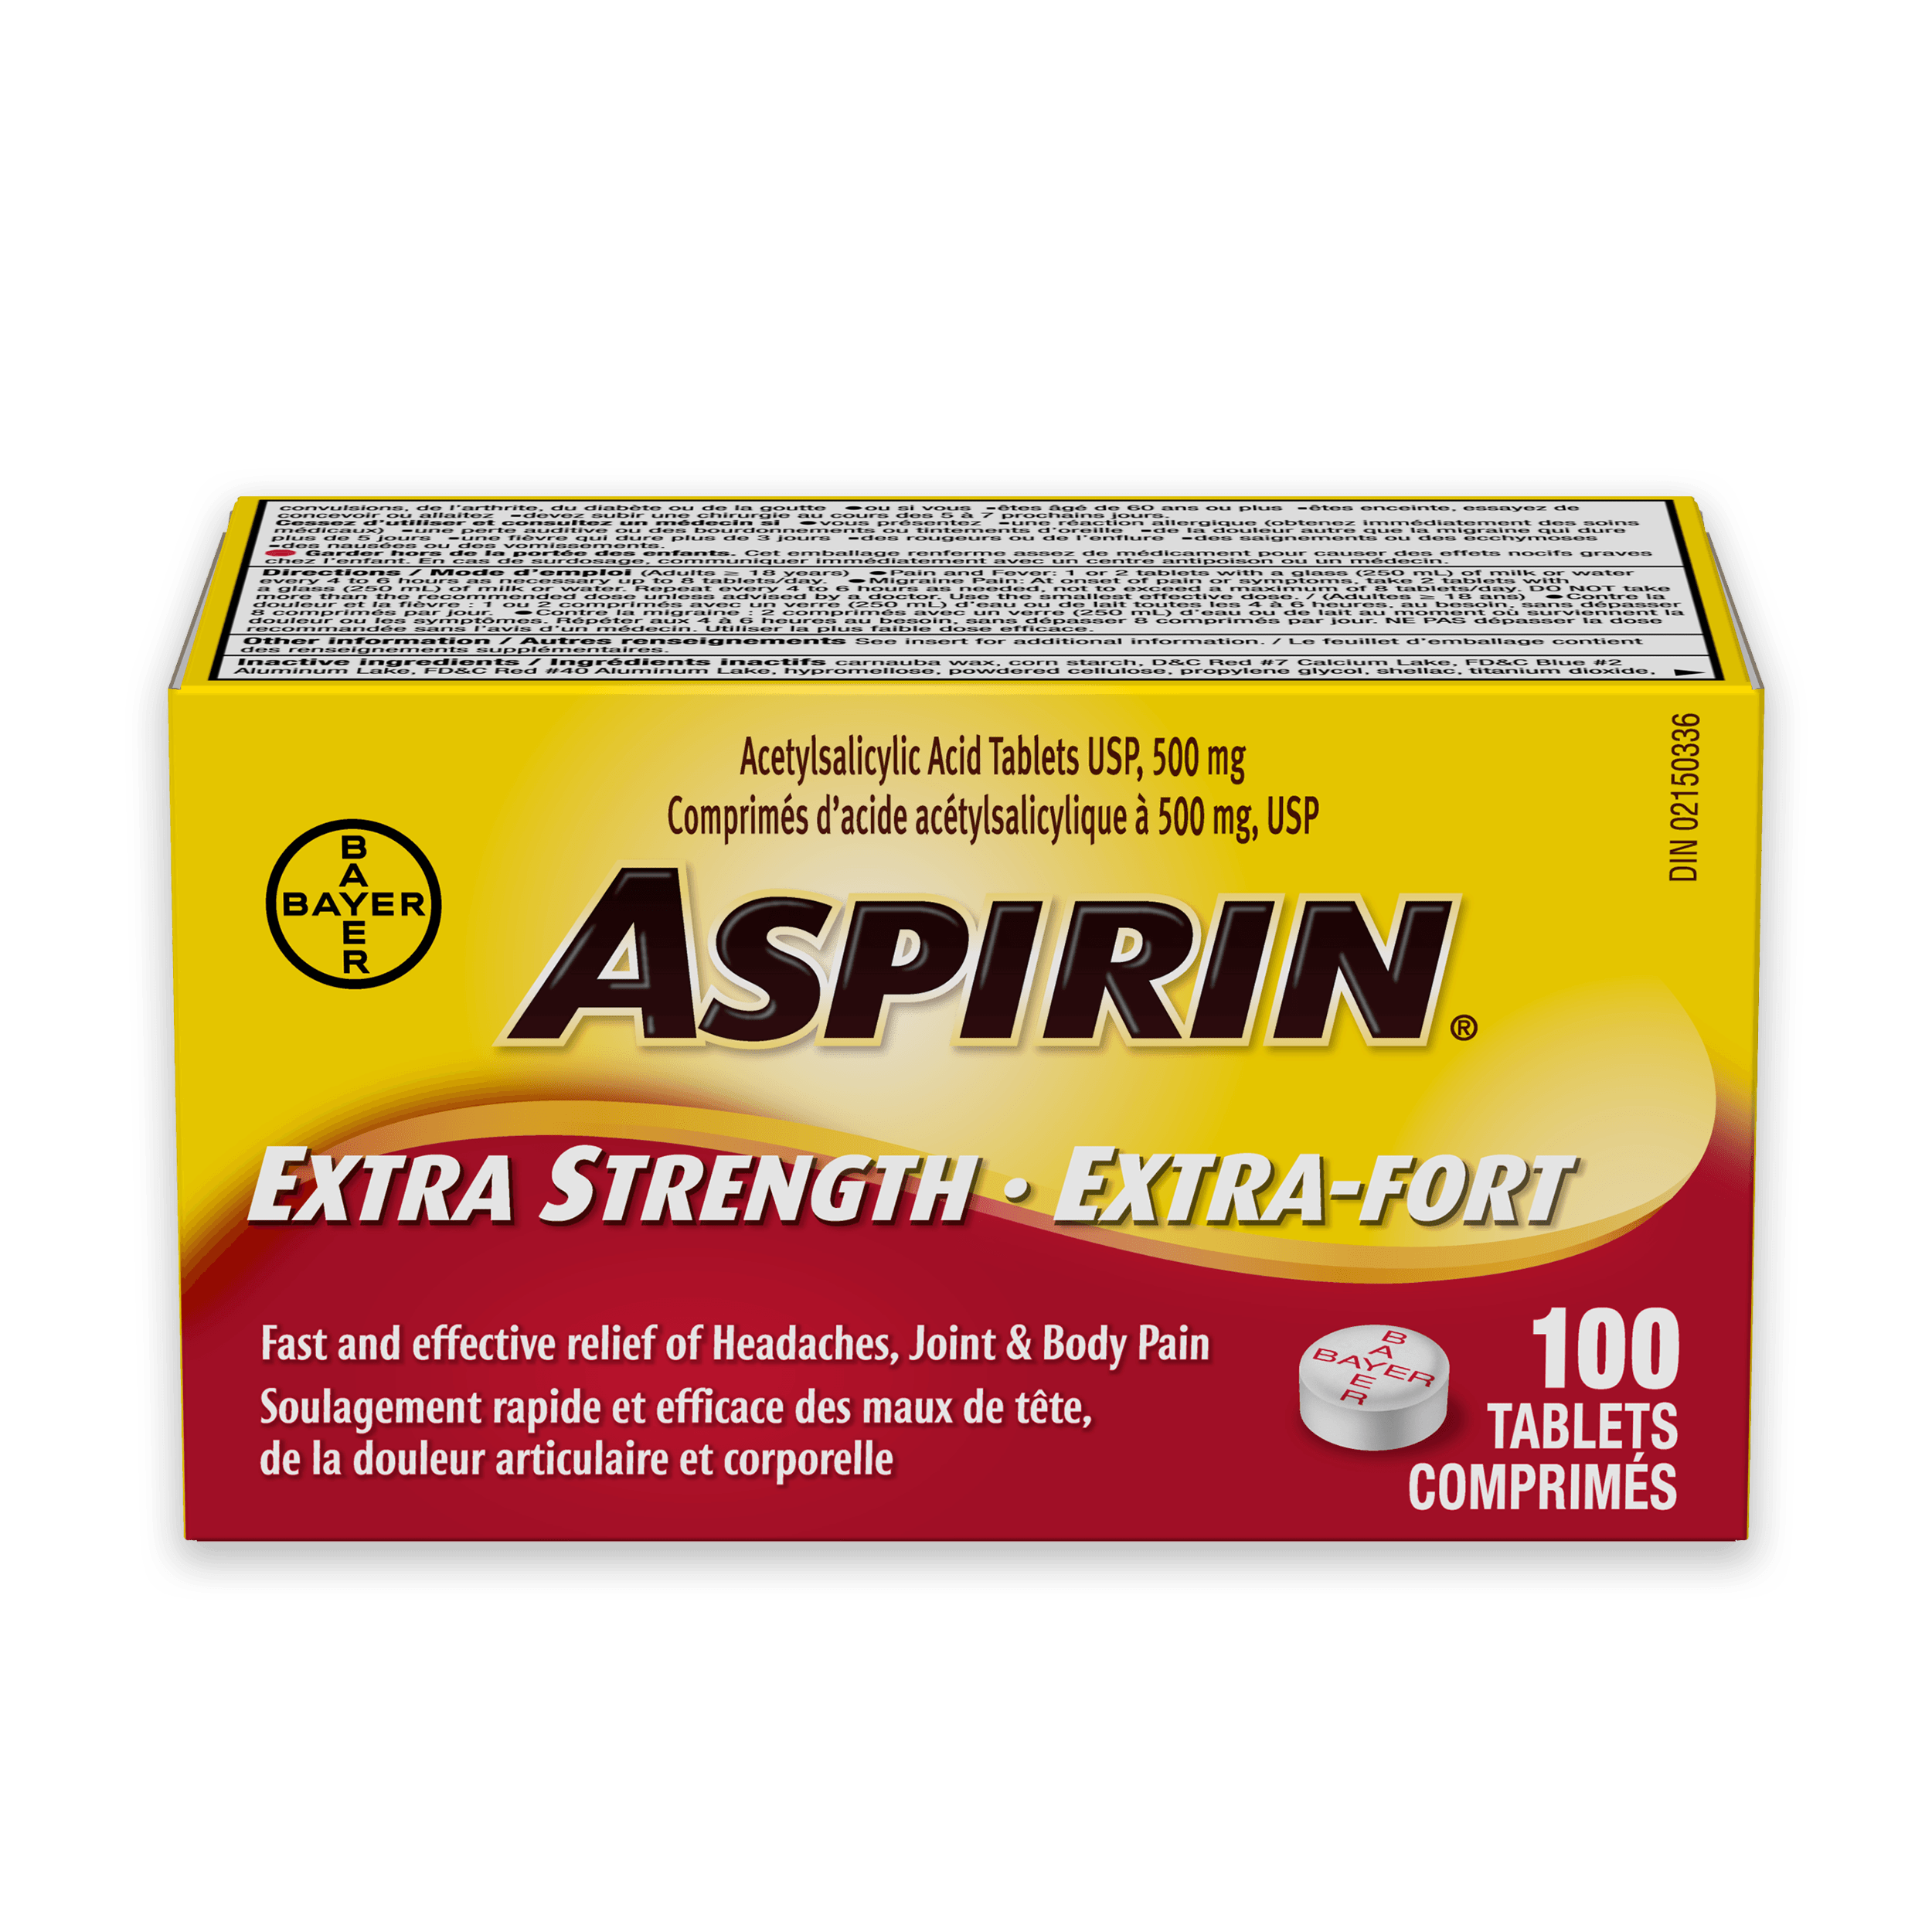

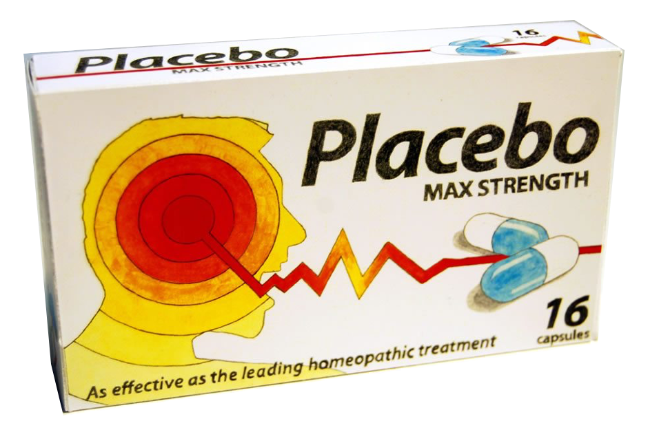













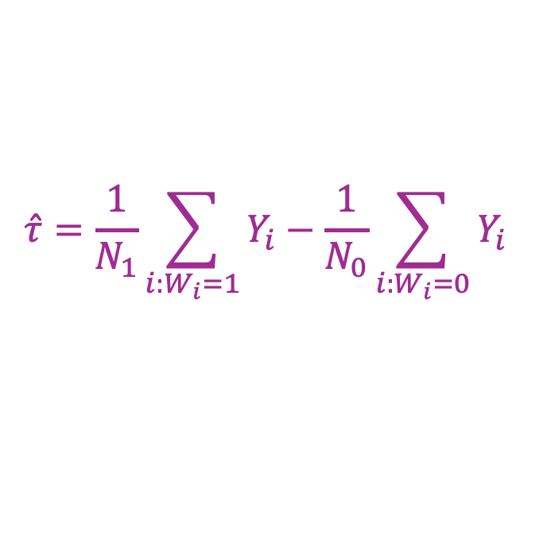










Aspirin example from last time
$$\hat{τ}=\frac{1}{N_{1}}\sum_{i:W_{i}=1}{Y_{i}}−\frac{1}{N_{0}}\sum_{i:W_{i}=0}{Y_{i}}$$
Randomly choose 3 of the 6 units for the control group, the rest are in the treatment group.
$N_{0}=N_{1}=3$
For each $i$, $W_{i}=1$ with probability ½ and $W_{i}=0$ with probability ½
Discuss:
What is $𝔼[\hat{τ}]$ in this example?
$$1$$
$$2$$
$$3$$
$$4$$
$$5$$
$$6$$
$$i$$
$$Y_{i}(1)$$
$$1$$
$$1$$
$$1$$
$$0$$
$$1$$
$$0$$
$$Y_{i}(0)$$
$$0$$
$$0$$
$$0$$
$$0$$
$$0$$
$$1$$

Slide 38
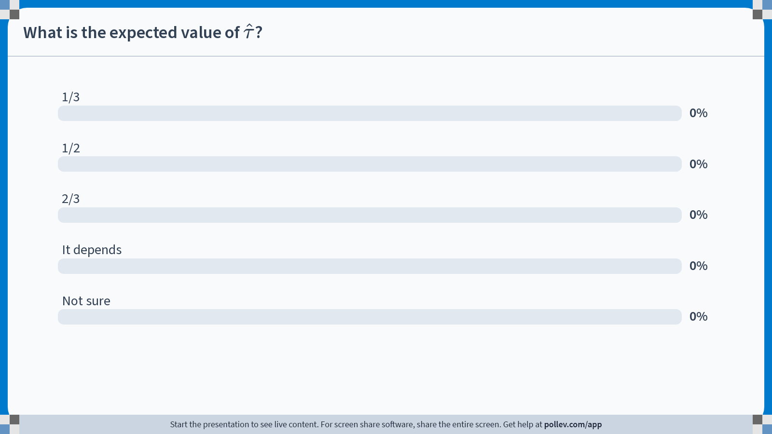
Notes:
Do not modify the notes in this section to avoid tampering with the Poll Everywhere activity. More info at polleverywhere.com/support What is the expected value of $$\hat{\tau}$$?
https://www.polleverywhere.com/multiple_choice_polls/Yd4I7U6FvNrYJilEMviEJ?state=opened&flow=Default&onscreen=persist

Slide 39


Aspirin example from last time
$$\hat{τ}=\frac{1}{N_{1}}\sum_{i:W_{i}=1}{Y_{i}}−\frac{1}{N_{0}}\sum_{i:W_{i}=0}{Y_{i}}$$
Randomly choose 3 of the 6 units for the control group, put the rest in the treatment group.
Discuss:
What is $𝔼[\hat{τ}]$ in this example?
$$1$$
$$2$$
$$3$$
$$4$$
$$5$$
$$6$$
$$i$$
$$Y_{i}(1)$$
$$1$$
$$1$$
$$1$$
$$0$$
$$1$$
$$0$$
It’s ½! Same as ATE!
$$Y_{i}(0)$$
$$0$$
$$0$$
$$0$$
$$0$$
$$0$$
$$1$$

Slide 40
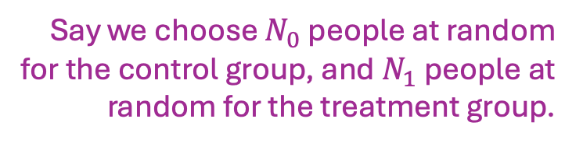

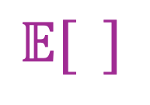
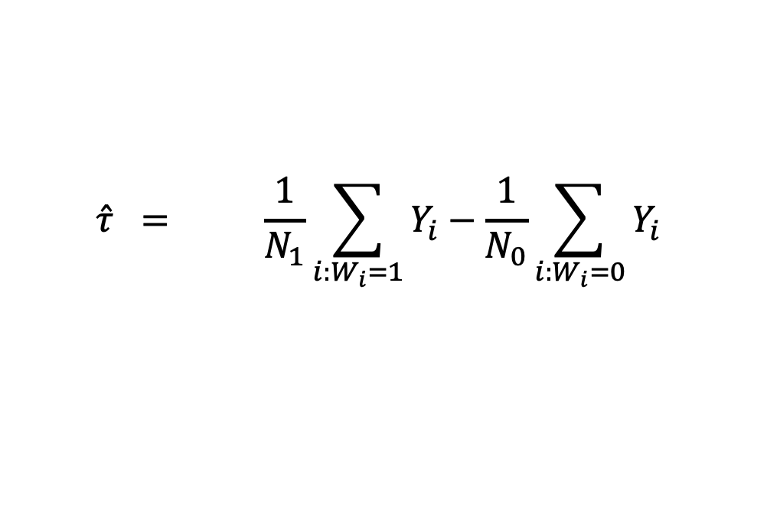
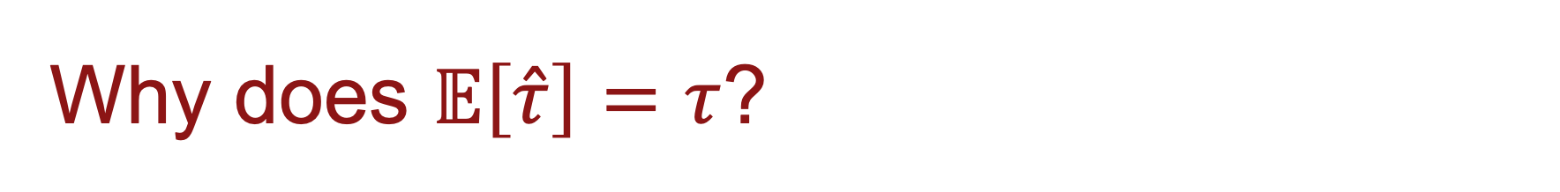
Why does $𝔼\left[\hat{τ}\right]=τ$?
Say we choose $N_{0}$ people at random for the control group, and $N_{1}$ people at random for the treatment group.
$$\hat{τ} = \frac{1}{N_{1}}\sum_{i:W_{i}=1}{Y_{i}}−\frac{1}{N_{0}}\sum_{i:W_{i}=0}{Y_{i}}$$
$$𝔼[ ]$$
$$𝔼[ ]$$

Slide 41
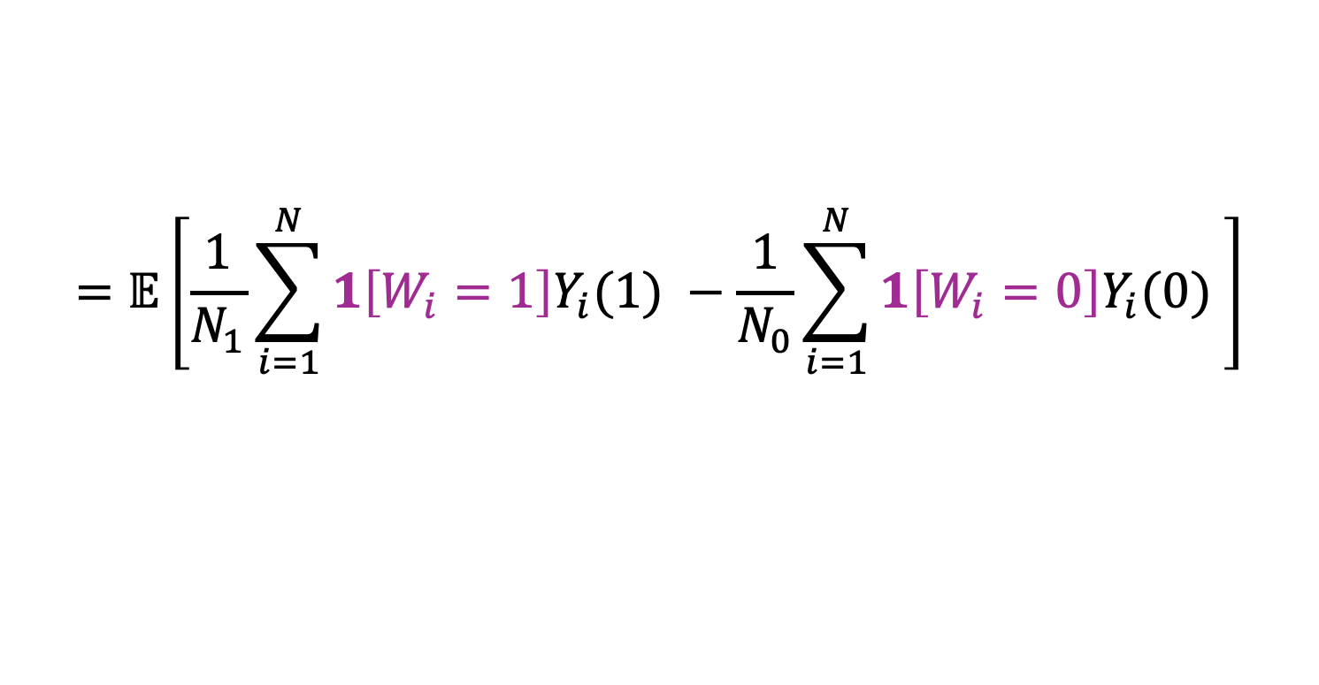
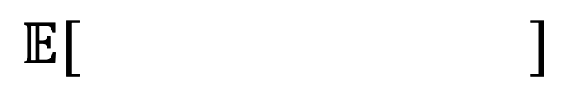
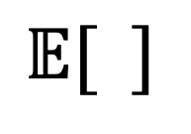
Why does $𝔼\left[\hat{τ}\right]=τ$?
Say we choose $N_{0}$ people at random for the control group, and $N_{1}$ people at random for the treatment group.
$$\hat{τ} = \frac{1}{N_{1}}\sum_{i:W_{i}=1}{Y_{i}}−\frac{1}{N_{0}}\sum_{i:W_{i}=0}{Y_{i}}$$
$$𝔼[ ]$$
$$𝔼[ ]$$
$$=𝔼\left[\frac{1}{N_{1}}\sum_{i=1}^{N}{1\left[W_{i}=1\right]Y_{i}(1) −\frac{1}{N_{0}}}\sum_{i=1}^{N}{1\left[W_{i}=0\right]Y_{i}(0) }\right]$$

Slide 42
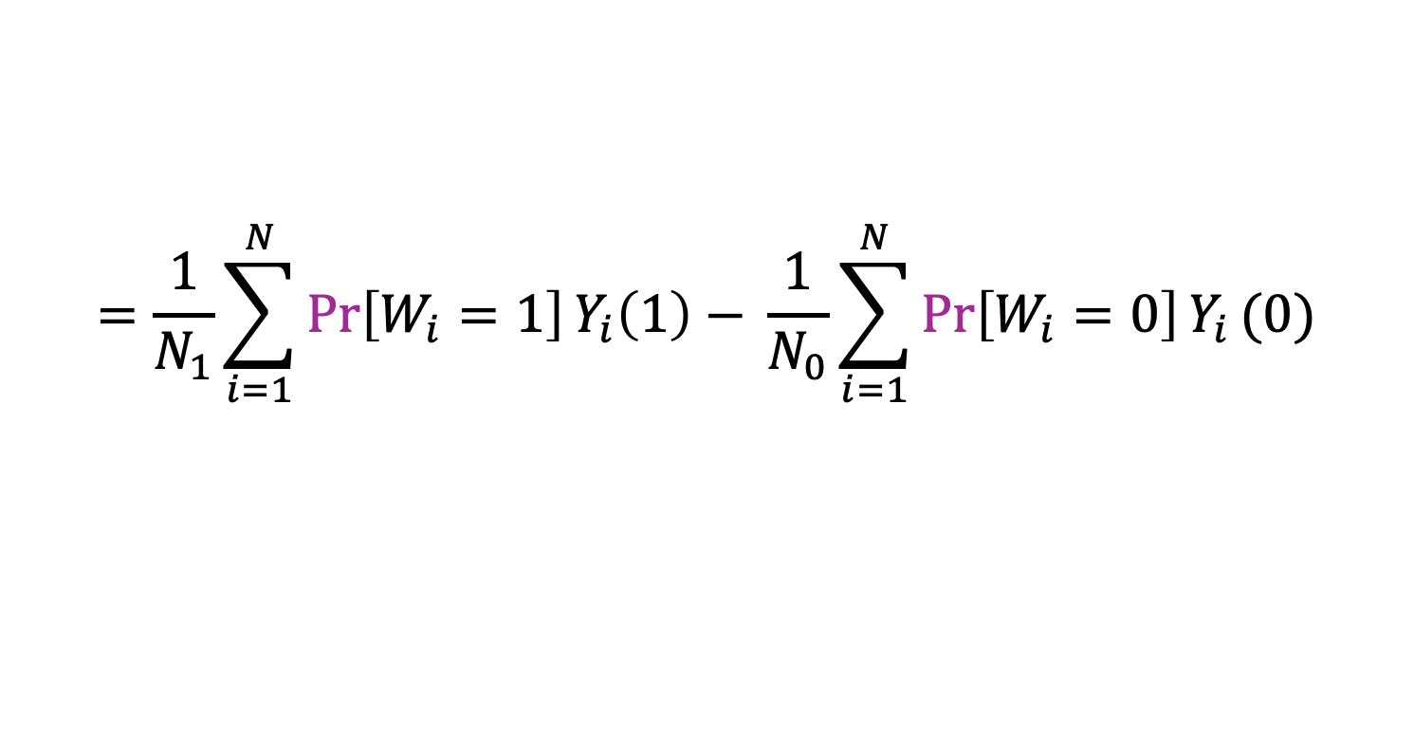
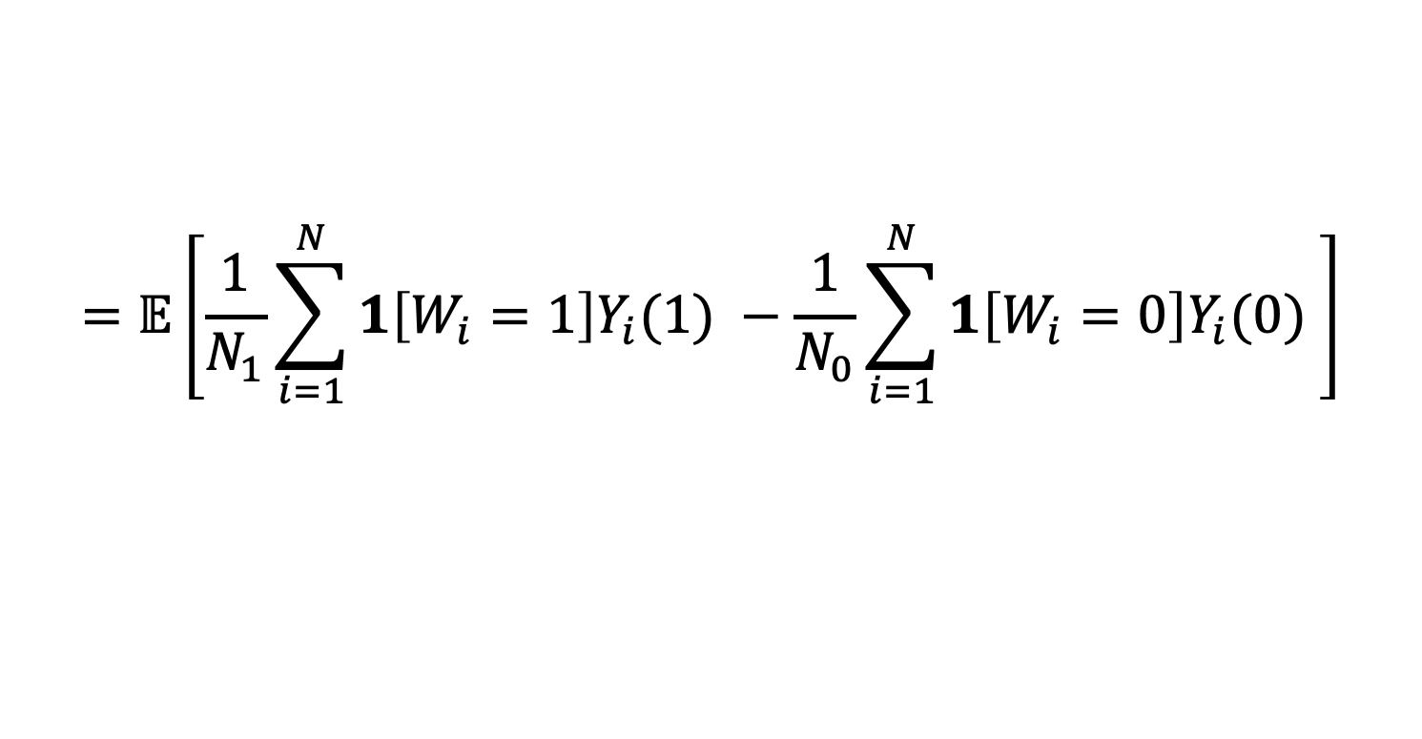
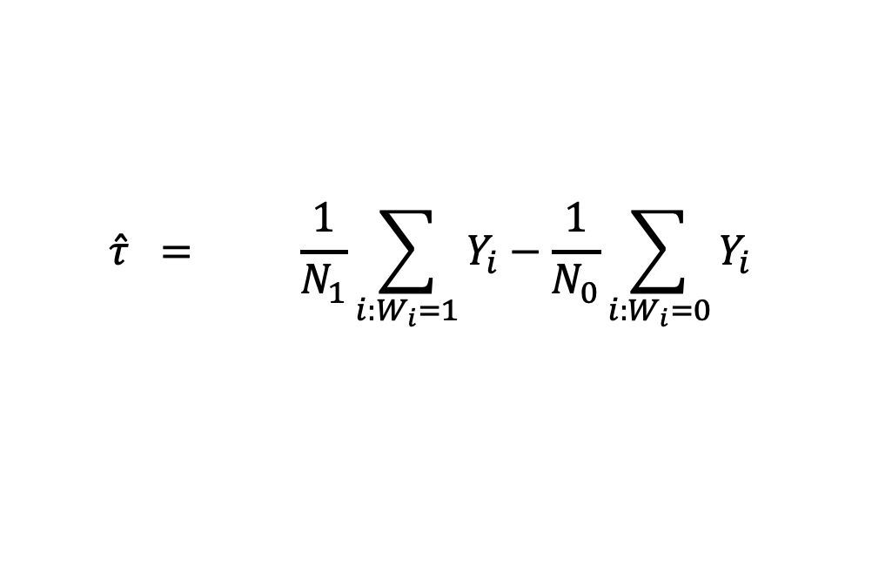
Why does $𝔼\left[\hat{τ}\right]=τ$?
Say we choose $N_{0}$ people at random for the control group, and $N_{1}$ people at random for the treatment group.
$$\hat{τ} = \frac{1}{N_{1}}\sum_{i:W_{i}=1}{Y_{i}}−\frac{1}{N_{0}}\sum_{i:W_{i}=0}{Y_{i}}$$
$$𝔼[ ]$$
$$𝔼[ ]$$
$$=𝔼\left[\frac{1}{N_{1}}\sum_{i=1}^{N}{1\left[W_{i}=1\right]Y_{i}(1) −\frac{1}{N_{0}}}\sum_{i=1}^{N}{1\left[W_{i}=0\right]Y_{i}(0) }\right]$$
$$=\frac{1}{N_{1}}\sum_{i=1}^{N}{\operatorname{Pr}\left[W_{i}=1\right]Y_{i}\left(1\right)− }\frac{1}{N_{0}}\sum_{i=1}^{N}{\operatorname{Pr}\left[W_{i}=0\right]Y_{i}}(0)$$
Linearity of Expectation!

Slide 43
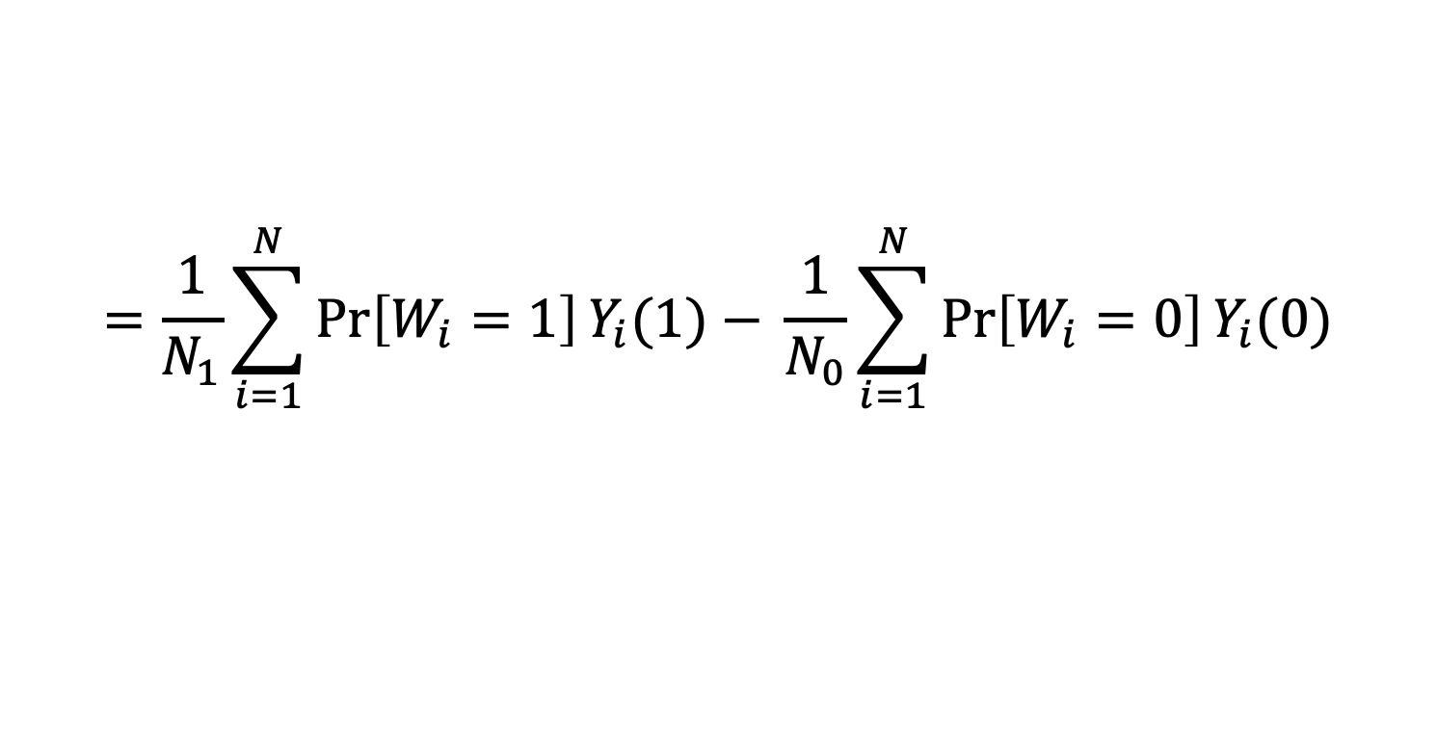

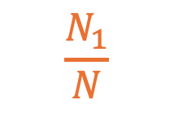
Why does $𝔼\left[\hat{τ}\right]=τ$?
Say we choose $N_{0}$ people at random for the control group, and $N_{1}$ people at random for the treatment group.
$$\hat{τ} = \frac{1}{N_{1}}\sum_{i:W_{i}=1}{Y_{i}}−\frac{1}{N_{0}}\sum_{i:W_{i}=0}{Y_{i}}$$
$$𝔼[ ]$$
$$𝔼[ ]$$
$$=𝔼\left[\frac{1}{N_{1}}\sum_{i=1}^{N}{1\left[W_{i}=1\right]Y_{i}(1) −\frac{1}{N_{0}}}\sum_{i=1}^{N}{1\left[W_{i}=0\right]Y_{i}(0) }\right]$$
$$=\frac{1}{N_{1}}\sum_{i=1}^{N}{\operatorname{Pr}\left[W_{i}=1\right]Y_{i}(1)− }\frac{1}{N_{0}}\sum_{i=1}^{N}{\operatorname{Pr}\left[W_{i}=0\right]Y_{i}(0)}$$
$$\frac{N_{1}}{N}$$
$$\frac{N_{0}}{N}$$

Slide 44


Why does $𝔼\left[\hat{τ}\right]=τ$?
Say we choose $N_{0}$ people at random for the control group, and $N_{1}$ people at random for the treatment group.
$$\hat{τ} = \frac{1}{N_{1}}\sum_{i:W_{i}=1}{Y_{i}}−\frac{1}{N_{0}}\sum_{i:W_{i}=0}{Y_{i}}$$
$$𝔼[ ]$$
$$𝔼[ ]$$
$$=𝔼\left[\frac{1}{N_{1}}\sum_{i=1}^{N}{1\left[W_{i}=1\right]Y_{i}(1) −\frac{1}{N_{0}}}\sum_{i=1}^{N}{1\left[W_{i}=0\right]Y_{i}(0) }\right]$$
$$=\frac{1}{N_{1}}\sum_{i=1}^{N}{\operatorname{Pr}\left[W_{i}=1\right]Y_{i}\left(1\right)− }\frac{1}{N_{0}}\sum_{i=1}^{N}{\operatorname{Pr}\left[W_{i}=0\right]Y_{i}}(0)$$
$$=\frac{1}{N_{1}}\sum_{i=1}^{N}{\frac{N_{1}}{N}⋅Y_{i}(1) − }\frac{1}{N_{0}}\sum_{i=1}^{N}{\frac{N_{0}}{N}{⋅Y}_{i}(0)}$$

Slide 45


Why does $𝔼\left[\hat{τ}\right]=τ$?
Say we choose $N_{0}$ people at random for the control group, and $N_{1}$ people at random for the treatment group.
$$\hat{τ} = \frac{1}{N_{1}}\sum_{i:W_{i}=1}{Y_{i}}−\frac{1}{N_{0}}\sum_{i:W_{i}=0}{Y_{i}}$$
$$𝔼[ ]$$
$$𝔼[ ]$$
$$=𝔼\left[\frac{1}{N_{1}}\sum_{i=1}^{N}{1\left[W_{i}=1\right]Y_{i}(1) −\frac{1}{N_{0}}}\sum_{i=1}^{N}{1\left[W_{i}=0\right]Y_{i}(0) }\right]$$
$$=\frac{1}{N_{1}}\sum_{i=1}^{N}{\operatorname{Pr}\left[W_{i}=1\right]Y_{i}\left(1\right)− }\frac{1}{N_{0}}\sum_{i=1}^{N}{\operatorname{Pr}\left[W_{i}=0\right]Y_{i}}(0)$$
$$=\frac{1}{N_{1}}\sum_{i=1}^{N}{\frac{N_{1}}{N}⋅Y_{i}(1) − }\frac{1}{N_{0}}\sum_{i=1}^{N}{\frac{N_{0}}{N}{⋅Y}_{i}(0)}$$
$$=\frac{1}{N}\sum_{i=1}^{N}{\left(Y_{i}\left(1\right)−Y_{i}\left(0\right)\right)=τ}$$

Slide 46


$\hat{τ}$ is an unbiased estimator for $τ$ (Always, not just in the aspirin example)
Great! So if we do an RCT, we can compute $\hat{τ}$, and in expectation we should get $τ$ (ATE)!
But… in any specific case we may be off, maybe far off!
We should be more careful!
What is the variance of $\hat{τ}$? (And what are standard errors?)
Is it likely that $\hat{τ}$ is close to $τ$? (And what are the confidence intervals?)
And how do these things depend on the size of our treatment/control groups?

Slide 47














Our toy aspirin example is too small…
Be wary of small sample sizes!
Let’s look at a bigger version of this example for the rest of this discussion.
Now, there are 6000 units.
Notice that ATE is still ½.
Draw $N_{1}$ at random for the treatment group, $N_{0}$ at random for the control group.
$4000$ of these
$1000$ of these
$1000$ of these
$$i$$
$$Y_{i}(1)$$
$$1$$
$$0$$
$$0$$
$$Y_{i}(0)$$
$$0$$
$$0$$
$$1$$

Slide 48



What happens when the control/treatment groups grow?
Mean of $\hat{τ}$
Std. Dev. of $\hat{τ}$
Distribution of $\hat{τ}$
6000 people, choose 3 for each group.
6000 people, choose 30 for each group.
6000 people, choose 300 for each group.
Discuss:
Qualitatively, how do you think these things will change as the number of people in the control/treatment group increases?
(While the larger population stays the same, 6000 people)
We did each experiment 10,000 times to generate this data.

Slide 49



What happens when the control/treatment groups grow?
Mean of $\hat{τ}$
Std. Dev. of $\hat{τ}$
Distribution of $\hat{τ}$
6000 people, choose 3 for each group.
6000 people, choose 30 for each group.
6000 people, choose 300 for each group.
1/2
0.345
1/2
0.11
1/2
0.03
We did each experiment 10,000 times to generate this data.

Slide 50

Bigger treatment/control groups are better
But how can we measure how good they are?
In the previous slide, we cheated by running 10,000 experiments for each $N_{0}$, $N_{1}$ -- in real life, we typically only get one experiment.
Last week, we saw two methods for computing standard errors and constructing confidence intervals:
Resampling (aka bootstrapping)
Analytical methods
Both work here!

Slide 51

Resampling (aka bootstrapping)
Basic idea:
Use the data you have to construct a bunch of “fake” (bootstrap) datasets at random, by resampling with replacement.
Look at the distribution of those.

Slide 52



Resampling
Suppose we have a random treatment group $T$ and a control group $C$
Choose $N_{0}$ people with repetition in $C$ at random.
Choose $N_{1}$ people with repetition in $T$ at random.
Create “new” treatment and control groups from these samples.
Actual Treatment Group $T$
Actual Control Group $C$

Slide 53



Resampling
Suppose we have a random treatment group $T$ and a control group $C$
Choose $N_{0}$ people with repetition in $C$ at random.
Choose $N_{1}$ people with repetition in $T$ at random.
Create “new” treatment and control groups from these samples.
Compute $\hat{τ}$ with these treatment/control groups.
Repeat a bunch of times and look at the distribution of what you get.
“New/bootstrapped” Treatment Group $T^{∗}$
“New/bootstrapped” Control Group $C^{∗}$

Slide 54

Resampling
Suppose we have a random treatment group $T$ and a control group $C$
Choose $N_{0}$ people with repetition in $C$ at random.
Choose $N_{1}$ people with repetition in $T$ at random.
Create “new” treatment and control groups from these samples.
Compute $\hat{τ}$ with these treatment/control groups.
Repeat a bunch of times and look at the distribution of what you get.
For standard errors:
Take the square root of the sample variance (as discussed in Week 1)
For confidence intervals:
Use the method from HW0

Slide 55

Analytical methods
Basic idea:
Do some math to figure out what the distribution of $\hat{τ}$ should be
Maybe we have to plug in some estimates

Slide 56



Analytic Variance Estimator
Essentially, $\hat{τ}$ is a sum of $N_{0}+N_{1}$ independent* things:
$$\hat{τ}=\frac{1}{N_{1}}\sum_{i:W_{i}=1}{Y_{i}}−\frac{1}{N_{0}}\sum_{i:W_{i}=0}{Y_{i}}$$
We saw in Week 1 that $Var\left(\frac{1}{N_{1}}\sum_{i:W_{i}=1}{Y_{i}}\right)$ should be something like $s_{1}^{2}/N_{1}$, and similarly for the second term.
Together, we get $Var\left(\hat{τ}\right)≈\frac{s_{1}^{2}}{N_{1}}+\frac{s_{0}^{2}}{N_{0}}$
$s_{1}^{2}=$ Sample variance of $Y_{i}$ among the treatment group
$s_{0}^{2}=$ Sample variance of $Y_{i}$ among the control group
*Not actually independent! This is because, e.g., someone can’t be in both the control group and the treatment group at the same time. But pretty close when N is big.

Slide 57


With our estimate of $Var(\hat{τ})$…
We can construct standard errors
Take the square root of our estimate: $\sqrt{\frac{s_{1}^{2}}{N_{1}}+\frac{s_{0}^{2}}{N_{0}}}$
We can construct confidence intervals
By the CLT, $\hat{τ}≈N(τ, Var\left(\hat{τ}\right))$
Plug in $Var\left(\hat{τ}\right)≈\frac{s_{1}^{2}}{N_{1}}+\frac{s_{0}^{2}}{N_{0}}$
Look at the 95% (or whatever) confidence interval for the corresponding Gaussian

Slide 58

This allows us to do hypothesis testing!
Figure out a 95% (or whatever) confidence interval based on $\hat{τ}$
Either analytically or with resampling
Null hypothesis: $τ=0$ (there is no effect)
If $0$ lies outside the confidence interval, reject the null with p-value 0.05 (or whatever).
In this case we’d say: “There is a statistically significant effect of aspirin on headaches (p-value 0.05)”
Typically we’d do this the other way around ... Instead of first picking “95%” and seeing if we can reject the null hypothesis with p-value 0.05, we’d start with the null and see what p-value would allow us to reject it.

Slide 59
Putting in all together and interpreting results

Slide 60

Putting it all together Analyzing an RCT
Design and run your RCT (we didn’t really talk about this today)
Check that your control and treatment groups “balance” observables.
Compute:
$$\hat{τ}=\left(average in treatment group\right) −(average in control group)$$
Are we confident that there is an effect?
Construct a confidence interval (say, 95%) for $τ$
Either analytically, or via resampling
If 0 doesn’t lie in the confidence interval, we are confident there is an effect!
With p-value 0.05 for a 95% confidence interval, etc.
How big is the effect?
First, decide if you think that your estimate of $\hat{τ}$ is about the same as the true $τ$
Either with confidence intervals, or by comparing to standard errors
Then, decide if you think that effect is “big,” aka “important”…
2.5 points on a 100 point exam? How important this is is subjective!
A result can be very statistically significant without being very big (aka important)!

Slide 61
Looking at RCTs in papers etc
Let’s look at a few tables and try to interpret them!

Slide 62
Made-up Study
We did* a study of the effect of chocolate on test scores.
About half of a large undergraduate class at Stanford was randomly given chocolate half an hour prior to the (timed, in-person) exam.**
*We did not do this study.
**This did not happen.

Slide 63

Suppose we saw this
Square brackets are sample standard deviations.
Round brackets are standard errors.
Discuss:
What do you take away from this?

Slide 64

How about now?
Square brackets are sample standard deviations.
Round brackets are standard errors.
Discuss:
What do you take away from this?

Slide 65

And now?
Square brackets are sample standard deviations.
Round brackets are standard errors.
Discuss:
What do you take away from this?

Slide 66
Recap and Looking ahead
Don’t forget to wait for the exit ticket!

Slide 67

Recap
RCTs are magical!
Use randomness to get around selection effects/confounding variables!
They can provide compelling evidence with big policy impact.
We can analyze them!
The key is estimating the variance of the estimator $\hat{τ}$ (observational comparison)
Two ways: analytically or by re-sampling.
Once we have that, we can construct confidence intervals, quantify statistical significance.

Slide 68
Looking ahead
RCTs aren’t perfect.
We’ll discuss some (more) of the issues next time.

Slide 69
Before next time
HW1, part 1 due on Monday!
Reading response before next class (Due Monday 11:59pm)

Slide 70


Exit ticket
Don’t forget to fill out the exit ticket before you leave class!

