Slide 1
Returns to Education Some theory and some regressions!
Causality, Decision-Making, and Data Science
Lecture 10

Slide 2
Announcements
HW2 Part 2 Due Monday ☺
We’ll get you feedback on your project ideas soon!
After you get feedback (or even before), feel free to come chat with us about them in office hours!
We’ll be seeing lots of new techniques in the coming weeks…
Instrumental Variables
Regression Discontinuity
Difference-in-differences
Matrix Completion
Synthetic Controls
… As we learn these, think if they can help your project!

Slide 3
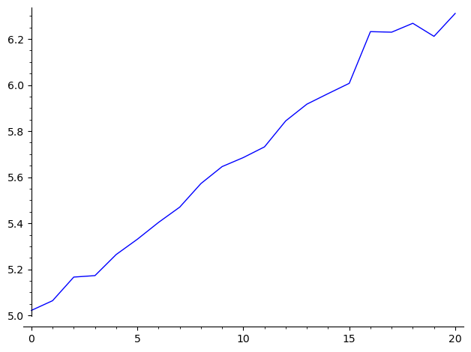

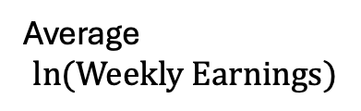
New Unit! Returns to Education
What is the effect of education on…
Earnings?
Well-being?
…
Average
$$\ln{(Weekly Earnings)}$$
Certainly there is a correlation!
At least with earnings
Data is from the 1980 census, including men born between 1930 and 1939 with positive value for usual weekly wage.
There are about 330,000 people in this sample.
$$Years of schooling$$

Slide 4
New Unit! Returns to Education
What is the effect of education on…
Earnings?
Well-being?
…
The plan:
Today: More regression! And Twin Studies!
Next time: Instrumental Variables
Next next time: More Instrumental Variables and Neural Networks
Next next next time: Regression Discontinuity

Slide 5
Agenda
Simple model for returns to education: Mincer 1964
Omitted Variable Bias
Twin Studies

Slide 6
Mincer Model of returns to education

Slide 7
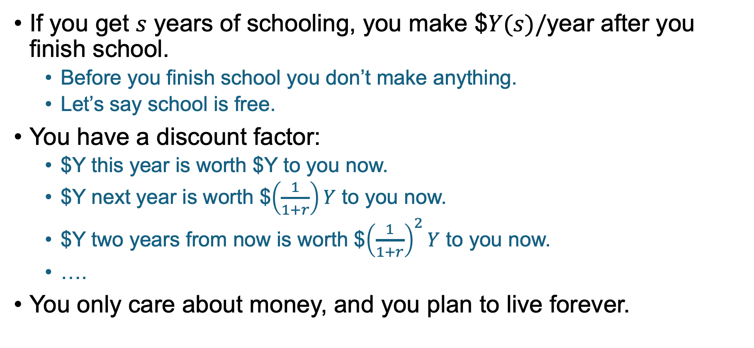
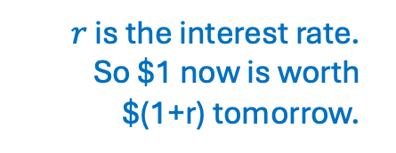
Simple Model How do you decide to stay in school?
If you get $s$ years of schooling, you make $$Y(s)/$year after you finish school.
Before you finish school you don’t make anything.
Let’s say school is free.
You have a discount factor:
$Y this year is worth $Y to you now.
$Y next year is worth $$\left(\frac{1}{1+r}\right)Y$ to you now.
$Y two years from now is worth $${\left(\frac{1}{1+r}\right)}^{2}Y$ to you now.
….
You only care about money, and you plan to live forever.
$r$ is the interest rate.
So $1 now is worth $(1+r) tomorrow.

Slide 8



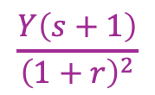

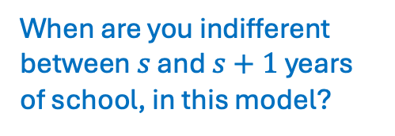


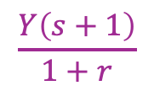
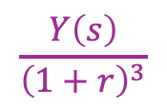



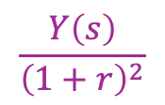


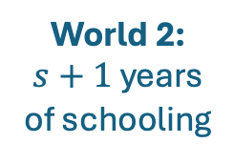

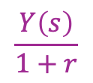
Simple Model Continued How do you decide to stay in school?
When are you indifferent between $s$ and $s+1$years of school, in this model?
In school, no income
$$\frac{Y\left(s\right)}{1+r}$$
$$\frac{Y\left(s\right)}{{\left(1+r\right)}^{2}}$$
$$\frac{Y\left(s\right)}{{\left(1+r\right)}^{3}}$$
World 1:
$s$ years of schooling
$$Y(s)$$
$$s$$
$$s+1$$
$$s+2$$
$$s+3$$
In school, no income
$$\frac{Y\left(s+1\right)}{1+r}$$
$$\frac{Y\left(s+1\right)}{{\left(1+r\right)}^{2}}$$
$$\frac{Y\left(s+1\right)}{{\left(1+r\right)}^{3}}$$
World 2:
$s+1$ years of schooling
$$s$$
$$s+1$$
$$s+2$$
$$s+3$$
Now

Slide 9
TODO
Write pollev answers on board ahead of time so that they can look at them and the previous slide at the same time!

Slide 10
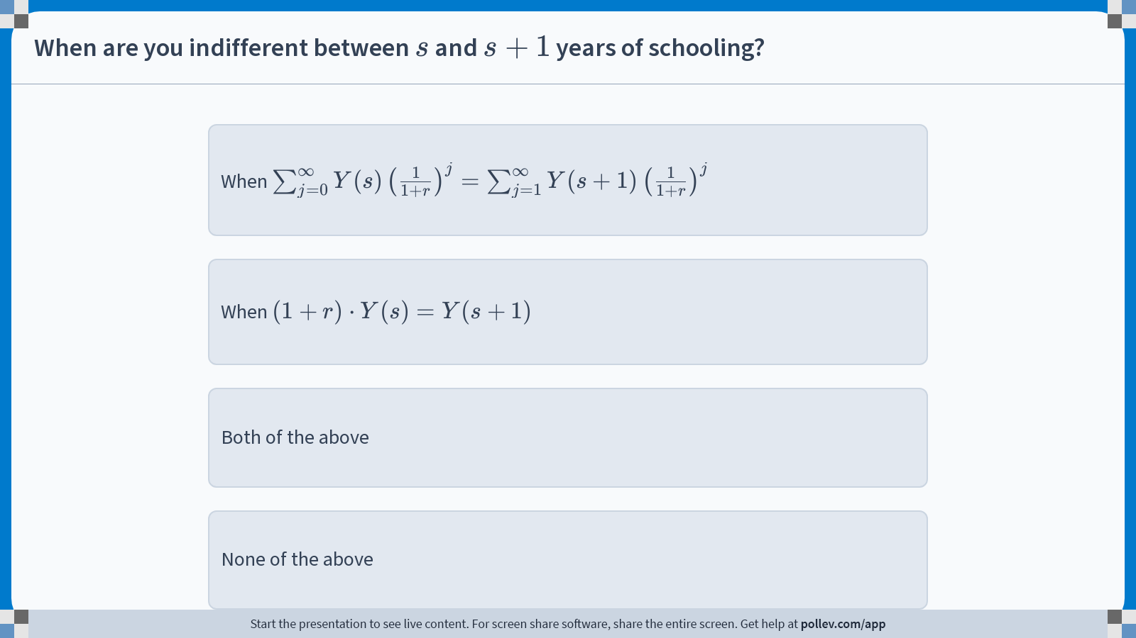
Notes:
Do not modify the notes in this section to avoid tampering with the Poll Everywhere activity. More info at polleverywhere.com/support When are you indifferent between $$s$$ and $$s+1$$ years of schooling?
https://www.polleverywhere.com/multiple_choice_polls/sRwfi1KLhfDhRW8HzZvjw?display_state=instructions&activity_state=opened&state=opened&flow=Engagement&onscreen=persist

Slide 11
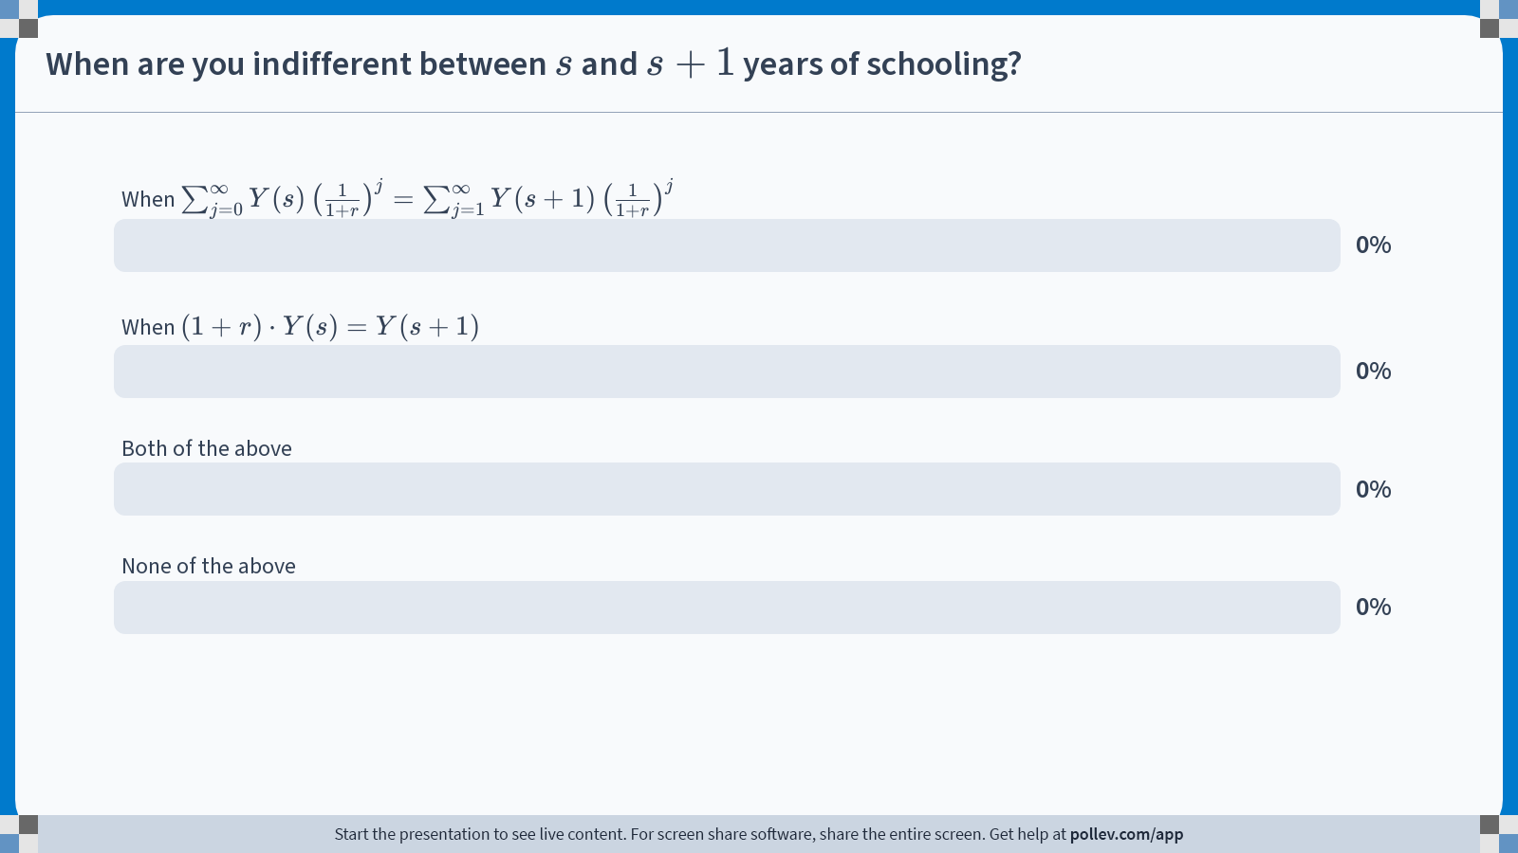
Notes:
Do not modify the notes in this section to avoid tampering with the Poll Everywhere activity. More info at polleverywhere.com/support When are you indifferent between $$s$$ and $$s+1$$ years of schooling?
https://www.polleverywhere.com/multiple_choice_polls/sRwfi1KLhfDhRW8HzZvjw?display_state=chart&activity_state=opened&state=opened&flow=Engagement&onscreen=persist

Slide 12

Notes:
Do not modify the notes in this section to avoid tampering with the Poll Everywhere activity. More info at polleverywhere.com/support When are you indifferent between $$s$$ and $$s+1$$ years of schooling?
https://www.polleverywhere.com/multiple_choice_polls/sRwfi1KLhfDhRW8HzZvjw?display_state=chart&activity_state=closed&state=closed&flow=Engagement&onscreen=persist

Slide 13




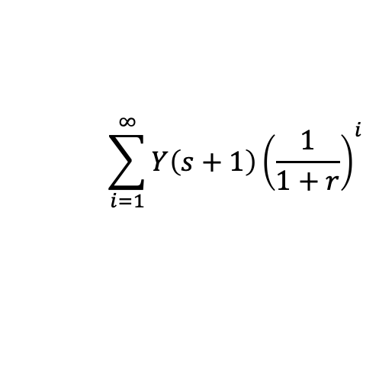




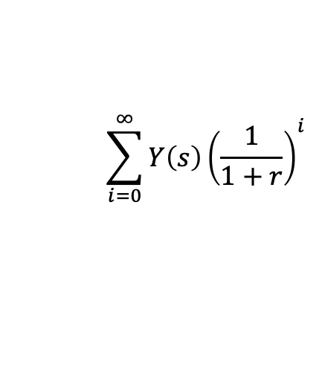









All of the above!
$$\sum_{i=0}^{∞}{Y\left(s\right){\left(\frac{1}{1+r}\right)}^{i}}$$
$$\sum_{i=1}^{∞}{Y\left(s+1\right){\left(\frac{1}{1+r}\right)}^{i}}$$
(A)
Adding up World 1:
Adding up World 2:
So you are indifferent when they are equal!
In school, no income
$$\frac{Y\left(s\right)}{1+r}$$
$$\frac{Y\left(s\right)}{{\left(1+r\right)}^{2}}$$
$$\frac{Y\left(s\right)}{{\left(1+r\right)}^{3}}$$
World 1:
$s$ years of schooling
$$Y(s)$$
$$s$$
$$s+1$$
$$s+2$$
$$s+3$$
In school, no income
$$\frac{Y\left(s+1\right)}{1+r}$$
$$\frac{Y\left(s+1\right)}{{\left(1+r\right)}^{2}}$$
$$\frac{Y\left(s+1\right)}{{\left(1+r\right)}^{3}}$$
World 2:
$s+1$ years of schooling
$$s$$
$$s+1$$
$$s+2$$
$$s+3$$
Now

Slide 14
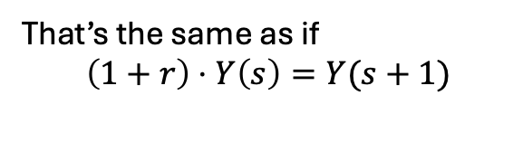
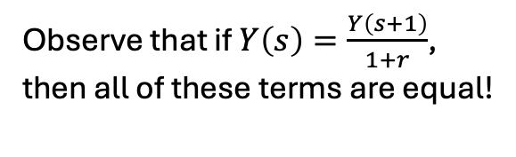
All of the above!
$$\sum_{i=0}^{∞}{Y\left(s\right){\left(\frac{1}{1+r}\right)}^{i}}$$
$$\sum_{i=1}^{∞}{Y\left(s+1\right){\left(\frac{1}{1+r}\right)}^{i}}$$
(A)
Adding up World 1:
Adding up World 2:
So you are indifferent when they are equal!
(B)
Observe that if $Y\left(s\right)=\frac{Y\left(s+1\right)}{1+r}$, then all of these terms are equal!
In school, no income
$$\frac{Y\left(s\right)}{1+r}$$
$$\frac{Y\left(s\right)}{{\left(1+r\right)}^{2}}$$
$$\frac{Y\left(s\right)}{{\left(1+r\right)}^{3}}$$
World 1:
$s$ years of schooling
$$Y(s)$$
That’s the same as if
$$\left(1+r\right)⋅Y\left(s\right)=Y(s+1)$$
$$s$$
$$s+1$$
$$s+2$$
$$s+3$$
So if (B) holds, (A) also holds and you are indifferent.
In school, no income
$$\frac{Y\left(s+1\right)}{1+r}$$
$$\frac{Y\left(s+1\right)}{{\left(1+r\right)}^{2}}$$
$$\frac{Y\left(s+1\right)}{{\left(1+r\right)}^{3}}$$
World 2:
$s+1$ years of schooling
$$s$$
$$s+1$$
$$s+2$$
$$s+3$$
Now

Slide 15


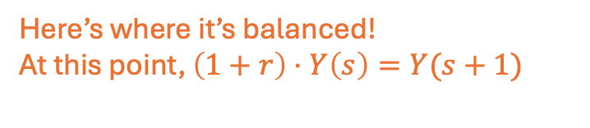
Why does indifference matter?
Personally, I’m pretty indifferent about indifference…
Idea: You’ll leave school when it stops being worth it.
Value of staying in school one more year
The amount of money I’ll make with a high school degree is worth waiting to enter the workforce!
Here’s where it’s balanced!
At this point, $\left(1+r\right)⋅Y\left(s\right)=Y(s+1)$
$$s$$
Time
The extra salary from that second PhD isn’t worth the lost earnings from wasting 5+ years being in school…

Slide 16
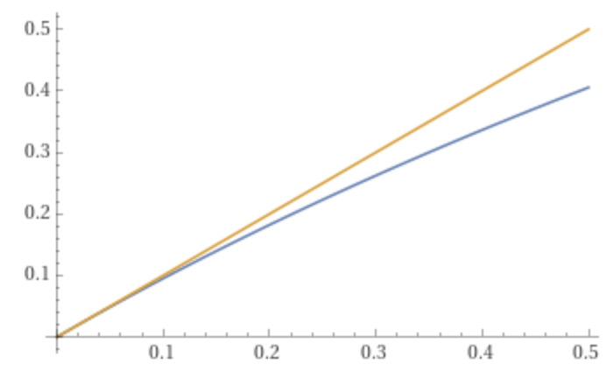







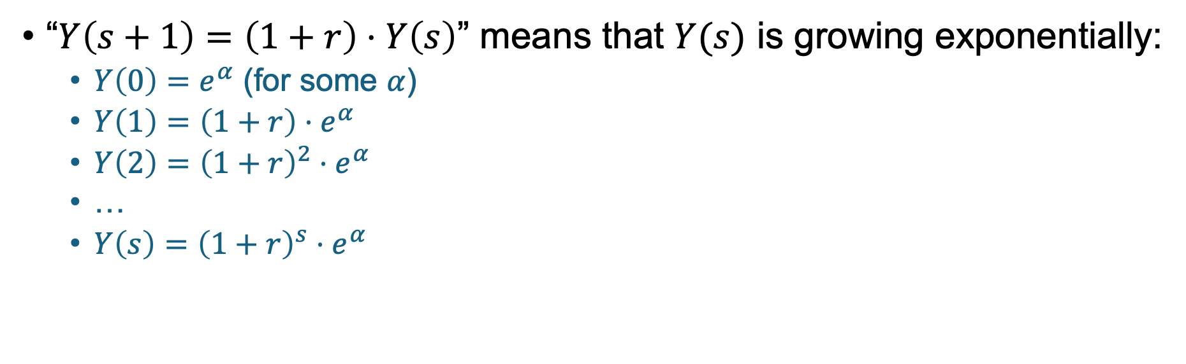

This tells us about $Y(s)$! at the point $s$ where someone leaves school
At this point,
$$\left(1+r\right)⋅Y\left(s\right)=Y(s+1)$$
$$s$$
“$Y\left(s+1\right)=\left(1+r\right)⋅Y\left(s\right)$” means that $Y(s)$ is growing exponentially:
$Y\left(0\right)=e^{α}$ (for some $α$)
$Y\left(1\right)=\left(1+r\right){⋅e}^{α}$
$Y\left(2\right)={\left(1+r\right)}^{2}⋅e^{α}$
…
$Y\left(s\right)={\left(1+r\right)}^{s}⋅e^{α}$
For small $r$, $\ln\left(1+r\right)≈r$:
Take natural log of both sides:
$$r$$
$$\ln\left(Y\left(s\right)\right)=s⋅\ln\left(1+r\right)+α$$
$$ln⁡(1+r)$$
$$\ln\left(Y(s)\right)≈s⋅r+α$$

Slide 17
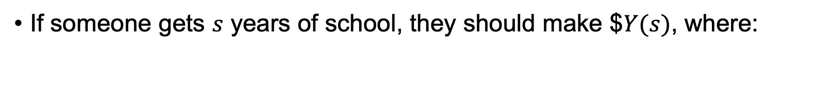



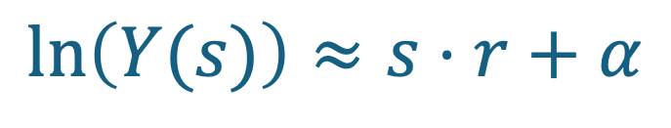
This tells us about $Y(s)$! at the point $s$ where someone leaves school
If someone gets $s$ years of school, they should make $$Y(s)$, where:
$$\ln\left(Y(s)\right)≈s⋅r+α$$
That means that $\ln\left(Earnings\right)$ should have an approximately linear relationship with $Years of Schooling$.
Average
$$\ln{(Weekly Earnings)}$$
This sounds like a job for…
Seems about right?
Regression!
$$Years of schooling$$

Slide 18






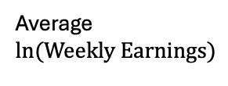

Regression Time!
Dependent Variable: $Y=ln⁡(Earnings)$
Independent Variable: $S=$ years of Education
Fit a regression model: $Y=α+β⋅S+noise$
Discuss:
Should “$0.0709$” be interpreted causally?
(At least for the population
in this dataset?)
“If some gets one more year of schooling their income will multiply by $e^{0.0709}≈1.07$”
Come up with at least one reason why this may be compelling, and at least one reason why it is not.
$$Y=4.995+0.0709⋅S$$
$$(0.005)$$
$$(0.0004)$$
Average
$$\ln{(Weekly Earnings)}$$
Looks pretty linear!
$$Years of schooling$$
Data from the 1980 census, including men born between 1930 and 1939 with positive value for usual weekly wage. About 330,000 people.

Slide 19
Should we interpret this regression causally?
Reasons why we should:
The Mincer model predicted a linear relationship, and in that model there is some sort of causality.
Reasons why we might be wary:
We may not believe the Mincer model…
There are lots of other reasons people go to school
There are lots of other reasons people make money
Maybe there are confounding variables we have left out!

Slide 20
Omitted Variable Bias

Slide 21
Omitted Variable Bias
We’ve already seen that we can “control” for a confounding variable by including it in a regression (or a random forest).
How “bad” is our estimate if we don’t do that?
Aka, what is the Bias caused by Omitting that Variable?

Slide 22
Example
Omitted variable: “ability” (as measured by an IQ test)
People with higher “ability” (at the time they are deciding to get more schooling) may be more likely to get more schooling, and may also have more returns to it.
Years of Schooling
IQ test scores
Income

Slide 23


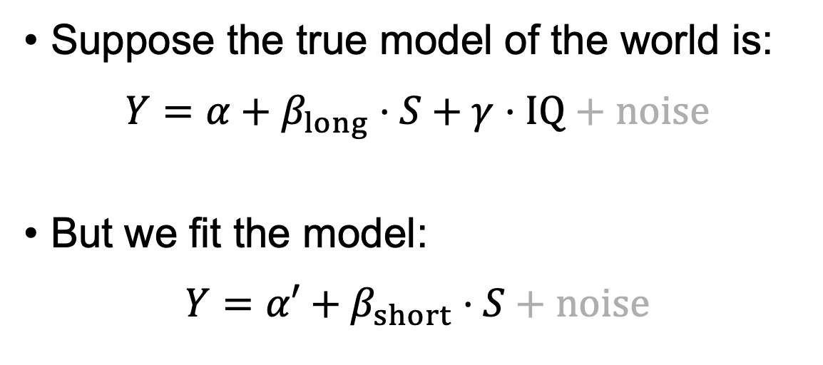



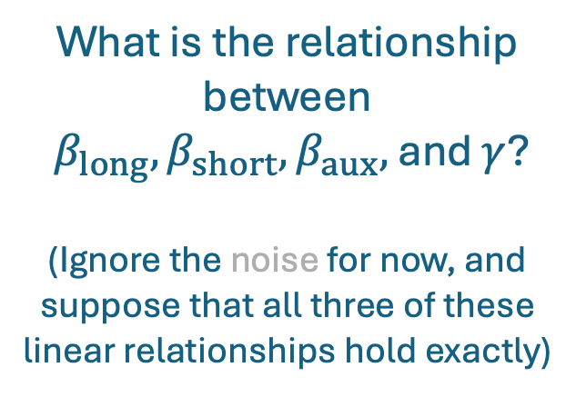
Example Continued
$S$
yrs of school
$$IQ$$
$$Y$$
Log(Income)
Suppose the true model of the world is:
$$Y=α+β_{long}⋅S+γ⋅IQ+noise$$
But we fit the model:
$$Y=α′+β_{short}⋅S+noise$$
What is the relationship between
$β_{long}, β_{short}, β_{aux},$ and $γ$?
(Ignore the noise for now, and suppose that all three of these linear relationships hold exactly)
Consider also the auxiliary regression:
$$IQ=α′′+β_{aux}⋅S+noise$$
Hint: Plug the auxiliary regression into our “true model of the world,” and compare that to the model that we fit.

Slide 24
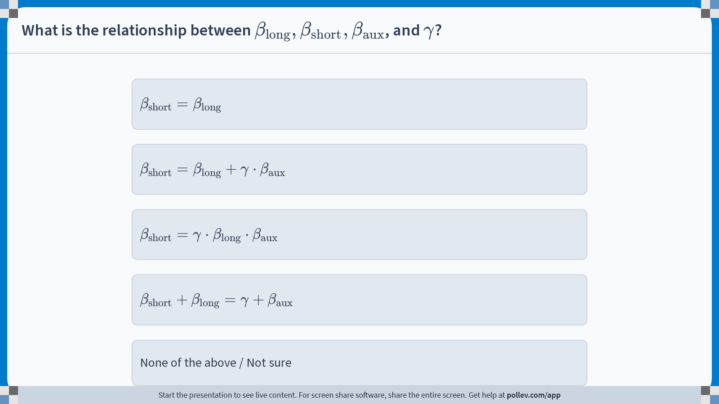
Notes:
Do not modify the notes in this section to avoid tampering with the Poll Everywhere activity. More info at polleverywhere.com/support What is the relationship between $$\beta_{\text{long}}, \beta_{\text{short}}, \beta_{\text{aux}}$$, and $$\gamma$$?
https://www.polleverywhere.com/multiple_choice_polls/e66NhbSmQcBfawuWQOVM5?display_state=instructions&activity_state=opened&state=opened&flow=Engagement&onscreen=persist

Slide 25
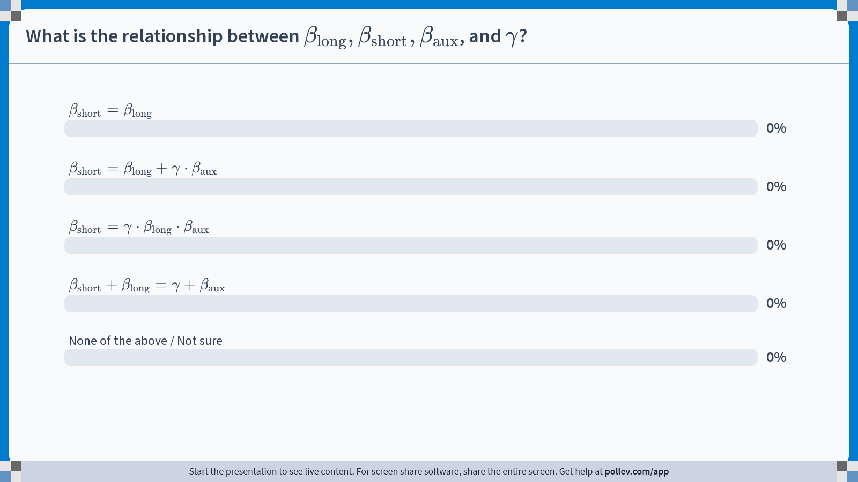
Notes:
Do not modify the notes in this section to avoid tampering with the Poll Everywhere activity. More info at polleverywhere.com/support What is the relationship between $$\beta_{\text{long}}, \beta_{\text{short}}, \beta_{\text{aux}}$$, and $$\gamma$$?
https://www.polleverywhere.com/multiple_choice_polls/e66NhbSmQcBfawuWQOVM5?display_state=chart&activity_state=opened&state=opened&flow=Engagement&onscreen=persist

Slide 26

Notes:
Do not modify the notes in this section to avoid tampering with the Poll Everywhere activity. More info at polleverywhere.com/support What is the relationship between $$\beta_{\text{long}}, \beta_{\text{short}}, \beta_{\text{aux}}$$, and $$\gamma$$?
https://www.polleverywhere.com/multiple_choice_polls/e66NhbSmQcBfawuWQOVM5?display_state=chart&activity_state=closed&state=closed&flow=Engagement&onscreen=persist

Slide 27
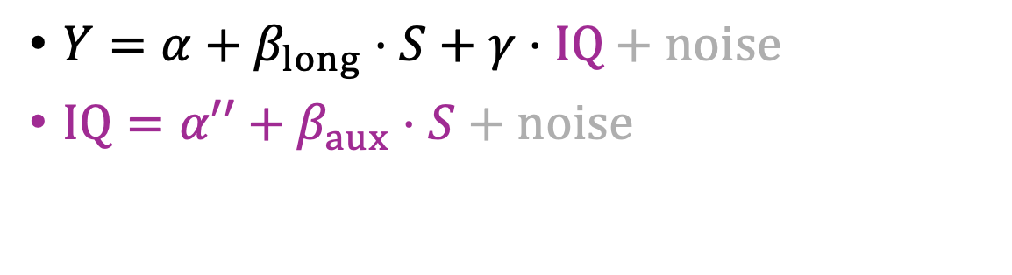
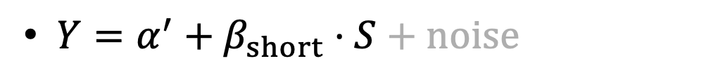
Example Continued
$S$
yrs of school
$$IQ$$
$$Y$$
Log(Income)
$Y=α+β_{long}⋅S+γ⋅IQ+noise$
$IQ=α′′+β_{aux}⋅S+noise$
$Y=α^{′}+β_{short}⋅S+noise$

Slide 28
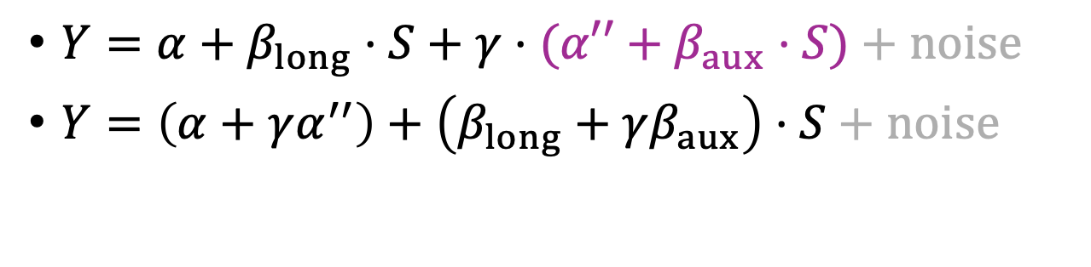
Example Continued
$S$
yrs of school
$$IQ$$
$$Y$$
Log(Income)
$Y=α+β_{long}⋅S+γ⋅(α′′+β_{aux}⋅S)+noise$
$Y=\left(α+γα^{′′}\right)+\left(β_{long}+γβ_{aux}\right)⋅S+noise$
$Y=α^{′}+β_{short}⋅S+noise$

Slide 29
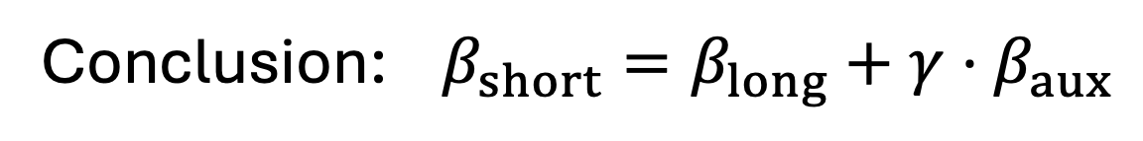
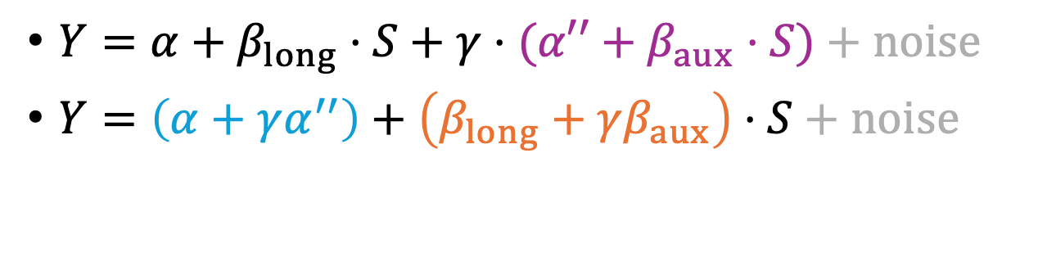
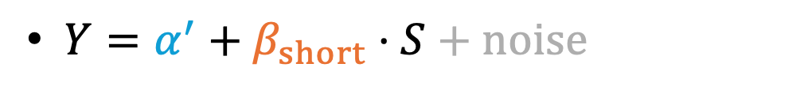
Example Continued
$S$
yrs of school
$$IQ$$
$$Y$$
Log(Income)
$Y=α+β_{long}⋅S+γ⋅(α′′+β_{aux}⋅S)+noise$
$Y=\left(α+γα^{′′}\right)+\left(β_{long}+γβ_{aux}\right)⋅S+noise$
$Y=α^{′}+β_{short}⋅S+noise$
Conclusion: $β_{short}=β_{long}+γ⋅β_{aux}$
(And the same will be approximately true of our estimates)

Slide 30

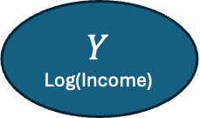


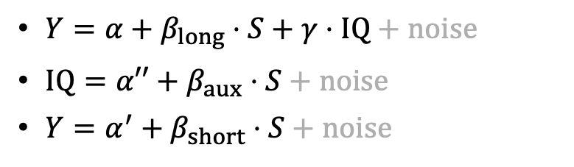
Intuition
How much Y changes with IQ
How much IQ changes with S
$$β_{short}=β_{long}+γ⋅β_{aux}$$
If you change S, how much does Y change?
If you change S and keep IQ constant, how much does Y change?
If you change S, that’s correlated with a change in IQ…how much does that change in IQ change Y?
$S$
yrs of school
$Y=α+β_{long}⋅S+γ⋅IQ+noise$
$IQ=α′′+β_{aux}⋅S+noise$
$Y=α^{′}+β_{short}⋅S+noise$
$$Y$$
Log(Income)
$$IQ$$

Slide 31
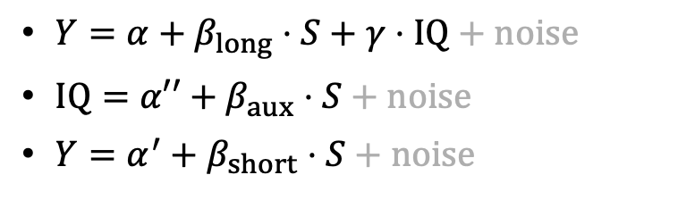

Aside: The chain rule in calculus!
We have $Y=f(S,IQ)$ for some function $f$.
Chain rule says:
$$\frac{∂Y}{∂S}=\frac{∂f}{∂S}⋅\frac{∂S}{∂S}+\frac{∂f}{∂IQ}⋅\frac{∂IQ}{∂S}$$
$Y=α+β_{long}⋅S+γ⋅IQ+noise$
$IQ=α′′+β_{aux}⋅S+noise$
$Y=α^{′}+β_{short}⋅S+noise$

Slide 32








Aside: The chain rule in calculus!
We have $Y=f(S,IQ)$ for some function $f$.
Chain rule says:
$$\frac{∂Y}{∂S}=\frac{∂f}{∂S}⋅\frac{∂S}{∂S}+\frac{∂f}{∂IQ}⋅\frac{∂IQ}{∂S}$$
$$γ$$
$$β_{short}$$
$$β_{long}$$
$${⋅β}_{aux}$$
$$=$$
$$⋅1$$
$$+$$
$Y=α+β_{long}⋅S+γ⋅IQ+noise$
$IQ=α′′+β_{aux}⋅S+noise$
$Y=α^{′}+β_{short}⋅S+noise$

Slide 33
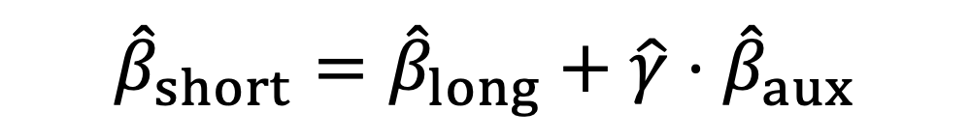
Back to our original question
If we omit a variable, what is the bias?
$${\hat{β}}_{short}={\hat{β}}_{long}+\hat{γ}⋅{\hat{β}}_{aux}$$
What we estimate from our “short” regression
The “correct” answer from the “long” regression
This is the bias!
In this example, do you expect the bias term to be positive or negative?
$Y=α+β_{long}⋅S+γ⋅IQ+noise$
$IQ=α′′+β_{aux}⋅S+noise$
$Y=α^{′}+β_{short}⋅S+noise$

Slide 34
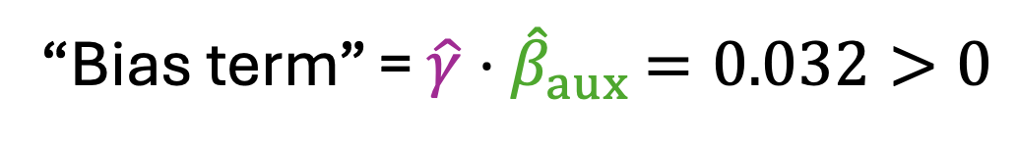




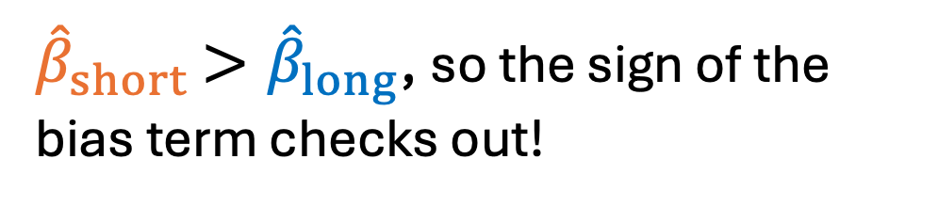

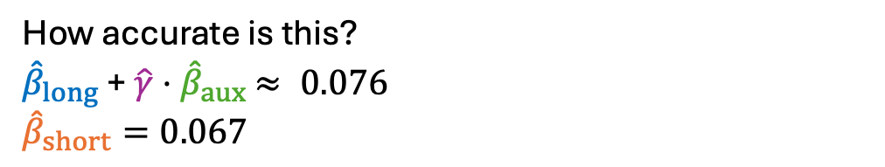
What do we actually get?
$${\hat{β}}_{long}$$
$$\hat{γ}$$
$Y=4.705+0.044⋅S+0.006⋅IQ$
$IQ=53.65+3.53⋅S$
$Y=5.05+0.067⋅S$
(0.100)
(0.007)
(0.001)
$${\hat{β}}_{aux}$$
“Bias term” = $\hat{γ}⋅{\hat{β}}_{aux}$ $=0.032>0$
(2.62)
(0.192)
${\hat{β}}_{short}$ $>{\hat{β}}_{long}$, so the sign of the bias term checks out!
$${\hat{β}}_{short}$$
(0.08)
(0.006)
How accurate is this?
${\hat{β}}_{long}$ + $\hat{γ}⋅{\hat{β}}_{aux}$ $≈ 0.076$
$${\hat{β}}_{short}=0.067$$

Slide 35

Take-Aways: Omitted Variable Bias
Just like always, if we don’t include confounding variables in our regression, it can bias our estimate.
The bias has the form…
ATE of independent variable on omitted variable
ATE of omitted variable on outcome
$${\hat{β}}_{short}={\hat{β}}_{long}+\hat{γ}⋅{\hat{β}}_{aux}$$
What we have
What we want
Bias!
We don’t know the bias…
… But maybe we can reason about it intuitively!
Positive/Negative? Big/Small?

Slide 36
How to get around omitted variables?
If only we could control for more of the possible confounders…
…maybe by matching up people who are very similar?

Slide 37
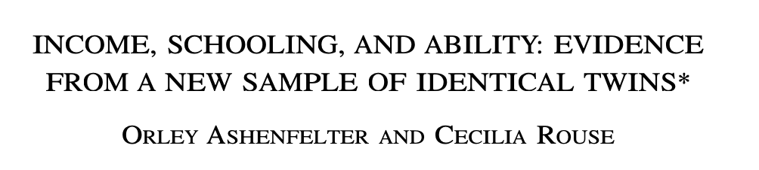
Twin Studies!
Quarterly Journal of Economics, 1998

Slide 38




Where to find twins?
The Twinsburg Twins Festival in Twinsburg, Ohio!

Slide 39
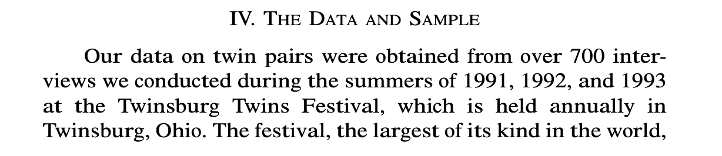

The data: interviewing twins

Slide 40
Also: Less entertaining data
Current Population Survey (CPS)
A monthly survey of about 50,000 American households
Used to calculate the monthly unemployment rate
Also asks about earnings*
*Sometimes…
Notes:
*sometimes means
Period. Source of Earnings Data Frequency
========================================
1940–1961 Occasional supplements. Irregular
1962–1975 March Income Supplement Annual
1976–present March ASEC Annual
1979, 1981 May Earnings Supplements Occasional
1983–1993 May Earnings Supplements Annual
1994–present. Monthly CPS (outgoing rotation groups). Monthly

Slide 41


Let’s run some regressions! So far nothing fancy about twins, just treat them as a normal data set
Outcome: $Y_{ }$ = log(hourly wage)
Variable of interest: $S_{ }$ = education (years)
Other Variables ($\vec{X}$):
Age
Age² / 100
Female?
White?
This $⟨⋅, ⋅⟩$ notation is just a concise way of saying “throw in all those other variables”
$$Y=α+β⋅S+⟨\vec{γ},\vec{X}⟩+noise$$

Slide 42


The results
This column: results with CPS data
This column: results with twins data
$$Y=α+β⋅S+⟨\vec{γ},\vec{X}⟩+noise$$

Slide 43

The results
Estimates of $\hat{β}$ and standard errors
Coefficients and standard errors on the other variables
External validity?
Things aren’t too far off, except the coefficient on “White”
$$Y=α+β⋅S+⟨\vec{γ},\vec{X}⟩+noise$$
Notes:
External validity: among the population of twins in twinsburg ohio, if you tell me someone is a 20-year-old female with 10 years of education, and THEN you tell me they are white, then I think they'd make less money than if you told me they were not white. But in the general population, I'd think that they'd make more money.

Slide 44



Lets do another regression! This time with just the twins
Dependent Variable:
$Y$ = log(twin1 hourly wage) – log(twin2 hourly wage)
Independent Variable:
$S$ = (twin1 years of ed.) – (twin2 years of ed.)
Other Variables...don’t matter since they are the same for twins!
$$Y=α+β⋅S+noise$$
This is smaller than the “plain old regression” estimate on the same data:
$0.110 (0.009)$
Result: $\hat{β}=0.070 (0.019)$

Slide 45

Do you believe this effect is causal?
Discuss!
What are some concerns with the ”twins” approach?
What are some strengths?
Which do you think is a better estimate?
$\hat{β}=0.110$ (from the “plain old” regression)
$\hat{β}=0.070$(from the “twinned” regression)
What more information would you want to see about the study?
You thought a bit about this before class – share your thoughts with your neighbor!
Notes:
On the board, keep track of pros and cons of each
Possible answers (that they brought up in responses):
Regression:
+ More data
- Might miss unobserved confounding vars
Twins:
+ Can match on unobservables
Spillovers between twins (eg, your twin goes to college, makes lots of connections and learns a lot, and you benefit too)
External validity: being a twin (at this festival) is a weird population
NOTE: lots of people said “doesn’t control for confounders,” but in a linear model they cancel out. Do the math on the board if they bring it up.
If two twins get different levels of ed, that’s pretty weird… what else is different?
Ignores heterogeneity (both approaches do)

Slide 46
A few points the paper makes
Biology suggests that lots is the same (these are identical twins)
These twins seem to have been treated similarly...
50% of twins had names that began with the same letter
27% had names that rhymed
Ask the twins! “Why did you two get different levels of education?”
Among female twins, the modal response had something to do with who got married/divorced
Among males, the modal response was that the two twins had different career interests
First-borns are different (tend to be larger, which is correlated with education, IQ, etc).
But, turns out, birth order has no predictive power for education (in this sample).

Slide 47

Look at other attributes of the twins

Slide 48
Look at other attributes of the twins
In the whole sample (if we forget whose twin is whose), education and spouse’s education are quite correlated.
If we only look at variation between identical twins, this correlation goes away.
(Even though the correlation between education and
earnings did not).
Argument: if the twin with less education was “different” in some way, they’d have a “different” sort of spouse...but that’s not the case.

Slide 49


So. Many. Twins. Studies.
Economics of Education Review, 1999
Regressions ignoring “twin” structure (controlling for age, race, gender)
Regression that pairs twins up

Slide 50
So. Many. Twins. Studies.
Economics of Education Review, 1999
Regressions ignoring “twin” structure (controlling for age, race, gender)
Regression that pairs twins up
Generally, the “twinned” estimates of the effect of education on earnings are smaller than the “non-twinned” estimates.

Slide 51
Take-aways: Twin studies
That is, confounding variables we’ve worried about would make education and earnings go up at the same time, leading to an overestimate.
Pros:
Twins do share a lot.
Seems plausible that all of these estimates are too big.
Since the “twinned” estimates are generally smaller, that’s evidence they are better than plain old regression.
Cons:
Twins can differ, especially if they have different education/earnings.
Seems not implausible that some estimates are too small.
Twinsburg might not be the most representative place. (External validity)

Slide 52
What else can we do?

Slide 53
Discuss!
Other than running regressions with as many variables as we can think of, and looking at identical twins, how else can we get at the returns to education?

Slide 54
In the next few classes…
New techniques!
Instrumental Variables
Regression Discontinuity

Slide 55
Wrapping Up and Looking Ahead
Don’t forget to stick around for the exit ticket!

Slide 56

Recap: Returns to Education!
First two attempts:
Run some regressions
Match up twins (and run some regressions)
Both of these attempts suggest that if you get one more year of education, your earnings will increase by a factor of $1.07$ to $1.1$.
Do we believe it??

Slide 57

Next time: Instrumental Variables!

Slide 58


Exit ticket
Don’t forget to fill out the exit ticket before you leave class!

