Slide 1
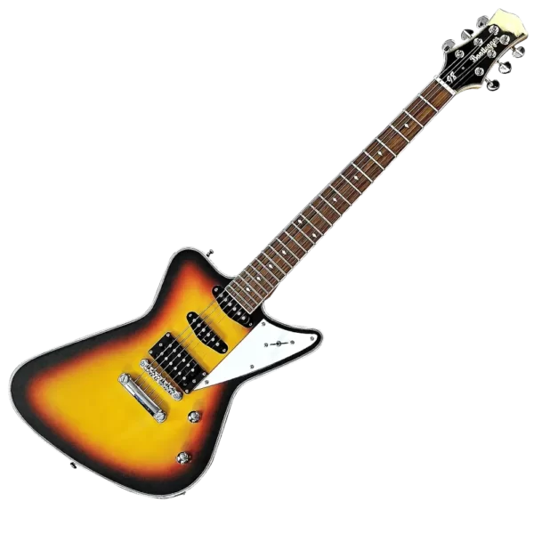
Instrumental Variables and the effect of military service
Causality, Decision-Making, and Data Science
Lecture 11

Slide 2
Announcements
HW3 part 1 due Monday!

Slide 3
Agenda
Instrumental Variables: High-Level Introduction
Example: Effects of Military Service
Compliance and Non-Compliance
Local Average Treatment Effects (LATE)
In general
Compliance and Non-Compliance
Local Average Treatment Effects (LATE)
Interpreting LATE: who are the compliers?

Slide 4
High-Level Intro

Slide 5



Instrumental Variables
Suppose we want to know the effect of X on Y
Education on Earnings, say
We can’t do a perfect randomized experiment
Not feasible/ethical/…
But we want to randomize something…
Solution: Randomize something that affects $X$! (But not $Y$ except through X)
$$Z$$
$$X$$
$$Y$$
Instrumental
Variable!

Slide 6



IVs for Returns to Education
$$X$$
Years of education
$$Z$$
$$Y$$
Earnings
A few examples:
Proximity to a college (Card 1993)
Easier to go to college if one is nearby
Birth quarter (Angrist + Krueger 1991)
Can you drop out of school a bit earlier?
Birth cohort (Harmon + Walker 1995)
The rules changed, people a year older can drop out earlier/later
Vietnam draft number (Angrist and Krueger 1992)
The risk of being drafted makes people seek an educational deferment
Sex of siblings (Butcher + Case, 1994)
Women with only brothers received more schooling in the early 20th c.
Lots more!

Slide 7
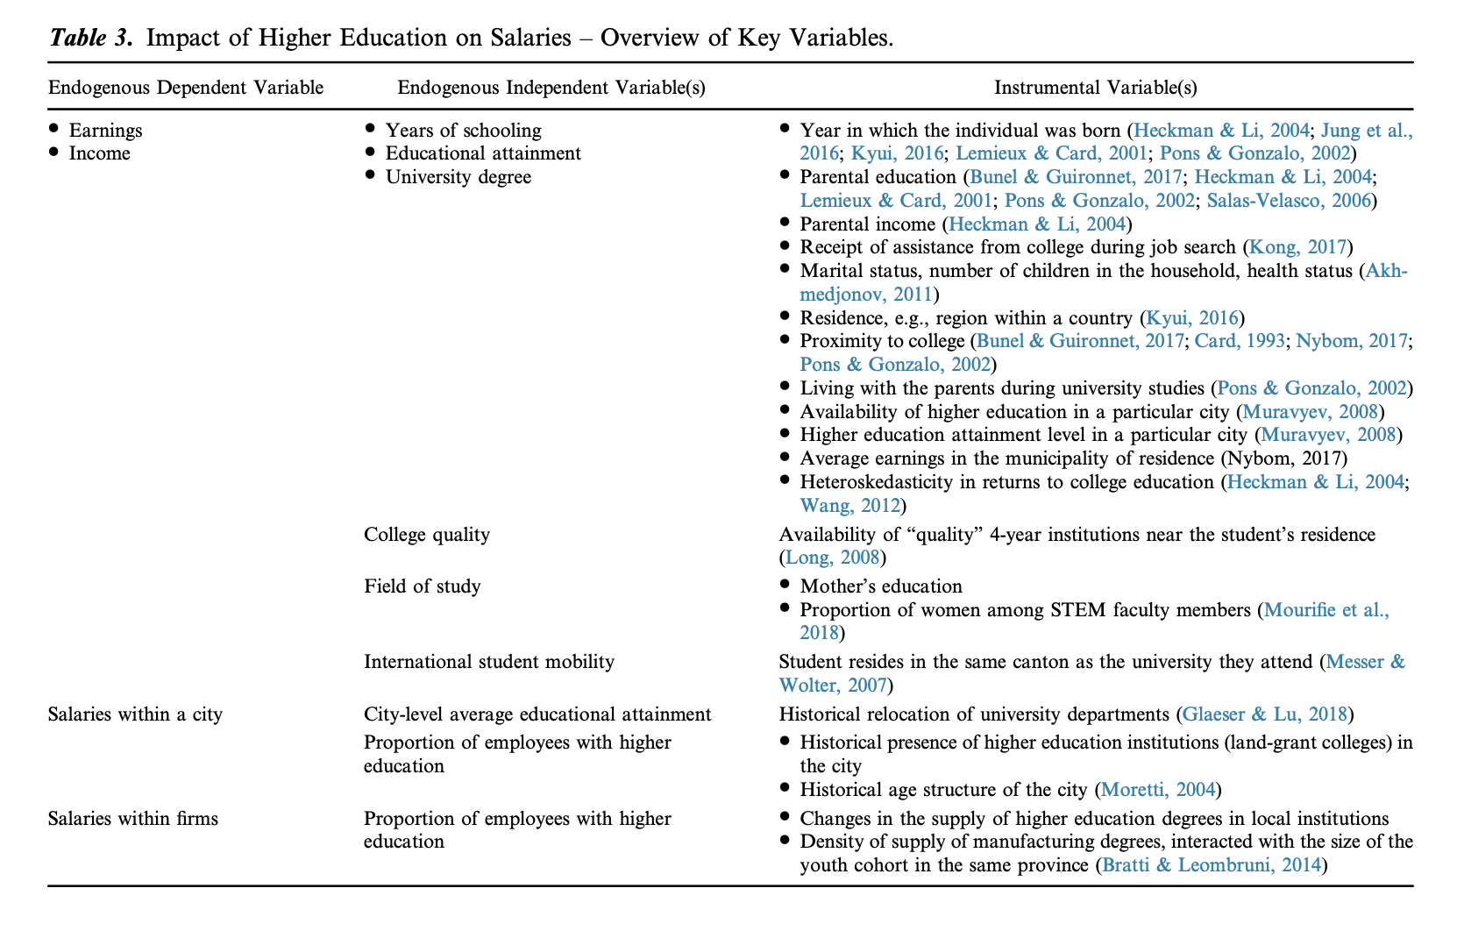


Slide 8
Questions we need to answer first!
will
Z doesn’t perfectly affect X, so how do we compute ATE of X on Y?
We can’t just look at (treated) – (untreated) anymore.
What population are we computing the ATE on?
Z might affect X differently for some people than others…
$$Z$$
$$X$$
$$Y$$
Instrumental
Variable!

Slide 9
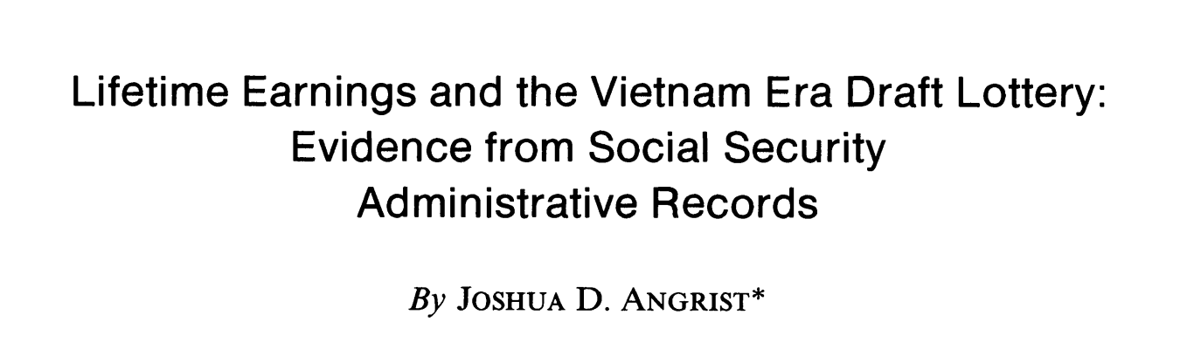

Example
American Economic Review, 1990
We’re going to come back to returns to education next class – this example is cleaner!
What is the effect of military service on earnings?

Slide 10
Question
What is the effect of military service on later earnings?
This question is important for, say, policy on compensating veterans

Slide 11
Instrument: Draft lottery number
During the 1970s, young men in the US were drafted to serve in the Vietnam War.
All eligible men got a random number based on their birth date.
Lower numbers were called up first.

Slide 12

Hooray! We have a randomized experiment?
What might we miss if we compute
[average earnings among drafted]
– [average earnings among non-drafted]
How is this related to your pre-class reflection?
Discuss!

Slide 13
A few issues
Not all men who were drafted served
Some were conscientious objectors; some pursued educational deferment; some were unfit for duty; some ran away to Canada; …
Not all men who were not drafted did not serve
Some voluntarily signed up
This is a two-sided version of the problem in the pre-class reflection:
Not everyone assigned to the treatment group actually took the drug.

Slide 14

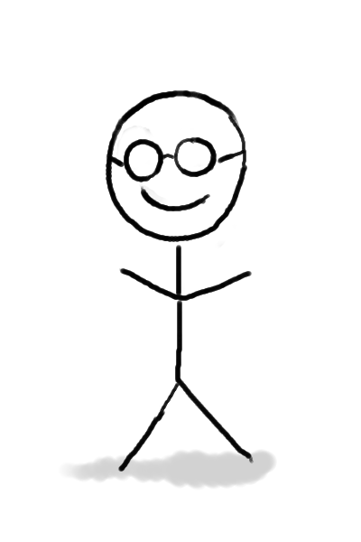



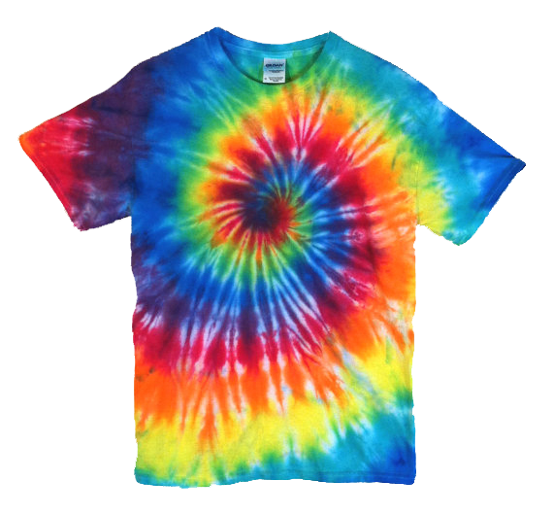
Four types of people (w/r/t the Vietnam draft)
Always-Takers
Never-Takers
Compliers
Defiers
Drafted
Not
Drafted

Slide 15
Four types of people (w/r/t the Vietnam draft)
I’m a conscientious objector. I won’t serve no matter what.
Don’t tell me what to do!
Even if I’m not drafted, I’ll volunteer!
I’ll serve if asked
Always-Takers
Never-Takers
Compliers
Defiers
Drafted
Not
Drafted

Slide 16
Four types of people (w/r/t the Vietnam draft)
This seems unlikely in this context.
Always-Takers
Never-Takers
Compliers
Defiers
Drafted
Not
Drafted

Slide 17

Two questions
What is the ATE of being drafted on earnings?
What is the ATE of military service on earnings?
Discuss:
For each of these three types:
Are the answers to the two questions the same?
Which of the two questions can we hope to answer?
Always-Takers
Never-Takers
Compliers
Drafted
Not
Drafted

Slide 18
Two questions
What is the ATE of being drafted on earnings?
What is the ATE of military service on earnings?
For compliers:
The answers are the same! We may hope to figure it out…
Always-Takers
Never-Takers
Compliers
For always-takers:
The answers may be different!
The answer to Q1 is “zero”
We have no way of answering Q2.
Drafted
For never-takers: Same* as always-takers.
Not
Drafted
*At least for Q2… if you run away to Canada when drafted, that may affect your earnings…
Notes:
Disclaimer: arguably for the never-takers, being drafted DOES affect downstream earnings, since if they are drafted and have to dodge the draft, they may take steps that they wouldn’t otherwise (going to Canada, going to school, etc), which probably would effect their earnings.

Slide 19
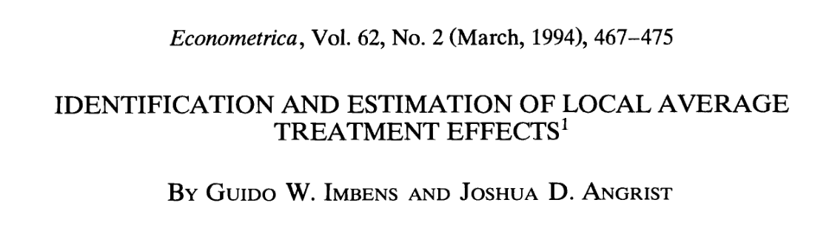
LATE: Answering for just the compliers Local Average Treatment Effect
We can’t hope to estimate ATE of serving on earnings for always-takers or never-takers.
So let’s just try to estimate ATE for the compliers.
That’s called a Local ATE (LATE)
It’s local to the population of compliers in this experiment.
Note that who is a complier depends on the experiment.
It’s not a property of a person.

Slide 20
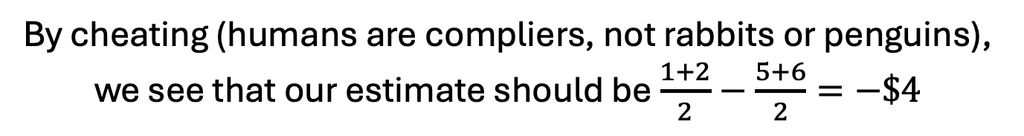
Let’s compute LATE! What is the ATE of serving for the compliers?
Suppose we see:
People who were drafted
People who were not drafted
Hourly Wage in 1980
$1
$8
$4
$2
$5
$4
$6
$8
What is the ATE of serving for the compliers? (Aka, LATE of being drafted)
By cheating (humans are compliers, not rabbits or penguins),
we see that our estimate should be $\frac{1+2}{2}−\frac{5+6}{2}=−\$4$

Slide 21
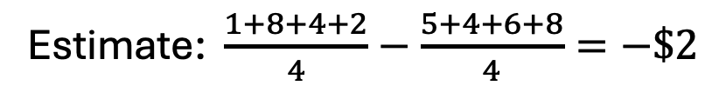
Let’s compute LATE! What is the ATE of serving for the compliers?
Suppose we see:
People who were drafted
People who were not drafted
Hourly Wage in 1980
$1
$8
$4
$2
$5
$4
$6
$8
What is the ATE of being drafted on wages, for everyone?
Estimate: $\frac{1+8+4+2}{4}−\frac{5+4+6+8}{4}=−\$2$
But this doesn’t tell us about the effect of serving…

Slide 22
Let’s compute LATE! What is the ATE of serving for the compliers?
Suppose we see:
People who were drafted
People who were not drafted
Hourly Wage in 1980
$1
$8
$4
$2
$5
$4
$6
$8
What is the ATE of being drafted on wages, for everyone?
Estimate: $\frac{1+8+4+2}{4}−\frac{5+4+6+8}{4}=−\$2$
But this doesn’t tell us about the effect of serving…
What is the ATE of serving on wages, for everyone?
Observational Comparison: $\frac{1+8+8+2}{4}−\frac{5+4+6+4}{4}=\$0$
This doesn’t seem causal at all!

Slide 23
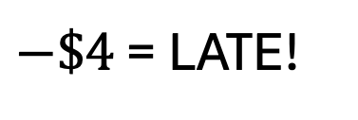
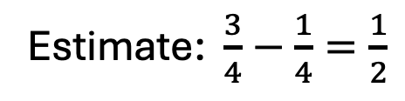
Let’s compute LATE! What is the ATE of serving for the compliers?
Suppose we see:
People who were drafted
People who were not drafted
Hourly Wage in 1980
$1
$8
$4
$2
$5
$4
$6
$8
What is the ATE of being drafted on wages, for everyone?
Estimate: $\frac{1+8+4+2}{4}−\frac{5+4+6+8}{4}=−\$2$
But this doesn’t tell us about the effect of serving…
What is the ATE of being drafted on serving, for everyone?
Estimate: $\frac{3}{4}−\frac{1}{4}=\frac{1}{2}$
What is the first divided by the second?
$−\$4$ = LATE!

Slide 24
Computing LATE The ATE of serving on wages, for the compliers
0. Assume there are no defiers in the population.
Estimate the ATE of being drafted on wages (for everyone)
Estimate the ATE of being drafted on serving (for everyone)
Divide (1) by (2) and assert that this is the LATE!
Discuss:
Why does this work???
Drafted:
$1
$2
$4
$8
Not Drafted:
$5
$6
$4
$8

Slide 25
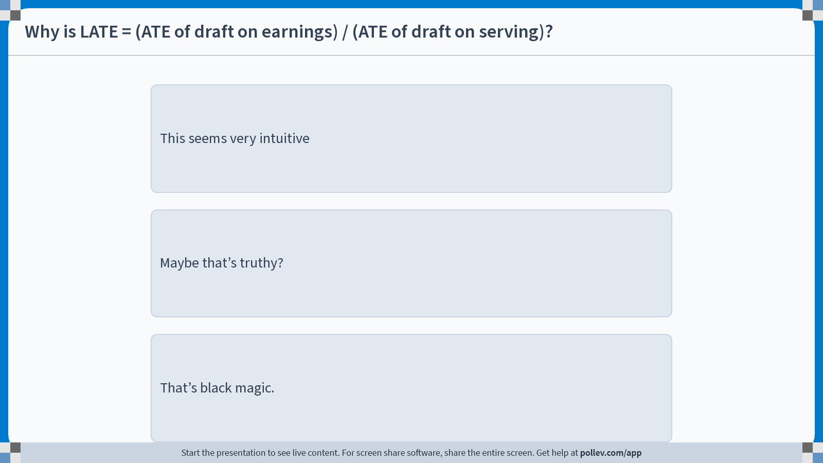
Notes:
Do not modify the notes in this section to avoid tampering with the Poll Everywhere activity. More info at polleverywhere.com/support Why is LATE = (ATE of draft on earnings) / (ATE of draft on serving)?
https://www.polleverywhere.com/multiple_choice_polls/l93AAMCDpo3b5PH40n0ve?display_state=instructions&activity_state=opened&state=opened&flow=Engagement&onscreen=persist

Slide 26
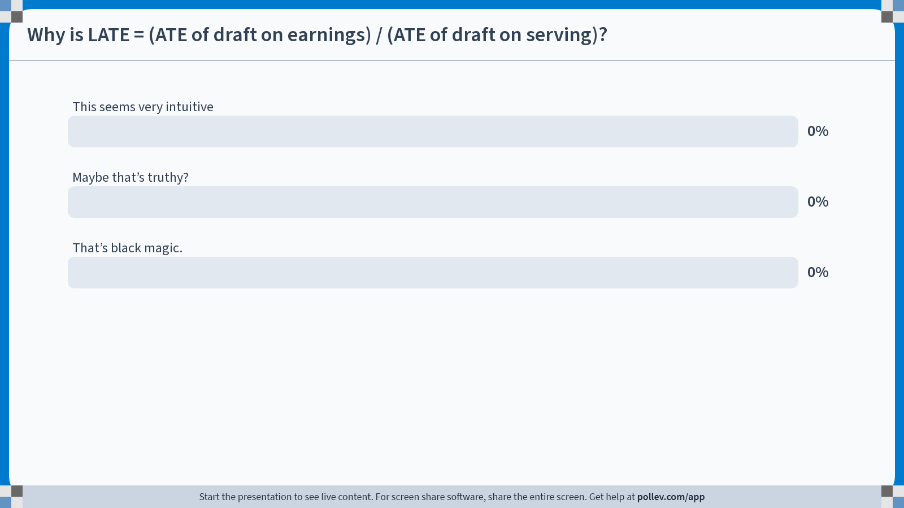
Notes:
Do not modify the notes in this section to avoid tampering with the Poll Everywhere activity. More info at polleverywhere.com/support Why is LATE = (ATE of draft on earnings) / (ATE of draft on serving)?
https://www.polleverywhere.com/multiple_choice_polls/l93AAMCDpo3b5PH40n0ve?display_state=chart&activity_state=opened&state=opened&flow=Engagement&onscreen=persist

Slide 27

Notes:
Do not modify the notes in this section to avoid tampering with the Poll Everywhere activity. More info at polleverywhere.com/support Why is LATE = (ATE of draft on earnings) / (ATE of draft on serving)?
https://www.polleverywhere.com/multiple_choice_polls/l93AAMCDpo3b5PH40n0ve?display_state=chart&activity_state=closed&state=closed&flow=Engagement&onscreen=persist

Slide 28
Explanation 1
Compliers
Not Drafted
ATE of being drafted on earnings in this group:
LATE.
Drafted
Average of both: ATE of being drafted on earnings.
Never-Takers /
Always-Takers
Not Drafted
ATE of being drafted on earnings in this group:
Zero.
Drafted
ATE of being drafted
on earnings.
If we compute ATE of being drafted on earnings, we are averaging in a bunch of zeros we don’t want!
To fix it, renormalize:
LATE =
Fraction of people
who are compliers

Slide 29
Explanation 1
Compliers
Not Drafted
ATE of being drafted on earnings in this group:
LATE.
Drafted
Average of both: ATE of being drafted on earnings.
Never-Takers /
Always-Takers
Not Drafted
ATE of being drafted on earnings in this group:
Zero.
Drafted
ATE of being drafted
on earnings.
If we compute ATE of being drafted on earnings, we are averaging in a bunch of zeros we don’t want!
To fix it, renormalize:
LATE =
ATE of being drafted
on serving

Slide 30


Explanation 2
Chain rule type argument:
Effect of being drafted
on serving
$$×$$
Effect of serving
on earnings
$$=$$
Effect of being drafted
on earnings
Effect of being drafted
on earnings
Effect of serving
on earnings
$$=$$
Effect of being drafted
on serving

Slide 31

Notes:
Do not modify the notes in this section to avoid tampering with the Poll Everywhere activity. More info at polleverywhere.com/support Why is LATE = (ATE of draft on earnings) / (ATE of draft on serving)?
https://www.polleverywhere.com/multiple_choice_polls/kjVqKBh2bxRbY4ZkyOVJC?display_state=instructions&activity_state=opened&state=opened&flow=Engagement&onscreen=persist

Slide 32

Notes:
Do not modify the notes in this section to avoid tampering with the Poll Everywhere activity. More info at polleverywhere.com/support Why is LATE = (ATE of draft on earnings) / (ATE of draft on serving)?
https://www.polleverywhere.com/multiple_choice_polls/kjVqKBh2bxRbY4ZkyOVJC?display_state=chart&activity_state=opened&state=opened&flow=Engagement&onscreen=persist

Slide 33

Notes:
Do not modify the notes in this section to avoid tampering with the Poll Everywhere activity. More info at polleverywhere.com/support Why is LATE = (ATE of draft on earnings) / (ATE of draft on serving)?
https://www.polleverywhere.com/multiple_choice_polls/kjVqKBh2bxRbY4ZkyOVJC?display_state=chart&activity_state=closed&state=closed&flow=Engagement&onscreen=persist

Slide 34
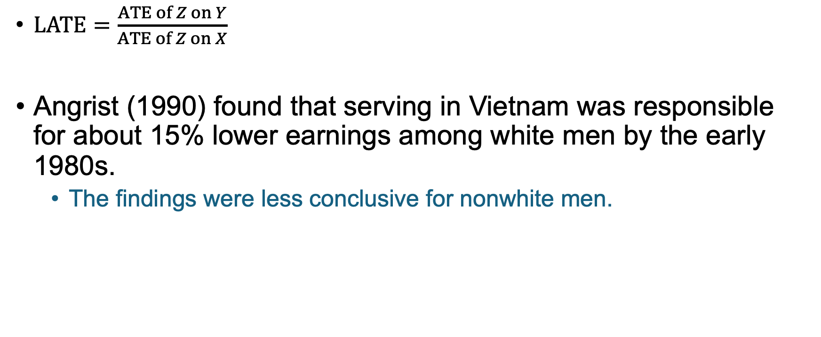
LATE in this example ATE among the compliers
$LATE=\frac{ATE of Z on Y}{ATE of Z on X}$
Angrist (1990) found that serving in Vietnam was responsible for about 15% lower earnings among white men by the early 1980s.
The findings were less conclusive for nonwhite men.

Slide 35
Back to Instrumental Variables

Slide 36
Instrumental Variables
In the example we just saw:
Z = being drafted
X = serving in the military
Y = log(earnings)
But this framework is very general!
For today, suppose Z and X are binary – we’ll generalize next time.
$$Z$$
$$X$$
$$Y$$
Instrumental
Variable!

Slide 37
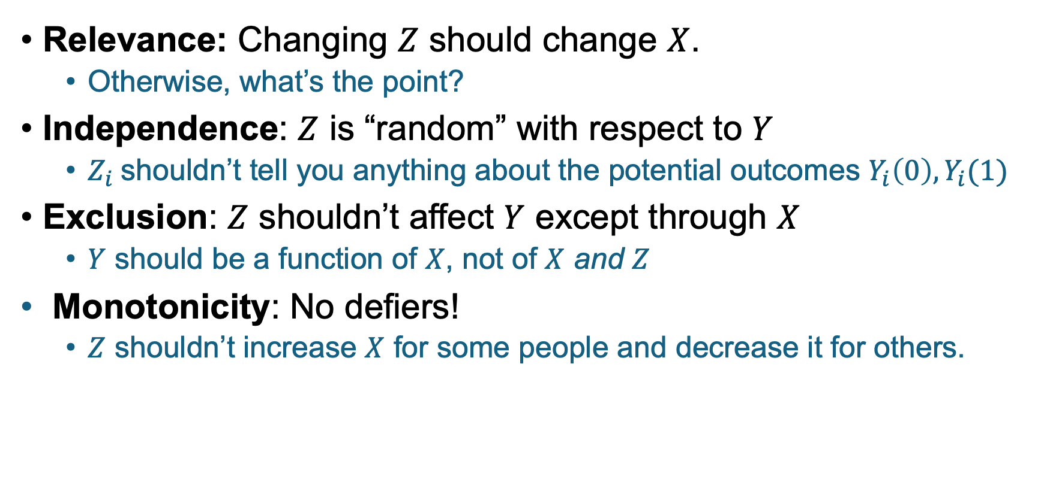



What do we need in an IV if we want to interpret the result as a LATE?
Relevance: Changing $Z$ should change $X$.
Otherwise, what’s the point?
Independence: $Z$ is “random” with respect to $Y$
$Z_{i}$shouldn’t tell you anything about the potential outcomes $Y_{i}\left(0\right), Y_{i}(1)$
Exclusion: $Z$ shouldn’t affect $Y$ except through $X$
$Y$ should be a function of $X$, not of $X$ and $Z$
Monotonicity: No defiers!
$Z$ shouldn’t increase $X$ for some people and decrease it for others.
$$Z$$
$$X$$
$$Y$$
Instrumental
Variable!

Slide 38
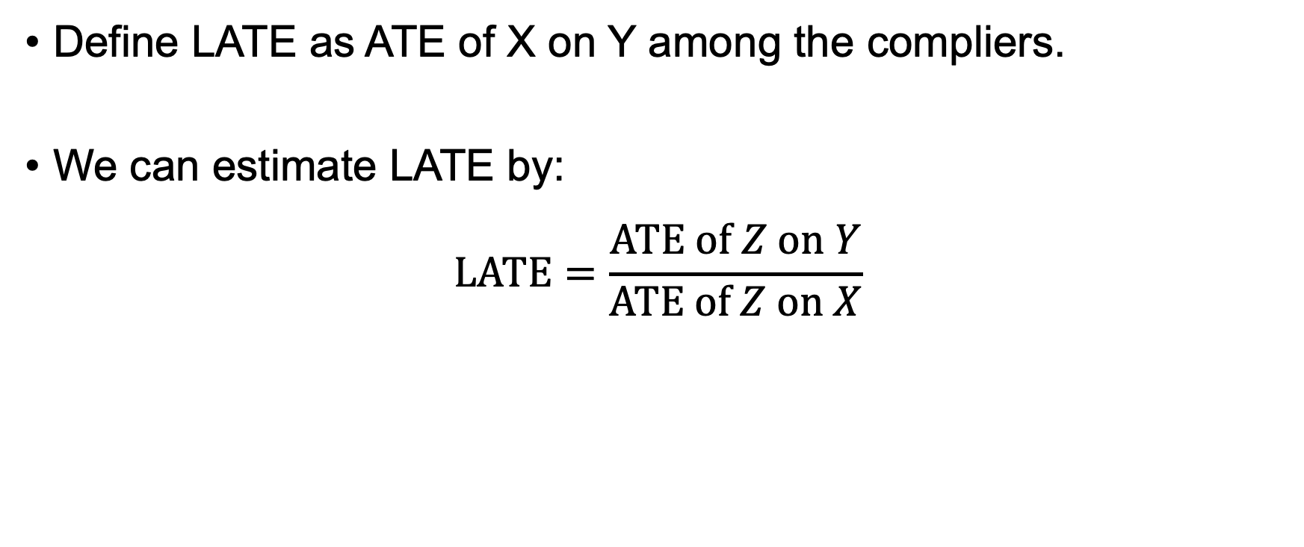



If those things* hold…
$$Z$$
$$X$$
$$Y$$
Instrumental
Variable!
Define LATE as ATE of X on Y among the compliers.
We can estimate LATE by:
$$LATE=\frac{ATE of Z on Y}{ATE of Z on X}$$
We can estimate each of these from our data!
*Those things:
Relevance
Independence
Exclusion
Monotonicity

Slide 39
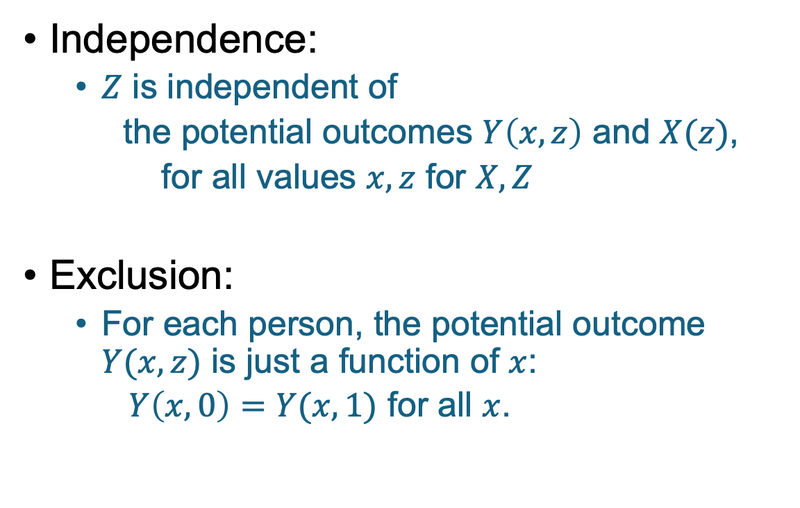

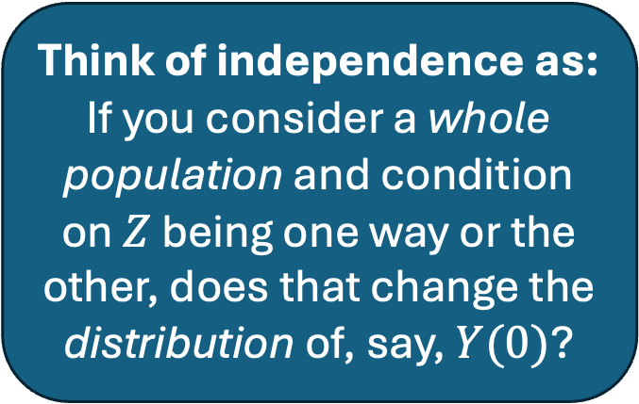
What does independence/exclusion mean? Formally?
Think of independence as:
If you consider a whole population and condition on $Z$ being one way or the other, does that change the distribution of, say, $Y(0)$?
Independence:
$Z$ is independent of
the potential outcomes $Y\left(x,z\right)$ and $X(z)$,
for all values $x,z$ for $X,Z$
Exclusion:
For each person, the potential outcome $Y(x,z)$ is just a function of $x$:
$Y\left(x,0\right)=Y(x,1)$ for all $x$.
Think of exclusion as:
If you consider a particular person $i$ and fiddle with $Z_{i}$, does that change, say, $Y_{i}(0)$for that person?

Slide 40
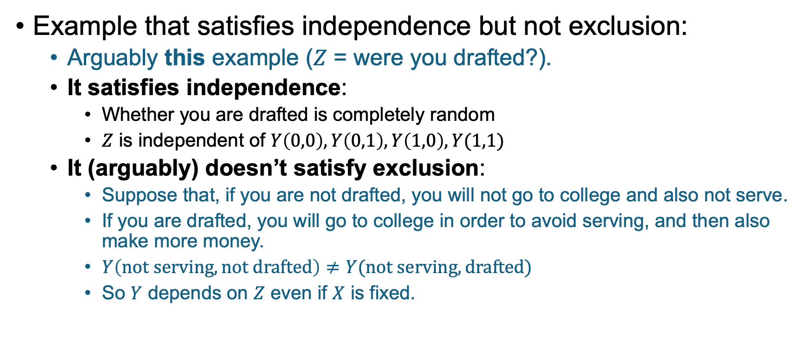
Difference between independence and exclusion
Example that satisfies independence but not exclusion:
Arguably this example ($Z$ = were you drafted?).
It satisfies independence:
Whether you are drafted is completely random
$Z$ is independent of $Y\left(0,0\right), Y\left(0,1\right), Y\left(1,0\right), Y(1,1)$
It (arguably) doesn’t satisfy exclusion:
Suppose that, if you are not drafted, you will not go to college and also not serve.
If you are drafted, you will go to college in order to avoid serving, and then also make more money.
$Y\left(not serving, not drafted\right)≠Y(not serving, drafted)$
So $Y$ depends on $Z$ even if $X$ is fixed.

Slide 41
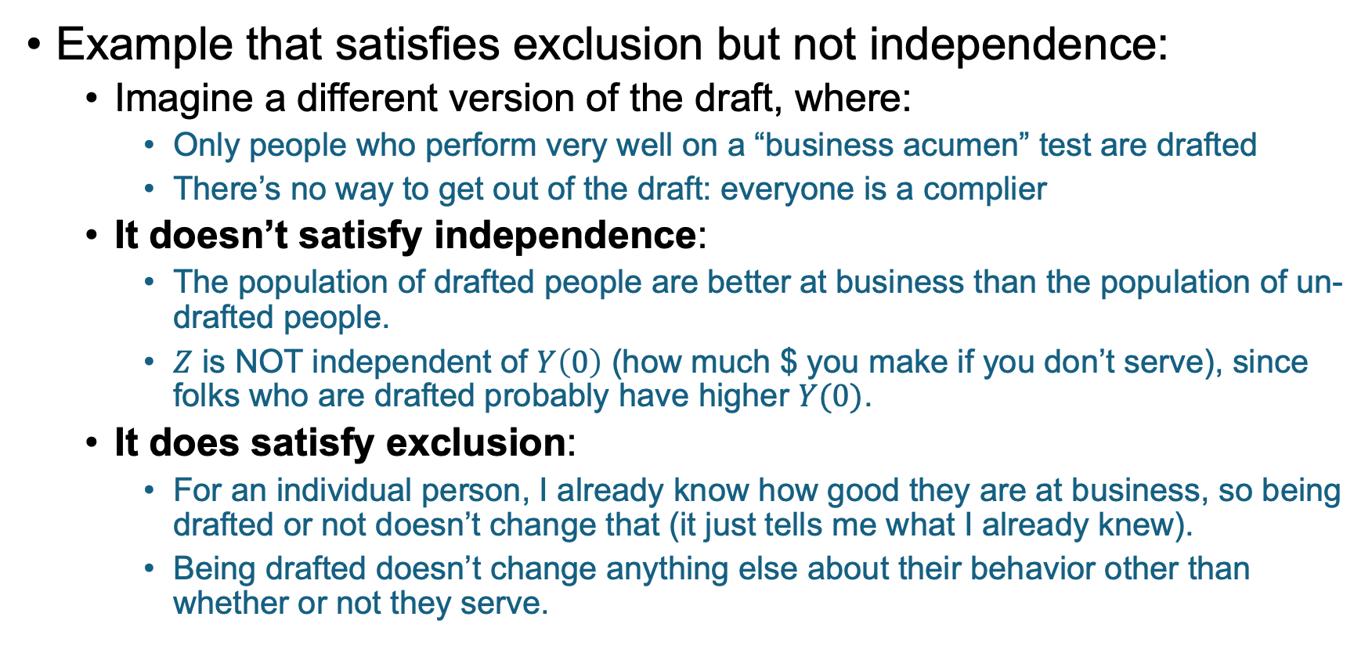
Difference between independence and exclusion
Example that satisfies exclusion but not independence:
Imagine a different version of the draft, where:
Only people who perform very well on a “business acumen” test are drafted
There’s no way to get out of the draft: everyone is a complier
It doesn’t satisfy independence:
The population of drafted people are better at business than the population of un-drafted people.
$Z$ is NOT independent of $Y\left(0\right)$ (how much $ you make if you don’t serve), since folks who are drafted probably have higher $Y(0)$.
It does satisfy exclusion:
For an individual person, I already know how good they are at business, so being drafted or not doesn’t change that (it just tells me what I already knew).
Being drafted doesn’t change anything else about their behavior other than whether or not they serve.

Slide 42
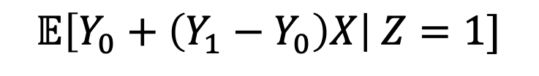
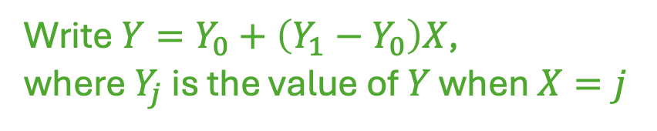
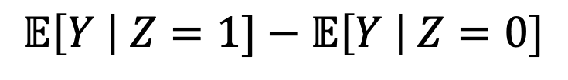
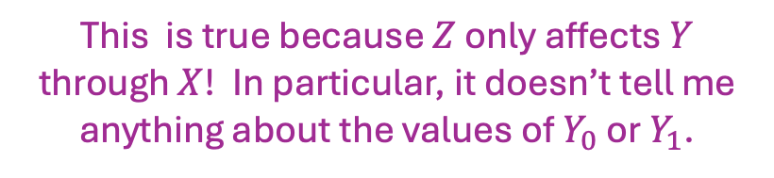
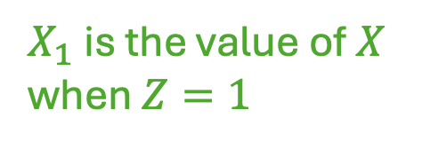

Proof Sketch Where do those 4 things come into it?
$$Z$$
$$X$$
$$Y$$
Instrumental
Variable!
$$𝔼\left[Y \right| Z=1]−𝔼\left[Y \right| Z=0]$$
Write $Y=Y_{0}+\left(Y_{1}−Y_{0}\right)X$,
where $Y_{j}$ is the value of $Y$ when $X=j$
$X_{1}$ is the value of $X$ when $Z=1$
$$𝔼\left[Y_{0}+\left(Y_{1}−Y_{0}\right)X\right| Z=1]$$
$$=𝔼[Y_{0}+\left(Y_{1}−Y_{0}\right)X_{1}]$$
This is true because $Z$ only affects $Y$ through $X$! In particular, it doesn’t tell me anything about the values of $Y_{0}$ or $Y_{1}$.

Slide 43
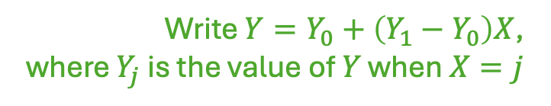
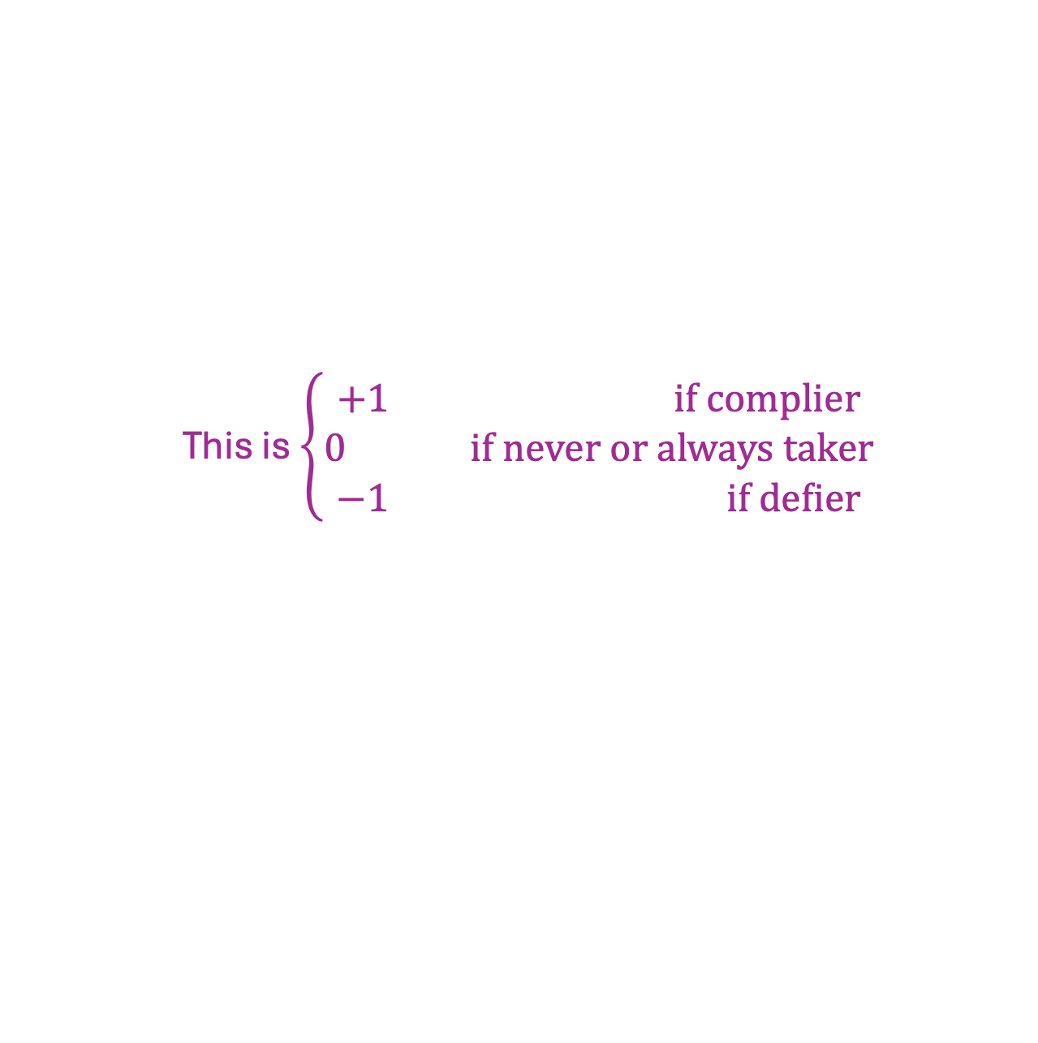

Proof Sketch Where do those 4 things come into it?
$$Z$$
$$X$$
$$Y$$
Instrumental
Variable!
$$𝔼\left[Y \right| Z=1]−𝔼\left[Y \right| Z=0]$$
Write $Y=Y_{0}+\left(Y_{1}−Y_{0}\right)X$,
where $Y_{j}$ is the value of $Y$ when $X=j$
$$=𝔼\left[Y_{0}+\left(Y_{1}−Y_{0}\right)X_{1}\right]−𝔼[Y_{0}+\left(Y_{1}−Y_{0}\right)X_{0}]$$
$X_{j}$ is the value of $X$ when $Z=j$
$$=𝔼[\left(Y_{1}−Y_{0}\right)X_{1}−\left(Y_{1}−Y_{0}\right)X_{0}]$$
Linearity of expectation!
$$=𝔼[\left(Y_{1}−Y_{0}\right)\left(X_{1}−X_{0}\right)]$$
This is $\left\{\begin{aligned}+1 if complier \\ 0 if never or always taker \\ −1 if defier\end{aligned}\right.$
No defiers!

Slide 44
Proof Sketch Where do those 4 things come into it?
$$Z$$
$$X$$
$$Y$$
Instrumental
Variable!
$$𝔼\left[Y \right| Z=1]−𝔼\left[Y \right| Z=0]$$
Write $Y=Y_{0}+\left(Y_{1}−Y_{0}\right)X$,
where $Y_{j}$ is the value of $Y$ when $X=j$
$$=𝔼\left[Y_{0}+\left(Y_{1}−Y_{0}\right)X_{1}\right]−𝔼[Y_{0}+\left(Y_{1}−Y_{0}\right)X_{0}]$$
$X_{j}$ is the value of $X$ when $Z=j$
$$=𝔼[\left(Y_{1}−Y_{0}\right)X_{1}−\left(Y_{1}−Y_{0}\right)X_{0}]$$
Linearity of expectation!
$$=𝔼\left[\left(Y_{1}−Y_{0}\right)\right]⋅1[complier]]$$
$$=LATE ×(fraction of compliers)$$

Slide 45
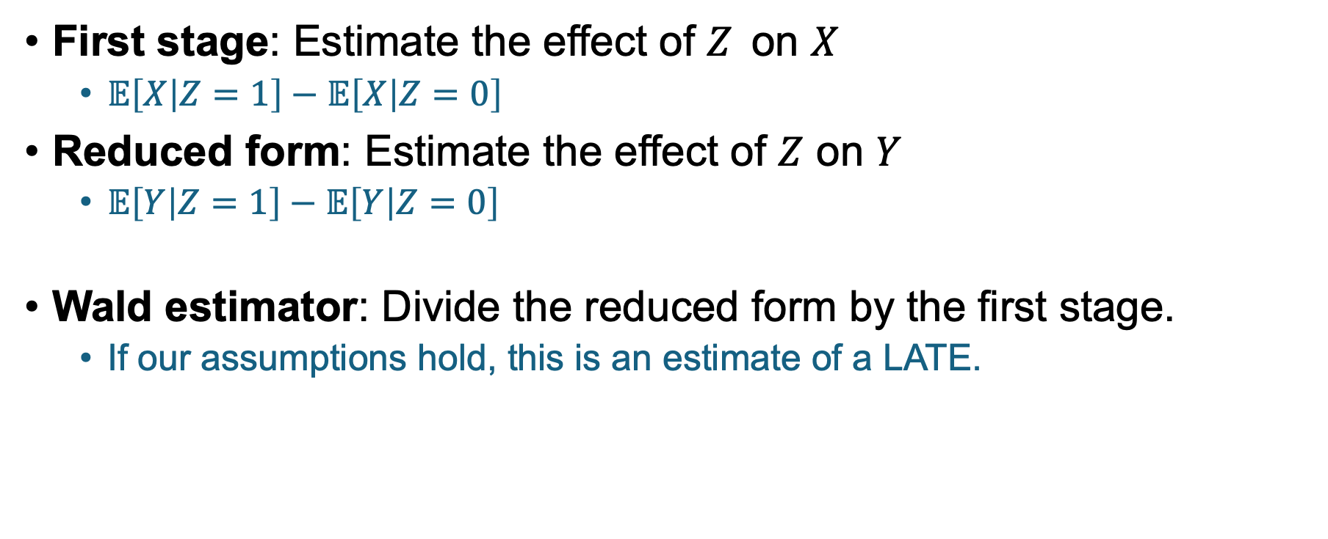



Jargon
$$Z$$
$$X$$
$$Y$$
Instrumental
Variable!
First stage: Estimate the effect of $Z_{ }$ on $X$
$𝔼\left[X | Z=1\right]−𝔼\left[X | Z=0\right]$
Reduced form: Estimate the effect of $Z$ on $Y$
$𝔼\left[Y | Z=1\right]−𝔼\left[Y | Z=0\right]$
Wald estimator: Divide the reduced form by the first stage.
If our assumptions hold, this is an estimate of a LATE.

Slide 46
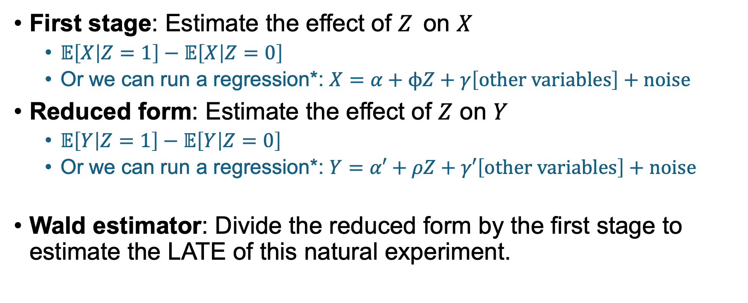
Jargon
$$Z$$
$$X$$
$$Y$$
Instrumental
Variable!
First stage: Estimate the effect of $Z_{ }$ on $X$
$𝔼\left[X | Z=1\right]−𝔼\left[X | Z=0\right]$
Or we can run a regression*: $X=α+ϕZ+γ\left[other variables\right]+noise$
Reduced form: Estimate the effect of $Z$ on $Y$
$𝔼\left[Y | Z=1\right]−𝔼\left[Y | Z=0\right]$
Or we can run a regression*: $Y=α′+ρZ+γ′\left[other variables\right]+noise$
Wald estimator: Divide the reduced form by the first stage to estimate the LATE of this natural experiment.
*More on this next time

Slide 47
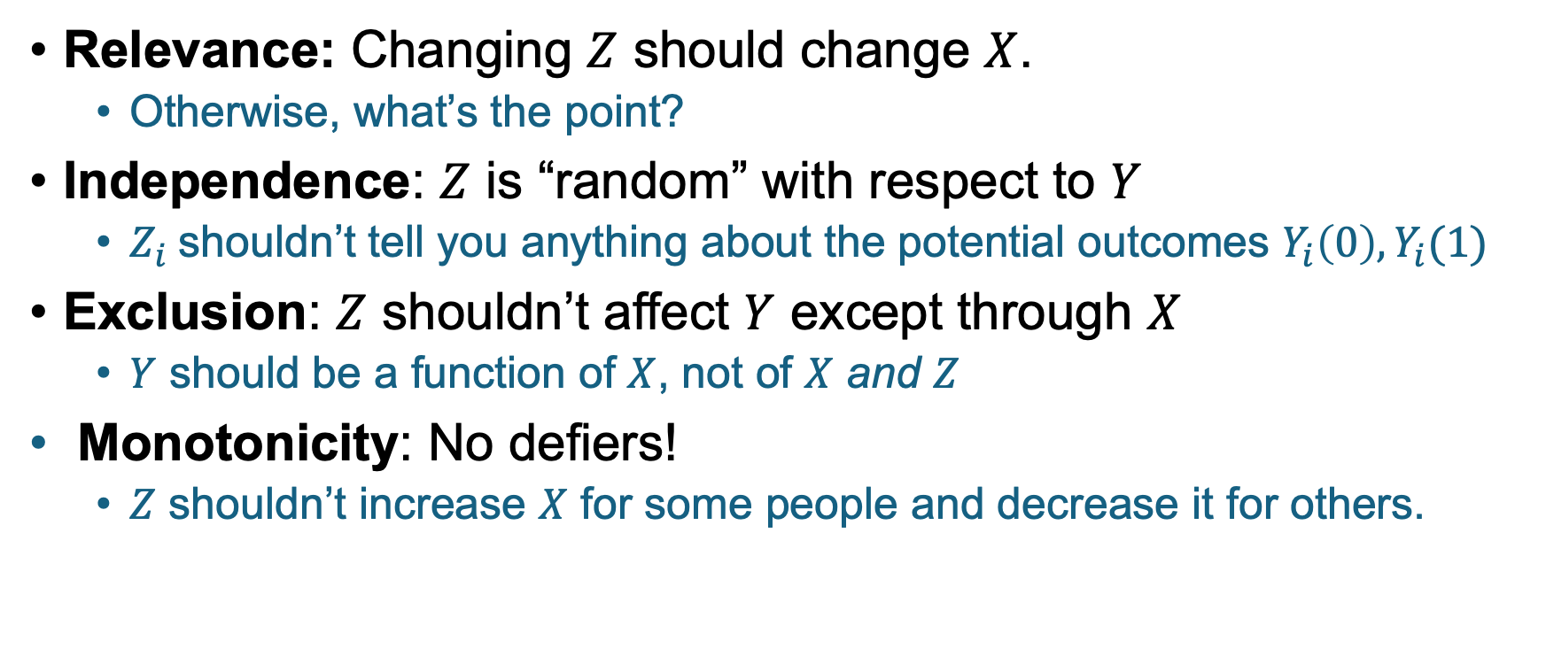
Let’s look at each of these assumptions
$$Z$$
$$X$$
$$Y$$
Instrumental
Variable!
Relevance: Changing $Z$ should change $X$.
Otherwise, what’s the point?
Independence: $Z$ is “random” with respect to $Y$
$Z_{i}$shouldn’t tell you anything about the potential outcomes $Y_{i}\left(0\right), Y_{i}(1)$
Exclusion: $Z$ shouldn’t affect $Y$ except through $X$
$Y$ should be a function of $X$, not of $X$ and $Z$
Monotonicity: No defiers!
$Z$ shouldn’t increase $X$ for some people and decrease it for others.

Slide 48
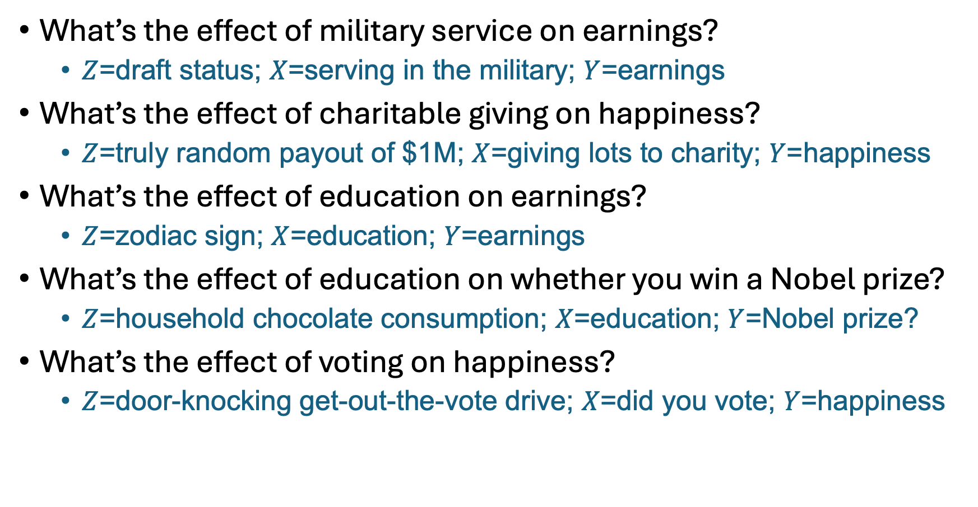



For each of these examples, assess each of the four requirements!
Relevance
Independence
Exclusion
Monotonicity
What’s the effect of military service on earnings?
$Z$=draft status; $X$=serving in the military; $Y$=earnings
What’s the effect of charitable giving on happiness?
$Z$=truly random payout of $1M; $X$=giving lots to charity; $Y$=happiness
What’s the effect of education on earnings?
$Z$=zodiac sign; $X$=education; $Y$=earnings
What’s the effect of education on whether you win a Nobel prize?
$Z$=household chocolate consumption; $X$=education; $Y$=Nobel prize?
What’s the effect of voting on happiness?
$Z$=door-knocking get-out-the-vote drive; $X$=did you vote; $Y$=happiness
$$Z$$
$$X$$
$$Y$$

Slide 49

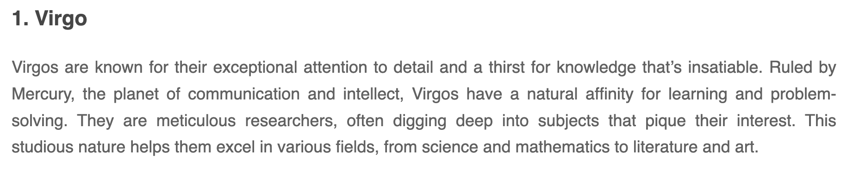
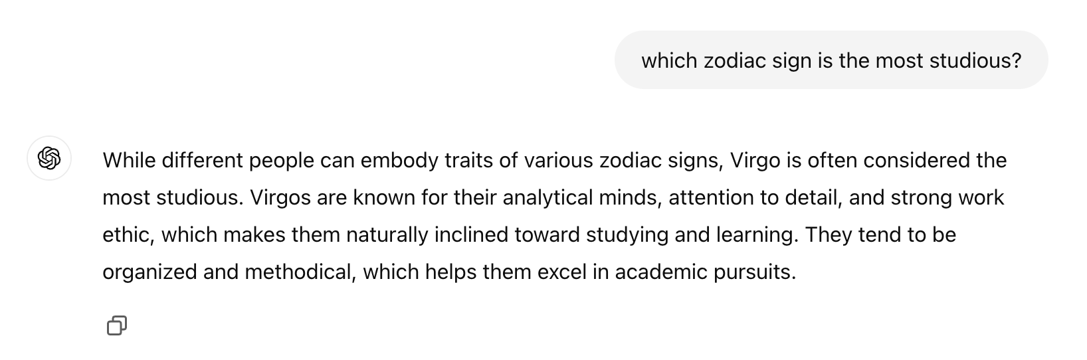

Does “zodiac sign” satisfy the relevance condition? aka, does zodiac sign affect education?
Apparently virgos are more studious. We’re still not sure about relevance, but I guess it’s good to keep an open mind…

Slide 50
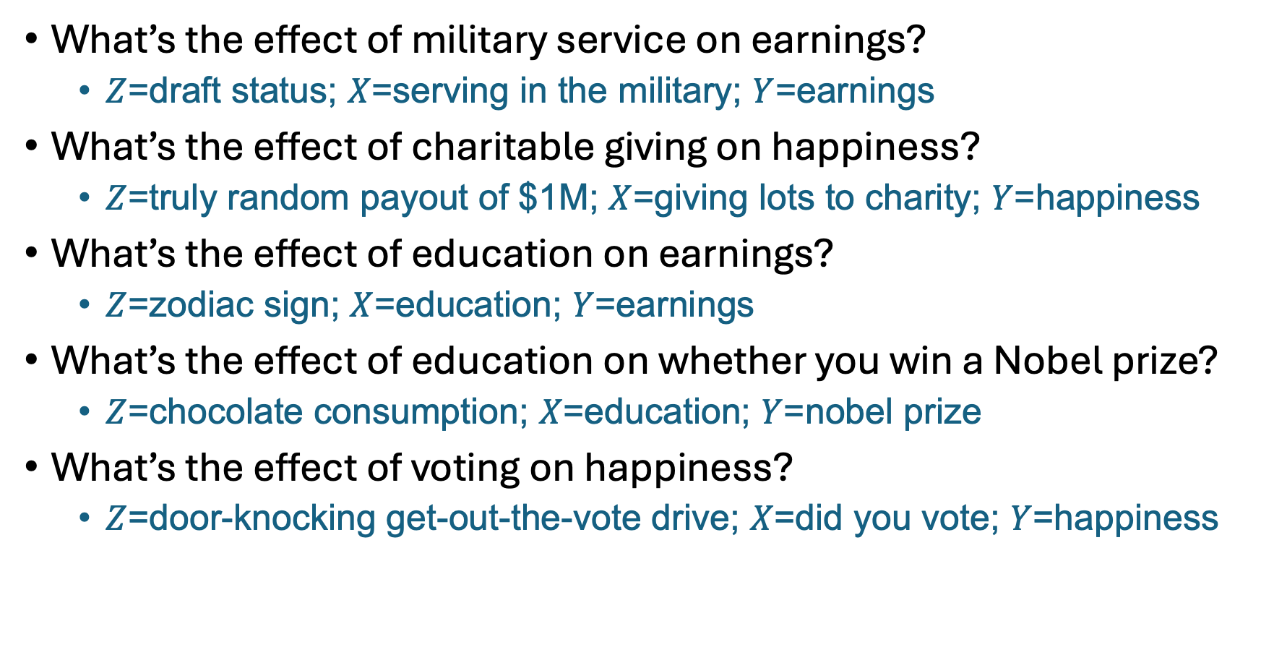



For each of these examples, assess each of the four requirements!
Relevance
Independence
Exclusion
Monotonicity
$$Z$$
$$X$$
$$Y$$
Pass. (Maybe exclusion is an issue?)
What’s the effect of military service on earnings?
$Z$=draft status; $X$=serving in the military; $Y$=earnings
What’s the effect of charitable giving on happiness?
$Z$=truly random payout of $1M; $X$=giving lots to charity; $Y$=happiness
What’s the effect of education on earnings?
$Z$=zodiac sign; $X$=education; $Y$=earnings
What’s the effect of education on whether you win a Nobel prize?
$Z$=chocolate consumption; $X$=education; $Y$=nobel prize
What’s the effect of voting on happiness?
$Z$=door-knocking get-out-the-vote drive; $X$=did you vote; $Y$=happiness
Exclusion fails! I might be happier because I’m rich, not b/c I gave to charity!
Relevance fails! Zodiac sign doesn’t have much to do with whether or not I go to college.*
Independence fails! Chocolate consumption is correlated with Nobel prizes
Monotonicity may fail! Some people react badly to folks knocking on their door.
*Actually, month of birth is correlated with lots of things…

Slide 51
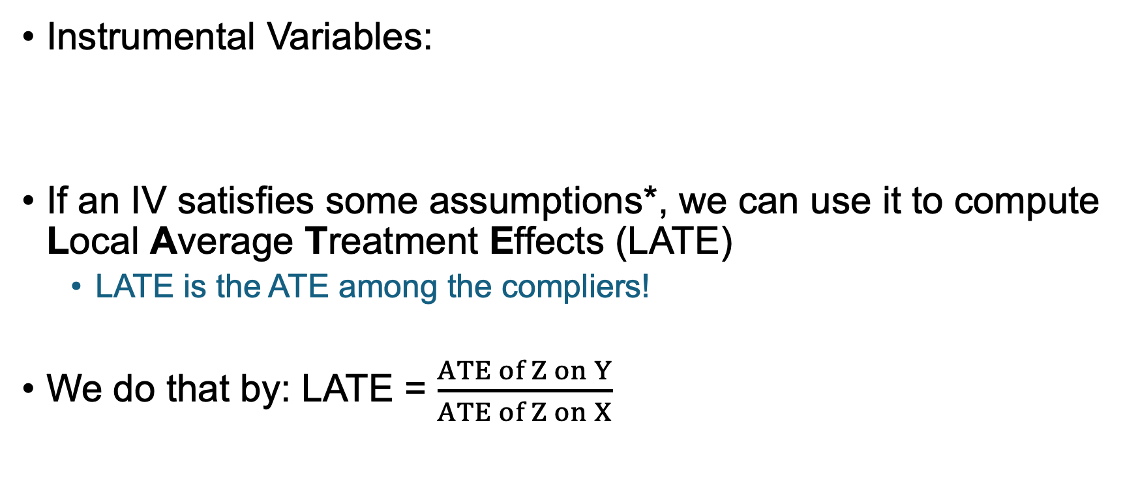



Summary: IVs and LATE
*Assumptions:
Relevance
Independence
Exclusion
Monotonicity
Instrumental Variables:
If an IV satisfies some assumptions*, we can use it to compute Local Average Treatment Effects (LATE)
LATE is the ATE among the compliers!
We do that by: LATE = $\frac{ATE of Z on Y}{ATE of Z on X}$
$$Z$$
$$X$$
$$Y$$

Slide 52
Let’s take a quick break
During the break, think about:
Is being able to estimate
a LATE useful?
What does this actually tell us?

Slide 53

Where do we stand?
Hey, there’s this cool thing called LATE! We can learn the average treatment effect for the population of compliers! It’s -$4!
Is that a big population?
Is -$4 big or small compared to average earnings in this population?
Is that population at all representative of the larger population?
I have so many questions!

Slide 54
We can actually answer these questions!

Slide 55
Q1: How many compliers are there? Reprise of our toy example with 8 people; no defiers
What can we say about these people?
3 people
1 person
Compliers? Always-takers? Never-takers?
Always-takers!
Served
These people?
Always-takers or compliers!
1 person
3 people
These people?
Never-takers!
These people?
Did not
serve
Never-takers or compliers!
Drafted
Not Drafted

Slide 56
Q1: How many compliers are there? Reprise of our toy example with 8 people; no defiers
3 people
1 person
Assume that the always-takers got split evenly into drafted and not-drafted.
The power of randomness!
How many always-takers here?
Always-takers
or compliers
Always-takers
Served
1 person, same as the not drafted group!
1 person
3 people
So how many compliers are here?
Never-takers
or compliers!
3-1=2 people!
Never-takers
Drafted
Did not
serve
How about here?
1 never-taker and 2 compliers, by the same logic!
Not drafted
Drafted
Not Drafted

Slide 57

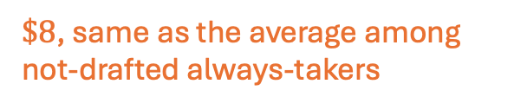

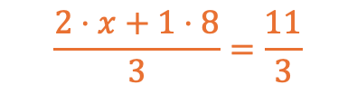
Q2: Is -$4 big or small?
What is the average income among the always-takers here?
3 people
1 person
1 Always-takers
2 Compliers
1 Always-taker
$\$8$, same as the average among not-drafted always-takers
Served
Avg income: $$\frac{11}{3}$
Avg income: $8
What is the average income among the compliers here?
1 person
3 people
$$\frac{2⋅x+1⋅8}{3}=\frac{11}{3}$$
$$⇒x=1.5$$
1 Never-taker
1 Never-taker
2 Compliers
Drafted:
So the average income among drafted compliers is $1.50…
$4 is a big deal!
Did not
serve
Avg income: $4
Avg income: $5
$1
$2
$4
$8
Not Drafted:
Drafted
Not Drafted
$5
$6
$4
$8

Slide 58
Q3: Are compliers similar to the general population? For example, what about race?
3 people
1 person
1 Always-takers
2 Compliers
1 Always-taker
Served
2 White
1 Non-White
1 White
Figure it out!
How many of the 4 compliers are white?
Assume that the white and non-white populations are evenly split by the draft.
1 person
3 people
1 Never-taker
1 Never-taker
2 Compliers
Did not
serve
1 Non-White
1 White
2 Non-White
Drafted
Not Drafted

Slide 59
Q3: Are compliers similar to the general population? For example, what about race?
Answer: the compliers are evenly split between white and non-white
same as the general population in this toy example
3 people
1 person
1 Always-takers
2 Compliers
1 Always-taker
Served
2 White
1 Non-White
1 White
Logic:
The drafted always-taker is white (to match the non-drafted always-taker).
So the compliers who served are 1 white and 1 non-white.
The non-drafted never-taker is non-white.
So the compliers who did not serve are 1 white and one non-white.
1 person
3 people
1 Never-taker
1 Never-taker
2 Compliers
Did not
serve
1 Non-White
1 White
2 Non-White
Drafted
Not Drafted

Slide 60
Where do we stand?
Hey, there’s this cool thing called LATE! We can learn the average treatment effect for the population of compliers! It’s -$4!
Is that a big population?
Is -$4 big or small compared to average earnings in this population?
Is that population at all representative of the larger population?
I have so many questions!
We can answer these questions!
(Approximately, assuming that Z is actually random relative to observables).

Slide 61
When is computing LATE useful?
Depends on the context!
But at least we can compute stuff about the complier population to help us decide.

Slide 62
Recap and Looking ahead
Don’t forget to stick around for the exit ticket!

Slide 63



Recap
$$Z$$
$$X$$
$$Y$$
Instrumental variables:
LATE = Local Average Treatment Effect = ATE among compliers.
We can’t hope to estimate the ATE of X on Y in the whole population.
But we can hope to estimate it among the compliers!
LATE = (ATE of Z on Y) / (ATE of Z on X)
We can learn things about the compliers!
How many are there? What are their demographics, etc?
Instrumental
Variable!

Slide 64
Next time…
Let’s get fancy
Non-binary Z and X
Multiple instruments
Non-linear models
What do IVs have to say about returns to education?

Slide 65

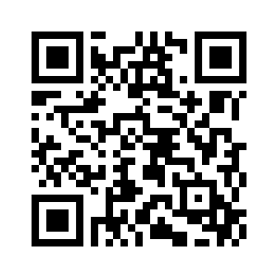
Exit ticket
Don’t forget to fill out the exit ticket before you leave class!

