Slide 1
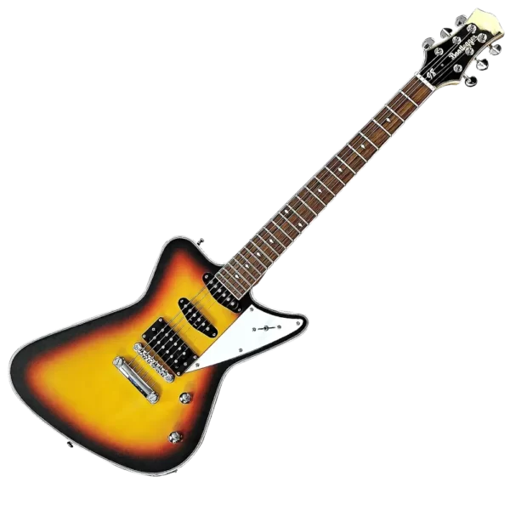

Instrumental Variables
The return of
Causality, Decision Making, and Data Science, Class 12
Non-binary variables!
Covariates!
Non-lInear models!
Asking LLMs to do our work for us!
SpoOooOoooOOOooky!

Slide 2
Announcements
No class Tuesday Nov 4
It’s Democracy Day!
HW3 Part 1 Due Monday Nov 3!
Looking a bit ahead… Project Check-Ins due Monday Nov 10!
By then you should have gone to office hours to talk to at least one of us about your project!

Slide 3
Agenda: Fancy IVs!
Recap and finishing up LATE
What happens when…
The IV isn’t binary?
The treatment isn’t binary?
There are covariates?
There are multiple IVs?
IV for returns to education: Quarter of birth
Using ML to use/find IVs
Using Deep Neural Nets instead of linear models
Where do we get IVs?

Slide 4
Recap
Instrumental Variables and LATE

Slide 5





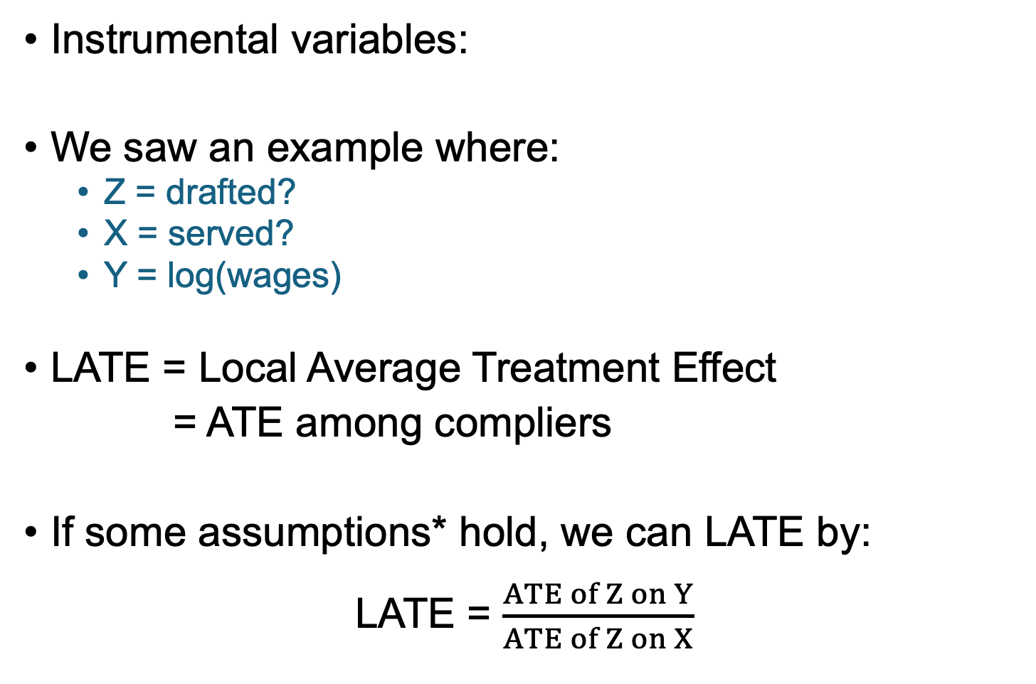



Recap: IVs and LATE
$$Z$$
$$X$$
$$Y$$
Instrumental variables:
We saw an example where:
Z = drafted?
X = served?
Y = log(wages)
LATE = Local Average Treatment Effect
= ATE among compliers
If some assumptions* hold, we can LATE by:
LATE = $\frac{ATE of Z on Y}{ATE of Z on X}$
Instrumental
Variable!
Compliers
Always-Takers
Never-Takers
Drafted
Not
Drafted
*Assumptions:
Relevance
Independence
Exclusion
Monotonicity

Slide 6
Recall our example from last time…
People who were drafted
People who were not drafted
Hourly Wage in 1980
$1
$8
$4
$2
$5
$4
$6
$8
Always-Takers
Never-Takers
Compliers
Drafted
LATE = -$4
Not
Drafted

Slide 7
Recall our example from last time…
People who were drafted
People who were not drafted
Hourly Wage in 1980
$1
$8
$4
$2
$5
$4
$6
$8
LATE = -$4

Slide 8


Where do we stand?
Hey, there’s this cool thing called LATE! We can learn the average treatment effect for the population of compliers! It’s -$4!
Is that a big population?
Is -$4 big or small compared to average earnings in this population?
Is that population at all representative of the larger population?
I have so many questions!

Slide 9
We can actually answer these questions!

Slide 10
Q1: How many compliers are there? Reprise of our toy example with 8 people; no defiers
What can we say about these people?
3 people
1 person
Compliers? Always-takers? Never-takers?
Always-takers!
Served
These people?
Always-takers or compliers!
1 person
3 people
These people?
Never-takers!
These people?
Did not
serve
Never-takers or compliers!
Drafted
Not Drafted

Slide 11
Q1: How many compliers are there? Reprise of our toy example with 8 people; no defiers
3 people
1 person
Assume that the always-takers got split evenly into drafted and not-drafted.
The power of randomness!
How many always-takers here?
Always-takers
or compliers
Always-takers
Served
1 person, same as the not drafted group!
1 person
3 people
So how many compliers are here?
Never-takers
or compliers!
3-1=2 people!
Never-takers
Drafted
Did not
serve
How about here?
1 never-taker and 2 compliers, by the same logic!
Not drafted
Drafted
Not Drafted

Slide 12

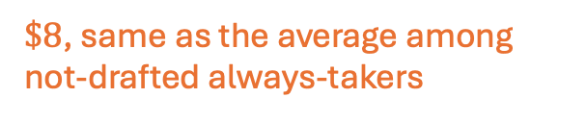

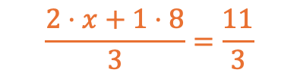
Q2: Is -$4 big or small?
What is the average income among the always-takers here?
3 people
1 person
1 Always-takers
2 Compliers
1 Always-taker
$\$8$, same as the average among not-drafted always-takers
Served
Avg income: $$\frac{11}{3}$
Avg income: $8
What is the average income among the compliers here?
1 person
3 people
$$\frac{2⋅x+1⋅8}{3}=\frac{11}{3}$$
$$⇒x=1.5$$
1 Never-taker
1 Never-taker
2 Compliers
Drafted:
So the average income among drafted compliers is $1.50…
$4 is a big deal!
Did not
serve
Avg income: $4
Avg income: $5
$1
$2
$4
$8
Not Drafted:
Drafted
Not Drafted
$5
$6
$4
$8

Slide 13

Q3: Are compliers similar to the general population? For example, what about race?
3 people
1 person
1 Always-takers
2 Compliers
1 Always-taker
Served
2 White
1 Non-White
1 White
Figure it out!
How many of the 4 compliers are white?
Assume that the white and non-white populations are evenly split by the draft.
1 person
3 people
1 Never-taker
1 Never-taker
2 Compliers
Did not
serve
1 Non-White
1 White
2 Non-White
Drafted
Not Drafted

Slide 14
Q3: Are compliers similar to the general population? For example, what about race?
Answer: the compliers are evenly split between white and non-white
same as the general population in this toy example
3 people
1 person
1 Always-takers
2 Compliers
1 Always-taker
Served
2 White
1 Non-White
1 White
Logic:
The drafted always-taker is white (to match the non-drafted always-taker).
So the compliers who served are 1 white and 1 non-white.
The non-drafted never-taker is non-white.
So the compliers who did not serve are 1 white and one non-white.
1 person
3 people
1 Never-taker
1 Never-taker
2 Compliers
Did not
serve
1 Non-White
1 White
2 Non-White
Drafted
Not Drafted

Slide 15
Where do we stand?
Hey, there’s this cool thing called LATE! We can learn the average treatment effect for the population of compliers! It’s -$4!
Is that a big population?
Is -$4 big or small compared to average earnings in this population?
Is that population at all representative of the larger population?
I have so many questions!
We can answer these questions!
(Approximately, assuming that Z is actually random relative to observables).

Slide 16
When things get complicated and Two-Stage Least Squares
What if Z and X aren’t binary? What if there are covariates? What if there is more than one instrument?

Slide 17
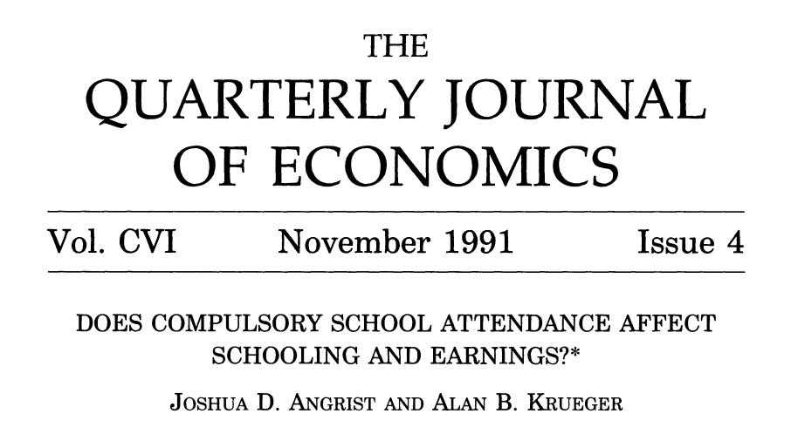
Running example that you read about (We’ll return to this in more detail later)
Angrist + Krueger 1991
Instrument: Quarter of birth
Idea: people who are born in Q1 can drop out of school earlier
Hopefully what quarter you are born in doesn’t have much to do with your ability or other unmeasured confounding variables.
Outcome: Earnings

Slide 18
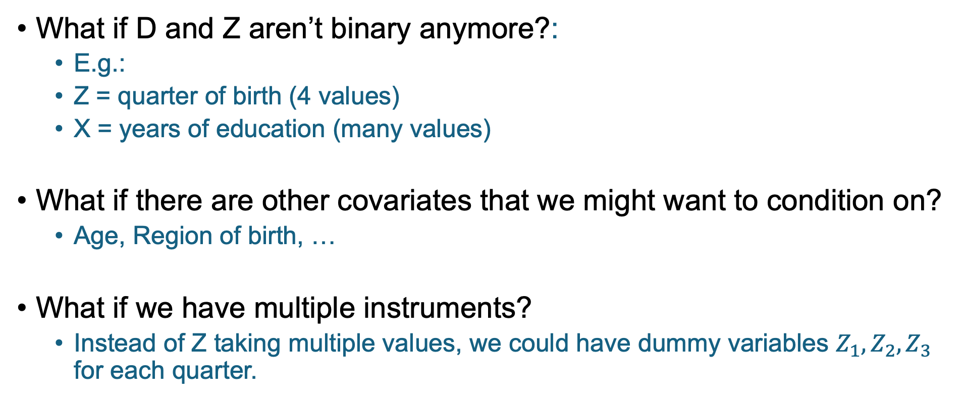
What if things get more complicated?
What if D and Z aren’t binary anymore?:
E.g.:
Z = quarter of birth (4 values)
X = years of education (many values)
What if there are other covariates that we might want to condition on?
Age, Region of birth, …
What if we have multiple instruments?
Instead of Z taking multiple values, we could have dummy variables $Z_{1},Z_{2},Z_{3}$ for each quarter.

Slide 19
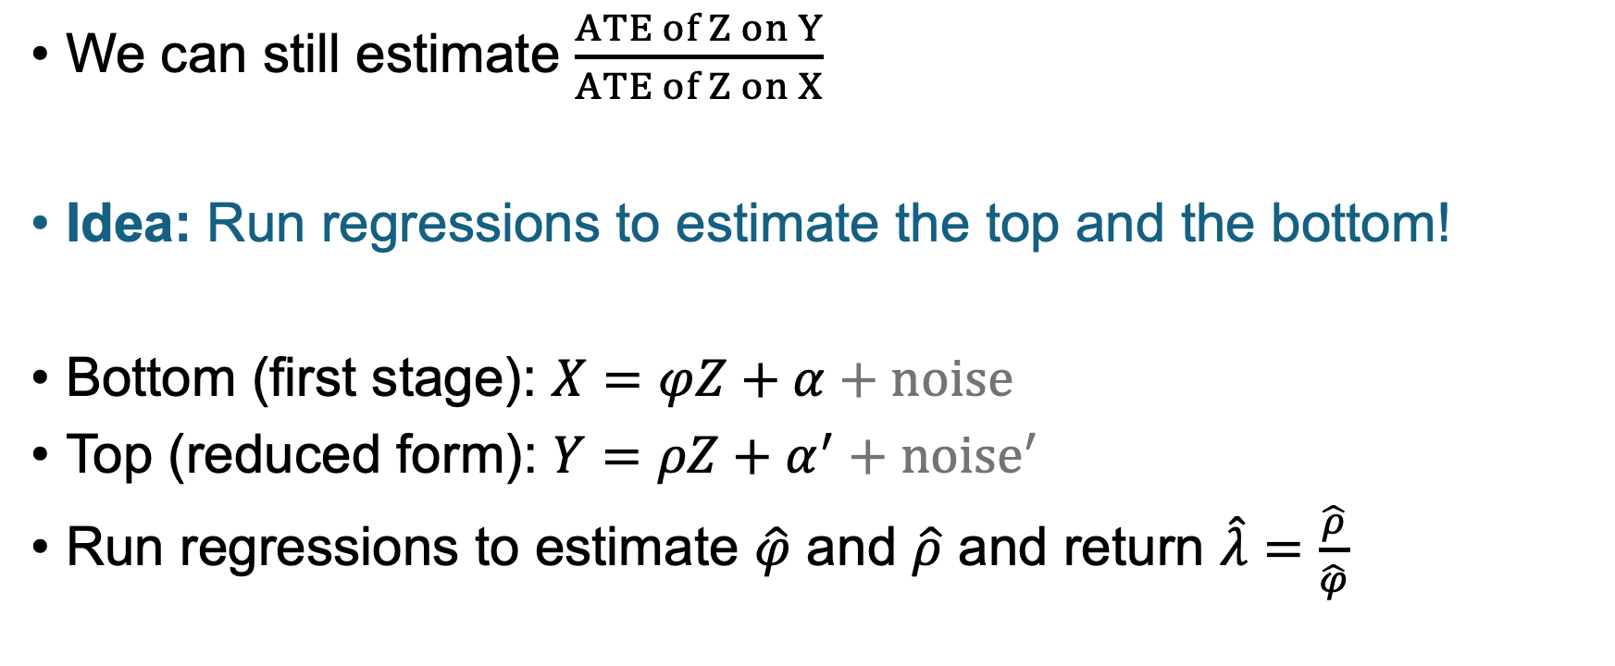

If D and Z aren’t binary
We can still estimate $\frac{ATE of Z on Y}{ATE of Z on X}$
Idea: Run regressions to estimate the top and the bottom!
Bottom (first stage): $X=φZ+α+noise$
Top (reduced form): $Y=ρZ+α^{′}+noise^{′}$
Run regressions to estimate $\hat{φ}$ and $\hat{ρ}$ and return $\hat{λ}=\frac{\hat{ρ}}{\hat{φ}}$
But how do we interpret $\hat{λ}$?

Slide 20
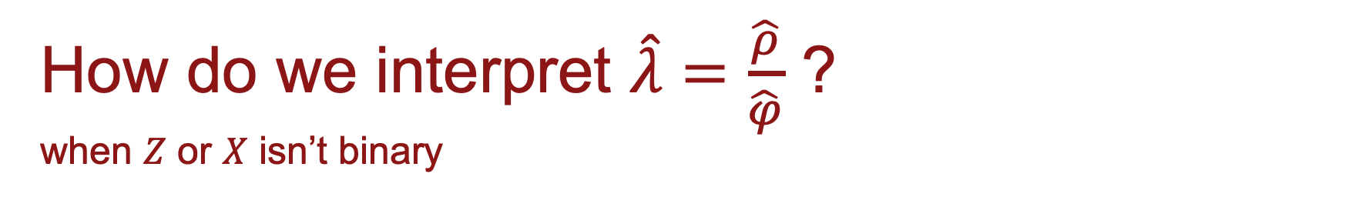
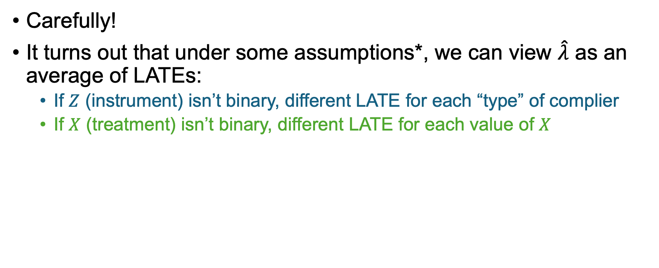
How do we interpret $\hat{λ}=\frac{\hat{ρ}}{\hat{φ}}$ ? when $Z$ or $X$ isn’t binary
*Assumptions:
Relevance
Independence + Exclusion
Monotonicity
Carefully!
It turns out that under some assumptions*, we can view $\hat{λ}$ as an average of LATEs:
If $Z$ (instrument) isn’t binary, different LATE for each “type” of complier
If $X$ (treatment) isn’t binary, different LATE for each value of $X$
E.g., I’m the “type” who goes to college if I’m born in Q3 or Q4, but not Q1 or Q2.
E.g., I got 11 years of schooling, so I contribute to the “LATE for the population who got 11 years of schooling”
Notes:
Types of compliers:
* The type who will go to college if born in Q2, Q3, Q4
* The type who will go to college if born in Q3, Q4
* The type who will go to college if born in Q4
always takers will go to college if born in any quarter
never takes will never go to college

Slide 21
Interpretation when Z isn’t binary
Freedom!
$$Z$$
$$X$$
$$Y$$

Slide 22
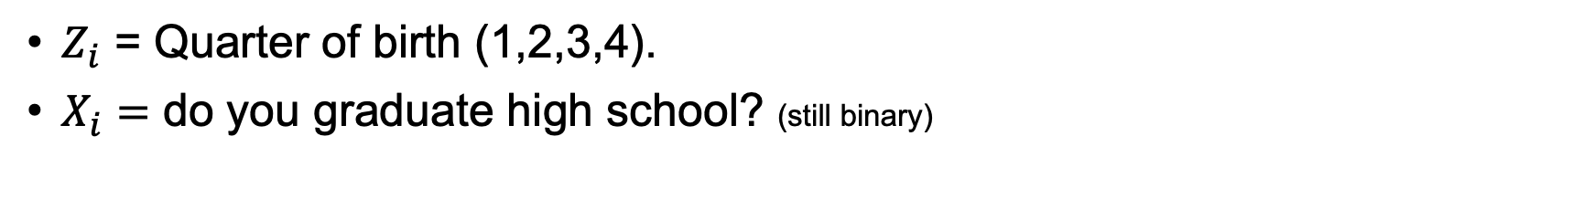
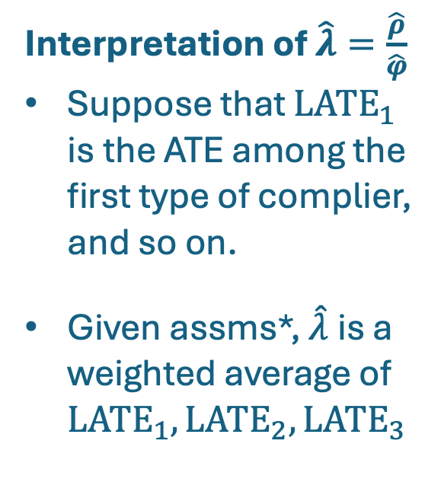
Interpretation when Z isn’t binary
*Assumptions:
Relevance
Independence + Exclusion
Monotonicity
$Z_{i}$ = Quarter of birth (1,2,3,4).
$X_{i}=$ do you graduate high school? (still binary)
Interpretation of $\hat{λ}=\frac{\hat{ρ}}{\hat{φ}}$
Suppose that $LATE_{1}$ is the ATE among the first type of complier, and so on.
Given assms*, $\hat{λ}$is a weighted average of $LATE_{1},LATE_{2}, LATE_{3}$
Types of people:
Three types of compliers!
Always-taker
Never-taker
Q1
Grad
Dropout
Dropout
Dropout
Dropout
Q2
Grad
Grad
Dropout
Dropout
Dropout
Q3
Grad
Grad
Dropout
Dropout
Quarter of birth
Grad
Q4
Grad
Grad
Grad
Grad
Dropout

Slide 23
Interpretation when X isn’t binary
Freedom!
$$Z$$
$$X$$
$$Y$$

Slide 24
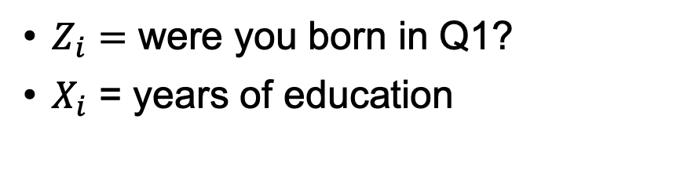



Interpretation when X isn’t binary
$Z_{i}=$ were you born in Q1?
$X_{i}$ = years of education
Lots of types of people:
Years of schooling if born in Q1
…
10
10
15
10
12
19
Q1
Years of schooling if not born in Q1
11
12
15
13
12
20
Q2,3,4

Slide 25
Interpretation when X isn’t binary
$Z_{i}=$ were you born in Q1?
$X_{i}$ = years of education
Suppose we care about the returns to an 11’th year of education.
These types are the “11-year compliers”
Lots of types of people:
Years of schooling if born in Q1
…
10
10
15
10
12
19
Q1
Years of schooling if not born in Q1
11
12
15
13
12
20
Q2,3,4

Slide 26
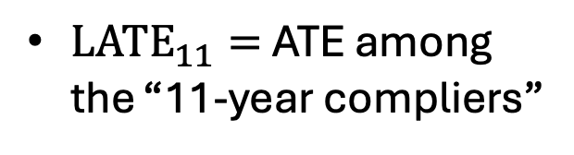
Interpretation when X isn’t binary
$Z_{i}=$ were you born in Q1?
$X_{i}$ = years of education
Suppose we care about the returns to an 11’th year of education.
These types are the “11-year compliers”
$LATE_{11}=$ ATE among the “11-year compliers”
Lots of types of people:
…
10
10
15
10
12
19
Q1
11
12
15
13
12
20
Q2,3,4

Slide 27
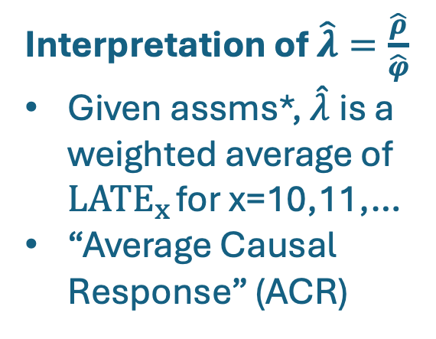
Interpretation when X isn’t binary
*Assumptions:
Relevance
Independence + Exclusion
Monotonicity
$Z_{i}=$ were you born in Q1?
$X_{i}$ = years of education
Suppose we care about the returns to an 11’th year of education.
These types are the “11-year compliers”
$LATE_{11}=$ ATE among the “11-year compliers”
Lots of types of people:
Interpretation of $\hat{λ}=\frac{\hat{ρ}}{\hat{φ}}$
Given assms*, $\hat{λ}$is a weighted average of $LATE_{x}$ for x=10,11,…
“Average Causal Response” (ACR)
…
10
10
15
10
12
19
Q1
11
12
15
13
12
20
Q2,3,4

Slide 28

What if things get more complicated?
What if D and Z aren’t binary anymore?:
E.g.:
Z = quarter of birth (4 values)
X = years of education (many values)
What if there are other covariates that we might want to condition on?
Age, Region of birth, …
What if we have multiple instruments?
Instead of Z taking multiple values, we could have dummy variables $Z_{1},Z_{2},Z_{3}$ for each quarter.

Slide 29
What about controlling for other variables?
In our running example…
Maybe we are worried about age
Slightly older people may make slightly more money.
So we may want to control for age (up to the quarter).
Maybe we are worried about state of birth
Different states have slightly different compulsory schooling rules, and different populations.
So we may want to control for state of birth.
We can also throw in more observables, just in case!
E.g., we can control for race, marital status, do you live in a city, etc.

Slide 30

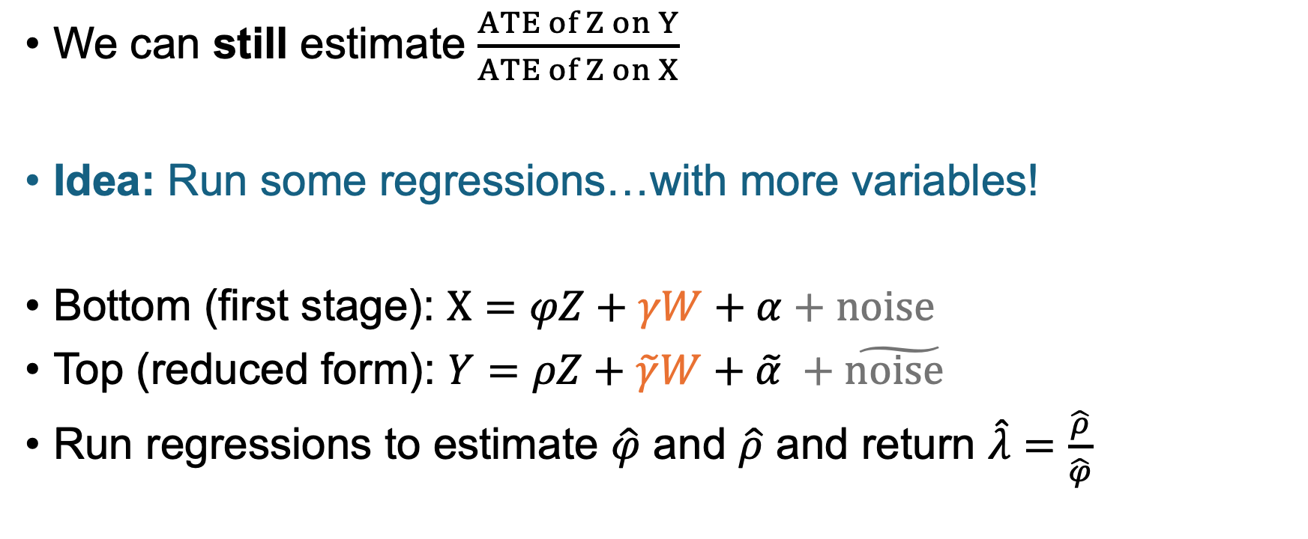
Controlling for other variables Say, $W$= age, state of birth, race, …
We can still estimate $\frac{ATE of Z on Y}{ATE of Z on X}$
Idea: Run some regressions…with more variables!
Bottom (first stage): $X=φZ+γW+α+noise$
Top (reduced form): $Y=ρZ+{\tilde{γ}W+\tilde{α}}^{ }+\tilde{noise }$
Run regressions to estimate $\hat{φ}$ and $\hat{ρ}$ and return $\hat{λ}=\frac{\hat{ρ}}{\hat{φ}}$
But how do we interpret $\hat{λ}$?

Slide 31
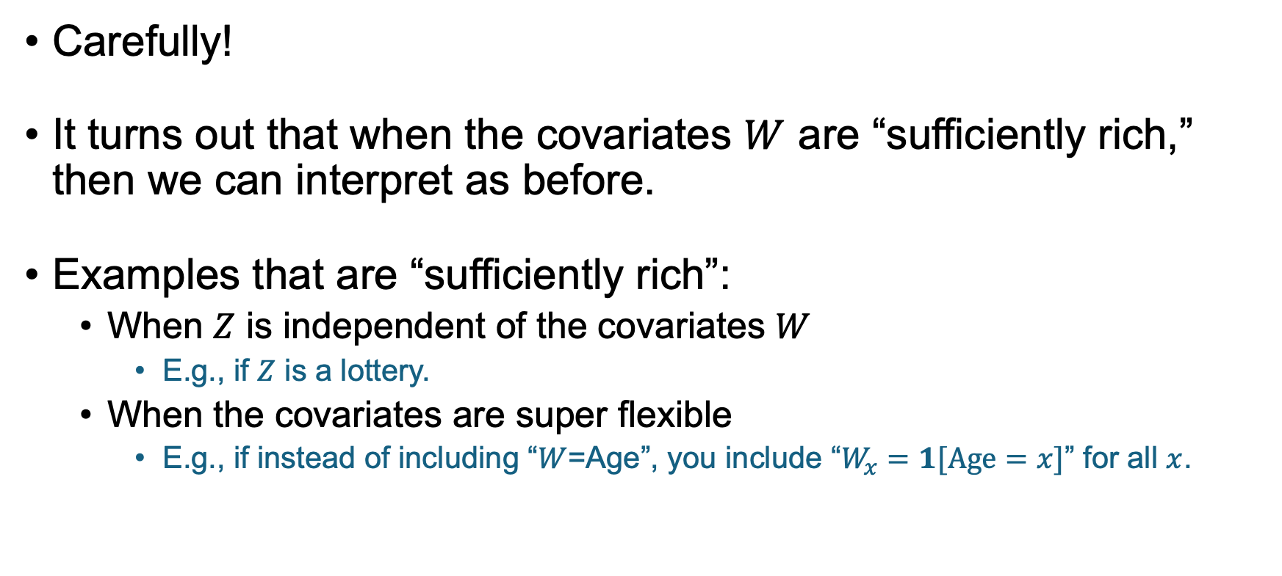

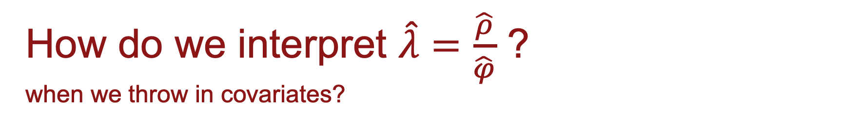
How do we interpret $\hat{λ}=\frac{\hat{ρ}}{\hat{φ}}$ ? when we throw in covariates?
Intuitively, “sufficiently rich” means that the expectation of $Z$ given $W$ is the same as what $W$ would “predict” $Z$ to be in a linear model.
Carefully!
It turns out that when the covariates $W$ are “sufficiently rich,” then we can interpret as before.
Examples that are “sufficiently rich”:
When $Z$ is independent of the covariates $W$
E.g., if $Z$ is a lottery.
When the covariates are super flexible
E.g., if instead of including “$W$=Age”, you include “$W_{x}=1[Age=x]$” for all $x$.
Notes:
Aka, covariates being sufficiently rich means that we need to approximately believe our linear model

Slide 32
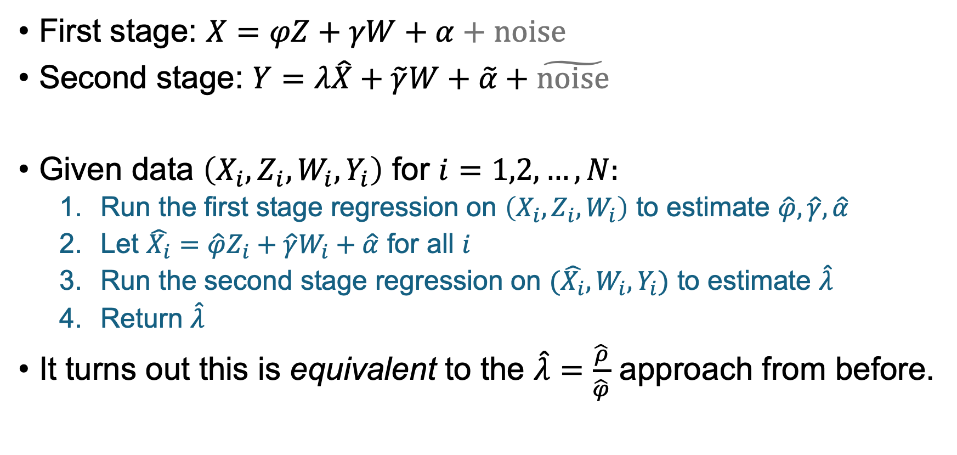
Equivalent way to do it: 2SLS Two-Stage Least Squares
First stage: $X=φZ+γW+α+noise$
Second stage: $Y=λ\hat{X}+\tilde{γ}W+\tilde{α}+\tilde{noise}$
Given data $\left(X_{i}, Z_{i}, W_{i},Y_{i}\right)$ for $i=1,2,…,N:$
Run the first stage regression on $\left(X_{i}, Z_{i}, W_{i}\right)$ to estimate $\hat{φ}, \hat{γ}, \hat{α}$
Let $\hat{X_{i}}=\hat{φ}Z_{i}+\hat{γ}W_{i}+\hat{α}$ for all $i$
Run the second stage regression on $(\hat{X_{i}},W_{i},Y_{i})$ to estimate $\hat{λ}$
Return $\hat{λ}$
It turns out this is equivalent to the $\hat{λ}=\frac{\hat{ρ}}{\hat{φ}}$ approach from before.

Slide 33
What if things get more complicated?
What if D and Z aren’t binary anymore?:
E.g.:
Z = quarter of birth (4 values)
X = years of education (many values)
What if there are other covariates that we might want to condition on?
Age, Region of birth, …
What if we have multiple instruments?
Instead of Z taking multiple values, we could have dummy variables $Z_{1},Z_{2},Z_{3}$ for each quarter.

Slide 34
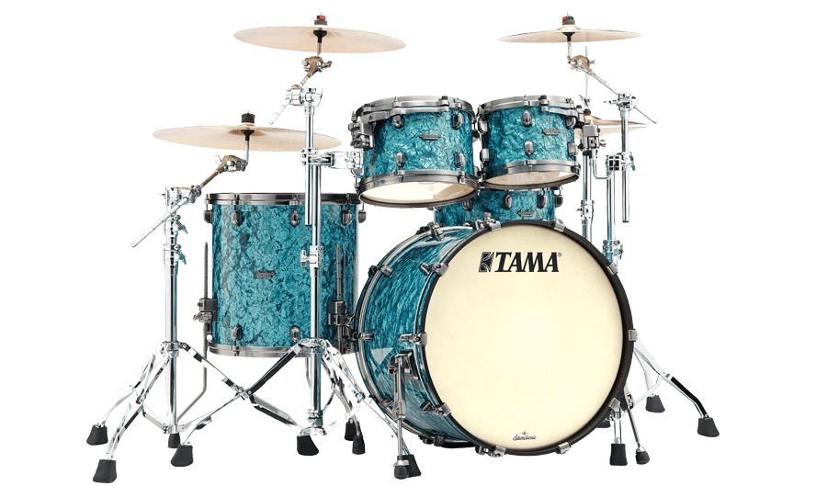
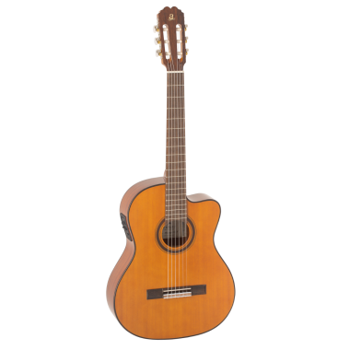
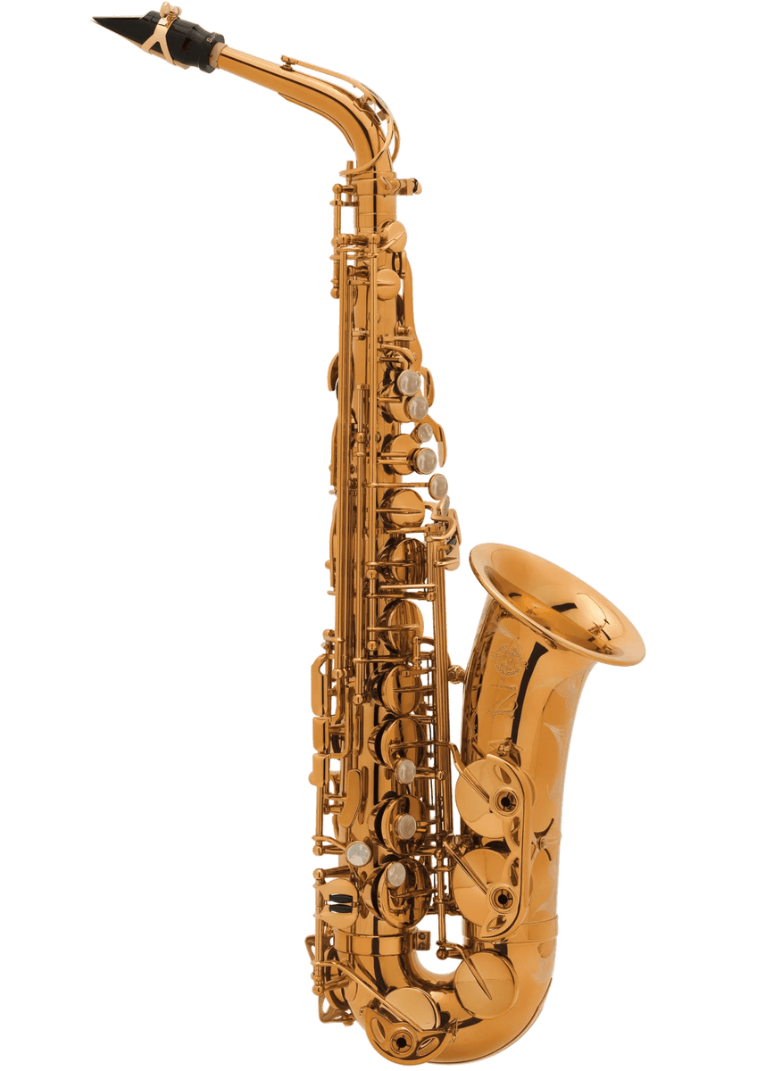
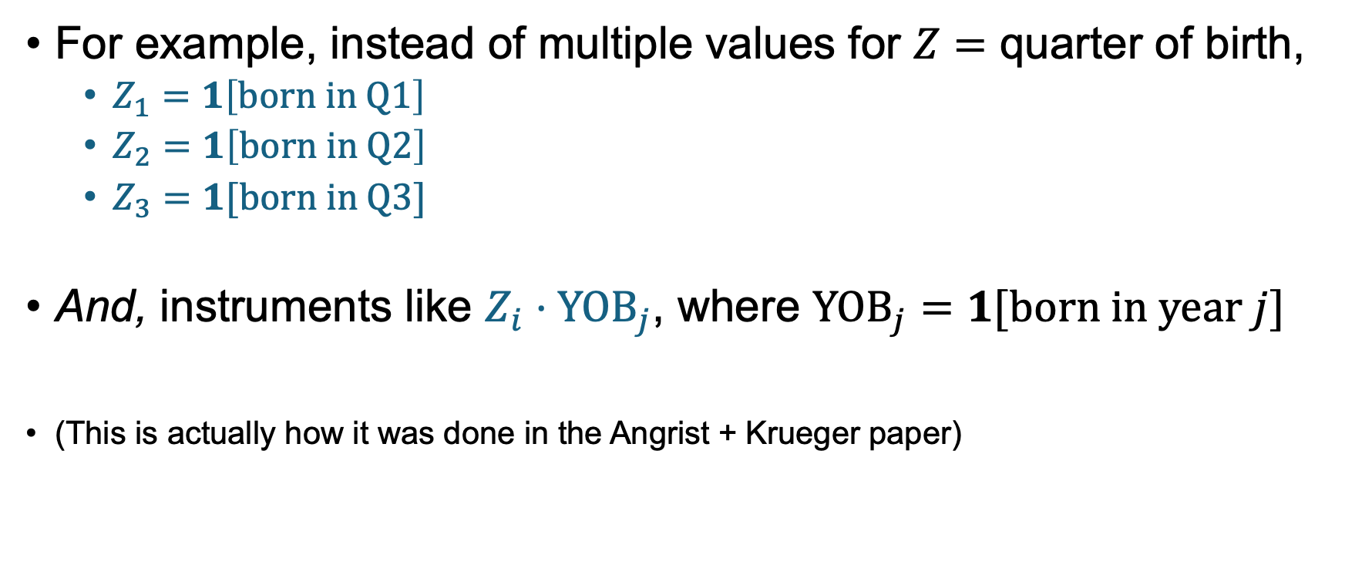
Multiple Instruments
For example, instead of multiple values for $Z=$ quarter of birth,
$Z_{1}=1\left[born in Q1\right]$
$Z_{2}=1\left[born in Q2\right]$
$Z_{3}=1[born in Q3]$
And, instruments like $Z_{i}⋅{YOB}_{j}$, where ${YOB}_{j}=$ $1[born in year j]$
(This is actually how it was done in the Angrist + Krueger paper)

Slide 35
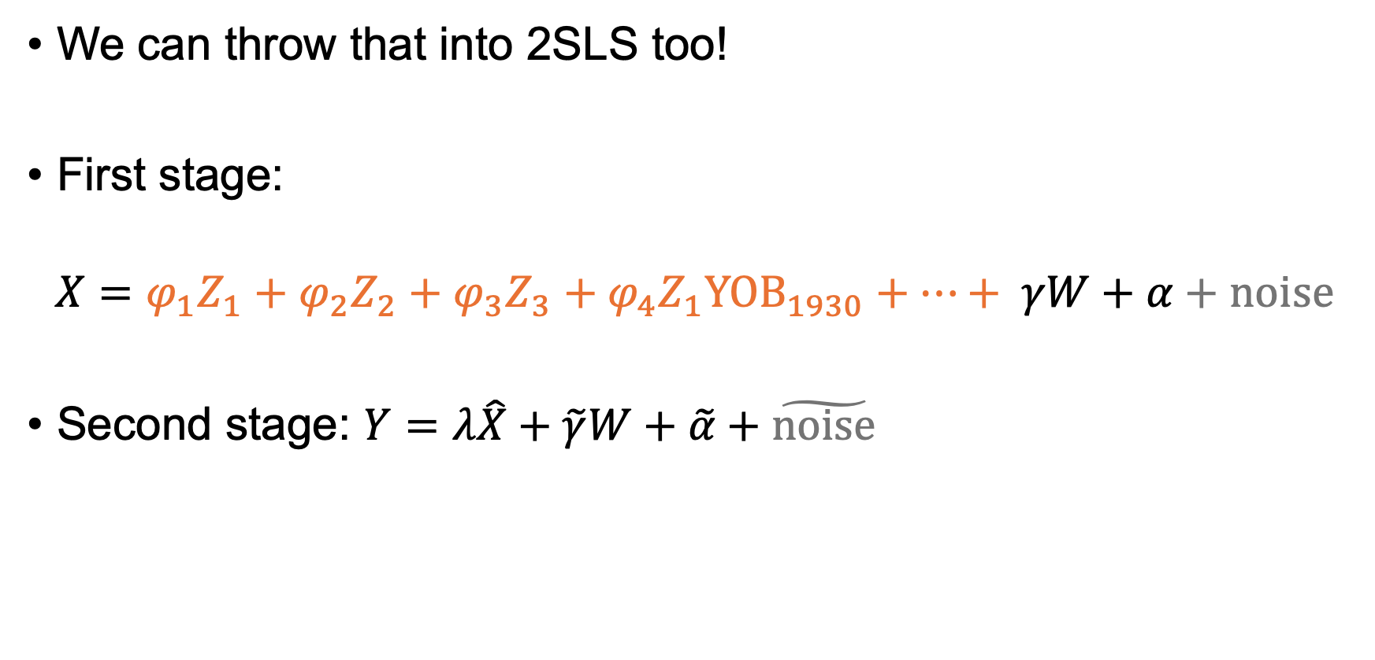

Multiple Instruments
We can throw that into 2SLS too!
First stage:
$$X=φ_{1}Z_{1}+φ_{2}Z_{2}+φ_{3}Z_{3}+φ_{4}Z_{1}YOB_{1930}+⋯+ γW+α+noise$$
Second stage: $Y=λ\hat{X}+\tilde{γ}W+\tilde{α}+\tilde{noise}$
So many instruments!
But how do we interpret $\hat{λ}$?

Slide 36
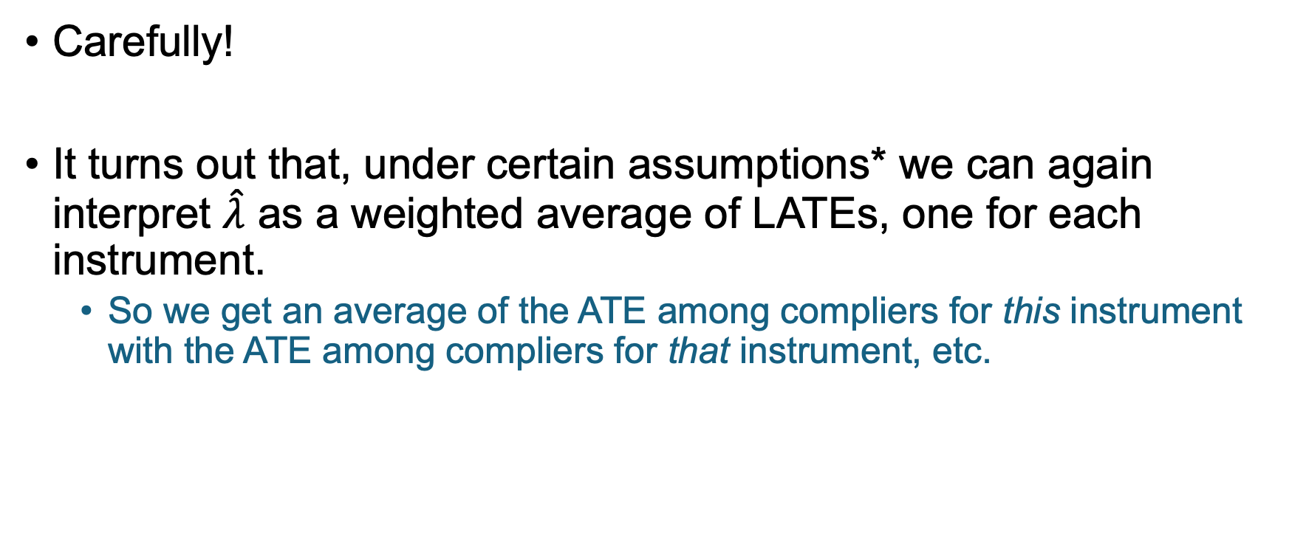
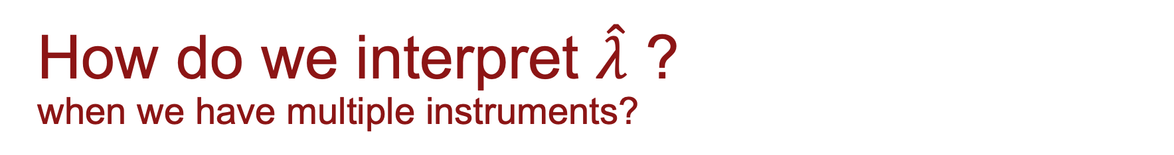
How do we interpret $\hat{λ}$ ? when we have multiple instruments?
*All the ones from before; and, e.g. that the instruments satisfy some sort of monotonicty, and the covariates are sufficiently rich.
Carefully!
It turns out that, under certain assumptions* we can again interpret $\hat{λ}$ as a weighted average of LATEs, one for each instrument.
So we get an average of the ATE among compliers for this instrument with the ATE among compliers for that instrument, etc.

Slide 37

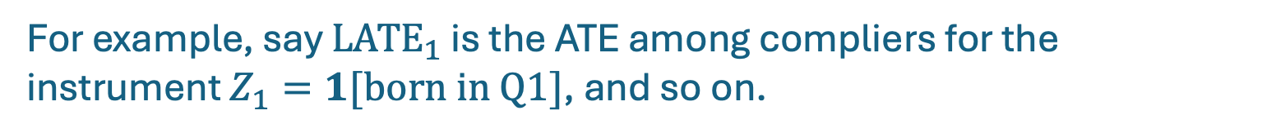
Interpretation with multiple instruments
We could have used each instrument individually and interpreted it as a LATE (if the assumptions hold).
Doing them all together in a 2SLS will generate a linear combination of these LATEs:
That’s more interpretable if the $α_{i}$’s are non-negative...
For example, say $LATE_{1}$ is the ATE among compliers for the instrument $Z_{1}=1[born in Q1]$, and so on.
$$\hat{λ}=α_{1}LATE_{1}+α_{2}LATE_{2}+α_{3}LATE_{3}+⋯$$
They are non-negative under some assumptions…
For example, if the instruments satisfy some sort of monotonicity; and if the covariates are sufficiently rich.

Slide 38
What if things get more complicated?
What if D and Z aren’t binary anymore?:
E.g.:
Z = quarter of birth (4 values)
X = years of education (many values)
What if there are other covariates that we might want to condition on?
Age, Region of birth, …
What if we have multiple instruments?
Instead of Z taking multiple values, we could have dummy variables $Z_{1},Z_{2},Z_{3}$ for each quarter.

Slide 39
Summary: When things get complicated
We can do lots of fancy things!
Non-binary Z and X
Covariates
Multiple Instruments
Mechanically… it’s not too bad!
Use regressions to estimate the first stage and reduced form
Equivalently, throw it all into 2SLS!
Thoughtfully… things get complicated.
Under some assumptions, you can view the result as a weighted average of LATEs.
The assumptions get more complicated with the situation.

Slide 40
Angrist and Krueger 1991
A closer look

Slide 41
What did you think after reading the intro?
Share your thoughts with your neighbor!
Notes:
Put on the board:
External Validity
Construct Validity
Independence
Exclusion
Monotonicity
Relevance
Other
And fill in underneath

Slide 42
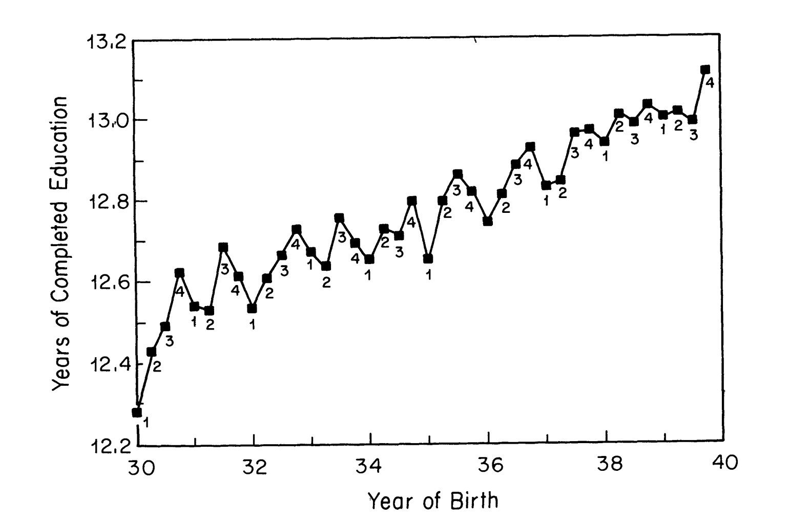
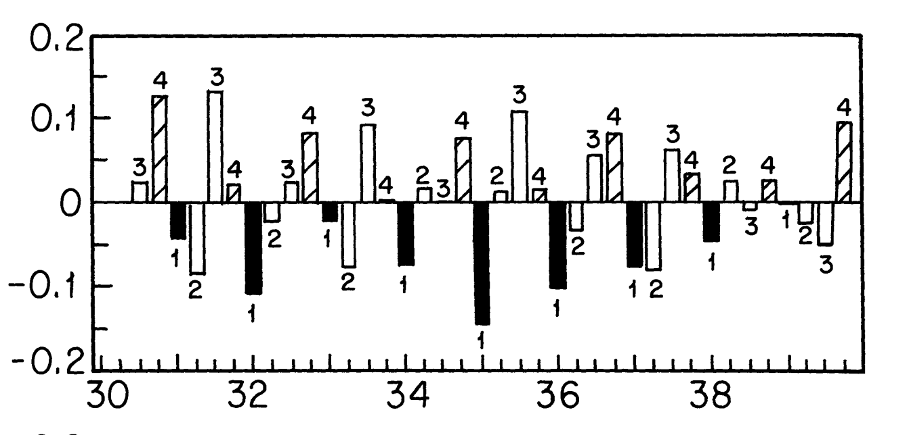

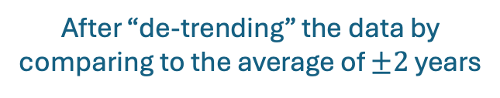
First Stage: Does Quarter of birth affect education?
These little numbers are quarter of birth
After “de-trending” the data by comparing to the average of $±2$ years

Slide 43
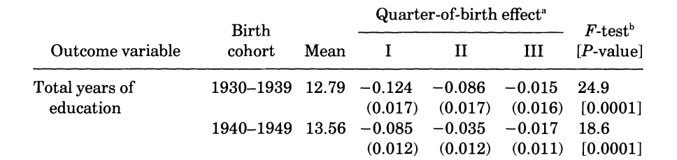
First Stage: Does Quarter of birth affect education?
The coefficient on being born in Q1 is more negative than Q2 or Q3.

Slide 44
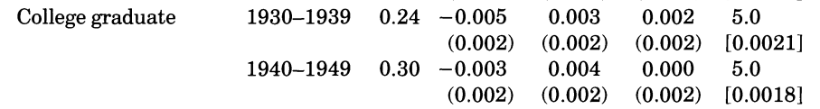
First Stage: Does Quarter of birth affect education?
Much smaller effects for college graduation, which makes sense:

Slide 45
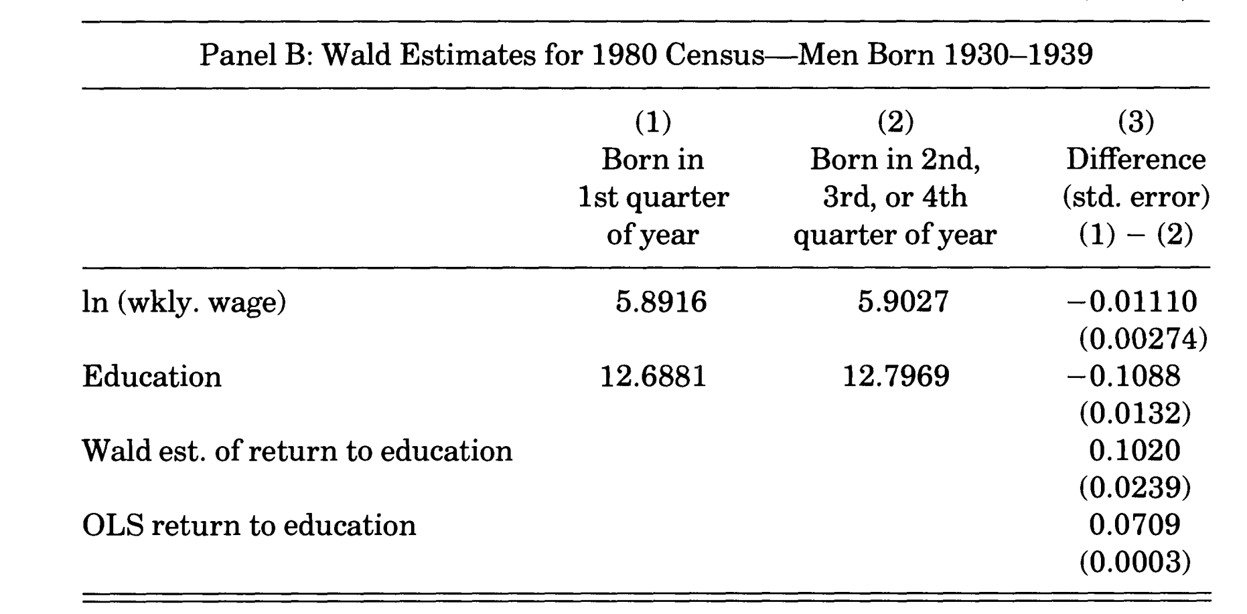
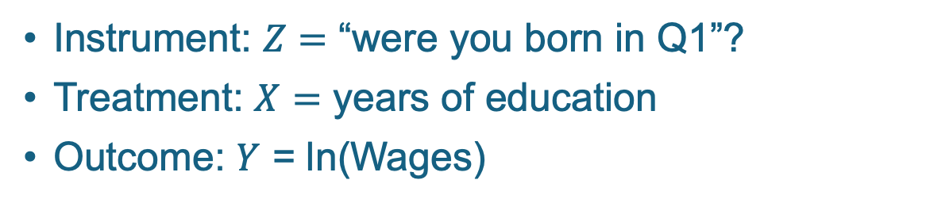
Wald Estimator No covariates or anything yet…
Instrument: $Z=$ “were you born in Q1”?
Treatment: $X=$ years of education
Outcome: $Y$ = ln(Wages)
$$Z$$
$$X$$
$$Y$$
Reduced form: ATE of Z on Y
First stage:
ATE of Z on X
Quotient: Wald estimator
Plain old regression

Slide 46

Wald Estimator No covariates or anything yet…
Instrument: $Z=$ “were you born in Q1”?
Treatment: $X=$ years of education
Outcome: $Y$ = ln(Wages)
$$Z$$
$$X$$
$$Y$$
Can/should we interpret “0.102” as a LATE?
Reduced form: ATE of Z on Y
First stage:
ATE of Z on X
Quotient: Wald estimator
Plain old regression

Slide 47
Wald Estimator No covariates or anything yet…
Instrument: $Z=$ “were you born in Q1”?
Treatment: $X=$ years of education
Outcome: $Y$ = ln(Wages)
$$Z$$
$$X$$
$$Y$$
Reduced form: ATE of Z on Y
First stage:
ATE of Z on X
Quotient: Wald estimator
Plain old regression

Slide 48
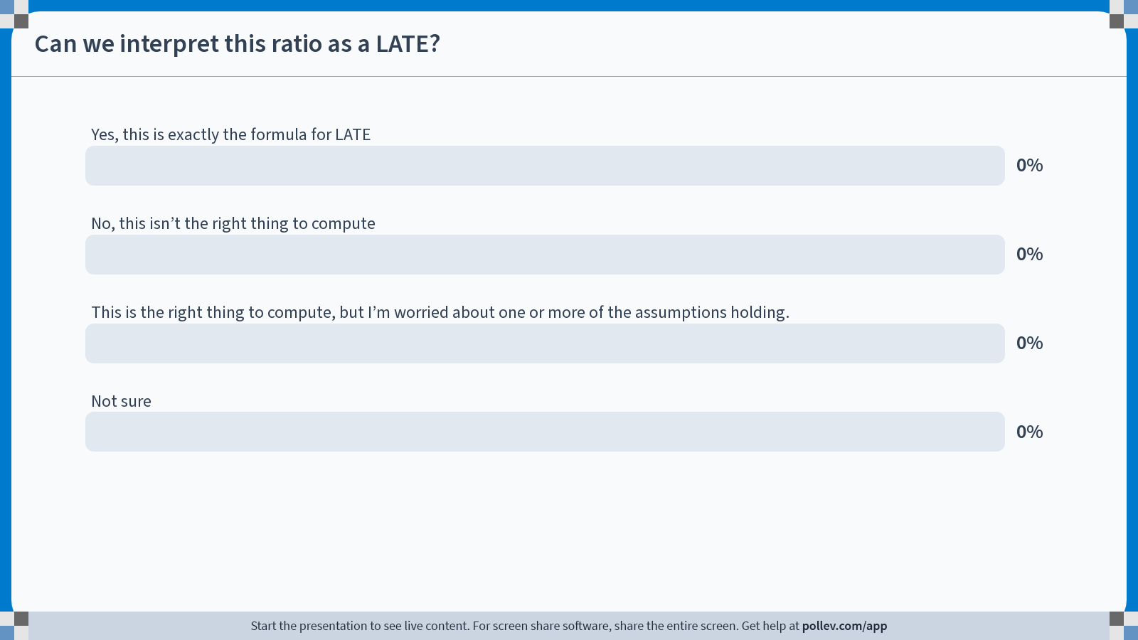
Notes:
Do not modify the notes in this section to avoid tampering with the Poll Everywhere activity. More info at polleverywhere.com/support Can we interpret this ratio as a LATE?
https://www.polleverywhere.com/multiple_choice_polls/anRy0DC5Fq0VlBNAkuodt?state=opened&flow=Default&onscreen=persist

Slide 49
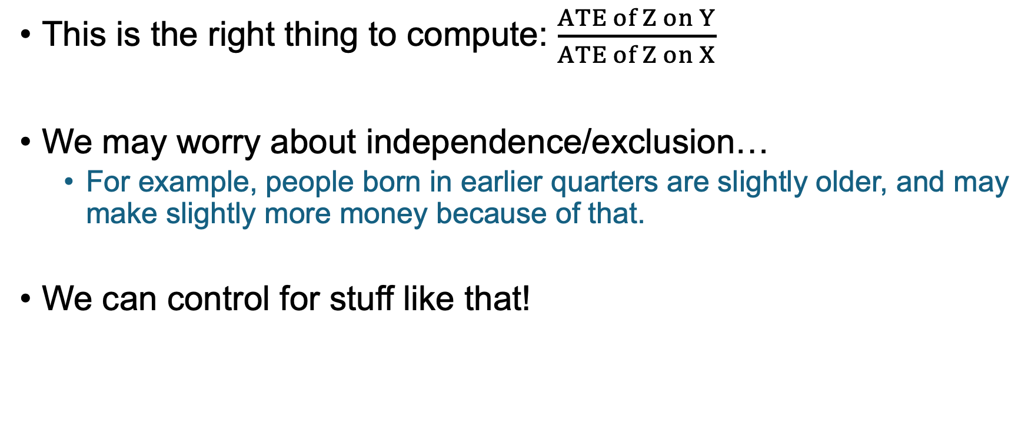
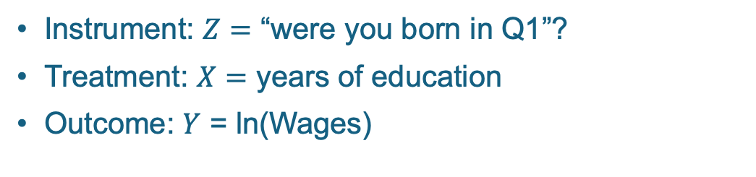
Is this LATE?
Instrument: $Z=$ “were you born in Q1”?
Treatment: $X=$ years of education
Outcome: $Y$ = ln(Wages)
$$Z$$
$$X$$
$$Y$$
This is the right thing to compute: $\frac{ATE of Z on Y}{ATE of Z on X}$
We may worry about independence/exclusion…
For example, people born in earlier quarters are slightly older, and may make slightly more money because of that.
We can control for stuff like that!

Slide 50
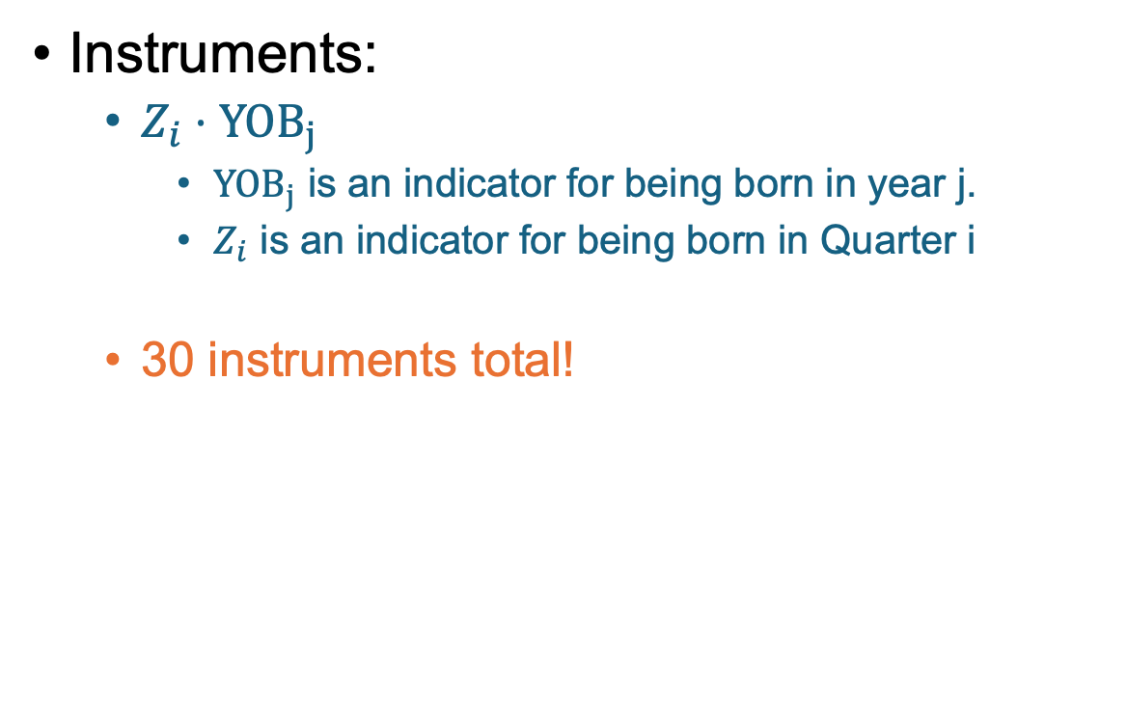
Let’s Get Fancy! 2SLS with multiple instruments and covariates
Covariates:
Race
Do you live in a city?
Marital status
Year of birth
Region of residence
Age and Age²
Instruments:
$Z_{i}⋅YOB_{j}$
$YOB_{j}$ is an indicator for being born in year j.
$Z_{i}$ is an indicator for being born in Quarter i
30 instruments total!

Slide 51
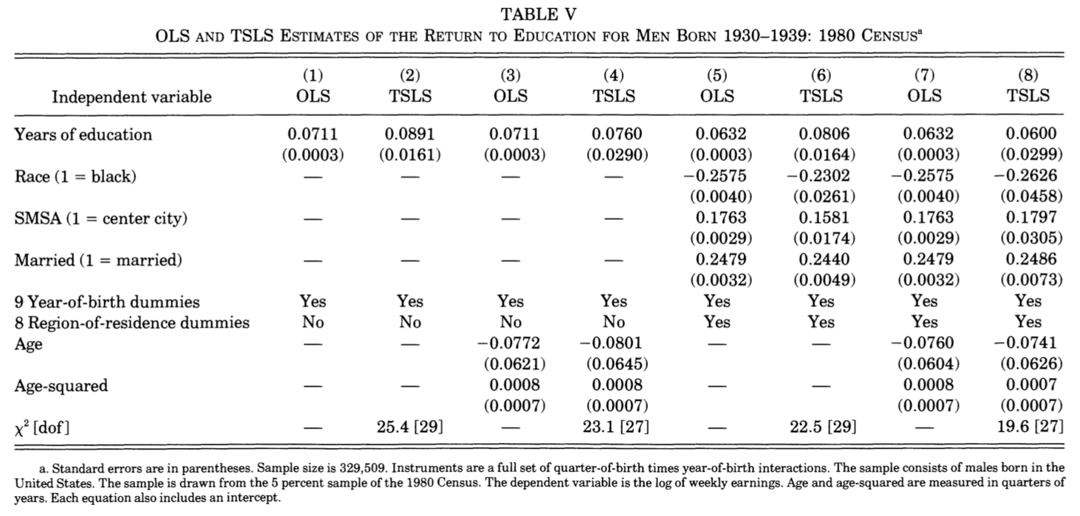
What do they get? 2SLS with multiple instruments and covariates
Not many covariates
All the covariates
Plain old regression
2-Stage Least-Squares
Plain old regression
2-Stage Least-Squares

Slide 52
One conclusion
All the covariates
2-Stage Least-Squares
These numbers look pretty similar:
That’s evidence that omitted variable bias (conditional on all the covariates we did condition on) isn’t a big deal in Plain Old Regression.
At least if we believe the instruments are legit
Plain old regression
0.0632
(0.0003)
0.0600
(0.0299)

Slide 53
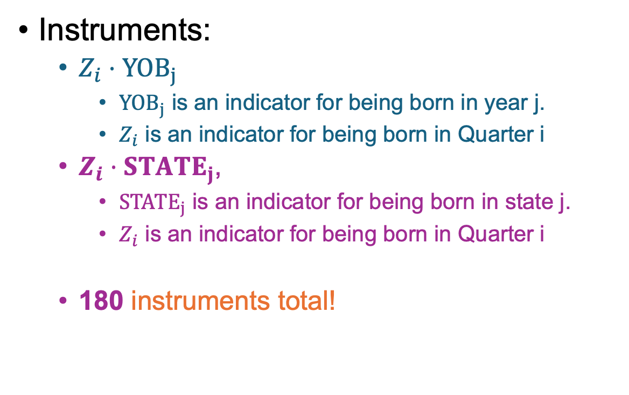
What if we add in state-by-state info?
Covariates:
Race
Do you live in a city?
Marital status
Year of birth
Region of residence
Age and Age²
State of birth
Instruments:
$Z_{i}⋅YOB_{j}$
$YOB_{j}$ is an indicator for being born in year j.
$Z_{i}$ is an indicator for being born in Quarter i
$Z_{i}⋅STATE_{j}$,
$STATE_{j}$ is an indicator for being born in state j.
$Z_{i}$ is an indicator for being born in Quarter i
180 instruments total!

Slide 54
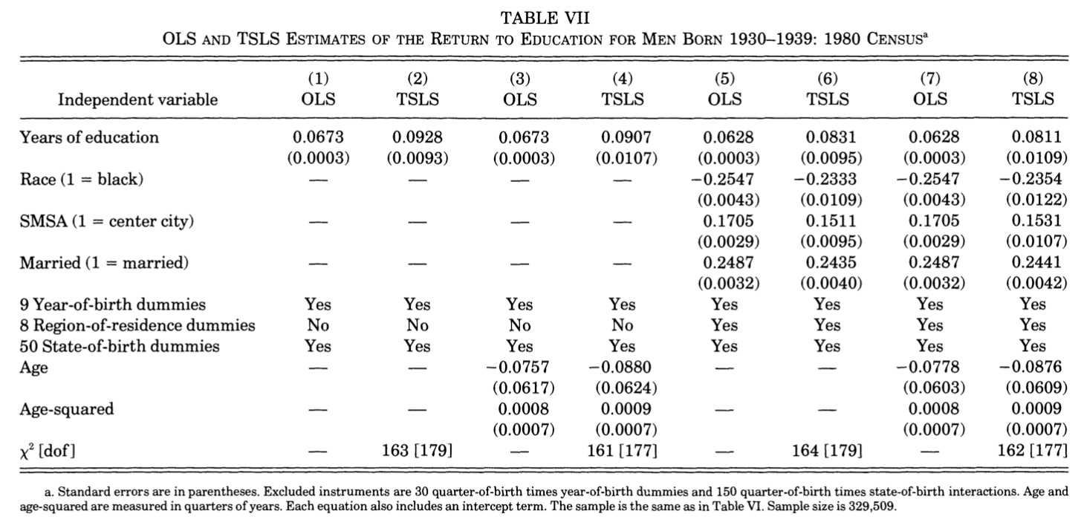
Now 2SLS gives a bigger estimate
Not many covariates
All the covariates
Plain old regression
2-Stage Least-Squares
Plain old regression
2-Stage Least-Squares

Slide 55
What did you think now? After seeing the results in more detail?
Do you find this compelling? What are some concerns?

Slide 56
Let’s revisit our concerns…
First, any new concerns after seeing the results?
Notes:
Go back to what we wrote on the board, maybe add some more things

Slide 57
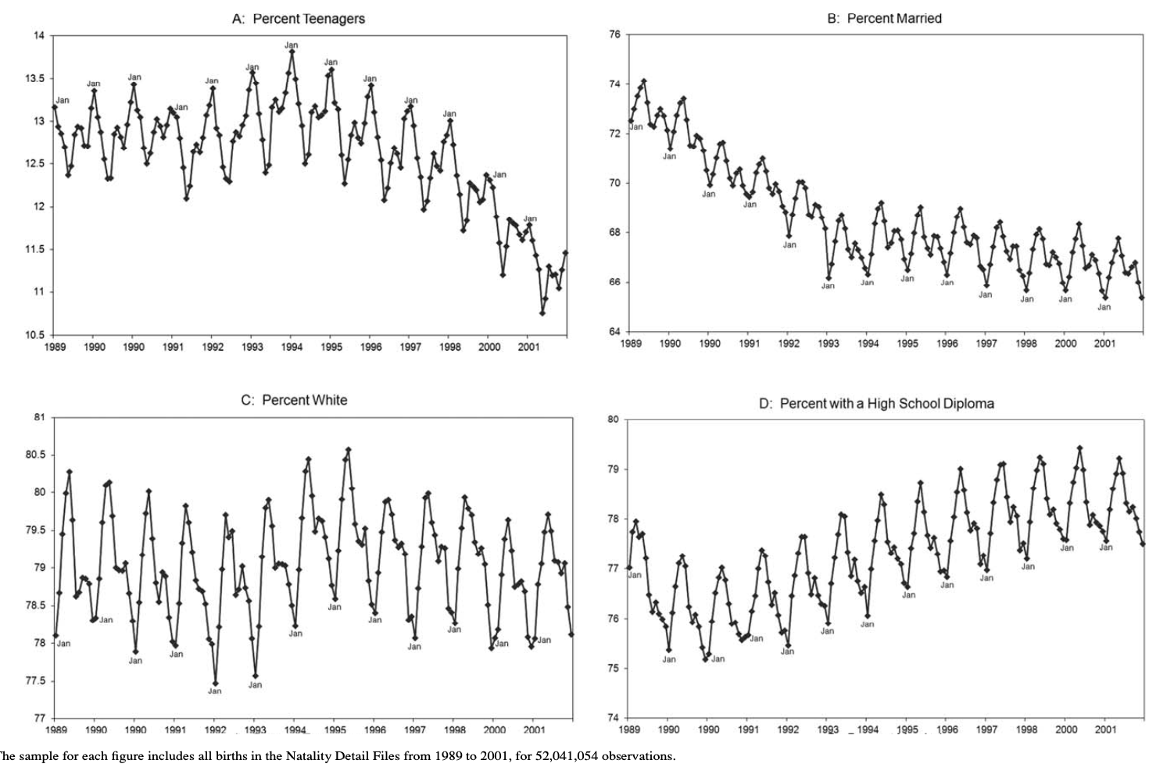
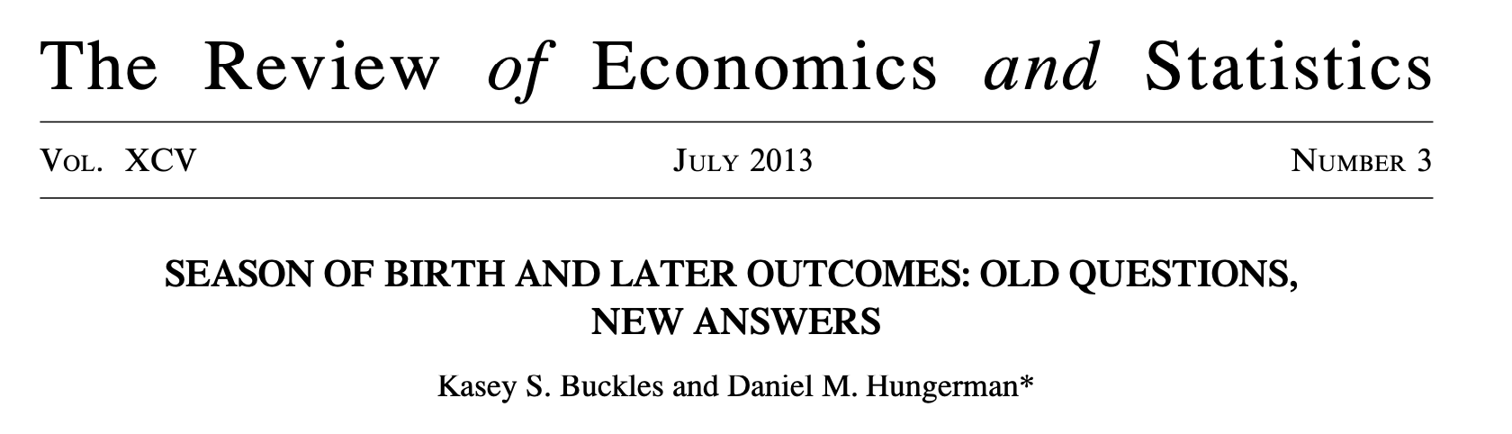
Concern: Independence/Exclusion
Season of birth is correlated with maternal characteristics.
E.g., January births are more likely to be from mothers who are:
Teenagers
Unmarried
Non-white
No HS diploma

Slide 58
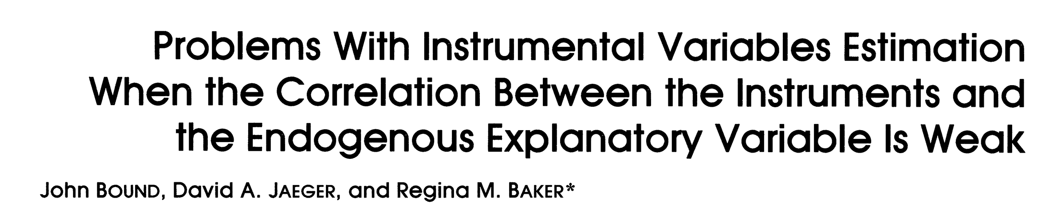
Concern: The effect of Z on X is weak
$$Z$$
$$X$$
$$Y$$
Quarter of birth has a significant but weak effect on education.
That would be fine if exclusion/independence holds, if we had infinite data, etc…
Small error terms matter more when the effect of Z on X is weak.
Intuitively, you are dividing a small error term by another small number, which might make it a large error term
This paper got similar results to [Angrist-Krueger’91] with made-up random data about birth quarter used as the instrument(s). That may make us suspicious.

Slide 59

Time for a break!
When we come back…how can machine learning help us with Instrumental Variables?
EXOGENEITY TEST FAILED.
WARNING
WARNING
WARNING

Slide 60
ML Methods for IV

Slide 61
Two questions
How can we use ML to analyze instruments?
How can we use ML to identify instruments?

Slide 62
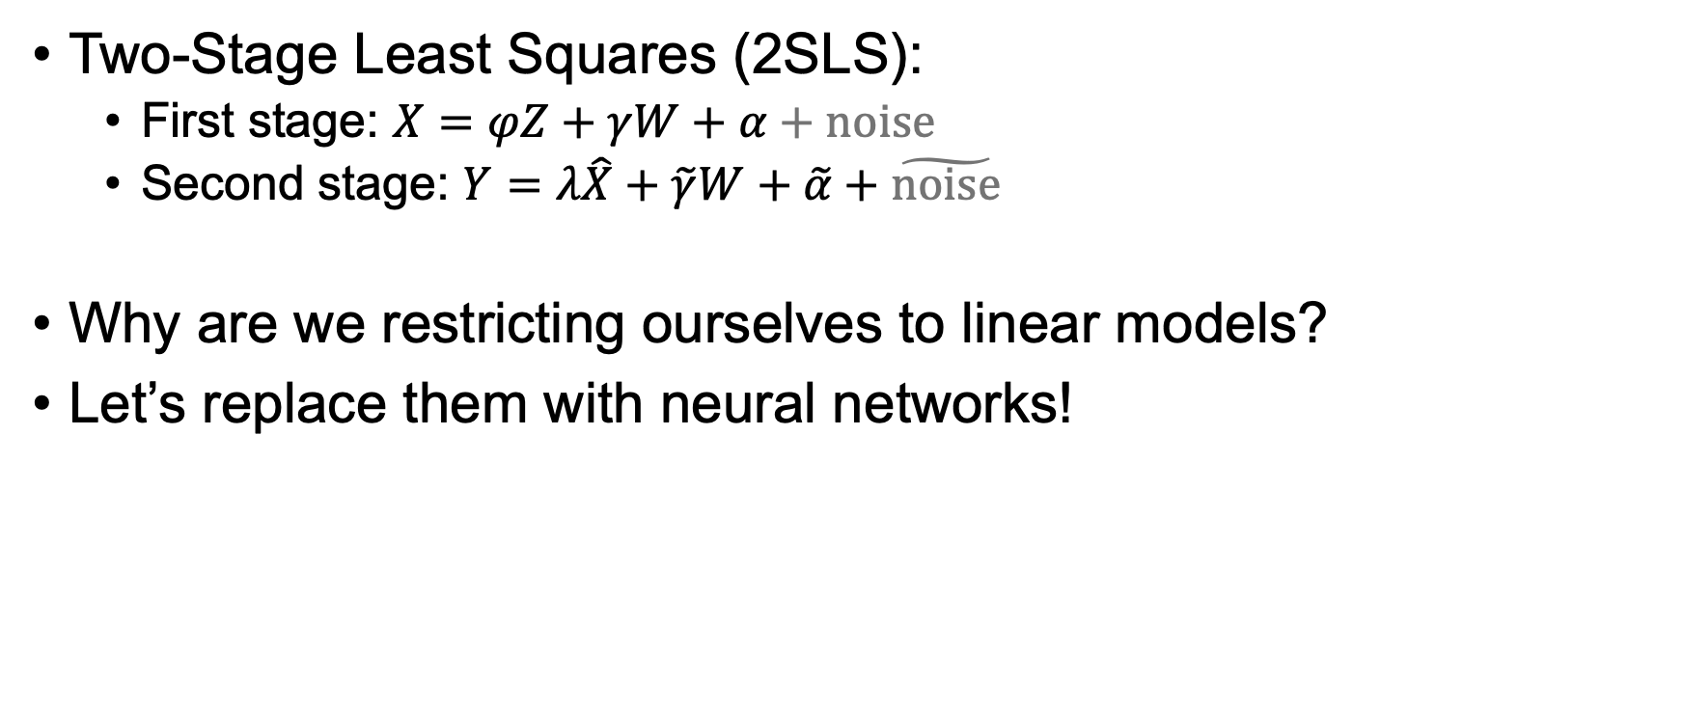
The story so far
Two-Stage Least Squares (2SLS):
First stage: $X=φZ+γW+α+noise$
Second stage: $Y=λ\hat{X}+\tilde{γ}W+\tilde{α}+\tilde{noise}$
Why are we restricting ourselves to linear models?
Let’s replace them with neural networks!
There are often good reasons to restrict to simpler models – e.g. to prevent over-fitting – but let’s say we have tons of data and want to take advantage of it.

Slide 63
Aside: Neural Networks
Each edge has a “weight” that tells the network how to propagate values from the input to the output.
A neural network is a function that looks something* like this:
Inputs
Output
*very simplified, relative to current state of the art…

Slide 64
Aside: Neural Networks
Each edge has a “weight” that tells the network how to propagate values from the input to the output.
A neural network is a function that looks something* like this
If you give it a bunch of examples of (Input, Output) pairs, it can “learn” weights to predict future examples.
“Learn” = “Solve an optimization problem to find the best weights”
Inputs
Output
*very simplified, relative to current state of the art…

Slide 65
Aside: Neural Networks
Each edge has a “weight” that tells the network how to propagate values from the input to the output.
A neural network is a function that looks something* like this
If you give it a bunch of examples of (Input, Output) pairs, it can “learn” weights to predict future examples.
“Learn” = “Solve an optimization problem to find the best weights”
This gives us a non-parametric way of describing a function.
…but it’s not very interpretable…
Inputs
Output
*very simplified, relative to current state of the art…

Slide 66
The story so far
Two-Stage Least Squares (2SLS):
First stage: $X=φZ+γW+α+noise$
Second stage: $Y=λ\hat{X}+\tilde{γ}W+\tilde{α}+\tilde{noise}$
Why are we restricting ourselves to linear models?
Let’s replace them with neural networks!
There are often good reasons to restrict to simpler models – e.g. to prevent over-fitting – but let’s say we have tons of data and want to take advantage of it.

Slide 67

The story so far
Two-Stage Least Squares (2SLS):
First stage: $X=φZ+γW+α+noise$
Second stage: $Y=λ\hat{X}+\tilde{γ}W+\tilde{α}+\tilde{noise}$
Why are we restricting ourselves to linear models?
Let’s replace them with neural networks!
But how?
There are often good reasons to restrict to simpler models – e.g. to prevent over-fitting – but let’s say we have tons of data and want to take advantage of it.
Notes:
In the first stage and second stage above, the thing we care about (lambda) is parameter in our model. NNs are essentially non-parametric... So how do we do that?

Slide 68
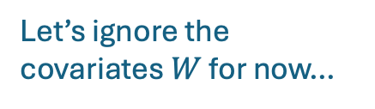
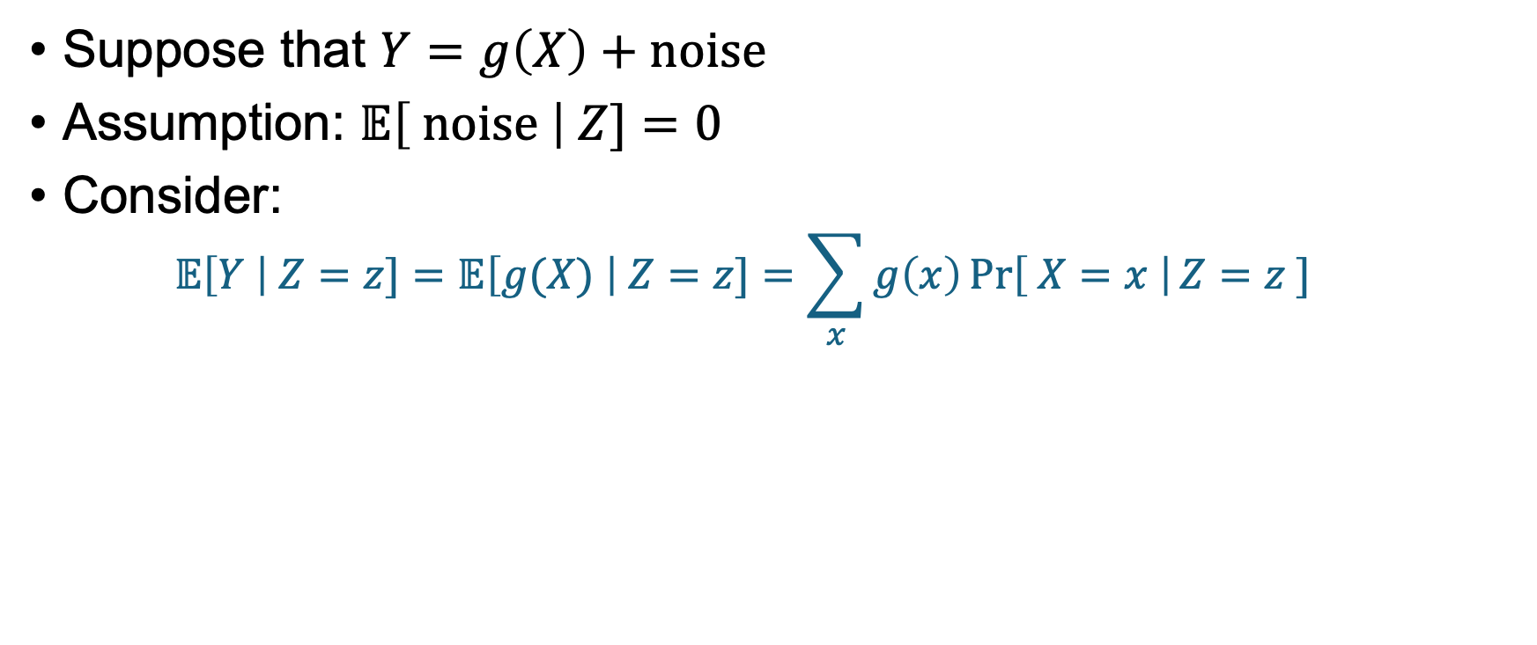
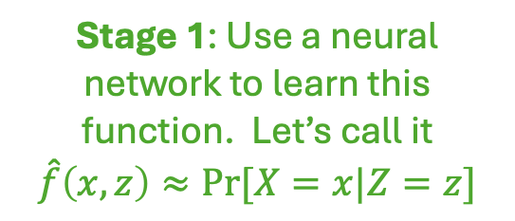



One way to use (D)NNs to approximate LATE Loosely following [Hartford, Lewis, Leyton-Brown, Taddy, 2017]
$$Z$$
$$X$$
$$Y$$
Let’s ignore the covariates $W$ for now…
Suppose that $Y=g\left(X\right)+noise$
Assumption: $𝔼\left[ noise \right| Z]=0$
Consider:
$$𝔼\left[Y \right| Z=z]=𝔼\left[g(X) \right| Z=z]=\sum_{x}{g\left(x\right)\operatorname{Pr}\left[ X=x \right|Z=z ]}$$
Plug in $Y$
Definition of $𝔼$
Stage 1: Use a neural network to learn this function. Let’s call it
$$\hat{f}\left(x,z\right)≈Pr[X=x|Z=z]$$
We know this! We see both $Y_{i}$ and $Z_{i}$ for each $i$
Notes:
LHS: Expected earnings, given that you were born in Q2
First stage: Probability that you got 10 years of schooling, conditional on being born in Q2

Slide 69






One way to use (D)NNs to approximate LATE Loosely following [Hartford, Lewis, Leyton-Brown, Taddy, 2017]
$$Z$$
$$X$$
$$Y$$
Let’s ignore the covariates $W$ for now…
Suppose that $Y=g\left(X\right)+noise$
Assumption: $𝔼\left[ noise \right| Z]=0$
Consider:
$$𝔼\left[Y \right| Z=z]=𝔼\left[g(X) \right| Z=z]=\sum_{x}{g\left(x\right)\operatorname{Pr}\left[ X=x \right|Z=z ]}$$
Plug in $Y$
Definition of $𝔼$
Stage 1: Use a neural network to learn this function. Let’s call it
$$\hat{f}\left(x,z\right)≈Pr[X=x|Z=z]$$
Stage 2: Use a NN to learn $\hat{g}$ so that
$$𝔼\left[Y \right| Z=z]≈\sum_{x}{\hat{g}\left(x\right)}\hat{f}(x,z)$$

Slide 70




One way to use (D)NNs to approximate LATE Loosely following [Hartford, Lewis, Leyton-Brown, Taddy, 2017]
$$Z$$
$$X$$
$$Y$$
Let’s ignore the covariates $W$ for now…
Suppose that $Y=g\left(X\right)+noise$
Assumption: $𝔼\left[ noise \right| Z]=0$
Consider:
$$𝔼\left[Y \right| Z=z]=𝔼\left[g(X) \right| Z=z]=\sum_{x}{g\left(x\right)\operatorname{Pr}\left[ X=x \right|Z=z ]}$$
Plug in $Y$
Definition of $𝔼$
Stage 1: Use a neural network to learn this function. Let’s call it
$$\hat{f}\left(x,z\right)≈Pr[X=x|Z=z]$$
Stage 2: Use a NN to learn $\hat{g}$ so that
$$𝔼\left[Y \right| Z=z]≈\sum_{x}{\hat{g}\left(x\right)}\hat{f}(x,z)$$
Last step: Now we have $\hat{g}(x)$, so we can compute counterfactuals!
E.g. if $X$ is years of school, $\hat{g}\left(10\right)−\hat{g}\left(9\right)≈$ returns to a 10’th year of school

Slide 71



A bit more detail Stage 1
E.g., what is the probability that someone gets $x$ years of schooling given that they were born in Quarter $z$ ?
We want to know $\operatorname{Pr}\left[X=x \right|Z=z]$
Learn a function $\hat{f}(X,Z)$ of a particular form so that:
$\hat{f}$ is a legit conditional probability distribution, and
$\hat{f}$ (approximately) minimizes something like:
$$−\sum_{i=1}^{N}{\log\left(\hat{f}\left(X_{i},Z_{i}\right)\right) }$$
Intuition:
If $(x,z)$ shows up a lot, then this objective function “wants” $f(x,z)$ to be close to 1, so that $−log⁡(f\left(x,z\right))$ isn’t too big.
If $(x,z)$ doesn’t show up a lot, then this objective function is okay with $f(x,z)$ being pretty small.
Notes:
Formally, we put a softmax at the end of f, so we have f(x,z) = exp( h(x,z) ) / \sum_x exp( h(x,z) ), so for any fixed z it’s a legit dist on x

Slide 72

A bit more detail Stage 2
Goal: Use a DNN to find $\hat{g}(x)$ so that $𝔼\left[Y \right| Z=z]≈\sum_{x}{\hat{g}\left(x\right)}\hat{f}(x,z)$
To do this: Try to minimize the loss function
$$\frac{1}{N}{\sum_{i=1}^{N}{\left(Y_{i}−\sum_{x}{\hat{g}\left(x\right)}\hat{f}\left(x,Z_{i}\right) \right)}}^{2}$$
Notes:
Formally, we put a softmax at the end of f, so we have f(x,z) = exp( h(x,z) ) / \sum_x exp( h(x,z) ), so for any fixed z it’s a legit dist on x

Slide 73




One way to use (D)NNs to approximate LATE Loosely following [Hartford, Lewis, Leyton-Brown, Taddy, 2017]
$$g(X,\vec{W})$$
$$Z$$
$$X$$
$$Y$$
Let’s ignore the covariates $W$ for now…
Suppose that $Y=g\left(X\right)+noise$
Assumption: $𝔼\left[ noise \right| Z]=0$
Consider:
$$𝔼\left[Y \right| Z=z]=𝔼\left[g(X) \right| Z=z]=\sum_{x}{g\left(x\right)\operatorname{Pr}\left[ X=x \right|Z=z ]}$$
If you want to include covariates, just throw them in at every step!
This lets us deal with heterogeneity.
Plug in $Y$
Definition of $𝔼$
Stage 1: Use a neural network to learn this function. Let’s call it
$$\hat{f}\left(x,z\right)≈Pr[X=x|Z=z]$$
Stage 2: Use a NN to learn $\hat{g}$ so that
$$𝔼\left[Y \right| Z=z]≈\sum_{x}{\hat{g}\left(x\right)}\hat{f}(x,z)$$
Last step: Now we have $\hat{g}(x)$, so we can compute counterfactuals!
E.g. if $X$ is years of school, $\hat{g}\left(10\right)−\hat{g}\left(9\right)≈$ returns to a 10’th year of school
$\hat{g}\left(x=10, gender=F\right)−\hat{g}(x=9,gender=F)$ $≈$ returns to a 10th year of education among women

Slide 74

This generalizes 2SLS!
If $g\left(X\right)=λX+\tilde{α}$ and $X=φZ+α$…
Stage 1: Run a regression to learn $\hat{X}$, based on $Z$
Analogous to learning $\hat{f}\left(X,Z\right)≈\operatorname{Pr}\left[X \right| Z]$
Stage 2: Find the $λ,\tilde{α}$ that minimizes $\frac{1}{N}\sum_{i=1}^{N}{{\left(Y_{i}−\left(λ\hat{X}+\tilde{α}\right)\right)}^{2}}$
Analogous to the optimization problem on the previous slide

Slide 75

Take-Aways
We can replace the linear regressions in 2SLS with neural networks! (Or any other non-parametric model).
Pros:
Can be more accurate (at least, in experiments with synthetic data)
Great when you have tons of features
Can deal with heterogeneous treatment effects (CATE)
Just throw in some observable variables $\vec{w}$ and learn $\hat{g}\left(x,\vec{w}\right)$
Cons:
Very hard to reason about analytically, not very transparent
Concerns about overfitting
Notes:
We didn’t talk about heterogeneous treatment effects in the slides for simplicity, but just throw in a bunch of features w to learn g(x,w)

Slide 76
Two questions
How can we use ML to analyze instruments?
How can we use ML to identify instruments?

Slide 77

Where do we get good instruments?
Buy them at auction for $15M?

Slide 78

It’s hard to come up with instruments
Maybe ML can help?
Actual academic answer: “Let’s ask ChatGPT!”

Slide 79
Why might this be a good idea?
Coming up with good IVs and justifying them is an exercise in story-telling. (Especially the exclusion requirement)
Why doesn’t Z directly affect Y?
Can you come up with a story where Z might directly affect Y?
Etc.
LLMs can speed up the process by helping humans think up such stories.

Slide 80

Example Prompt

Slide 81

Some suggestions in this paper (using ChatGPT4) Returns to attending college
Distance from home to college
Hey, that one looks familiar!
“This is purely geographical and independent of personal attributes”
Personal savings for education
“Largely determined by external economic conditions and family support.”
Number of siblings attending college
“Depends on family/siblings’ decisions, unrelated to the student’s personal characteristics”
Parents’ education
“A demographic factor that precedes the student’s own choices and abilities”
Religious affiliation
“A personal and family cultural factor, not a direct influence on personal academic or career potential.”
…

Slide 82
Some suggestions in this paper (using ChatGPT4) Returns to years of college
Credits required for graduation (at college attended)
“does not depend on your personal qualities or the quality of the school, but can determine the length of time you stay in school”
State education laws
“Laws mandating education until a certain age affect all students irrespective of individual abilities or school quality.”
Distance to nearest College/University
“doesn’t depend on your ability but can influence the decision to pursue further education”
Transportation Availability
“affects your ability to attend and continue education, independent of personal academic qualities or school resources”
Local unemployment rates
“might incentivize staying in school longer to defer entering a bad job market, a decision not influenced by personal academic prowess.”
…

Slide 83
From that paper
“This essay … merely serves as a starting point”
Do you think asking ChatGPT for this sort of thing is a good idea?
What sort of caveats do you have?

Slide 84
Recap and Looking Ahead
Don’t forget to stick around for the exit ticket!

Slide 85
Recap
We can get fancy with instrumental variables!
Nonbinary Z and X
Covariates
Multiple Instruments
Interpreting this gets harder the fancier we get.
Under assumptions, interpret as a weighted average of LATEs
Example: Angrist and Krueger 1991 (IV: quarter of birth)
ML can help!
But, as always with AI / ML, we should be very careful about what we believe and how we interpret the results.

Slide 86
Causal inference is hard! The real world is messy!
Maybe you are compelled by [Angrist, Krueger '91], or maybe not.
You’ll see another IV approach [Card ‘93] on HW
Instrument: College proximity
Before next time, think about… What else could you do?

Slide 87
Next time
No class Tuesday!
On Thursday (one week from now):
Yet more approaches to the returns to education: Regression Discontinuity!
Happy Halloween!

Slide 88


Exit ticket
Don’t forget to fill out the exit ticket before you leave class!

