Slide 1
Difference-in-Differences and a bit about placebo analysis
Causality, Decision-Making, and Data Science
Class 15

Slide 2
Announcements
HW4 Part 1 due Monday!
End-of-quarter party!
December 4, 6pm, at Guido’s house
See Canvas announcement for details and RSVP link!

Slide 3
Agenda
Recap
Difference-in-Differences: Take 1
Some issues
Placebo methods: How we can detect if there are issues?
DiD Take 2: Fancier versions

Slide 4
Recap: Panel data and what we want

Slide 5
































Our data: It’s a matrix!
Time
Time
$$1$$
$$2$$
$$⋯$$
$$T$$
$$1$$
$$2$$
$$⋯$$
$$T$$
1
2
3
1
2
3
$$Y_{1,1}$$
$$Y_{1,2}$$
$$⋯$$
$$Y_{1,T}$$
$$0$$
$$0$$
$$⋯$$
$$0$$
$$Y_{2,1}$$
$$Y_{2,2}$$
$$Y_{2,T}$$
$$0$$
$$0$$
$$0$$
Units
$$Y_{3,1}$$
$$Y_{3,2}$$
$$Y_{3,T}$$
$$0$$
$$0$$
$$0$$
$$⋮$$
$$⋮$$
$$⋮$$
$$⋮$$
$$⋮$$
$$⋮$$
n
$$Y_{n,1}$$
$$Y_{n,2}$$
$$⋯$$
$$Y_{n,T}$$
n
$$0$$
$$0$$
$$⋯$$
$$0$$
$$1$$
$$1$$
$$1$$
Matrix $Y$ of outcomes
Matrix $W$ of treatments

Slide 6






























































Counter-factuals!
$$1$$
$$2$$
$$⋯$$
$$T$$
1
2
3
$$0$$
$$0$$
$$⋯$$
$$0$$
$$0$$
$$0$$
$$0$$
We care about only those times/units that are treated
$$0$$
$$0$$
$$0$$
ATE: $𝔼_{i,t}[Y_{i,t}\left(1\right)−Y_{i,t}\left(0\right)]$
ATT: $𝔼_{i,t}\left[Y_{i,t}\left(1\right)−Y_{i,t}\left(0\right) \right|{ W}_{i,t}=1]$
$$⋮$$
$$⋮$$
$$⋮$$
n
$$0$$
$$0$$
$$⋯$$
$$0$$
$$1$$
$$1$$
$$1$$
Matrix $W$ of treatments
$$T$$
$$1$$
$$2$$
$$T$$
$$1$$
$$2$$
$$⋯$$
$$⋯$$
1
2
3
1
2
3
$$Y_{1,1}(1)$$
$$Y_{1,2}(1)$$
$$⋯$$
$$Y_{1,T}(1)$$
$$Y_{1,1}$$
$$Y_{1,2}$$
$$⋯$$
$$Y_{1,T}$$
$$Y_{2,1}$$
$$Y_{2,2}$$
$$Y_{2,T}$$
$$Y_{2,1}(1)$$
$$Y_{2,2}(1)$$
$$Y_{2,T}(1)$$
$$Y_{3,1}$$
$$Y_{3,2}$$
$$Y_{3,T}$$
$$Y_{3,1}(1)$$
$$Y_{3,2}(1)$$
$$Y_{3,t}(1)$$
$$⋮$$
$$⋮$$
$$⋮$$
$$⋮$$
$$⋮$$
$$⋮$$
n
$$⋯$$
n
$$Y_{n,1}(1)$$
$$Y_{n,2}(1)$$
$$⋯$$
$$Y_{n,T−2}{ Y}_{n,T−1} { Y}_{n,T}$$
$$Y_{n,1}$$
$$Y_{n,2}$$
$$Y_{n,T−2}(0) Y_{n,T−1}(0) Y_{n,T}(0)$$
Matrix $Y(0)$ of potential outcomes if not treated
Matrix $Y(1)$ of potential outcomes if treated

Slide 7


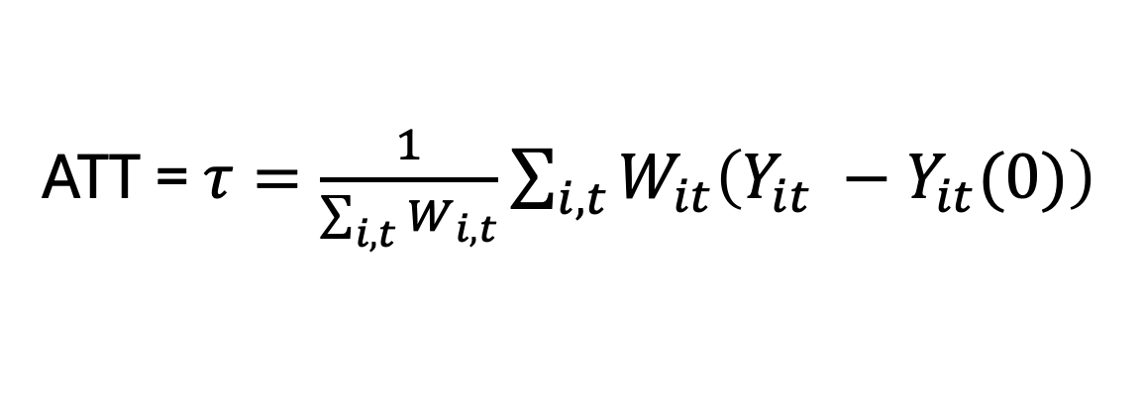
Counter-factuals!
$$1$$
$$2$$
$$⋯$$
$$T$$
1
2
3
$$0$$
$$0$$
$$⋯$$
$$0$$
$$0$$
$$0$$
$$0$$
$$0$$
$$0$$
$$0$$
ATT = $τ=\frac{1}{\sum_{i,t}{W_{i,t}}}\sum_{i,t}^{ }{W_{it}\left(Y_{it} −Y_{it}(0)\right) }$
$$⋮$$
$$⋮$$
$$⋮$$
n
$$0$$
$$0$$
$$⋯$$
$$0$$
$$1$$
$$1$$
$$1$$
We see this
We don’t see this
Matrix $W$ of treatments
$$T$$
$$1$$
$$2$$
$$T$$
$$1$$
$$2$$
$$⋯$$
$$⋯$$
Just like with ATE, we can’t compute ATT directly! We’ll need to estimate it.
1
2
3
1
2
3
$$Y_{1,1}(1)$$
$$Y_{1,2}(1)$$
$$⋯$$
$$Y_{1,T}(1)$$
$$Y_{1,1}$$
$$Y_{1,2}$$
$$⋯$$
$$Y_{1,T}$$
$$Y_{2,1}$$
$$Y_{2,2}$$
$$Y_{2,T}$$
$$Y_{2,1}(1)$$
$$Y_{2,2}(1)$$
$$Y_{2,T}(1)$$
$$Y_{3,1}$$
$$Y_{3,2}$$
$$Y_{3,T}$$
$$Y_{3,1}(1)$$
$$Y_{3,2}(1)$$
$$Y_{3,t}(1)$$
$$⋮$$
$$⋮$$
$$⋮$$
$$⋮$$
$$⋮$$
$$⋮$$
n
$$⋯$$
n
$$Y_{n,1}(1)$$
$$Y_{n,2}(1)$$
$$⋯$$
$$Y_{n,T−2}{ Y}_{n,T−1} { Y}_{n,T}$$
$$Y_{n,1}$$
$$Y_{n,2}$$
$$Y_{n,T−2}(0) Y_{n,T−1}(0) Y_{n,T}(0)$$
Matrix $Y(0)$ of potential outcomes if not treated
Matrix $Y(1)$ of potential outcomes if treated

Slide 8
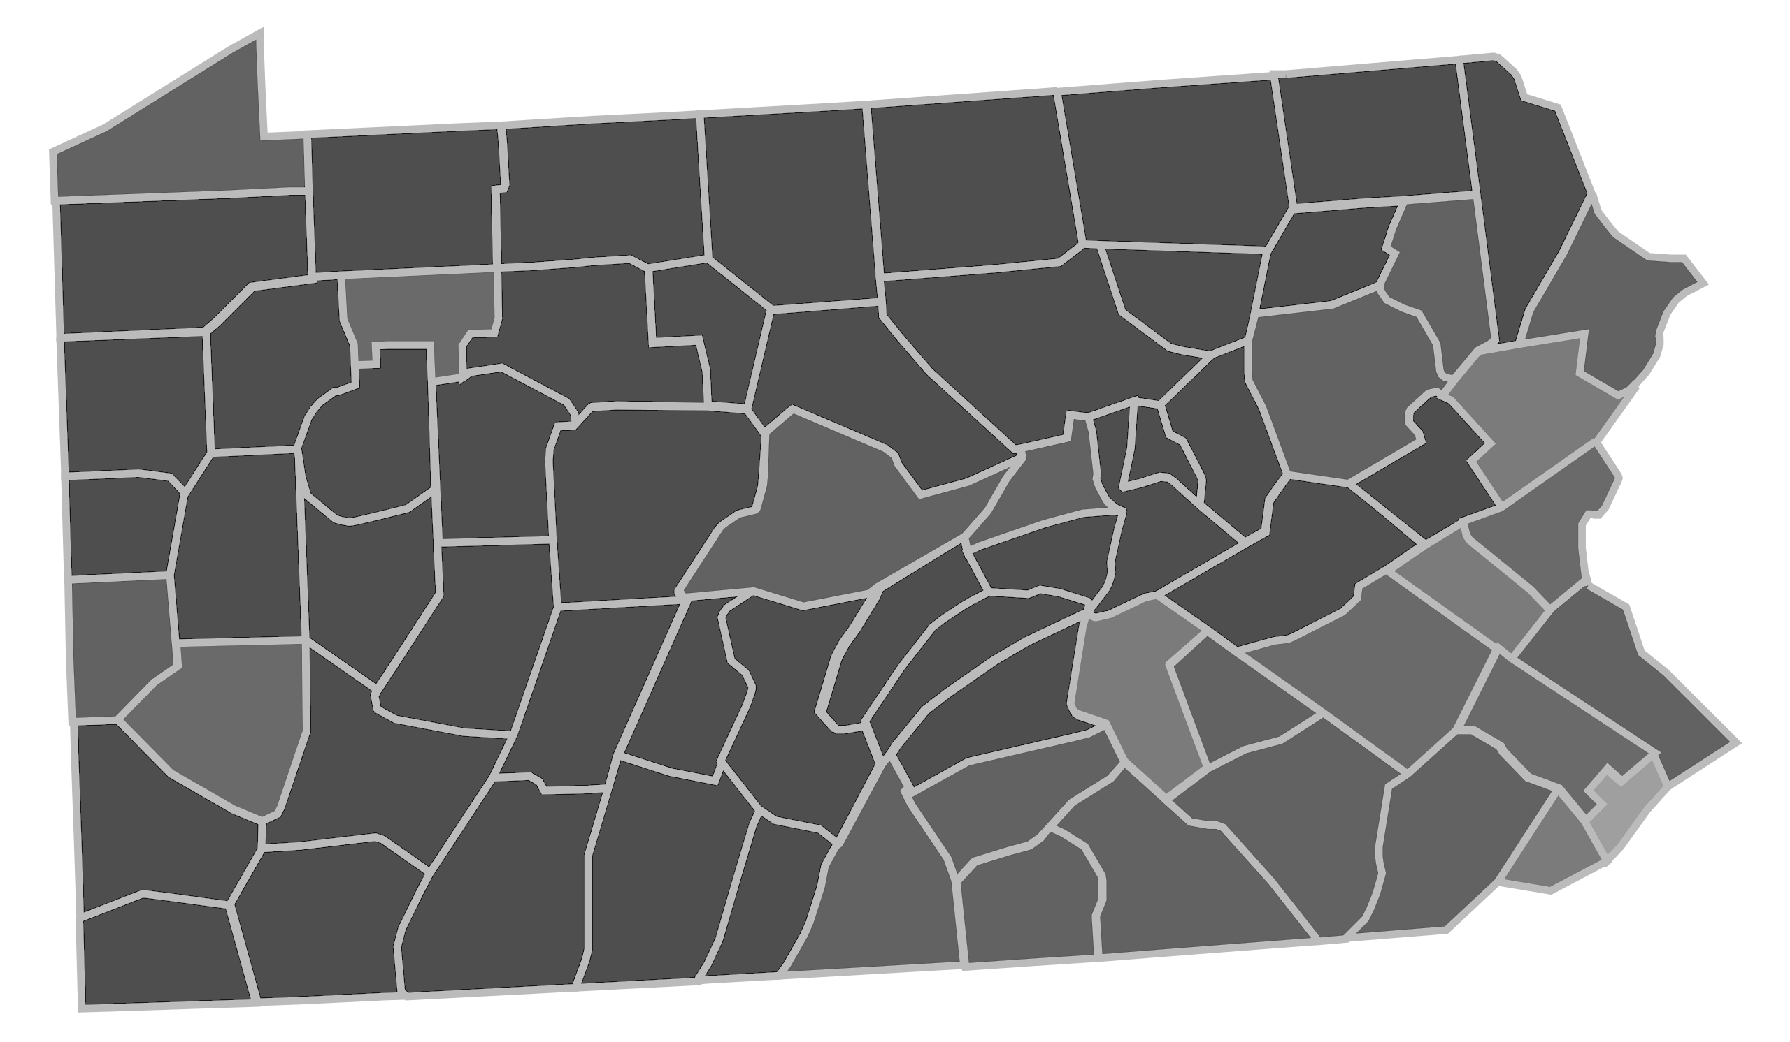
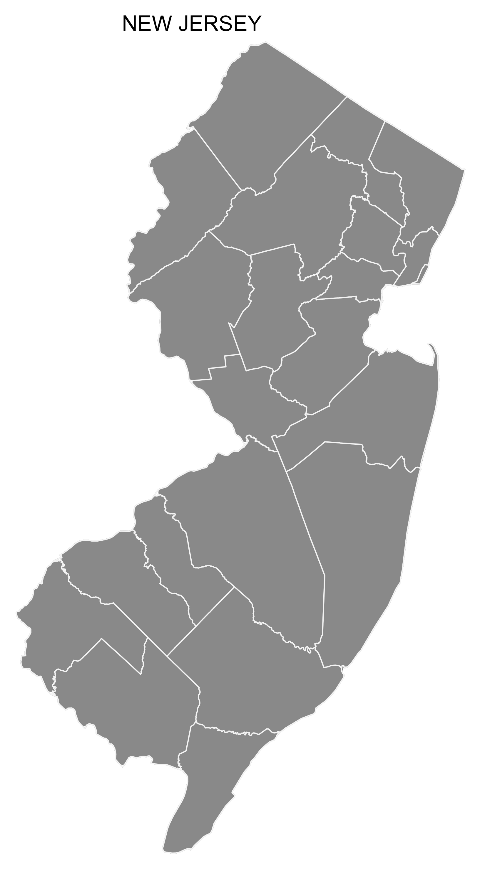

One Example Effect of raising the minimum wage? Card and Krueger (1994)
Substantive question: Does raising the minimum wage reduce employment?
We’re raising the minimum wage to $5.05!
Units: Fast food restaurants in NJ and PA
315 in NJ, 76 in PA
Data from 1 year before change and 1 year after change
Outcome: Employment (# workers)
Treatment: Increase in minimum wage in NJ
Treatment pattern: Block design
New Jersey
(NJ)
Pennsylvania (PA)
1991
1992
Nah.
$4.25 for us.
PA
0
0
NJ
0
1
$$W$$

Slide 9
Today: Difference-in-Differences (DiD)
Our running example today will be the effect of raising the minimum wage. On your homework, you’ll look at Brexit!
Treated unit
These differences are different!
This suggests there is an effect.
Outcome
Untreated unit
Time
Change for treated unit

Slide 10
Difference-in-Differences Part 1: Before and After

Slide 11

Simplest setting We only have two time periods
Discuss:
What would you do to implement the DiD intuition?
Treated unit
Outcome
Untreated unit
Before
Change for treated unit(s)
After

Slide 12
…take a difference between differences.
Outcome
Before
After

Slide 13
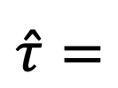

…take a difference between differences.
Estimate:
$$\hat{τ}=$$
Difference
post-treatment
$$−$$
Difference
pre-treatment
Difference
post-treatment
Outcome
Difference
pre-treatment
Before
After

Slide 14
Example Effect of raising the minimum wage? Card and Krueger (1994)
Substantive question: Does raising the minimum wage reduce employment?
We’re raising the minimum wage to $5.05
Units: Fast food restaurants in NJ and PA
315 in NJ, 76 in PA
Data from 1 year before change and 1 year after change
Outcome: Employment (# workers)
Treatment: Increase in minimum wage in NJ
Treatment pattern: Block design
New Jersey
(NJ)
Pennsylvania (PA)
1991
1992
Nah.
$4.25 for us.
PA
0
0
NJ
0
1
$$W$$

Slide 15
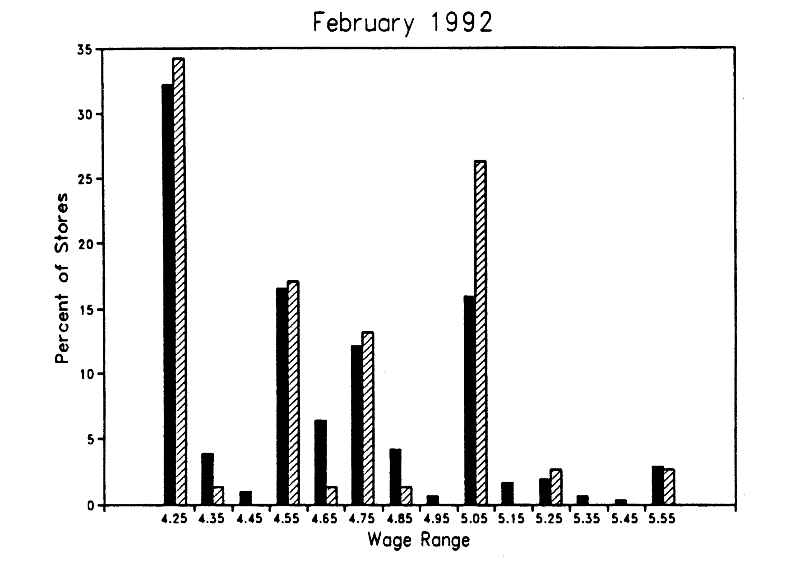
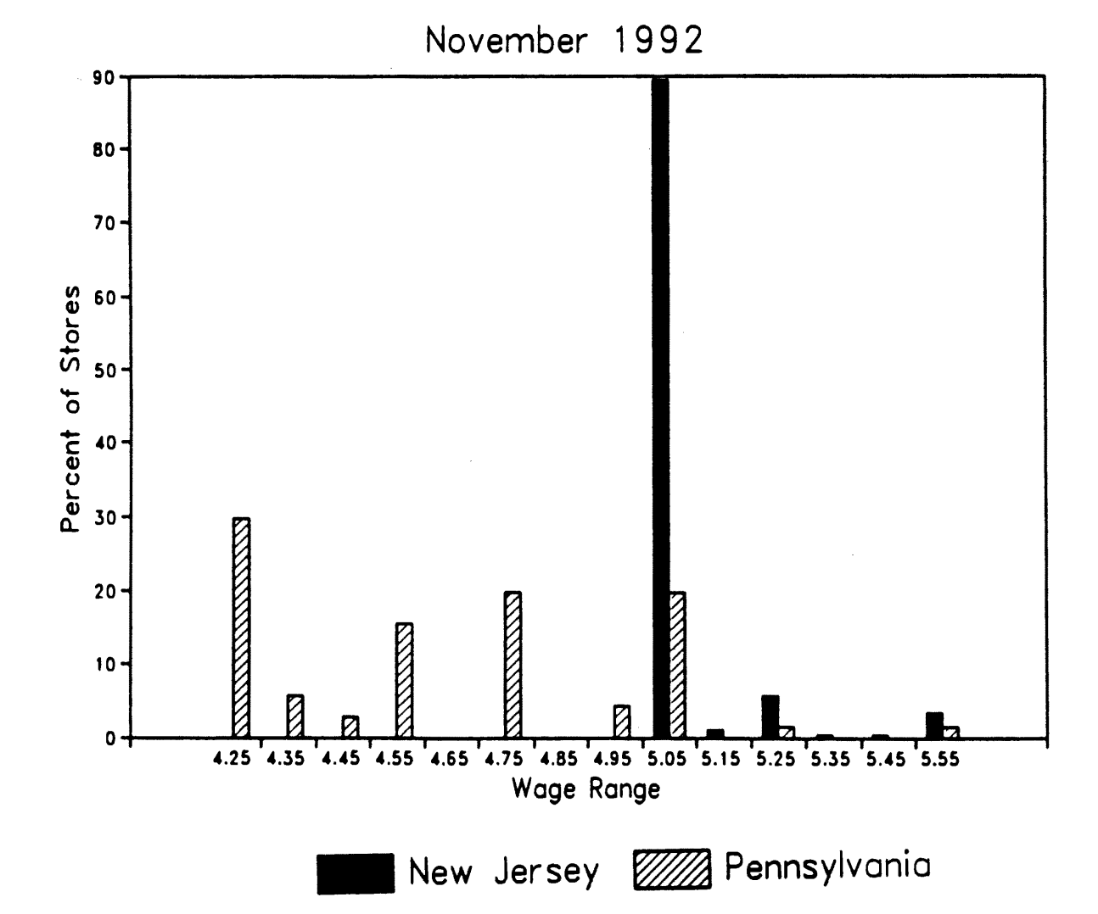
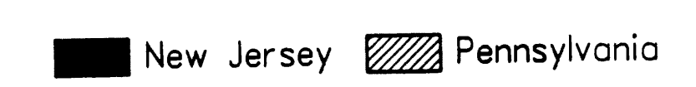
How much were NJ wages affected?
Before:
After:

Slide 16

DiD in this example effect on employment
Is this what you expected?
What is the take-away about the effect of the minimum wage on employment?
 | Before | After | Diff
PA | 23.33 (1.35) | 21.17 (0.94) | -2.16 (1.25)
NJ | 20.44 (0.51) | 21.03 (0.52) | 0.59 (0.54)
Diff | -2.89 (1.44) | -0.14 (1.07) | 2.76 (1.36)
NJ
PA
23.33
Employment
21.17
21.03
20.44
18.28 =
implied counterfactual
Before
After
Numbers are average FTE employment per store

Slide 17

Notes:
Do not modify the notes in this section to avoid tampering with the Poll Everywhere activity. More info at polleverywhere.com/support Is this what you expected?
https://www.polleverywhere.com/multiple_choice_polls/RsUaVQzVAe5omV2RAF10I?display_state=instructions&activity_state=opened&state=opened&flow=Engagement&onscreen=persist

Slide 18
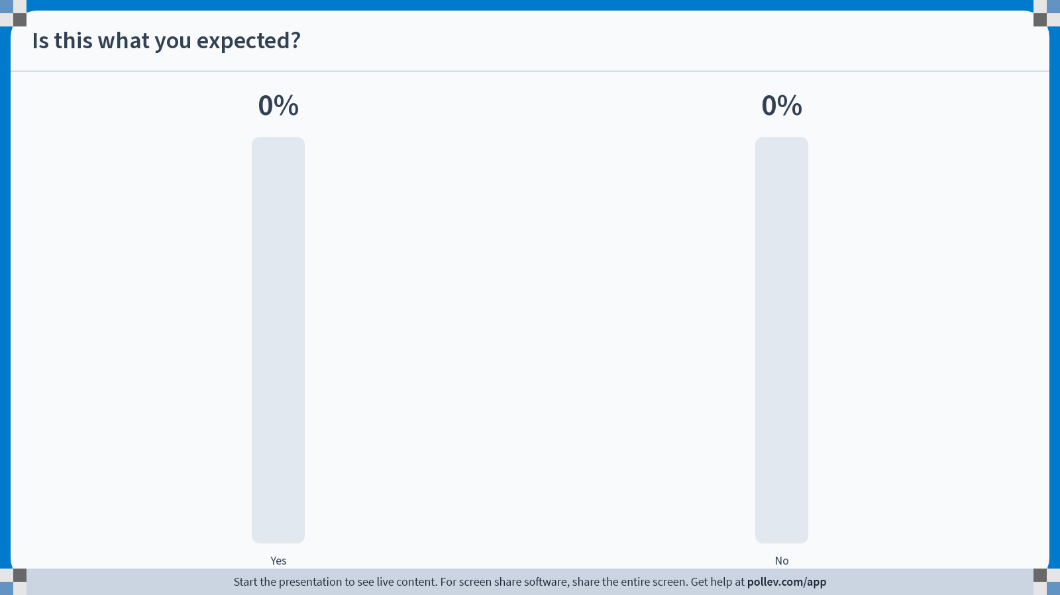
Notes:
Do not modify the notes in this section to avoid tampering with the Poll Everywhere activity. More info at polleverywhere.com/support Is this what you expected?
https://www.polleverywhere.com/multiple_choice_polls/RsUaVQzVAe5omV2RAF10I?display_state=chart&activity_state=opened&state=opened&flow=Engagement&onscreen=persist

Slide 19

Notes:
Do not modify the notes in this section to avoid tampering with the Poll Everywhere activity. More info at polleverywhere.com/support Is this what you expected?
https://www.polleverywhere.com/multiple_choice_polls/RsUaVQzVAe5omV2RAF10I?display_state=chart&activity_state=closed&state=closed&flow=Engagement&onscreen=persist

Slide 20
DiD in this example
Implication:
The average effect of raising the minimum wage is to hire an average of 2.76 more workers.
 | Before | After | Diff
PA | 23.33 (1.35) | 21.17 (0.94) | -2.16 (1.25)
NJ | 20.44 (0.51) | 21.03 (0.52) | 0.59 (0.54)
Diff | -2.89 (1.44) | -0.14 (1.07) | 2.76 (1.36)
NJ
PA
23.33
Employment
21.17
21.03
20.44
18.28 =
implied counterfactual
Before
After
Numbers are average FTE employment per store

Slide 21
Do you believe this result? Policy implication: Raising the minimum wage won’t meaningfully decrease employment, and may even increase it.
What assumptions are we implicitly making when we assert that DiD can give us a reasonable estimate of the counterfactual?
Do you think these assumptions hold here?
Discuss!

Slide 22
A few implicit assumptions
Assumptions about the nature of the treatment:
Raising the minimum wage in NJ is the only important change that happened in NJ in this time period.
Employers did not start reacting to the minimum wage hike until it was actually enacted.
Assumptions about the model:
The way to project into the future is to add something to something else.
Assumptions about the comparison:
Parallel Trends: NJ and PA were / would be on the same track.

Slide 23
The plan
We’ll talk about each of these assumptions
We’ll talk about a general way to sanity-check our assumptions
We’ll look at some generalizations of DiD

Slide 24
Assumptions

Slide 25

The treatment only affects “treated” units
We’re raising the minimum wage!
…But now I have to raise my wages since otherwise workers will just go across the border!
New Jersey
(NJ)
We can try to assess this:
Pennsylvania (PA)
Nah.

Slide 26
Assumption about the nature of the treatment The treatment is the only thing that’s going on
Suppose that NJ raised the minimum wage, and at the same time also passed a law that made it more difficult to fire workers.
Can we do anything with this data to disentangle the two?
With just the employment numbers, no.
Perhaps we could do something with more info about which stores were more affected by the minimum wage hike…

Slide 27
Assumption about the nature of the treatment “Before and after” really is before and after
If employers suspected ahead of time that the minimum wage would rise, maybe they had already started making changes.
In this example, NJ announced the change in early 1990; it was enacted in April 1992.
How can we deal with this?
Ideally we’d get data from before the minimum wage increase was announced/anticipated.

Slide 28
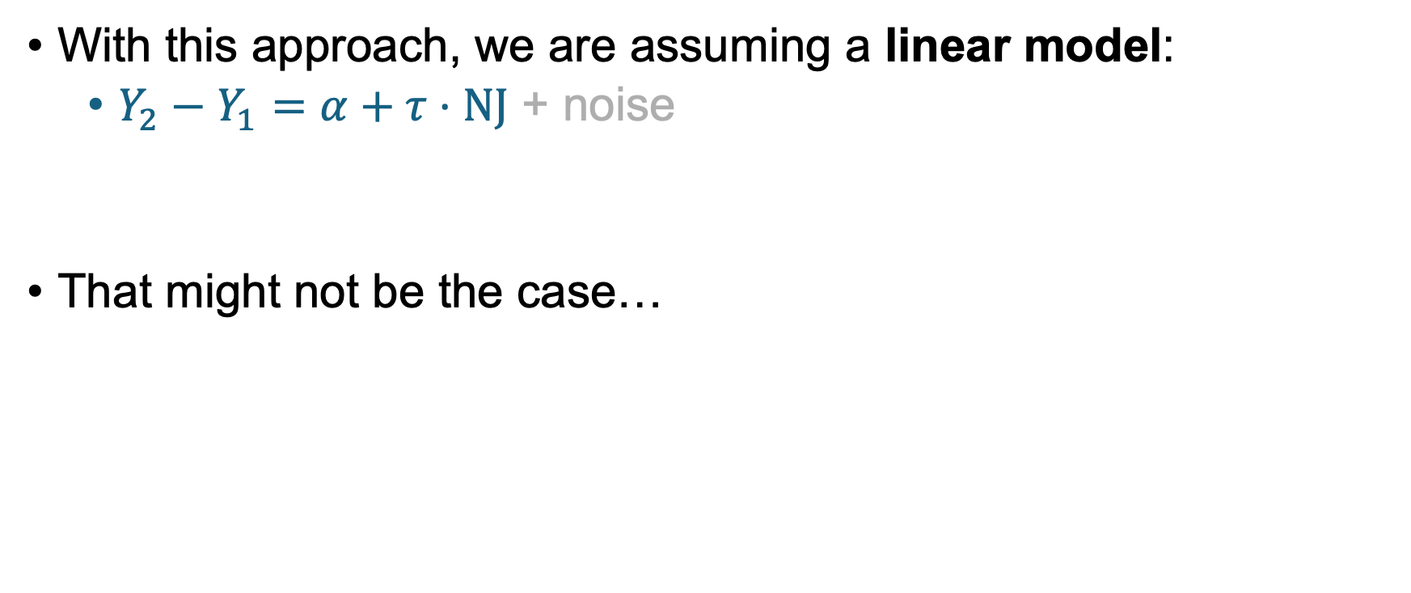



Assumptions about the model Linearity
With this approach, we are assuming a linear model:
$Y_{2}−Y_{1}=α+τ⋅NJ$ + noise
That might not be the case…
Outcome after
Outcome before
NJ
PA
$$α$$
Employment
20.44
$$α$$
$$τ$$
implied counterfactual
Before
After

Slide 29
Assumptions about the model Linearity
It might be that things are linear after some transformation, e.g., taking logs.
With this approach, we are assuming a linear model:
$Y_{2}−Y_{1}=α+τ⋅NJ$ + noise
That might not be the case…
Outcome after
Outcome before
NJ
PA
$$α$$
Employment
For example, now the estimated “counterfactual employment” is negative!
1.44
$$α$$
$$τ$$
implied counterfactual
Before
After

Slide 30
Assumption about the comparison Parallel Trends
To assess this directly, we need more data than just “before” and “after.”
Ideally, the data would look like this:
Outcome
Untreated unit
Implied counterfactual
Treated unit
Time
Change for treated unit

Slide 31
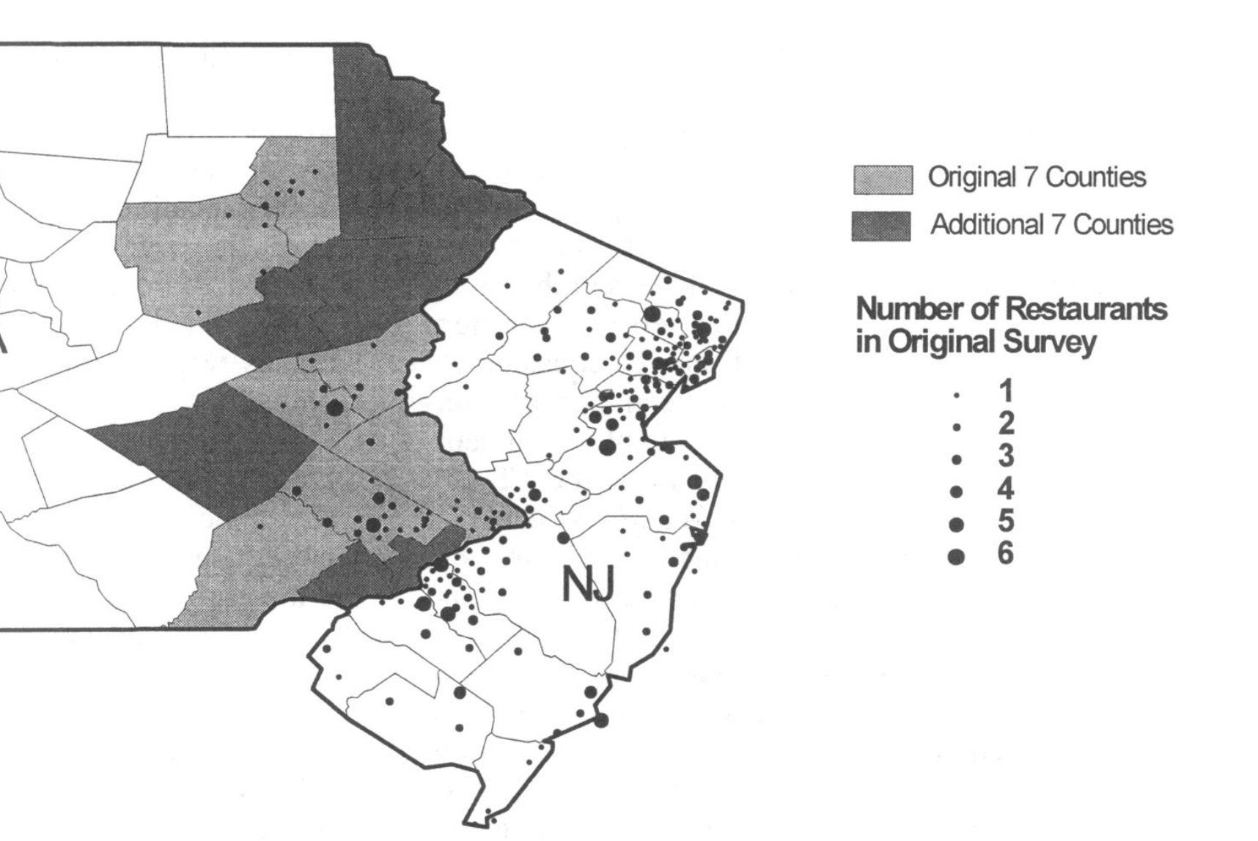
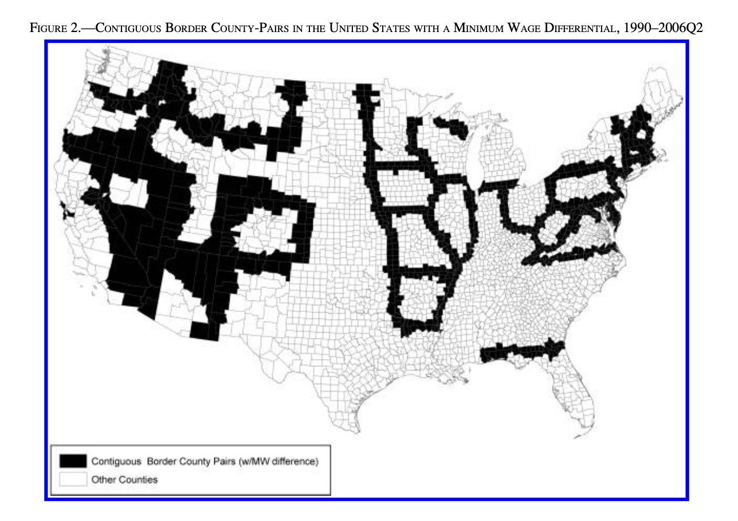

(Hoping to fulfill) assumptions about the comparison Picking control groups
Card and Krueger, 2000
How do we choose the “control group”?
All counties in eastern PA?
Some counties in eastern PA?
What about all cross-border differences?
Can we pair up “similar” restaurants?
$Y_{2}−Y_{1}=α+τ⋅NJ+γ⋅Y_{1}$ + noise
Outcome after
Outcome before
This term “controls” for pre-treatment size.
Dube, Lester, and Reich, 2010

Slide 32
Placebo Analysis Can we test our assumptions?

Slide 33


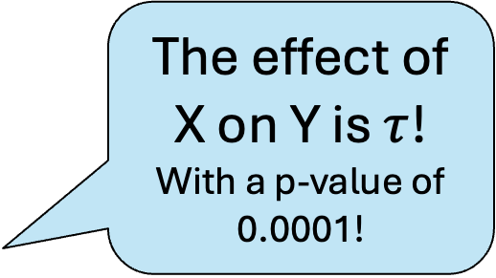
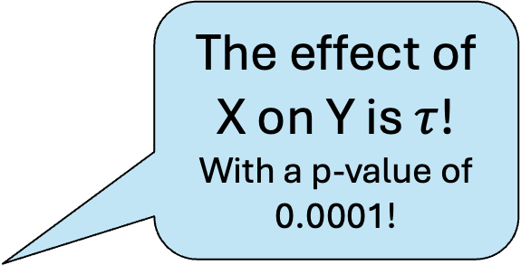

Placebo Analysis: Idea
The effect of X on Y is $τ$!
With a p-value of 0.0001!
Complicated
Statistics!
Data
Matrices $Y,W$
The effect of X on Y is $τ$!
With a p-value of 0.0001!
Let’s falsify our data!
Complicated
Statistics!
Isn’t that, like, really bad?
$$\tilde{Data}$$
Matrices $\tilde{Y}, \tilde{W}$
Don’t worry, it’s white-hat data hacking!
Change the data slightly so that we know what the answer should be (usually 0).
I call BS!

Slide 34
How can we falsify our data productively? Please do not share the title of this slide out of context… ☺
Discuss! How can we implement this?
The goal is to change the data (employment numbers, or who is “treated”/”not treated”) so that we know that the effect should be zero.

Slide 35
Common ways to do this
You did this on HW2, when you looked at “pseudo-outcomes,” in that case earnings before someone won the lottery.
Pretend a control unit was “treated.”
E.g., pretend that Western PA was “treated” (or NY, or one of the counties in Eastern PA, etc).
This approach requires more than two units.
Pretend that the “outcome” was something pre-treatment.
E.g., look suppose that the “outcome” is 1991 employment, instead of 1992 employment
The approach requires more than two time periods.
In either case, we should get 0.

Slide 36
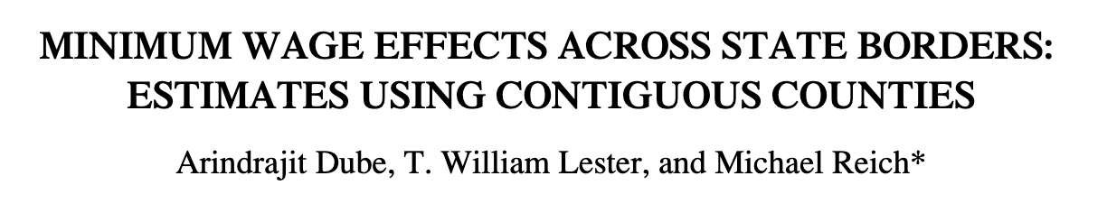
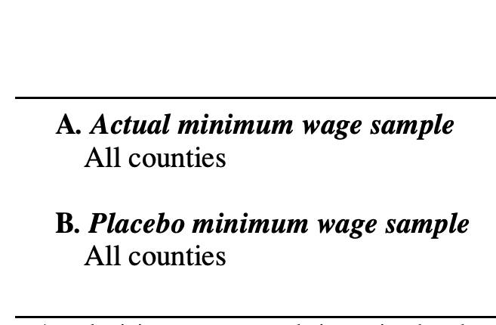
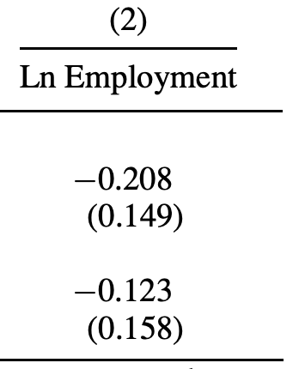
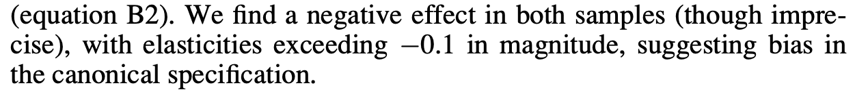
Example In the minimum wage setting
Idea: pretend that border counties that always have the federal minimum wage are “treated.”
Normal:
Effect of NJ wage hike on NJ
Effect of NJ wage hike on PA
Not zero!
Placebo:
Their conclusion:
Doing DiD across the whole country isn’t a good idea.
Instead they propose matching up neighboring counties.
*They look at more than just PA and NJ

Slide 37
Generalizations of DiD
More time periods! Controlling for stuff! Yay!

Slide 38


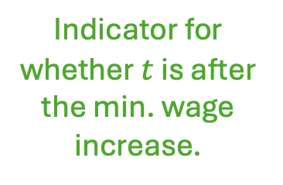

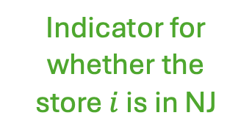

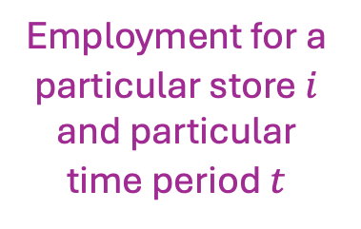

Setting up DiD as regression
$Y_{i,t}= α+β⋅{NJ}_{i}+λ⋅T_{t}+δ⋅{NJ}_{i}⋅T_{t}$ + noise
Interaction term
Employment for a particular store $i$ and particular time period $t$
Indicator for whether the store $i$ is in NJ
Indicator for whether $t$ is after the min. wage increase.
Employment
NJ
$$α+β+λ+δ$$
PA
$$α+β+λ$$
Counterfactual NJ
$$α+β$$
$$α+λ$$
$$α$$
Time
Before
Min wage increase
After

Slide 39
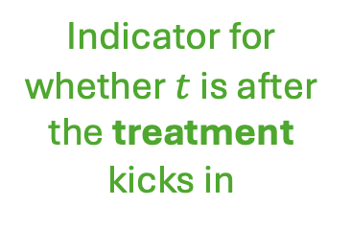
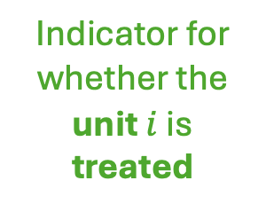
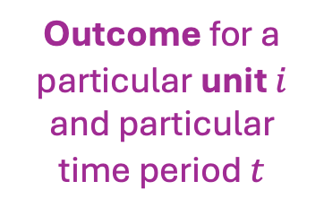
More generally
$Y_{i,t}= α+β⋅D_{i}+λ⋅T_{t}+δ⋅D_{i}⋅T_{t}$ + noise
Interaction term
Outcome for a particular unit $i$ and particular time period $t$
Indicator for whether the unit $i$ is treated
Indicator for whether $t$ is after the treatment kicks in
Outcome
Treated
$$α+β+λ+δ$$
Untreated
$$α+β+λ$$
Counterfactual
$$α+β$$
$$α+λ$$
$$α$$
Time
Before
Treatment
After

Slide 40
Why did we do that?
This is more flexible! Now we can…
Work with data for more than two periods
Control for things
Pre-treatment trends, other parameters, …
Work with multiple units with staggered rollout
Work with continuous treatments
E.g., the value of the minimum wage as it changes over time
Generalize the “parallel trends” assumption
…
We’ll briefly mention the first few of these…

Slide 41
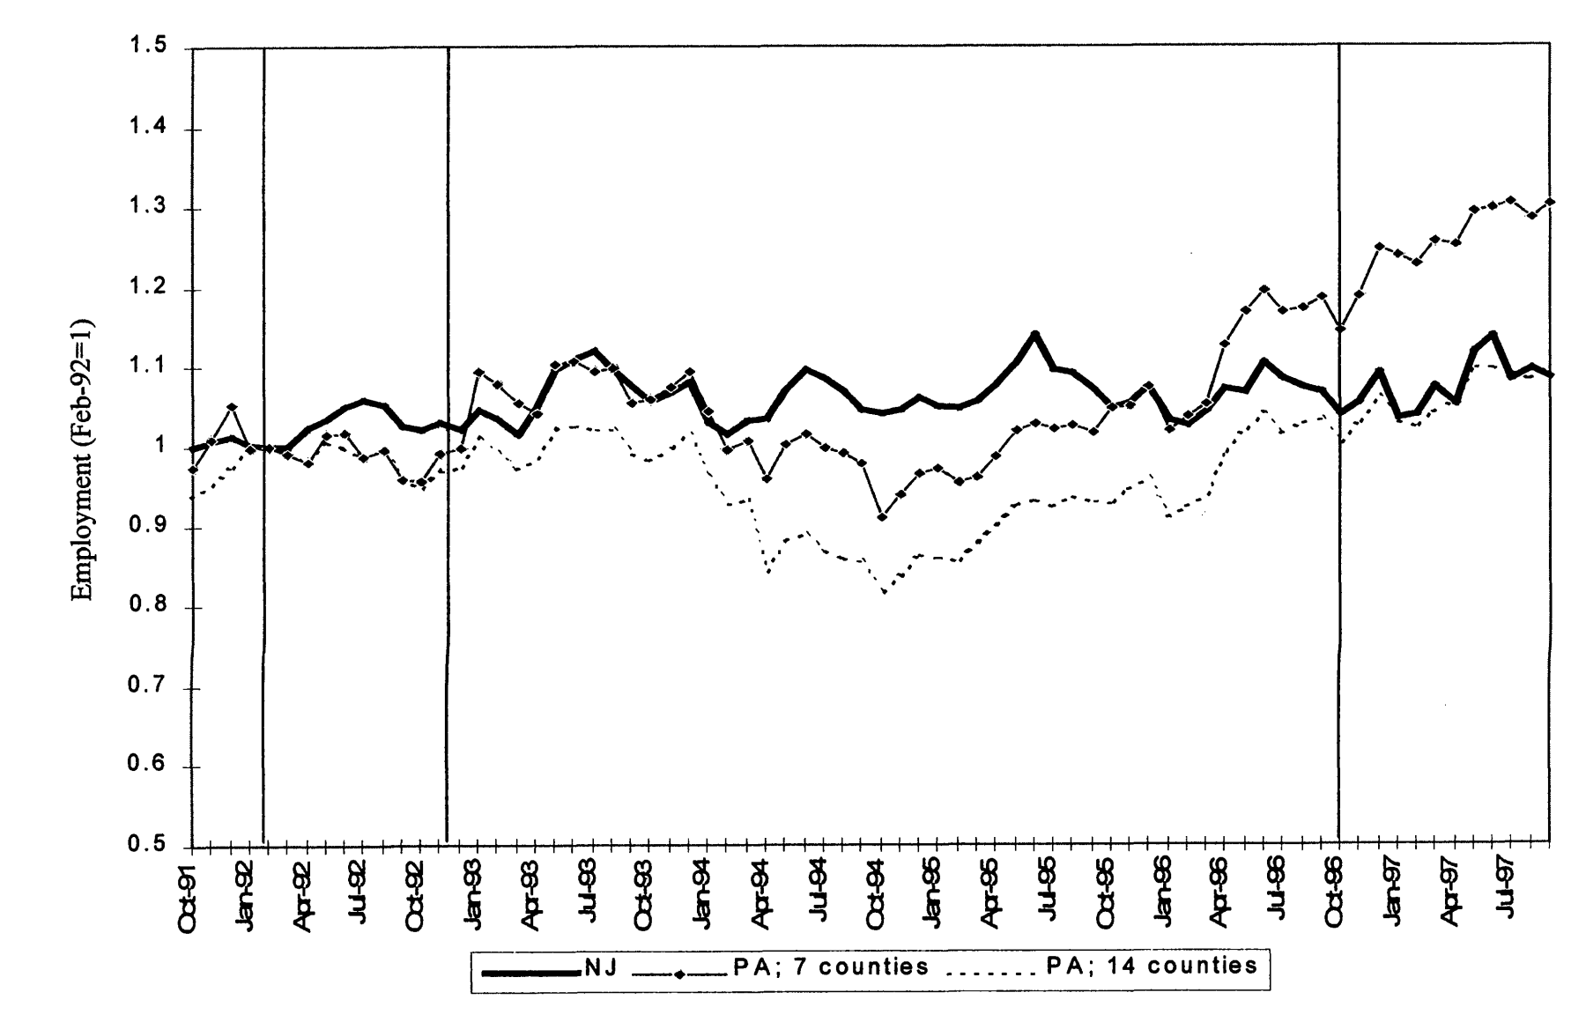
Data for more than two periods
In 1996 there was a federal minimum wage increase which caused PA to raise the min wage but not NJ
E.g., from [Card and Krueger, 2000]:
Original paper’s data

Slide 42


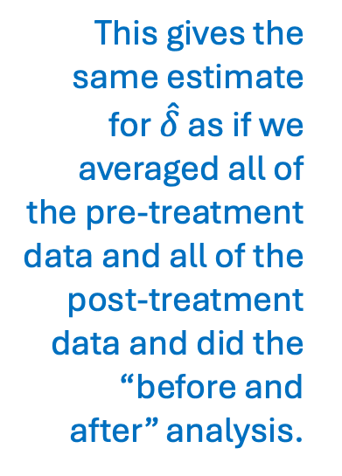
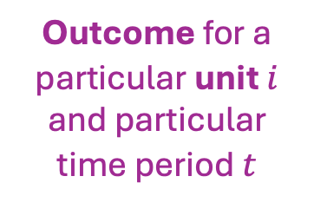
We can do the same regression!
This gives the same estimate for $\hat{δ}$ as if we averaged all of the pre-treatment data and all of the post-treatment data and did the “before and after” analysis.
$Y_{i,t}= α+β⋅D_{i}+λ⋅T_{t}+δ⋅D_{i}⋅T_{t}$ + noise
Outcome for a particular unit $i$ and particular time period $t$
Indicator for whether the unit $i$ is treated
Indicator for whether $t$ is after the treatment kicks in
Outcome
$$β+δ$$
$$β$$
Treated
Time
Untreated
Treatment

Slide 43

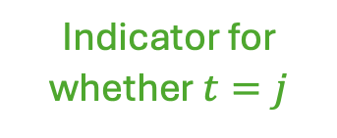
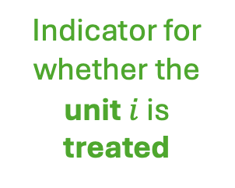
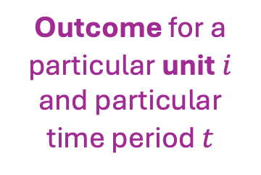
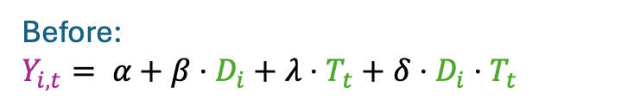
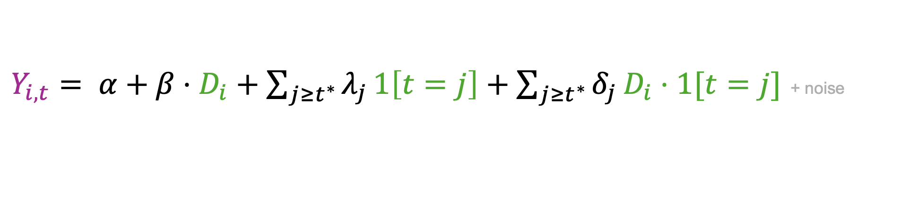

Lots of time periods! Dynamic treatment effects!
$Y_{i,t}= α+β⋅D_{i}+\sum_{j≥t^{∗}}{λ_{j}}1\left[t=j\right]+\sum_{j≥t^{∗}}{δ_{j}}D_{i}⋅1[t=j]$ + noise
Outcome for a particular unit $i$ and particular time period $t$
Indicator for whether the unit $i$ is treated
Indicator for whether $t=j$
Before:
$Y_{i,t}= α+β⋅D_{i}+λ⋅T_{t}+δ⋅D_{i}⋅T_{t}$
Outcome
$$β+δ_{j}$$
$$β$$
Treated
$$j$$
Time
Untreated
Treatment, time t*

Slide 44
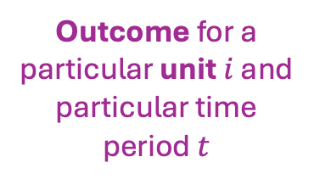
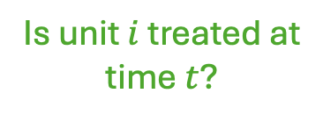
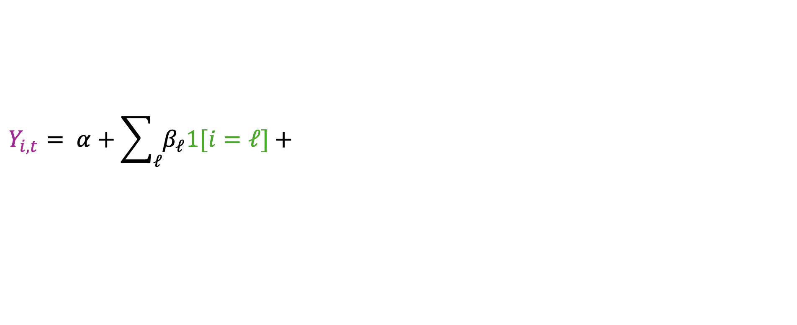

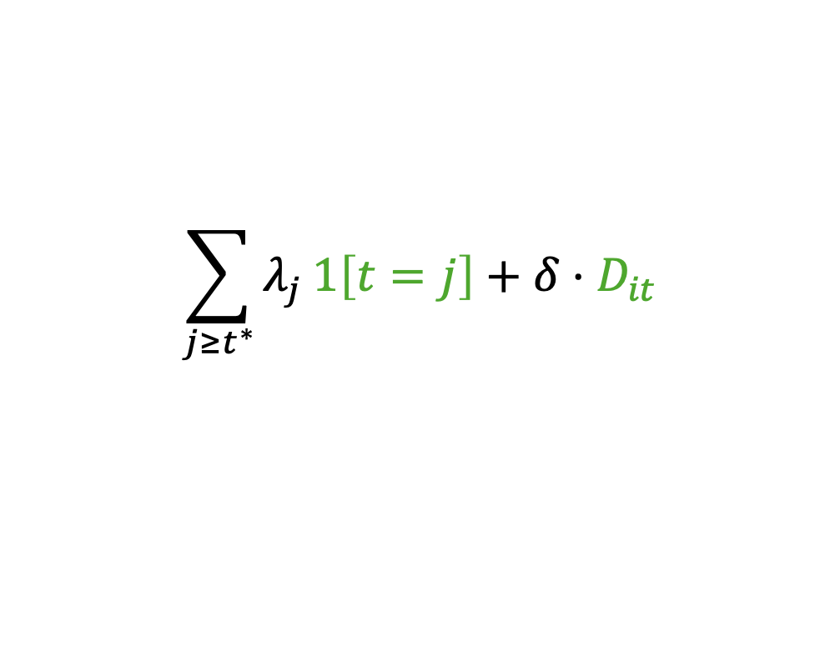

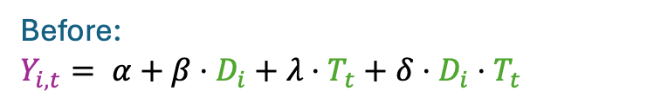
Multiple units; staggered rollout
$$\sum_{j≥t^{∗}}{λ_{j}}1\left[t=j\right]+δ⋅D_{it}$$
$$Y_{i,t}= α+\sum_{ℓ}{β_{ℓ}1[i=ℓ]}+$$
+ noise
Outcome for a particular unit $i$ and particular time period $t$
Are you unit $ℓ?$
Is it time $j$?
Is unit $i$ treated at time $t$?
Before:
$Y_{i,t}= α+β⋅D_{i}+λ⋅T_{t}+δ⋅D_{i}⋅T_{t}$
Technically one should be a bit more careful than this… see, e.g., [Goodman-Bacon, Journal of Econometrics, 2021]
Outcome
NY
NJ
Treatment in NJ
Time
PA
Treatment in NY

Slide 45
Controlling for things!
What is the comparison we want to make?
Restaurants that are about the same size?
Restaurants that are from the same chain?
We can throw those covariates into the regression!

Slide 46
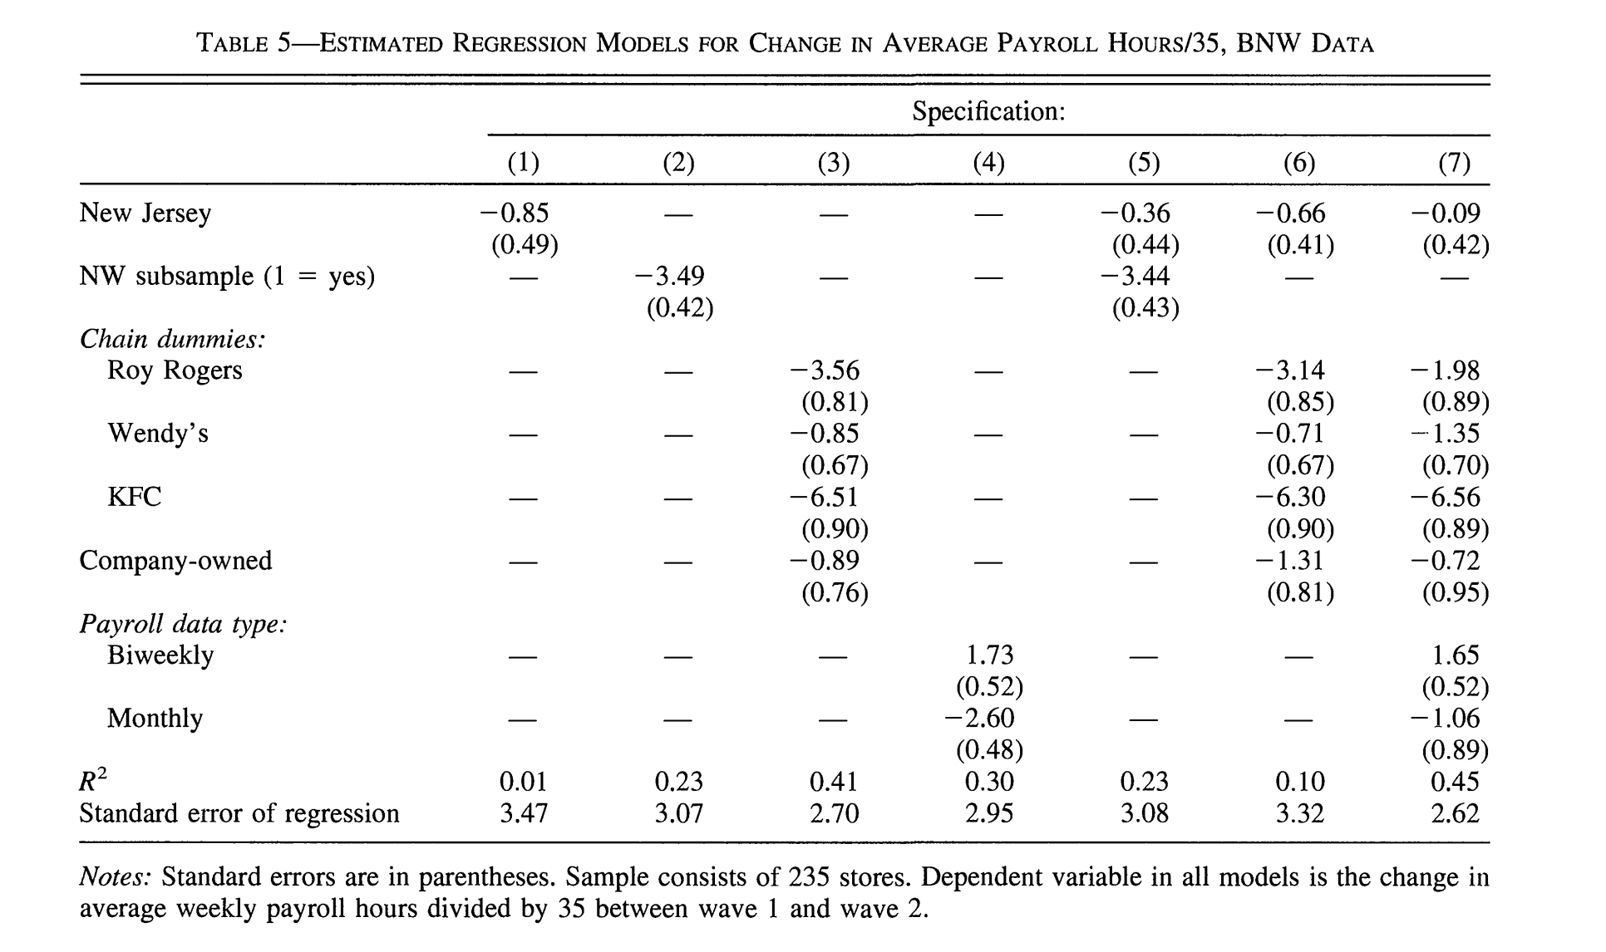
Example: Controlling for stuff [Card and Krueger 2000]
What we care about: in NJ?
What chain does the restaurant belong to?
Company-owned or franchised?
What type of payroll?

Slide 47
Back to Brexit Thought experiment
Are there concerns you have about DiD for Brexit that you’d want to watch out for?
How would you watch out for them?
Are there covariates you’d like to control for?

Slide 48
Recap and looking ahead

Slide 49


Recap
NJ
PA
23.33
Employment
21.17
21.03
Difference-in-differences:
Basic idea:
But it can get (a lot) fancier
20.44
18.28 = implied counterfactual
Before
After
Placebo Analysis:
The effect of X on Y is $τ$!
With a p-value of 0.0001!
I call BS!
Complicated
Statistics!
$$\tilde{Data}$$
Matrices $\tilde{Y}, \tilde{W}$
Fake data

Slide 50
Next time
New technique: Matrix completion!

Slide 51


Exit ticket
Don’t forget to fill out the exit ticket before you leave class!

