Slide 1
Empirical Evidence on the Effect of Unearned Income
Causality, Decision Making, and Data Science
Lecture 8

Slide 2
Announcements
HW2 Part 1 and Project Ideas due Monday!

Slide 3
Agenda
Recap
Three studies on the effects of UBI / unearned income

Slide 4
Recap

Slide 5
What have we seen so far?
Some theory:
Friedman’s Permanent Income Hypothesis says that people “smooth” consumption over their lifetime.
If you get a windfall now, you’ll save most of it
If you know you’re going to make more later, you’ll start spending some of it now
Some techniques:
(Multivariate) regression!
Regression fits a linear model
You can “control” for observables by including them in the model
Some older studies:
What happens when people get windfall income?
Conflicting results!

Slide 6
Today
Three more recent studies on the effects of UBI / unearned income:
Lotteries!
You’re looking at this on your homework!
A randomized experiment on UBI done in the US
You looked at this one before class!
A randomized experiment on UBI done in Finland (if time)
This one is new!

Slide 7
Three Studies

Slide 8
As we go through these studies… Think about:
Internal Validity
Does this get at a causal effect in the population studied?
External Validity
Does this get at a causal effect in other relevant populations?
Construct Validity
Are we measuring the right thing?
If we care about UBI? If we care about stimulus checks? If we care about social security? Etc…
Spillover Effects
Might the fact that some people got the “treatment” affect those who didn’t?
Ethical Concerns
Is it ethical to randomize? For observational data, privacy issues?

Slide 9
As we go through these studies… Think about:
What are the take-aways for a policy-maker thinking about UBI?
If we had a UBI…
Would people work less? Work more?
What would people do with the money?
Is there heterogeneity in the effects?
Other policy-relevant questions?
How confident does the study make you in the answers to the above?

Slide 10
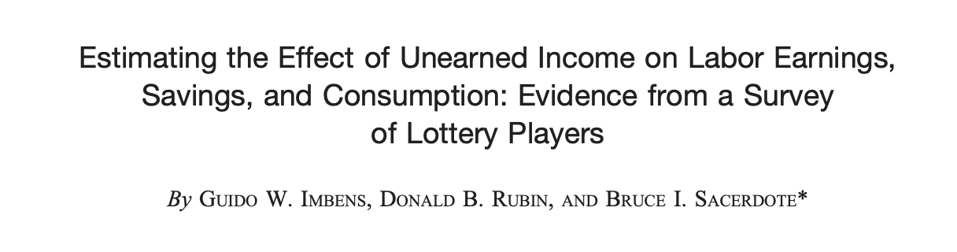
Study 1: Massachusetts Lottery Winners
American Economic Review, 2001

Slide 11
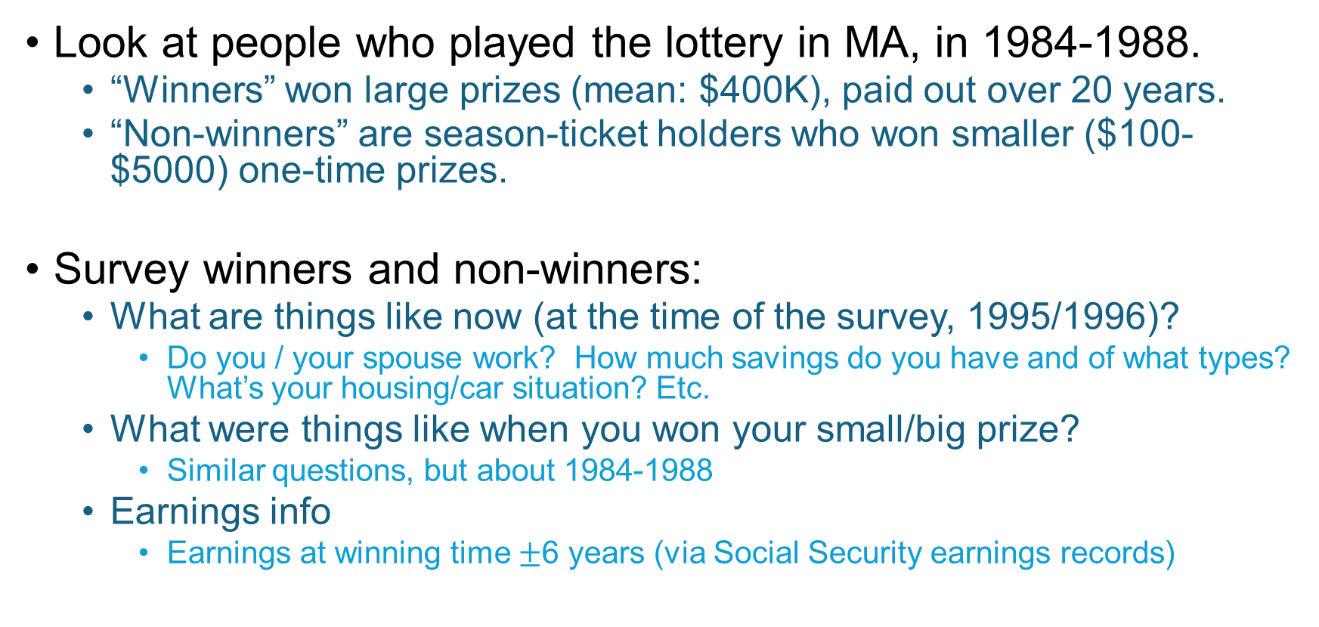
The study
Look at people who played the lottery in MA, in 1984-1988.
“Winners” won large prizes (mean: $400K), paid out over 20 years.
“Non-winners” are season-ticket holders who won smaller ($100-$5000) one-time prizes.
Survey winners and non-winners:
What are things like now (at the time of the survey, 1995/1996)?
Do you / your spouse work? How much savings do you have and of what types? What’s your housing/car situation? Etc.
What were things like when you won your small/big prize?
Similar questions, but about 1984-1988
Earnings info
Earnings at winning time $±$6 years (via Social Security earnings records)

Slide 12
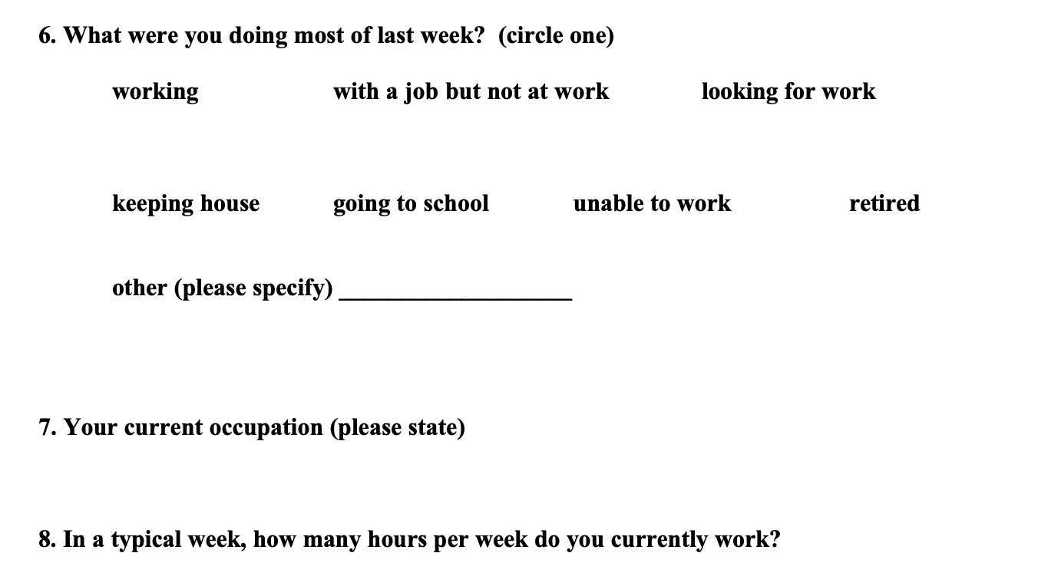
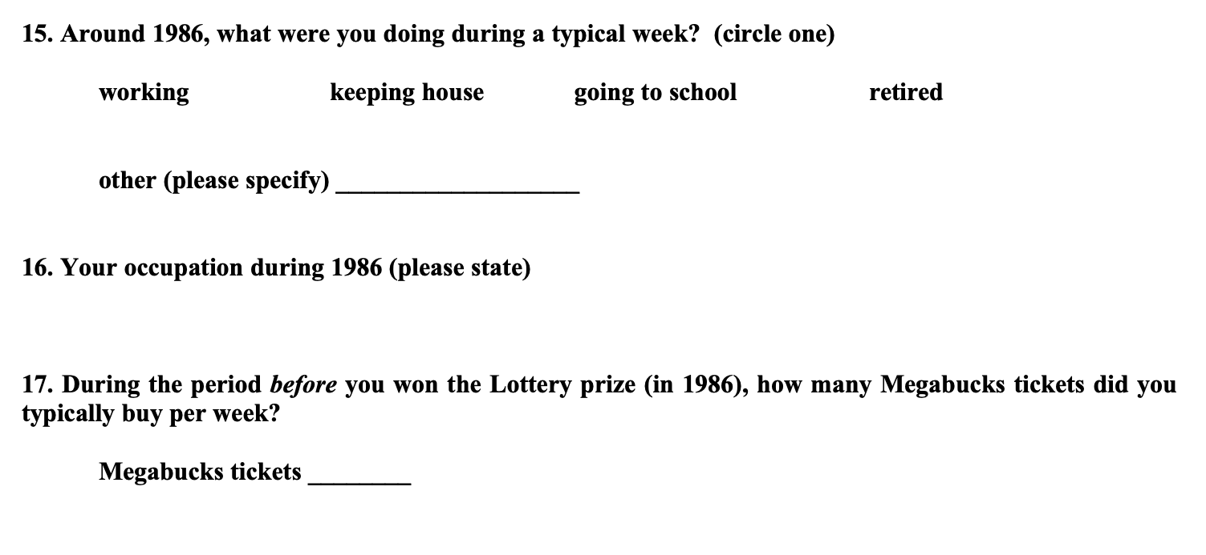
Examples There were a lot more questions – you can see some of these data in your HW!
A few questions about “now” (1995-1996)
A few questions about “when you won” (1986):

Slide 13
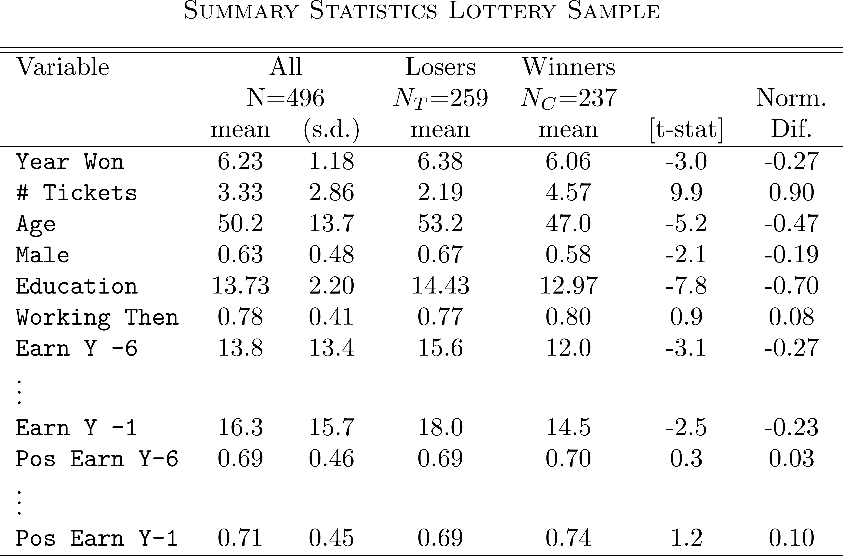
Summary statistics

Slide 14

Summary statistics
Discuss:
Are there meaningful differences between winners and losers?
If so, why might that be?

Slide 15
Some possible reasons…
Survey response rate was only around 50% for winners and 42% for non-winners.
Different types of people might be more/less likely to reply when they are winners/non-winners.
The lottery is random by tickets, not by people
Number of tickets bought may be correlated with other characteristics.

Slide 16
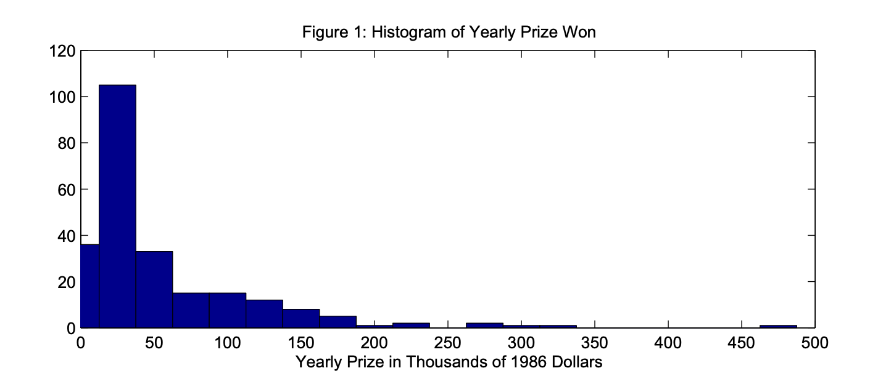

What does “winning” look like?
Histogram of yearly payouts for winners:
Lots of winners received about $20,000 per year for 20 years.

Slide 17
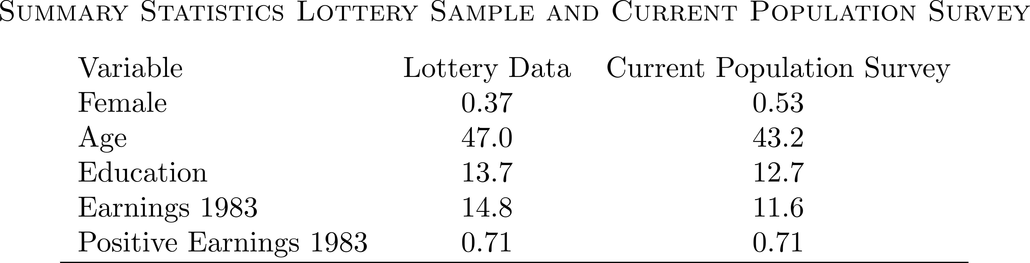
External Validity?
How do lottery players compare to the rest of the population?
Here is a comparison to the Current Population Survey, a nationally representative survey

Slide 18
Findings
You’ll get to play around with these data and see if you find similar things in your homework!
Lottery study

Slide 19
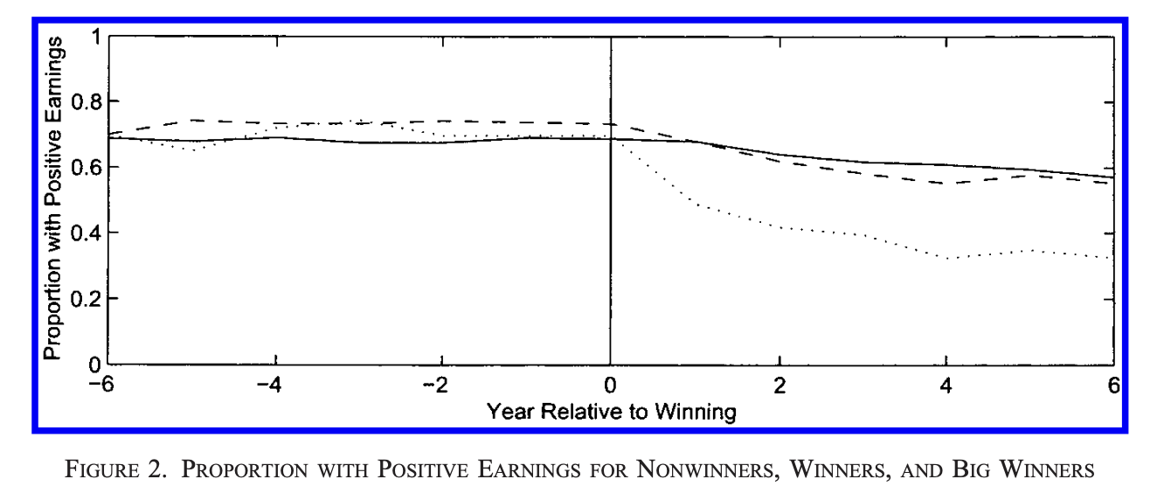
Looks like there’s an effect… On whether or not you work
Non-Winners
Winners
Big winners

Slide 20
Looks like there’s an effect… On whether or not you work
But how do we quantify it?
Non-Winners
Winners
Big winners

Slide 21
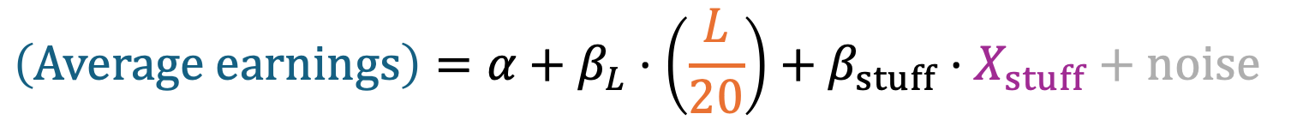
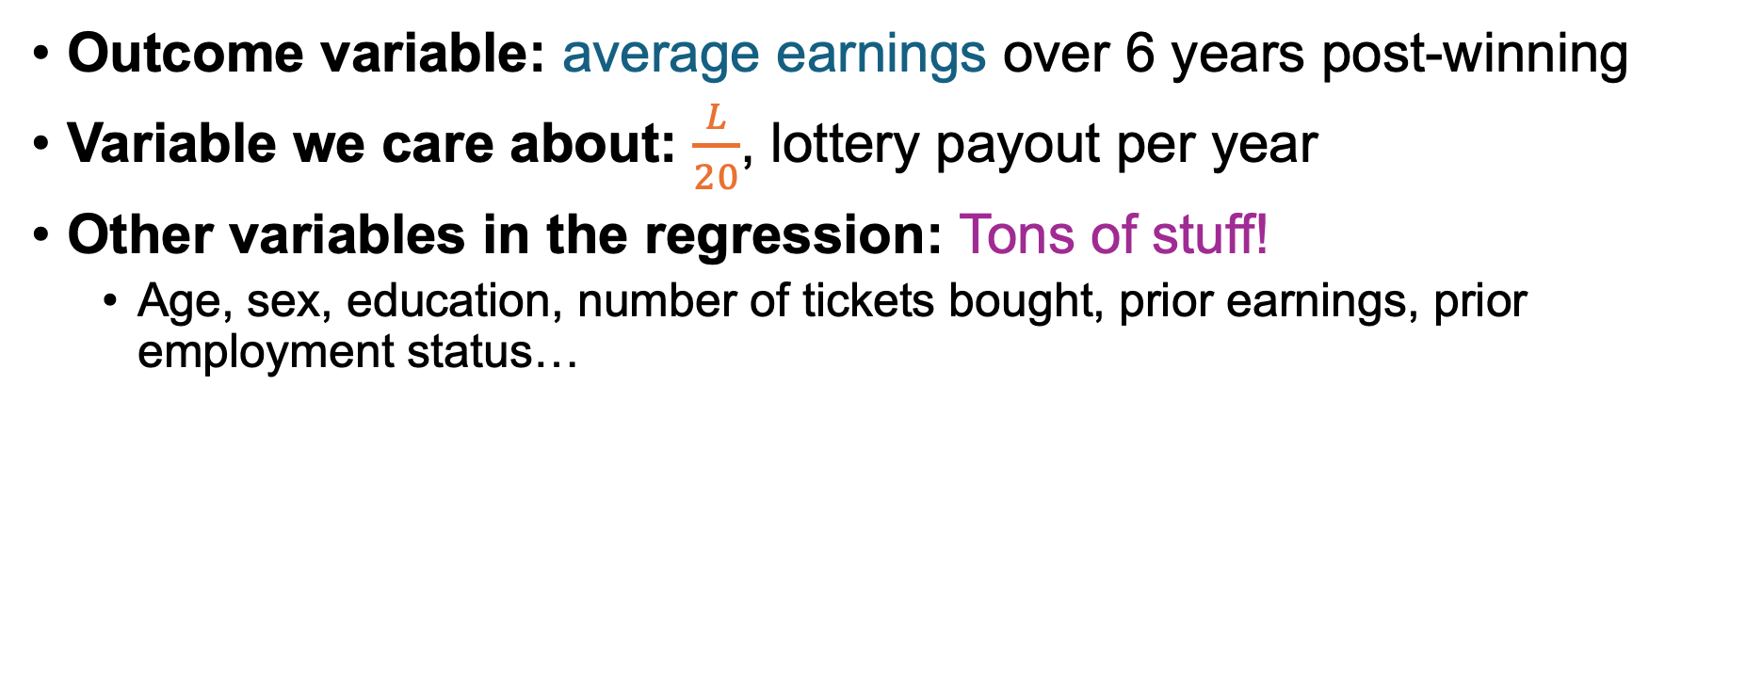
Run a multivariate regression!
Outcome variable: average earnings over 6 years post-winning
Variable we care about: $\frac{L}{20}$, lottery payout per year
Other variables in the regression: Tons of stuff!
Age, sex, education, number of tickets bought, prior earnings, prior employment status…
$$\left(Average earnings\right)=α+β_{L}⋅\left(\frac{L}{20}\right)+β_{stuff}⋅X_{stuff}+noise$$
Quick sanity-check: Do you think $β_{L}$ is positive or negative?

Slide 22
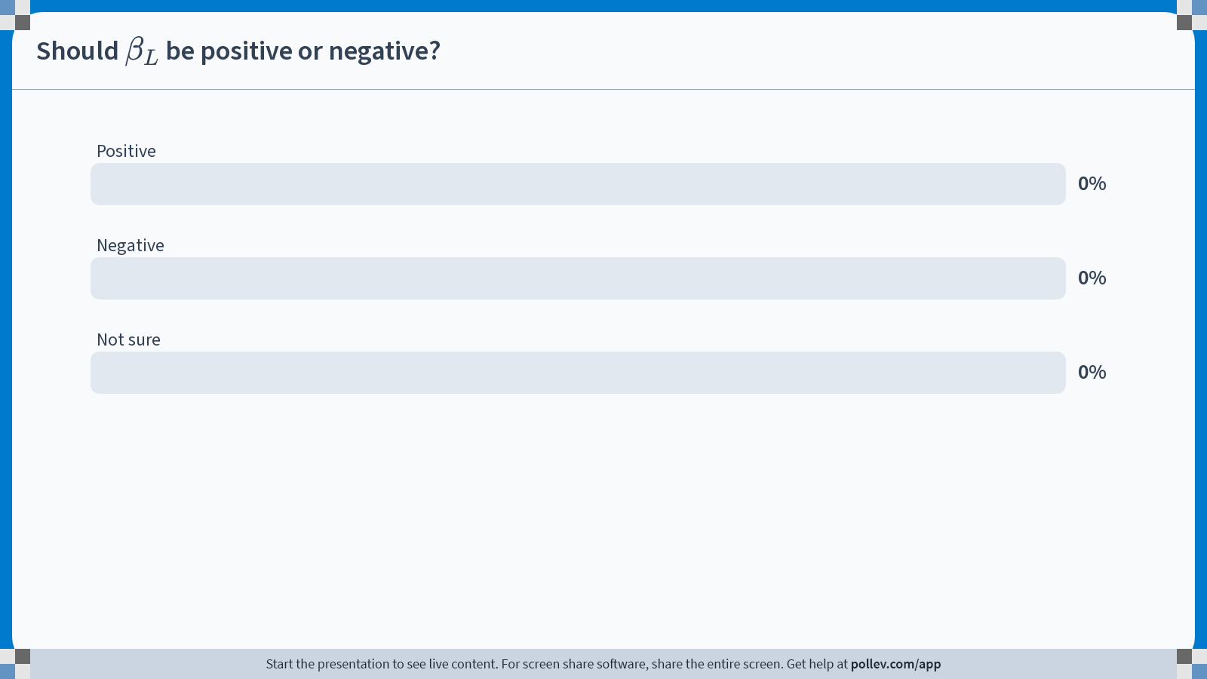
Notes:
Do not modify the notes in this section to avoid tampering with the Poll Everywhere activity. More info at polleverywhere.com/support Should $$\beta_L$$ be positive or negative?
https://www.polleverywhere.com/multiple_choice_polls/kCsbHoHpsxh7oZs1mQxKe?state=opened&flow=Default&onscreen=persist

Slide 23
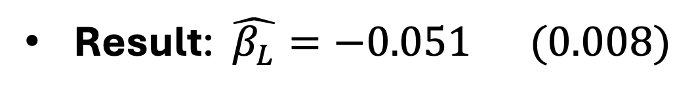
Run a multivariate regression!
Outcome variable: average earnings over 6 years post-winning
Variable we care about: $\frac{L}{20}$, lottery payout per year
Other variables in the regression: Tons of stuff!
Age, sex, education, number of tickets bought, prior earnings, prior employment status…
$$\left(Average earnings\right)=α+β_{L}⋅\left(\frac{L}{20}\right)+β_{stuff}⋅X_{stuff}+noise$$
Result: $\hat{β_{L}}=−0.051 (0.008)$
Every dollar of unearned yearly permanent income causes someone to earn 5¢ less, on average.

Slide 24
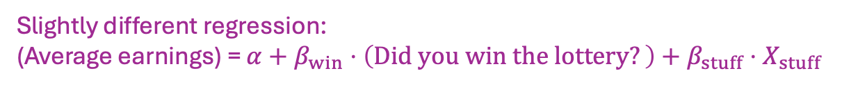
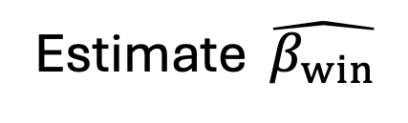
Sanity-check
What happens if we let the dependent variable be “average earnings in the 6 years before you won the lottery”?
We should get that the ATE is 0…
Outcome variable:
Estimate $\hat{β_{win}}$
Average of last 1 year of income
-0.53 (.78)
Average of last 3 years of income
-0.39 (.95)
Average of next 6 years of income
-5.74 (1.40)
Slightly different regression:
(Average earnings) = $α+β_{win}⋅\left(Did you win the lottery?\right)+β_{stuff}⋅X_{stuff }$

Slide 25
Take-aways?
Lottery study

Slide 26
What do you take away from this study?
Does this tell us something about what would happen if we implemented UBI?
How would you advise a policy-maker to act based on this study?

Slide 27
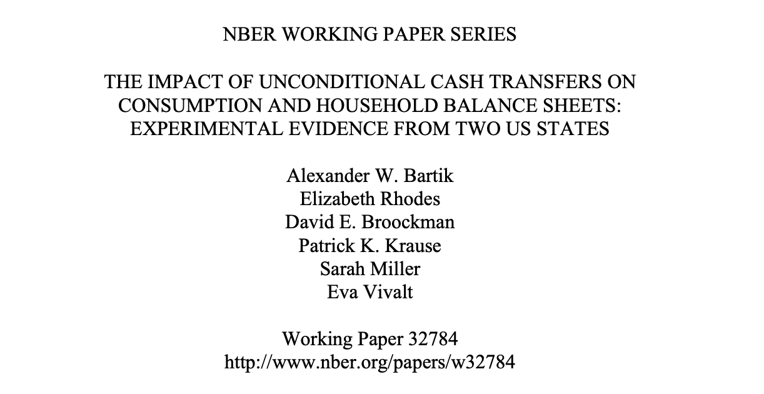
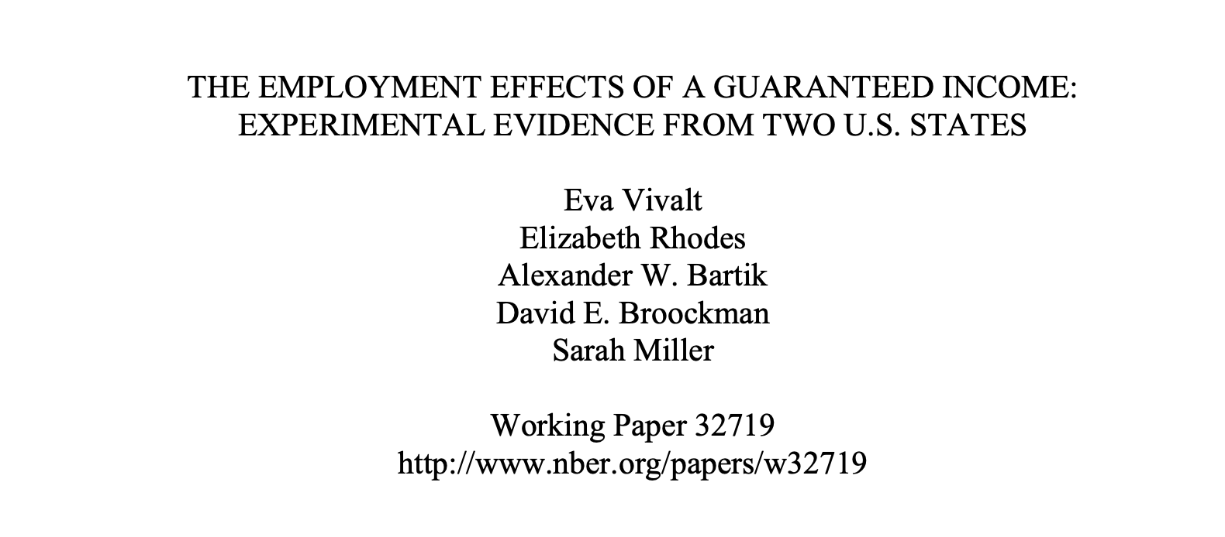
Study 2: OpenResearch Unconditional Income Study

Slide 28
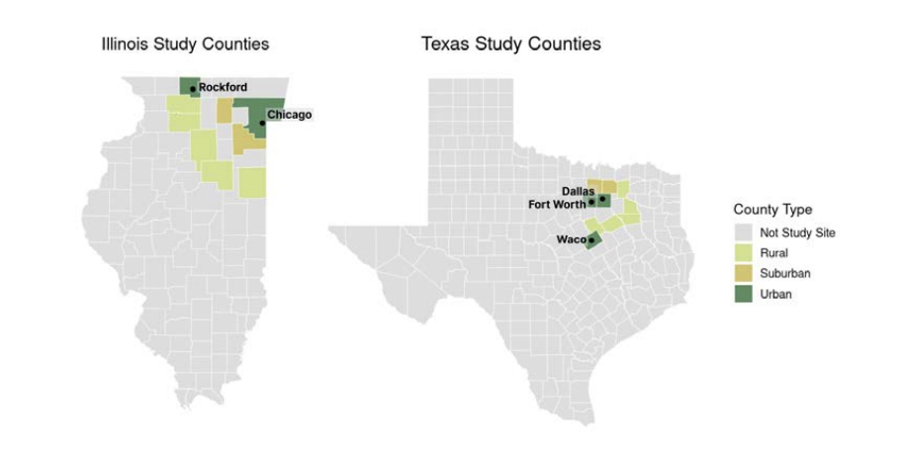
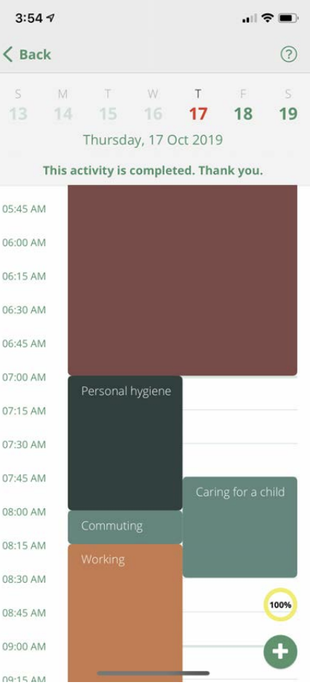
The study: A randomized experiment, 2020-2023
Population:
Eligible participants were between 21 and 40 years old, and less then 300% of federal poverty line
Two regions: Texas (including Dallas) and Illinois (including Chicago)
Treatment: 1000 people got $1000/month for 3 years
Control: 2000 people got $50/month for 3 years
Data Collected:
Survey data
Administrative/credit records
Time-use data from a phone app

Slide 29
You looked at some data from this study
What did you find interesting?
Share with your neighbor, then we’ll discuss together.

Slide 30
Findings
OpenResearch Study

Slide 31
How did people spend the money?
On average, out of $1000 per month,
$310 was spent on higher expenditures
$210 on increased leisure (i.e., reduced earned income),
$30 was spent on higher savings,
…but this was offset by the accumulation of $60/month of higher debt.

Slide 32
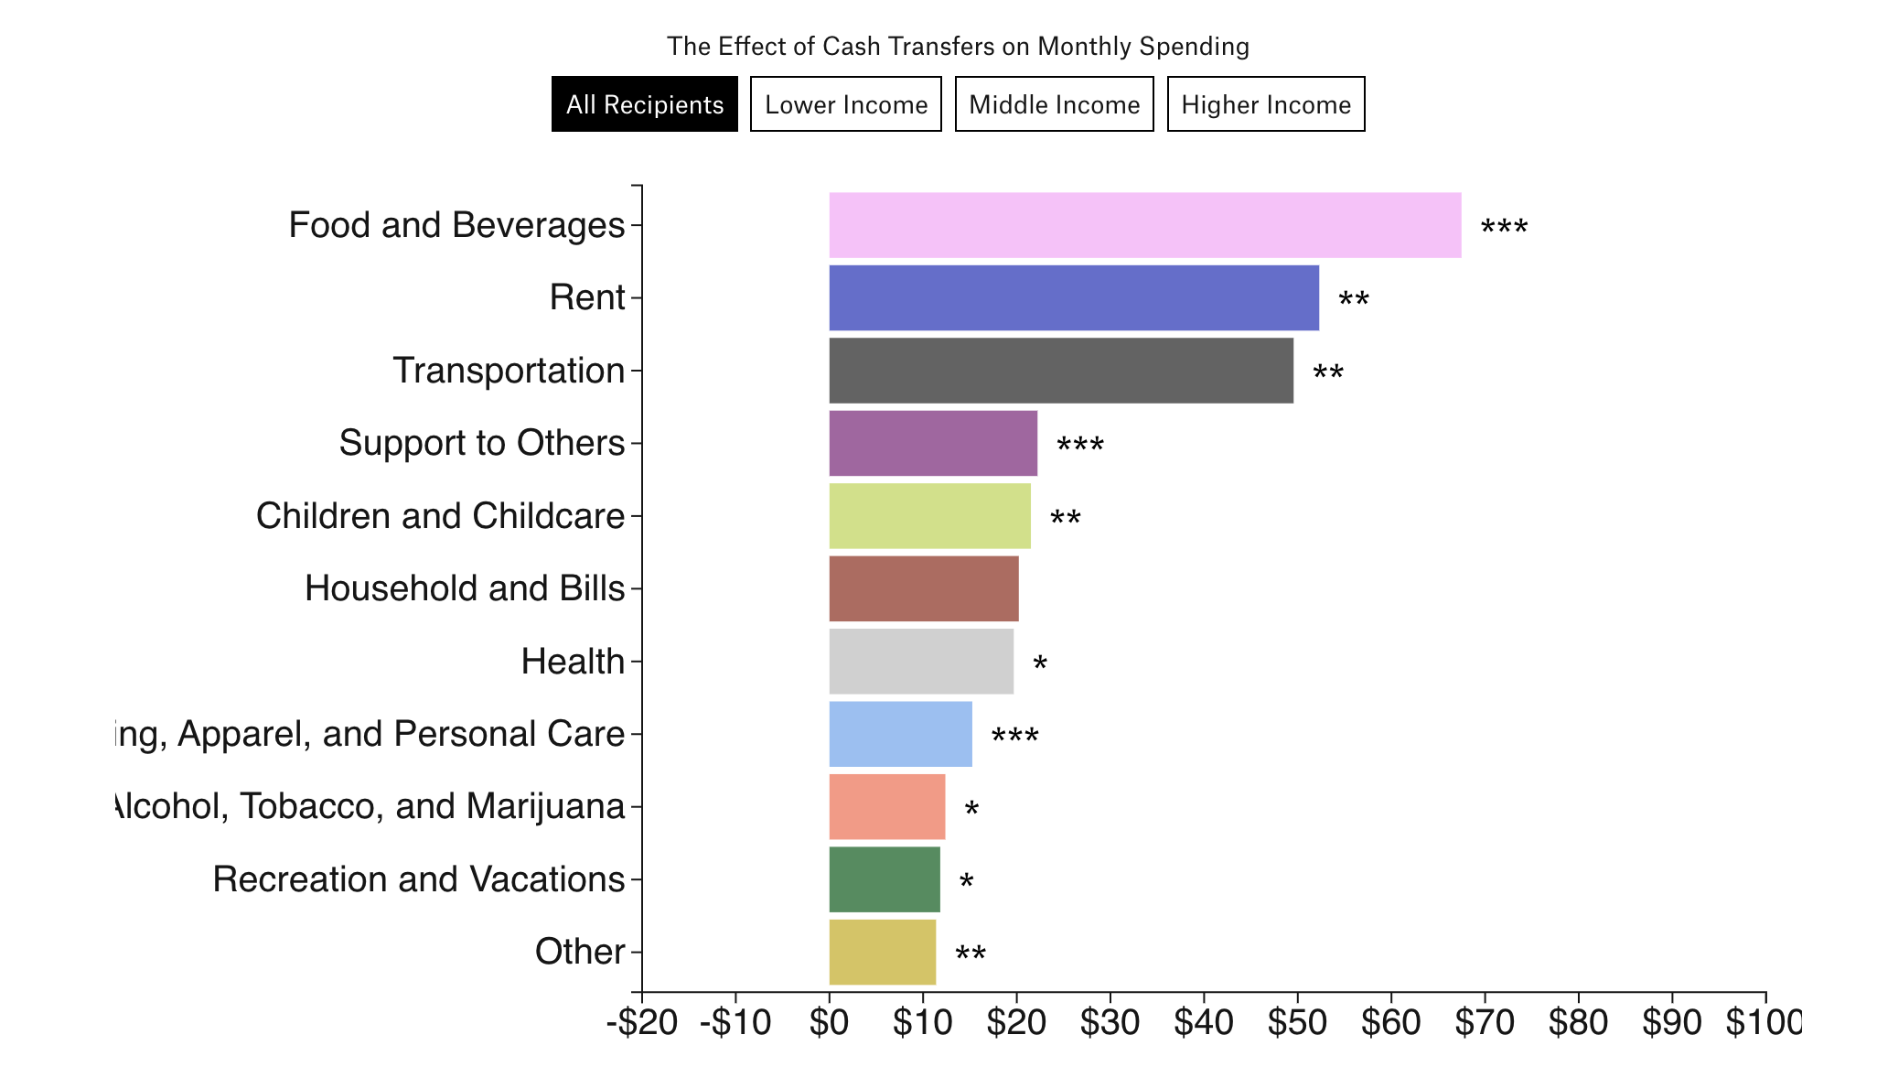
What did they spend the money on?
On average, monthly expenditures increased by $310 (out of $1000)

Slide 33
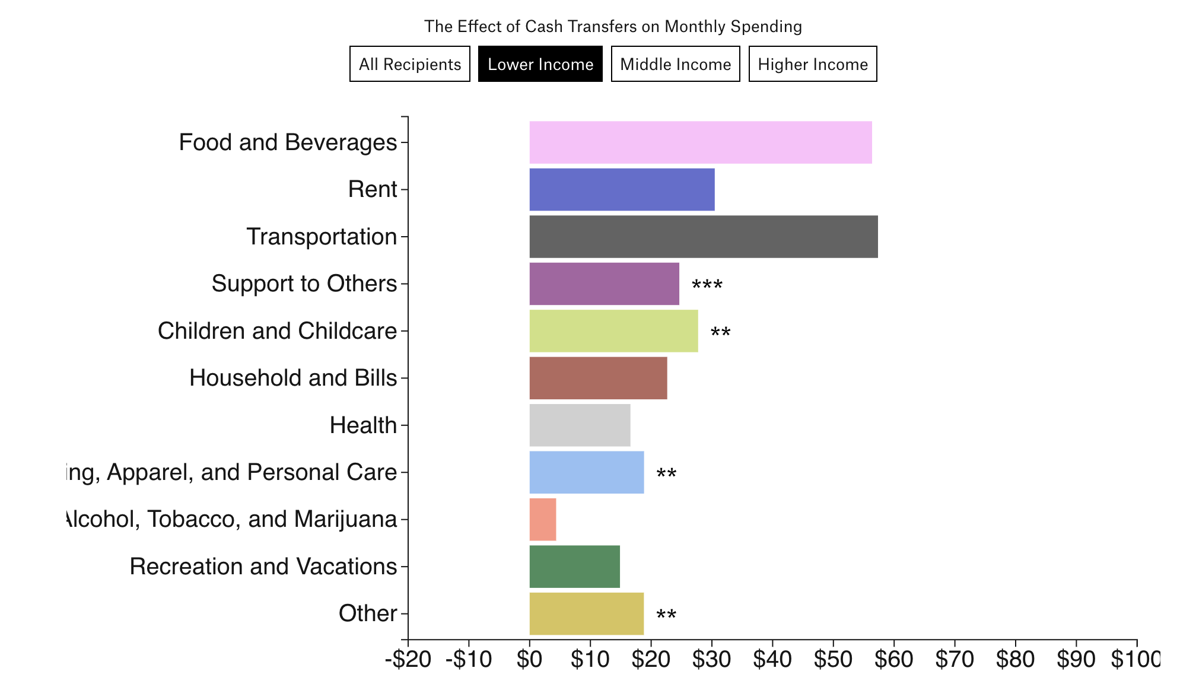
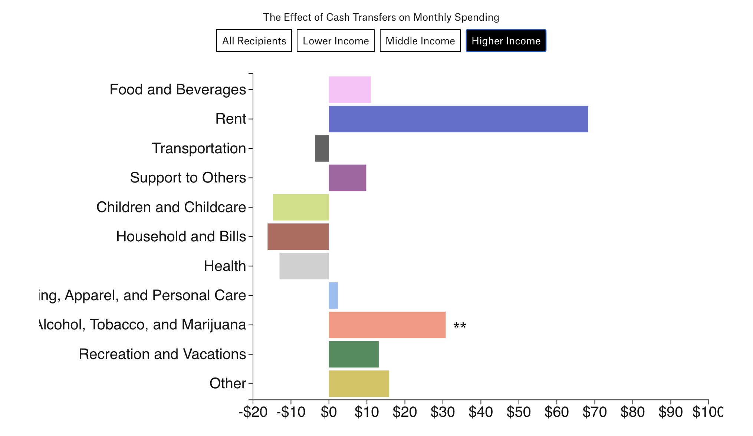
What did they spend the money on?
This differed by income level:
Low-income: Spending went up by $294
Medium-income: …by $427
High-income: … by $71
Lower income:
Higher income:

Slide 34
How did people spend their time/work?
2.0 percentage point decrease in labor market participation
1.3-1.4 hour-per-week reduction in hours
No statistically significant impact on:
Quality of employment
Investment in human capital
“Overall, our results suggest a moderate labor supply effect that does not appear offset by other productive activities.”

Slide 35
Take-aways?
OpenResearch Study

Slide 36
What do you take away from this study?
Does this tell us something about what would happen if we implemented UBI?
How would you advise a policy-maker to act based on this study?

Slide 37

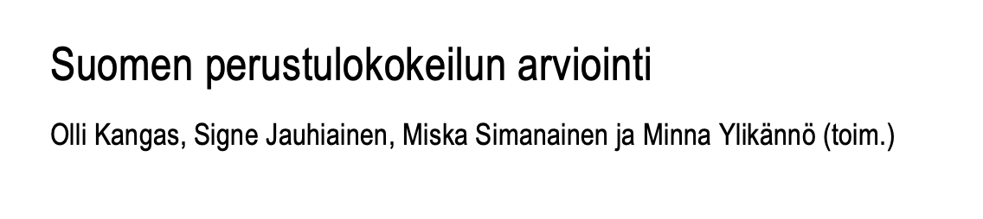
Study 3: UBI in Finland
The title translates to: “Evaluation of the Finnish basic income experiment”
(The full paper is only available in Finnish. These slides are based on Google Translate’s translation.)

Slide 38
The study
Ran for 2017 -2018
Treatment group: 2,000 randomly selected unemployed people across the country got a regular monthly income of €560, with no obligations.
Control group: people with unemployment benefits.
Question:
Would a guaranteed income encourage people to take up low-paid or temporary work without fear of losing benefits?
(In contrast to unemployment benefits)

Slide 39
Findings
Finland study

Slide 40
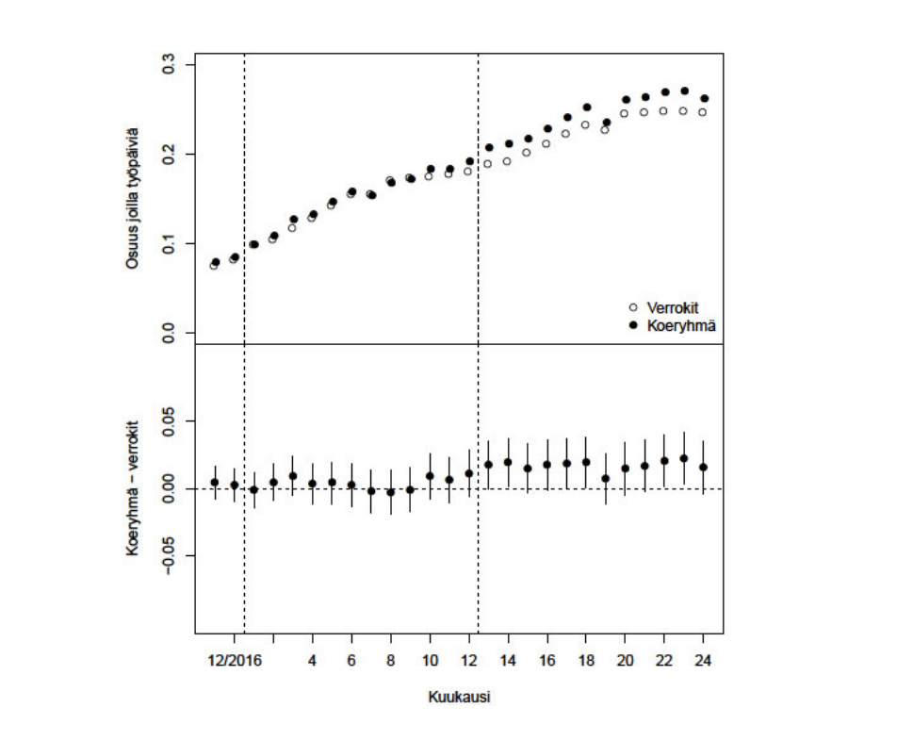
Did people work more?
● Treatment
A little bit!
Regression results:
The control group worked an average of 71 days in a year.
Nov 2017-Oct 2018
Estimate: treatment group worked about 6 more days in that period
Std. Err: 2.5 days
p-value: 0.02
○ Control
Monthly number of working days
Treatment – Control
(with 95% confidence intervals)
Regression controlled for: gender, age, education level and field, foreign language proficiency, family type, disease diagnosis, municipality group, residential area, type of unemployment benefit, unemployment days, working days, work income and amount of housing allowance

Slide 41
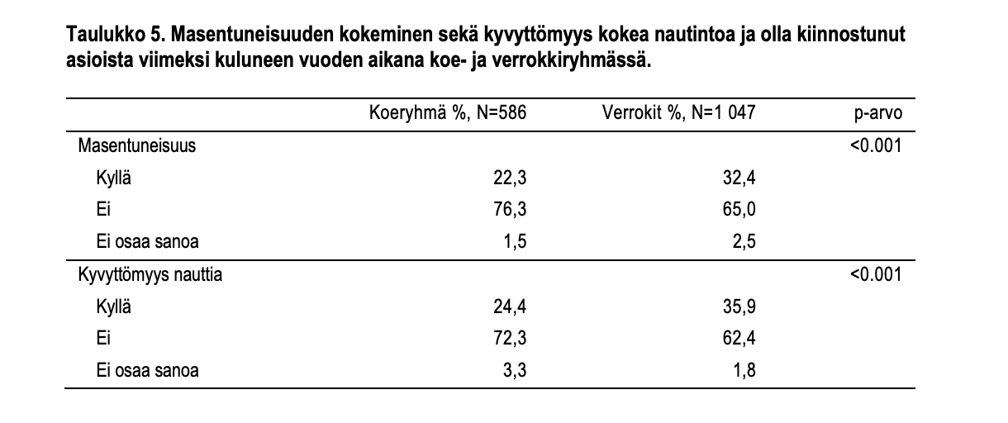
Were people happier/healthier?
Yes!
Treatment group reported better health, fewer trips to the hospital, better subjective sense of well-being, etc.
E.g:
Effects on depression
Treatment
Control
Dejection?
Yes
No
Can’t say
Inability to experience pleasure?
Yes
No
Can’t say

Slide 42
Take-aways?
Finland study

Slide 43
What do you take away from this study?
Does this tell us something about what would happen if we implemented UBI?
How would you advise a policy-maker to act based on this study?
What do you take away from all three studies together?

Slide 44
Wrap-Up and Looking Ahead

Slide 45
Today
Three more recent studies on the effects of unearned income/UBI.
Takeaways:
For policy-makers: still an ongoing conversation!
For us: Causal inference is hard!

Slide 46
Next time
Heterogeneous Treatment Effects! Random Forests!

Slide 47

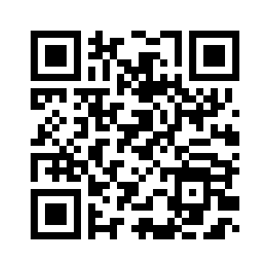
Exit ticket
Don’t forget to fill out the exit ticket before you leave class!

