Slide 1
Problems with Experiments
Causality, Decision Making, and Data Science
Lecture 4

Slide 2
Announcements
HW1 Part 1 Due soon!
Monday, 11:59pm

Slide 3

Agenda
Four experiments
Problems with these experiments, and experiments in general.
The problems that we’re going to talk about today can show up even if you do all the statistics correctly!
(That is, even if you have big sample sizes, compute accurate p-values, etc).

Slide 4
Reading responses
Last time in class, and in your reading responses, you thought about problems with the West Point laptop experiment.
The settings are different!
West Point students are different from Stanford students
Technology in 2014-2016 is different from 2024
Intro Econ is different than this class
Are test scores the right thing to measure?
Morally, is it right to take away agency from students?
…
Today we’ll discuss these issues more generally.

Slide 5
Four more experiments
Greater Avenues to Independence (GAIN)
Does a job training program work?
Perry Preschool Program
What is the effect of early childhood education?
Racial Discrimination in the Sharing Economy
Do Airbnb hosts discriminate against Black users?
Facebook Emotional Contagion
Do the emotions that we see expressed on Facebook effect our own emotions?

Slide 6
The plan
We’ll talk about each of these four in a “just-the-facts” way.
We’ll talk about some issues with experiments in general.
Along the way, we’ll revisit each of these four experiments and see which issues apply.
Pay attention to things like:
What population participates in the study?
What outcomes does the study measure?
What question is the study trying to answer?
…and think about other potential issues that might come up.

Slide 7
Four Experiments

Slide 8
Experiment 1 GAIN
Greater Avenues to Independence

Slide 9
Job training programs
Typically aimed at welfare recipients.
Provides some or all of:
Basic education
Vocational training
Support in finding a job

Slide 10
Questions we might want to answer
Are particular job training programs effective?
Which sort of job training program is more effective?

Slide 11
Greater Avenues to Independence (GAIN)
Job training program in CA (since 1986)
Implemented differently in different counties, e.g.:
Riverside:
“find a job first” focused program
Enrolled all welfare recipients in Riverside county
Los Angeles:
“build human capital” focused program
Enrolled long-term welfare recipients in LA county
Each county ran* an RCT.
1988-1990(ish)
*RCTs were run by Manpower Demonstration Research Corporation (MDRC)

Slide 12
Results
The Riverside program (jobs first) did great!
Participants were 39% more likely to find a job in the next 1-3 years.
Participants made 63% more money in the next 1-3 years.
These results were statistically significant (p-value 0.01)
The LA program (human capital first) didn’t look so good.
Nothing statistically significant 1-3 years out.

Slide 13
Results* 1-3 years after enrolling in the program
=Statistically significant (p=0.01)
Also measured:
# quarters employed
Earnings above min. wage
# quarters on AFDC/TANF benefits
Los Angeles (Human Capital first)
Riverside (Jobs first)
Control
Group
Treatment Group
Percentage difference
Control
Group
Treatment Group
Percentage difference
What fraction were employed at all that year?
24.5%
26.1%
+7%
35.3%
49%
+39%
Annual earnings (in 1999 dollars)
$1,849
$1,843
+0%
$2,253
$3,668
+63%
(1458 people total)
(2288 people total)
*Simplified ☺
Notes:
AFDC = Aid to Families with Dependent Children
TANF = California Tribal Temporary Assistance for Needy Families

Slide 14
This was impactful
Based on these data, the Wilson administration in California pushed to have all CA counties adopt the Riverside work-first approach.

Slide 15
Experiment 2: Perry Preschool Program

Slide 16
Perry Preschool Experiment
Experiment in early education conducted from 1962-1967
Population:
153 children at Perry Elementary School in Ypsilanti, MI
To be eligible, children had to be economically disadvantaged, Black, and “low-IQ” as measured by the Stanford-Binet IQ test.
Annual surveys until age 15, follow-ups every 10 years or so until today
Treatment: 2.5-hour educational preschool each weekday, based on active learning techniques, plus weekly home visits by teachers.
Notes:
Children enter at age 3

Slide 17
Findings
Look really good!
Short term improvements in IQ
Long term improvements in all sorts of things:
High-school graduation rate
Incarceration
Teen pregnancies
…
All of these is big and statistically significant effects.

Slide 18
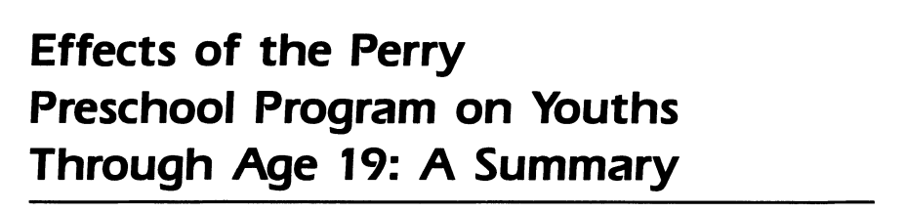

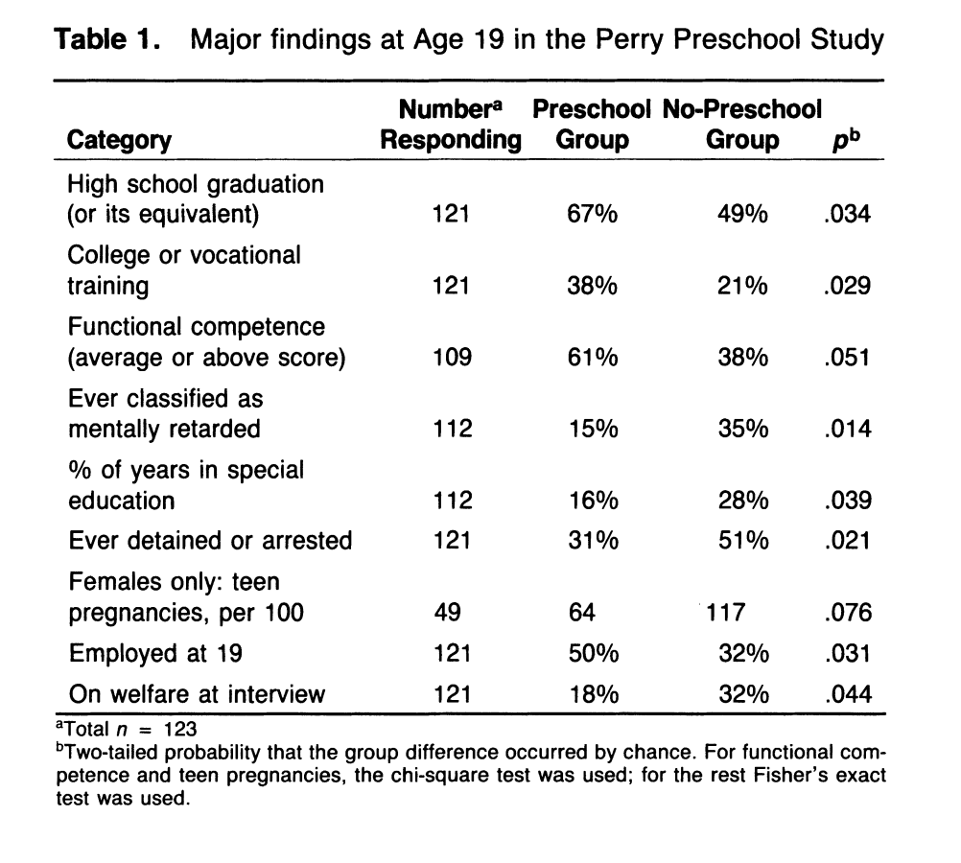
Findings
(1985)
Look really good!
Short-term increase in IQ
Longer-term increase in all sorts of good things.

Slide 19
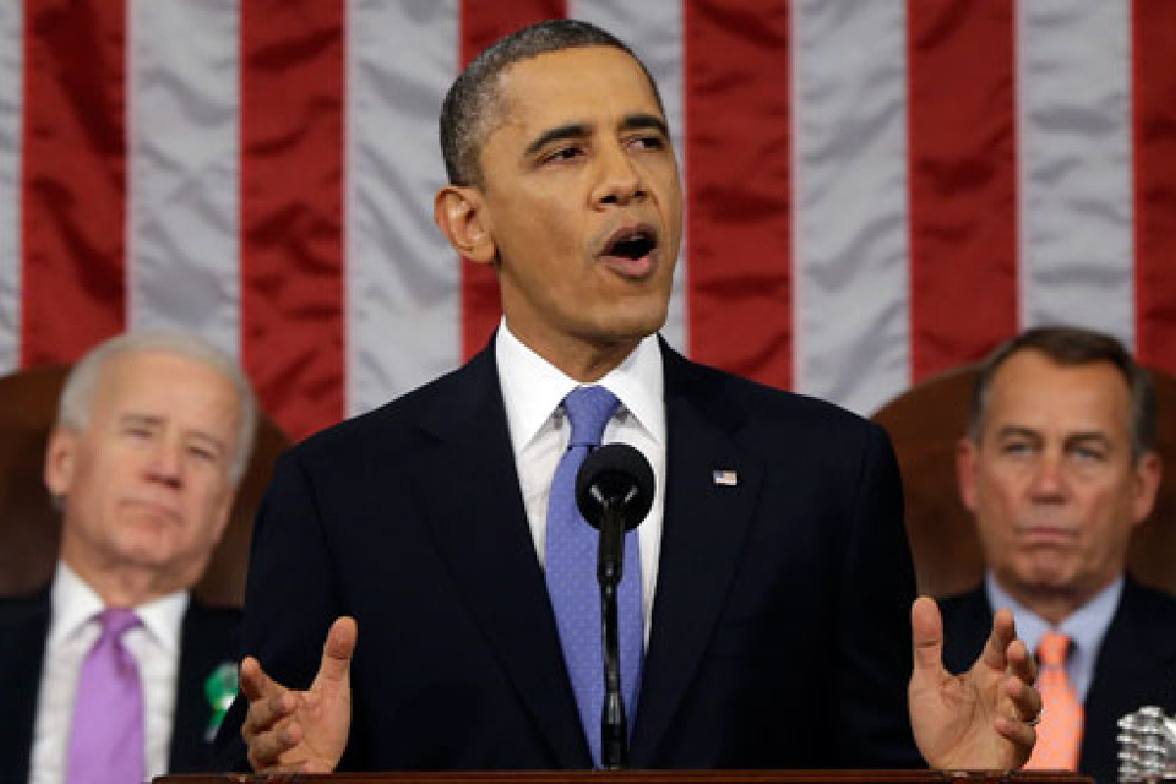
This was impactful
Influenced by this study, about 30% of HeadStart programs use this method.
President Obama referenced it (and follow-up analyses) in the 2013 State of the Union Address when discussing early childhood education.
“Every dollar we invest in high-quality early childhood education can save more than seven dollars later on -- by boosting graduation rates, reducing teen pregnancy, even reducing violent crime.”

Slide 20
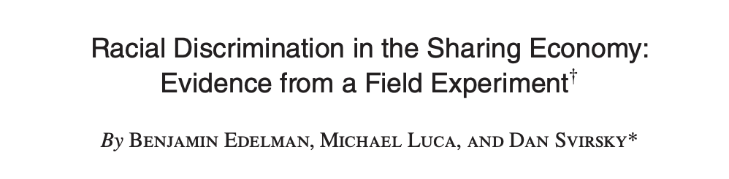

Experiment 3: Racial Discrimination on Airbnb

Slide 21
Do Airbnb hosts discriminate by race?
Back in 2015, “Instant Book” was not so common on Airbnb
You had to contact the host and ask to stay at their place

Slide 22
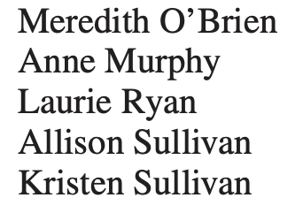
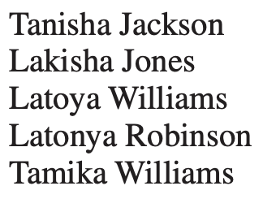
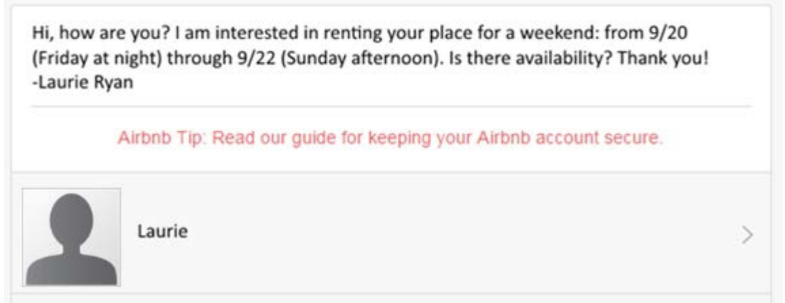
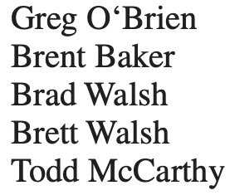
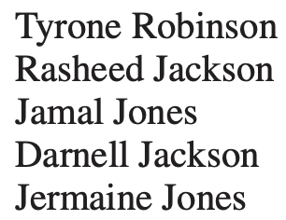
Experiment
The 5 cities:
Baltimore, Dallas, LA,
St. Louis, Washington DC
Randomly contact ~6400 listings in 5 US cities
Everything about the message is the same, except the names.
Names:
Coded “white”
Coded “Black”

Slide 23
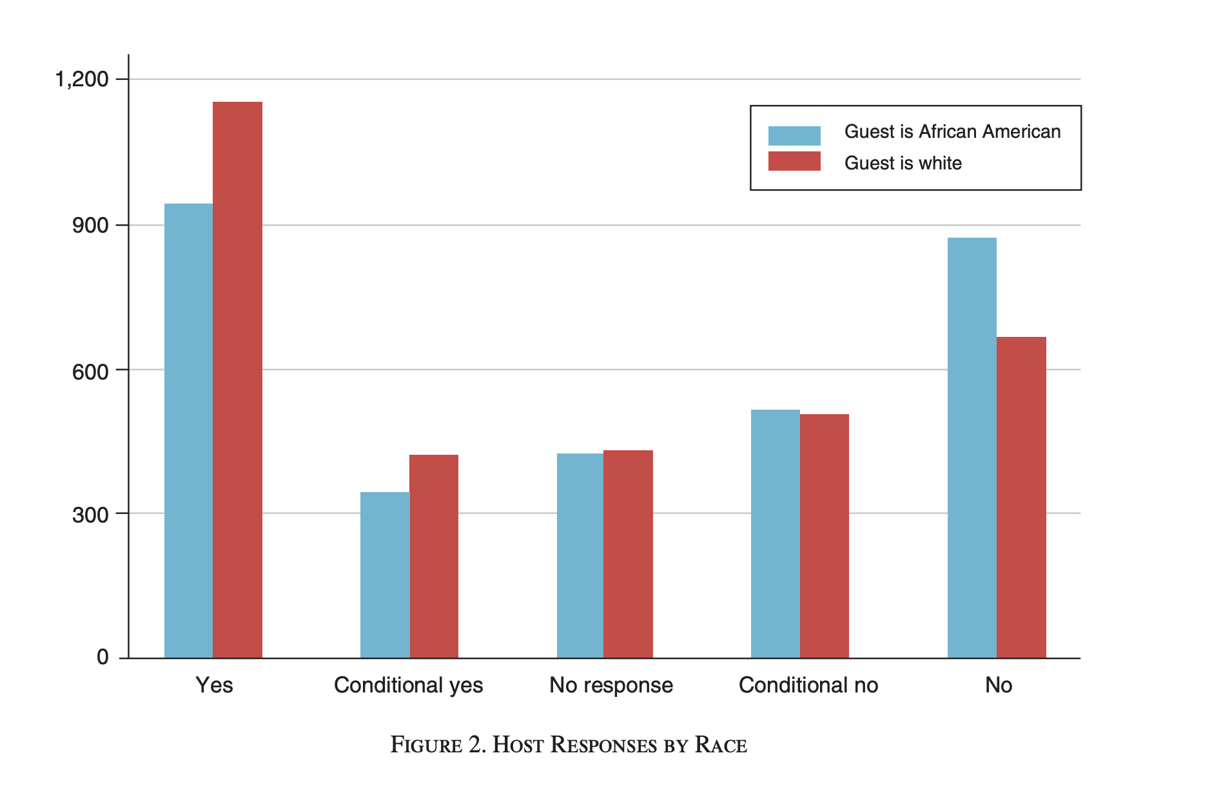
Findings
Black-sounding names got a 42% positive response rate.
White-sounding names got a 50% positive response rate.
p-value: 0.02
The paper also did a breakdown by host demographics, by city, by gender, etc, and found similar trends.

Slide 24
This was impactful?
Correlation does not imply causation, but around the time this paper came out:
Airbnb did their own audit
They have since made some changes to reduce discrimination

Slide 25
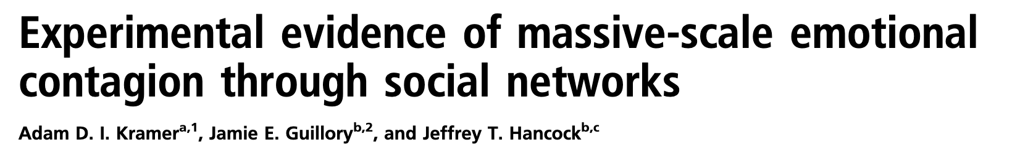

Experiment 4: Facebook Emotional Contagion Experiment
2014

Slide 26
Emotional Contagion
Research in psychology has found:
When people around you are sad, you feel sadder
When people around you are happy, you feel happier
Question: Is this true on social media?
Maybe face-to-face contact is important for the effect
Maybe non-verbal cues are important for the effect
etc

Slide 27
The experiment
Researchers at Facebook randomly manipulated what N=689,003 random users saw in their news feeds in 2012.
Control group: No change
Treatment group 1: Negative-emotion posts reduced in News Feed
Treatment group 2: Positive-emotion posts reduced in News Feed
Dependent Variable: Emotional valence of posts that follow
As measured by number of “positive” or “negative” words
All groups could still see all the posts by, e.g., going to a friend’s “wall” or “timeline”, this only affected their news feed.

Slide 28
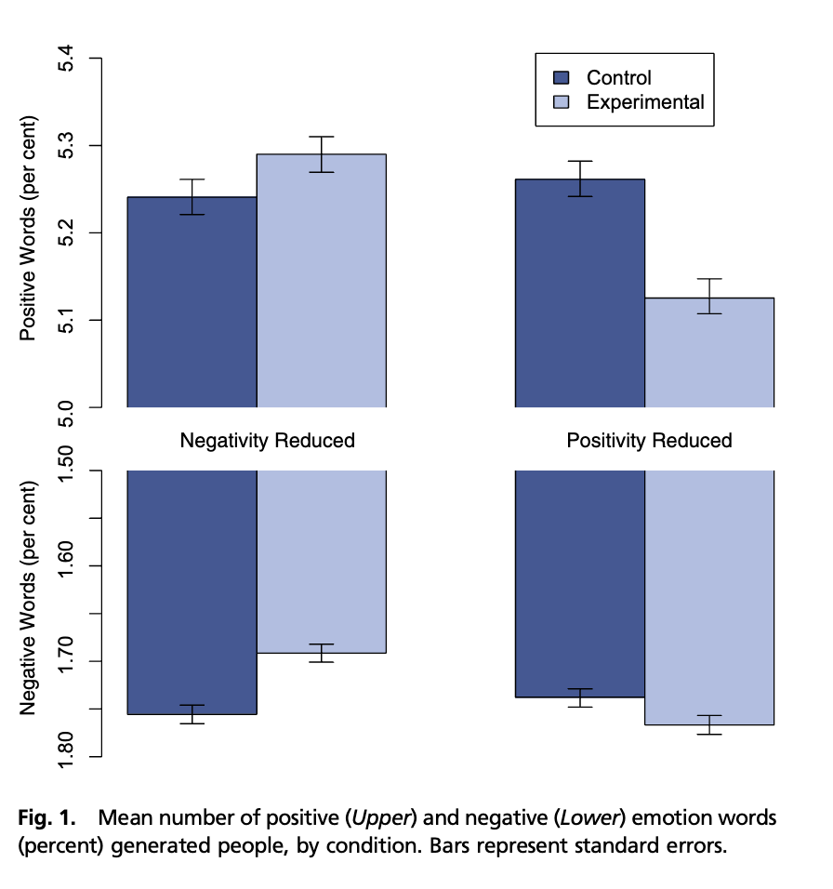
Findings
The emotional valence of your news feed effects the emotional valence of words you use.

Slide 29

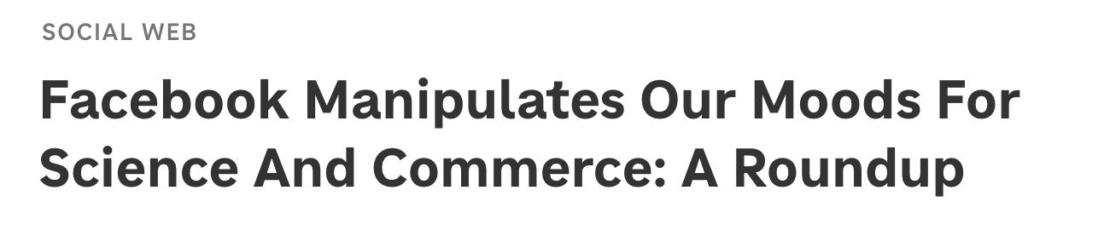
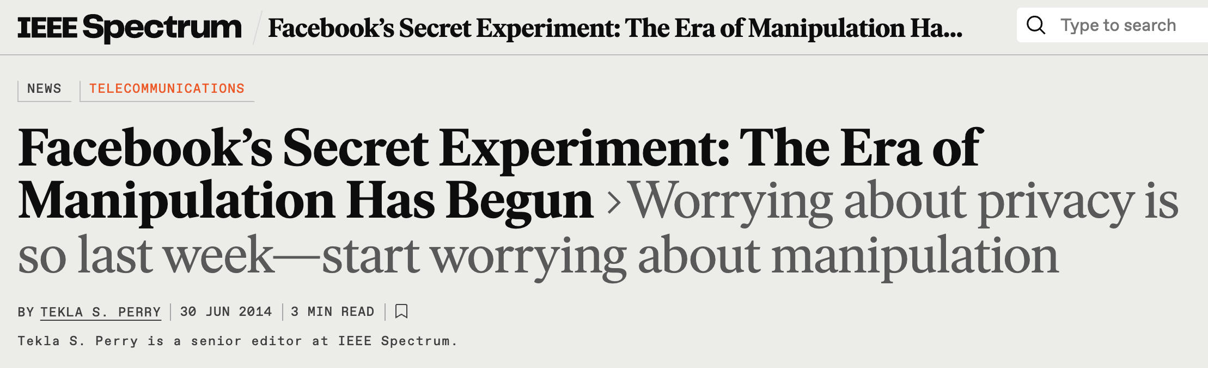
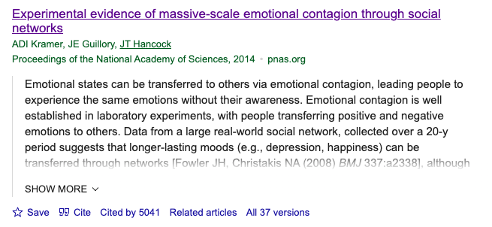
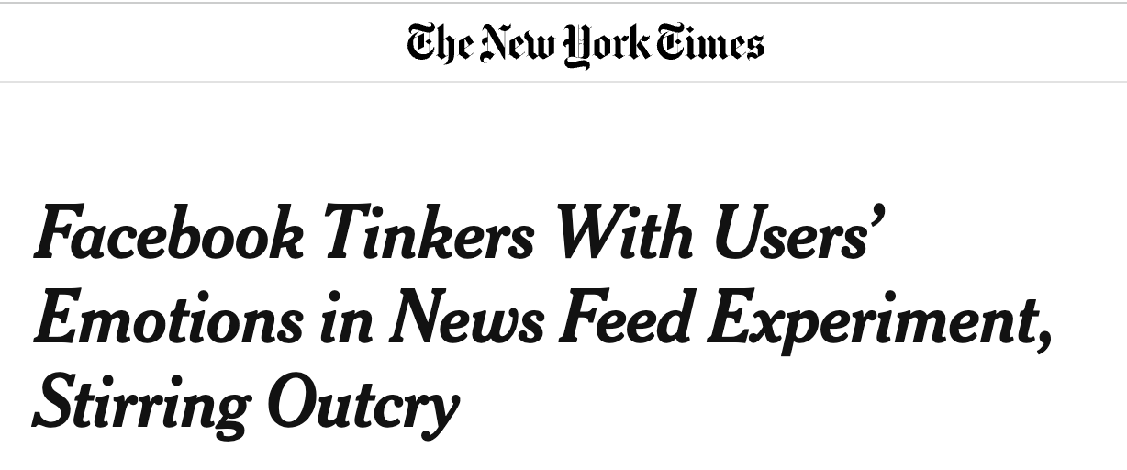
This was impactful?
At least it made a big splash…

Slide 30
Let’s take a quick break ☺
Get up, stretch, talk to your neighbor, start thinking about issues with these experiments…

Slide 31
Issues with Experiments

Slide 32
Four issues
External Validity
Construct Validity
Spillover Effects
Ethical Concerns

Slide 33
External Validity

Slide 34
Internal vs. External Validity
RCTs have good internal validity thanks to the randomization!
An experiment has good internal validity if it tells you something about the population in the study.
An experiment has good external validity if the results generalize to other populations.
Example:
Internal Validity: The laptop experiment tells us something about West Point students taking intro econ in 2016.
External Validity: Does this apply to Stanford students taking our class in 2025?

Slide 35

External Validity
Discuss!
Rate each of our four experiments on external validity:
1) Not externally valid
2) Maybe externally valid
3) Externally valid for an important population
What is one potential concern with external validity for each experiment?
GAIN (job training program in CA)
Perry Preschool Program (early childhood education program)
Racial Discrimination in the Sharing Economy (do Airbnb hosts discriminate?)
Facebook Emotional Contagion (does emotional contagion happen online?)

Slide 36
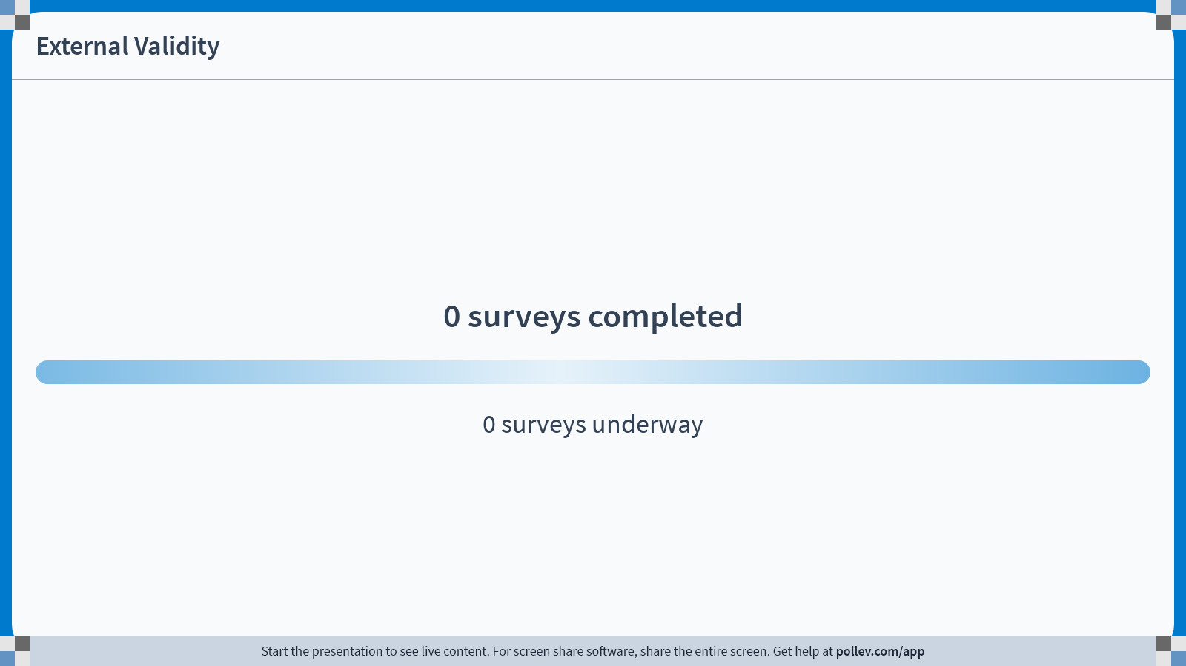
Notes:
Do not modify the notes in this section to avoid tampering with the Poll Everywhere activity. More info at polleverywhere.com/support External Validity
https://www.polleverywhere.com/surveys/rw6o7YWWzEIJx7tH4lVlj?display_state=chart&activity_state=opened&state=opened&flow=Engagement&onscreen=persist

Slide 37
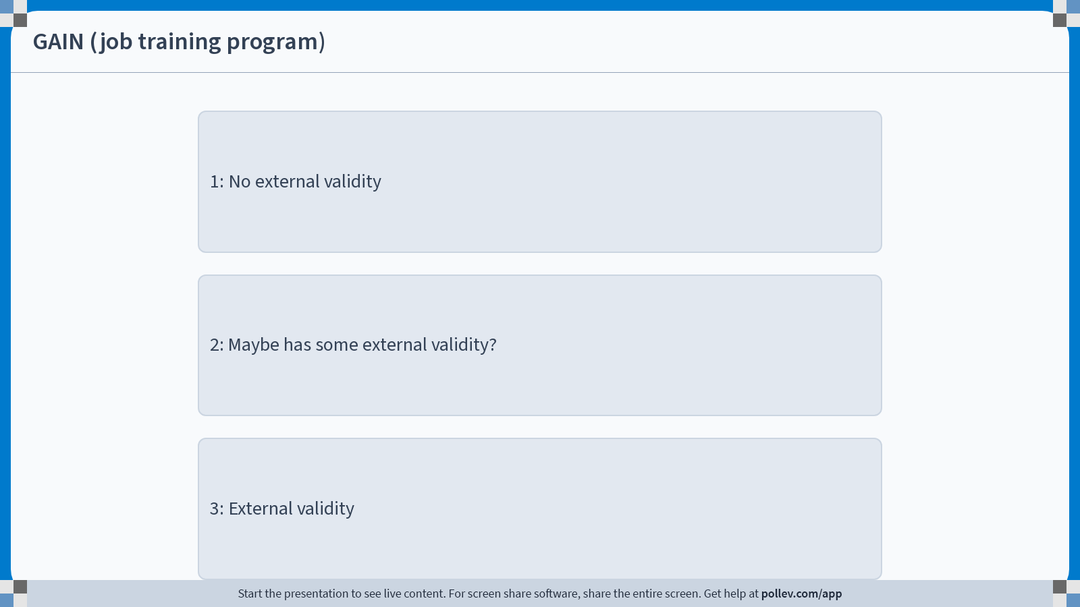
Notes:
Do not modify the notes in this section to avoid tampering with the Poll Everywhere activity. More info at polleverywhere.com/support GAIN (job training program)
https://www.polleverywhere.com/multiple_choice_polls/8mtUCXlK8Wm4FuAXwLYKp?display_state=chart&activity_state=opened&state=opened&flow=Engagement&onscreen=persist&hide=instructions

Slide 38
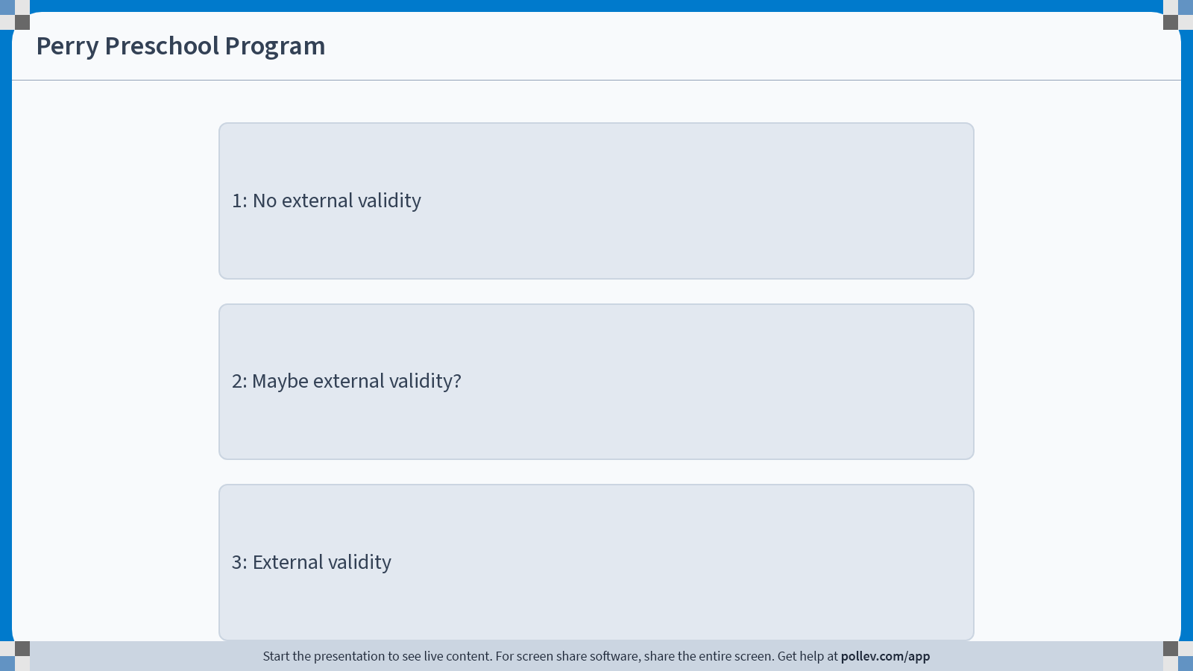
Notes:
Do not modify the notes in this section to avoid tampering with the Poll Everywhere activity. More info at polleverywhere.com/support Perry Preschool Program
https://www.polleverywhere.com/multiple_choice_polls/ch03Uilh2uFj4MhYJ3nHj?display_state=chart&activity_state=opened&state=opened&flow=Engagement&onscreen=persist&hide=instructions

Slide 39
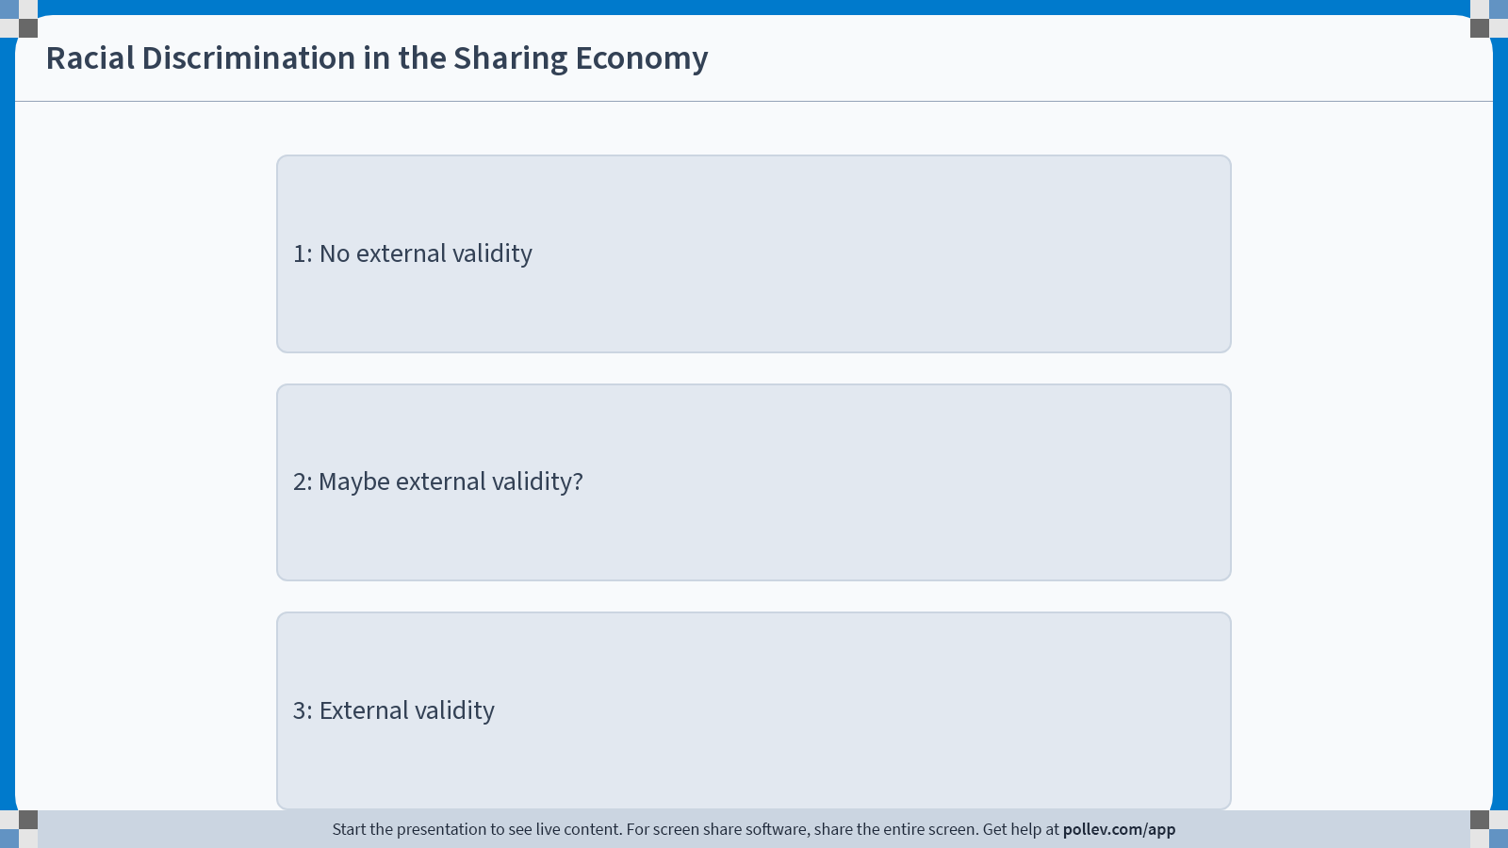
Notes:
Do not modify the notes in this section to avoid tampering with the Poll Everywhere activity. More info at polleverywhere.com/support Racial Discrimination in the Sharing Economy
https://www.polleverywhere.com/multiple_choice_polls/flqevcMK7vT85adzWURoS?display_state=chart&activity_state=opened&state=opened&flow=Engagement&onscreen=persist&hide=instructions

Slide 40
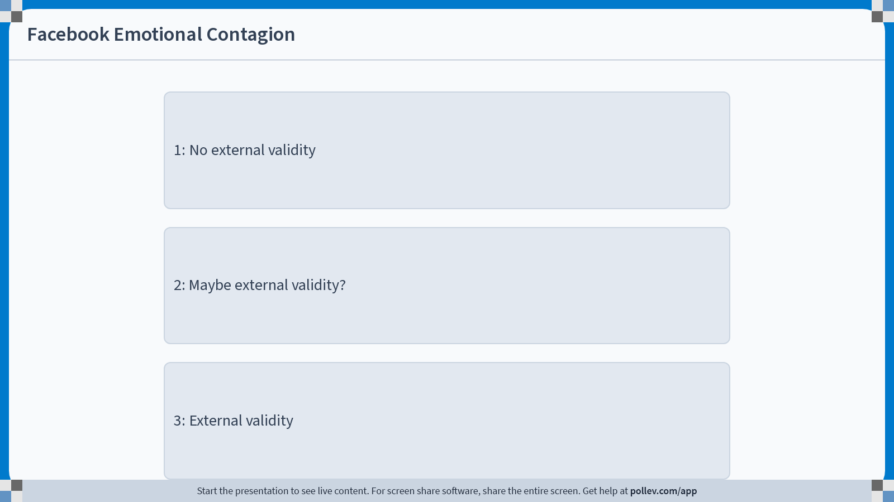
Notes:
Do not modify the notes in this section to avoid tampering with the Poll Everywhere activity. More info at polleverywhere.com/support Facebook Emotional Contagion
https://www.polleverywhere.com/multiple_choice_polls/KjrzT5a0Qr0rboso8T2up?display_state=chart&activity_state=opened&state=opened&flow=Engagement&onscreen=persist&hide=instructions

Slide 41
One concrete concern with external validity in each?
GAIN (job training program in CA)
Perry Preschool Program (early childhood education program)
Racial Discrimination in the Sharing Economy (do Airbnb hosts discriminate?)
Facebook Emotional Contagion (does emotional contagion happen online?)

Slide 42
Populations in the GAIN study
Different counties chose different populations.
Riverside chose to enroll all welfare recipients for GAIN.
Average last-quarter income: $453
52% white, 27% Hispanic, 16% Black
LA registered mostly long-term welfare recipients.
Average last-quarter income: $221
12% white, 32% Hispanic, 45% Black

Slide 43
Construct Validity

Slide 44
Construct Validity
An experiment has construct validity if it measures the thing we actually care about.
Example:
In the laptop experiment, they looked at scores on a final exam.
Is that what really matters? What about…
long-term retention and/or deep understanding of the material?
Student happiness/success in life?

Slide 45
Construct Validity
Discuss!
Rate each of our four experiments on construct validity:
1) Doesn’t measure what we actually care about
2) Maybe measures what we care about?
3) Measures what we care about.
What is one potential concern with construct validity for each experiment?
GAIN (job training program in CA)
Perry Preschool Program (early childhood education program)
Racial Discrimination in the Sharing Economy (do Airbnb hosts discriminate?)
Facebook Emotional Contagion (does emotional contagion happen online?)

Slide 46
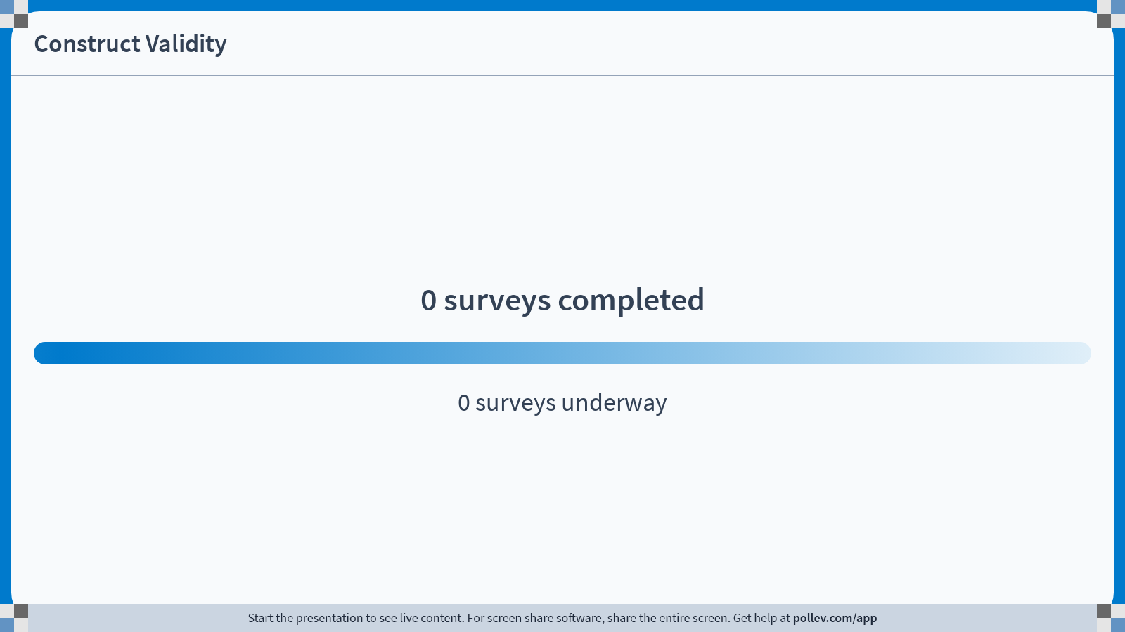
Notes:
Do not modify the notes in this section to avoid tampering with the Poll Everywhere activity. More info at polleverywhere.com/support Construct Validity
https://www.polleverywhere.com/surveys/rolcpIkupg9wpi5ECPrQb?display_state=chart&activity_state=opened&state=opened&flow=Engagement&onscreen=persist

Slide 47
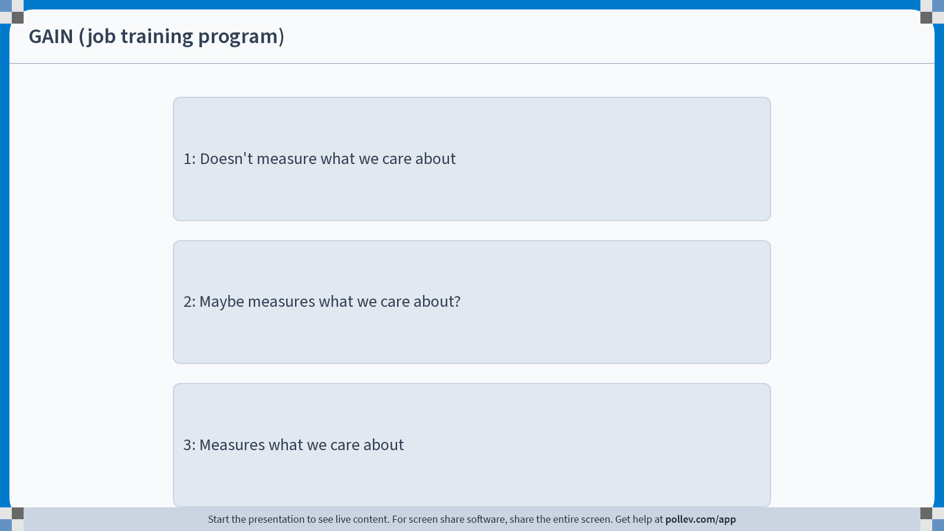
Notes:
Do not modify the notes in this section to avoid tampering with the Poll Everywhere activity. More info at polleverywhere.com/support GAIN (job training program)
https://www.polleverywhere.com/multiple_choice_polls/34sFZkrQoqQGq7PtQ4zrs?display_state=chart&activity_state=opened&state=opened&flow=Engagement&onscreen=persist&hide=instructions

Slide 48
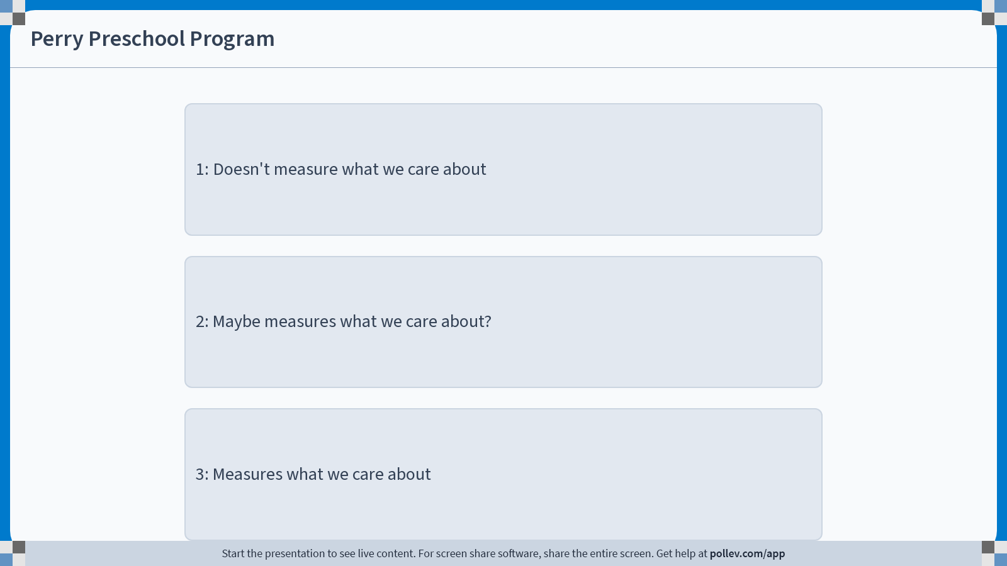
Notes:
Do not modify the notes in this section to avoid tampering with the Poll Everywhere activity. More info at polleverywhere.com/support Perry Preschool Program
https://www.polleverywhere.com/multiple_choice_polls/mqYuhBMhkg9QCLys3PIAn?display_state=chart&activity_state=opened&state=opened&flow=Engagement&onscreen=persist&hide=instructions

Slide 49
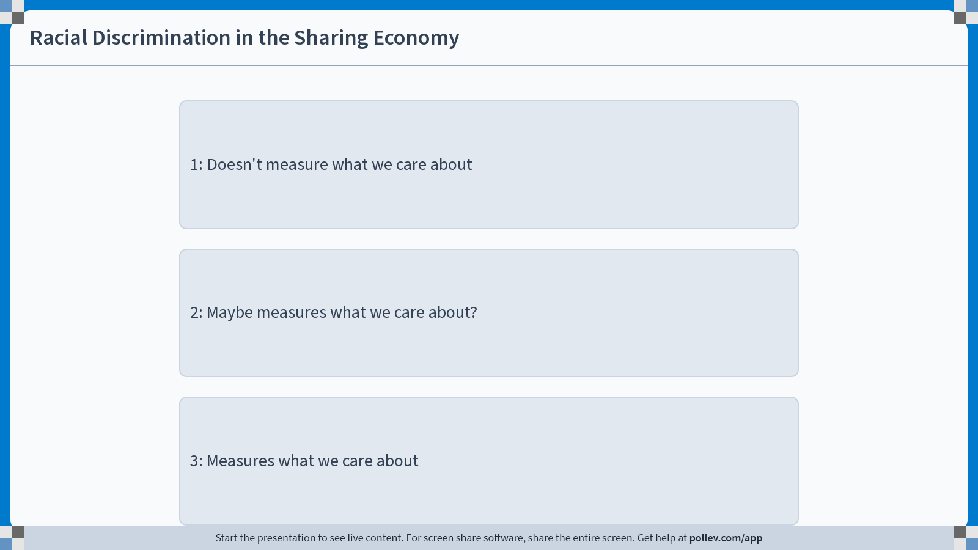
Notes:
Do not modify the notes in this section to avoid tampering with the Poll Everywhere activity. More info at polleverywhere.com/support Racial Discrimination in the Sharing Economy
https://www.polleverywhere.com/multiple_choice_polls/uf6Y7TLNoKI6RJQTLakDk?display_state=chart&activity_state=opened&state=opened&flow=Engagement&onscreen=persist&hide=instructions

Slide 50
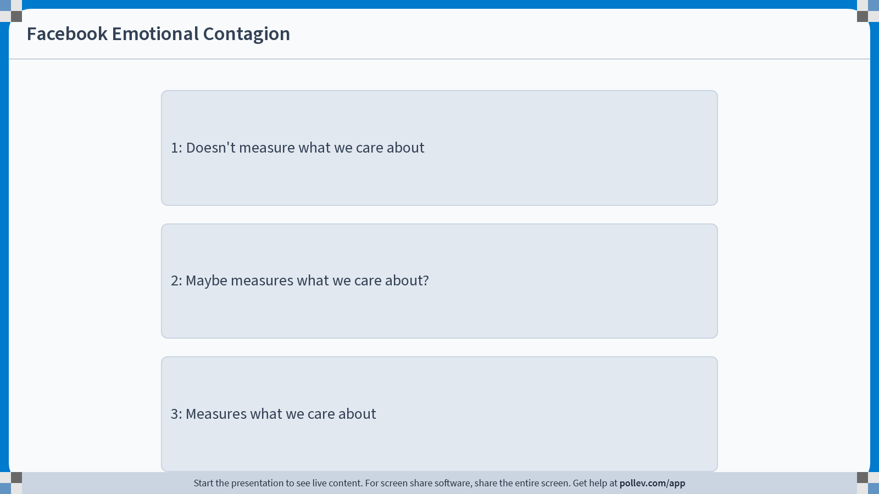
Notes:
Do not modify the notes in this section to avoid tampering with the Poll Everywhere activity. More info at polleverywhere.com/support Facebook Emotional Contagion
https://www.polleverywhere.com/multiple_choice_polls/S0OzecDxUN7kdWhotLVnf?display_state=chart&activity_state=opened&state=opened&flow=Engagement&onscreen=persist&hide=instructions

Slide 51
One concrete concern with construct validity in each?
GAIN (job training program in CA)
Perry Preschool Program (early childhood education program)
Racial Discrimination in the Sharing Economy (do Airbnb hosts discriminate?)
Facebook Emotional Contagion (does emotional contagion happen online?)

Slide 52
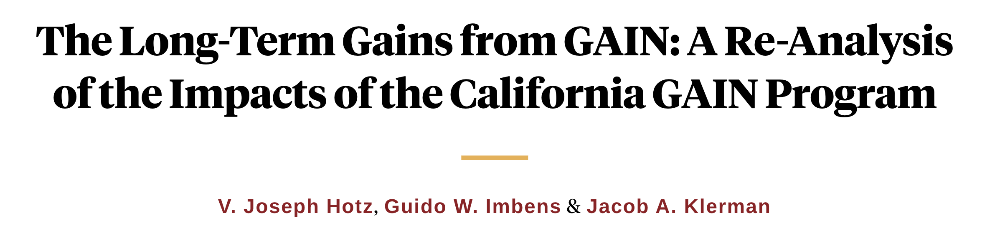
Longer-Term Results*
*Simplified ☺
=Statistically significant (p=0.01)
Los Angeles (Human Capital first)
Riverside (Jobs first)
Control
Group
Treatment Group
Percentage difference
Control
Group
Treatment Group
Percentage difference
1-3 yrs
24.5%
26.1%
+7%
35.3%
49%
+39%
What fraction were employed at all that year?
3-5 yrs
25.8%
29.2%
+13%
33.5%
40.4%
+21%
5-7 yrs
33.1%
36.9%
+11%
37.8%
39.3%
+4%
Annual earnings (in 1999 dollars)
1-3 yrs
$1,849
$1,843
+0%
$2,253
$3,668
+63%
3-5 yrs
$2,493
$2,615
+5%
$3,201
$4,363
+36%
5-7 yrs
$3,386
$3,689
+9%
$4,171
$4,585
+10%

Slide 53
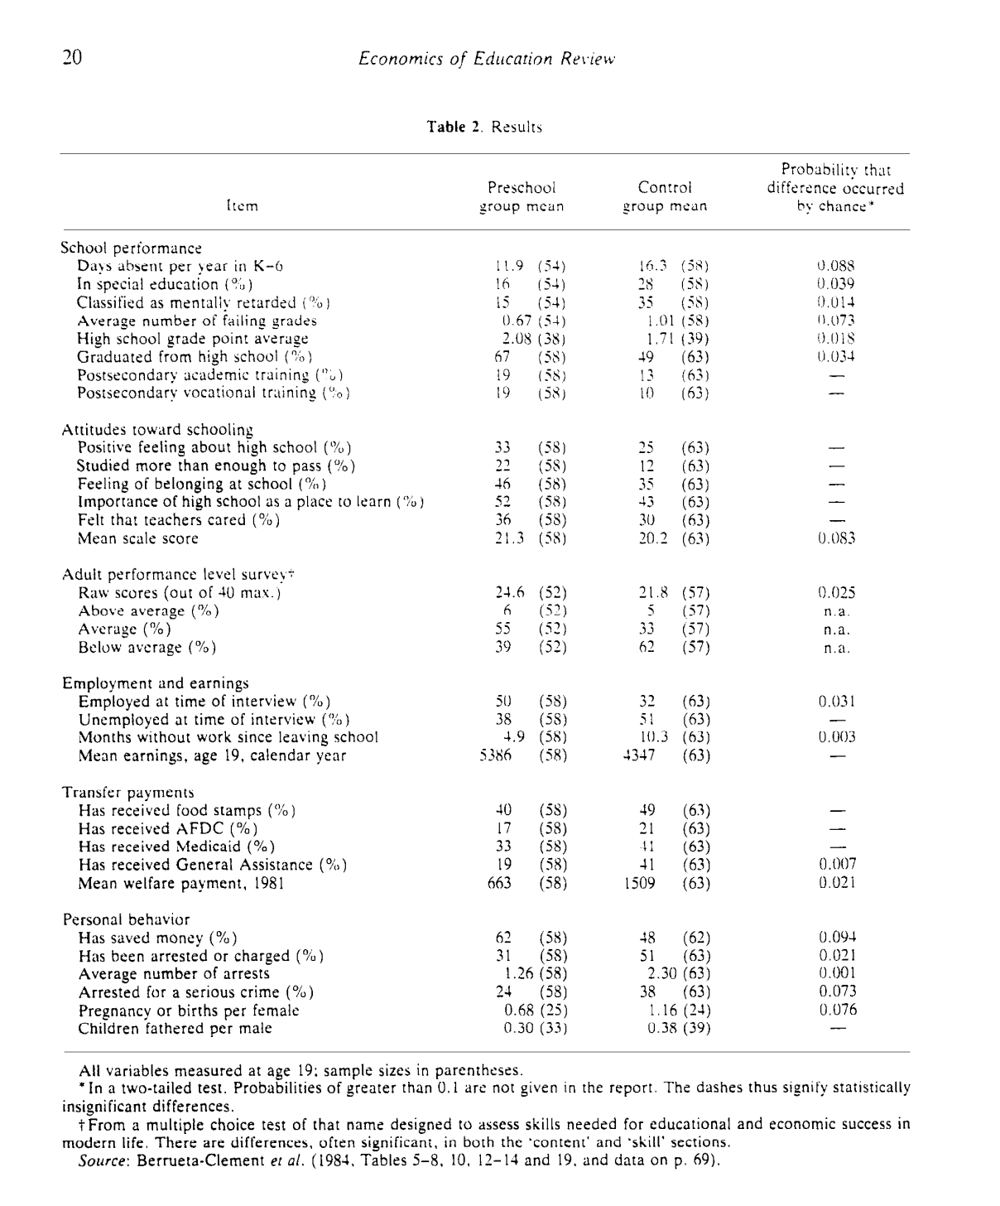
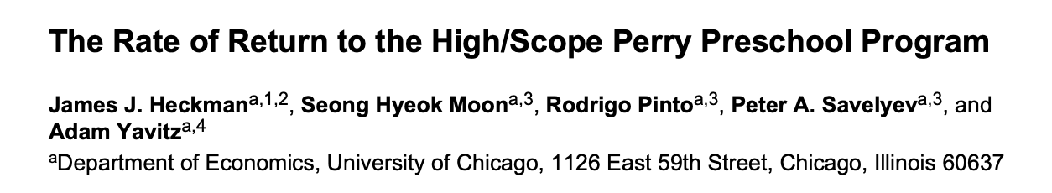
Even more outcomes for the Perry Preschool Experiment
Follow-up work has also tried to quantify how much money such a program would save.
“Each dollar invested returns in present value terms 7 to 12 dollars back to society”

Slide 54
Spillovers

Slide 55
Spillovers
When treating one individual “spills over” into affecting a non-treated individual, this can mess up how you interpret results.
Also called interference effects.

Slide 56






Stylized example Job placement program: helps workers find a job
We need 3 workers.
5 people need a job:
Put no one in the job placement program
3/5 of people get a job.

Slide 57
Stylized example Job placement program: helps workers find a job
We need 3 workers.
5 people need a job:
Put no one in the job placement program
3/5 of people get a job.
Randomly assign 2 people to the program
Everyone in the treatment group finds a job!
Only 1/3 of the control group finds a job.
The program looks like it helps a lot! ☺

Slide 58
Stylized example Job placement program: helps workers find a job
We need 3 workers.
5 people need a job:
Put no one in the job placement program
3/5 of people get a job.
Randomly assign 2 people to the program
Everyone in the treatment group finds a job!
Only 1/3 of the control group finds a job.
The program looks like it helps a lot! ☺
Put everyone in the program
3/5 of people get a job….the program doesn’t help ☹
This is an example of spillovers: Someone else being in the treatment group negatively affects people in the control group.

Slide 59
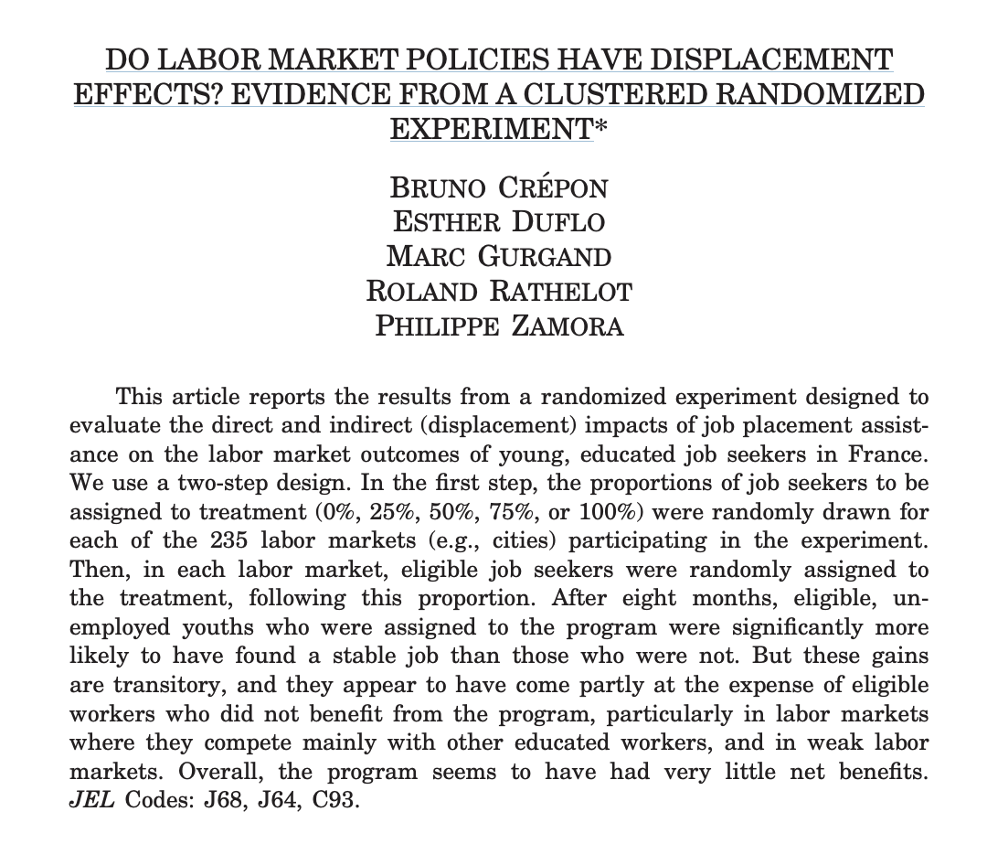
There’s evidence that this happens
Quarterly Journal of Economics, 2013

Slide 60
Spillovers
Discuss!
Rate each of our four experiments on spillovers:
1) Very concerned about spillovers
2) Somewhat concerned about spillovers
3) Not concerned about spillovers
What is one potential concern with spillovers for each experiment?
GAIN (job training program in CA)
Perry Preschool Program (early childhood education program)
Racial Discrimination in the Sharing Economy (do Airbnb hosts discriminate?)
Facebook Emotional Contagion (does emotional contagion happen online?)

Slide 61
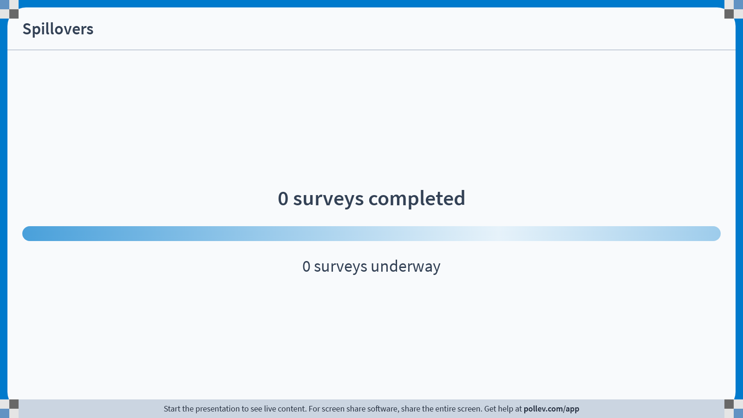
Notes:
Do not modify the notes in this section to avoid tampering with the Poll Everywhere activity. More info at polleverywhere.com/support Spillovers
https://www.polleverywhere.com/surveys/30cCRLDScNkv3AIB7ujLx?display_state=chart&activity_state=opened&state=opened&flow=Engagement&onscreen=persist

Slide 62
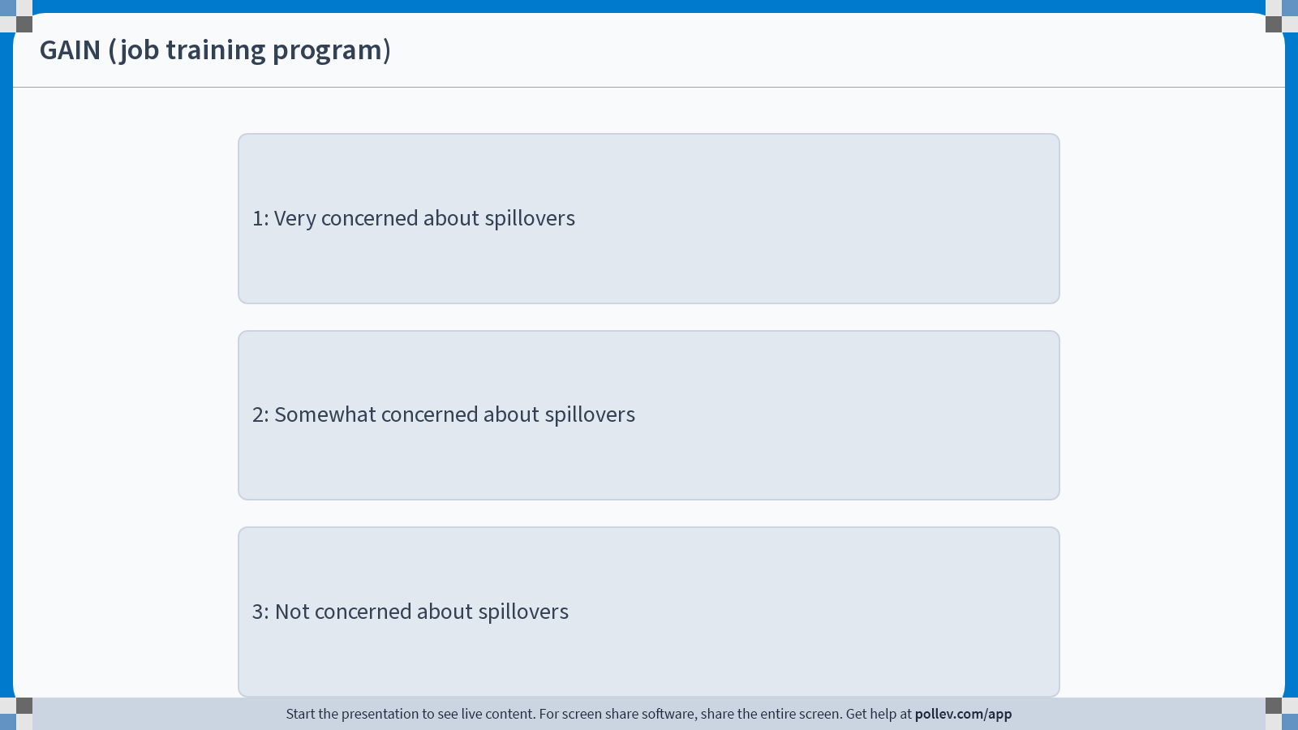
Notes:
Do not modify the notes in this section to avoid tampering with the Poll Everywhere activity. More info at polleverywhere.com/support GAIN (job training program)
https://www.polleverywhere.com/multiple_choice_polls/MfT8nabLrDK0veiml6mBh?display_state=chart&activity_state=opened&state=opened&flow=Engagement&onscreen=persist&hide=instructions

Slide 63

Notes:
Do not modify the notes in this section to avoid tampering with the Poll Everywhere activity. More info at polleverywhere.com/support Perry Preschool Program
https://www.polleverywhere.com/multiple_choice_polls/81UShyCnxkhjuNOVFa0oA?display_state=chart&activity_state=opened&state=opened&flow=Engagement&onscreen=persist&hide=instructions

Slide 64
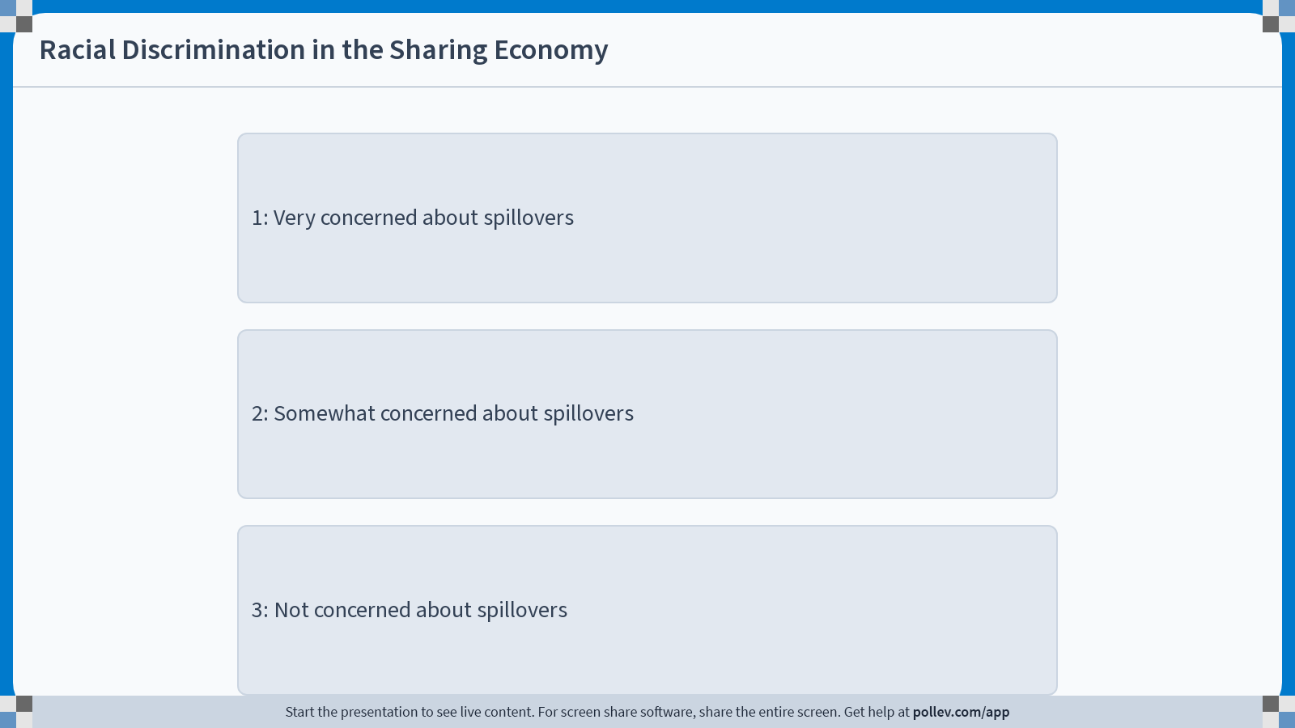
Notes:
Do not modify the notes in this section to avoid tampering with the Poll Everywhere activity. More info at polleverywhere.com/support Racial Discrimination in the Sharing Economy
https://www.polleverywhere.com/multiple_choice_polls/hp3eDLIhRFBlax6sw2Ozd?display_state=chart&activity_state=opened&state=opened&flow=Engagement&onscreen=persist&hide=instructions

Slide 65
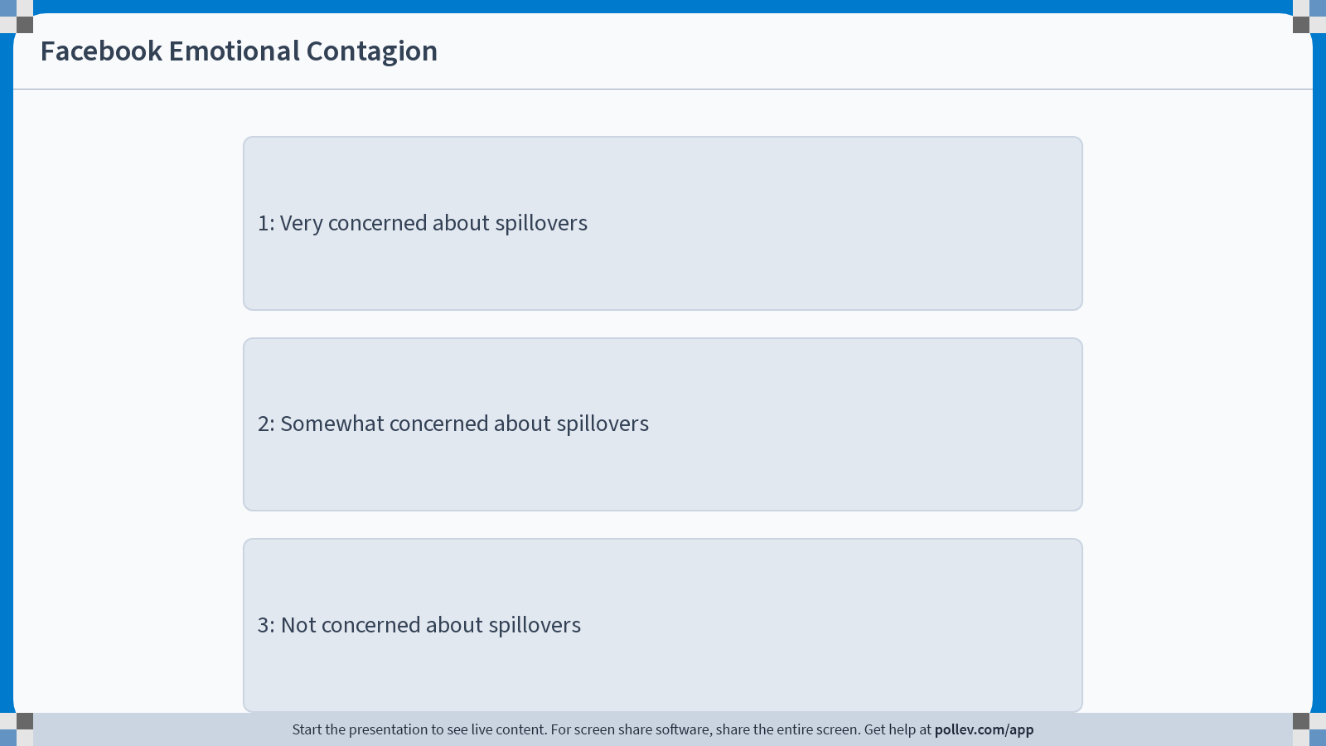
Notes:
Do not modify the notes in this section to avoid tampering with the Poll Everywhere activity. More info at polleverywhere.com/support Facebook Emotional Contagion
https://www.polleverywhere.com/multiple_choice_polls/5ilsEEMIxncQcOkflDe40?display_state=chart&activity_state=opened&state=opened&flow=Engagement&onscreen=persist&hide=instructions

Slide 66
One concrete concern with spillovers in each?
GAIN (job training program in CA)
Perry Preschool Program (early childhood education program)
Racial Discrimination in the Sharing Economy (do Airbnb hosts discriminate?)
Facebook Emotional Contagion (does emotional contagion happen online?)

Slide 67
Ethical Concerns

Slide 68


Ethical Concerns
Sometimes a randomized experiment might not be ethical…
I mean, I’m glad I’m in the treatment group, but is this really necessary?
I’m going to do an RCT to see if parachutes work!

Slide 69
More serious examples
Laptop experiment:
If we really believe that laptops hurt student learning, is it ethical to let half of students use laptops in class?
Is it ethical to purposely give half of students a different experience than another half?
Is it ethical to not give students a choice?
Medical RCTs are very tightly regulated
But, say, RCTs that tech companies do are not

Slide 70
Ethical Concerns
Discuss!
Rate each of our four experiments on ethics:
1) Major ethical concerns
2) Some ethical concerns
3) No ethical concerns
What is one potential ethical concern for each experiment?
GAIN (job training program in CA)
Perry Preschool Program (early childhood education program)
Racial Discrimination in the Sharing Economy (do Airbnb hosts discriminate?)
Facebook Emotional Contagion (does emotional contagion happen online?)

Slide 71
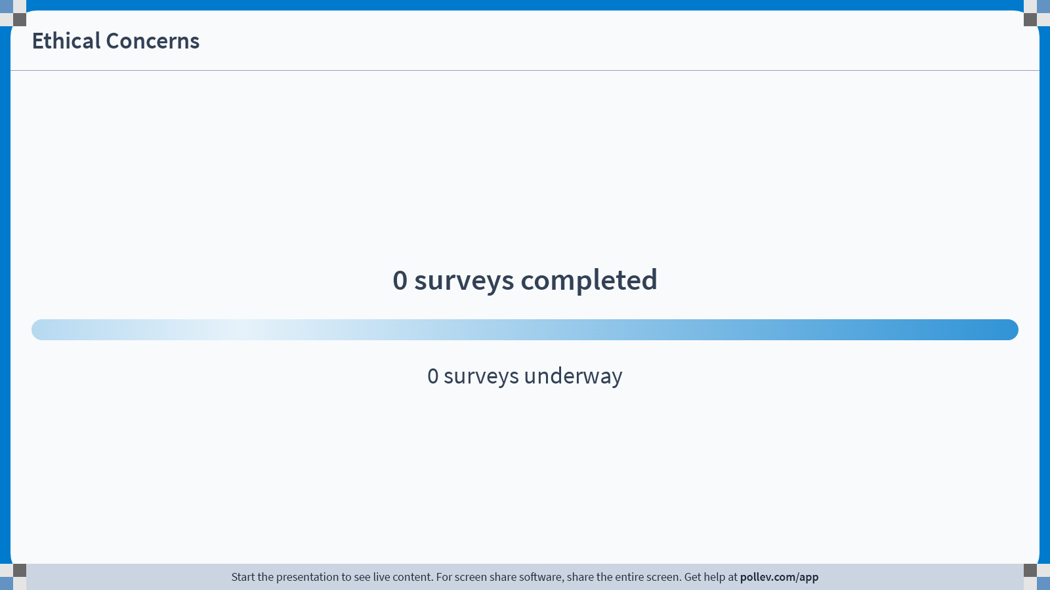
Notes:
Do not modify the notes in this section to avoid tampering with the Poll Everywhere activity. More info at polleverywhere.com/support Ethical Concerns
https://www.polleverywhere.com/surveys/j15Y713PtRtp1ykWiwGiI?display_state=chart&activity_state=opened&state=opened&flow=Engagement&onscreen=persist

Slide 72
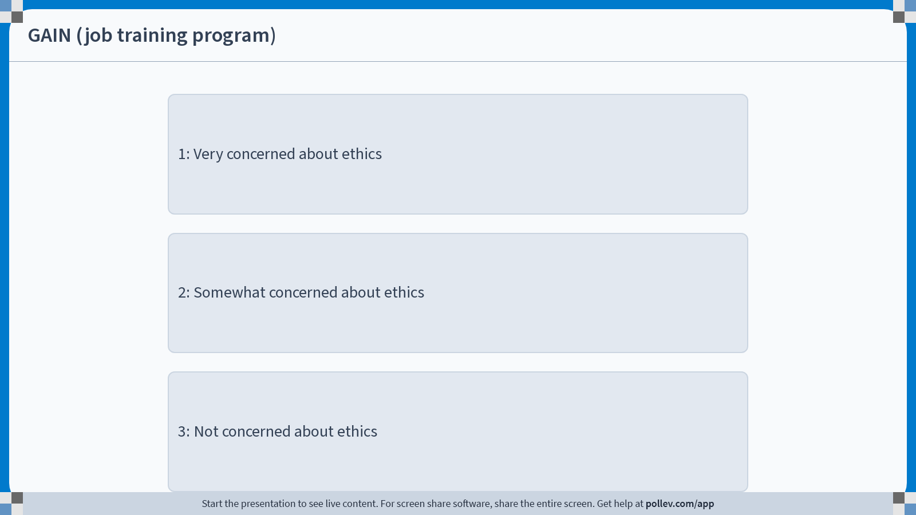
Notes:
Do not modify the notes in this section to avoid tampering with the Poll Everywhere activity. More info at polleverywhere.com/support GAIN (job training program)
https://www.polleverywhere.com/multiple_choice_polls/pMjJ9Pytyrn5vOrN3SfmY?display_state=chart&activity_state=opened&state=opened&flow=Engagement&onscreen=persist&hide=instructions

Slide 73
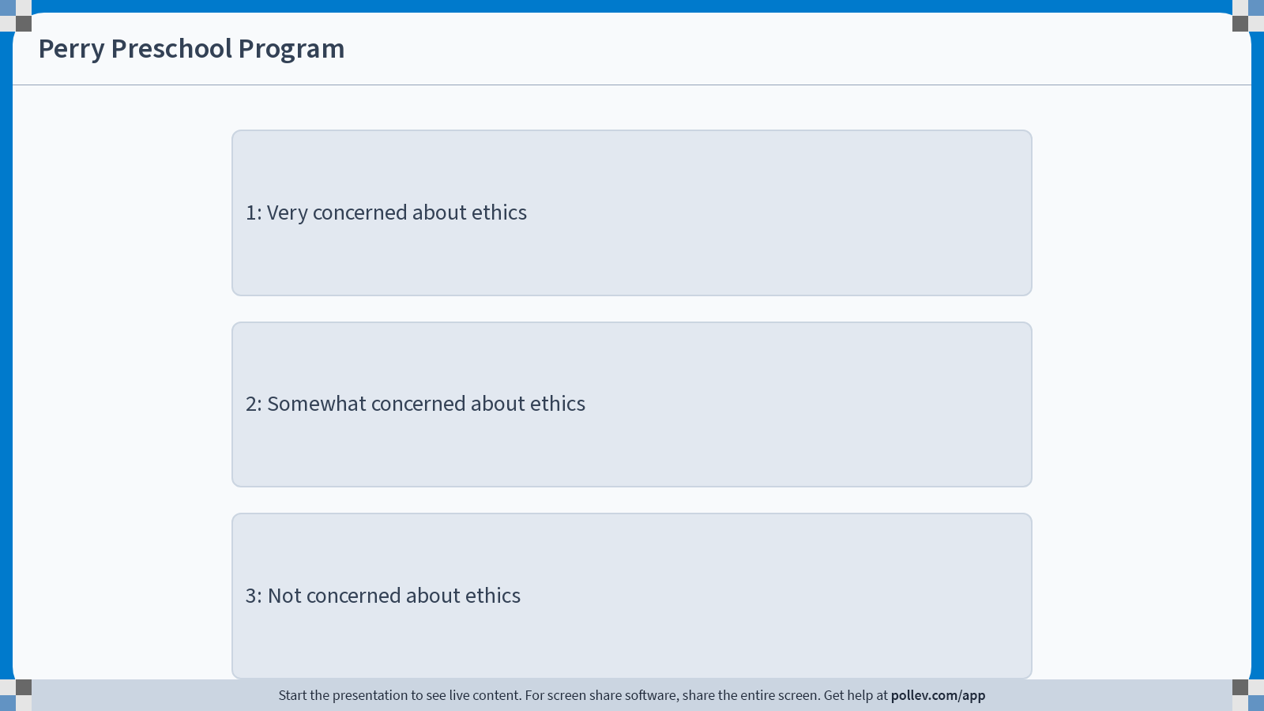
Notes:
Do not modify the notes in this section to avoid tampering with the Poll Everywhere activity. More info at polleverywhere.com/support Perry Preschool Program
https://www.polleverywhere.com/multiple_choice_polls/kB19ViGNfqN6LIdlwxzsP?display_state=chart&activity_state=opened&state=opened&flow=Engagement&onscreen=persist&hide=instructions

Slide 74
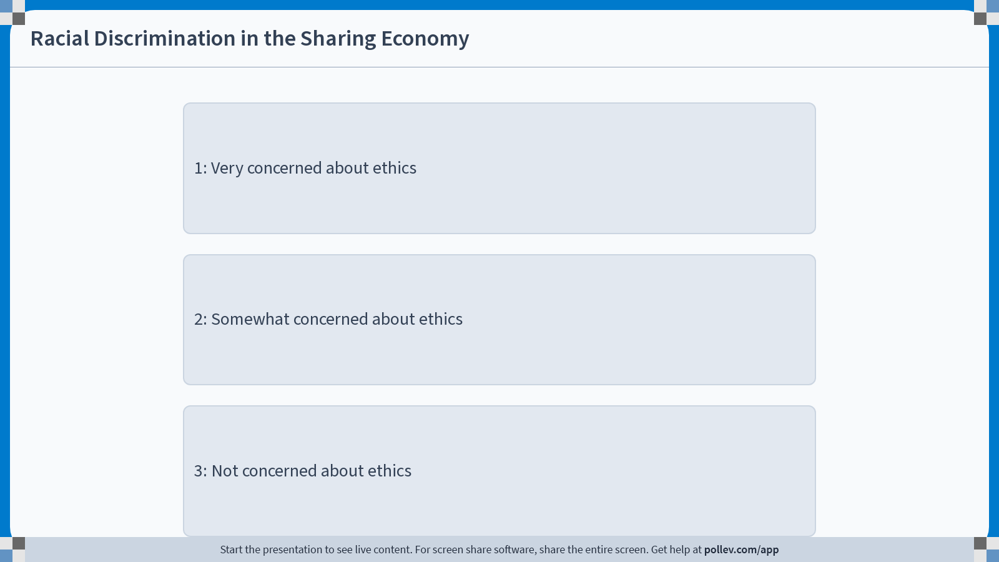
Notes:
Do not modify the notes in this section to avoid tampering with the Poll Everywhere activity. More info at polleverywhere.com/support Racial Discrimination in the Sharing Economy
https://www.polleverywhere.com/multiple_choice_polls/8T4lBLas6zzhP8OQmnCB3?display_state=chart&activity_state=opened&state=opened&flow=Engagement&onscreen=persist&hide=instructions

Slide 75
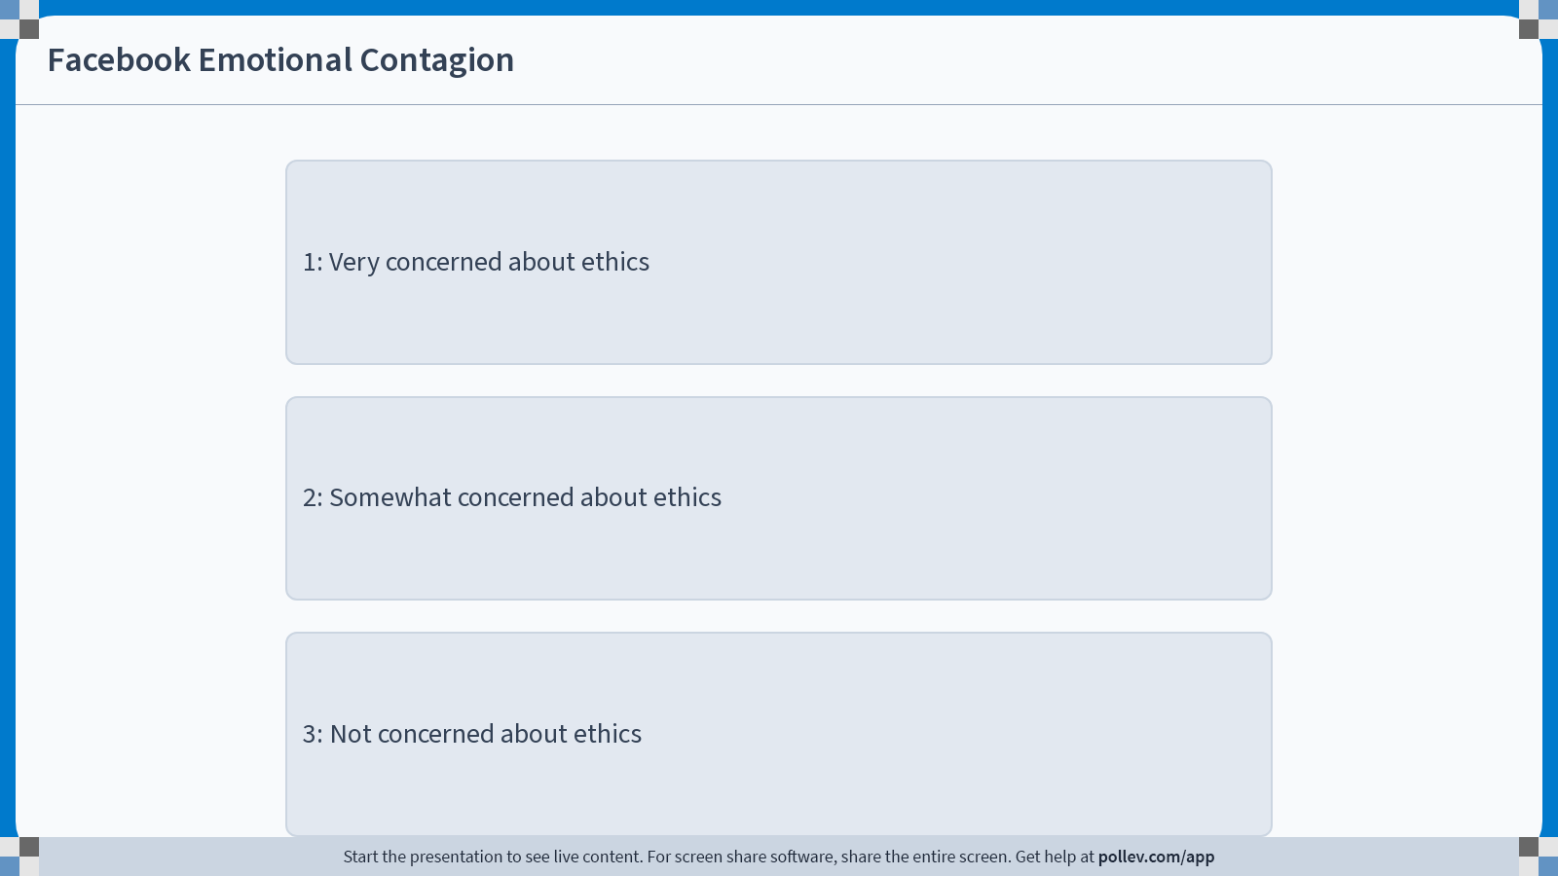
Notes:
Do not modify the notes in this section to avoid tampering with the Poll Everywhere activity. More info at polleverywhere.com/support Facebook Emotional Contagion
https://www.polleverywhere.com/multiple_choice_polls/XfHEDRzXpW4KRUd62AqFS?display_state=chart&activity_state=opened&state=opened&flow=Engagement&onscreen=persist&hide=instructions

Slide 76
One concrete ethical concern in each?
GAIN (job training program in CA)
Perry Preschool Program (early childhood education program)
Racial Discrimination in the Sharing Economy (do Airbnb hosts discriminate?)
Facebook Emotional Contagion (does emotional contagion happen online?)

Slide 77
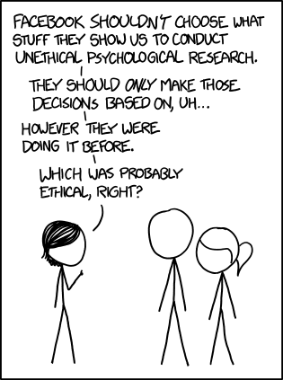
https://xkcd.com/1390/

Slide 78
To play devil’s advocate:
Shouldn’t tech companies try to understand the impact they have on users’ emotions?
Doesn’t that mean that it would be unethical not to run an RCT?
https://xkcd.com/1390/

Slide 79
Recap and Looking Ahead
Don’t forget to stick around until the exit ticket!

Slide 80
Recap
Four things to be concerned about with experiments:
External Validity
Construct Validity
Spillovers
Ethics
And we learned last time that we should be concerned about, say, doing good statistics!
Getting big enough sample sizes
Computing accurate standard errors, p-values, etc, and interpreting them thoughtfully

Slide 81
Side note
There are other things to be worried about with experiments!
Attrition
Non-Compliance
…
We’ll talk about these more later!

Slide 82
Next time
Adaptive Experiments!
And multi-armed bandits!

Slide 83
Before next time
Reading response!
HW1.1 due Monday!

Slide 84

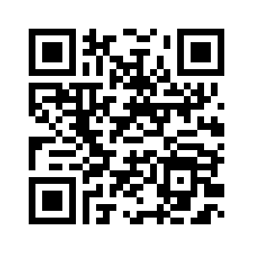
Exit ticket
Don’t forget to fill out the exit ticket before you leave class!

