Slide 1
Regression Discontinuity
Causality, Decision-Making, and Data Science
Lecture 13

Slide 2
Announcements
HW3.2 due Monday 11/10
Project check-ins due Monday 11/10!
By then you should have attended office hours with at least one of us to discuss your project.
A few people have been asking for slides to be posted before class
We don’t do that since we don’t want “spoilers” for the in-class discussions…
But they are posted right after class!

Slide 3
Agenda: Regression Discontinuity
0. Finishing up from last time: ML and IV!
Big picture
Mechanics
Two examples about the returns to education

Slide 4

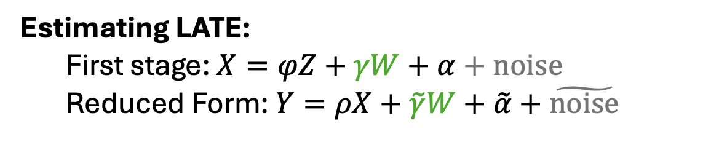


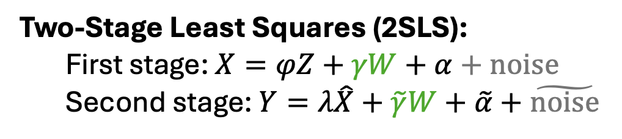

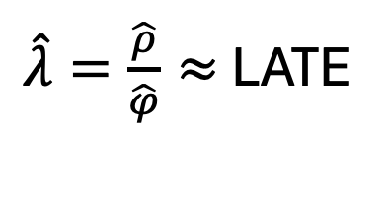
Recall: Instrumental Variables
$$Z$$
$$X$$
$$Y$$
Estimating LATE:
First stage: $X=φZ+γW+α+noise$
Reduced Form: $Y=ρX+\tilde{γ}W+\tilde{α}+\tilde{noise}$
$\hat{λ}=\frac{\hat{ρ}}{\hat{φ}}≈$ LATE
Equivalently…
Two-Stage Least Squares (2SLS):
First stage: $X=φZ+γW+α+noise$
Second stage: $Y=λ\hat{X}+\tilde{γ}W+\tilde{α}+\tilde{noise}$

Slide 5
ML Methods for IV
Abbreviated – check out slides from last time for (a few) more details!
[The point is to give you a flavor and some pointers to the literature]

Slide 6
Two questions
How can we use ML to analyze instruments?
How can we use ML to identify instruments?

Slide 7

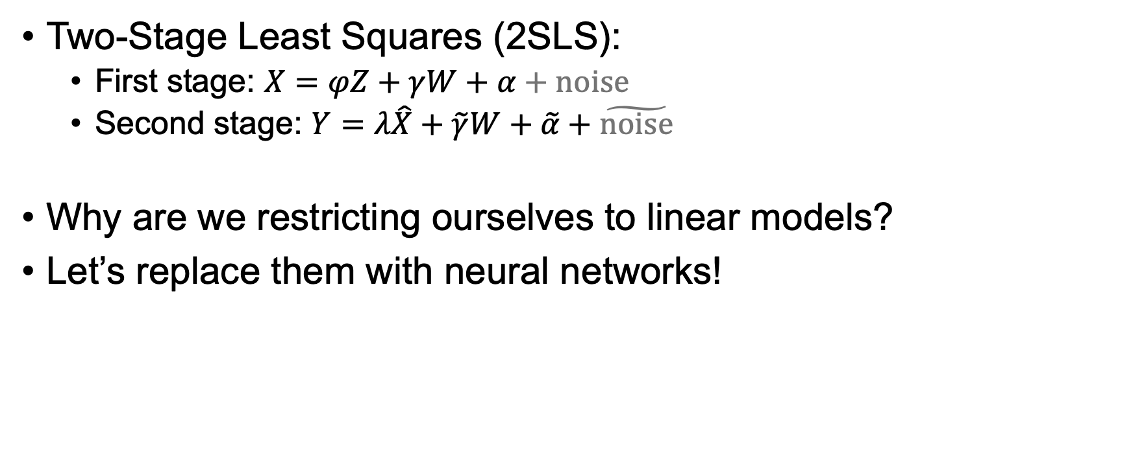
The story so far
Two-Stage Least Squares (2SLS):
First stage: $X=φZ+γW+α+noise$
Second stage: $Y=λ\hat{X}+\tilde{γ}W+\tilde{α}+\tilde{noise}$
Why are we restricting ourselves to linear models?
Let’s replace them with neural networks!
There are often good reasons to restrict to simpler models – e.g. to prevent over-fitting – but let’s say we have tons of data and want to take advantage of it.

Slide 8
Aside: Neural Networks
Each edge has a “weight” that tells the network how to propagate values from the input to the output.
A neural network is a function that looks something* like this:
Inputs
Output
*very simplified, relative to current state of the art…

Slide 9
Aside: Neural Networks
Each edge has a “weight” that tells the network how to propagate values from the input to the output.
A neural network is a function that looks something* like this
If you give it a bunch of examples of (Input, Output) pairs, it can “learn” weights to predict future examples.
“Learn” = “Solve an optimization problem to find the best weights”
Inputs
Output
*very simplified, relative to current state of the art…

Slide 10
Aside: Neural Networks
Each edge has a “weight” that tells the network how to propagate values from the input to the output.
A neural network is a function that looks something* like this
If you give it a bunch of examples of (Input, Output) pairs, it can “learn” weights to predict future examples.
“Learn” = “Solve an optimization problem to find the best weights”
This gives us a non-parametric way of describing a function.
…but it’s not very interpretable…
Inputs
Output
*very simplified, relative to current state of the art…

Slide 11
The story so far
Two-Stage Least Squares (2SLS):
First stage: $X=φZ+γW+α+noise$
Second stage: $Y=λ\hat{X}+\tilde{γ}W+\tilde{α}+\tilde{noise}$
Why are we restricting ourselves to linear models?
Let’s replace them with neural networks!
There are often good reasons to restrict to simpler models – e.g. to prevent over-fitting – but let’s say we have tons of data and want to take advantage of it.

Slide 12

The story so far
Two-Stage Least Squares (2SLS):
First stage: $X=φZ+γW+α+noise$
Second stage: $Y=λ\hat{X}+\tilde{γ}W+\tilde{α}+\tilde{noise}$
Why are we restricting ourselves to linear models?
Let’s replace them with neural networks!
But how?
There are often good reasons to restrict to simpler models – e.g. to prevent over-fitting – but let’s say we have tons of data and want to take advantage of it.
Notes:
In the first stage and second stage above, the thing we care about (lambda) is parameter in our model. NNs are essentially non-parametric... So how do we do that?

Slide 13
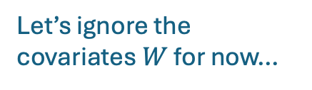
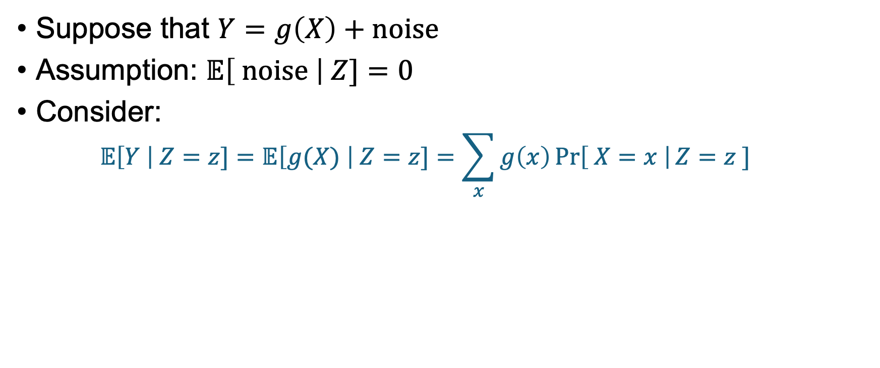
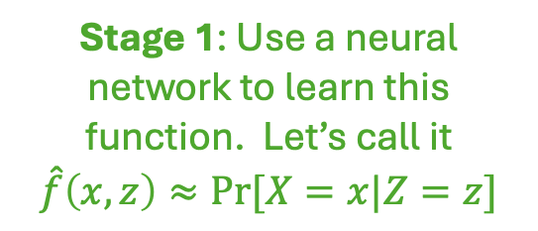



One way to use (D)NNs to approximate LATE Loosely following [Hartford, Lewis, Leyton-Brown, Taddy, 2017]
$$Z$$
$$X$$
$$Y$$
Let’s ignore the covariates $W$ for now…
Suppose that $Y=g\left(X\right)+noise$
Assumption: $𝔼\left[ noise \right| Z]=0$
Consider:
$$𝔼\left[Y \right| Z=z]=𝔼\left[g(X) \right| Z=z]=\sum_{x}{g\left(x\right)\operatorname{Pr}\left[ X=x \right|Z=z ]}$$
Plug in $Y$
Definition of $𝔼$
Stage 1: Use a neural network to learn this function. Let’s call it
$$\hat{f}\left(x,z\right)≈Pr[X=x|Z=z]$$
We know this! We see both $Y_{i}$ and $Z_{i}$ for each $i$
Notes:
LHS: Expected earnings, given that you were born in Q2
First stage: Probability that you got 10 years of schooling, conditional on being born in Q2

Slide 14

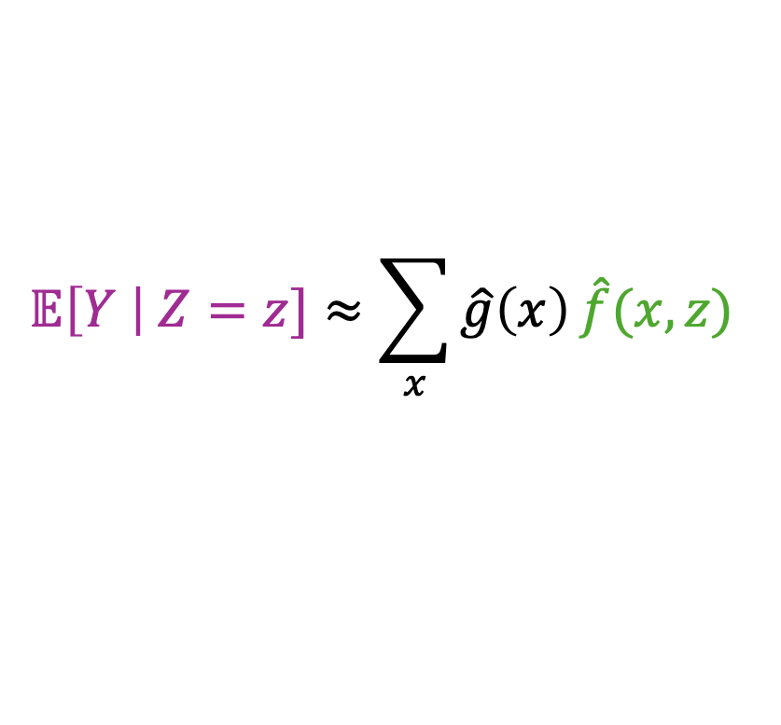

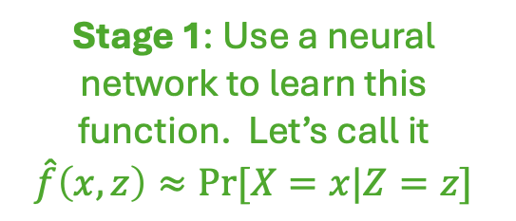
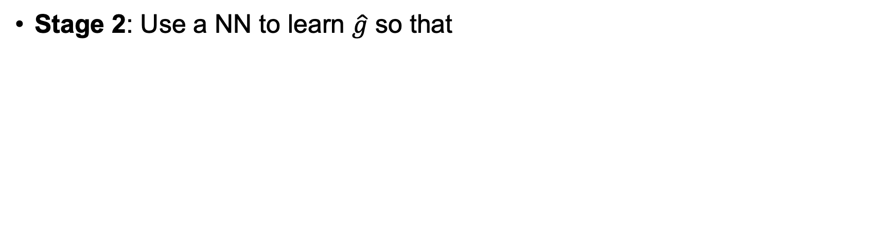

One way to use (D)NNs to approximate LATE Loosely following [Hartford, Lewis, Leyton-Brown, Taddy, 2017]
$$Z$$
$$X$$
$$Y$$
Let’s ignore the covariates $W$ for now…
Suppose that $Y=g\left(X\right)+noise$
Assumption: $𝔼\left[ noise \right| Z]=0$
Consider:
$$𝔼\left[Y \right| Z=z]=𝔼\left[g(X) \right| Z=z]=\sum_{x}{g\left(x\right)\operatorname{Pr}\left[ X=x \right|Z=z ]}$$
Plug in $Y$
Definition of $𝔼$
Stage 1: Use a neural network to learn this function. Let’s call it
$$\hat{f}\left(x,z\right)≈Pr[X=x|Z=z]$$
Stage 2: Use a NN to learn $\hat{g}$ so that
$$𝔼\left[Y \right| Z=z]≈\sum_{x}{\hat{g}\left(x\right)}\hat{f}(x,z)$$

Slide 15
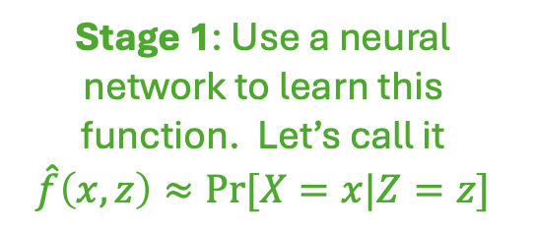
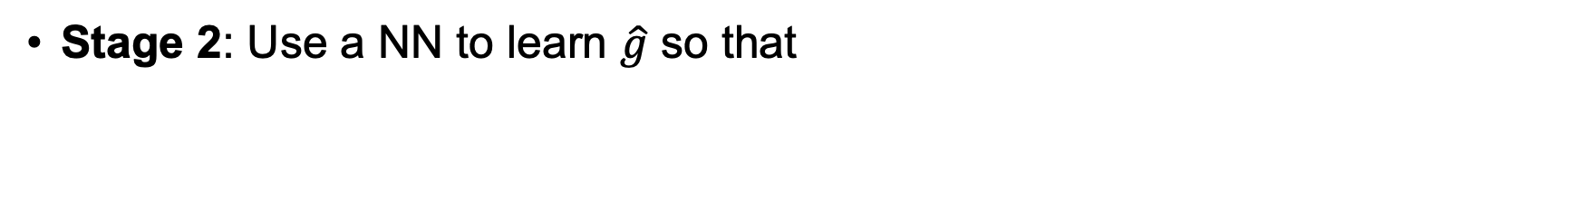

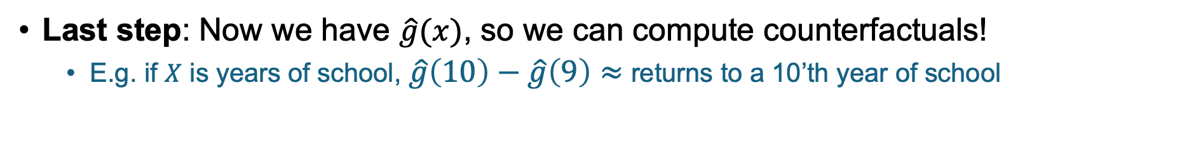
One way to use (D)NNs to approximate LATE Loosely following [Hartford, Lewis, Leyton-Brown, Taddy, 2017]
$$Z$$
$$X$$
$$Y$$
Let’s ignore the covariates $W$ for now…
Suppose that $Y=g\left(X\right)+noise$
Assumption: $𝔼\left[ noise \right| Z]=0$
Consider:
$$𝔼\left[Y \right| Z=z]=𝔼\left[g(X) \right| Z=z]=\sum_{x}{g\left(x\right)\operatorname{Pr}\left[ X=x \right|Z=z ]}$$
Plug in $Y$
Definition of $𝔼$
Stage 1: Use a neural network to learn this function. Let’s call it
$$\hat{f}\left(x,z\right)≈Pr[X=x|Z=z]$$
Stage 2: Use a NN to learn $\hat{g}$ so that
$$𝔼\left[Y \right| Z=z]≈\sum_{x}{\hat{g}\left(x\right)}\hat{f}(x,z)$$
Last step: Now we have $\hat{g}(x)$, so we can compute counterfactuals!
E.g. if $X$ is years of school, $\hat{g}\left(10\right)−\hat{g}\left(9\right)≈$ returns to a 10’th year of school

Slide 16
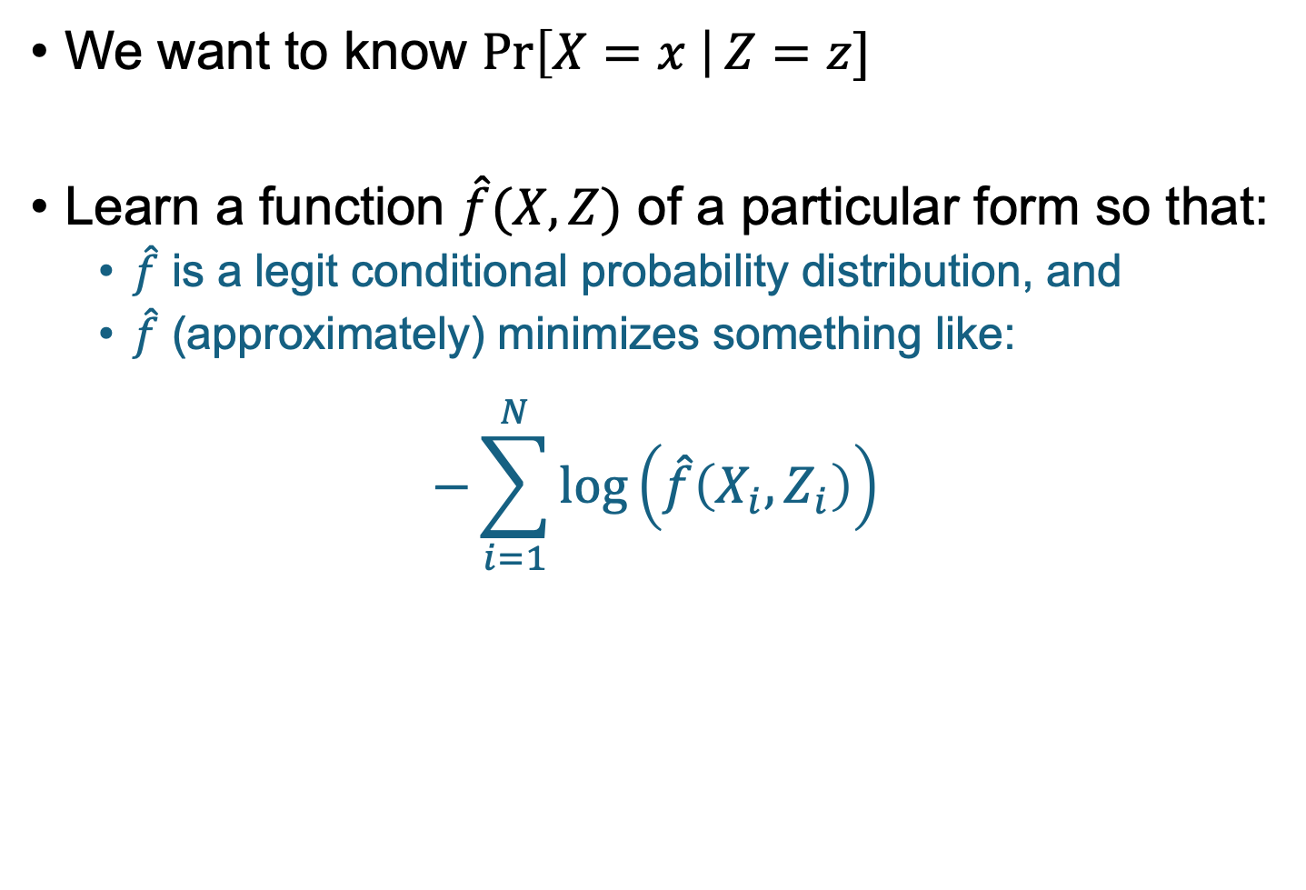

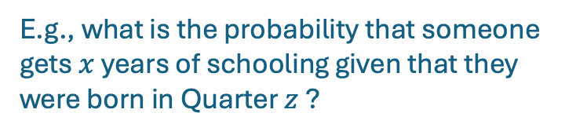
A bit more detail Stage 1
E.g., what is the probability that someone gets $x$ years of schooling given that they were born in Quarter $z$ ?
We want to know $\operatorname{Pr}\left[X=x \right|Z=z]$
Learn a function $\hat{f}(X,Z)$ of a particular form so that:
$\hat{f}$ is a legit conditional probability distribution, and
$\hat{f}$ (approximately) minimizes something like:
$$−\sum_{i=1}^{N}{\log\left(\hat{f}\left(X_{i},Z_{i}\right)\right) }$$
Intuition:
If $(x,z)$ shows up a lot, then this objective function “wants” $f(x,z)$ to be close to 1, so that $−log⁡(f\left(x,z\right))$ isn’t too big.
If $(x,z)$ doesn’t show up a lot, then this objective function is okay with $f(x,z)$ being pretty small.
Notes:
Formally, we put a softmax at the end of f, so we have f(x,z) = exp( h(x,z) ) / \sum_x exp( h(x,z) ), so for any fixed z it’s a legit dist on x

Slide 17
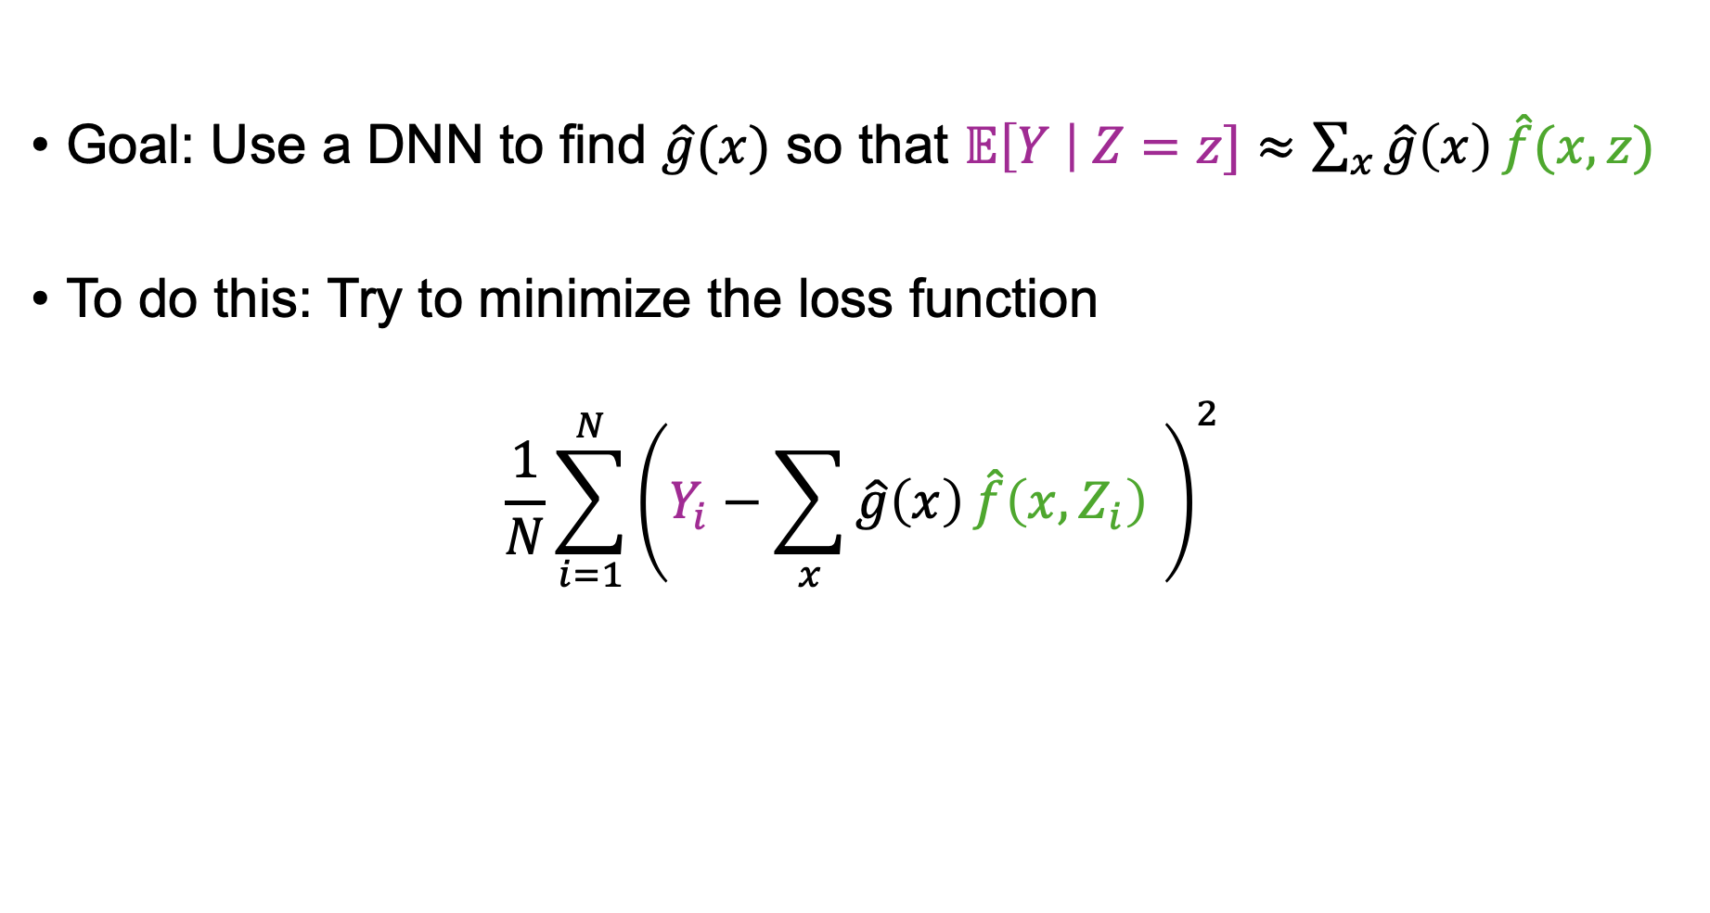
A bit more detail Stage 2
Goal: Use a DNN to find $\hat{g}(x)$ so that $𝔼\left[Y \right| Z=z]≈\sum_{x}{\hat{g}\left(x\right)}\hat{f}(x,z)$
To do this: Try to minimize the loss function
$$\frac{1}{N}{\sum_{i=1}^{N}{\left(Y_{i}−\sum_{x}{\hat{g}\left(x\right)}\hat{f}\left(x,Z_{i}\right) \right)}}^{2}$$
Notes:
Formally, we put a softmax at the end of f, so we have f(x,z) = exp( h(x,z) ) / \sum_x exp( h(x,z) ), so for any fixed z it’s a legit dist on x

Slide 18

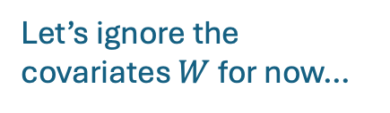

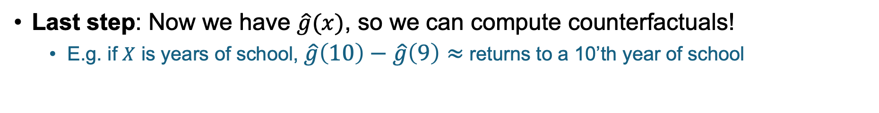
One way to use (D)NNs to approximate LATE Loosely following [Hartford, Lewis, Leyton-Brown, Taddy, 2017]
$$g(X,\vec{W})$$
$$Z$$
$$X$$
$$Y$$
Let’s ignore the covariates $W$ for now…
Suppose that $Y=g\left(X\right)+noise$
Assumption: $𝔼\left[ noise \right| Z]=0$
Consider:
$$𝔼\left[Y \right| Z=z]=𝔼\left[g(X) \right| Z=z]=\sum_{x}{g\left(x\right)\operatorname{Pr}\left[ X=x \right|Z=z ]}$$
If you want to include covariates, just throw them in at every step!
This lets us deal with heterogeneity.
Plug in $Y$
Definition of $𝔼$
Stage 1: Use a neural network to learn this function. Let’s call it
$$\hat{f}\left(x,z\right)≈Pr[X=x|Z=z]$$
Stage 2: Use a NN to learn $\hat{g}$ so that
$$𝔼\left[Y \right| Z=z]≈\sum_{x}{\hat{g}\left(x\right)}\hat{f}(x,z)$$
Last step: Now we have $\hat{g}(x)$, so we can compute counterfactuals!
E.g. if $X$ is years of school, $\hat{g}\left(10\right)−\hat{g}\left(9\right)≈$ returns to a 10’th year of school
$\hat{g}\left(x=10, gender=F\right)−\hat{g}(x=9,gender=F)$ $≈$ returns to a 10th year of education among women

Slide 19

One way to use (D)NNs to approximate LATE Loosely following [Hartford, Lewis, Leyton-Brown, Taddy, 2017]
$$g(X,\vec{W})$$
$$Z$$
$$X$$
$$Y$$
Let’s ignore the covariates $W$ for now…
Suppose that $Y=g\left(X\right)+noise$
Assumption: $𝔼\left[ noise \right| Z]=0$
Consider:
$$𝔼\left[Y \right| Z=z]=𝔼\left[g(X) \right| Z=z]=\sum_{x}{g\left(x\right)\operatorname{Pr}\left[ X=x \right|Z=z ]}$$
If you want to include covariates, just throw them in at every step!
This lets us deal with heterogeneity.
Plug in $Y$
Definition of $𝔼$
Stage 1: Use a neural network to learn this function. Let’s call it
$$\hat{f}\left(x,z\right)≈Pr[X=x|Z=z]$$
Stage 2: Use a NN to learn $\hat{g}$ so that
$$𝔼\left[Y \right| Z=z]≈\sum_{x}{\hat{g}\left(x\right)}\hat{f}(x,z)$$
$$\hat{g}(X,\vec{W})$$
Last step: Now we have $\hat{g}(x)$, so we can compute counterfactuals!
E.g. if $X$ is years of school, $\hat{g}\left(10\right)−\hat{g}\left(9\right)≈$ returns to a 10’th year of school
$\hat{g}\left(x=10, gender=F\right)−\hat{g}(x=9,gender=F)$ $≈$ returns to a 10th year of education among women

Slide 20
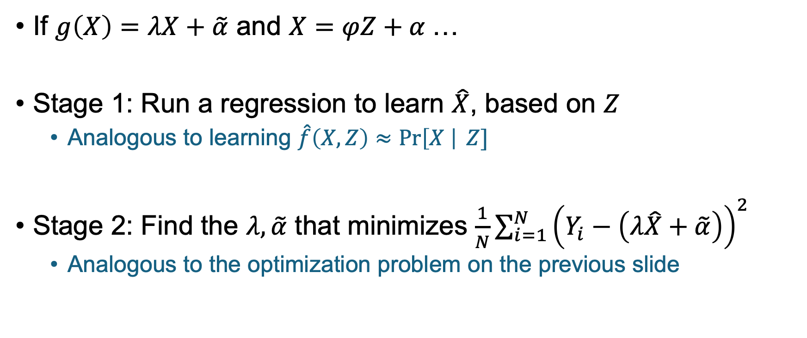
This generalizes 2SLS!
If $g\left(X\right)=λX+\tilde{α}$ and $X=φZ+α$…
Stage 1: Run a regression to learn $\hat{X}$, based on $Z$
Analogous to learning $\hat{f}\left(X,Z\right)≈\operatorname{Pr}\left[X \right| Z]$
Stage 2: Find the $λ,\tilde{α}$ that minimizes $\frac{1}{N}\sum_{i=1}^{N}{{\left(Y_{i}−\left(λ\hat{X}+\tilde{α}\right)\right)}^{2}}$
Analogous to the optimization problem on the previous slide

Slide 21
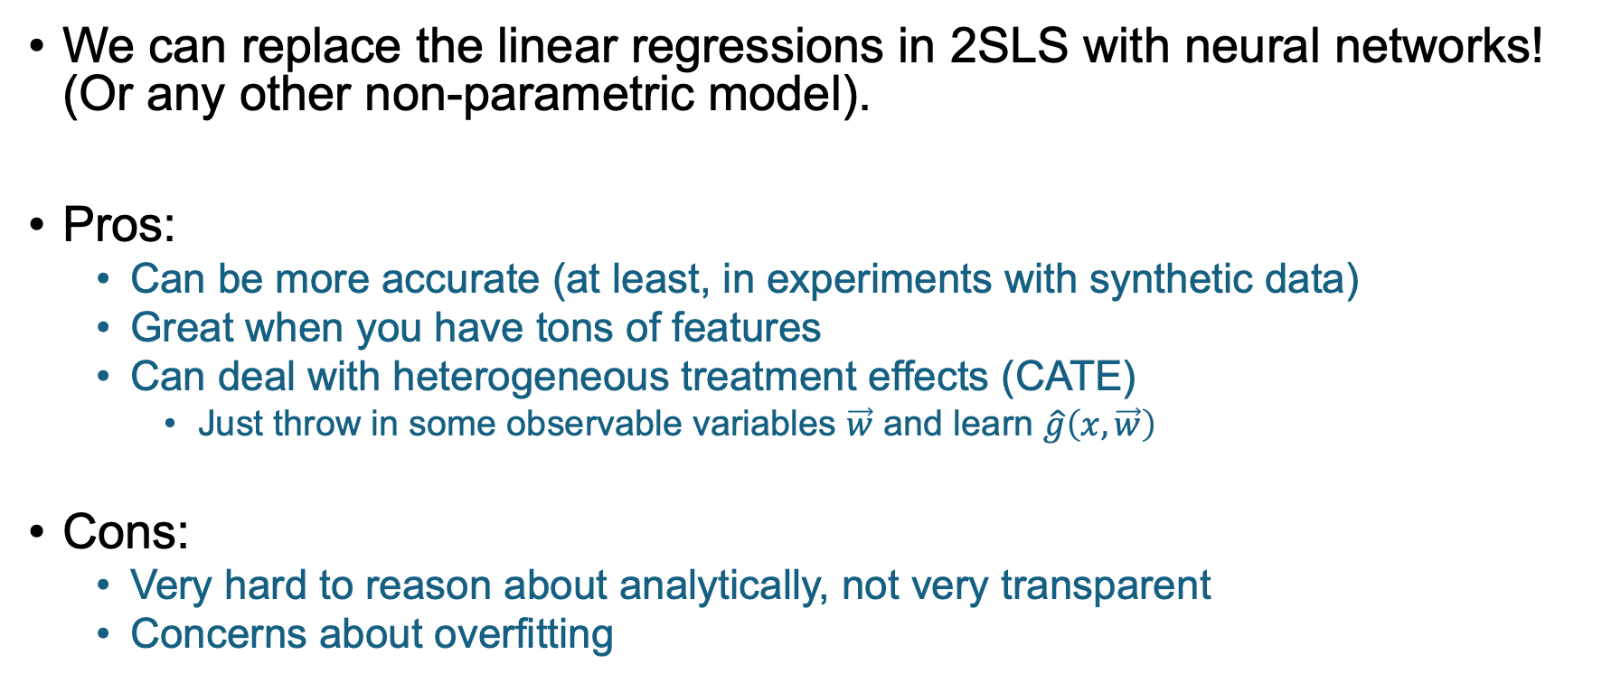
Take-Aways
We can replace the linear regressions in 2SLS with neural networks! (Or any other non-parametric model).
Pros:
Can be more accurate (at least, in experiments with synthetic data)
Great when you have tons of features
Can deal with heterogeneous treatment effects (CATE)
Just throw in some observable variables $\vec{w}$ and learn $\hat{g}\left(x,\vec{w}\right)$
Cons:
Very hard to reason about analytically, not very transparent
Concerns about overfitting
Notes:
We didn’t talk about heterogeneous treatment effects in the slides for simplicity, but just throw in a bunch of features w to learn g(x,w)

Slide 22
Two questions
How can we use ML to analyze instruments?
How can we use ML to identify instruments?

Slide 23
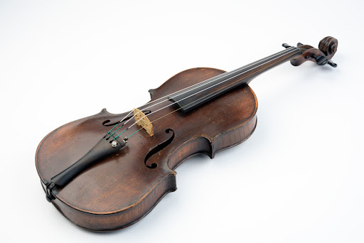
Where do we get good instruments?
Buy them at auction for $15M?

Slide 24
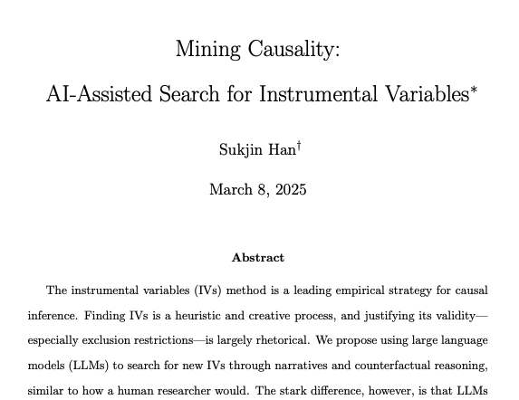
It’s hard to come up with instruments
Maybe ML can help?
Actual academic answer: “Let’s ask ChatGPT!”

Slide 25
Why might this be a good idea?
Coming up with good IVs and justifying them is an exercise in story-telling. (Especially the exclusion requirement)
Why doesn’t Z directly affect Y?
Can you come up with a story where Z might directly affect Y?
Etc.
LLMs can speed up the process by helping humans think up such stories.

Slide 26
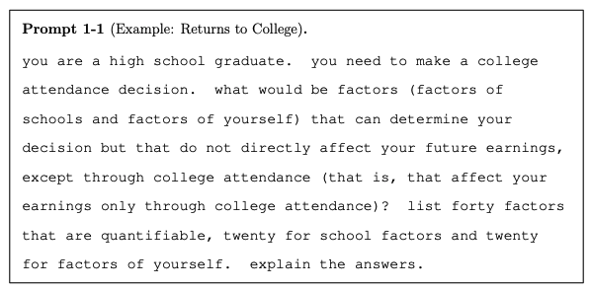
Example Prompt

Slide 27

Some suggestions in this paper (using ChatGPT4) Returns to attending college
Distance from home to college
Hey, that one looks familiar!
“This is purely geographical and independent of personal attributes”
Personal savings for education
“Largely determined by external economic conditions and family support.”
Number of siblings attending college
“Depends on family/siblings’ decisions, unrelated to the student’s personal characteristics”
Parents’ education
“A demographic factor that precedes the student’s own choices and abilities”
Religious affiliation
“A personal and family cultural factor, not a direct influence on personal academic or career potential.”
…

Slide 28
Some suggestions in this paper (using ChatGPT4) Returns to years of college
Credits required for graduation (at college attended)
“does not depend on your personal qualities or the quality of the school, but can determine the length of time you stay in school”
State education laws
“Laws mandating education until a certain age affect all students irrespective of individual abilities or school quality.”
Distance to nearest College/University
“doesn’t depend on your ability but can influence the decision to pursue further education”
Transportation Availability
“affects your ability to attend and continue education, independent of personal academic qualities or school resources”
Local unemployment rates
“might incentivize staying in school longer to defer entering a bad job market, a decision not influenced by personal academic prowess.”
…

Slide 29

From that paper
“This essay … merely serves as a starting point”
Do you think asking ChatGPT for this sort of thing is a good idea?
What sort of caveats do you have?

Slide 30
Agenda: Regression Discontinuity
0. Finishing up from last time: ML and IV!
Big picture
Mechanics
Two examples about the returns to education

Slide 31
Regression Discontinuity The big picture

Slide 32

Regression Discontinuity: Idea via example Suppose we want to measure returns to education (at College C)
College C admits students with a 1300 or higher on the SATs.
Hope: 1290 vs 1310 on the SATs is basically random.
Compare people just above and below the cut-off.
SAT: 1310
ln(earnings)
This is the “effect” of
going to College C
(among people close to the cutoff)
SAT: 1290
SAT Score
1300

Slide 33
Where else might RD come up?
Can you think of other examples where there are sharp cut-offs?
Not necessarily about education, could be medical, could be legal

Slide 34
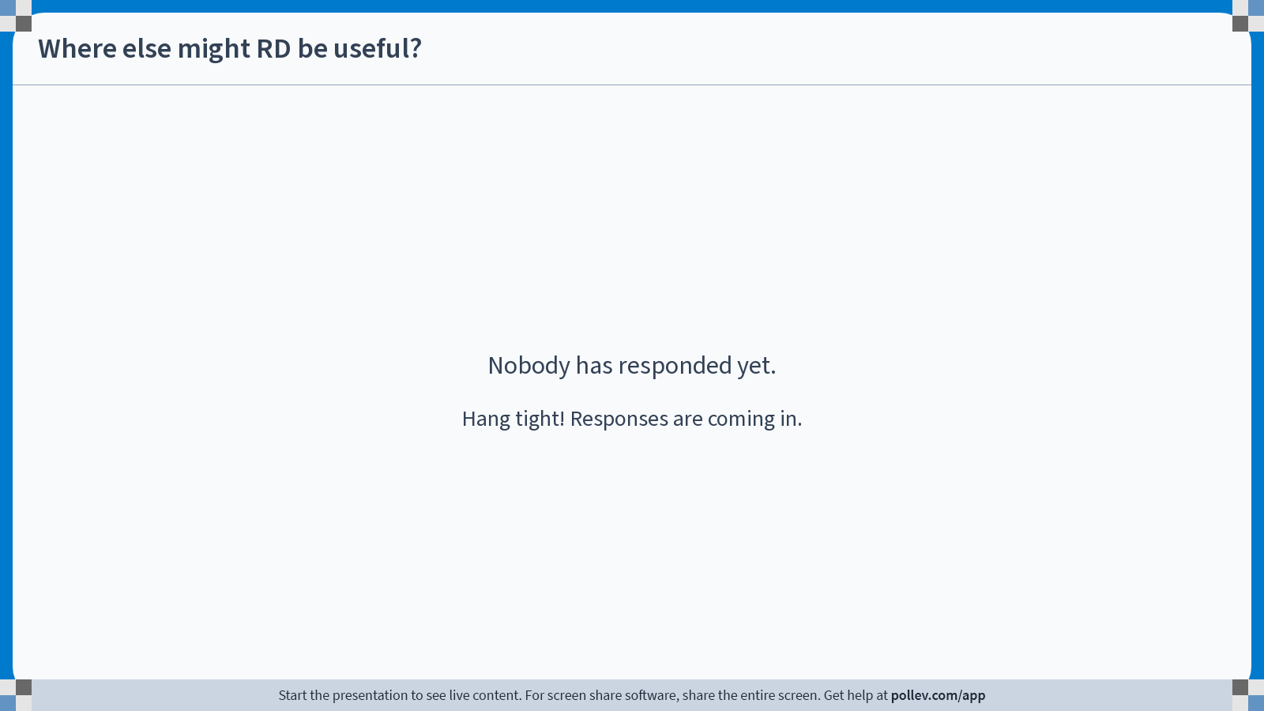
Notes:
Do not modify the notes in this section to avoid tampering with the Poll Everywhere activity. More info at polleverywhere.com/support Where else might RD be useful?
https://www.polleverywhere.com/free_text_polls/oodKW8BIc4wBc2gCCuDiq

Slide 35

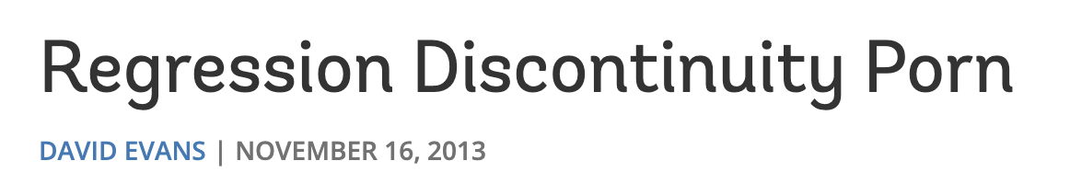
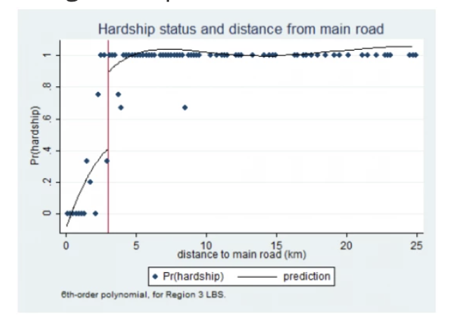
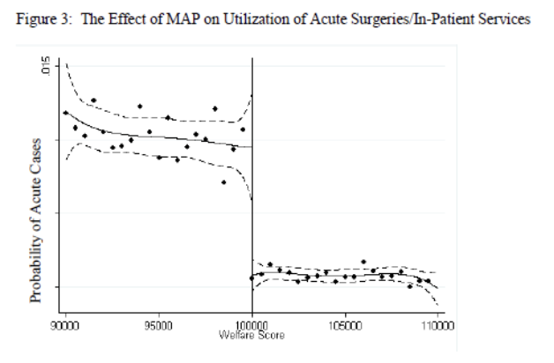
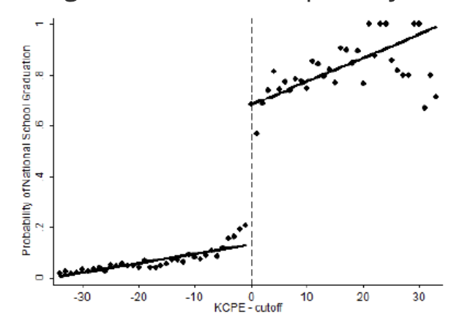
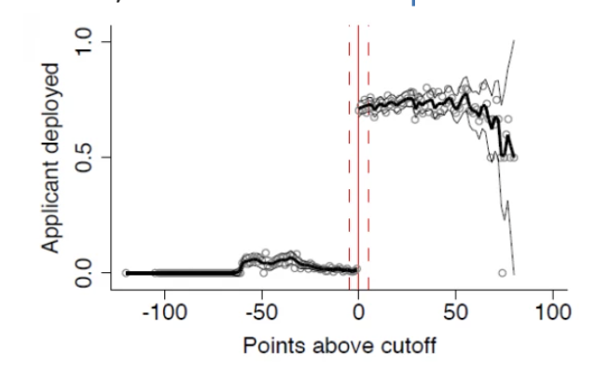
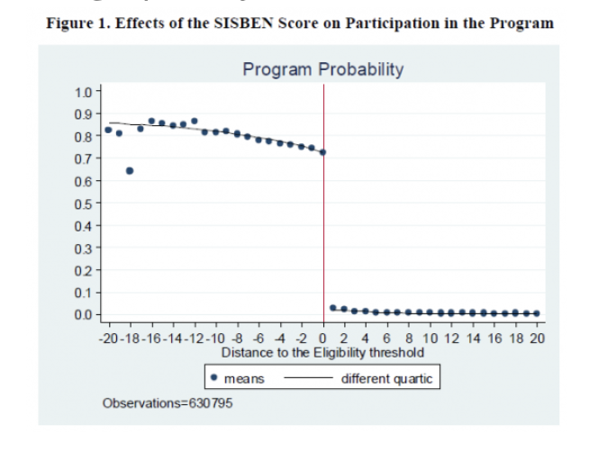
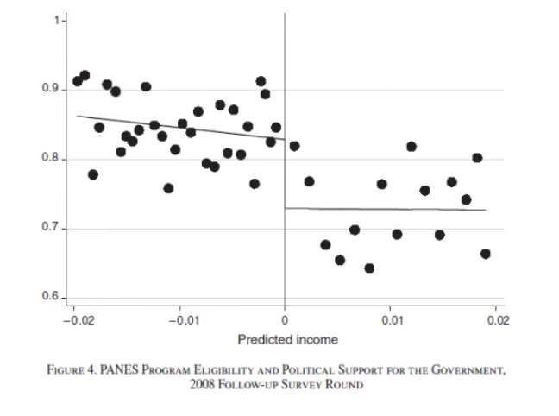
It comes up everywhere!
A few examples from
Students in Kenya need to pass a primary exam to enter secondary school
Teachers in Gambia received hardship allowance based on proximity to a main road.
There was a “welfare score” cut-off to get access to health insurance in Georgia
Hou & Chao (2008)
Mbiti & Lucas (2013)
Pugatch & Schroeder (2013)
There was a cutoff on a language test for workers in the Philippines to be allowed to travel to Korea
“Poor enough” people in Uruguay are eligible for benefits…and more likely to support the incumbent government!
“Poor enough” people in Columbia got a cash transfer as long as their children stay in school
Political support
Manacorda, Miguel, & Vigorito (2011)
Baez & Camacho (2011)
Clemens & Tiongson (2012)

Slide 36
A quick caveat before we get started…
Back to test scores, what would happen if the teachers grading the exams cared about the students and knew about the cut-offs?
They might grade differently around the cut-off!
Outcome
We need to be careful!
Is this causal??
Test Score
1300

Slide 37
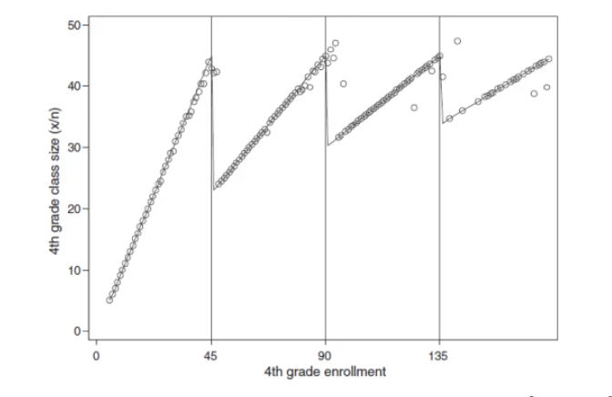
Another example
There are rules about classroom size limits, and this creates sharp changes in class size based on enrollment…
But it turns out that schools make different policy decisions around this!
E.g., schools might raise tuition to try to keep enrollment under 45.
Urquiola & Verhoogen (2009)

Slide 38
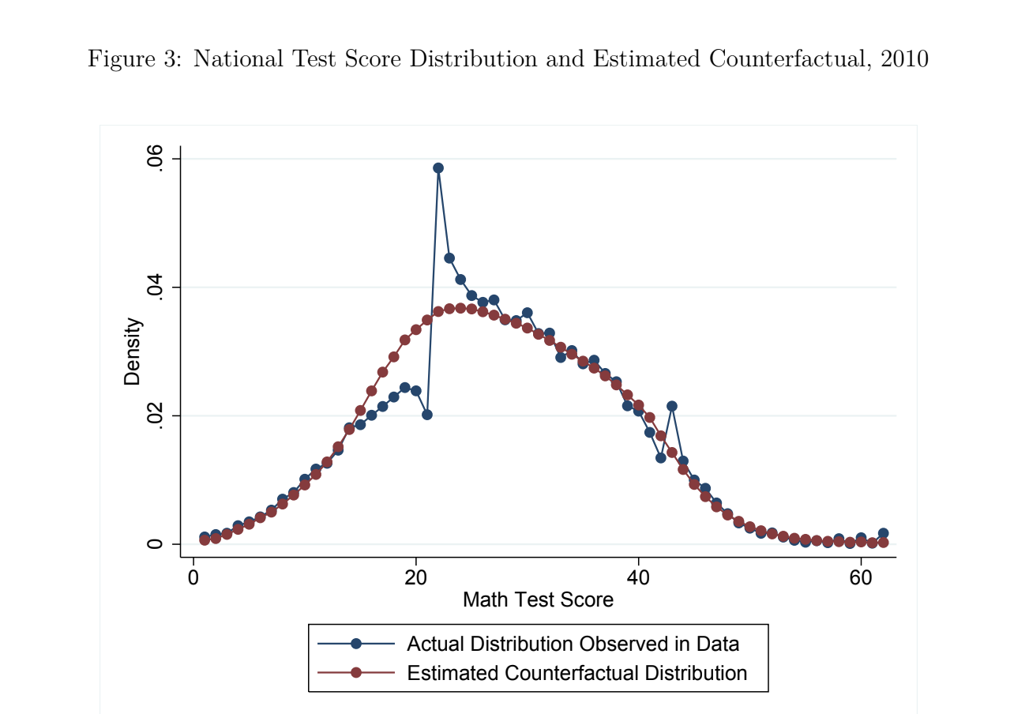
How to be careful?
One way: Look at whether covariates are “smooth” through the cut-off.
McCrary test: Is there a discontinuity of the running variable (e.g. SAT score) at the threshold?
Here is an example that fails:
Diamond, Persson, 2016
Notes:
Here we have a cut-off

Slide 39
Regression Discontinuity Making it formal

Slide 40


Making this idea formal Attempt 0
Attempt 0: Look at the average just above and below the cutoff
Population: People close to the cut-off
Compute $𝔼\left[Y \right| treated]−𝔼\left[Y \right| untreated]$
where $Y=ln⁡(Earnings)$
Call these people “untreated”
Call these people “treated”
Distribution of SAT scores*
1300
*Disclaimer: not real SAT data

Slide 41
Making this idea formal Attempt 0
Attempt 0: Look at the average just above and below the cutoff
Population: People close to the cut-off
Compute $𝔼\left[Y \right| treated]−𝔼\left[Y \right| untreated]$
where $Y=ln⁡(Earnings)$
Discuss:
What are some issues with this?
Can you think of a better method?
(Maybe you did on your pre-lecture response?)
Call these people “untreated”
Call these people “treated”
Distribution of SAT scores*
1300
*Disclaimer: not real SAT data

Slide 42
One issue
How far away from the cut-off should we go?
Too close, we might not get enough data
Too far, we might overstate the effect
The “control” group is by definition very different from the “treatment” group!
This average is “too small”
This average
is “too big”
ln(earnings)
ln(earnings)
1300
SAT Score
1300
SAT Score
Very little data!
Notes:
The “control group” is by definition different than the “treatment group” with respect to an important covariate! Typically running variables are chosen because they are important.

Slide 43



Making this idea formal
SAT score
Run a regression! $Y=α+βT+γZ+noise$
1 if SAT score > 1300
0 otherwise
ln(earnings)
$\hat{γ}$ = Slope
$\hat{β}$ = size of jump
$\hat{γ}$ = Slope
1300
SAT Score

Slide 44

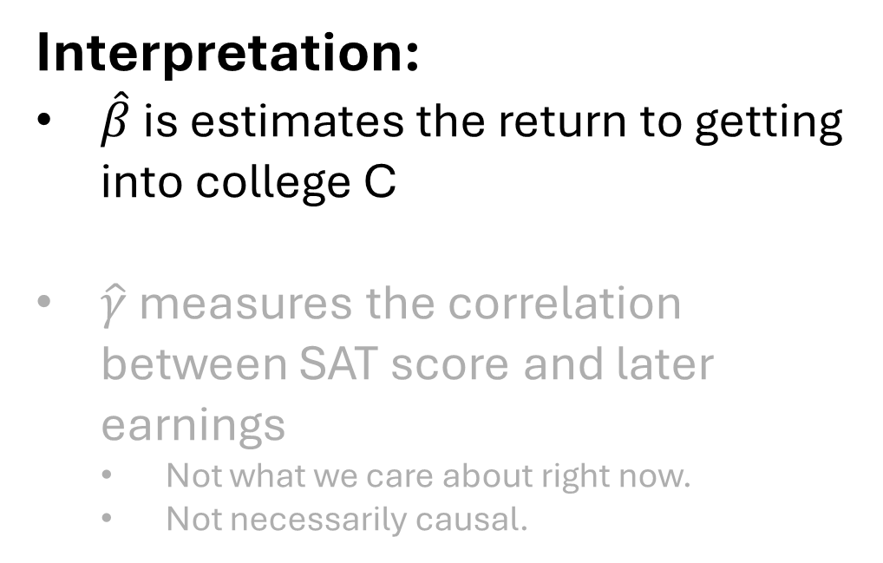

Making this idea formal
SAT score
Run a regression! $Y=α+βT+γZ+noise$
1 if SAT score > 1300
0 otherwise
Interpretation:
$\hat{β}$ is estimates the return to getting into college C
$\hat{γ}$ measures the correlation between SAT score and later earnings
Not what we care about right now.
Not necessarily causal.
ln(earnings)
$$\hat{β}$$
$\hat{γ}$ = Slope
SAT Score
1300

Slide 45
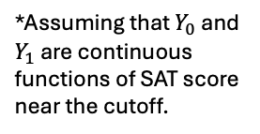
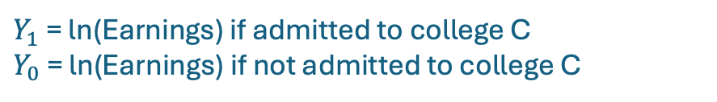

Sharp Regression Discontinuity
$Y_{1}$ = ln(Earnings) if admitted to college C
$Y_{0}$ = ln(Earnings) if not admitted to college C
This is what “sharp” refers to – it’s a sharp cutoff.
Suppose that:
The people who get into college C are exactly the people who get above a 1300 on the SAT
Then (theorem):
$$\hat{β}≈\lim_{z↘1300}𝔼\left[Y_{1}−Y_{0} \right| Z=z⁡] −\lim_{z↗1300}𝔼\left[Y_{1}−Y_{0} \right| Z=z⁡]$$
*
$$=𝔼\left[Y_{1}−Y_{0} \right| Z=1300⁡]$$
This represents the returns to admission to College C (among the marginal population)
ln(earnings)
$$\hat{β}$$
*Assuming that $Y_{0}$ and $Y_{1}$ are continuous functions of SAT score near the cutoff.
SAT Score
1300

Slide 46

Nonlinearity?
As with plain-old-regression, we can throw in higher-order terms.
This can be helpful so we don’t confuse nonlinearity with a jump at the cutoff!
$$Y=α+βT+γ_{1}Z+ γ_{2}Z^{2}{+ γ}_{3}Z^{3}+⋯+noise$$
Same nonlinear data with no jump at the cutoff.
But a linear model thinks there’s a jump!
ln(Earnings)
$$\hat{β}$$
ln(Earnings)
ln(Earnings)
!!!
1300
Z (SAT Score)
1300
Z (SAT Score)
1300
Z (SAT Score)

Slide 47
But what if we care about going to college? not getting into College C
Shucks, I didn’t get into college C.
I guess I just won’t go to college.
Yay, I got into college C!
I’ll go to college!
…Or maybe I don’t really want to go to college after all.
…Or I guess I could just go to Stanford or something.
SAT: 1290
SAT: 1310
SAT score doesn’t give sharp cut-off for going to college!
It’s a fuzzy cut-off!

Slide 48
Fuzzy Regression Discontinuity
Someone who gets above a 1300 on the SAT is more likely to get more education than someone who doesn’t.
They have the additional option of going to College C.
Now there’s discontinuity in the intensity/likelihood of treatment.
Not a “sharp” discontinuity in getting the treatment.
Pr[Go to college]
SAT score
1300

Slide 49


This looks a lot like IV!
Use “above or below the cutoff” as an instrument!
SAT score > 1300?
Did you go to college?
ln(earnings)
$$T$$
$$X$$
$$Y$$
$$Z$$
Limit sample to students with SAT scores close to 1300 (aka control for Z)
SAT score

Slide 50
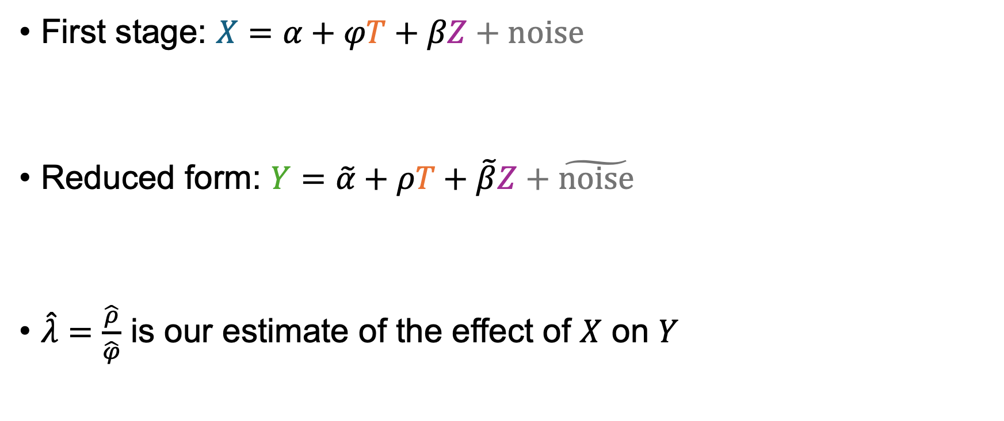
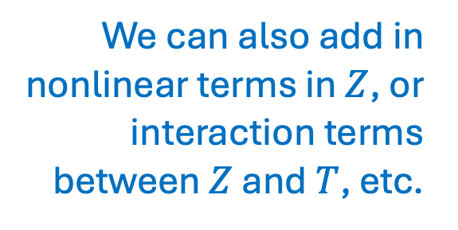
Fuzzy Regression as IV
SAT score
First stage: $X=α+φT+βZ+noise$
Reduced form: $Y=\tilde{α}+ρT+\tilde{β}Z+\tilde{noise}$
$\hat{λ}=\frac{\hat{ρ}}{\hat{φ}}$ is our estimate of the effect of $X$ on $Y$
We can also add in nonlinear terms in $Z$, or interaction terms between $Z$ and $T$, etc.
Treatment:
Did you go to college?
1 if SAT score > 1300
0 otherwise
Outcome: ln(earnings)
Notes:
First stage and reduced form, then divide the one by the other

Slide 51

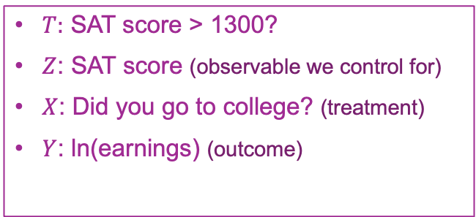

Do our assumptions hold? Which of these do we worry about with RD?
ln(Earnings)
$$\hat{β}$$
Relevance: Does $T$ affect $X$?
Independence: Conditional on $Z$, is $T$ independent from the potential outcomes $Y_{0}, Y_{1}$?
Exclusion: Can $T$ affect $Y$ other than via $X$?
Monotonicity: Are there defiers?
If the picture looks like this, it seems to…
(But this picture is made-up; real examples soon!)
1300
Z (SAT Score)
This holds automatically! Conditional on Z, T is fixed!
Hopefully not, if the cutoff is arbitrary
But not slam dunk... e.g., T affects where you go to college, which may affect earnings in a variety of ways. Manipulation may be a concern.
$T:$ SAT score > 1300?
$Z$: SAT score (observable we control for)
$X$: Did you go to college? (treatment)
$Y$: ln(earnings) (outcome)
In this example monotonicity seems reasonable…
Notes:
Note: here we're viewing Z as an observable that we will condition on, and T is the instrument, so the "Independence" condition is "Independence conditioned on observables"

Slide 52
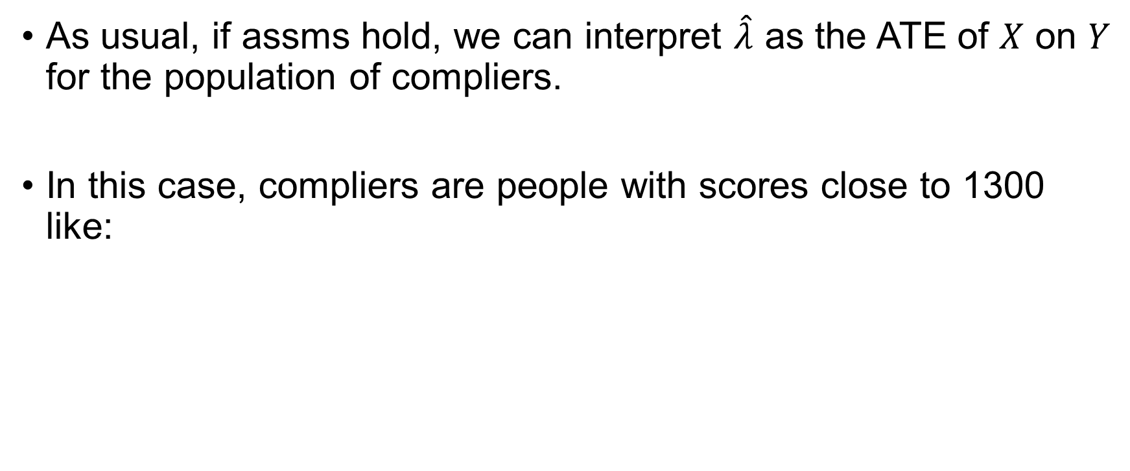

Interpretation
First stage: $X=α+φT+βZ+noise$
Reduced form: $Y=\tilde{α}+ρT+\tilde{β}Z+\tilde{noise}$
$\hat{λ}=\frac{\hat{ρ}}{\hat{φ}}$ is our estimate of the effect of $X$ on $Y$
As usual, if assms hold, we can interpret $\hat{λ}$ as the ATE of $X$ on $Y$ for the population of compliers.
In this case, compliers are people with scores close to 1300 like:
Shucks, I didn’t get into college C.
I guess I just won’t go to college.
Yay, I got into college C!
I’ll go to college!
SAT: 1290
SAT: 1310

Slide 53
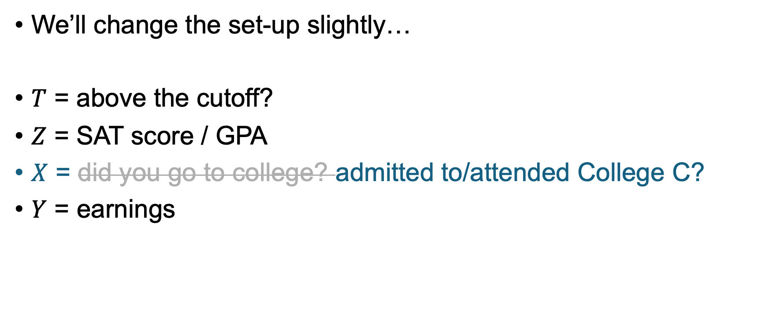
Next up… How does this play out with real data?
We’ll change the set-up slightly…
$T$ = above the cutoff?
$Z$ = SAT score / GPA
$X$ = did you go to college? admitted to/attended College C?
$Y$ = earnings
This X is easier to see in real data.
It’s still fuzzy, since (a) the thresholds for admission aren’t that sharp, and (b) admission is not the same as attendance.

Slide 54
RD Example 1

Slide 55
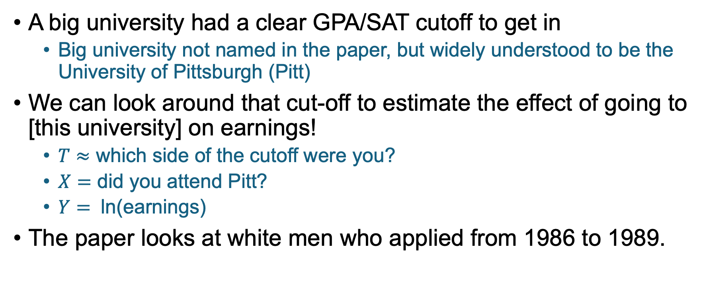
Set Up
A big university had a clear GPA/SAT cutoff to get in
Big university not named in the paper, but widely understood to be the University of Pittsburgh (Pitt)
We can look around that cut-off to estimate the effect of going to [this university] on earnings!
$T≈$ which side of the cutoff were you?
$X=$ did you attend Pitt?
$Y=$ ln(earnings)
The paper looks at white men who applied from 1986 to 1989.
Notes:
To go from a 2-dimensional cutoff (GPA and SAT), the author converted this into a GPA-dependent SAT-cutoff, and looked at how much above or below that cutoff students were (presumably controlling for GPA).
Earnings are measured in 1998-2005, so that’s 9-19 years after graduation, not that different from the FIU study

Slide 56


First stage: Does $T$ have an effect on $X$?
It looks like there really is a jump in attendance around the admissions cut-off.
Yay relevance!
Enrollment rate
SAT pts vs cutoff

Slide 57


Reduced form: Does $T$ have an effect on $Y$?
It seems like there’s some jump in earnings around the cutoff.
It’s noisier, but statistically significant
Log(Earnings)
SAT pts vs cutoff

Slide 58

Actual numbers
Reduced form:
ATE of admission on earnings at the cutoff.
Outcome of 2SLS when…
Treatment X is admission
Treatment X is enrollment

Slide 59


Putting them together
Outcome is $ln⁡(earnings)$,
So earnings multiply by $e^{0.223}≈1.249$
Results of 2SLS: $\hat{λ}≈0.223$
If we replace “X=enroll at Pitt” with “X = admission to Pitt”, $\hat{λ}≈0.135$
Interpretation:
Attending Pitt caused a 24.9% increase in future earnings
Admission to Pitt caused a 14.4% increase in future earnings
(Both on average among compliers)
Note: Marginal students who did not go to Pitt probably did go to another college.
Most didn’t make much money for the next 2-4 years, suggesting that they were in school.

Slide 60
RD Example 2
The Returns to College Admission for Academically Marginal Students
Seth Zimmerman, Journal of Labor Economics, Vol. 32, No. 4, October 2014, 711-754

Slide 61


Set Up
Florida International University had a GPA cut-off* for admission
Same fuzzy RD strategy as earlier.
Some differences:
Different populations
Students rejected from FIU were unlikely to get into any state university, as FIU had a more generous admissions policy.
Students rejected from Pitt seemed likely to get into and go to another university
Changes interpretation of effect, but causal in both cases.
SAT scores today, according to CollegeBoard.org
Pitt
e.g.
FIU
*GPA cutoff was dependent on having low enough SAT scores, which most of these applicants did. Data is from late 1990s and early 2000s.

Slide 62
Some facts about this population All graduated from public HS in Florida between 1996 and 2002
Notes:
FIU applicant sample is everyone who applied to FIU in the dataset
Marginal applicant sample is the subset of FIU applicants who were close to the cutoff
Labor force sample is the subsample of marginal FIU applicants for whom follow-up earnings data are available.
Data comes from the florida state govt, public school seniors from 14 FL counties, graduating between 1996 and 2002

Slide 63
Set Up
Florida International University had a GPA cut-off* for admission
Same fuzzy RD strategy as earlier.
Some differences:
Different populations
Students rejected from FIU were unlikely to get into any state university, as FIU had a more generous admissions policy.
Students rejected from Pitt seemed likely to get into and go to another state university
SAT scores today, according to CollegeBoard.org
Pitt
e.g.
FIU
Discuss: How do you expect the results to compare to the Pitt study? Is the effect bigger? Smaller? Why?
*GPA cutoff was dependent on having low enough SAT scores, which most of these applicants did. Data is from late 1990s and early 2000s.

Slide 64

Notes:
Do not modify the notes in this section to avoid tampering with the Poll Everywhere activity. More info at polleverywhere.com/support There was approximately the same research design at Pitt and FIU. Which number do you think is bigger?
https://www.polleverywhere.com/multiple_choice_polls/VnZevYjL5f4KmeCG2N1uU?state=opened&flow=Default&onscreen=persist

Slide 65
Let’s see the results!

Slide 66

First stage: Does $Z$ have an effect on $X$?
It looks like there really is a jump in admission and attendance around the cut-off.
Admission rate
Enrollment rate
GPA vs cutoff
GPA vs cutoff

Slide 67

Reduced form: Does $Z$ have an effect on $Y$?
It seems like there’s some jump in earnings around the cutoff.
Again, it is statistically significant
Earnings
GPA vs cutoff
Notes:
Earnings are measured between 8 and 14 years after high school graduation

Slide 68

Putting them together
Estimated effect on earnings of admission to FIU: $22\%$
(Compare to the effect of admission to Pitt $≈25\%$)
Notes:
Both are looking roughly 10-15 years out.

Slide 69

Sanity-check
Observable traits look “smooth” through the cut-off:

Slide 70
Recap: Regression Discontinuity
It shows up everywhere!
Sharp-ish cut-offs are common!
We can leverage them to understand the treatment effect near the cut-off.
But we should be careful!
McCrary test: make sure running variable is smooth through the cut-off
Also check to make sure covariates are smooth through the cut-off

Slide 71
Lots of methods For measuring some notion of “returns to education”
Regression controlling for all of the (observable) things!
Twin studies
Instrumental variables
Proximity to college
Quarter of birth
Regression Discontinuity
GPA/SAT cut-offs

Slide 72
Which do you find the most compelling? For measuring some notion of “returns to education”?
Regression controlling for all of the (observable) things!
Twin studies
Instrumental variables
Proximity to college
Quarter of birth
Regression Discontinuity
GPA/SAT cut-offs

Slide 73

Notes:
Do not modify the notes in this section to avoid tampering with the Poll Everywhere activity. More info at polleverywhere.com/support What do you find most compelling?
https://www.polleverywhere.com/multiple_choice_polls/X4FSB2d6iBHb3kvwJutmN?state=opened&flow=Default&onscreen=persist

Slide 74
All of them have some problems…
But at the end of the day, we/policymakers need to make decisions!
Probably it’s good to have as many tools as possible?
(As long as we are mindful of their shortcomings)

Slide 75
Looking ahead

Slide 76
Next time
New unit! Panel Data!

Slide 77


Exit ticket
Don’t forget to fill out the exit ticket before you leave class!

