Slide 1
Friedman’s Permanent Income Hypothesis
Causality, Decision-Making, and Data Science
Lecture 6

Slide 2
Announcements
HW1 part 2 due Monday 10/13!
Project ideas due a week from Monday! (10/20)

Slide 3

New Unit! The effects of UBI UBI = Universal Basic Income
Today: Theory: the Permanent Income Hypothesis
Next time: Tools: Regression!
Next next time: Using the tools: Some Experiments!
Next next next time: Heterogeneous Treatment Effects and Random Forests
Universal Basic Income is a policy where everyone would get some base level of income (say, $10,000 a year), no matter what.
Some politicians and some Silicon Valley bajillionaires (and some others) are fans.

Slide 4
Agenda
Some questions
How do people act when they get a bunch of money?
Why do these questions matter?
Impact on policy decisions
Some theory
How “should” you act if you got a bunch of money?

Slide 5
Some Questions

Slide 6
What would you do if someone gave you $10,000 right now?
Spend it on stuff you wouldn’t buy otherwise
Save it
Work less and spend more time on leisure
Invest it in your education / business / side hustle
Something else?

Slide 7
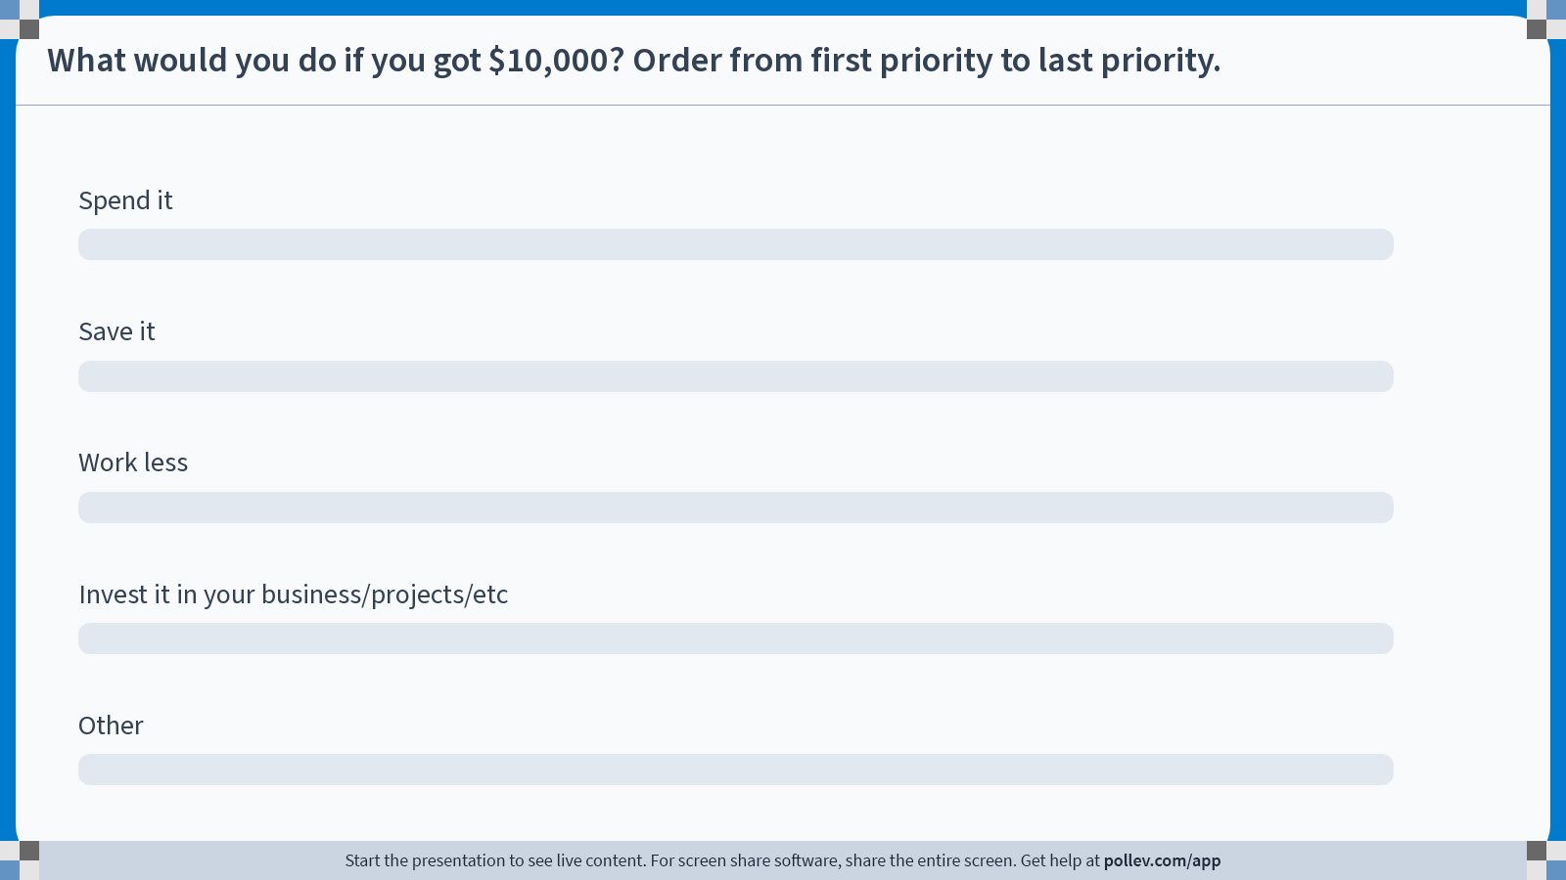
Notes:
Do not modify the notes in this section to avoid tampering with the Poll Everywhere activity. More info at polleverywhere.com/support What would you do if you got $10,000? Order from first priority to last priority.
https://www.polleverywhere.com/ranking_polls/aCJXSvRuam3A83VVQXSEA

Slide 8
What about someone else? If they got $10,000 today
What would your parents (or people you know aged 35-65) do?
The same or different?

Slide 9
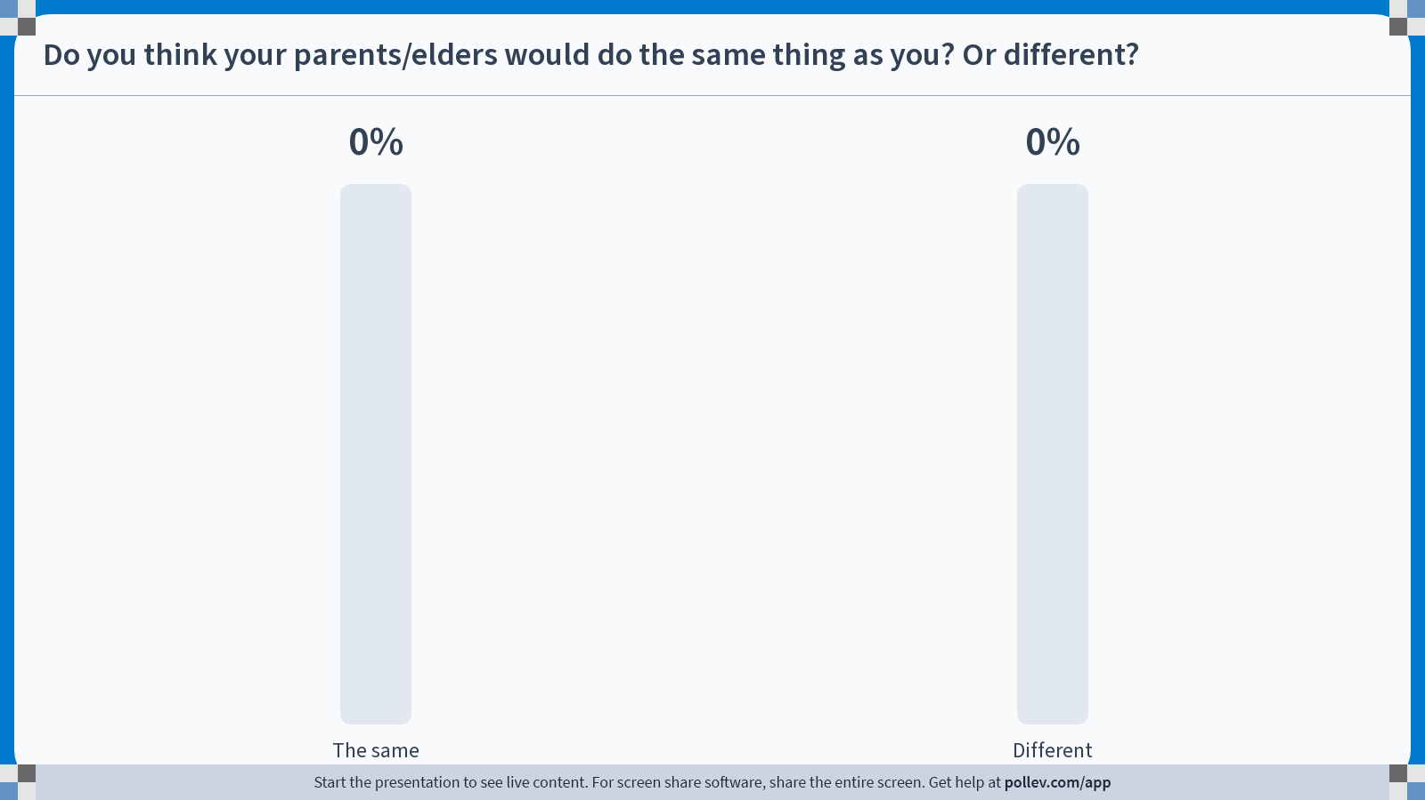
Notes:
Do not modify the notes in this section to avoid tampering with the Poll Everywhere activity. More info at polleverywhere.com/support Do you think your parents/elders would do the same thing as you? Or different?
https://www.polleverywhere.com/multiple_choice_polls/HXAjhEtE2uXpB0q4smyKE?state=opened&flow=Default&onscreen=persist

Slide 10
For those of you who said different…
Why?
In what way?

Slide 11
What would you do if someone gave you $10,000 every year for the rest of your life?
The same thing as I said in the last poll, but I’d do that every year
I’d spend $10,000 more each year for the rest of my life
I’d go into debt and spend lots of money now
Something else?

Slide 12
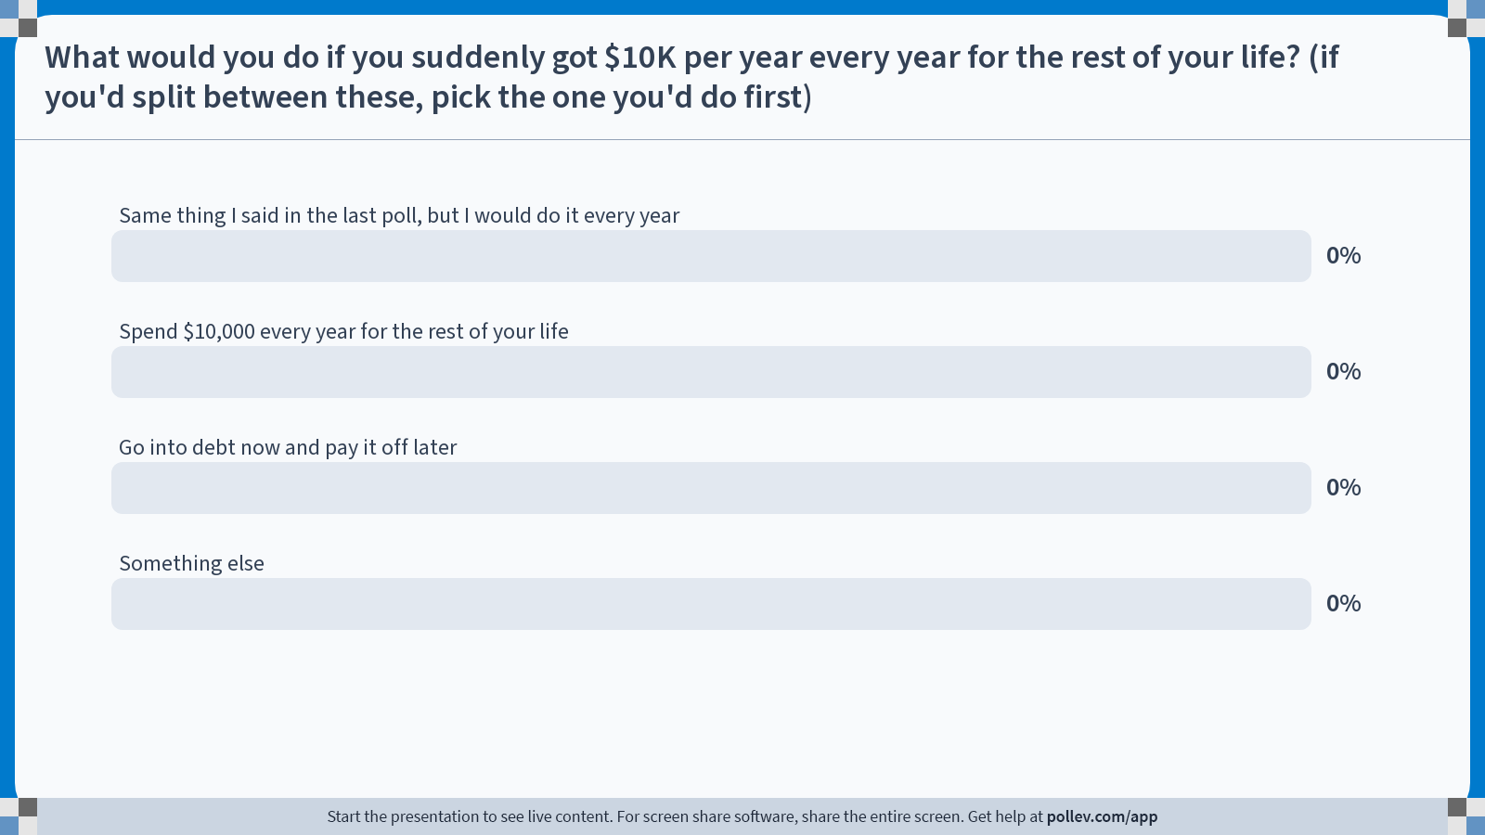
Notes:
Do not modify the notes in this section to avoid tampering with the Poll Everywhere activity. More info at polleverywhere.com/support What would you do if you suddenly got $10K per year every year for the rest of your life? (if you'd split between these, pick the one you'd do first)
https://www.polleverywhere.com/multiple_choice_polls/XU7R7KevBqLf4AncvOWDm?state=opened&flow=Default&onscreen=persist

Slide 13
Why do these questions matter?

Slide 14
Some policy questions
What would happen if we sent out one-time stimulus checks?
You get $X today!
What would happen if we re-structured social security?
You get $Y/month once you’re old enough!
What would happen if we implemented Universal Basic Income?
You get $Z/year no matter what!

Slide 15
What would people do?
Spend More!
You may think that some of these outcomes are “better” for society than others.
Which will happen?
Buy stuff you wouldn’t otherwise
Work fewer hours and use the free time to play video games
Invest in your
education / business / etc
Work Less!
Work More!
Save it

Slide 16
Some Theory
Friedman’s Permanent Income Hypothesis

Slide 17
Why do we need theory? After all, we have data!
…Because we need to make sense of that data!
“If we are not to get lost in the overwhelming, bewildering mass of statistical data that are now becoming available, we need the guidance and help of a powerful theoretical framework.”
ASIDE: When do you think this was written?
Before 1950; 1950-1970; 1970-1990; 1990-today?

Slide 18
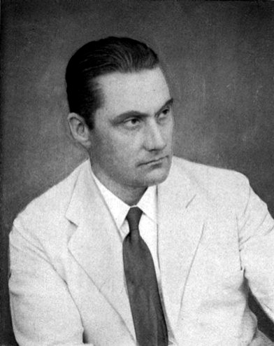
This quote is from 1933! In an editorial for the first issue of Econometrica
“Big Data” has been a thing since long before computers!
It’s (one reason) why we (still) need theory ☺
Ragnar Frisch

Slide 19
What kind of theory do we need?
We need a model of people that predicts decisions about:
Spending
Saving
Working more or less (but this actually won’t be in the model we discuss today)
The model should:
Allow people to “look ahead”
But also acknowledge that people have to make decisions now

Slide 20
Friedman’s Permanent Income Hypothesis (PIH)
A model of how people will behave.
Core assumptions of the model:
People are maximizing some (concave) utility function
E.g., A $10K raise means a more to someone making $20K than someone making $200K.
“Complete Markets”
People can borrow as much money as they “should” be able to borrow.
We’ll discuss later whether or not these assumptions seem reasonable!
For now, let’s go with them.

Slide 21

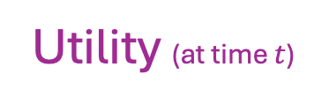
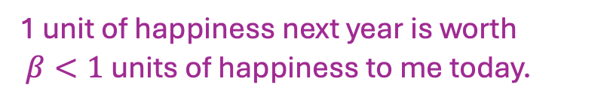


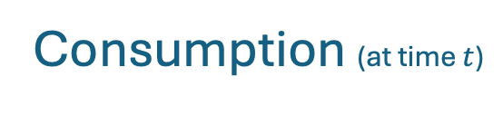

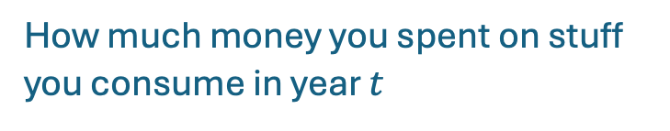
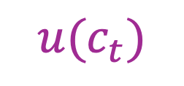
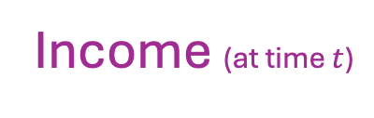


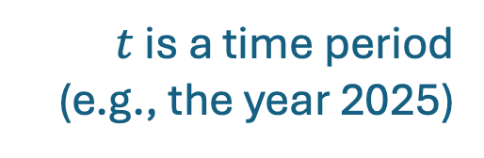

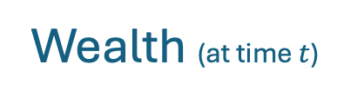
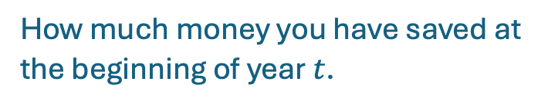
PIH: The Math (Part 1)
$t$ is a time period (e.g., the year 2025)
Variable
Definition
Interpretation
$$A_{t}$$
Wealth (at time $t$)
How much money you have saved at the beginning of year $t$.
$$y_{t}$$
Income (at time $t$)
How much money you make in year $t$.
$$c_{t}$$
Consumption (at time $t$)
How much money you spent on stuff you consume in year $t$
$${u(c}_{t})$$
Utility (at time $t$)
How happy that consumption made you in year $t$.
$$r$$
Interest rate
If you put $1 in the bank this year, you’ll have $(1+r) next year.
$$β$$
Discount factor
1 unit of happiness next year is worth
$β<1$ units of happiness to me today.

Slide 22

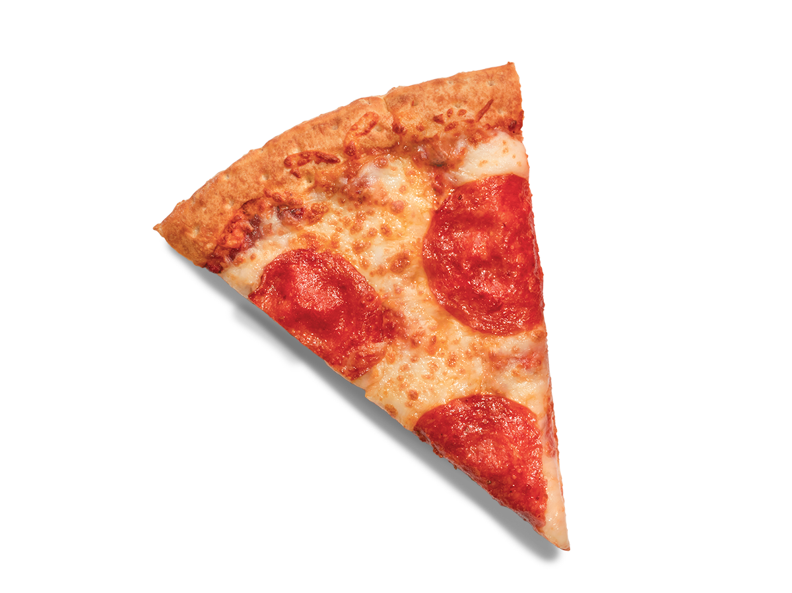


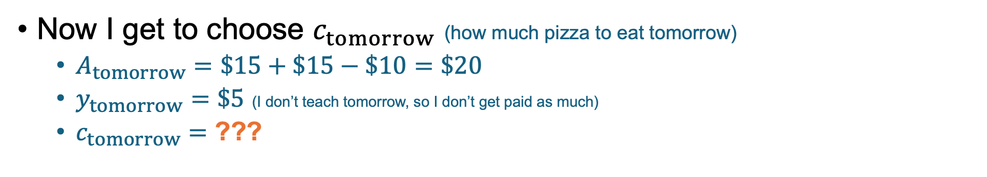



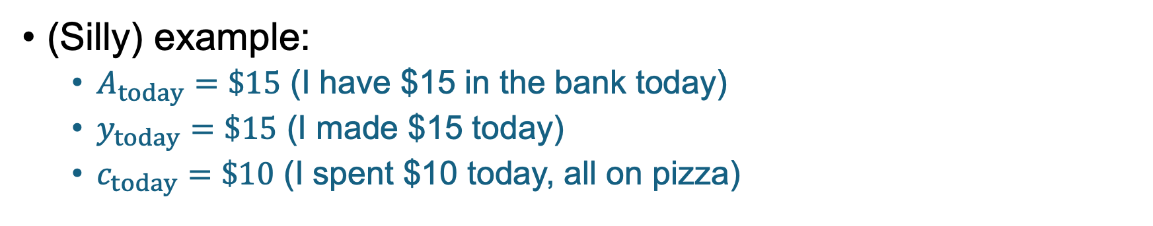

Given $A_{t},y_{t},c_{t}$ How should I behave in period $t+1$?
$A_{t}$: Wealth
$y_{t}$: Income
$c_{t}$: Consumption
$β$: Discount factor
(Silly) example:
$A_{today}=\$15$ (I have $15 in the bank today)
$y_{today}=\$15$ (I made $15 today)
$c_{today}=\$10$ (I spent $10 today, all on pizza)
Utility
consumption
Now I get to choose $c_{tomorrow}$ (how much pizza to eat tomorrow)
$A_{tomorrow}=\$15+\$15−\$10=\$20$
$y_{tomorrow}=\$5$ (I don’t teach tomorrow, so I don’t get paid as much)
$c_{tomorrow}=$ ???
(Discussion on board!)
How should I choose $c_{tomorrow}$?

Slide 23
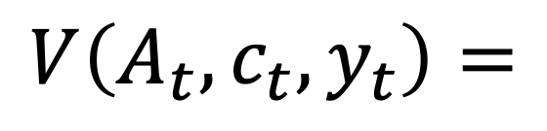








PIH: The Math (Part 2)
$A_{t}$: Wealth
$y_{t}$: Income
$c_{t}$: Consumption
$V(A_{t}, c_{t}, y_{t})$ is how much I value the situation “$A_{t}, c_{t}, y_{t}$” today, assuming I make optimal decisions going forward.
Then:
Utility that I got from my consumption this year
However much I would value $(A_{t+1},c_{t+1},y_{t+1})$ next year
$$u\left(c_{t}\right)$$
$$β⋅$$
$$V\left(A_{t}, c_{t}, y_{t}\right)=$$
$$+$$
The best I can do with my situation this year (time t)
Discount factor

Slide 24
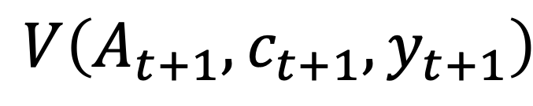

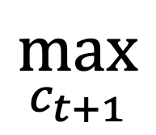
PIH: The Math (Part 2)
$A_{t}$: Wealth
$y_{t}$: Income
$c_{t}$: Consumption
$V(A_{t}, c_{t}, y_{t})$ is how much I value the situation “$A_{t}, c_{t}, y_{t}$” today, assuming I make optimal decisions going forward.
Then:
Utility that I got from my consumption this year
$$\max_{c_{t+1}}$$
$$u\left(c_{t}\right)$$
$$𝔼$$
$$β⋅$$
$$V\left(A_{t+1}, c_{t+1}, y_{t+1}\right)$$
$$V\left(A_{t}, c_{t}, y_{t}\right)=$$
$$+$$
The best I can do with my situation this year (time t)
Discount factor
How well I expect to do with the resulting situation next year
Make the best choice over consumption next year (time t+1)

Slide 25
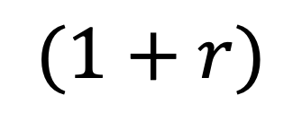
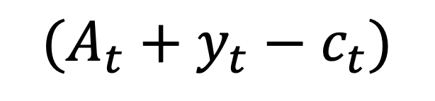

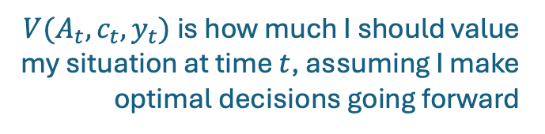
PIH: The Math (Part 3)
$V(A_{t}, c_{t}, y_{t})$ is how much I should value my situation at time $t$, assuming I make optimal decisions going forward
$$V\left(A_{t}, c_{t}, y_{t}\right)=\max_{c_{t+1}}\left[u\left(c_{t}\right)+β⋅𝔼V\left(A_{t+1}, c_{t+1}, y_{t+1}\right)\right]$$
subject to:
$$A_{t+1}=$$
$$(1+r)$$
$$(A_{t}+y_{t}−c_{t})$$
Savings at the beginning of next year
Savings + earnings – consumption this year
Plus interest!

Slide 26
PIH: The Math (Part 4)
$V(A_{t}, c_{t}, y_{t})$ is how much I should value my situation at time $t$, assuming I make optimal decisions going forward
$$V\left(A_{t}, c_{t}, y_{t}\right)=\max_{c_{t+1}}\left[u\left(c_{t}\right)+β⋅𝔼V\left(A_{t+1}, c_{t+1}, y_{t+2}\right)\right]$$
subject to:
$$A_{t+1}=(1+r)(A_{t}+y_{t}−c_{t})$$
Folks who have taken CS161 or another algorithms course may recognize this as a dynamic program!

Slide 27
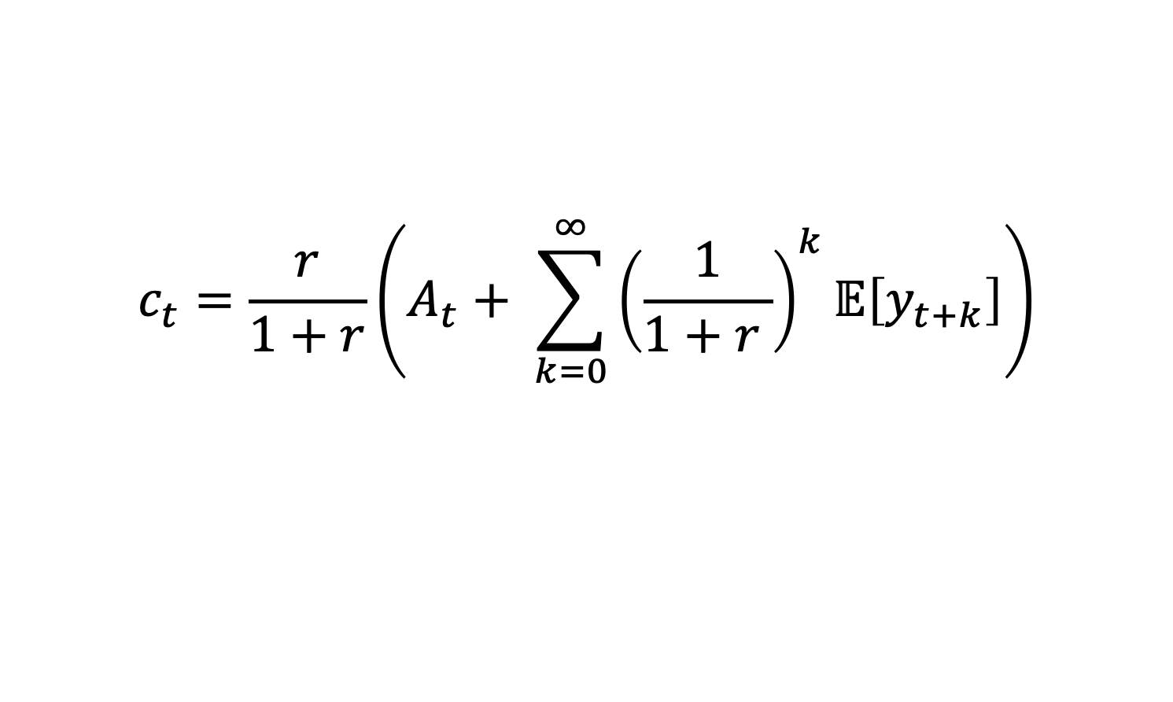
PIH: The Math (Part 5)
Under some assumptions, it turns out the solution to this dynamic program is:
$$c_{t}=\frac{r}{1+r}\left(A_{t}+ \sum_{k=0}^{∞}{{\left(\frac{1}{1+r }\right)}^{k}𝔼\left[y_{t+k}\right]}\right)$$
How much should you spent at time t?
How much you have saved at time t
Something to do with how much you expect to make going forward…

Slide 28
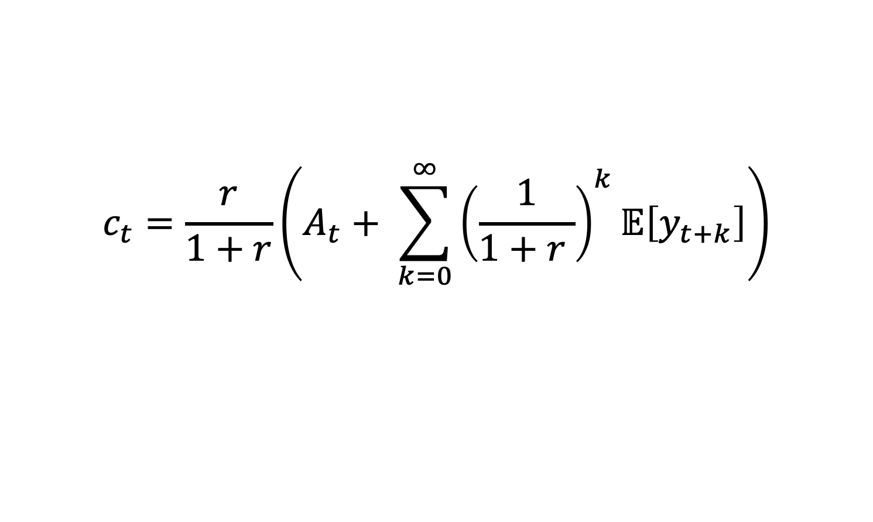
Phew, that was a lot of math!
Let’s take a quick break.
If you just can’t stop math-ing, think about:
What does this say about what you should do if you won $10K in the lottery?
What does this say about what you should do if you won a long-term prize of $10K per year for the rest of your life?
$$c_{t}=\frac{r}{1+r}\left(A_{t}+ \sum_{k=0}^{∞}{{\left(\frac{1}{1+r }\right)}^{k}𝔼\left[y_{t+k}\right]}\right)$$

Slide 29

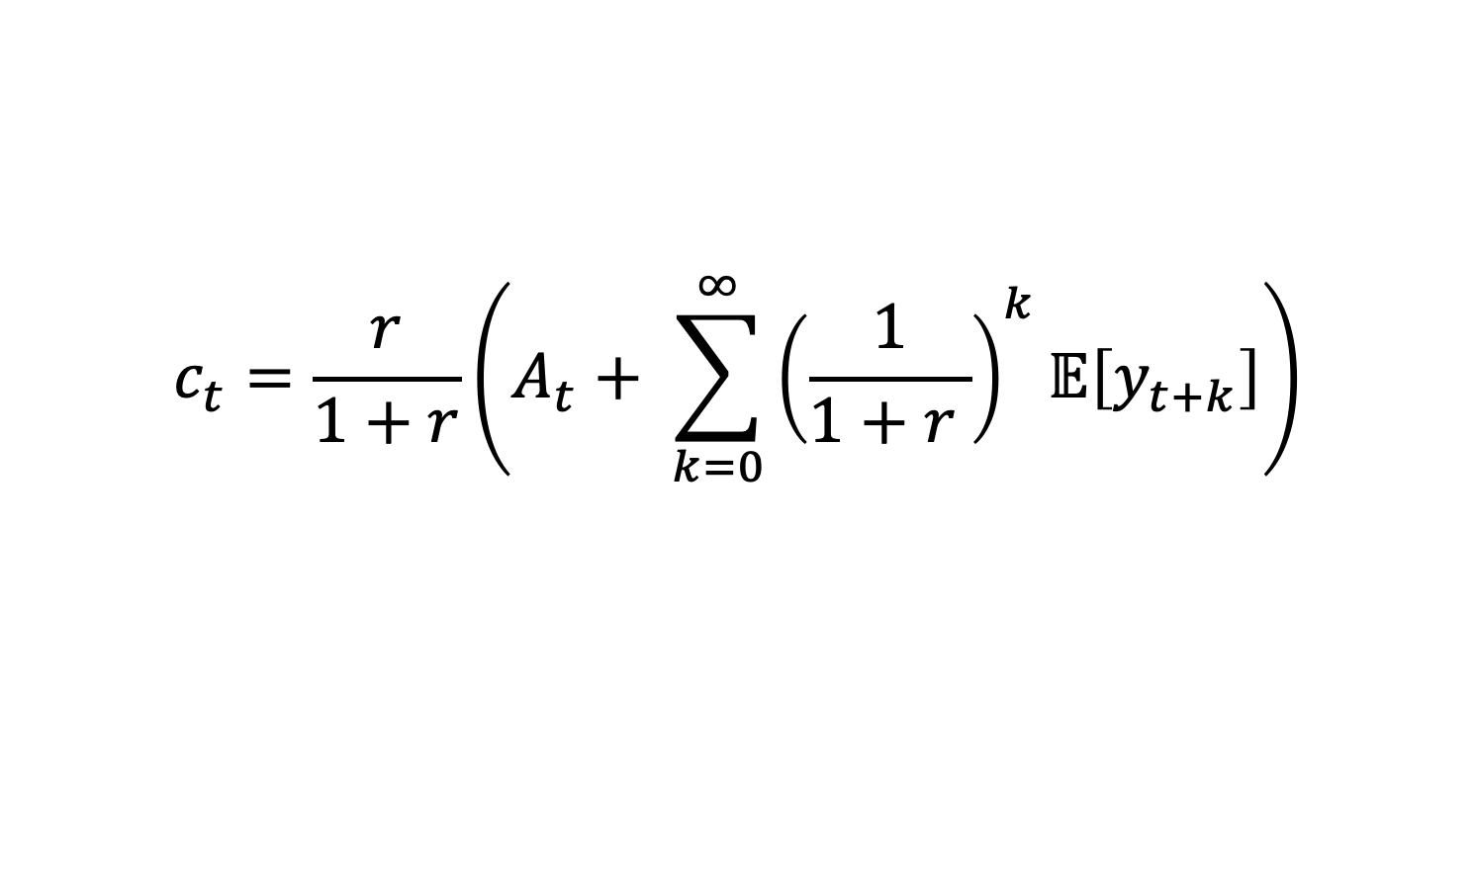
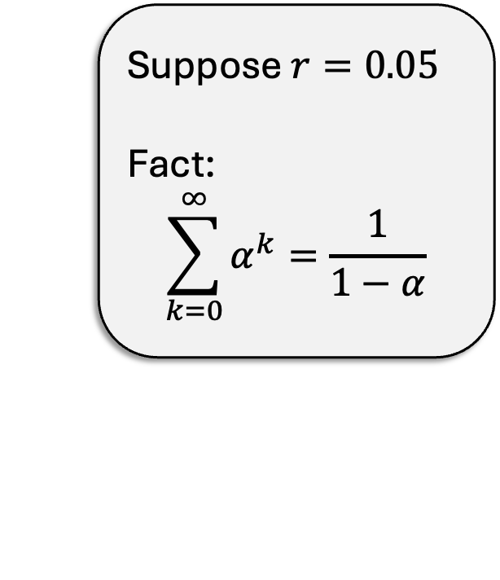
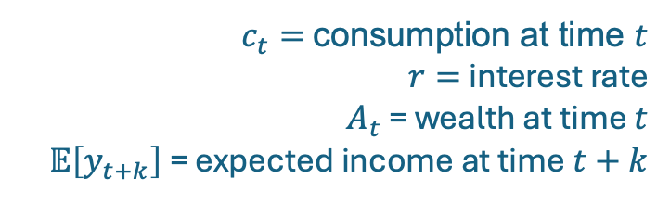
PIH: The Math (Part 5)
$c_{t}=$ consumption at time $t$
$r=$ interest rate
$A_{t}$ = wealth at time $t$
$𝔼\left[y_{t+k}\right]$= expected income at time $t+k$
Under some assumptions, it turns out the solution to this dynamic program is:
$$c_{t}=\frac{r}{1+r}\left(A_{t}+ \sum_{k=0}^{∞}{{\left(\frac{1}{1+r }\right)}^{k}𝔼\left[y_{t+k}\right]}\right)$$
Suppose $r=0.05$
Fact:
$$\sum_{k=0}^{∞}{α^{k}=\frac{1}{1−α}}$$
Let’s take a few minutes to understand this.
According to this equation:
If you got $10,000 more in wealth today, how much more “should” you spend this year?
If you got $10,000 more every year starting today, how much more “should” you spend this year?

Slide 30
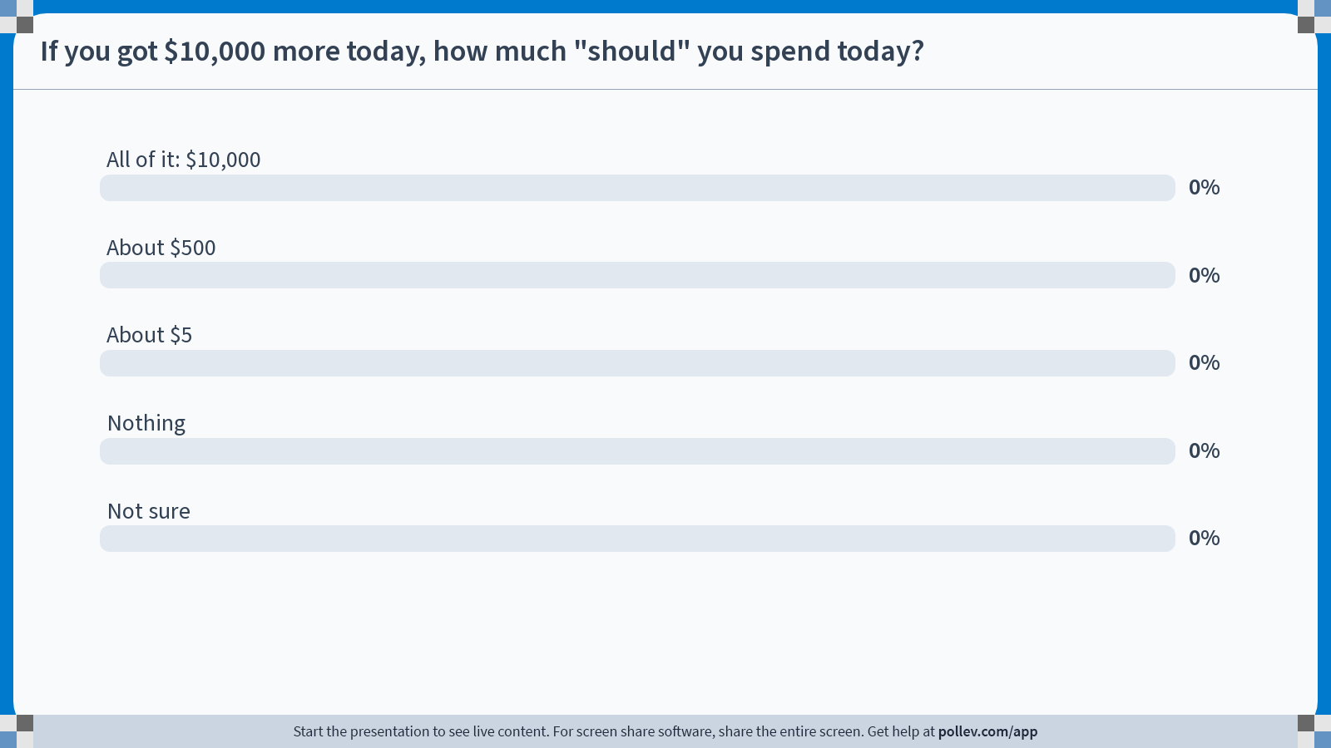
Notes:
Do not modify the notes in this section to avoid tampering with the Poll Everywhere activity. More info at polleverywhere.com/support If you got $10,000 more today, how much "should" you spend today?
https://www.polleverywhere.com/multiple_choice_polls/43XqS4QCImaSGzxLQNSg6?state=opened&flow=Default&onscreen=persist

Slide 31
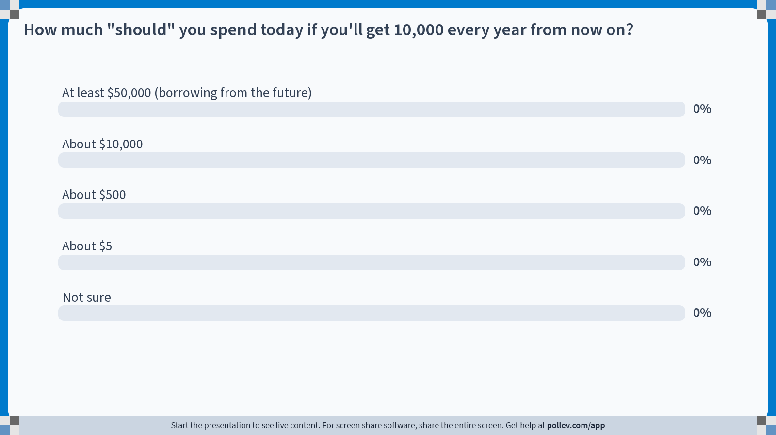
Notes:
Do not modify the notes in this section to avoid tampering with the Poll Everywhere activity. More info at polleverywhere.com/support How much "should" you spend today if you'll get 10,000 every year from now on?
https://www.polleverywhere.com/multiple_choice_polls/VSROv5CZrTbpyYYfQwDpB?state=opened&flow=Default&onscreen=persist

Slide 32
Answers
If you get $10,000 more today,
you should spend about $500 more this year.
If you get $10,000 more every year going forward,
you should spend about $10,000 this year.

Slide 33
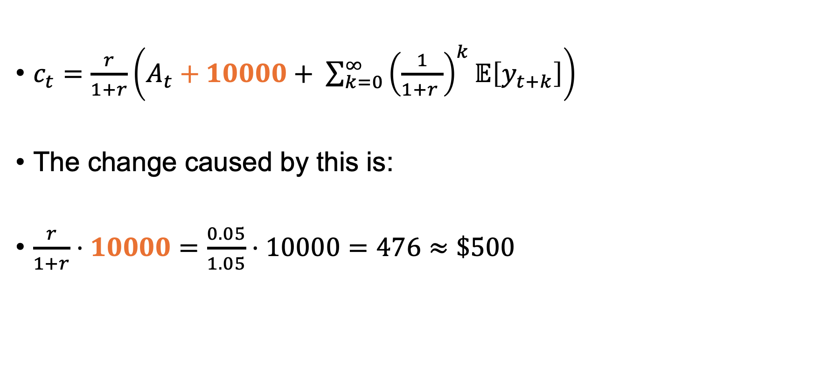
What if I get $10,000 more today?
$c_{t}=\frac{r}{1+r}\left(A_{t}+10000+ \sum_{k=0}^{∞}{{\left(\frac{1}{1+r }\right)}^{k}𝔼\left[y_{t+k}\right]}\right)$
The change caused by this is:
$\frac{r}{1+r}⋅10000=\frac{0.05}{1.05}⋅10000=476≈\$500$

Slide 34
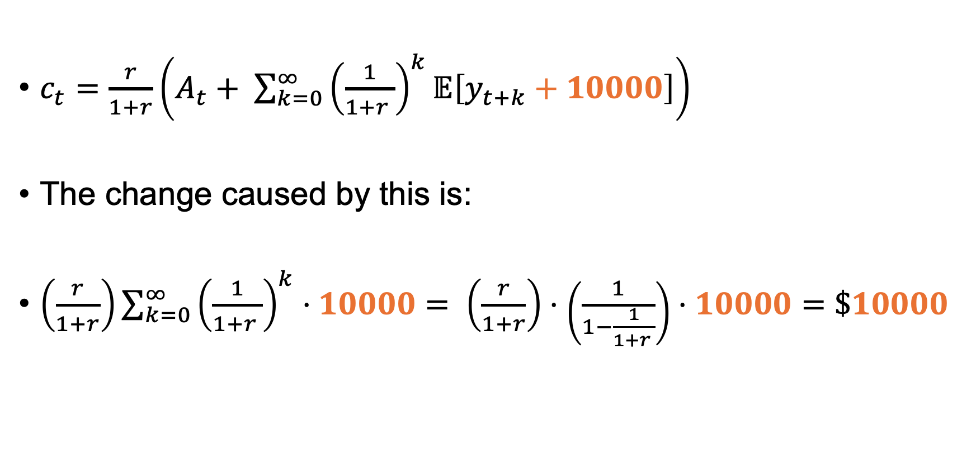
What if I get $10,000 more every year?
$c_{t}=\frac{r}{1+r}\left(A_{t}+ \sum_{k=0}^{∞}{{\left(\frac{1}{1+r }\right)}^{k}𝔼\left[y_{t+k}+10000\right]}\right)$
The change caused by this is:
$\left(\frac{r}{1+r}\right)\sum_{k=0}^{∞}{{\left(\frac{1}{1+r }\right)}^{k}}⋅10000= \left(\frac{r}{1+r}\right)⋅\left(\frac{1}{1−\frac{1}{1+r }}\right)⋅10000=\$10000$
This is 1!

Slide 35
Take-aways: PIH
Suppose that some assumptions* hold.
For every dollar you get in wealth (transitory income),
you spend only a little bit today.
For every dollar you get in permanent income,
you spend all of it today.
If you are a poor college student today, but expect to be making lots more money when you graduate…
…you should spend some of those future earnings today!
*Notably, people are optimizing a concave utility function; and there are complete markets

Slide 36
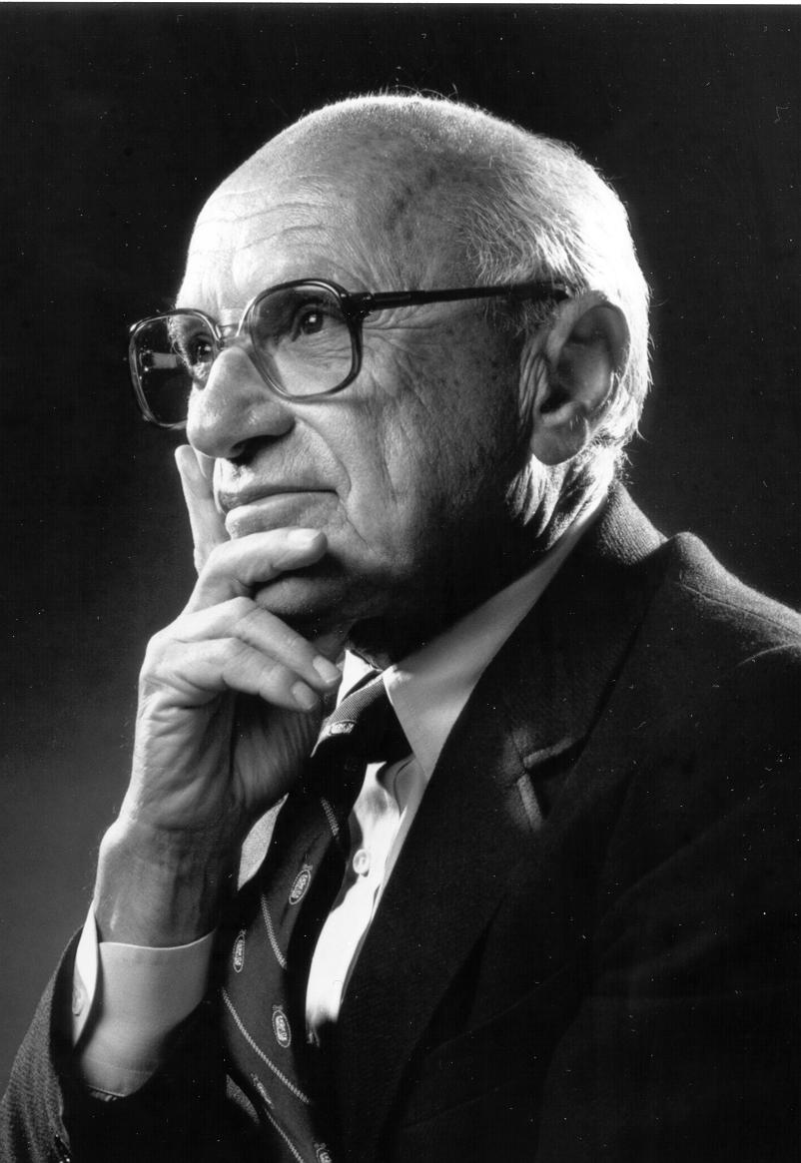
Does this make sense?
Yet from another point of view, the assumption
seems highly implausible.
Will not a man who receives an unexpected windfall
use at least some part of it in "riotous living"
i.e. in consumption expenditures?
Would he be likely to add the whole of it to his wealth?
Aka, “Surely normal people would spend lottery winnings on sex, drugs, and rock and roll!”
Milton Friedman

Slide 37

Does this make sense?
Yet from another point of view, the assumption
seems highly implausible.
Will not a man who receives an unexpected windfall
use at least some part of it in "riotous living"
i.e. in consumption expenditures?
Would he be likely to add the whole of it to his wealth?
Aka, “Surely normal people would spend lottery winnings on sex, drugs, and rock and roll!”
Milton Friedman
Discuss: Do you think the PIH is realistic? If not, which of the assumptions* seem suspicious?
*Assumptions:
People are optimizing a concave utility function
People can borrow as much as they “should” be able to

Slide 38
How would we test the PIH?
What is the effect of permanent income on consumption?
E.g., $10,000 every year
What is the effect of transitory income on consumption?
E.g., $10,000 this year
How could we design a study/survey to answer these questions?
Is there existing data we could use?

Slide 39

Challenges
Consumption is hard to measure
How do we measure transitory and permanent income?
Do people even know what part of their income is transitory and what part is permanent?
I spent $250 on packaged ramen last week, but some of that I won’t eat until later, so it doesn’t count for consumption now. Oh, and I guess the joy of owning a car counts as consumption value, even though I’ve already paid off the car…
This year, I made, ummm, $200 from lawn-mowing, and something like $50 playing poker, but that was off the books, and I work at the library for $15/hour but the hours are all over the place…

Slide 40
In the next few lectures
We’ll talk more about the sorts of studies we can do, and how to analyze them!

Slide 41
Recap and Looking ahead

Slide 42
Recap
What do people do when they get more money?
This question is important for policy!
The Permanent Income Hypothesis gives us a theory of consumption given permanent/transient income.
We may or may not believe it, but it helps us organize the data.

Slide 43
Looking ahead
In the next few classes (and in your homework!), we’ll talk about actual studies, and how to analyze them!

Slide 44

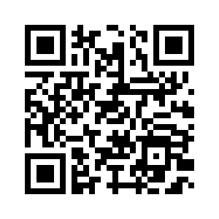
Exit ticket
Don’t forget to fill out the exit ticket before you leave class!

