Slide 1
Synthetic Controls and course recap
Causality, Decision Making, and Data Science, Lecture 17

Slide 2

Announcements
Next week is fall break!
This is our last class before your project presentations!
We are looking forward to your presentations after the break!
You have 7 minutes per group for your presentations – please upload slides by Dec 1.
HW4 Part 2 (last one!!!) due Monday after fall break.
But you might want to get it done earlier, to (a) enjoy fall break, and (b) have more time to work on your projects before fall break!
End-of-quarter celebration!
December 4 at Guido’s house!
Please fill out RSVP form (via Canvas announcement)

Slide 3
Agenda
Synthetic Controls
Idea and examples
How does this compare to DiD and Matrix Completion?
Recap!
What just happened???

Slide 4
Synthetic Controls

Slide 5
Idea of synthetic control
Suppose we want to predict a counterfactual
What would have happened without Brexit?
Maybe this?
GDP
UK
Gondor
Time
2020
Thought experiment with made-up data!

Slide 6
Idea of synthetic control
Suppose we want to predict a counterfactual
What would have happened without Brexit?
GDP
Maybe this?
Lothlorian
UK
The idea is to average the two of these!
Rohan
Time
2020
Thought experiment with made-up data!

Slide 7
Questions about this idea
How do we implement it?
How can we find which countries to average?
With what weights?
Can we take into account covariates?
Does it matter that Lothlorian has a population of mostly elves, while the UK has a population of mostly humans?
How does this compare to other approaches we’ve seen?
Difference-in-differences; Matrix completion

Slide 8
Running example for today’s class
No spoilers! You can do this on an optional part of your HW if you want!
The Brexit example
The CA Prop. 99 Example (anti-smoking legislation)

Slide 9
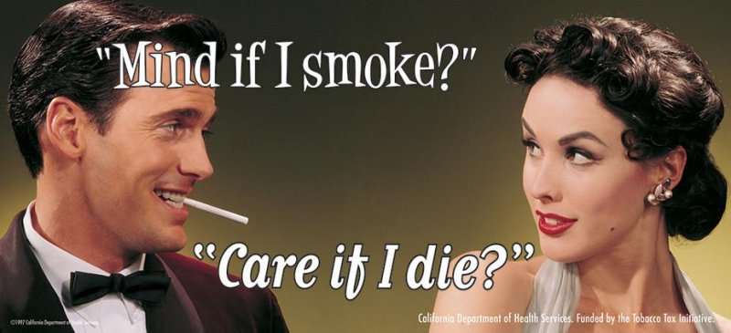

Effect of anti-smoking legislation Abadie, Diamond and Hainmueller (2010)
Substantive question: Do anti-smoking programs lower rates of smoking?
CA Prop. 99 (passed in 1988)
Raised taxes on tobacco products and funded an anti-smoking campaign.
Units: US States
Outcome: Per-capita smoking rate
Treatment: CA Prop. 99 passed in 1988
Treatment pattern: Single treated unit
CA is treated
11 other states are somewhat treated (these were discarded)
38 remaining states are the “controls”
…
…
1970
1988
2000
0 0 0
…
0 0 0
California Department of Health Services. Funded by the Tobacco Tax Initiative.
0 0 0
…
0 0 0
…
…
…
0 0 0
0 0 0
…
CA
0 0 0
1 1 1 1 1
$$W$$

Slide 10
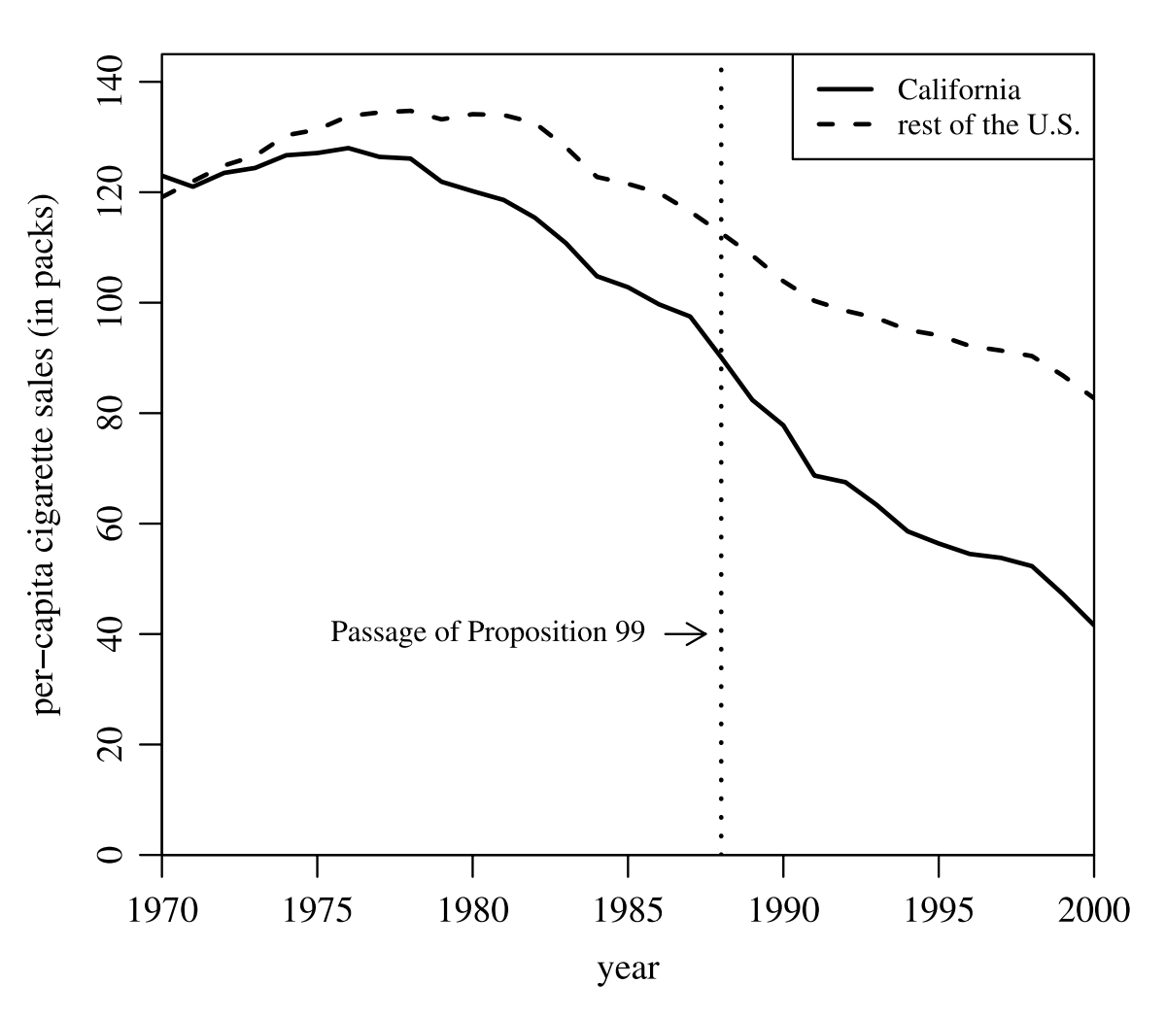
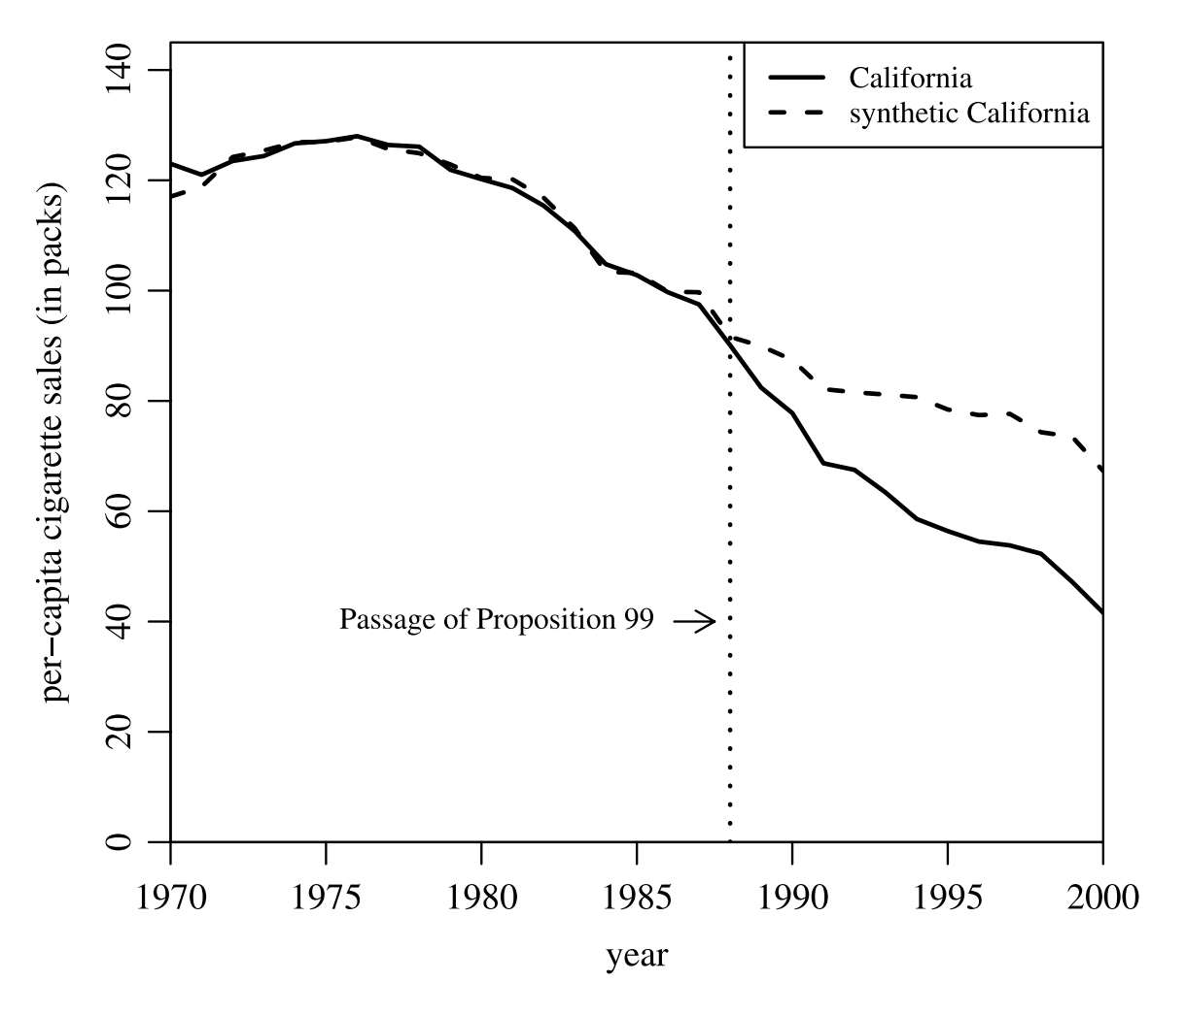
What do we get?
The paper’s conclusion: The average person in CA in 2000 bought 26 packs fewer per year than they would have without Prop. 99.
California vs. U.S. Average
California vs “Synthetic CA”
This is the implied “causal” effect.

Slide 11
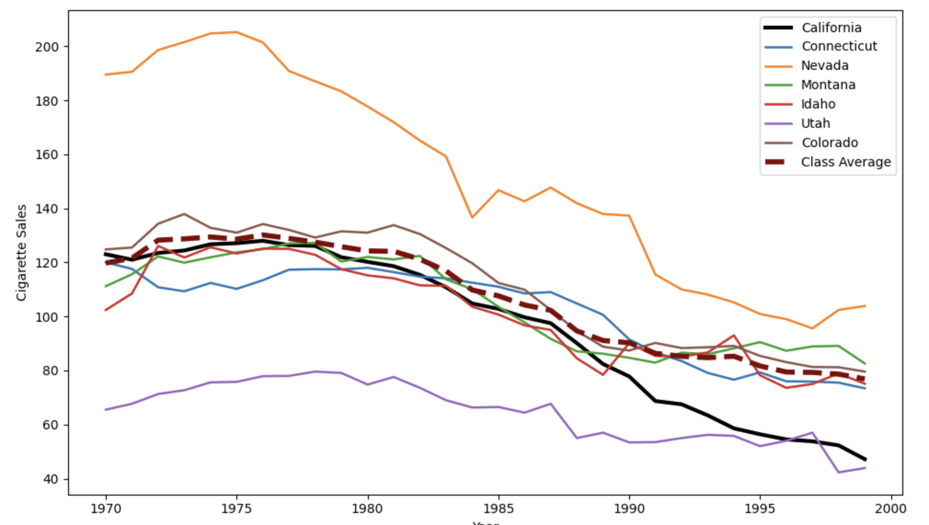

How do we make “synthetic CA”?
Your suggestions:
Folks also suggested NY, MA, NJ, WA, OR, AZ, which are states that were omitted from the paper’s dataset since they had also passed smoking-related legislation.

Slide 12
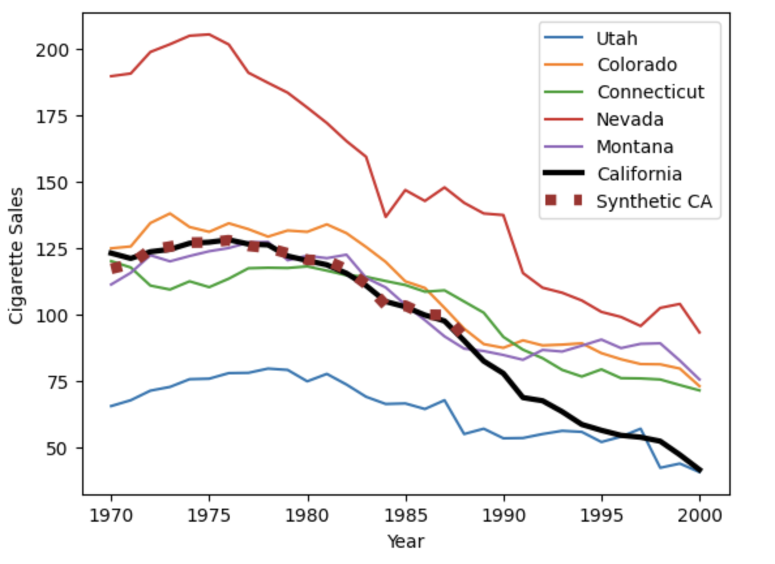
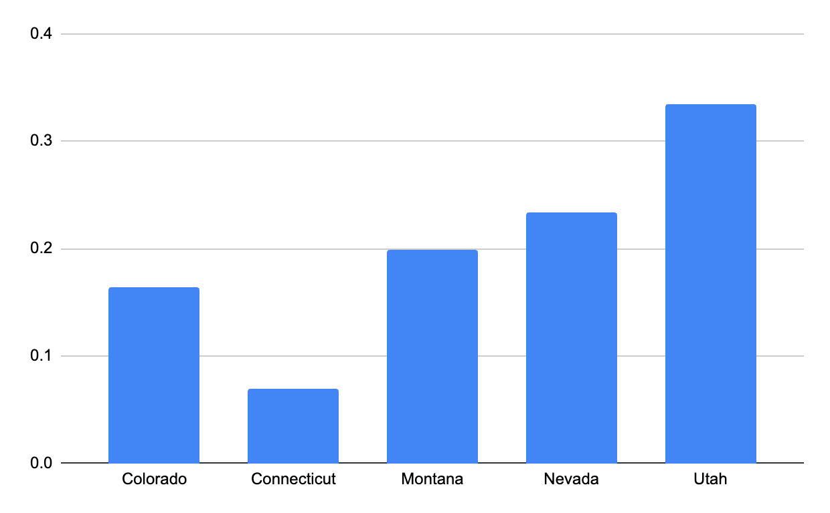
How did they make “synthetic CA”?
33%
23%
19%
16%
7%

Slide 13
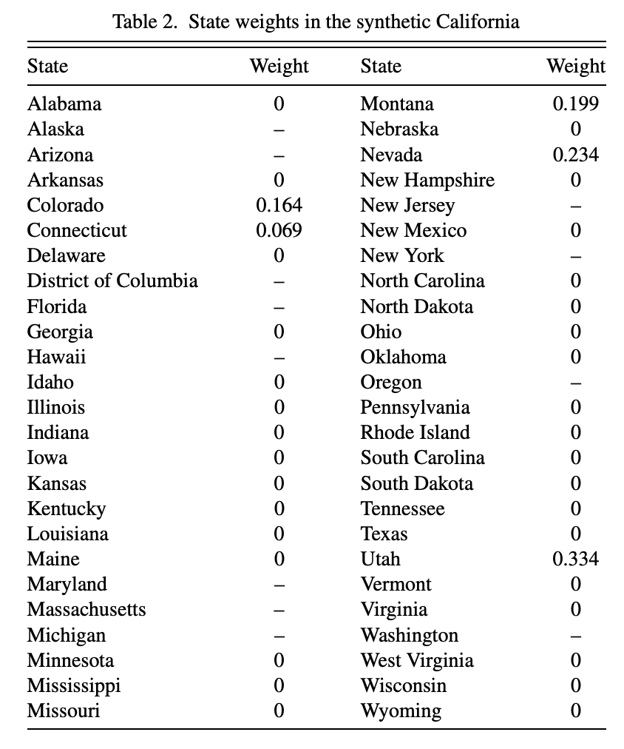
How did they make “synthetic CA”?

Slide 14
That’s how they got this result
California vs “Synthetic CA”
The paper’s conclusion: The average person in CA in 2000 bought 26 packs fewer per year than they would have without Prop. 99.
This is the implied “causal” effect.

Slide 15

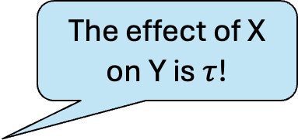


Do we believe the results?
Placebo analysis!
The effect of X on Y is $τ$!
What should our $\tilde{Data}$ be?
Complicated
Statistics!
$$\tilde{Data}$$
Slightly fudged data where we think we know the answer.
(Can fudge with Y, or with treated/non-treated assignment, or…)
Whatever process we have to do synthetic controls

Slide 16
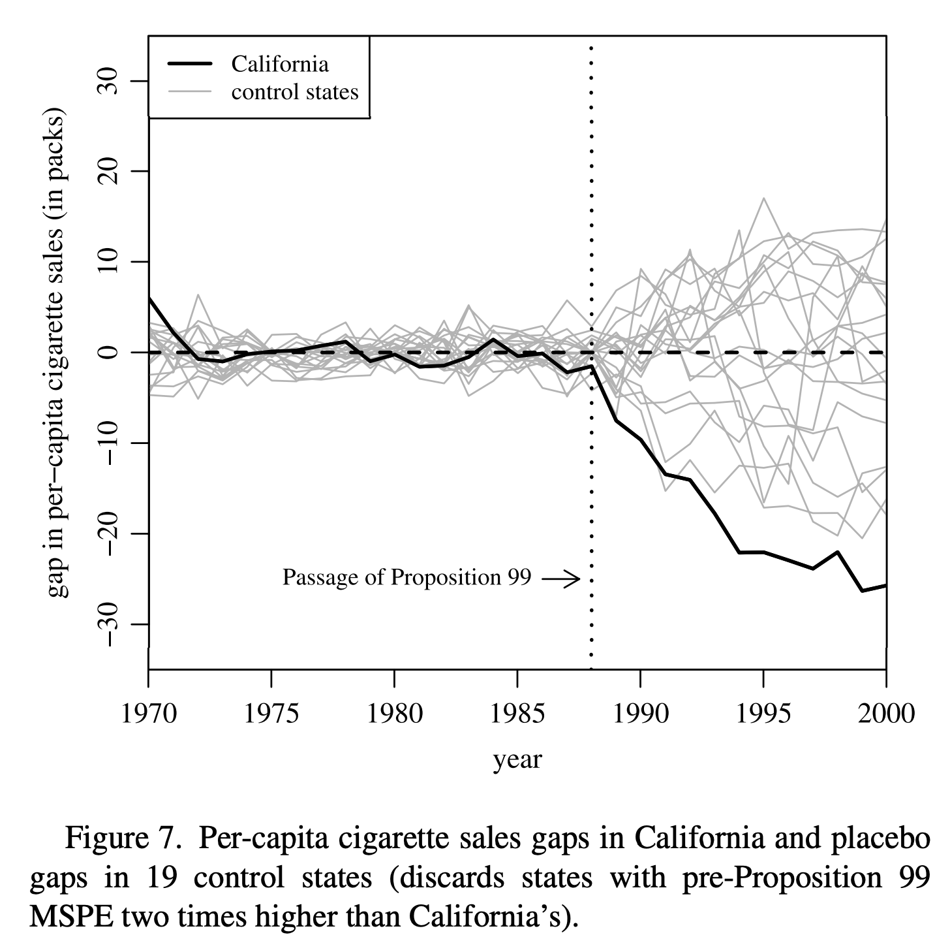


Do we believe it?
Placebo analysis!
The effect of Prop 99 on Nevada is $τ$!
Complicated
Statistics!
$$\tilde{Data}$$
Suppose that we treat, say, Nevada, as the “treated” state. Do we get results as extreme?
What we would get if we did the same analysis for the 19 other states that can be “syntheticified” about as well as CA can be.

Slide 17
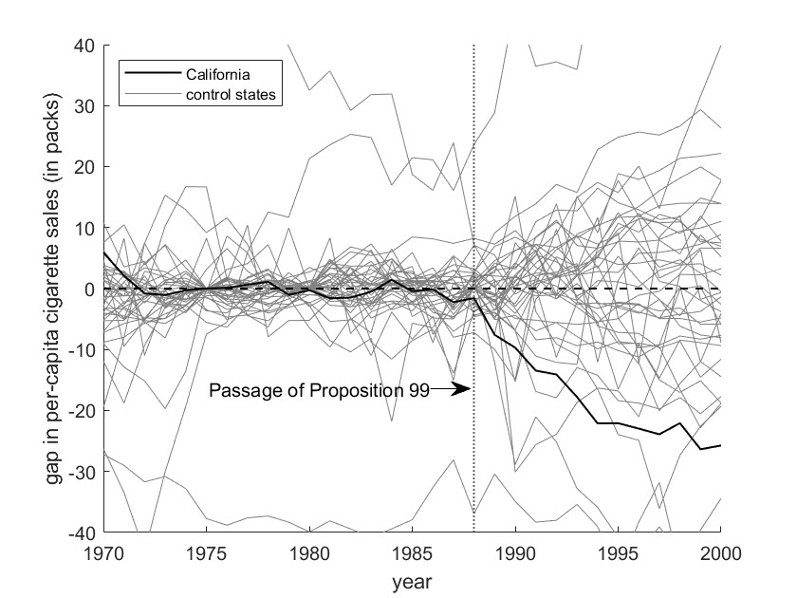
Do we believe it?
Placebo analysis!
The effect of Prop 99 on Nevada is $τ$!
Complicated
Statistics!
$$\tilde{Data}$$
Suppose that we treat, say, Nevada, as the “treated” state. Do we get results as extreme?
What we would get if we did the same analysis for all the 38 other states.

Slide 18
Questions about this idea
How do we implement it?
How can we find which countries to average?
With what weights?
Can we take into account covariates?
Does it matter that Lothlorian has a population of mostly elves, while the UK has a population of mostly humans?
How does this compare to other approaches we’ve seen?
Difference-in-differences; Matrix completion

Slide 19
How do we find the best weights?

Slide 20



















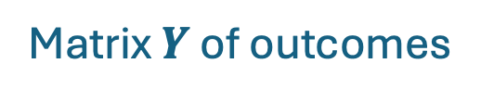
Suppose there are no covariates
All you have is cigarette sales
Years
1970
1971
2000
$$1$$
$$2$$
$$T$$
What would you do?
Or, what optimization problem would you ask a computer to solve?
1
2
3
AL
$$Y_{1,1}$$
$$Y_{1,2}$$
$$⋯$$
$$Y_{1,T}$$
AK
$$Y_{2,1}$$
$$Y_{2,2}$$
$$Y_{2,T}$$
States
$$Y_{3,1}$$
$$Y_{3,2}$$
$$Y_{3,T}$$
CA
$$⋮$$
$$⋮$$
$$⋮$$
n
$$Y_{n,1}$$
$$Y_{n,2}$$
$$⋯$$
$$Y_{n,T}$$
WY
Matrix $Y$ of outcomes

Slide 21
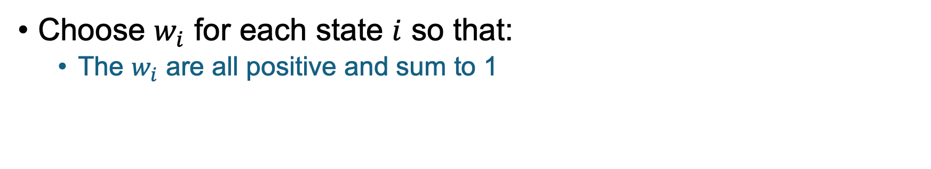
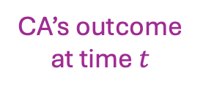
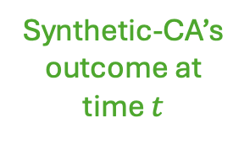
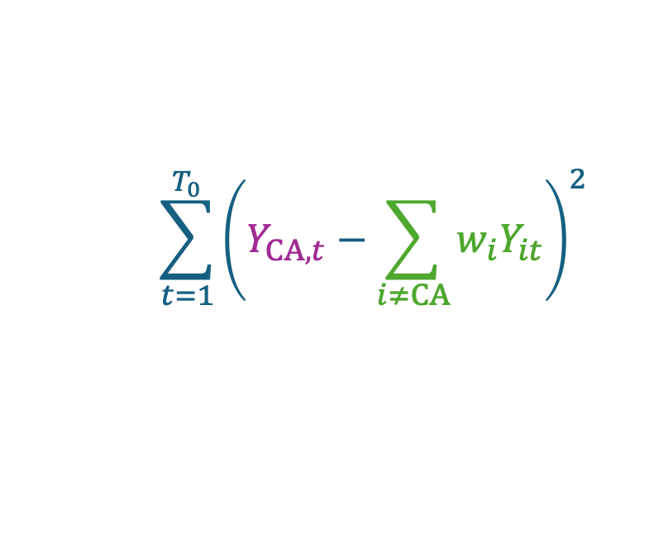
Minimize MSE!
Choose $w_{i}$ for each state $i$ so that:
The $w_{i}$ are all positive and sum to 1
$$\sum_{t=1}^{T_{0}}{{\left(Y_{CA,t}−\sum_{i≠CA}{w_{i}Y_{it}}\right)}^{2} }$$
The error
is as small as possible
Sum over all time periods before the treatment
CA’s outcome at time $t$
Synthetic-CA’s outcome at time $t$

Slide 22


















What if you had covariates?
Years
Beer consumption per capita
Percent of population aged 15-24
1970
1971
2000
GDP per capita
Retail price of cigarettes
$$1$$
$$2$$
$$T$$
1
2
3
AL
$$Y_{1,1}$$
$$Y_{1,2}$$
$$⋯$$
$$Y_{1,T}$$
$$Z_{1,GDP}$$
$$Z_{1,beer}$$
$$Z_{1,\$}$$
$$Z_{1,age}$$
AK
$$Y_{2,1}$$
$$Y_{2,2}$$
$$Y_{2,T}$$
$$Z_{2,GDP}$$
$$Z_{2,beer}$$
$$Z_{2,\$}$$
$$Z_{2,age}$$
States
$$Y_{3,1}$$
$$Y_{3,2}$$
$$Y_{3,T}$$
$$⋮$$
$$⋮$$
$$⋮$$
$$⋮$$
$$⋮$$
$$⋮$$
$$⋮$$
WY
n
$$Y_{n,1}$$
$$Y_{n,2}$$
$$⋯$$
$$Y_{n,T}$$
$$Z_{n,GDP}$$
$$Z_{n,beer}$$
$$Z_{n,\$}$$
$$Z_{n,age}$$
What would you do to find the weights?
Or, what optimization problem would you ask a computer to solve?

Slide 23
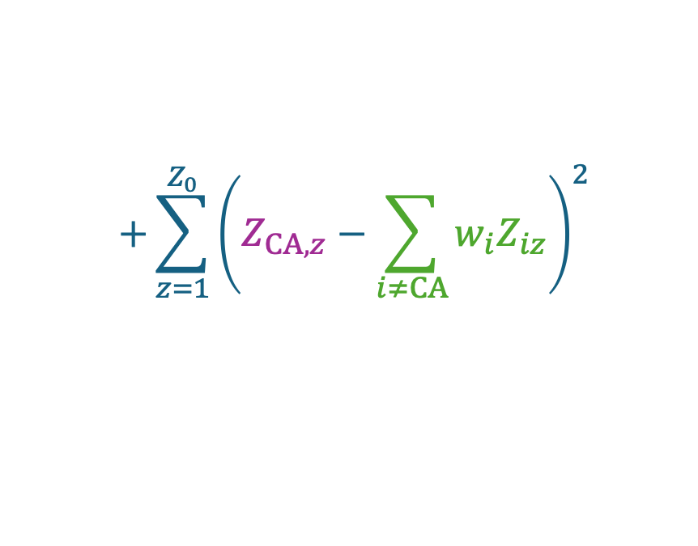
Minimize MSE!
Choose $w_{i}$ for each state $i$ so that:
The $w_{i}$ are all positive and sum to 1
$$\sum_{t=1}^{T_{0}}{{\left(Y_{CA,t}−\sum_{i≠CA}{w_{i}Y_{it}}\right)}^{2} }$$
$$+\sum_{z=1}^{Z_{0}}{{\left(Z_{CA,z}−\sum_{i≠CA}{w_{i}Z_{iz}}\right)}^{2} }$$
The error
is as small as possible
CA’s covariate value
Sum over all time periods before the treatment
CA’s outcome at time $t$
Synthetic-CA’s outcome at time $t$
Synthetic-CA’s covariate value
Sum over all covariates

Slide 24
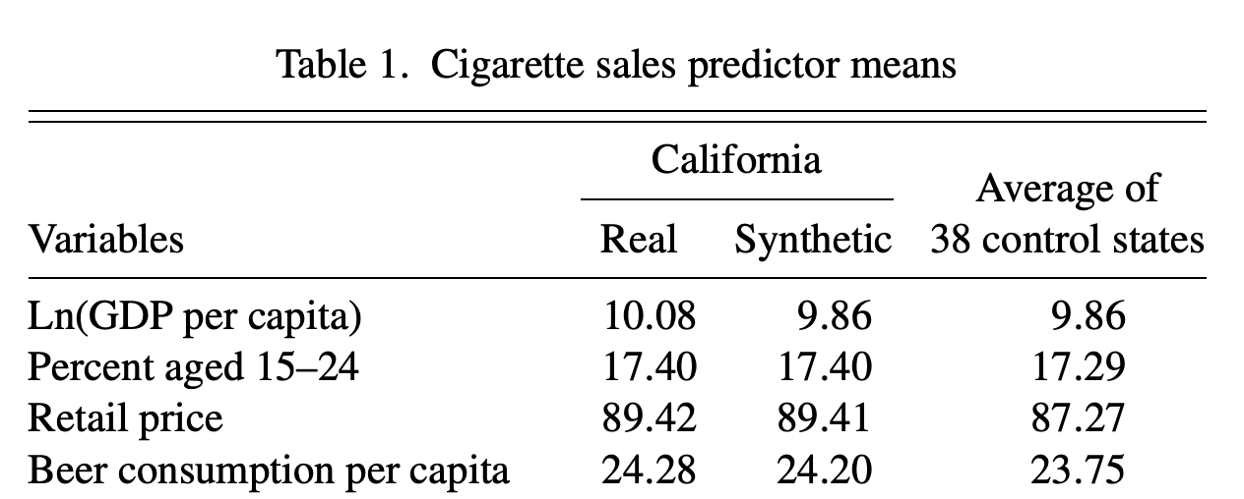
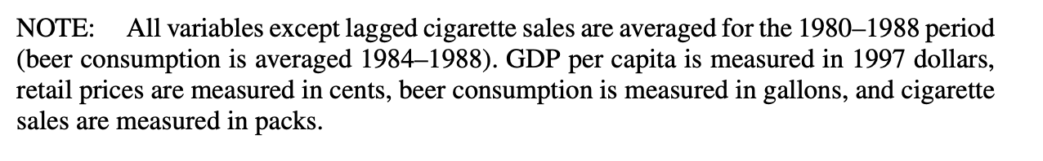
In this example…
Synthetic CA has lower GDP per capita than real CA, but otherwise it matches pretty well.

Slide 25

Questions about this idea
How do we implement it?
How can we find which countries to average?
With what weights?
Can we take into account covariates?
Does it matter that Lothlorian has a population of mostly elves, while the UK has a population of mostly humans?
How does this compare to other approaches we’ve seen?
Difference-in-differences; Matrix completion

Slide 26
Seems like a good time for a break
During the break, think about how DiD, Matrix Completion, and Synthetic controls compare!
(Or just stretch)

Slide 27
So far we’ve seen three methods for dealing with panel data
Difference-in-differences
Matrix Completion
Synthetic Controls

Slide 28
DiD vs Synthetic Controls
Big assumption in DiD: Parallel Trends
Most of you said in your pre-class response that you didn’t think this holds.
Doesn’t seem very parallel!

Slide 29
Synthetic controls generalizes DiD
Suppose parallel trends did hold:
What would synthetic controls do here?
Cigarette sales
Colorado
California
Nevada
Time
Prop. 99 enacted

Slide 30
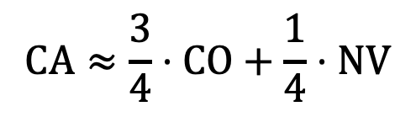
Synthetic controls generalizes DiD
Suppose parallel trends did hold:
Cigarette sales
Colorado
California
Nevada
In pre-treatment data,
Time
Prop. 99 enacted
$$CA≈\frac{3}{4}⋅CO+\frac{1}{4}⋅NV$$

Slide 31
Synthetic controls generalizes DiD
Suppose parallel trends did hold:
Cigarette sales
Colorado
Synthetic CA
California
Nevada
In pre-treatment data,
Time
Prop. 99 enacted
$$CA≈\frac{3}{4}⋅CO+\frac{1}{4}⋅NV$$

Slide 32
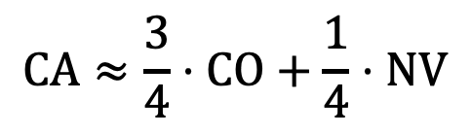
Synthetic controls generalizes DiD
Suppose parallel trends did hold:
When the parallel trends assumption does hold, SC gives the same thing as DiD!
Cigarette sales
Colorado
Synthetic CA
This is the effect of Prop. 99!
California
Nevada
In pre-treatment data,
Time
Prop. 99 enacted
$$CA≈\frac{3}{4}⋅CO+\frac{1}{4}⋅NV$$

Slide 33
Synthetic controls generalizes DiD
When the parallel trends assumption doesn’t hold, DiD doesn’t work, but synthetic controls still applies.

Slide 34

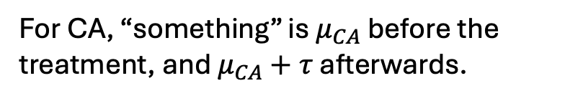

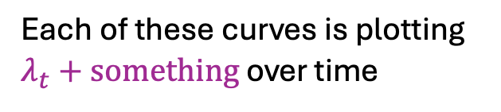
Mathematically, what’s the difference?
One (more) way to write DiD:
This is the third(?) different way we’ve written down the regression for DiD. Don’t worry about the equations if you don’t find them helpful.
$$Y_{it}=λ_{t}+μ_{i}+τ⋅D_{it}$$
Outcome for state i at time t
Was state i treated at time t?
Something that just depends on time
Something that just depends on the state
The thing we care about!
Outcome
Each of these curves is plotting $λ_{t}+something$ over time
Maryland
Colorado
Implied counterfactual for CA
For non-CA states i, “something” is $μ_{i}$
For CA, “something” is $μ_{CA}$ before the treatment, and $μ_{CA}+τ$ afterwards.
California
Treatment kicks in
Time

Slide 35
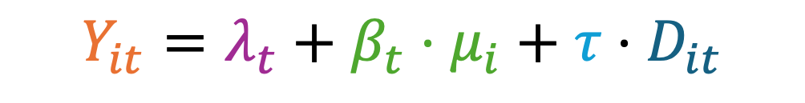
Mathematically, what’s the difference?
One (more) way to write DiD:
$$Y_{it}=λ_{t}+μ_{i}+τ⋅D_{it}$$
Outcome for state i at time t
Was state i treated at time t?
Something that just depends on time
Something that just depends on the state
The thing we care about!
The setting in which synthetic controls works:
$$Y_{it}=λ_{t}+{β_{t}⋅μ}_{i}+τ⋅D_{it}$$
Now this term gets to depend on time also!
California

Slide 36



















Matrix Completion vs. Synthetic Controls
Recall: Matrix completion.
1970
1971
2000
1970
1971
1989
2000
AL
$$X$$
$$B$$
AL
$$≈$$
$$Y_{AL,1}$$
$$Y_{AL,2}$$
$$⋯$$
$$Y_{AL,T}$$
AK
AK
$$Y_{AK,1}$$
$$Y_{AK,2}$$
$$Y_{AK,T}$$
CA
? ? ? ? ?
CA
$$Y_{CA,1}$$
$$Y_{CA,2}$$
$$Y_{CA,T}$$
$$⋮$$
$$⋮$$
WY
WY
$$Y_{WY,1}$$
$$Y_{WY,2}$$
$$⋯$$
$$Y_{WY,T}$$
Assumption: the data are approximately low-rank.
Use the low-rank model to predict the counter-factuals for CA

Slide 37



















Claim: if the data are low-rank These are doing very* similar things
Synthetic Control: Suppose CA is the average of these
Intuition:
That corresponds to CA’s “Matrix Completion Feature Vector” being the average of these!
1970
1989
2000
1970
1989
2000
AL
$$X$$
$$B$$
$$≈$$
AL
$$Y_{AL,1}$$
$$Y_{AL,2}$$
$$⋯$$
$$Y_{AL,T}$$
AK
AK
$$Y_{AK,1}$$
$$Y_{AK,2}$$
$$Y_{AK,T}$$
CA
$$Y_{CA,1}$$
$$Y_{CA,2}$$
? ? ? ? ?
CA
$$Y_{CA,T}$$
$$⋮$$
$$⋮$$
WY
$$Y_{WY,1}$$
$$Y_{WY,2}$$
$$⋯$$
$$Y_{WY,T}$$
WY

Slide 38
Claim: if the data are low-rank These are doing very* similar things
Intuition:
Synthetic Control:
Predict ???? by the average of these
Matrix completion: predict ???? by to this matrix-vector product, which (turns out) is the same thing!
1970
1989
2000
1970
1989
2000
AL
$$X$$
$$B$$
$$≈$$
AL
$$Y_{AL,1}$$
$$Y_{AL,2}$$
$$⋯$$
$$Y_{AL,T}$$
AK
AK
$$Y_{AK,1}$$
$$Y_{AK,2}$$
$$Y_{AK,T}$$
CA
$$Y_{CA,1}$$
$$Y_{CA,2}$$
? ? ? ? ?
CA
$$Y_{CA,T}$$
$$⋮$$
$$⋮$$
WY
$$Y_{WY,1}$$
$$Y_{WY,2}$$
$$⋯$$
$$Y_{WY,T}$$
WY

Slide 39
Synthetic controls vs Matrix completion
If the data matrix is approximately low rank, they are doing approximately* the same thing.
So whenever Matrix Completion applies, Synthetic Controls is doing approximately the same thing.

Slide 40
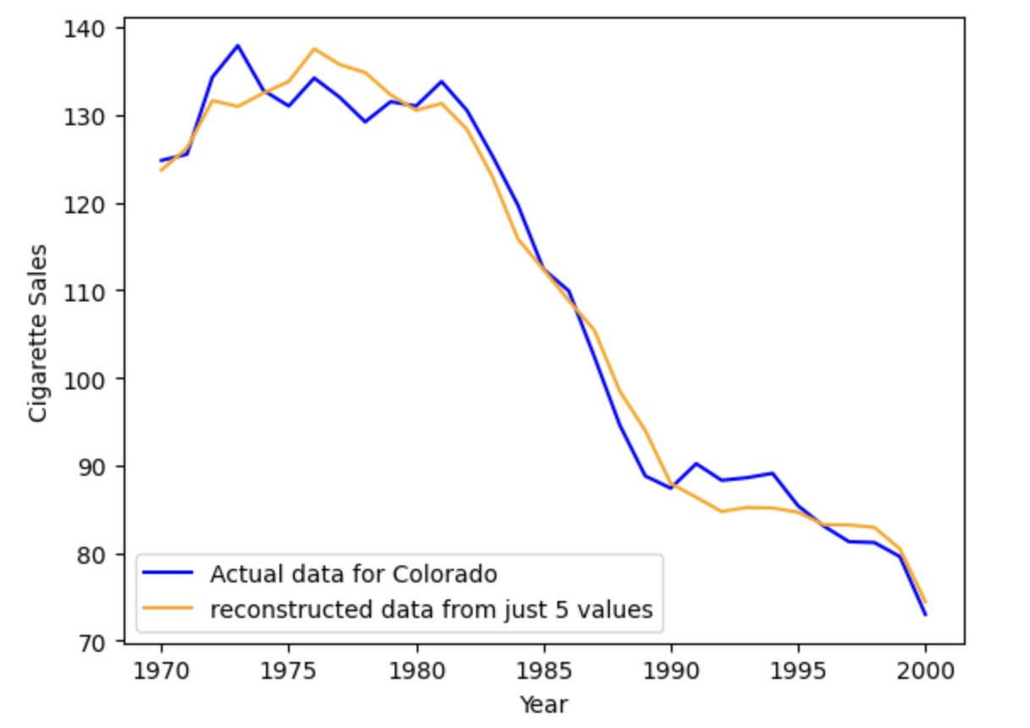
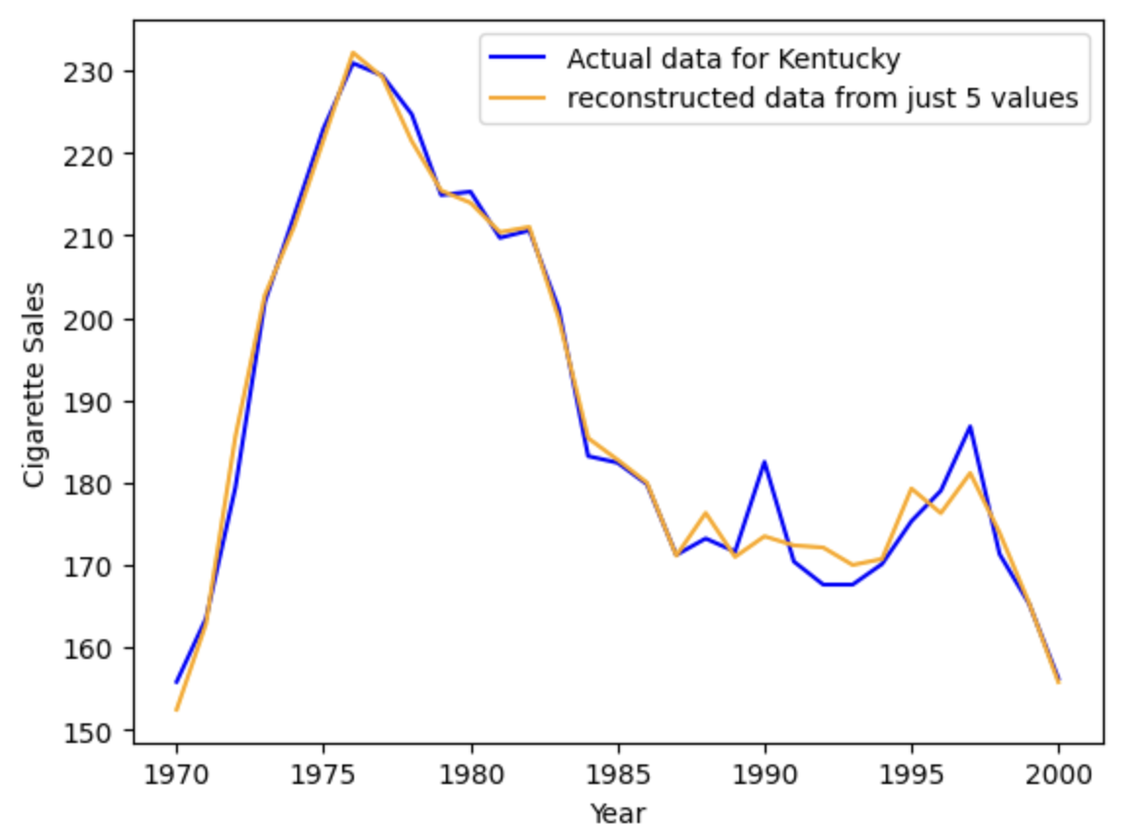
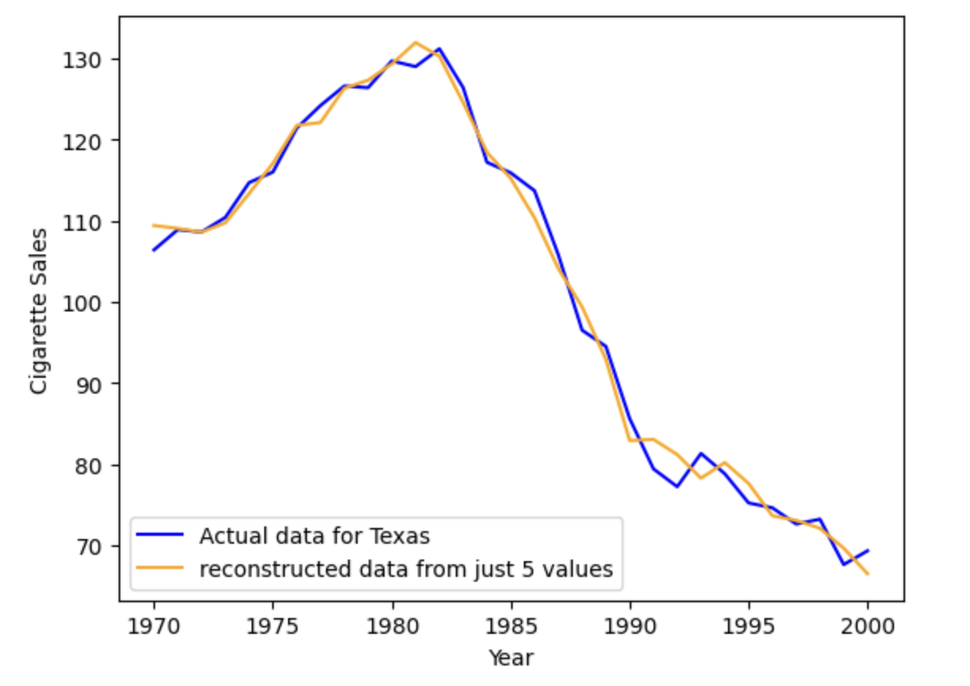
In this example?
The data are indeed approximately low-rank
Well-approximated by a matrix of rank <5.

Slide 41
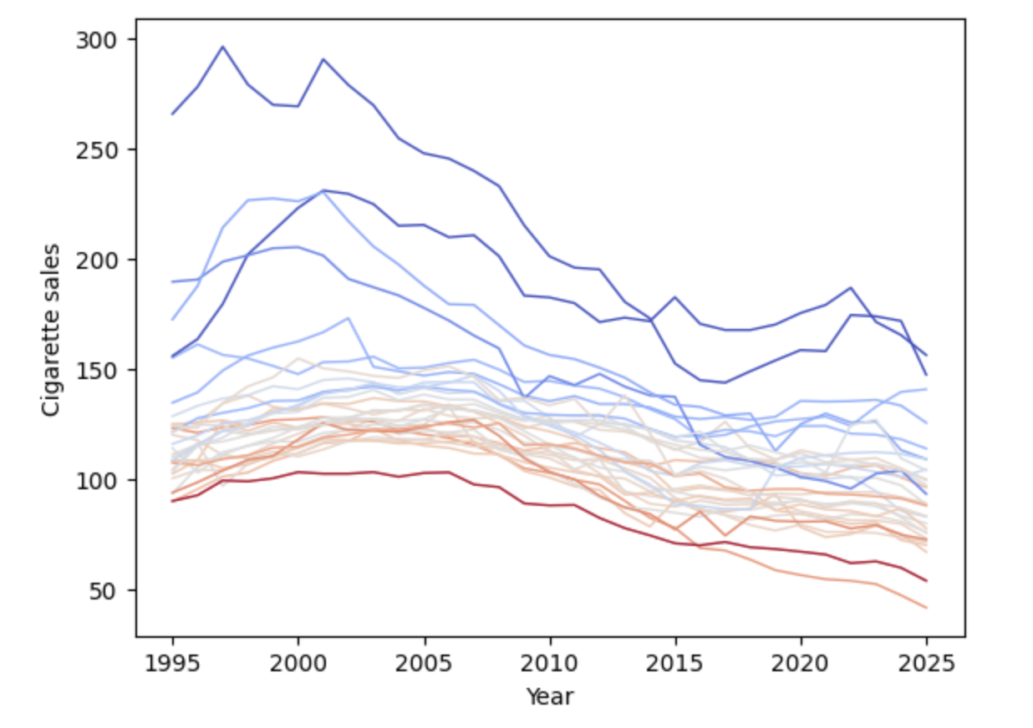
Most important feature
Average level of cigarette sales?

Slide 42
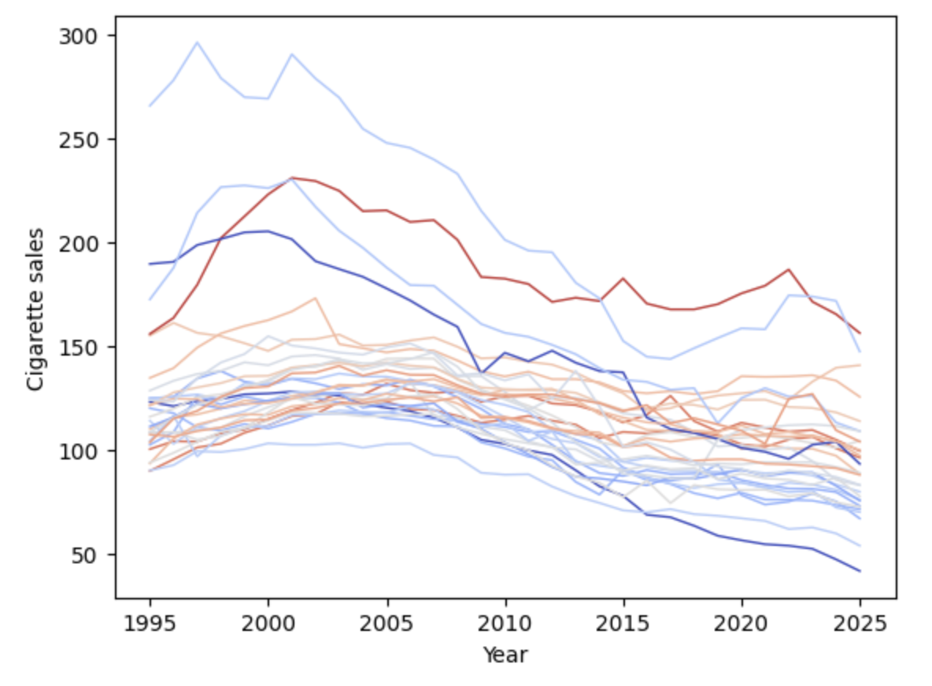
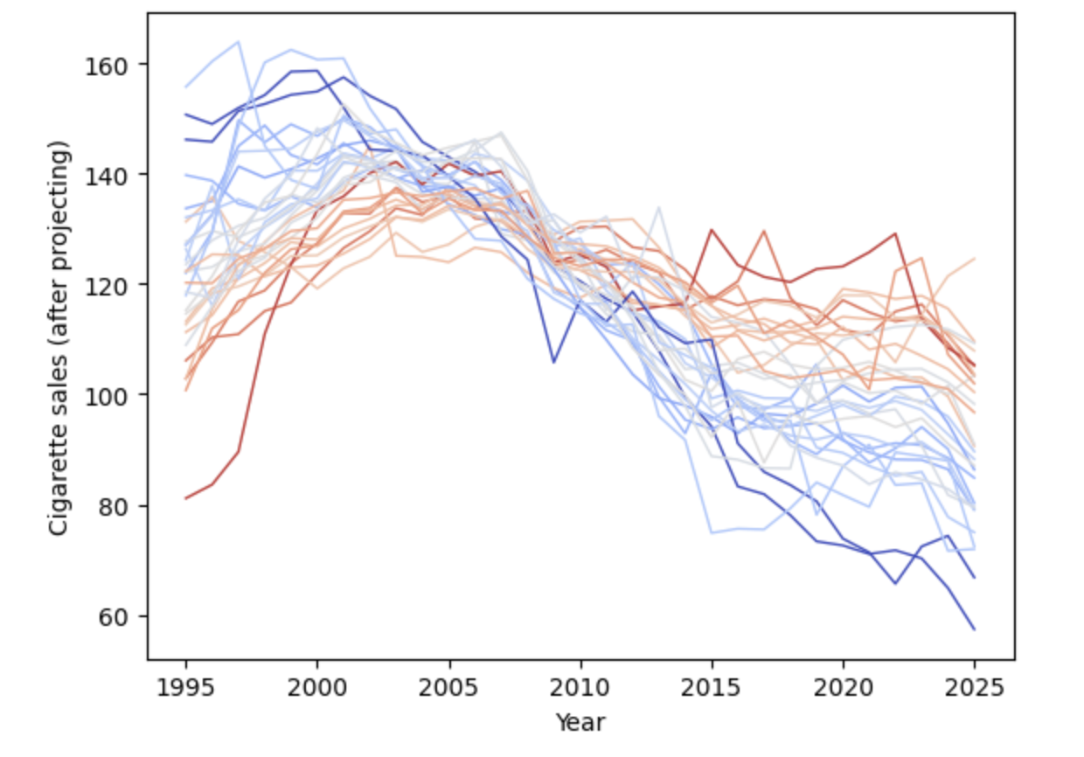
Second most important feature
Steepness of decline?

Slide 43
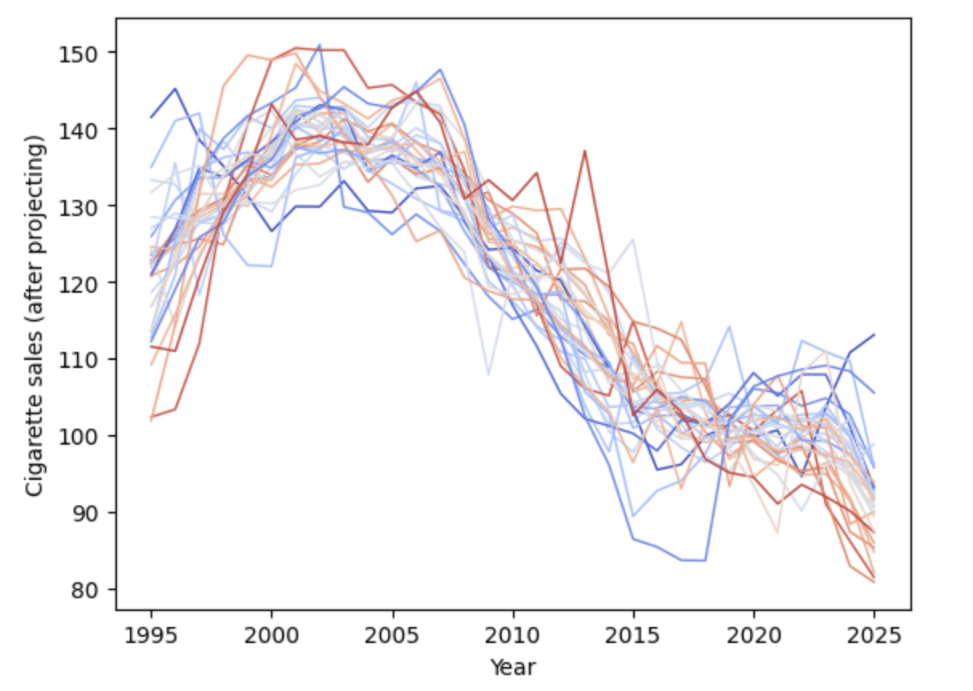
Third most important feature?
Kind of hard to tell…

Slide 44
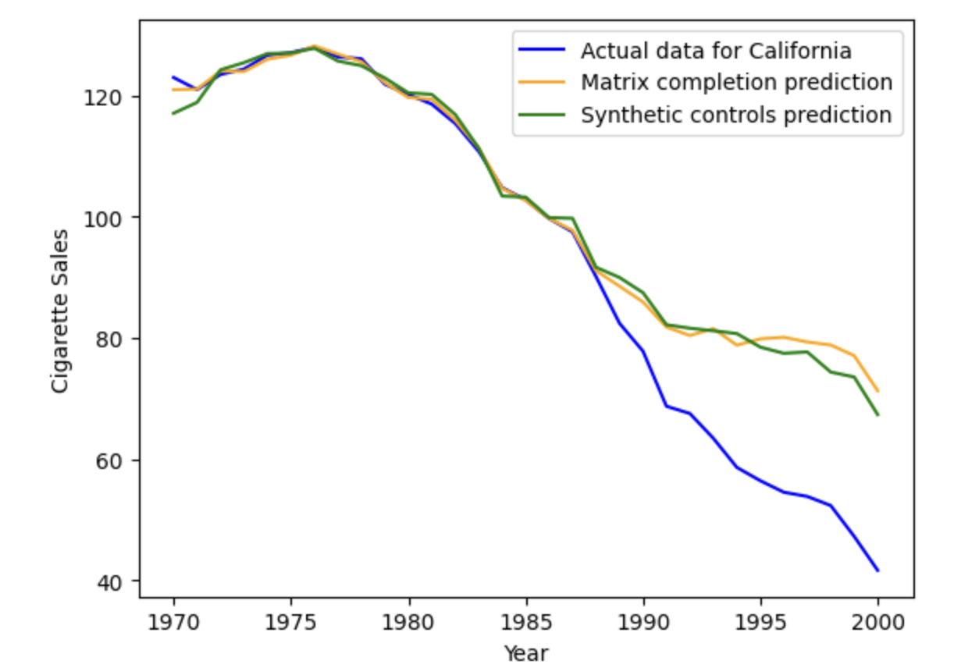
…And we get pretty similar results

Slide 45
Do you believe these results?
What assumptions is the synthetic controls approach making?
What might it be missing?
Discuss!

Slide 46
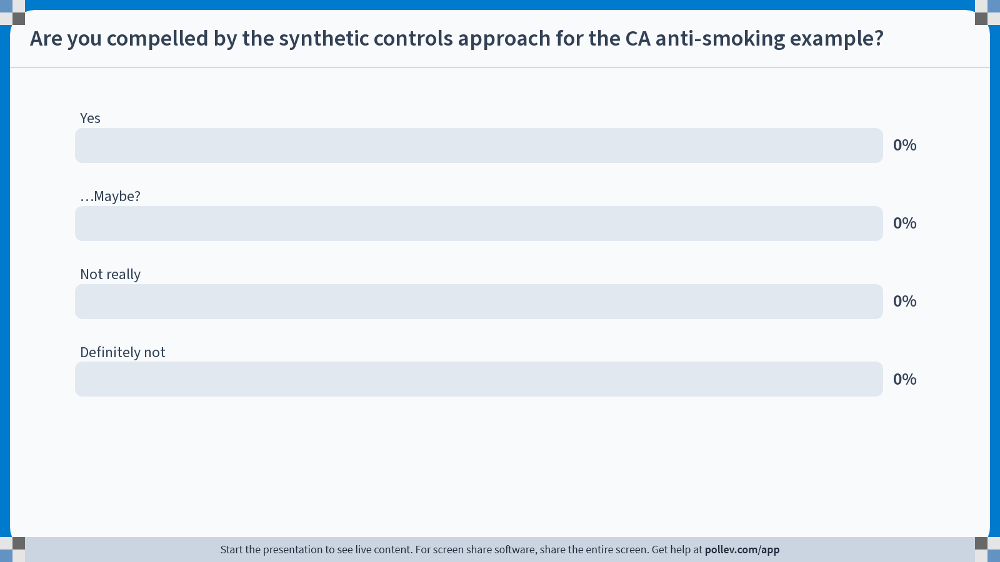
Notes:
Do not modify the notes in this section to avoid tampering with the Poll Everywhere activity. More info at polleverywhere.com/support Are you compelled by the synthetic controls approach for the CA anti-smoking example?
https://www.polleverywhere.com/multiple_choice_polls/X6apMw7EczW87nEanK9et?state=opened&flow=Default&onscreen=persist

Slide 47
One big concern
There’s something different about CA from the weighted average of {CO, CT, MO, NV, UT} that caused CA to pass such a bill when those other states did not…
It’s not captured in the covariates they looked at, but that doesn’t mean it isn’t there…
On the one hand, maybe it’s just that the CA proposition system makes it easy to pass such legislation, which maybe is unrelated to smoking?
On the other hand, maybe it’s something relevant, like an eagerness to follow health trends.

Slide 48
Spillovers?
When MA raised taxes on cigarettes, cigarette sales went down in MA, but went way up in NH…
Maybe it’s okay in CA, since it’s a long drive to NV from most major CA cities? (As opposed to a 1 hour drive to NH from Boston).

Slide 49
Which of the three approaches would you find most compelling to study Brexit?
Difference-in-differences
Matrix Completion
Synthetic Controls
Discuss!

Slide 50
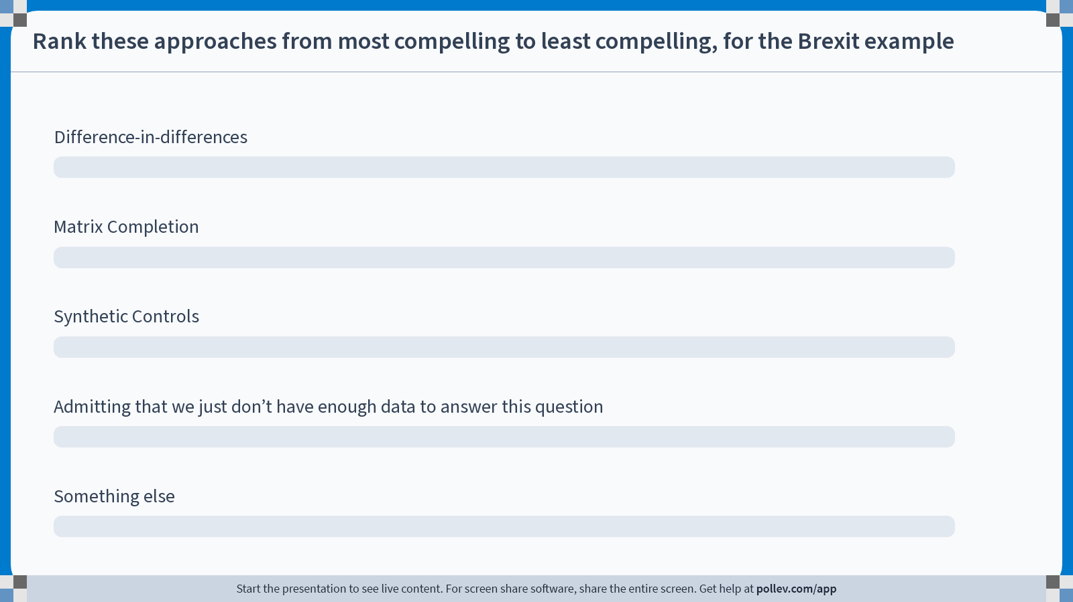
Notes:
Do not modify the notes in this section to avoid tampering with the Poll Everywhere activity. More info at polleverywhere.com/support Rank these approaches from most compelling to least compelling, for the Brexit example
https://www.polleverywhere.com/ranking_polls/3EhN09jviKeUC6n5SVBK9

Slide 51
Take-aways
Synthetic Controls, Matrix Completion, Diff-in-Diff are all similar in flavor:
We want to predict the counterfactual for the treated unit based on other units!
How well this works depends on how well the other units represent the treated unit.
DiD: Do we have parallel trends?
MC and SC: Can we make our treated unit as some linear combination of other units?
All: Do we believe that a past relationship would have carried on into the future?

Slide 52
What just happened?
Nine weeks in nine slides!

Slide 53
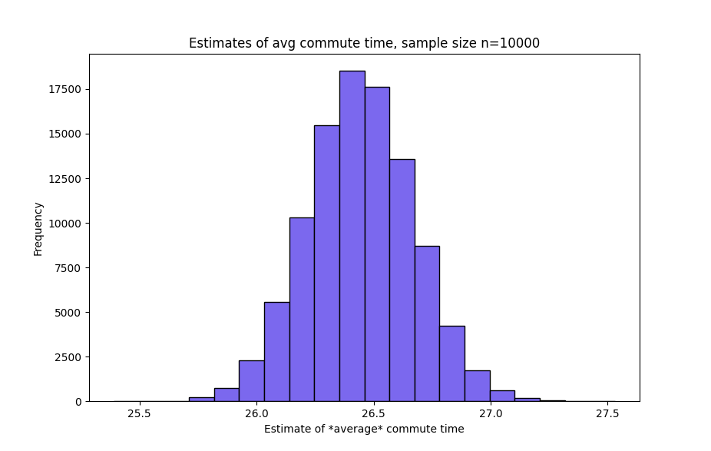
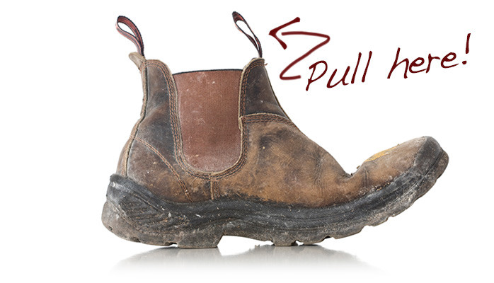
OMG STATISTICS
n=10,000
How good is an estimator?
Standard Errors!
Confidence Intervals!
p-values!
How do we estimate those?
Analytically! Usually by invoking the central limit theorem!
Empirically via resampling, aka the bootstrap!

Slide 54
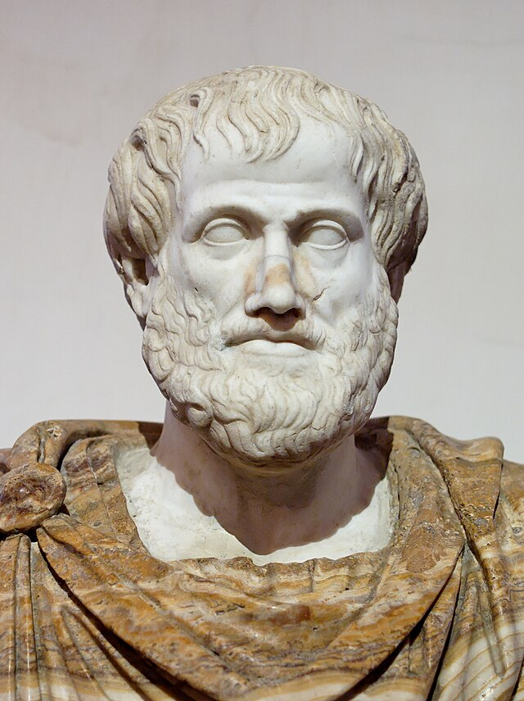


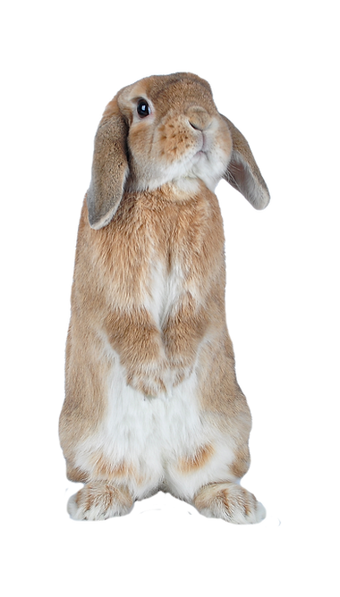
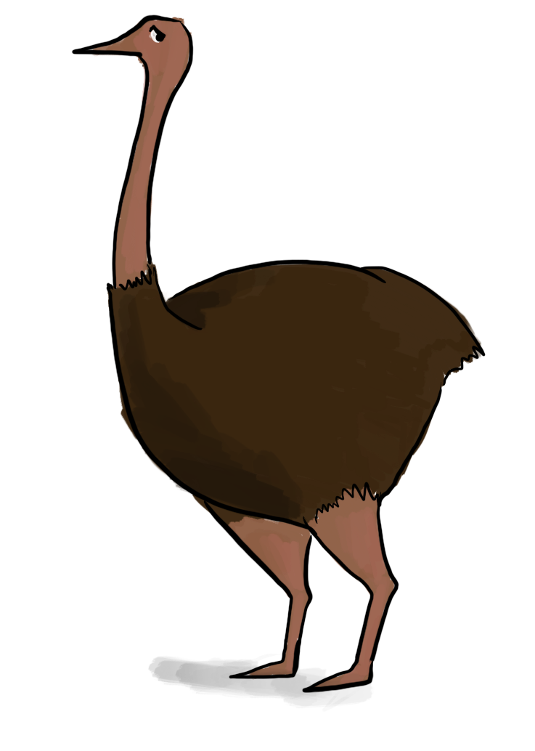



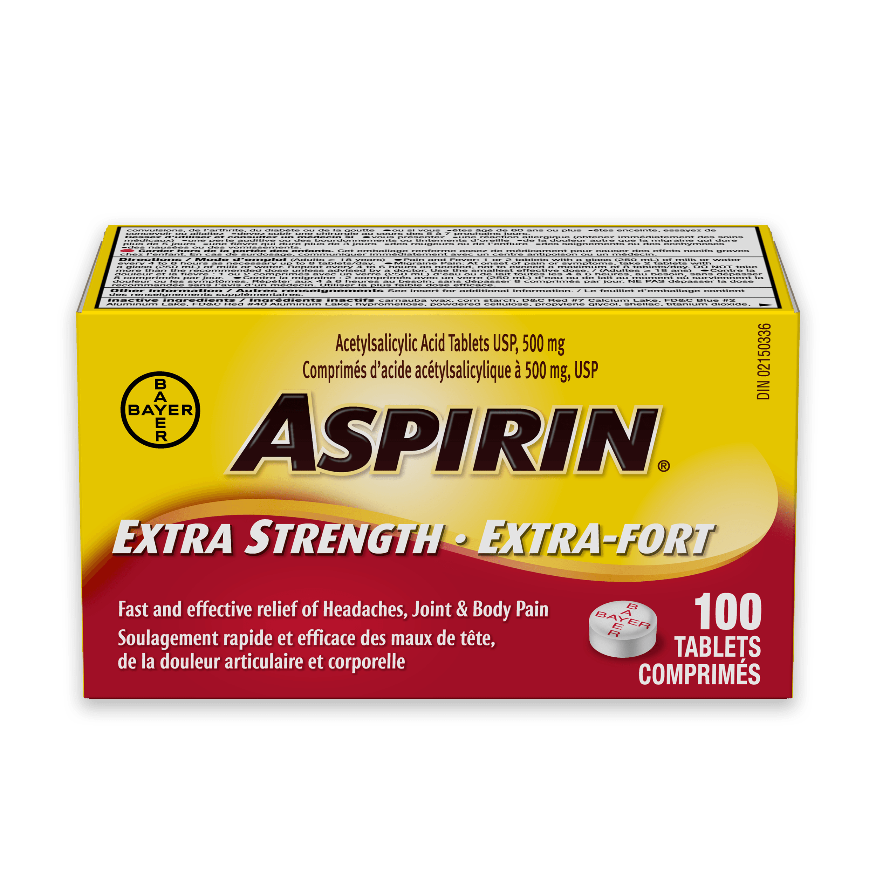


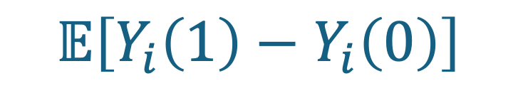
What is Causality? Definitely not the same as correlation!
Four types of causes:
Material: “Out of which the thing is made”
Formal: “Into which the thing is made”
Efficient: “What makes the thing”
Final: “For which the thing is made”
Philosophers have argued about it for a long time…
For us: it’s all about counterfactuals!
Potential outcomes:
What would have happened otherwise
Average Treatment Effect (ATE):
Aristotle
(4th c. BCE)
$$𝔼\left[Y_{i}\left(1\right)−Y_{i}\left(0\right)\right]$$
$$1$$
$$2$$
$$3$$
$$4$$
$$5$$
$$6$$
$$i$$
Fundamental problem of causal inference: We can’t compute this!
REDACTED
$$Y_{1}\left(1\right)=1$$
$$Y_{2}\left(1\right)=1$$
$$Y_{3}\left(1\right)=1$$
$$Y_{4}\left(1\right)=0$$
$$Y_{5}\left(1\right)=1$$
$$Y_{6}\left(1\right)=0$$
$$Y_{1}\left(0\right)=0$$
$$Y_{2}\left(0\right)=0$$
$$Y_{3}\left(0\right)=0$$
$$Y_{4}\left(0\right)=0$$
$$Y_{5}\left(0\right)=0$$
$$Y_{6}\left(0\right)=1$$

Slide 55



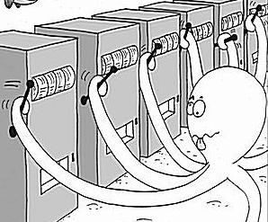
The magic of randomization!
With a randomized experiment, we can get an unbiased estimator for the ATE!
But we should still be worried…
External Validity
Construct Validity
Spillover Effects
Ethical Concerns
We can do fancy experiments!
Adaptive experiments and multi-armed bandits!
Thompson Sampling! UCB!
I’m going to do an RCT to see if parachutes work!
I mean, I’m glad I’m in the treatment group, but is this really necessary?

Slide 56
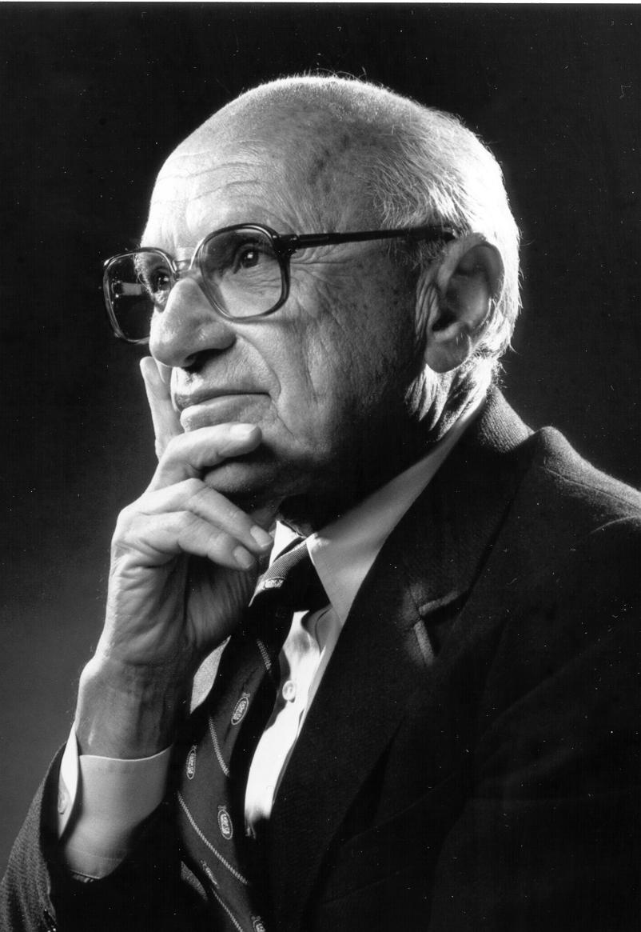

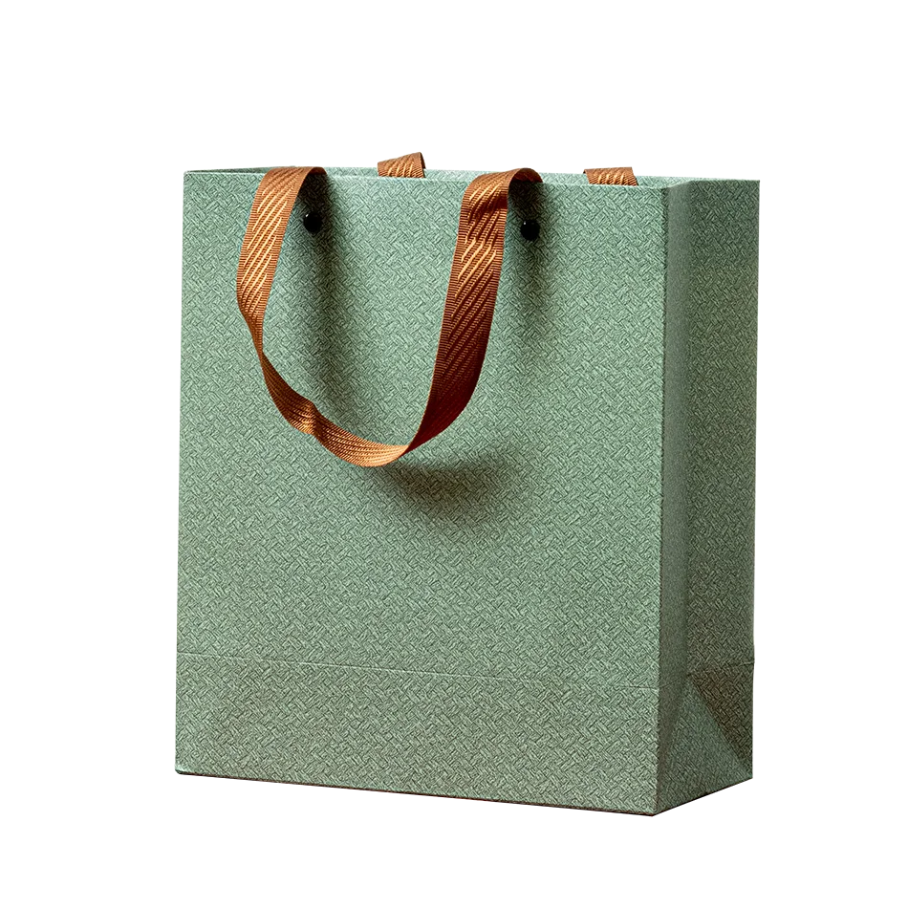



The effect of UBI
When people win a one-time lottery, they will only increase consumption by a little bit.
Oh is that so?
Milton Friedman
“Common Sense”

Slide 57
Regression!
One-dimensional version: find the line of best fit!
If we throw in more covariates we can “control” for them
We can do that for settings where folks get (hopefully) random-ish windfall income to see what happens!
Results are mixed.
Unexpected benefits payouts!
Lottery winners!
OpenResearch UBI study!
Consumption
Windfall Income
Permanent Income
We can also use non-parametric models, like random forests and causal forests!

Slide 58


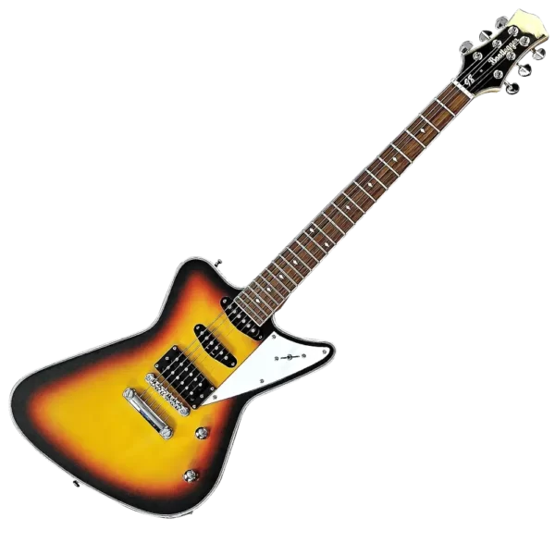

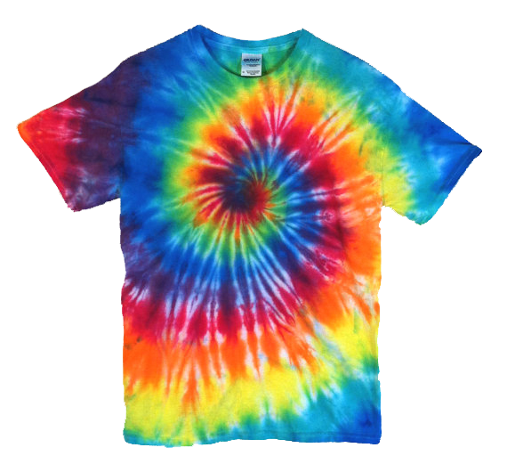

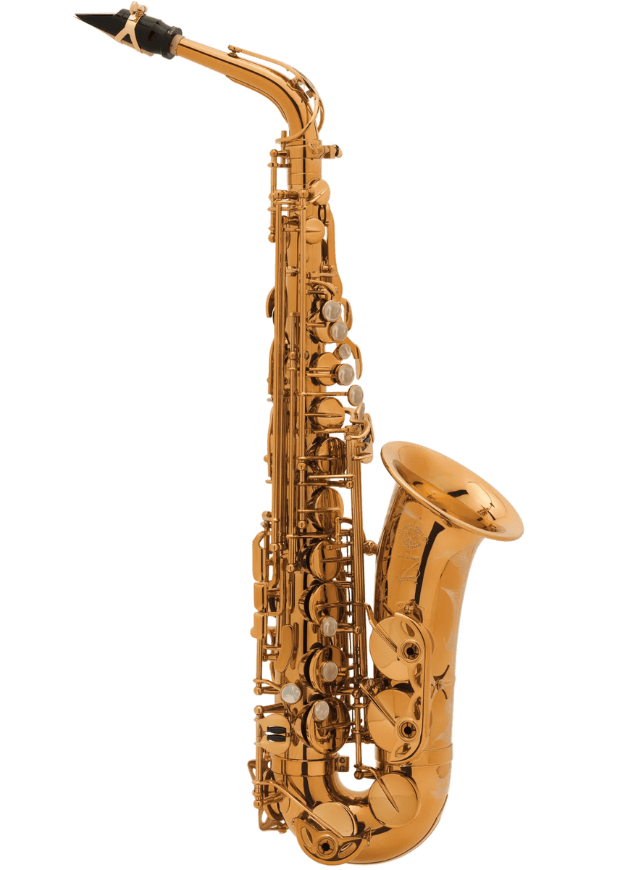
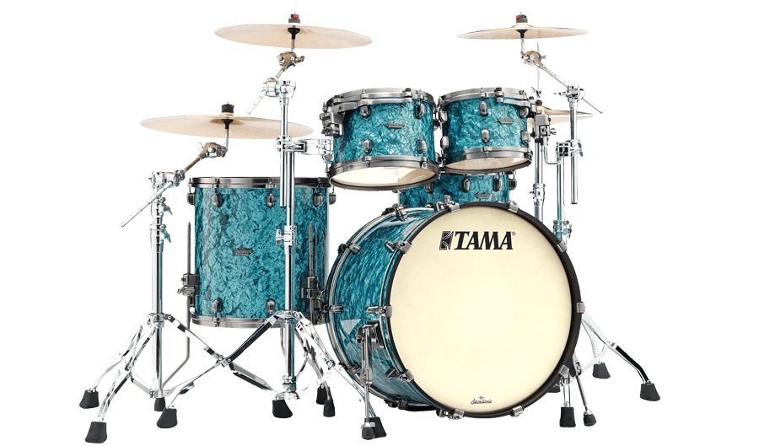
Returns to Education And IV and LATE!
More regressions yay!
Omitted Variable Bias! What happens if we don’t control for everything.
Twin studies! An attempt to control for everything!
Instrumental variables!
$$Z$$
$$X$$
$$Y$$
We can’t learn ATE…but we can learn LATE!
ATE on the compliers
And we can even do it for fancier settings! (Under some assumptions. Void where prohibited.)
Multiple instruments! Continuous treatments! 2SLS! Neural Networks!
Instrumental
Variable!
Quarter of birth!
Draft lottery number!
Proximity to college!
Always-Takers
Never-Takers
Compliers
Drafted
Not
Drafted

Slide 59


More Returns to Education Regression Discontinuity!
ln(Earnings)
$$\hat{β}$$
RD idea:
Sharp cut-offs $⇒$ Natural experiment!
1300
Z (SAT Score)
SAT: 1290
SAT: 1310
Basically the same rabbit, but have very different probabilities of attending college!
Fuzzy RD: Analyze it like IV!

Slide 60
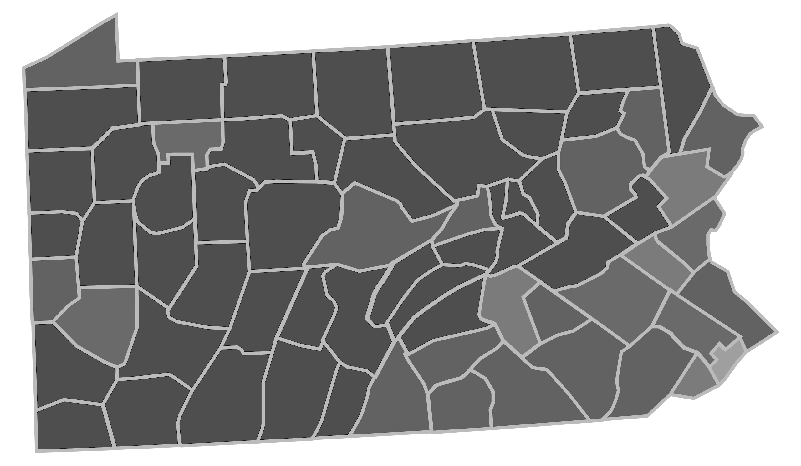


























































Panel Data!
$$1$$
$$2$$
$$⋯$$
$$T$$
$$1$$
$$2$$
$$⋯$$
$$T$$
$$1$$
$$2$$
$$⋯$$
$$T$$
1
2
3
1
2
3
1
2
3
$$0$$
$$0$$
$$⋯$$
$$0$$
$$Y_{1,1}$$
$$Y_{1,2}$$
$$⋯$$
$$Y_{1,T}$$
$$?$$
$$?$$
$$⋯$$
$$?$$
$$0$$
$$0$$
$$0$$
$$Y_{2,1}$$
$$Y_{2,2}$$
$$Y_{2,T}$$
$$?$$
$$?$$
$$?$$
$$0$$
$$0$$
$$0$$
$$Y_{3,1}$$
$$Y_{3,2}$$
$$Y_{3,T}$$
$$?$$
$$?$$
$$?$$
$$⋮$$
$$⋮$$
$$⋮$$
$$⋮$$
$$⋮$$
$$⋮$$
$$⋮$$
$$⋮$$
$$⋮$$
n
$$0$$
$$0$$
$$⋯$$
$$0$$
$$1$$
$$1$$
$$1$$
n
$$Y_{n,1}$$
$$Y_{n,2}$$
$$⋯$$
$$Y_{n,T−2}(0) Y_{n,T−1}(0) Y_{n,T}(0)$$
n
$$?$$
$$?$$
$$⋯$$
$$?$$
$$Y_{n,T−2}{ Y}_{n,T−1} { Y}_{n,T}$$
So many examples!
Matrix $W$ of treatments
Matrix $Y(0)$ of potential outcomes if not treated
Matrix $Y(1)$ of potential outcomes if treated
We’re raising the minimum wage!
Terrorism in the Basque Country
New Jersey
(NJ)
Palo Alto Watershed
Pennsylvania (PA)
Stanford
sub-watershed
Nah.
Minimum Wage
Brexit
Immigration and the Mariel Boatlift
COVID policies at Stanford
Anti-Smoking Campaigns

Slide 61






Three Methods and a Sanity-Check
Difference-in-Differences
Matrix Completion
Synthetic Controls
Placebo Methods
Untreated unit
Implied counterfactual
Treated unit
Treatment
Time
$$X$$
$$B$$
$$Y$$
The effect of Prop 99 on Nevada is $τ$!
? ? ? ? ?
Complicated
Statistics!
$$≈$$
$$\tilde{Data}$$
33%
I call BS!
19%
23%
= CA
16%
7%

Slide 62
And here we are!
Zooming out, a few take-aways:
Causal inference is hard.
We need to be thoughtful and to ask questions:
Is this answering a causal question? Does this extend to the population I care about? Am I measuring the right thing? …
Causal inference is hard.
We need to be creative to design solutions:
Identify natural experiments, find IVs, RDs, interesting datasets, …
Causal inference is hard.
We need to be actively skeptical of our answers:
Do placebo analyses. What testable implications does your “causal story” have? Test as many of them as you can!
But at some point, we need to make decisions.
Hopefully, we can amass enough evidence from being thoughtful enough and creative enough and skeptical enough that we can get some idea of what’s going on!

Slide 63
Next time: Project Presentations!

Slide 64


Exit ticket
Don’t forget to fill out the exit ticket before you leave class!
…and have a nice break!

