Slide 1
Panel Data!
Causality, Decision-Making, and Data Science
Class 14

Slide 2
Announcements
HW4.1 due Monday 11/17

Slide 3
Agenda
One motivating example for this unit: Brexit
What this unit is actually about: A general paradigm
Panel data and a particular statistical setting
Lots of examples
Overview of methods

Slide 4
One motivation for this unit Brexit

Slide 5
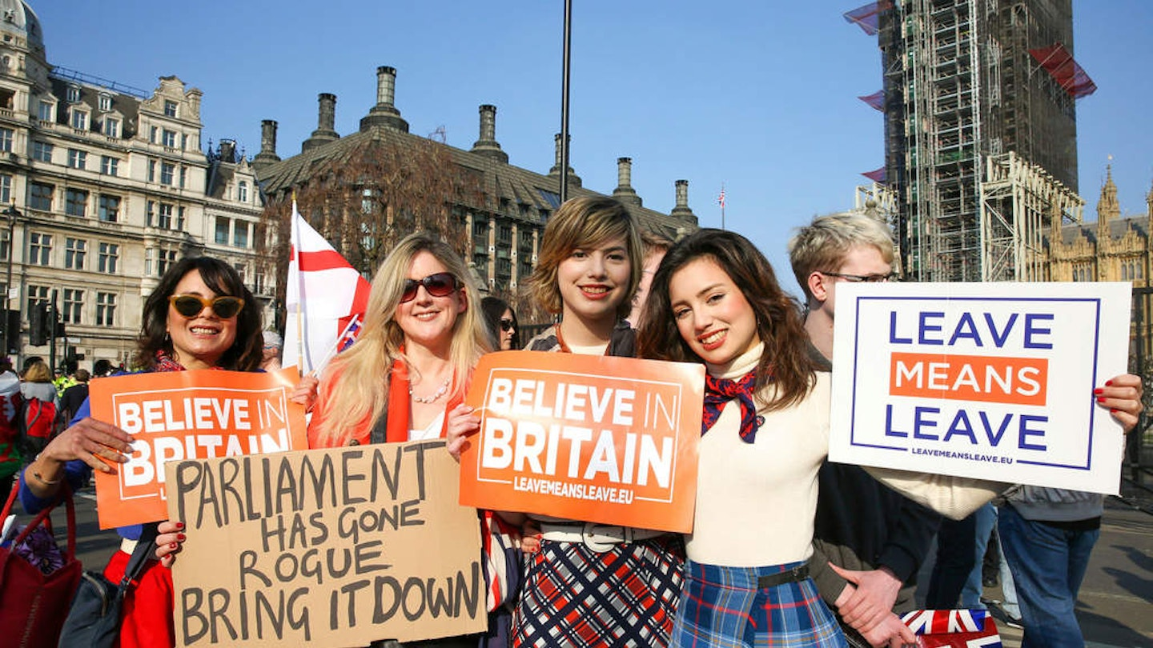
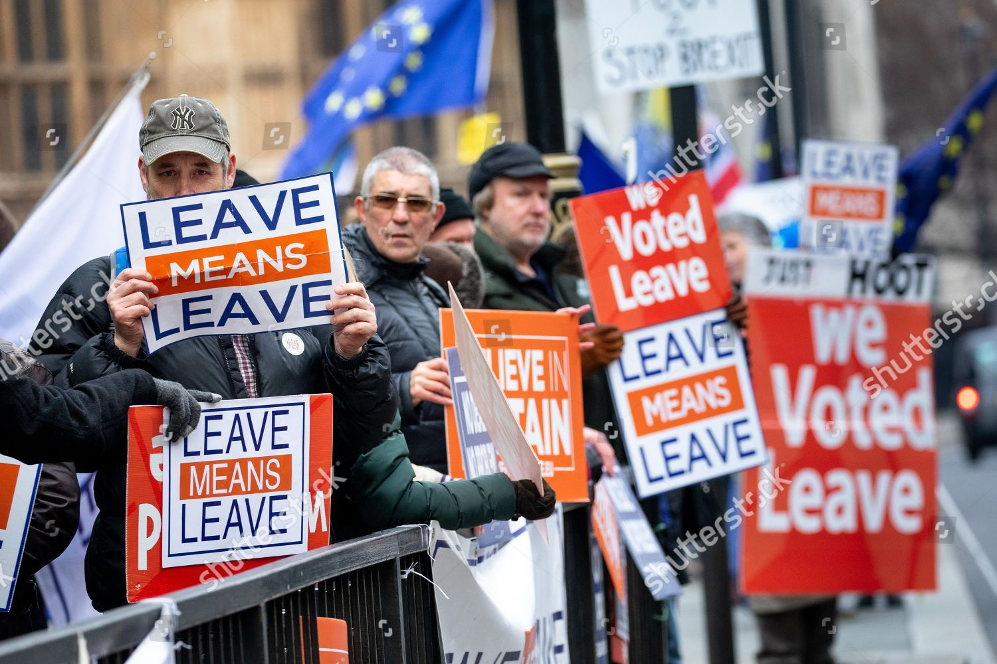
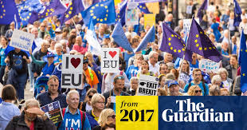
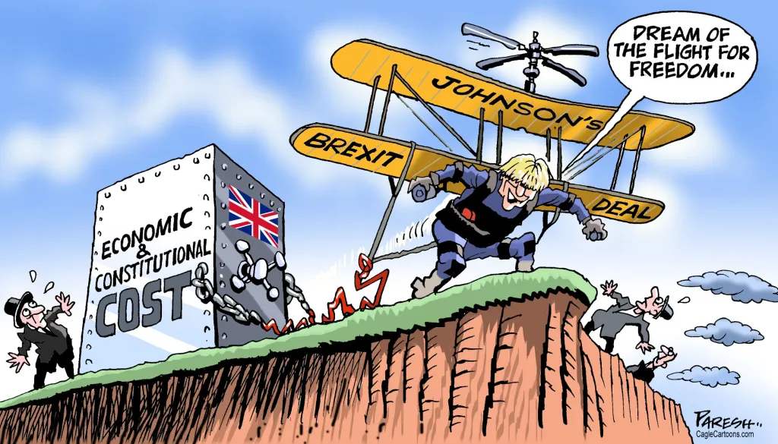
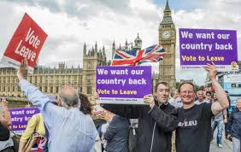
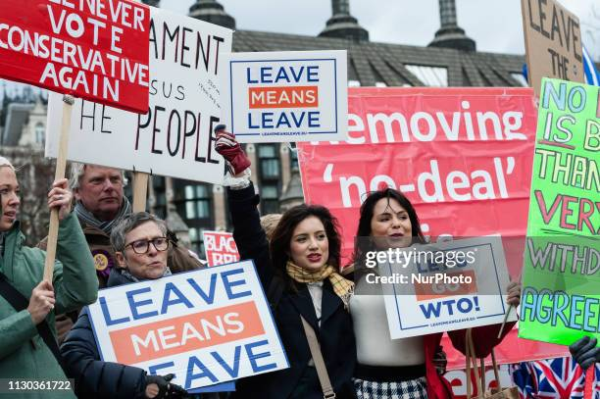

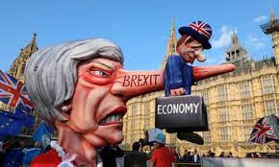
The UK left the EU in 2020
In referendum in 2016, 51.89% of voters were in favor of leaving, aka “Brexit.”

Slide 6
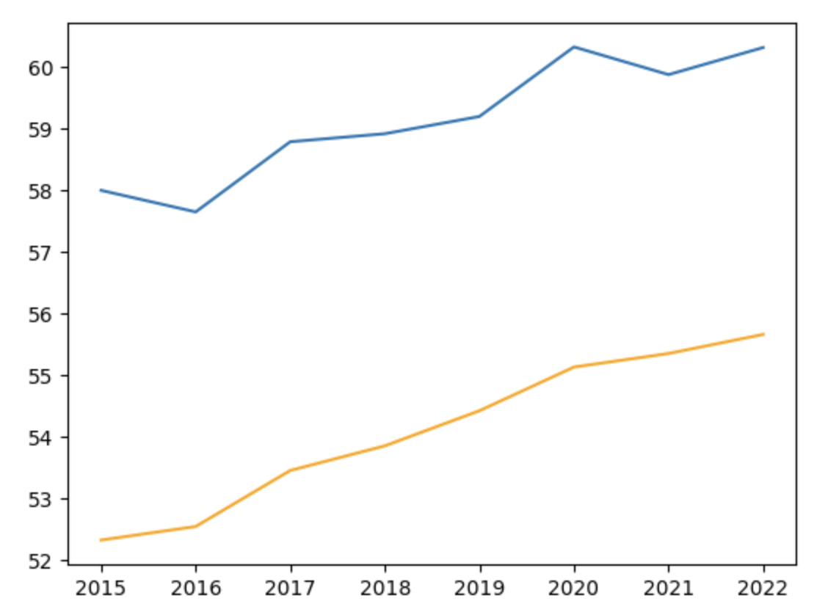

What was the effect of this? Say, on UK GDP?
Brexit
Looks like there was a dip following Brexit?
Vote
UK
But we know by now not to blindly make causal claims from observational data!
GDP
The rest of the EU is different from the UK
Something else big and disruptive happened in 2020…
EU average

Slide 7
Stepping back a bit…
What data do we have?
How do we frame this in our causal language (outcomes, treatments, etc)?
In that language, what is the question we want to answer?

Slide 8



What data do we have?
Panel data: Many units, each treated or not treated, over time
…
2018
2019
2020
2021
2022
Outcomes:
GDP
Switzerland
…
73.21 | 73.62 | 74.83 | 76.75 | 77.69
Netherlands
…
67.27 | 66.97 | 66.77 | 69.16 | 69.25
Units
= Countries in this example
France
…
67.41 | 67.64 | 67.68 | 66.48 | 65.47
$$⋮$$
$$⋮$$
$$⋮$$
Treatment: Leaving the EU
UK
…
58.92 | 59.20 | 60.33 | 59.88 | 60.32

Slide 9






What is our question?
Informally: What would have happened if Brexit hadn’t occurred?
A bit more formally:
Suppose we knew what would have happened otherwise
We want $τ=\frac{1}{3}\left(\left(60.33−Y_{20}\left(0\right)\right)+\left(59.88−Y_{21}\left(0\right)\right)+\left(60.32−Y_{22}\left(0\right)\right)\right)$
Interpretation: average treatment effect among the treated (ATT)
…
2018
2019
2020
2021
2022
…
2018
2019
2020
2021
2022
Switzerland
…
73.21 | 73.62 | 74.83 | 76.75 | 77.69
Switzerland
…
73.21 | 73.62 | 74.83 | 76.75 | 77.69
Netherlands
…
67.27 | 66.97 | 66.77 | 69.16 | 69.25
Netherlands
…
67.27 | 66.97 | 66.77 | 69.16 | 69.25
France
…
67.41 | 67.64 | 67.68 | 66.48 | 65.47
France
…
67.41 | 67.64 | 67.68 | 66.48 | 65.47
$$⋮$$
$$⋮$$
$$⋮$$
$$⋮$$
$$⋮$$
$$⋮$$
UK
…
58.92 | 59.20 | 60.33 | 59.88 | 60.32
UK
…
58.92 | 59.20 | $$Y_{20}(0)$$ | $$Y_{21}(0)$$ | $$Y_{22}(0)$$

Slide 10
Lots more questions Even before we get into “how do we estimate that?”
What counts as “treated” in this example?
Should we start in 2016 when the Brexit vote occurred, instead of 2020?
Should we include the US as a “treated” country as it was never in the EU?
What should we include as examples of “not treated”?
Other EU countries?
Other EU countries “similar” to the UK?
How far back in time should we go?
Back to the beginning of the EU?
Back to the financial crisis?
Back just a few years?
These are all important questions – we’ll keep them in mind as we our formalism more and see more examples!

Slide 11
A general paradigm
Panel data, with some treated and some untreated units over time

Slide 12
More generally and with some symbols
What data do we have?
What question do we want to answer?

Slide 13
































1. What data do we have? Panel Data
Time
Time
$$1$$
$$2$$
$$⋯$$
$$T$$
$$1$$
$$2$$
$$⋯$$
$$T$$
1
2
3
1
2
3
$$Y_{1,1}$$
$$Y_{1,2}$$
$$⋯$$
$$Y_{1,T}$$
$$0$$
$$0$$
$$⋯$$
$$0$$
$$Y_{2,1}$$
$$Y_{2,2}$$
$$Y_{2,T}$$
$$0$$
$$0$$
$$0$$
Units
$$Y_{3,1}$$
$$Y_{3,2}$$
$$Y_{3,T}$$
$$0$$
$$0$$
$$0$$
$$⋮$$
$$⋮$$
$$⋮$$
$$⋮$$
$$⋮$$
$$⋮$$
n
$$Y_{n,1}$$
$$Y_{n,2}$$
$$⋯$$
$$Y_{n,T}$$
n
$$0$$
$$0$$
$$⋯$$
$$0$$
$$1$$
$$1$$
$$1$$
Matrix $Y$ of outcomes
Matrix $W$ of treatments

Slide 14











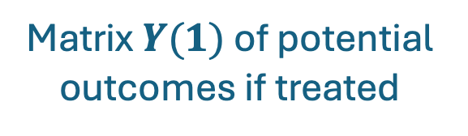











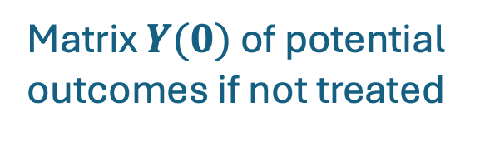














1. What data don’t we have?
For each unit and time period, what would have happened otherwise?
Time
Time
$$1$$
$$2$$
$$T$$
$$1$$
$$2$$
$$T$$
$$⋯$$
$$⋯$$
1
2
3
$$Y_{1,1}$$
$$Y_{1,2}$$
$$⋯$$
$$Y_{1,T}$$
1
2
3
$$?$$
$$?$$
$$⋯$$
$$?$$
$$Y_{2,1}$$
$$Y_{2,2}$$
$$Y_{2,T}$$
$$?$$
$$?$$
$$?$$
Units
$$Y_{3,1}$$
$$Y_{3,2}$$
$$Y_{3,T}$$
Units
$$?$$
$$?$$
$$?$$
$$⋮$$
$$⋮$$
$$⋮$$
$$⋮$$
$$⋮$$
$$⋮$$
n
$$⋯$$
$$?$$
$$?$$
n
$$Y_{n,1}$$
$$Y_{n,2}$$
$$Y_{n,T−3}$$
$$?$$
$$?$$
$$?$$
$$⋯$$
$$?$$
$$Y_{n,T−2} Y_{n,T−1} Y_{n,T}$$
Matrix $Y(0)$ of potential outcomes if not treated
Matrix $Y(1)$ of potential outcomes if treated
These question marks are standing in for potential outcomes: what would have happened otherwise.

Slide 15
































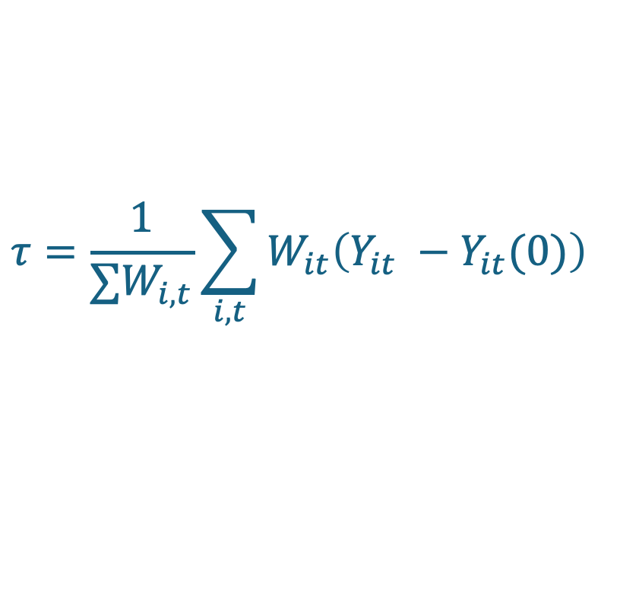



























What question do we want to answer?
What would have happened to the treated units otherwise?
ATT = Average Treatment Effect among the Treated =
$$τ=\frac{1}{∑W_{i,t}}\sum_{i,t}^{ }{W_{it}\left(Y_{it} −Y_{it}(0)\right) }$$
We see this
We don’t see this
$$1$$
$$2$$
$$T$$
$$1$$
$$2$$
$$⋯$$
$$T$$
$$1$$
$$2$$
$$T$$
$$⋯$$
$$⋯$$
1
2
3
$$0$$
$$0$$
$$⋯$$
$$0$$
1
2
3
$$Y_{1,1}$$
$$Y_{1,2}$$
$$⋯$$
$$Y_{1,T}$$
1
2
3
$$?$$
$$?$$
$$⋯$$
$$?$$
$$0$$
$$0$$
$$0$$
$$Y_{2,1}$$
$$Y_{2,2}$$
$$Y_{2,T}$$
$$?$$
$$?$$
$$?$$
$$0$$
$$0$$
$$0$$
$$Y_{3,1}$$
$$Y_{3,2}$$
$$Y_{3,T}$$
$$?$$
$$?$$
$$?$$
$$⋮$$
$$⋮$$
$$⋮$$
$$⋮$$
$$⋮$$
$$⋮$$
$$⋮$$
$$⋮$$
$$⋮$$
n
$$0$$
$$0$$
$$⋯$$
$$0$$
$$1$$
$$1$$
$$1$$
n
$$Y_{n,1}$$
$$Y_{n,2}$$
$$⋯$$
$$Y_{n,T−2}(0) Y_{n,T−1}(0) Y_{n,T}(0)$$
n
$$?$$
$$?$$
$$⋯$$
$$?$$
$$Y_{n,T−2}{ Y}_{n,T−1} { Y}_{n,T}$$
Matrix $W$ of treatments
Matrix $Y(0)$ of potential outcomes if not treated
Matrix $Y(1)$ of potential outcomes if treated

Slide 16
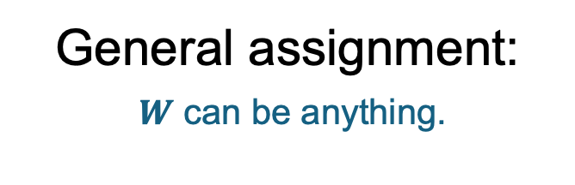



Types of treatment patterns
General assignment:
$W$ can be anything.
Staggered Adoption:
Treatment is rolled out for different units at different times
Block assignment:
Treatment is rolled out for some units all at the same time.
Time
Time
Time
1
0
0
0
1
0
0
0
0
1
0
0
0
0
0
1
0
1
0
0
0
0
0
1
1
0
0
1
1
1
Units
0
1
0
0
0
Units
0
0
0
1
1
Units
0
0
1
1
1
0
0
0
0
1
0
1
1
1
1
0
0
1
1
1
Matrix $W$ of treatments
Matrix $W$ of treatments
Matrix $W$ of treatments

Slide 17
This unit is about:
Techniques to think about problems of this type!
What data do we have?
Panel data: for each unit and each time period, some outcome of interest
At least one unit is “treated” for at least one time period
At least one unit is “not treated” for at least one time period (some units may never be treated)
e.g., GDP
e.g., UK post-2020
e.g., all the other EU countries
What is our question?
What is the average treatment effect among the treated?

Slide 18
We’ll cover the techniques in the next three classes
Brief preview at the end of today if time.
But now… examples!

Slide 19
Examples of this type of question
Other than Brexit

Slide 20
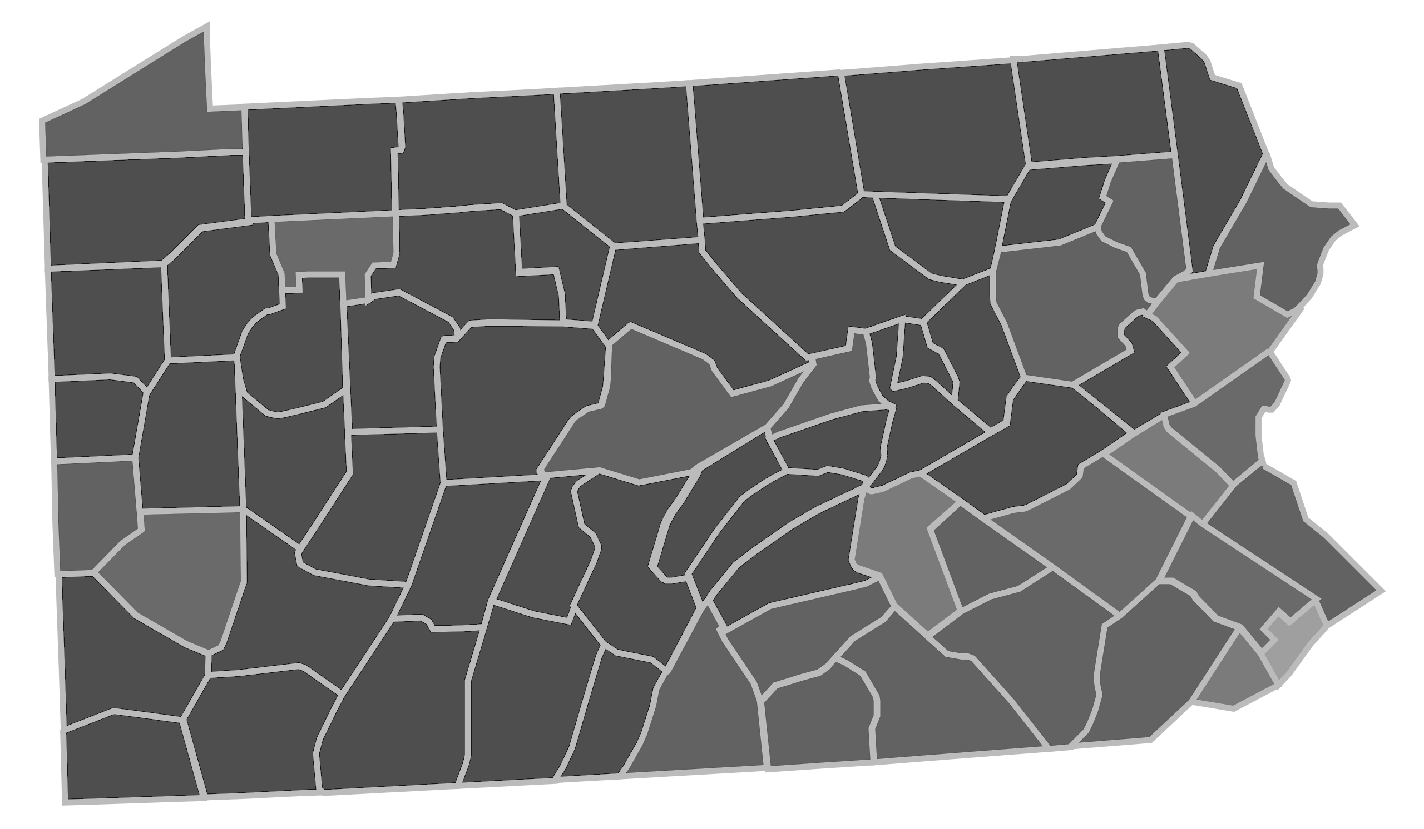
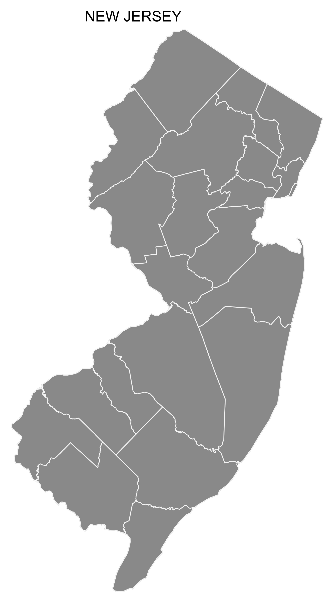

Example 1 Effect of raising the minimum wage? Card and Krueger (1994)
Substantive question: Does raising the minimum wage reduce employment?
We’re raising the minimum wage!
Units: Fast food restaurants in NJ and PA
315 in NJ, 76 in PA
Data from 1 year before change and 1 year after change
Outcome: Employment (# workers)
Treatment: Increase in minimum wage in NJ
Treatment pattern: Block design
New Jersey
(NJ)
Pennsylvania (PA)
1991
1992
Nah.
PA
0
0
NJ
0
1
$$W$$

Slide 21

Example 2 Effect of disability benefits? Meyer, Viscusi, Durbin (1995)
Substantive question: Does a more generous benefit system affect how long people stay off work after getting injured?
Units: Individuals injured in MI in the 1980s
~3000 injured workers
Data from 1 year before change and 1 year after change
Outcome: Injury duration
Treatment: Increase in benefits
Treatment pattern: Block design
Policy change in Michigan:
Weekly benefits if injured
Before
After
0
0
Higher-income people
0
0
$307
0
0
0
0
$181
0
1
Lower-income people
0
1
$144
0
1
0
1
1982
Time
$$W$$

Slide 22

Example 3 Effect of the EITC? Eissa and Liebman (1996)
Substantive question: Does increasing the Earned Income Tax Credit (EITC) increase employment?
1986 Expansion of EITC
(Stylized graph: truth is more complicated)
Units: Single, low-income women in the US
About 45,000 with children, 20,000 without
Before: 1984-1986; After: 1988-1990
Outcome: Any employment
Treatment: Change in EITC
Treatment pattern: Block design
Amount of earned income you get to keep
‘84
‘85
‘86
‘88
‘89
‘90
Single women with children
0 0 0
0 0 0
0 0 0
0 0 0
0 0 0
0 0 0
0 0 0
1 1 1
Single women with no children
0 0 0
1 1 1
0 0 0
1 1 1
0 0 0
1 1 1
1986
Time
$$W$$

Slide 23
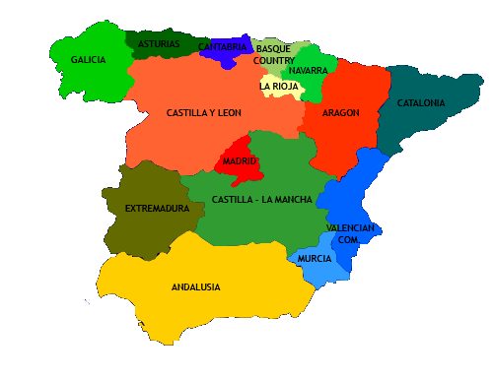

Example 4 Effect of terrorism? Abadie and Gardeazabal (2003)
Substantive question: Did terrorism in the Basque region lower per-capita GDP?
Units: Regions of Spain
1 region (Basque) “treated”; 16 others “untreated”
Data from 1955 to 2000
Outcome: GDP
Treatment: ETA’s terrorist activities*
Treatment pattern: Single treated unit
…
…
1955
1968
2000
0 0 0
…
0 0 0
0 0 0
…
0 0 0
…
…
0 0 0
…
0 0 0
*ETA is Euskadi Ta Askatasun, or “Basque Country and Freedom.” It was an armed separatist group, active from 1959 to 2018. Between 1968 and 2010, ETA killed 829 people (including 340 civilians) and injured more than 22,000.
…
0 0 0
1 1 1 1 1
$$W$$

Slide 24
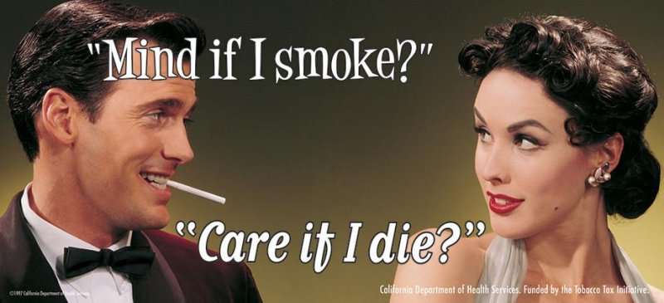

Example 5 Effect of anti-smoking legislation Abadie, Diamond and Hainmueller (2010)
Substantive question: Do anti-smoking programs lower rates of smoking?
Ad funded by CA Prop. 99:
Prop. 99 raised taxes on tobacco products and funded an anti-smoking campaign.
Units: US States
1 state (CA) treated; 38 others untreated
Data from 1970-2000
Outcome: Per-capita smoking rate
Treatment: CA Prop. 99 passed in 1988
Treatment pattern: Single treated unit
…
…
1970
1988
2000
0 0 0
…
0 0 0
California Department of Health Services. Funded by the Tobacco Tax Initiative.
0 0 0
…
0 0 0
…
…
…
0 0 0
0 0 0
…
CA
0 0 0
1 1 1 1 1
$$W$$

Slide 25

Example 6 Effect of German re-unification Abadie, Diamond and Hainmueller (2015)
Substantive question: What was the effect of German reunification on West German GDP?
Units: OECD Countries
1 treated unit (Germany); 16 control countries
Data 30 years pre-intervention, 13 years post-intervention.
Outcome: Per-capita GDP
Treatment: German reunification in 1990
Treatment pattern: Single treated unit
…
…
1960
1990
2003
0 0 0
…
0 0 0
0 0 0
…
0 0 0
…
…
…
0 0 0
0 0 0
*OECD = Organization for Economic Co-operation and Development. It is a forum of 38 countries.
…
DE
0 0 0
1 1 1 1 1
$$W$$

Slide 26


Example 7 Effect of Immigration and the Mariel Boatlift Card (1990)
Substantive question: Does immigration of low-skilled workers lead to less work for natives?
Units: Cities in the US
1 treated city (Miami), 4 control cities
Data 7 years pre-intervention, 7 years post-intervention.
Outcome: Employment rate
Treatment: Mariel boatlift (influx of ~125,000 Cuban immigrants to Miami in 1980)
Treatment pattern: Single treated unit
Cuban refugees arriving in crowded boats during the Mariel boatlift crisis in 1980
…
…
1973
1980
1987
Tampa
0 0 0
…
0 0 0
Houston
0 0 0
…
0 0 0
LA
0 0 0
…
0 0 0
Atlanta
0 0 0
…
0 0 0
Miami
0 0 0
1 1 1 1 1
…
$$W$$

Slide 27
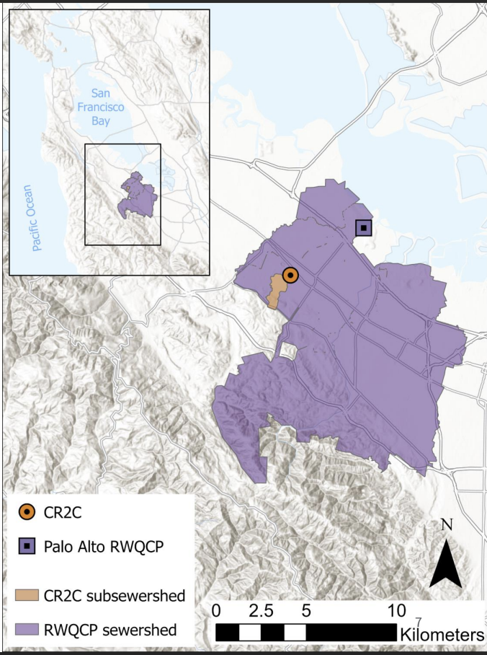
Example 8 Effect of Stanford Campus COVID Measures Chan, Bidwell, Li, Tilmans, Boehm (2024)
Substantive question: What was the effect of COVID policies at Stanford?
Palo Alto Watershed
Stanford
sub-watershed
Units: Palo Alto Watershed and Stanford sub-watershed
1 treated area (Stanford), one “untreated” (Palo Alto)
Data from 2021 to 2023
Outcome: Concentration of SARS-CoV-2 RNA in wastewater
Treatment: Various policy changes on the Stanford campus
Masking mandatory / encouraged
Parties banned / allowed
Etc…
Treatment pattern: Single treated unit
Aug 2021
…
Aug 2023
PA Watershed
0 0 0
…
0 0 0
0 0 0
…
Stanford sub-watershed
1 1 1 1 1
$$W$$

Slide 28
Methods of Analysis

Slide 29
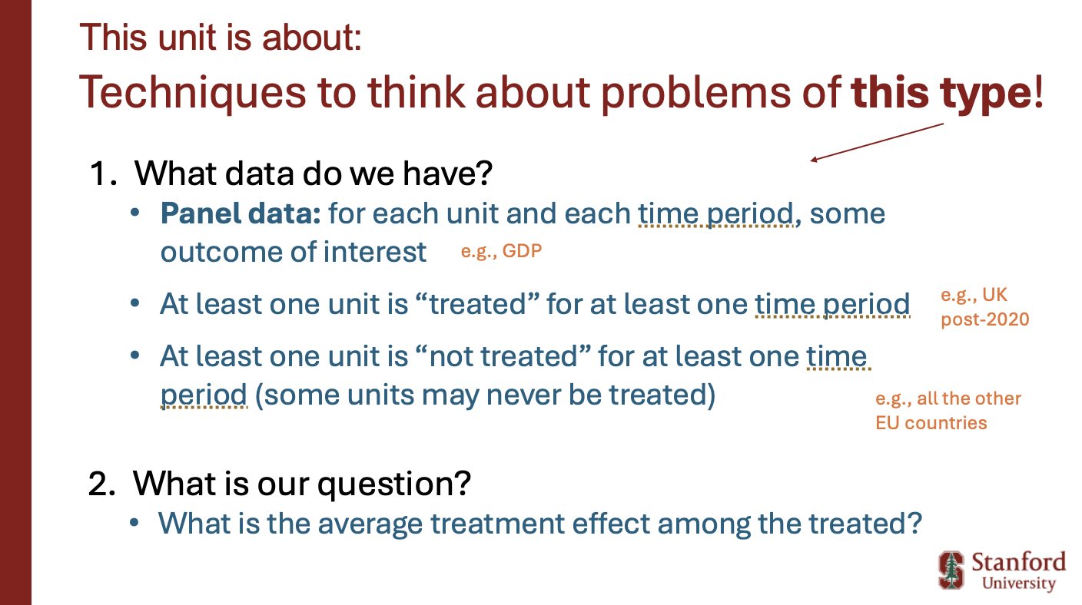

You thought about this in your pre-class response
What did you come up with?
How would you analyze this type of problem?

Slide 30
Three methods
Real quick overview here…we’ll dive into each of these in the next three classes!
Difference-in-differences
Matrix Completion
Synthetic Controls

Slide 31

1. Difference-in-Differences
Suppose we have one unit treated after time $t$
Another unit is never treated
Suppose we see this:
Treated unit
Outcome
Untreated unit
Time
Change for treated unit

Slide 32
1. Difference-in-Differences
Suppose we have one unit treated after time $t$
Another unit is never treated
Suppose we see this:
Treated unit
These differences are different!
This suggests there is an effect.
Outcome
Untreated unit
Time
Change for treated unit

Slide 33


2. Matrix completion
This model is related to the “linearity” model we use for regression.
Suppose that the world with no treatment is explained by a low-rank matrix model:
…
2018
2019
2020
2021
2022
Switzerland
…
73.21 | 73.62 | 74.83 | 76.75 | 77.69
Matrix A
Matrix B
Netherlands
…
67.27 | 66.97 | 66.77 | 69.16 | 69.25
France
…
67.41 | 67.64 | 67.68 | 66.48 | 65.47
$$≈$$
$$⋮$$
$$⋮$$
$$⋮$$
UK
…
58.92 | 59.20 | $$Y_{20}(0)$$ | $$Y_{21}(0)$$ | $$Y_{22}(0)$$
We can leverage the low-rank structure to “complete” the matrix and fill in the missing entries to compute ATT.

Slide 34




3. Synthetic controls
We’d like to come up with a good control group for, say, the UK
Problem: the untreated units are different from the UK!
…
2018
2019
2020
2021
2022
Switzerland
…
73.21 | 73.62 | 74.83 | 76.75 | 77.69
Strategy: approximate the UK’s pre-2020 trajectory using a linear combination of other EU countries.
Netherlands
…
67.27 | 66.97 | 66.77 | 69.16 | 69.25
France
…
67.41 | 67.64 | 67.68 | 66.48 | 65.47
$$⋮$$
$$⋮$$
$$⋮$$
UK
…
58.92 | 59.20 | $$Y_{20}(0)$$ | $$Y_{21}(0)$$ | $$Y_{22}(0)$$
Use that to predict the UK’s post-2020 trajectory if Brexit hadn’t happened.

Slide 35
Recap and looking ahead

Slide 36
Recap
The problem of “what is the effect of Brexit” is an example of a very general set-up:
What data do we have? Panel data. Some units treated sometimes.
What is our question? What’s the effect of the treatment on the treated?
SO. MANY. EXAMPLES.
Three methods that we will talk about more:
Diff-in-diff; Matrix Completion; Synthetic controls

Slide 37
Next Time
Difference-in-differences!
Treated unit
These differences are different!
This suggests there is an effect.
Outcome
Untreated unit
Time
Change for treated unit

Slide 38


Exit ticket
Don’t forget to fill out the exit ticket before you leave class!

