Slide 1
Welcome! Course Overview and Stats Refresher!
Causality, Decision Making, and Data Science
Lecture 1

Slide 2
Agenda
Introductions
Course overview
Statistics Refresher

Slide 3
Introductions

Slide 4

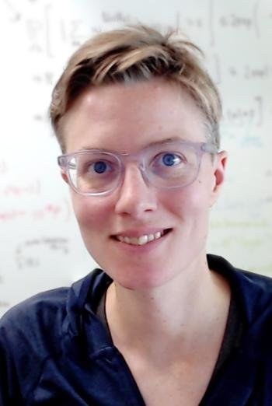


Who are we? (Course staff)
Instructors:
Guido Imbens
Mary Wootters
Awesome TAs:
Amar Venugopal
Anna Thomas
Best way to reach us:
cs171-aut2526-staff@lists.stanford.edu
Typical way to hear from us (outside of class):
Canvas announcements
Guido
Mary
Amar
Anna

Slide 5

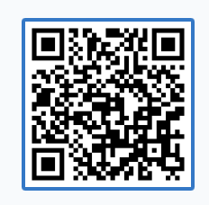
Who are you?
Get ready for a PollEverywhere!
Or go to:
pollev.com/busgen108
It may ask you to “register.”
If you log in with your Stanford email, and you are enrolled in the course, it should let you in.
If it doesn’t, click “Skip for now”.

Slide 6
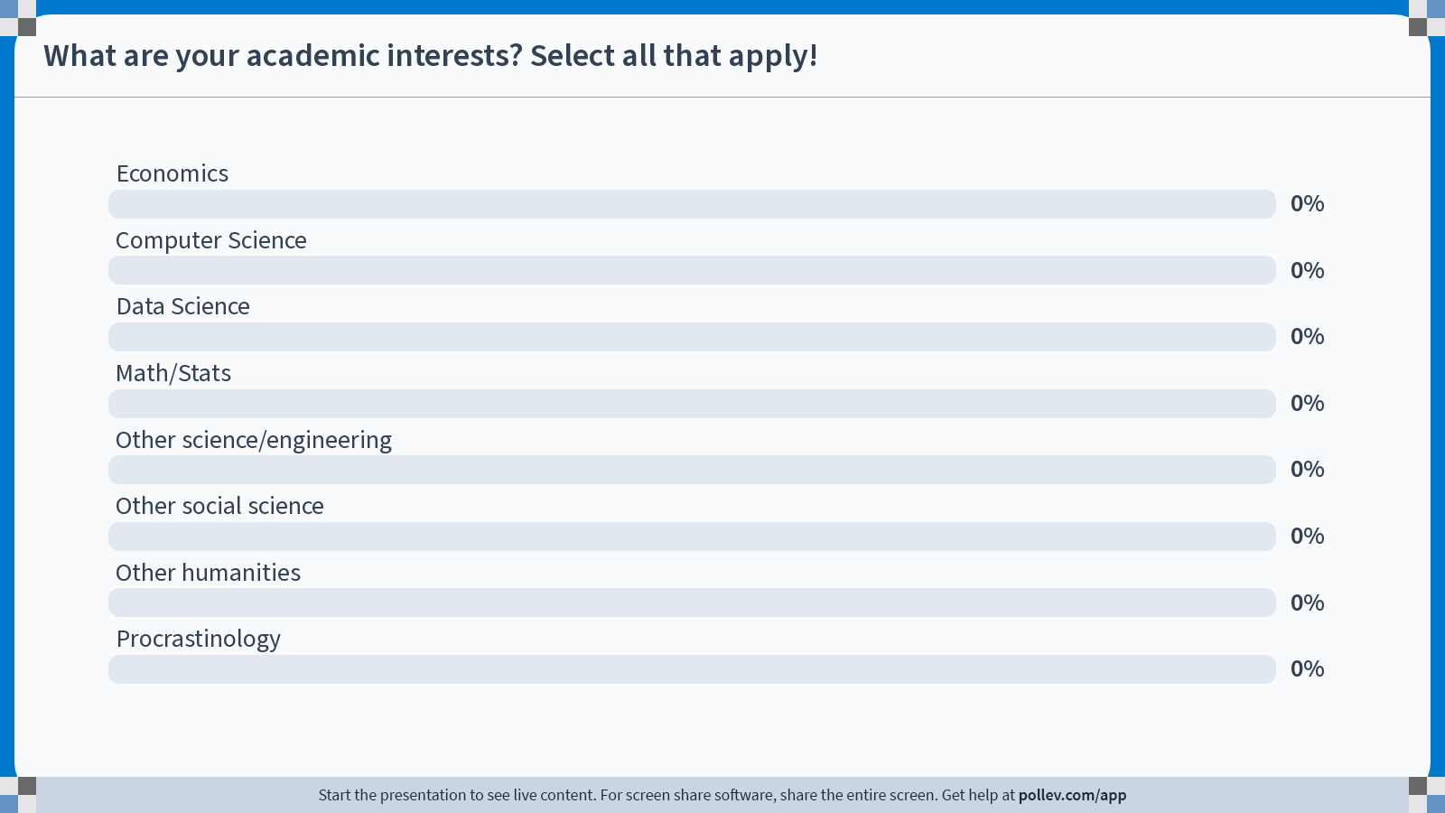
Notes:
Do not modify the notes in this section to avoid tampering with the Poll Everywhere activity. More info at polleverywhere.com/support What are your academic interests? Select all that apply!
https://www.polleverywhere.com/multiple_choice_polls/3bZCCM48pt1WABkN4pYcV?state=opened&flow=Default&onscreen=persist

Slide 7
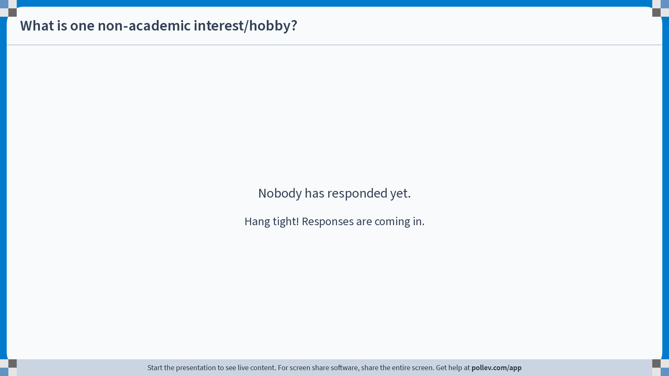
Notes:
Do not modify the notes in this section to avoid tampering with the Poll Everywhere activity. More info at polleverywhere.com/support What is one non-academic interest/hobby?
https://www.polleverywhere.com/free_text_polls/dIo4J0DkJC0wESERBQkBC

Slide 8
Course Overview

Slide 9
Course Pitch
Policymakers (in government, industry, education, …) want to know the effect of potential policies.
What is the effect of Universal Basic Income on overall productivity?
What is the effect of subsidizing education on eventual student earnings?
What is the effect of changing which ads we show to which people?
What is the effect of banning laptops in class on student learning?
How do we answer these questions?

Slide 10


These questions are highly non-trivial!
E.g., what is the effect of education on future earnings?
Appeal our inner intuition: probably positive?
I see no problem with blindly asserting that what I do has value!
Ivory Tower

Slide 11
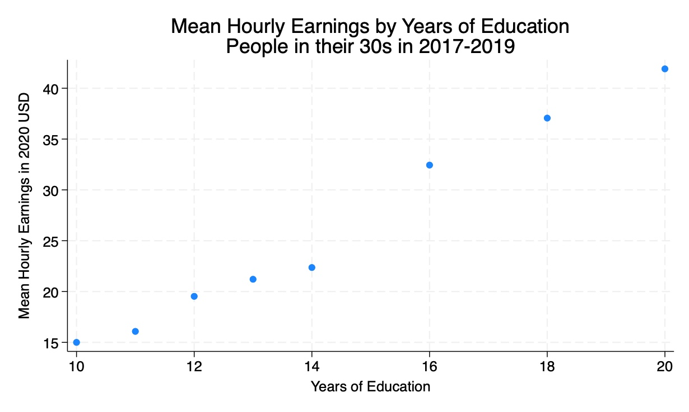

These questions are highly non-trivial!
E.g., what is the effect of education on future earnings?
Appeal our inner intuition: probably positive?
Look at people with different amounts of education?
Discuss:
What do you take away from this graph?
What does it say about the effect of education on earnings?
Data Source: Current Population Survey

Slide 12

These questions are highly non-trivial!
E.g., what is the effect of education on future earnings?
Appeal our inner intuition: probably positive?
Look at people with different amounts of education?
Wait…Correlation isn’t the same as causation!
Data Source: Current Population Survey

Slide 13

These questions are highly non-trivial!
E.g., what is the effect of education on future earnings?
Appeal our inner intuition: probably positive?
Look at people with different amounts of education?
Run a randomized control trial?
…wait, what exactly am I randomizing?
Can we instruct people
to go to school or not?

Slide 14
These questions are highly non-trivial!
E.g., what is the effect of education on future earnings?
Appeal our inner intuition: probably positive?
Look at people with different amounts of education?
Run a randomized control trial?
Look for a “natural experiment”?
What does that mean?
How do we find such an experiment?
How do we analyze the data when we do?

Slide 15
In this course, we’ll see how to answer these questions!
Approximate course outline
Week 1: The Basics: Statistics and Causality
Week 2-3: Analyzing Randomized Experiments
Week 3-5: Effects of Universal Basic Income
Week 6-7: Effects of Education
Week 8-9: Panel Data
Week 10: Project presentations!

Slide 16

Course Policies

Slide 17
Course Policies
The syllabus, and all other info about the course, is on Canvas!
Check out the syllabus for a full list of course policies.
Highlights:
Attendance is required!
We will make exceptions for good reasons (e.g., PLEASE don’t come to class when you are sick), just email the course staff email list ahead of time.
No laptops open in class.
We will be using PollEverywhere, so do bring your phones…just don’t stare at them unless we ask you to.
Tablets are okay for note-taking.
LLMs / ChatGPT policy
LLMs are a useful tool!
It works best when used to augment your thinking and learning, not to think for you.
We encourage you to do your own thinking, since that will lead to your own learning.
And also lead to better results ☺

Slide 18
A note about attendance
We will take attendance via exit tickets.
There will be a QR code to scan at the end of every class.
The QR code will link to a form that will ask you for some feedback, and also take attendance.
Don’t leave class without scanning the exit ticket!
Otherwise you won’t get credit for attending!
If you have to leave early, let us know ahead of time.
Also, we shouldn’t have to say this, but:
Don’t send the exit ticket link to your friend who skipped class… we can see who is here and we will notice. 🫤

Slide 19
Assignments
Check out syllabus/canvas for all the details.
HW0 is out now
Do this on your own – this one is graded only on completion.
Due this Sunday, 11:59pm, on Gradescope
Weekly HW
Four HW sets, each in two parts
Done in groups
Reading responses
Intention is to be light-weight
Due 11:59pm on Canvas the night before class
First one out now and due Thursday before class!
Final project
Project ideas due Oct. 20 (Week 5). See document on Canvas for details.

Slide 20
On HW you will be programming in Python
New to Python? That’s okay!
Python Boot Camp!
Friday Sep 26, 11:30am, Landau 351

Slide 21
HW Groups
HW groups will be randomly assigned for HW 2,3,4
We will post a tentative schedule of group assignments soon so you can coordinate.
HW1 and Final projects will be done in groups of your choice.
Collaboration policy
We encourage collaboration!
You may chat with folks outside your group for clarification, extra background, etc, but don’t ask any of them to do your homework for you ☺

Slide 22

Expectations
$$𝔼\left[this class\right]=lots of fun!$$
Show up
Participate
Show up
Participate
…(and learn the material, do the HW, etc)

Slide 23
Questions?
About the course?
About logistics?

Slide 24
Statistics Refresher!
Nothing Causal Yet!

Slide 25
We expect you all to know some probability/statistics
It’s a pre-req for this course!
But!
Different communities use different notation
It may have been a while
We’ll spend the rest of today with a quick refresher so that we are all on the same page with notation, etc.

Slide 26
Running Example For the rest of today’s class
There are about 340 million people in the US.
We have questions!
What is the average educational attainment?
What is the average yearly earnings?
What is the average time that people spend on their commute?
…
It would be a lot to gather this data from all 340 million people.
Instead, the American Community Survey (ACS, part of the US Census) asks about 3.5 million random households these questions every year.

Slide 27
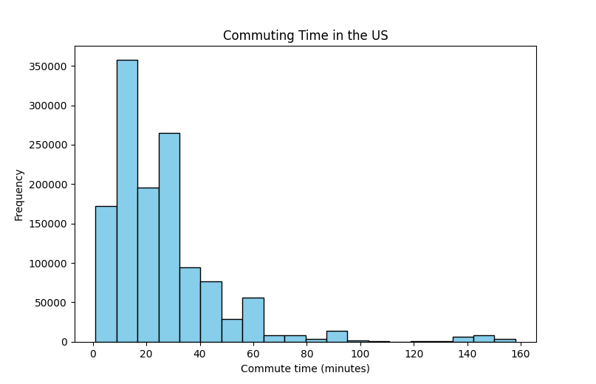
What is the average commute time in the US?
About 1.3M people in the 3.5M sample commuted at all.
Among those, average commute time to work was about 26.4 minutes.
Data Source: ACS (data.census.gov)

Slide 28
Motivating Example For the rest of today’s class
There are about 340 million people in the US.
We have questions!
What is the average educational attainment?
What is the average yearly earnings?
What is the average time that people spend on their commute?
…
It would be a lot to gather this data from all 340 million people.
Instead, the American Community Survey (ACS, part of the US Census) asks about 3.5 million random households these questions every year.
Question: How accurate are the estimates from this sample?

Slide 29
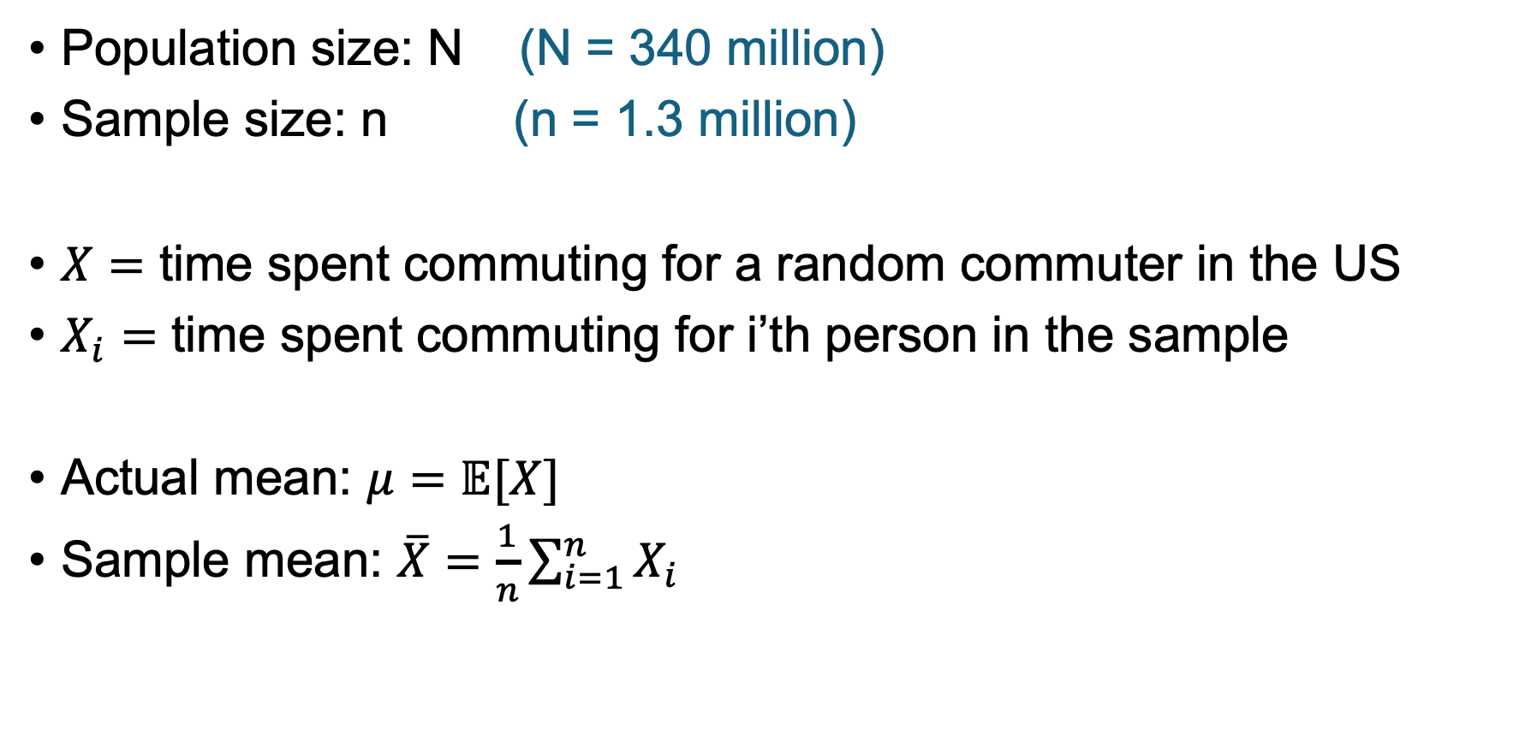
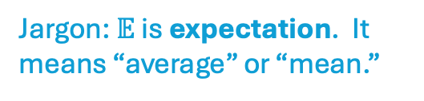

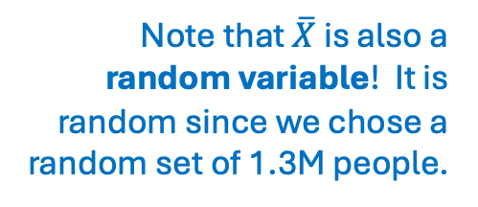
Notation
Population size: N (N = 340 million)
Sample size: n (n = 1.3 million)
$X=$ time spent commuting for a random commuter in the US
$X_{i}=$ time spent commuting for i’th person in the sample
Actual mean: $μ=𝔼[X]$
Sample mean: $\overline{X}=\frac{1}{n}\sum_{i=1}^{n}{X_{i}}$
Jargon: $X$ is a random variable!
Jargon: $𝔼$ is expectation. It means “average” or “mean.”
Note that $\overline{X}$ is also a random variable! It is random since we chose a random set of 1.3M people.

Slide 30
(Unbiased) Estimators

Slide 31

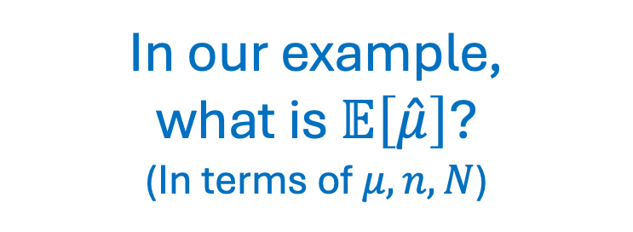
Estimators
An estimator for a quantity $θ$ is another quantity, $\hat{θ}$, that we can estimate from data.
Example: $\hat{μ}=\overline{X}=\frac{1}{n}\sum_{i=1}^{n}{X_{i}}$ (the sample mean) is an estimator for $μ$
In our example,
what is $𝔼\left[\hat{μ}\right]$?
(In terms of $μ, n, N$)

Slide 32
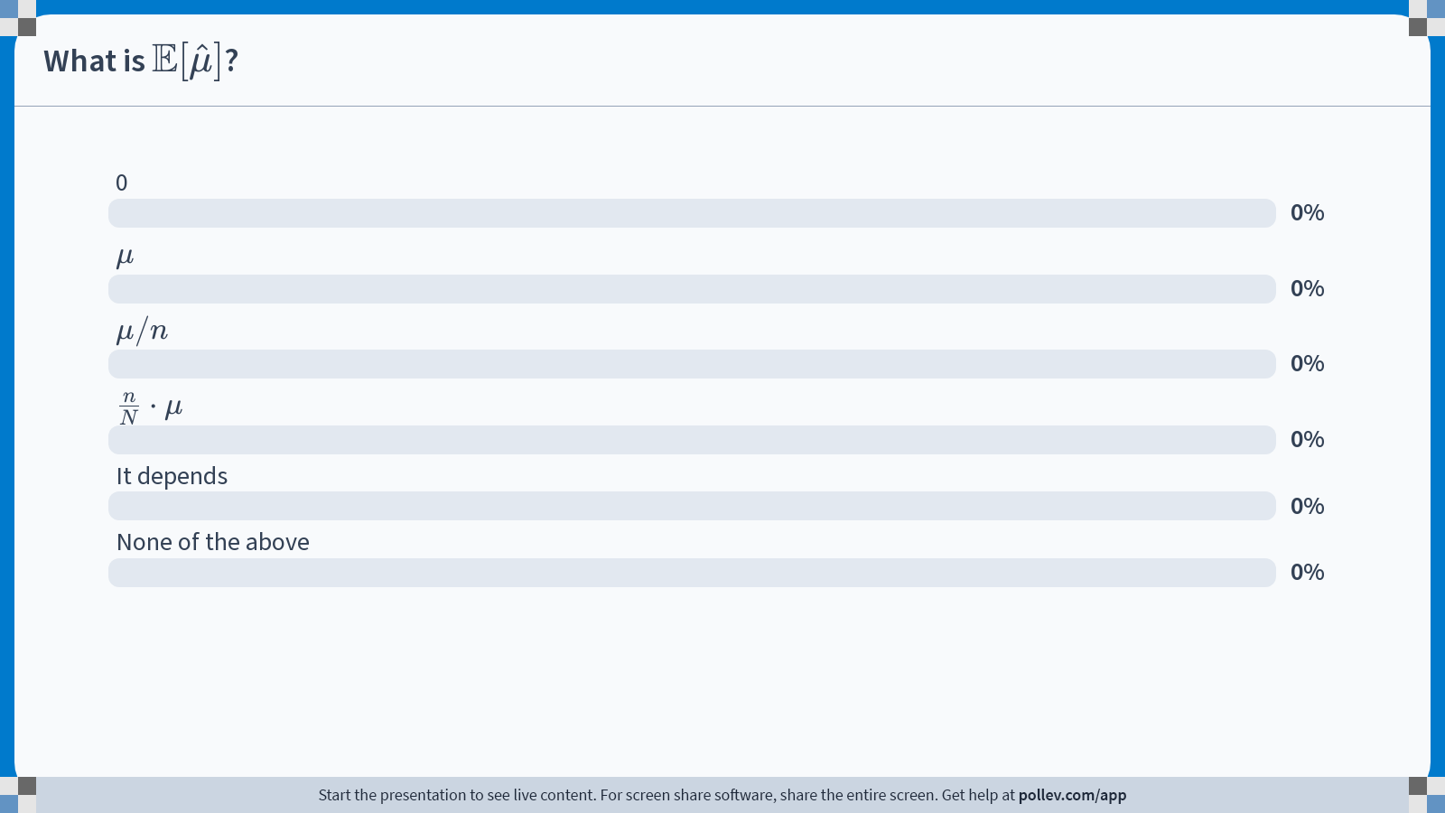
Notes:
Do not modify the notes in this section to avoid tampering with the Poll Everywhere activity. More info at polleverywhere.com/support What is $$\mathbb{E}[\hat{\mu}]$$?
https://www.polleverywhere.com/multiple_choice_polls/H1SBgZQQUSUb14oXo6TbX?state=opened&flow=Default&onscreen=persist

Slide 33
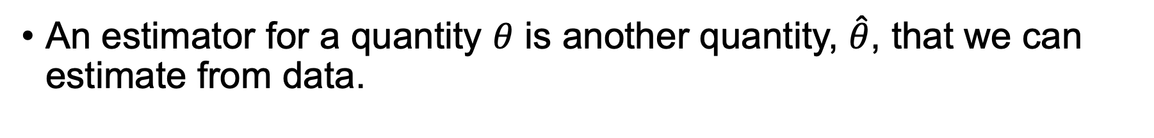
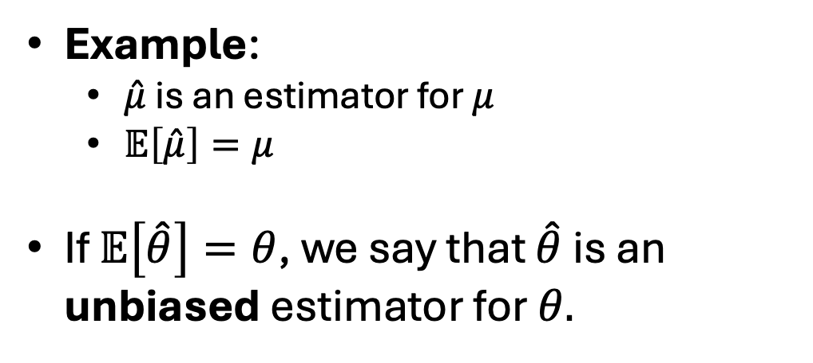
Estimators
An estimator for a quantity $θ$ is another quantity, $\hat{θ}$, that we can estimate from data.
Example:
$\hat{μ}$ is an estimator for $μ$
$𝔼\left[\hat{μ}\right]=μ$
If $𝔼\left[\hat{θ}\right]=θ$, we say that $\hat{θ}$ is an unbiased estimator for $θ.$
Fun exercise: prove this using linearity of expectation!

Slide 34


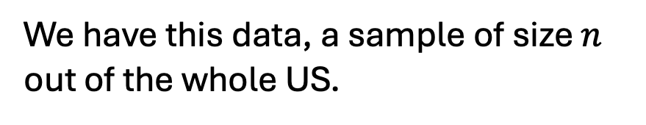

Another example
The variance measures how “spread out” a distribution is!
Consider variance of the commute time, $σ^{2}= 𝔼{\left(X−μ\right)}^{2}$
$X$ is the commute time for a random person in the US, and $μ=𝔼X$
We have this data, a sample of size $n$ out of the whole US.
Discuss:
What is a good estimator for $σ^{2}$?

Slide 35


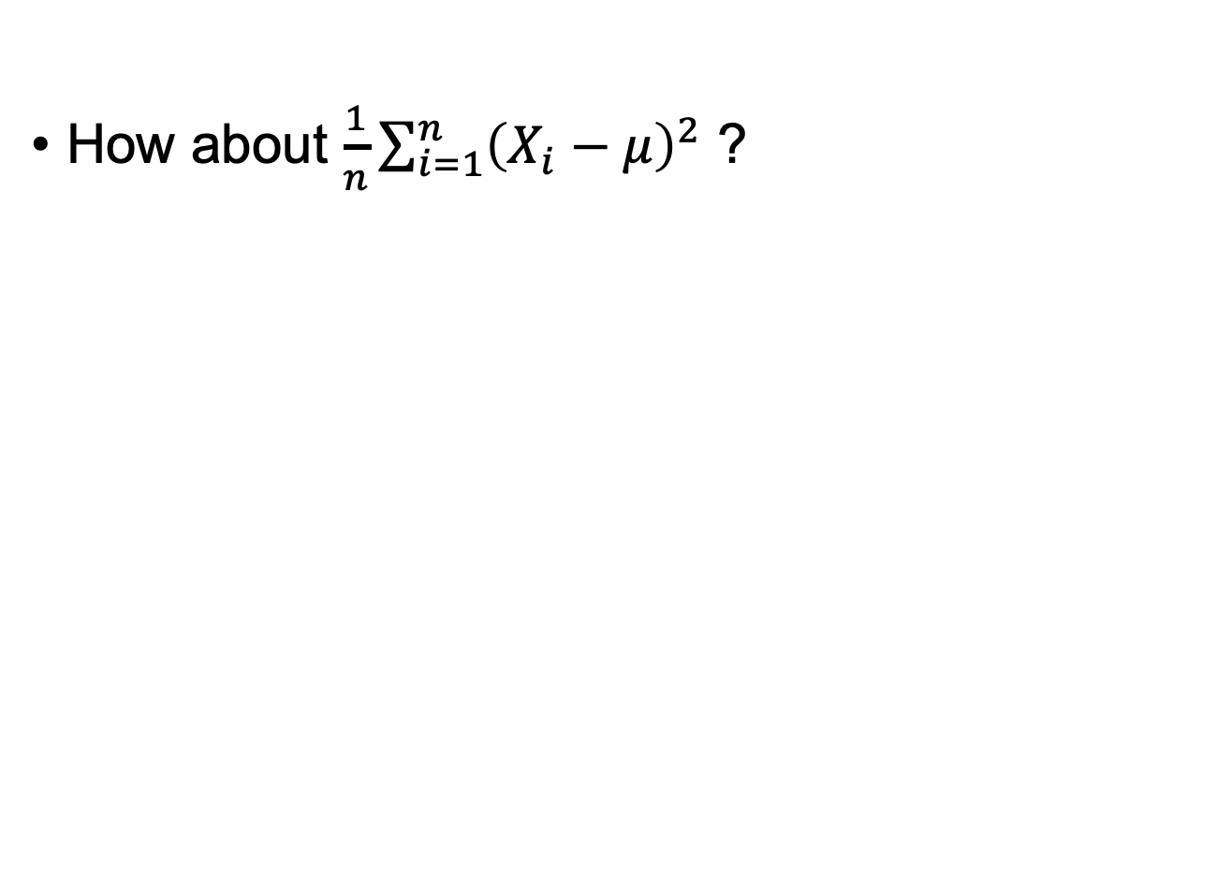
Estimating $σ^{2}=𝔼{\left(X−μ\right)}^{2}$
We don’t know $μ$!
How about $\frac{1}{n}\sum_{i=1}^{n}{{\left(X_{i}−μ\right)}^{2}}$ ?

Slide 36
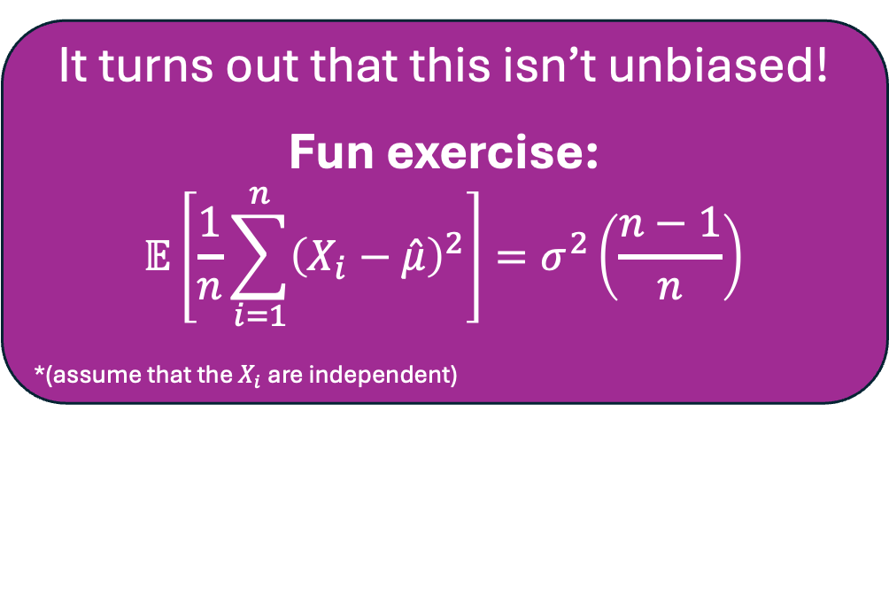

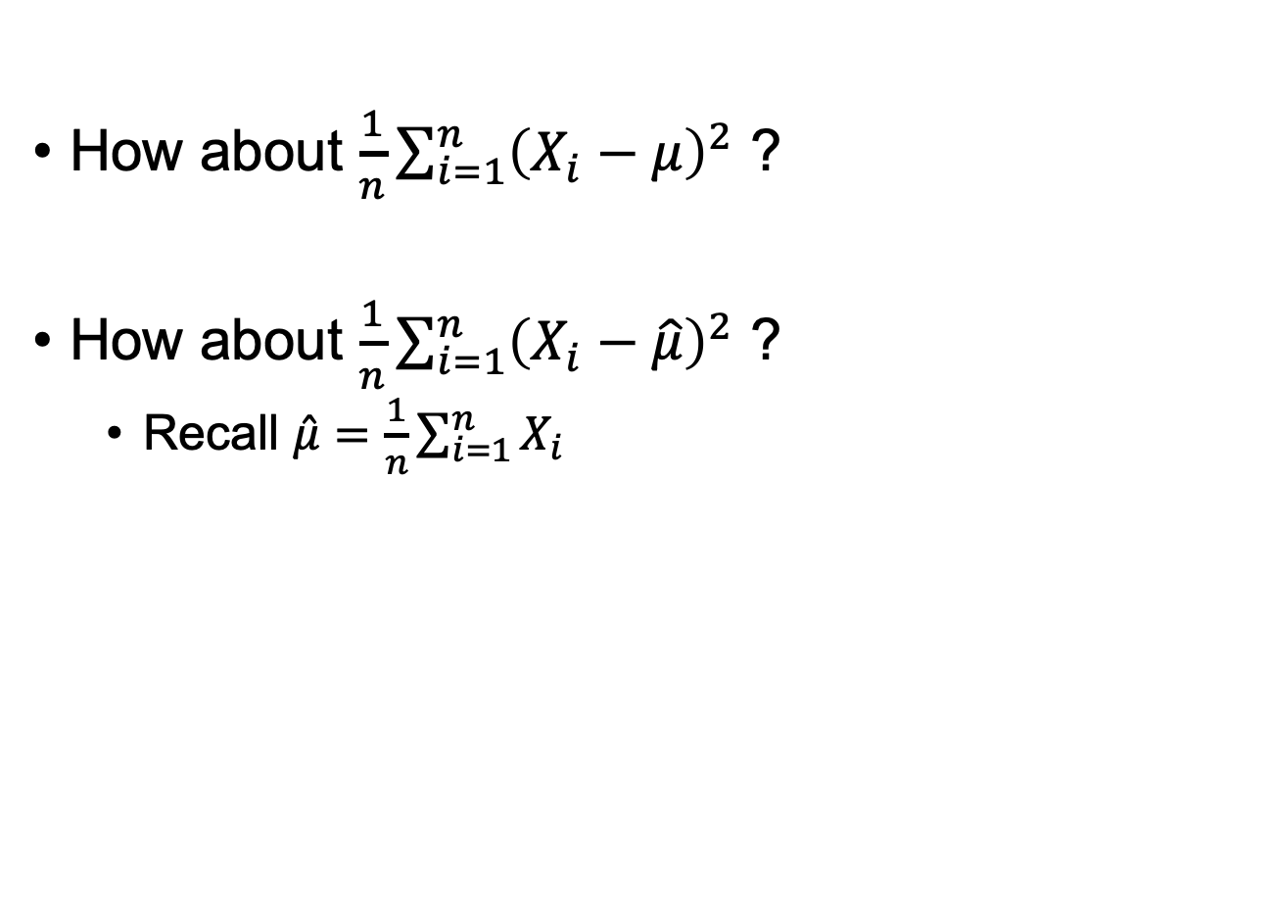
Estimating $σ^{2}=𝔼{\left(X−μ\right)}^{2}$
We don’t know $μ$!
How about $\frac{1}{n}\sum_{i=1}^{n}{{\left(X_{i}−μ\right)}^{2}}$ ?
How about $\frac{1}{n}\sum_{i=1}^{n}{{\left(X_{i}−\hat{μ}\right)}^{2}}$ ?
Recall $\hat{μ}=\frac{1}{n}\sum_{i=1}^{n}{X_{i}}$
It turns out that this isn’t unbiased!
Fun exercise:
$$𝔼\left[\frac{1}{n}\sum_{i=1}^{n}{{\left(X_{i}−\hat{μ}\right)}^{2}}\right]=σ^{2}\left(\frac{n−1}{n}\right)$$
*(assume that the $X_{i}$ are independent)

Slide 37
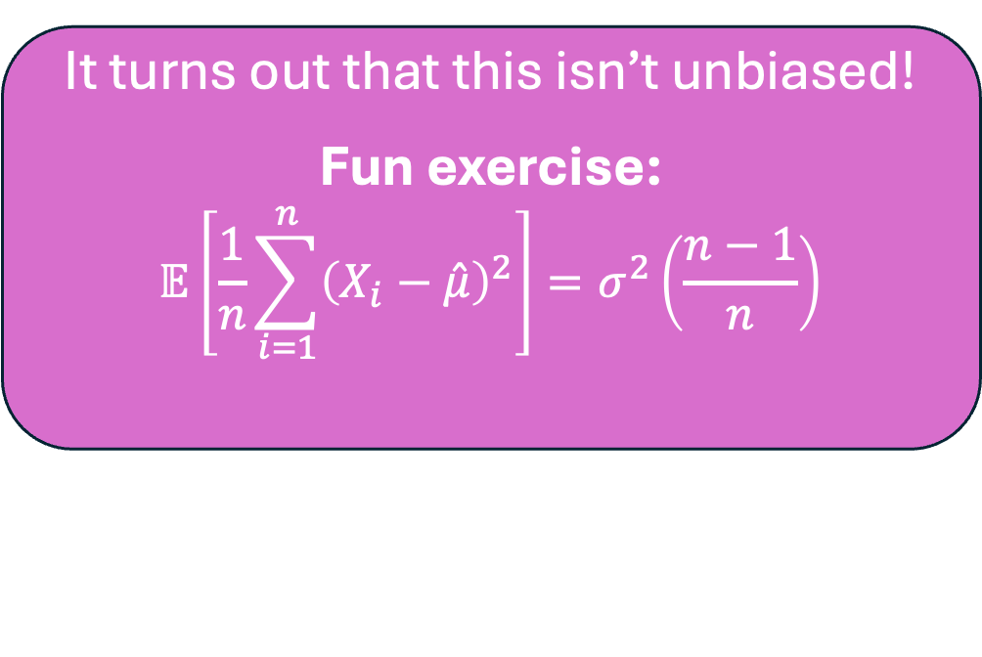
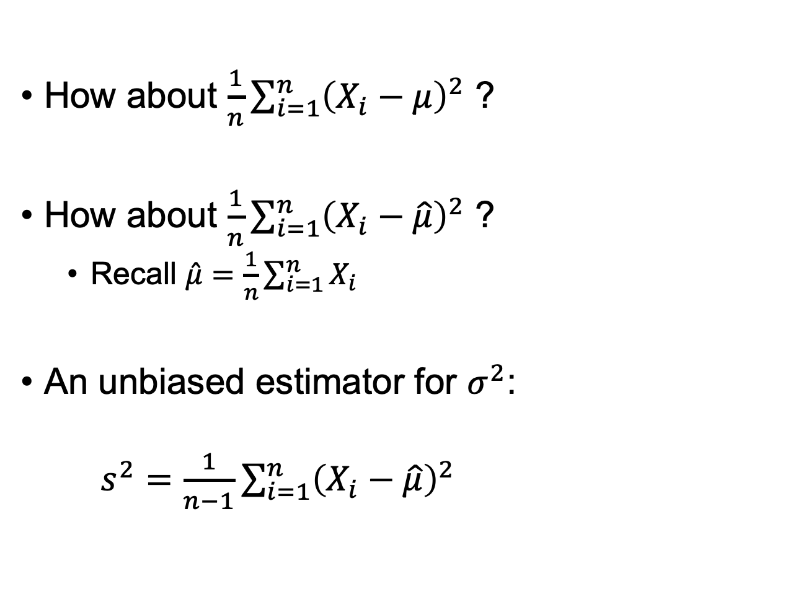
Estimating $σ^{2}=𝔼{\left(X−μ\right)}^{2}$
We don’t know $μ$!
How about $\frac{1}{n}\sum_{i=1}^{n}{{\left(X_{i}−μ\right)}^{2}}$ ?
How about $\frac{1}{n}\sum_{i=1}^{n}{{\left(X_{i}−\hat{μ}\right)}^{2}}$ ?
Recall $\hat{μ}=\frac{1}{n}\sum_{i=1}^{n}{X_{i}}$
An unbiased estimator for $σ^{2}$:
$s^{2}=\frac{1}{n−1}\sum_{i=1}^{n}{{\left(X_{i}−\hat{μ}\right)}^{2}}$
It turns out that this isn’t unbiased!
Fun exercise:
$$𝔼\left[\frac{1}{n}\sum_{i=1}^{n}{{\left(X_{i}−\hat{μ}\right)}^{2}}\right]=σ^{2}\left(\frac{n−1}{n}\right)$$
This is called the sample variance

Slide 38

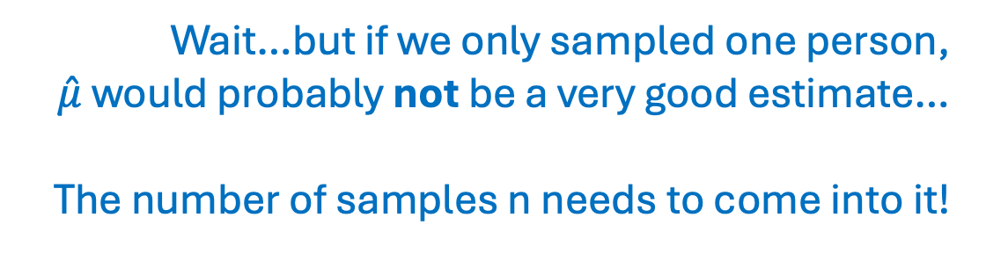

Back to our first example, $\hat{μ}=\overline{X}$
We saw that $\hat{μ}$ is an unbiased estimator for $μ$.
Great! That means we can treat $\hat{μ}$ as though it were about equal to $μ$ without any more thought, right?
Wait…but if we only sampled one person,
$\hat{μ}$ would probably not be a very good estimate…
The number of samples n needs to come into it!

Slide 39
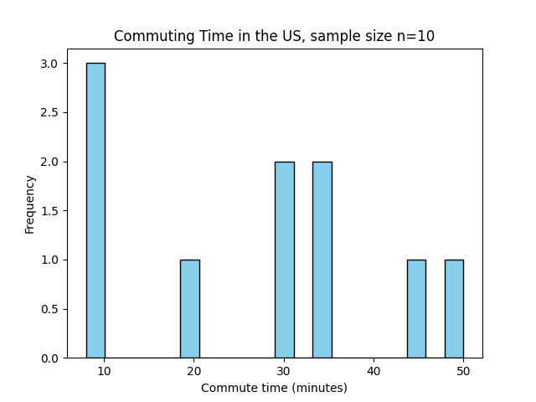
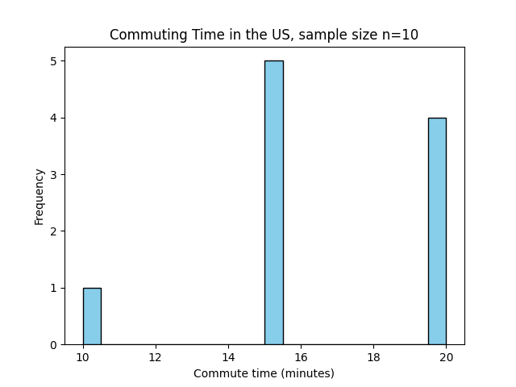
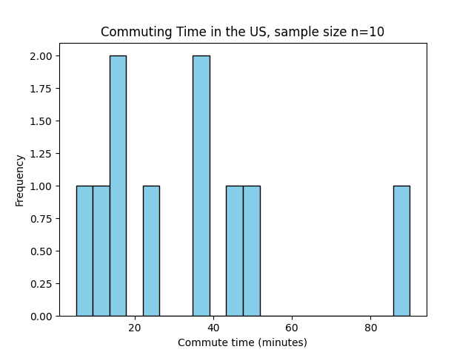
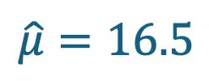

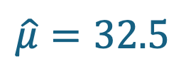


What if we only had $n$=10 samples?
Let’s try it a few times…*
$$\hat{μ}=27$$
$$\hat{μ}=16.5$$
$\hat{μ}$ is all over the place!
$$\hat{μ}=32.5$$
*We don’t run census so we couldn’t really do this…this is sampling 10 people randomly from the 1.3M.

Slide 40

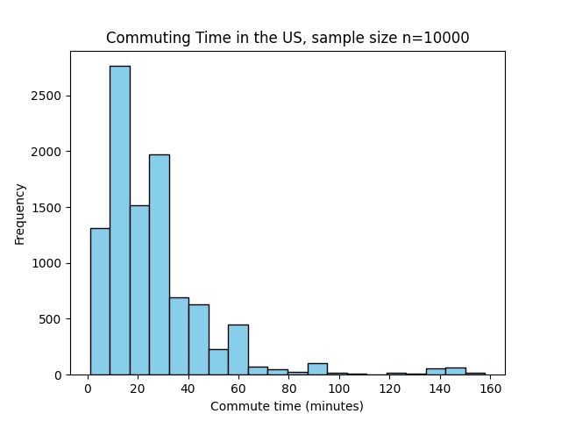





But if we have 10,000 samples…
$$\hat{μ}=26.7$$
$$\hat{μ}=26.6$$
$\hat{μ}$ is pretty stable!
$$\hat{μ}=26.2$$

Slide 41
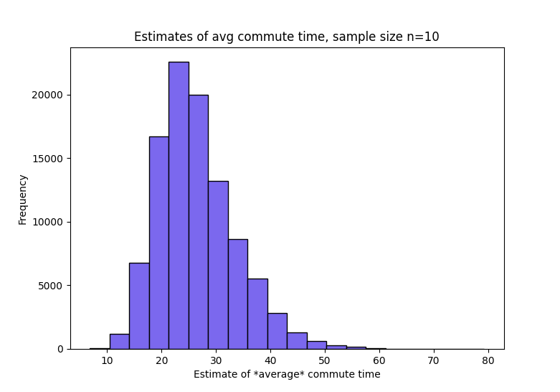
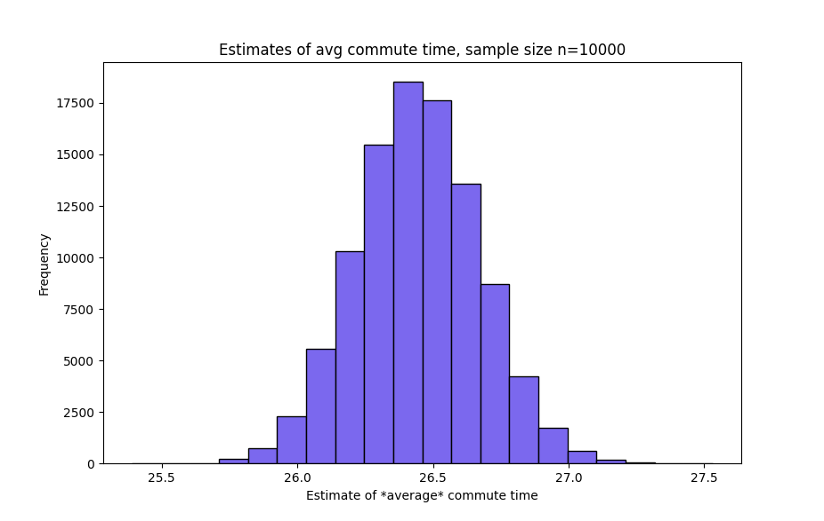
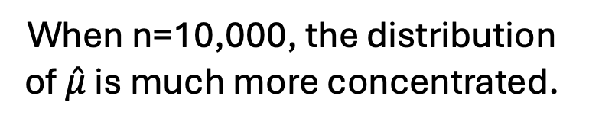
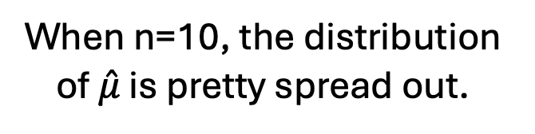
Do each of the previous slides 100,000 times
n=10
n=10,000
60
25.5
27.5
10
When n=10, the distribution of $\hat{μ}$ is pretty spread out.
When n=10,000, the distribution of $\hat{μ}$ is much more concentrated.

Slide 42

How can we quantify this phenomenon?
Discuss!
What is a number we can put on “how good an estimator is $\hat{μ}$?”
The goal is to quantitatively distinguish between these two cases:
n=10
n=10,000
10
60
25.5
27.5

Slide 43
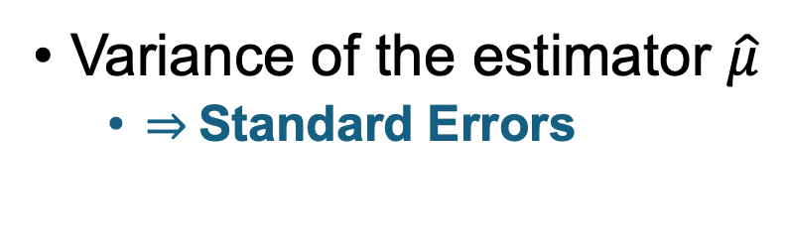
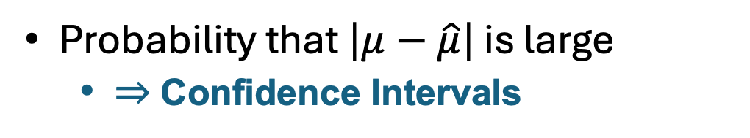
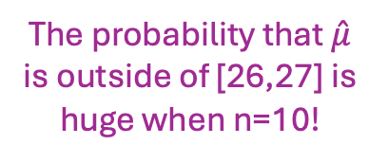
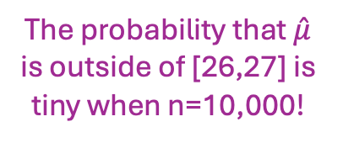
How can we quantify this phenomenon?
Variance of the estimator $\hat{μ}$
$⇒$Standard Errors
Probability that $\left|μ−\hat{μ}\right|$ is large
$⇒$Confidence Intervals
n=10
n=10,000
The probability that $\hat{μ}$ is outside of [26,27] is huge when n=10!
This one is a much “fatter” distribution: much larger variance!
n=10
n=10,000
The probability that $\hat{μ}$ is outside of [26,27] is tiny when n=10,000!

Slide 44
Next we’ll talk about both of these!
Variance of an estimator
And standard errors
Probability that at estimator is far from the thing that it estimates
And confidence intervals

Slide 45
Variance of an Estimator and Standard Errors

Slide 46

What is the variance of $\hat{μ}$?
In this example, the sample variance was…
n=10
n=10,000
60
25.5
27.5
10
Sample variance: 51.2
Sample variance: 0.05

Slide 47

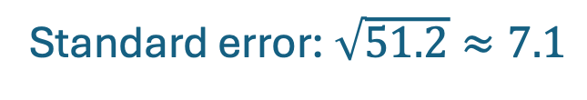
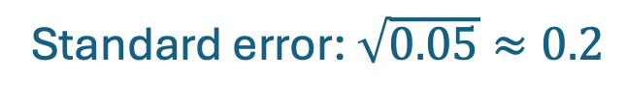


Standard errors
A standard error of an estimator $\hat{θ}$ is the standard deviation of $\hat{θ}$, or an estimate of it.
In our examples:
n=10
n=10,000
$$26.4±7.1$$
$$26.5±0.2$$
Sample variance: 51.2
Sample variance: 0.05
Standard error: $\sqrt{51.2}≈7.1$
Standard error: $\sqrt{0.05}≈0.2$

Slide 48


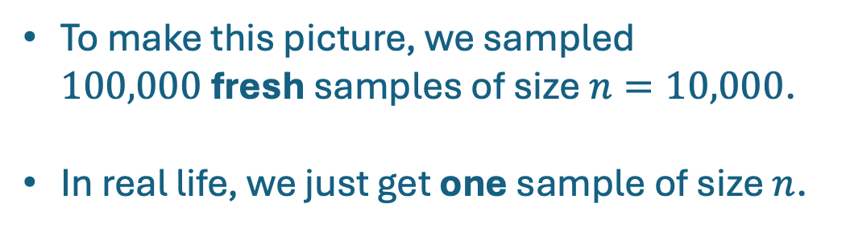

Standard errors
A standard error of an estimator $\hat{θ}$ is the standard deviation of $\hat{θ}$, or an estimate of it.
Standard errors give us a sense of how far off our estimate is.
But how can we compute them?
We don’t actually know the distribution of $\hat{μ}$!
n=10,000
To make this picture, we sampled $100,000$fresh samples of size $n=10,000$.
In real life, we just get one sample of size $n$.
Sample variance: 0.05
Standard error: $\sqrt{0.05}≈0.2$

Slide 49
Two methods to estimate the variance of an estimator
Resampling (aka, bootstrapping)
Analytically
You’ll explore both of these on HW0!

Slide 50

Probability that $|θ−\hat{θ}|$ is big and Confidence Intervals

Slide 51
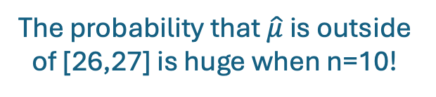
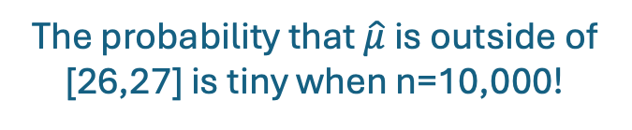
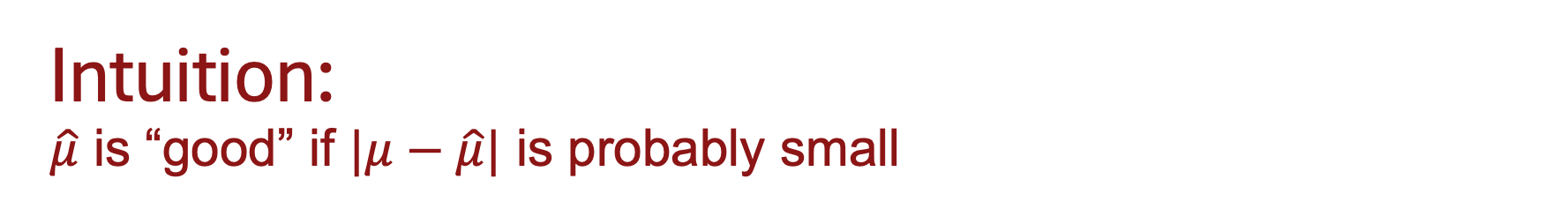
Intuition: $\hat{μ}$ is “good” if $|μ−\hat{μ}|$ is probably small
n=10,000
n=10
The probability that $\hat{μ}$ is outside of [26,27] is tiny when n=10,000!
The probability that $\hat{μ}$ is outside of [26,27] is huge when n=10!

Slide 52
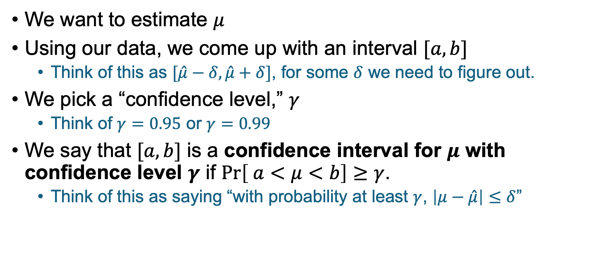
Confidence Intervals
We want to estimate $μ$
Using our data, we come up with an interval $[a,b]$
Think of this as $[\hat{μ}−δ,\hat{μ}+δ]$, for some $δ$ we need to figure out.
We pick a “confidence level,” $γ$
Think of $γ=0.95$ or $γ=0.99$
We say that $[a,b]$ is a confidence interval for $μ$ with confidence level $γ$ if $\operatorname{Pr}\left[ a<μ<b\right]≥γ$.
Think of this as saying “with probability at least $γ$, $\left|μ−\hat{μ}\right|≤δ$”

Slide 53



Confidence intervals: picture/example
Say we know that the distribution of $\hat{μ}$ looks like this:
$\operatorname{Pr}\left[ μ−0.6<\hat{μ}<μ+0.6\right]≥0.95$
$\operatorname{Pr}\left[ \hat{μ}−0.6<μ<\hat{μ}+0.6\right]≥0.95$
So $[\hat{μ}−0.6, \hat{μ}+0.6]$is a confidence interval for $μ$ with confidence level .95
95% of the mass is in this interval of width 1.2
0.6
0.6
2.5% of the mass is smaller than 25.8
2.5% of the mass is larger than 27
$$𝔼\left[\hat{μ}\right]=μ=26.4$$

Slide 54


But… how do we construct confidence intervals?
We don’t actually know the distribution of $\hat{μ}$!
To make this picture, we sampled $100,000$fresh samples of size $n=10,000$.
In real life, we just get one sample of size $n$.

Slide 55
Two methods to construct confidence intervals
Resampling (aka, bootstrapping)
Analytically
Gosh, this list seems familiar!
You’ll explore both of these on HW0!

Slide 56
Real quick… Hypothesis Testing

Slide 57
What is all this good for?
Eventually, we want to answer questions like:
Is the average commute time larger than 27.25 minutes?
Is the effect of education on income larger than zero?
Is the effect of laptops in classrooms negative?

Slide 58

What is all this good for?
A p-value is an upper bound on the probability that you saw something as extreme as you did, under the assumption that the null hypothesis holds.
Eventually, we want to answer questions like:
Is the average commute time larger than 27.25 minutes?
Is the effect of education on income larger than zero?
Is the effect of laptops in classrooms negative?
These can be answered with hypothesis tests.
Null hypothesis: $μ≥27.25$
Earlier, we saw that $\operatorname{Pr}\left[26.36<μ<27.24\right]≥0.95$
In fact, we saw that $\operatorname{Pr}\left[μ<27.24\right]≥0.975$
Null hypothesis
REJECTED
…with p-value 0.025

Slide 59

Recap A whole quarter of statistics in under 80 minutes…
We also learned that the average commute time in the US (among commuters) is about 26 minutes!
Say $\hat{θ}$ is an estimator for $θ$.
It’s an unbiased estimator if $𝔼\left[\hat{θ}\right]=θ$.
But we want to be able to know how good they are…
Standard errors: standard deviation of $\hat{θ}$. To compute:
Resampling
Analytically
Confidence intervals: Bound $θ$ with high probability. To compute:
Resampling
Analytically
We can use confidence intervals to reject hypotheses.

Slide 60
HW0 Due Monday, 9/29, 11:59pm! Out now: find it on Canvas
Please do this one on your own.
It is graded for completeness, not correctness.
You should be able to start right now!

Slide 61
Next time: Causality and Correlation!

Slide 62


Exit ticket
Don’t forget to fill out the exit ticket before you leave class!

