Slide 1
Lecture 16
max flows, min cuts, and Ford-Fulkerson

Slide 2
Announcements:
HW7 due today.
HW8 (last homework!) out today
Topics of this week’s lectures (including today) are included in the final exam.

Slide 3
The plan for today
Minimum s-t cuts
Maximum s-t flows
The Ford-Fulkerson Algorithm
Finds min cuts and max flows!
Applications
Why do we want to find these things?
This lecture will skip a few proofs, but you can find them in the lecture notes.
Lucky the lackadaisical lemur

Slide 4
Cuts in graphs
Last time, graphs were undirected and weighted.
A cut is a partition of the vertices into two nonempty parts.
Part 1
Part 2

Slide 5
Today
Graphs are directed and edges have “capacities” (weights)
We have a special “source” vertex s and “sink” vertex t.
s has only outgoing edges*
t has only incoming edges*
3
4
4
6
2
6
2
4
s
t
3
2
6
3
4
6
10
*simplifying assumptions, but everything can be generalized to arbitrary directed graphs

Slide 6
An s-t cut is a cut which separates s from t
3
4
4
6
2
6
2
4
s
t
3
2
6
3
4
6
10

Slide 7
An s-t cut is a cut which separates s from t
3
4
4
6
2
6
2
4
s
t
3
2
6
3
4
6
10

Slide 8
An s-t cut is a cut which separates s from t
An edge crosses the cut if it goes from s’s side to t’s side.
3
4
4
6
2
6
2
4
s
t
3
2
6
3
4
6
10

Slide 9
An s-t cut is a cut which separates s from t
An edge crosses the cut if it goes from s’s side to t’s side.
The cost (or capacity) of a cut is the sum of the capacities of the edges that cross the cut.
3
This cut has cost
4 + 2 + 10 = 16
4
4
6
2
6
2
4
s
t
3
2
6
3
4
6
this edge does not cross the cut; it’s going in the wrong direction.
10

Slide 10
A minimum s-t cut is a cut which separates s from t with minimum cost.
Question: how do we find a minimum s-t cut?
This cut has cost
4 + 3 + 4 = 11
3
4
4
6
2
6
2
4
s
t
3
2
6
3
4
6
10

Slide 11
Example where this comes up
1955 map of rail networks from the Soviet Union to Eastern Europe.
Declassified in 1999.
44 edges, 105 vertices
The US wanted to cut off routes from suppliers in Russia to Eastern Europe as efficiently as possible.
In 1955, Ford and Fulkerson gave an algorithm which finds the optimal s-t cut.
this says
“the bottleneck”
These numbers are capacities.
Schrijver 2002

Slide 12
Flows
flow
In addition to a capacity, each edge has a
(unmarked edges in the picture have flow 0)
The flow on an edge must be less than its capacity.
At each vertex, other than s, t, the incoming flows must equal the outgoing flows.
4 units in,
1+1+2 = 4 units out.
3
2
2
4
4
6
1
2
1
4
6
2
4
s
1
2
t
3
2
1+1 = 2 units in,
2 units out.
6
3
4
6
Think of this as meaning “send 2 units of stuff along this edge.”
10

Slide 13
Flows
Because of conservation of flows at vertices,
stuff you put in
=
stuff you take out.
The value of a flow is:
The amount of stuff coming out of s
The amount of stuff flowing into t
These are the same!
3
2
2
4
4
6
1
2
1
4
6
2
4
s
1
2
t
3
2
6
3
4
6
The value of this flow is 4.
10

Slide 14
A maximum flow is a flow of maximum value.
This example flow is pretty wasteful, I’m not utilizing the capacities very well.
3
2
2
4
4
6
1
2
1
4
6
2
4
s
1
2
t
3
2
6
3
4
6
The value of this flow is 4.
10

Slide 15
A maximum flow is a flow of maximum value.
This one is maximum; it has value 11.
3
3
3
4
4
6
2
1
4
6
2
4
s
2
3
4
t
3
5
2
6
3
1
6
4
4
5
10

Slide 16
Example where this comes up
1955 map of rail networks from the Soviet Union to Eastern Europe.
Declassified in 1999.
44 edges, 105 vertices
The Soviet Union wants to route supplies from suppliers in Russia to Eastern Europe as efficiently as possible.
These numbers are capacities.
These numbers are flows.
Schriver 2002

Slide 17
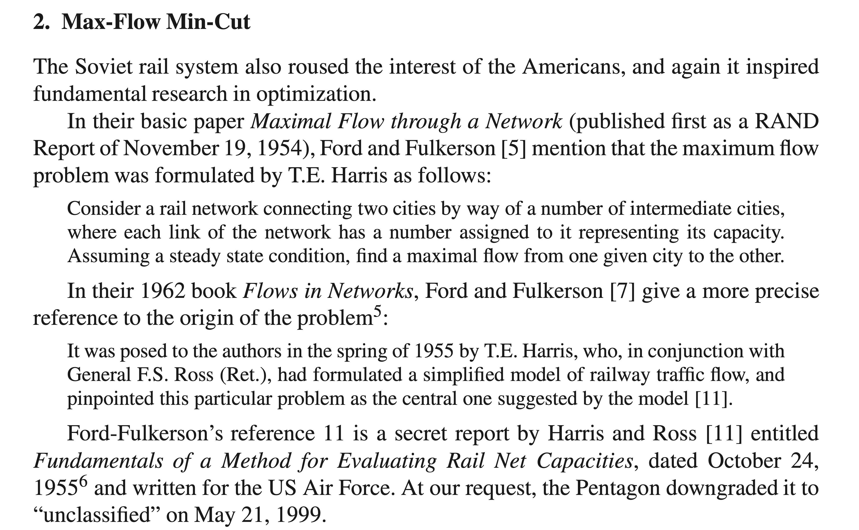

Slide 18
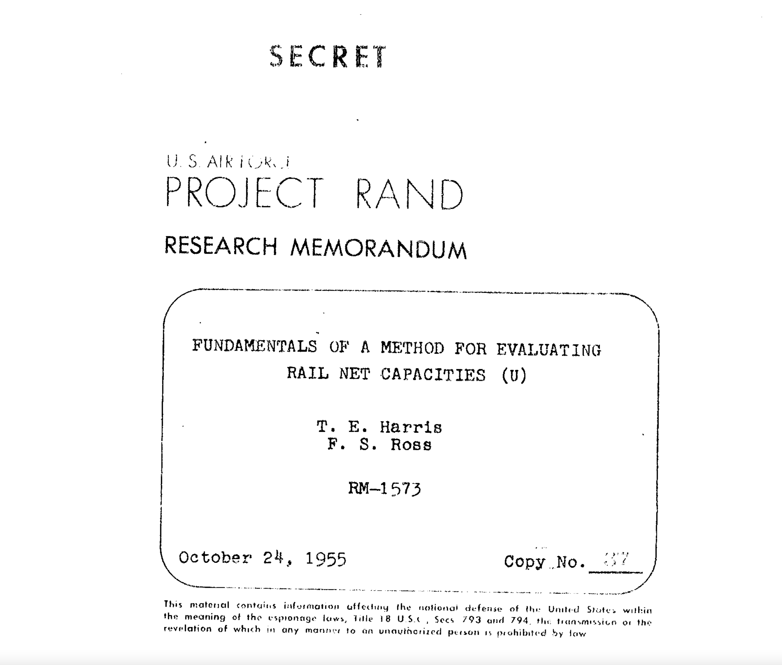

Slide 19
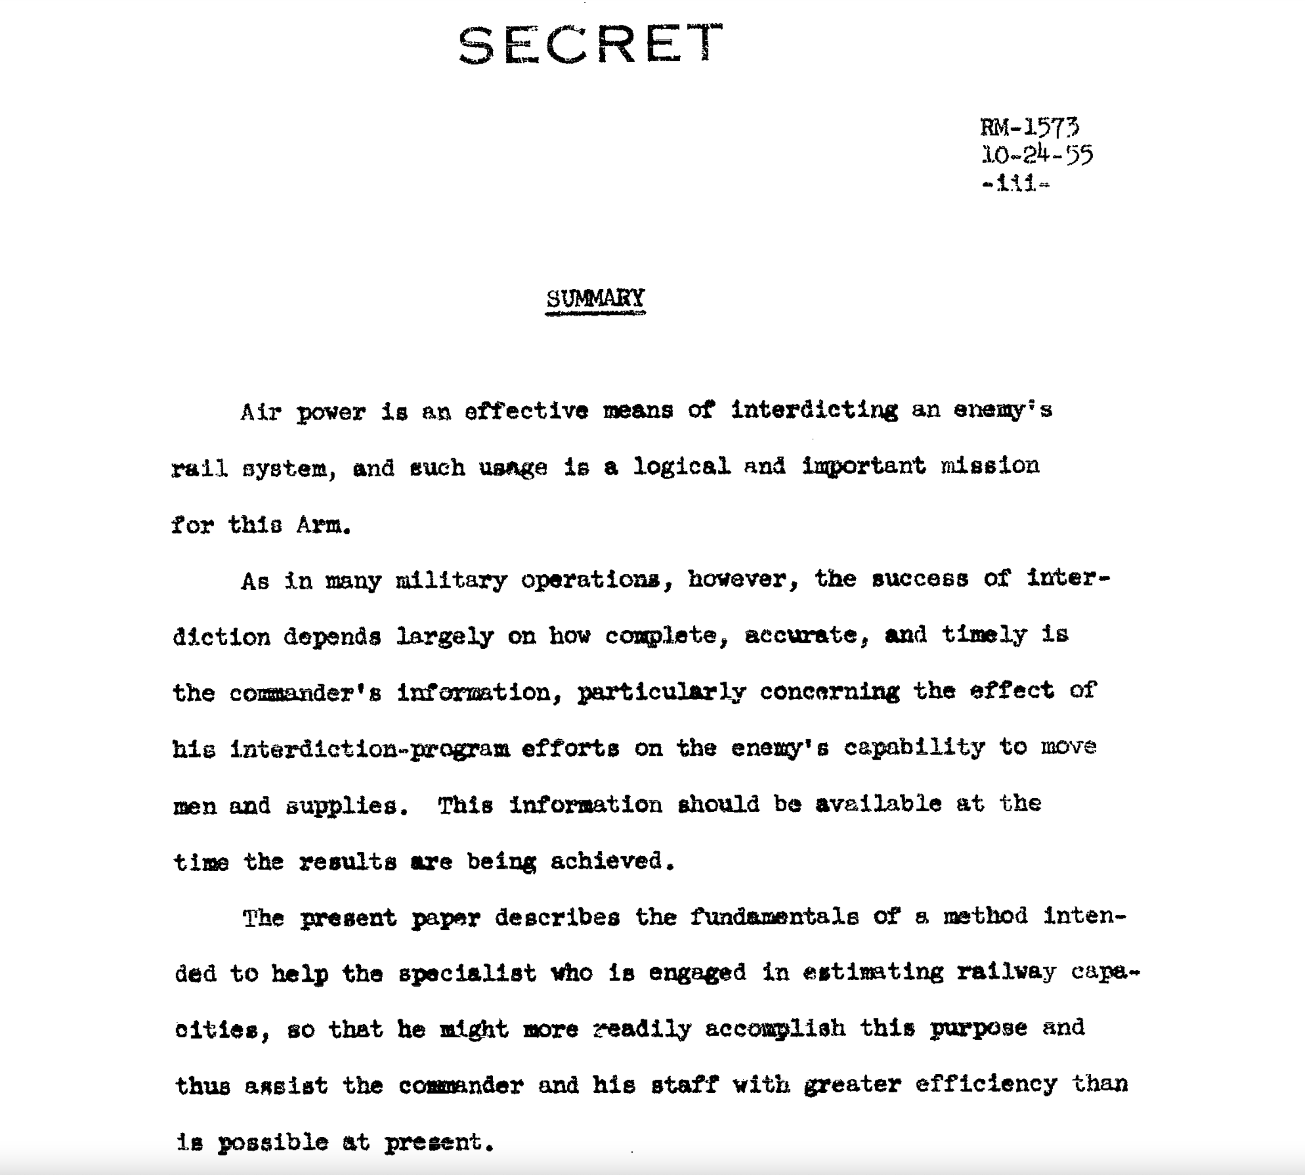

Slide 20
A maximum flow is a flow of maximum value.
That’s the same as the minimum cut in this graph!
This one is maximum; it has value 11.
3
3
3
4
4
6
2
1
4
6
2
4
s
2
3
4
t
3
5
2
6
3
1
6
4
4
5
10

Slide 21
Pre-lecture exercise
Each edge is a (directed) rickety bridge.
How many bridges need to fall down to disconnect s from t?
If only one person can be on a bridge at a time, and you want to keep traffic moving (aka, no waiting at vertices allowed), how many people can get to t at a time?
For this graph, 2
Also 2!
s
t

Slide 22
Pre-lecture exercise
Each edge is a (directed) rickety bridge.
How many bridges need to fall down to disconnect s from t?
If only one person can be on a bridge at a time, and you want to keep traffic moving (aka, no waiting at vertices allowed), how many people can get to t at a time?
For this graph, 2
Also 2!
s
t

Slide 23
How about now?
Each edge is a (directed) rickety bridge.
How many bridges need to fall down to disconnect s from t?
If only one person can be on a bridge at a time, and you want to keep traffic moving (aka, no waiting at vertices allowed), how many people can get to t at a time?
For this graph, 3
Also 3!
s
t

Slide 24
How about now?
Each edge is a (directed) rickety bridge.
How many bridges need to fall down to disconnect s from t?
If only one person can be on a bridge at a time, and you want to keep traffic moving (aka, no waiting at vertices allowed), how many people can get to t at a time?
For this graph, 3
Also 3!
s
t

Slide 25
Pre-lecture exercise
Can you find a graph where the two numbers are different?

Slide 26
Theorem Max-flow min-cut theorem
The value of a max flow from s to t
is equal to
the cost of a min s-t cut.
Intuition: in a max flow, the min cut better fill up, and this is the bottleneck.
3
3
3
4
4
6
2
1
4
6
2
4
s
2
3
4
t
3
5
2
6
3
1
6
4
4
5
10

Slide 27

Proof outline
Lemma 1: max flow $≤$ min cut.
Proof-by-picture
What we actually want: max flow $=$ min cut.
Proof-by-algorithm…the Ford-Fulkerson algorithm!
(Also using Lemma 1)

Slide 28


One half of Min-Cut Max-Flow Thm
Lemma 1:
For ANY s-t flow and ANY s-t cut, the value of the flow is at most the cost of the cut.
Hence max flow $≤$ min cut.
ANY s-t CUT
Proof by picture:
All that stuff has to cross the cut at some point.
So x $≤$ cost of this cut
x stuff comes out of s
t
s

Slide 29
One half of Min-Cut Max-Flow Thm
Lemma 1:
For ANY s-t flow and ANY s-t cut, the value of the flow is at most the cost of the cut.
Hence max flow $≤$ min cut.
That was proof-by-picture.
Good exercise to convert this to a proof-by-proof!

Slide 30
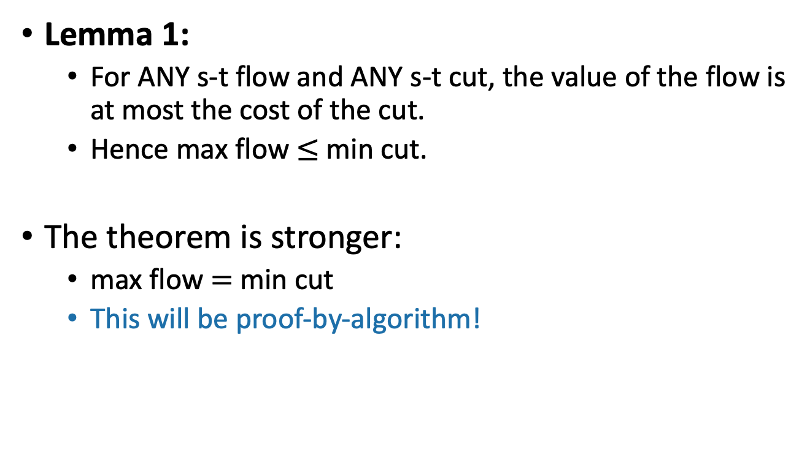
Min-Cut Max-Flow Thm
Lemma 1:
For ANY s-t flow and ANY s-t cut, the value of the flow is at most the cost of the cut.
Hence max flow $≤$ min cut.
The theorem is stronger:
max flow $=$ min cut
This will be proof-by-algorithm!

Slide 31
Maximum flow
Let’s brainstorm some algorithms for maximum flow.
Think-pair-share!
3
4
4
6
2
6
2
4
s
t
3
2
6
3
4
6
10

Slide 32
Ford-Fulkerson algorithm
Outline of algorithm:
Start with zero flow
We will maintain a “residual graph” G_{f}
A path from s to t in G_{f} will give us a way to improve our flow.
We will continue until there are no s-t paths left.
Assume for today that we don’t have edges like this, although it’s not necessary.

Slide 33
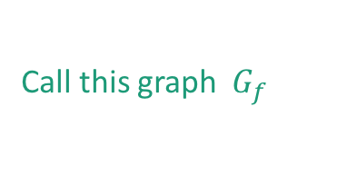
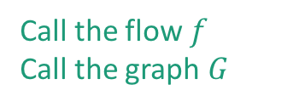
Tool: Residual networks Say we have a flow
a
This forward edge has weight “capacity – flow”.
2
6
2
3
This backward edge has weight “flow”.
4
1
t
s
8
1
3
2
a
b
3
Call the flow $f$
Call the graph $G$
2
0
1
5
1
t
Create a new residual network from this flow:
s
7
1
1
b
2
Call this graph $G_{f}$

Slide 34
Tool: Residual networks Say we have a flow
a
Forward edges are the amount that’s left.
Backwards edges are the amount that’s been used.
2
6
2
3
4
1
t
s
8
1
3
2
a
b
3
Call the flow $f$
Call the graph $G$
2
1
5
1
t
Create a new residual network from this flow:
s
7
1
1
b
2
Call this graph $G_{f}$

Slide 35

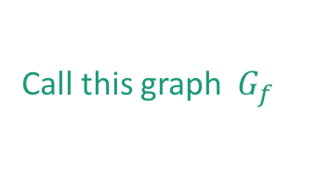
Residual networks tell us how to improve the flow.
Definition: A path from s to t in the residual network is called an augmenting path.
Claim: If there is an augmenting path, we can increase the flow along that path.
2
3
6
2
2
4
3
1
1
5
s
8
t
1
t
s
7
3
2
1
1
Call the flow $f$
Call the graph $G$
1
2
Call this graph $G_{f}$

Slide 36
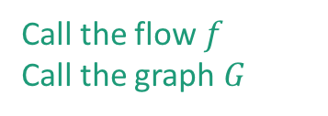
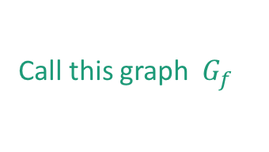
Claim: if there is an augmenting path, we can increase the flow along that path.
Easy case: every edge on the path in G_{f} is a forward edge.
Forward edges indicate how much stuff can still go through.
Just increase the flow on all the edges!
2
3
6
2
2
4
4
3
2
1
1
5
s
8
t
1
t
s
7
3
3
1
1
2
Call the flow $f$
Call the graph $G$
1
2
Call this graph $G_{f}$

Slide 37
Claim: if there is an augmenting path, we can increase the flow along that path.
Harder case: there are backward edges in the path.
Here’s a slightly different example of a flow:
2
1
6
2
2
4
1
1
3
5
s
3
t
1
t
s
2
3
0
3
1
Call the flow $f$
Call the graph $G$
1
Call this graph $G_{f}$
I changed some of the weights and edge directions.

Slide 38
Claim: if there is an augmenting path, we can increase the flow along that path.
Harder case: there are backward edges in the path.
Here’s a slightly different example of a flow:
2
1
6
2
2
4
1
1
3
5
s
3
t
1
t
s
2
3
0
3
1
Call the flow $f$
Call the graph $G$
1
Call this graph $G_{f}$
Now we should NOT increase the flow at all the edges along the path!
For example, that will mess up the conservation of stuff at this vertex.
I changed some of the weights and edge directions.

Slide 39
Claim: if there is an augmenting path, we can increase the flow along that path.
In this case we do something a bit different:
We will add flow here
We will remove flow here, since our augmenting path is going backwards along this edge.
2
1
6
2
2
4
1
2
1
3
0
t
5
s
3
s
1
t
3
2
3
0
1
1
Call the flow $f$
Call the graph $G$
1
Call this graph $G_{f}$
We will add flow here

Slide 40
Claim: if there is an augmenting path, we can increase the flow along that path.
In this case we do something a bit different:
Then we’ll update the residual graph:
2
2
6
2
2
4
1
2
1
2
0
t
6
s
3
s
t
3
2
2
0
1
1
Call the flow $f$
Call the graph $G$
1
1
Call this graph $G_{f}$

Slide 41
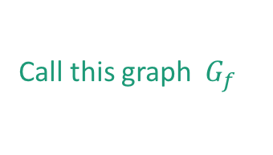


2 in, 2 out
Before:
flow value is 2
2
1
6
2
2
4
1
1
3
5
s
3
t
1
t
s
2
3
0
3
1
Call the flow $f$
Call the graph $G$
1
1 in, 1 out
Call this graph $G_{f}$
After:
2 in, 2 out
2
flow value is 3
2
6
2
2
4
1
2
1
2
0
t
6
s
3
s
t
3
2
2
0
1
1
Call the flow $f$
Call the graph $G$
1
1
1 in, 1 out
Call this graph $G_{f}$
Still a legit flow, but with a bigger value!

Slide 42


Claim: if there is an augmenting path, we can increase the flow along that path.
Check that this always makes a bigger (and legit) flow!
increaseFlow(path P in $Gf$ , flow f ):
x = min weight on any edge in P
for (u,v) in P:
if (u,v) in E, $f’\left(u,v\right)← f(u,v) + x.$
if (v,u) in E, $f’\left(v,u\right)← f(v,u) – x$
return f’
This is f’
5
3
1
5
2
2
4
5
1
3
0
s
2
t
flow f in G
x=2
3
4
3
2
s
t
path P in $Gf$

Slide 43
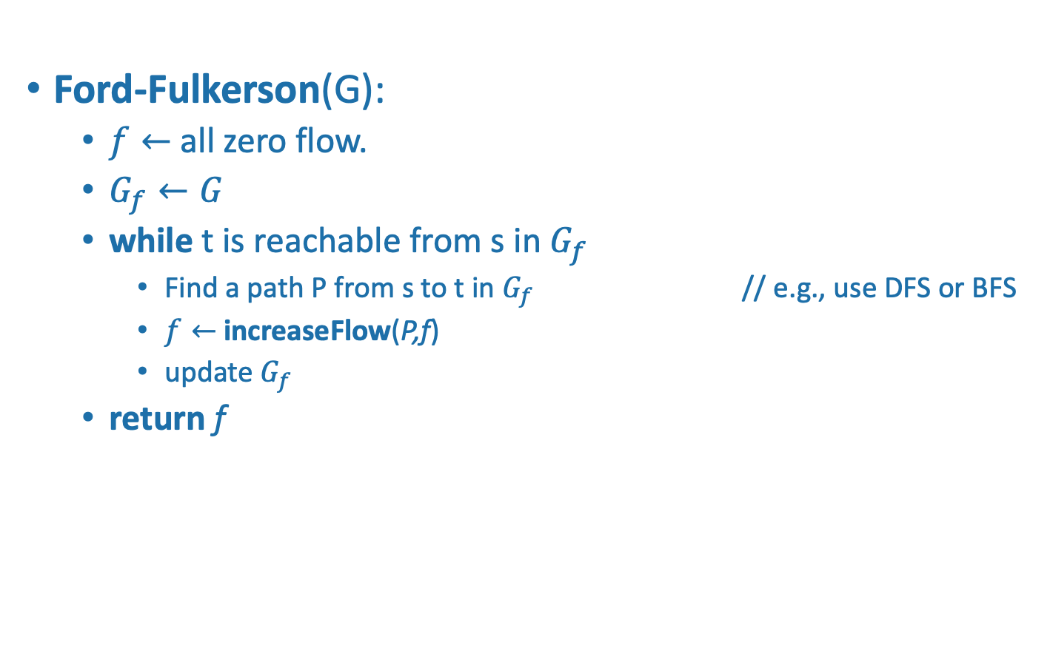
Ford-Fulkerson Algorithm
Ford-Fulkerson(G):
$f←$ all zero flow.
$G_{f}←G$
while t is reachable from s in $G_{f}$
Find a path P from s to t in $G_{f}$ // e.g., use DFS or BFS
$f←$increaseFlow(P,f)
update $G_{f}$
return f

Slide 44
Example of Ford-Fulkerson
3
0
4
4
6
0
0
0
2
4
s
0
0
0
t
3
0
3
6
0
4
0
10
0
3
4
4
6
3
4
s
t
2
3
6
4
10

Slide 45
Example of Ford-Fulkerson
3
0
4
4
6
0
0
0
2
4
s
0
0
0
t
3
0
3
6
0
4
0
10
0
3
4
4
6
3
4
s
t
2
3
6
4
10

Slide 46
Example of Ford-Fulkerson
3
0
4
4
6
4
0
4
2
4
s
0
0
4
t
3
0
3
6
0
4
0
10
0
3
4
4
2
4
3
4
s
t
2
3
6
4
10

Slide 47
Example of Ford-Fulkerson
3
0
4
4
6
4
0
4
2
4
s
0
0
4
t
3
0
3
6
0
4
0
10
0
3
4
4
2
4
3
4
s
t
2
3
6
4
10

Slide 48
Example of Ford-Fulkerson
3
0
4
4
6
4
0
4
2
4
s
0
0
4
t
3
4
3
6
0
4
4
10
4
3
4
4
2
4
3
4
s
t
2
4
3
4
2
4
6

Slide 49
Example of Ford-Fulkerson
We will remove flow from this edge.
3
0
4
4
6
4
0
4
2
4
s
0
0
4
t
3
4
3
6
0
4
4
10
4
Notice that we’re going back along one of the backwards edges we added.
3
4
4
2
4
s
3
t
2
4
4
3
4
2
4
6

Slide 50
Example of Ford-Fulkerson
We will remove flow from this edge.
3
2
4
4
6
2
2
4
2
4
s
2
2
4
t
3
4
3
6
0
4
4
10
4
Notice that we’re going back along one of the backwards edges we added.
1
2
2
4
4
2
2
2
s
1
t
4
3
2
4
4
2
4
6

Slide 51
Example of Ford-Fulkerson
We will remove flow from this edge AGAIN.
3
2
4
4
6
2
2
4
2
4
s
2
2
4
t
3
4
3
6
0
4
4
10
4
1
2
2
4
4
2
2
s
2
1
t
4
3
2
4
4
2
4
6

Slide 52
Example of Ford-Fulkerson
We will remove flow from this edge AGAIN.
3
3
4
4
6
1
3
4
2
4
s
2
3
4
t
3
5
3
6
1
4
4
10
5
3
1
4
5
3
1
s
2
t
4
2
3
5
4
1
1
5
5

Slide 53
Example of Ford-Fulkerson
Now we have nothing left to do!
3
3
4
4
6
1
3
4
2
4
s
2
3
4
t
3
5
3
6
1
4
4
10
5
3
1
4
5
3
1
s
2
t
3
4
5
2
1
4
1
5
5

Slide 54
Example of Ford-Fulkerson
Now we have nothing left to do!
3
3
4
4
6
1
3
4
2
4
s
2
3
4
t
3
5
3
6
1
4
4
10
5
3
1
4
5
3
1
s
2
t
3
4
There’s no path from s to t, and here’s the cut to prove it.
5
2
1
4
1
5
5

Slide 55

Why does Ford-Fulkerson work?
Just because we can’t improve the flow anymore using an augmenting path, does that mean there isn’t a better flow?
Lemma 2: If there is no augmenting path in $Gf$ then $f$ is a maximum flow.

Slide 56


No augmenting path $⇒$ max flow.
Suppose there is not a path from s to t in $Gf$.
Consider the cut given by:
{things reachable from s} , {things not reachable from s}
2
4
6
2
2
4
4
2
4
s
8
t
2
t
s
7
1
3
3
Call the flow $f$
Call the graph $G$
1
3
Call this graph $G_{f}$

Slide 57
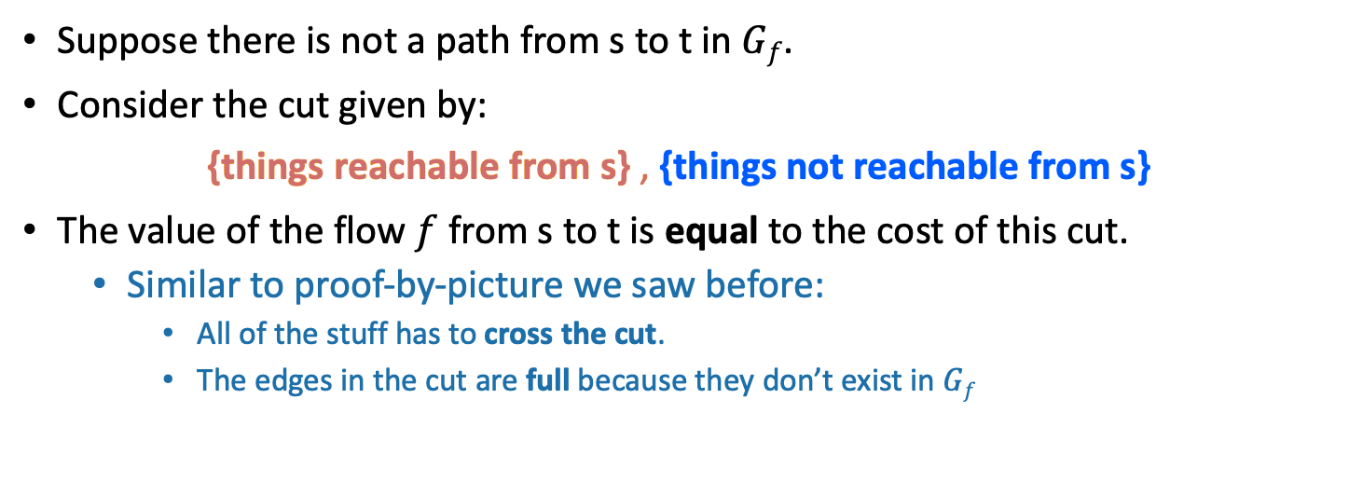
No augmenting path $⇒$ max flow.
Suppose there is not a path from s to t in $Gf$.
Consider the cut given by:
{things reachable from s} , {things not reachable from s}
The value of the flow $f$ from s to t is equal to the cost of this cut.
Similar to proof-by-picture we saw before:
All of the stuff has to cross the cut.
The edges in the cut are full because they don’t exist in $Gf$
t lives here
2
4
6
2
2
4
4
2
2
4
s
t
t
8
s
3
7
1
3
Call the flow $f$
Call the graph $G$
1
3
Call this graph $G_{f}$

Slide 58

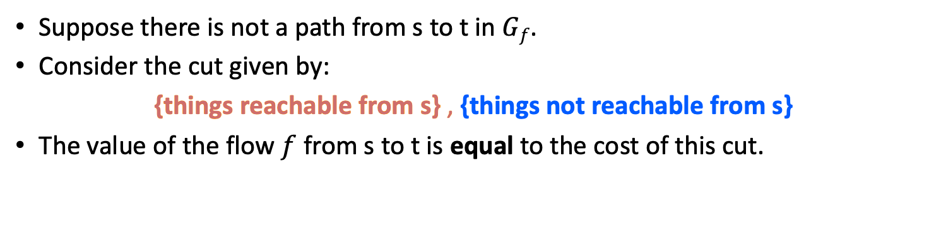

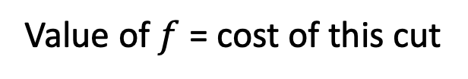
No augmenting path $⇒$ max flow.
Suppose there is not a path from s to t in $Gf$.
Consider the cut given by:
{things reachable from s} , {things not reachable from s}
The value of the flow $f$ from s to t is equal to the cost of this cut.
t lives here
Lemma 1
Value of $f$ = cost of this cut
$$≥min cut$$
$$≥max flow$$
2
4
6
2
2
4
4
2
2
4
s
t
t
8
s
3
7
1
3
Call the flow $f$
Call the graph $G$
1
3
Call this graph $G_{f}$

Slide 59
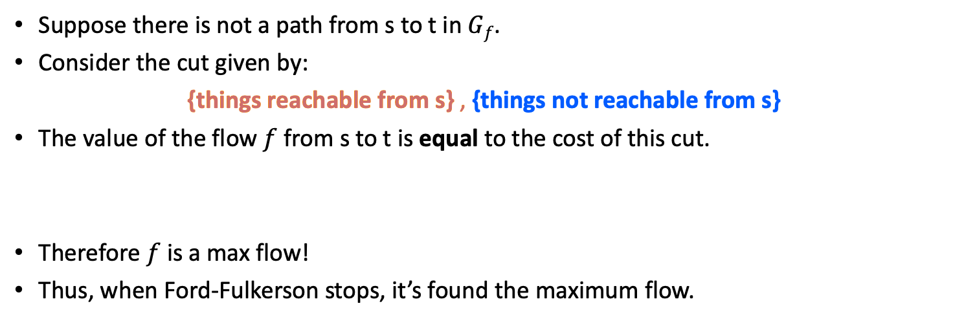
No augmenting path $⇒$ max flow.
Suppose there is not a path from s to t in $Gf$.
Consider the cut given by:
{things reachable from s} , {things not reachable from s}
The value of the flow $f$ from s to t is equal to the cost of this cut.
Therefore $f$ is a max flow!
Thus, when Ford-Fulkerson stops, it’s found the maximum flow.
t lives here
Lemma 1
Value of $f$ = cost of this cut
$$≥min cut$$
$$≥max flow$$
2
4
6
2
2
4
4
2
2
4
s
t
t
8
s
3
7
1
3
Call the flow $f$
Call the graph $G$
1
3
Call this graph $G_{f}$

Slide 60



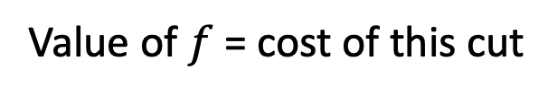
Min-Cut Max-Flow Theorem
$$max flow≥$$
Value of $f$ = cost of this cut
$$≥min cut$$
$$≥max flow$$
So everything is equal and min cut = max flow!

Slide 61
What have we learned?
Max s-t flow is equal to min s-t cut!
The USSR and the USA were trying to solve the same problem…
The Ford-Fulkerson algorithm can find the min-cut/max-flow.
Repeatedly improve your flow along an augmenting path.
How long does this take???

Slide 62
Why should we be concerned? Suppose we just picked paths arbitrarily.
a
Choose a really big number C.
C
C
0
0
0
1
t
s
C
0
C
0
b
a
C
C
1
t
s
C
C
b

Slide 63
Why should we be concerned? Suppose we just picked paths arbitrarily.
a
Choose a really big number C.
C
C
0
0
0
1
t
s
C
0
C
0
b
a
C
C
1
t
s
C
C
b

Slide 64
Why should we be concerned? Suppose we just picked paths arbitrarily.
a
Choose a really big number C.
C
C
1
0
1
1
t
s
C
1
C
0
b
a
1
C
C-1
1
The edge (b,a) disappeared from the residual graph!
t
s
1
C
C-1
b

Slide 65
Why should we be concerned? Suppose we just picked paths arbitrarily.
a
Choose a really big number C.
C
C
1
0
1
1
t
s
C
1
C
0
b
a
1
C
C-1
1
t
s
1
C
C-1
b

Slide 66
Why should we be concerned? Suppose we just picked paths arbitrarily.
a
Choose a really big number C.
C
C
1
1
0
1
t
s
C
1
C
1
b
a
1
1
C-1
C-1
The edge (b,a) re-appeared in the residual graph!
1
t
s
1
1
b
C-1
C-1

Slide 67
Why should we be concerned? Suppose we just picked paths arbitrarily.
a
Choose a really big number C.
C
C
1
1
0
1
t
s
C
1
C
1
b
a
1
1
C-1
C-1
1
t
s
1
1
b
C-1
C-1

Slide 68
Why should we be concerned? Suppose we just picked paths arbitrarily.
a
Choose a really big number C.
C
C
2
1
1
1
t
s
C
2
C
1
b
a
2
1
C-1
C-2
1
The edge (b,a) disappeared from the residual graph!
t
s
2
1
b
C-1
C-2

Slide 69
Why should we be concerned? Suppose we just picked paths arbitrarily.
a
Choose a really big number C.
C
C
2
This will go on for C steps, adding flow along (b,a) and then subtracting it again.
1
1
1
t
s
C
2
C
1
b
a
2
1
C-1
C-2
1
The edge (b,a) disappeared from the residual graph!
t
s
2
1
b
C-1
C-2

Slide 70
How do we choose which paths to use?
The analysis we did still works no matter how we choose the paths.
That is, the algorithm will be correct if it terminates.
However, the algorithm may not be efficient!!!
May take a long time to terminate
(Or may actually never terminate?)
We need to be careful with our path selection to make sure the algorithm terminates quickly.
Using BFS leads to the Edmonds-Karp algorithm.
It turns out this will work in time O(nm²) – proof skipped.
(That’s not the only way to do it!)

Slide 71
Running time
Slide skipped in class
Edmonds-Karp algorithm (aka Ford-Fulkerson with BFS) runs in time O(nm²).
We will skip the proof in class.
Basic idea:
The number of times you remove an edge from the residual graph is O(n).
This is the hard part
There are at most m edges.
Each time we remove an edge we run BFS, which takes time O(n+m).
Actually, O(m), since we don’t need to explore the whole graph, just the stuff reachable from s.

Slide 72
One more useful observation
If all the capacities are integers, then the flows in any max flow are also all integers.
When we update flows in Ford-Fulkerson, we’re only ever adding or subtracting integers.
Since we started with 0 (an integer), everything stays an integer.

Slide 73
But wait, there’s more!
Min-cut and max-flow are not just useful for the USA and the USSR in 1955.
The Ford-Fulkerson algorithm is the basis for many other graph algorithms.
For the rest of today, we’ll see a few:
Maximum bipartite matching
Integer assignment problems
Some of the following material shamelessly stolen from Jeff Erickson’s excellent lecture notes: http://jeffe.cs.illinois.edu/teaching/algorithms/2009/notes/17-maxflowapps.pdf

Slide 74
Maximum matching in bipartite graphs
Different students only want certain items of Stanford swag (depending on fit, style, etc.)
How can we make as many students as possible happy?
A
B
C
D
E
Stanford Students
Stanford Swag

Slide 75
Maximum matching in bipartite graphs
Different students only want certain items of Stanford swag (depending on fit, style, etc).
How can we make as many students as possible happy?
A
B
C
D
E
Stanford Students
Stanford Swag

Slide 76
Solution via max flow
All edges have capacity 1.
s
t
Stanford Students
Stanford Swag

Slide 77
Solution via max flow
All edges have capacity 1.
1
1
1
1
s
1
1
t
1
1
1
1
1
1
Stanford Students
Stanford Swag

Slide 78
Solution via max flow why does this work?
All edges have capacity 1.
1. Because the capacities are all integers, so are the flows – so they are either 0 or 1.
4. The value of the flow is the size of the matching.
1
1
1
1
s
1
t
Value of this flow is 4.
1
1
1
1
1
1
1
2. Stuff in = stuff out
means that the number of items assigned to each student 0 or 1. (And vice versa).
5. We conclude that the max flow corresponds to a max matching.
3. Thus, the edges with flow on them form a matching. (And, any matching gives a flow).

Slide 79
A slightly more complicated example: assignment problems
One set X
Example: Stanford students
Another set Y
Example: tubs of ice cream
Each x in X can participate in c(x) matches.
Student x can only eat 4 scoops of ice cream.
Each y in Y can only participate in c(y) matches.
Tub of ice cream y only has 10 scoops in it.
Each pair (x,y) can only be matched c(x,y) times.
Student x only wants 3 scoops of flavor y
Student x’ doesn’t want any scoops of flavor y’
Goal: assign as many matches as possible.

Slide 80
Example
How can we serve as much ice cream as possible?
6
4
1
3
3
3
3
1
This person wants 1 scoop of ice cream, either 1 chocolate or 1 vanilla.
10
1
1
5
10
3
10
This person wants two scoops of the sorbet.
2
2
6
Stanford Students
Tubs of ice cream

Slide 81
Solution via max flow
1
3
6
4
3
3
3
1
s
1
10
t
1
10
5
3
2
10
6
2
Stanford Students
Tubs of ice cream

Slide 82
Solution via max flow
Give this person
scoop of this ice cream.
1
1
1
3
4
4
3
6
4
3
3
3
3
1
3
3
s
1
10
t
1
1
1
3
7
10
1
5
3
1
2
2
6
2
10
6
2
6
Stanford Students
Tubs of ice cream

Slide 83
Solution via max flow
No more than 3 scoops of sorbet can be assigned.
1
1
3
4
We dish out 17 scoops of ice cream.
4
3
6
4
3
3
3
3
1
3
3
s
1
10
t
1
1
1
3
7
10
1
5
3
1
2
2
6
This student can have flow at most 10 going in, and so at most 10 going out, so at most 10 scoops assigned.
2
6
10
2
6
No more than 10 scoops of Cherry Garcia can be assigned to this student.
As before, flows correspond to assignments, and max flows correspond to max assignments.

Slide 84
What have we learned?
Max flows and min cuts aren’t just for railway routing.
Immediately, they apply to other sorts of routing too!
But also they are useful for assigning items to Stanford students!

Slide 85
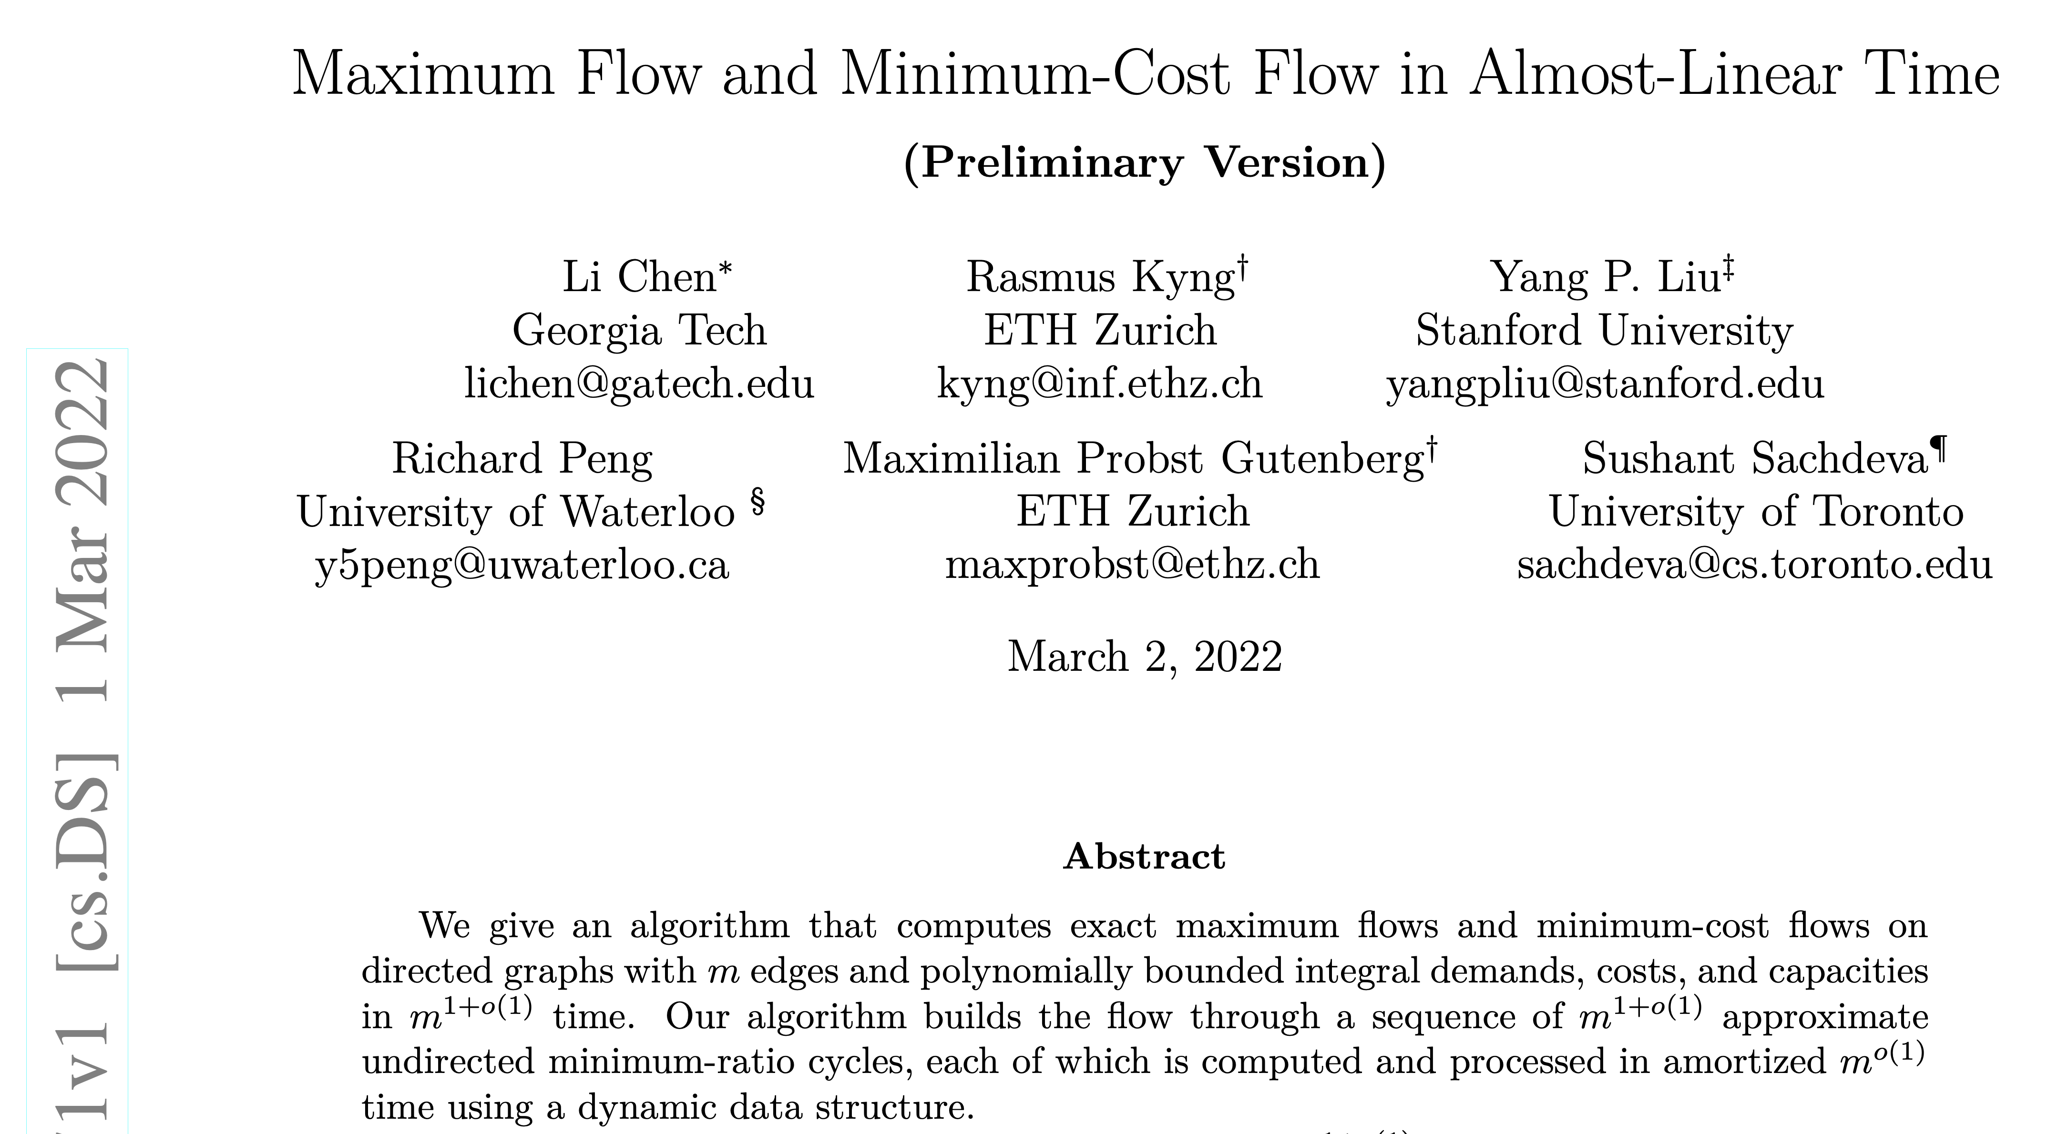
Can we do better? State-of-the-art max flow

Slide 86
Recap
Today we talked about s-t cuts and s-t flows.
The Min-Cut Max-Flow Theorem says that minimizing the cost of cuts is the same as maximizing the value of flows.
The Ford-Fulkerson algorithm does this!
Find an augmenting path
Increase the flow along that path
Repeat until you can’t find any more paths and then you’re done!
An important algorithmic primitive!
E.g., assignment problems.

Slide 87

Next time
Stable Matchings!
Deferred Acceptance (Gale-Shapley) Algorithm
Source: https://www.nrmp.org/about/

