Slide 1
CS161 Final Review
Hi, I’m Will! :)
Disclaimer: there’s a TON to get through, so I’ll do my best + focus on some topics from the latter half of the course, but please please please study up on everything!

Slide 2
Agenda
Shortest Path Algorithms 🎯
Dynamic Programming 😎
Greedy Algorithms 🤑
Minimum Spanning Trees 🌲
Max-Flow, Min-Cut, Ford-Fulkerson 🚰

Slide 3
Shortest-Path Algorithms

Slide 4
For a given graph…
Stanford
8
10
Shortest path problem: what’s the way to get from Stanford to everywhere else with the least cost?
Las Vegas
Portland
25
30
Nashville
Mexico City
7
New Orleans

Slide 5
Big idea for Dijkstra!
Shortest paths of shortest paths are shortest paths.

Slide 6
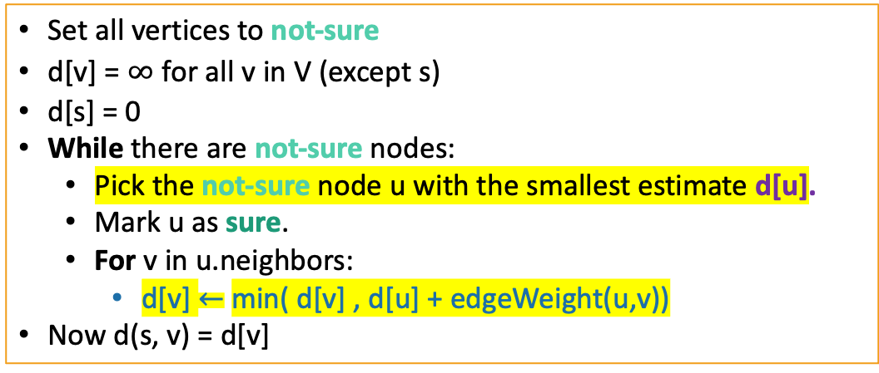
Dijkstra Pseudocode
Dijkstra(G,s):
Shouldn’t be used on graphs with negative edges!
Runtime? Will need to use Fibonacci heaps
to make operations highlighted operations run faster!
Notes:
Feel free to skip if time does not allow for it, but emphasize that the algorithm shouldn’t be used on graphs with negative edges!!

Slide 7
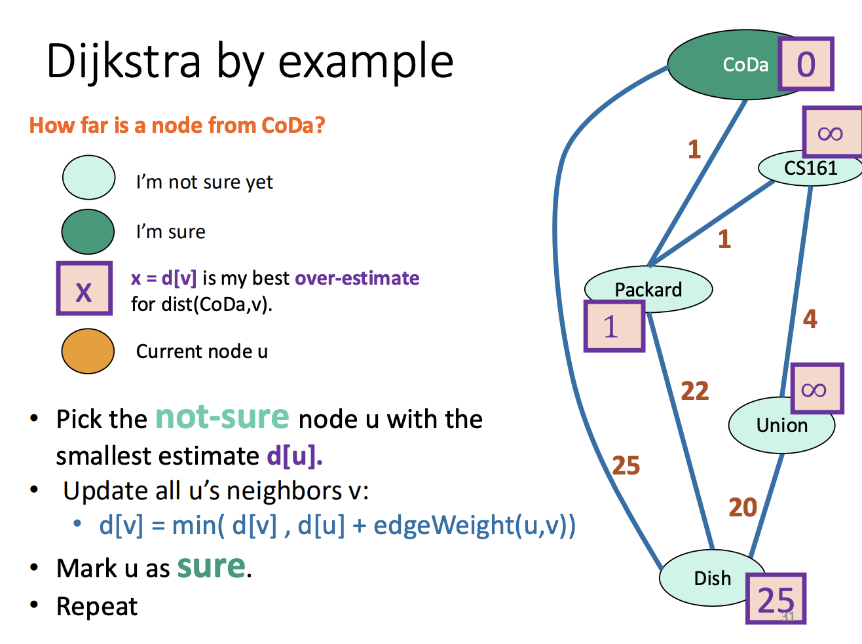

Slide 8
Dijkstra with Fibonacci Heap
T(extractMin) = O(log(n)) (amortized time*)
T(decreaseKey) = O(1) (amortized time*)
See CS166 for more! (or CLRS)
Running time of Dijkstra
O(n( T(extractMin) ) + m T(decreaseKey))
O(nlog(n) + m)
*This means that any sequence of d extractMin calls takes time at most O(dlog(n)). But a few of the d may take longer than O(log(n)) and some may take less time..

Slide 9
Check-In!
What is Dijkstra’s runtime? With what data structure?
T/F: Dijkstra can be used for finding a single-source shortest path solution with negative edges but not negative cycles
T/F: Dijkstra is the most efficient way to solve for a shortest path in an unweighted graph
T/F: Adding a new positive edge to an undirected weighted graph w/ positive edges cannot increase the output values of Dijkstra

Slide 10
Bellman-Ford
Dijkstra…but now we update every vertex each time!

Slide 11
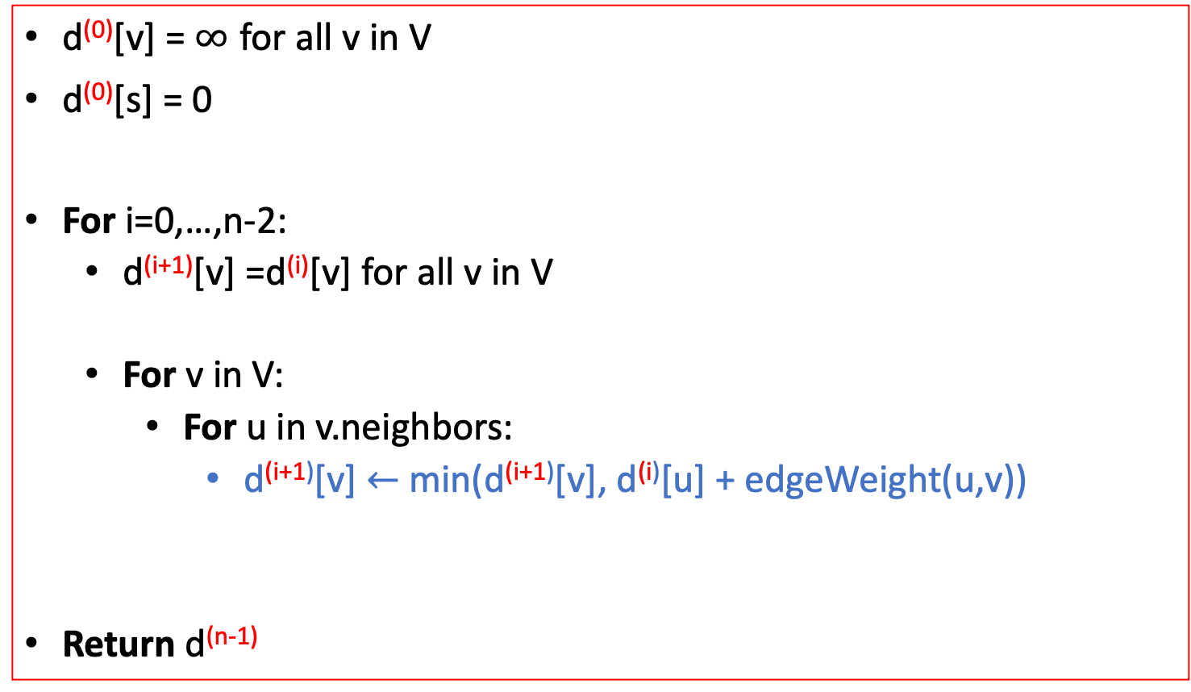
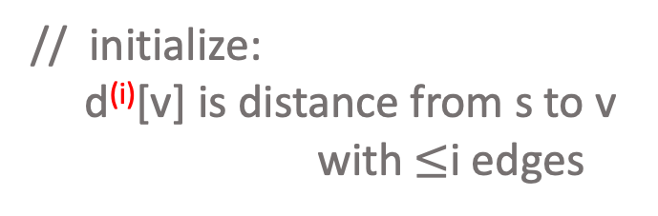
Bellman-Ford (algorithm)
Bellman-Ford(G,s):
// baseline distance: v doesn’t need (i+1)^{th} edge
// found a better path through u
Notes:
Compare the recurrence relation of BF with Dijkstra

Slide 12






Bellman-Ford (implementation)
Don’t actually keep all n arrays around.
Just keep two at a time: “last round” and “this round”
Point Reyes
Yellowstone
Stanford
S.F.
Yosemite
d⁽⁰⁾
0
d⁽¹⁾
0
1
-3
d⁽²⁾
0
-5
2
7
-3
d⁽³⁾
-4
-5
-4
6
-3
Only need these two in order to compute d⁽⁴⁾
d⁽⁴⁾
-4
-5
-4
6
-7

Slide 13
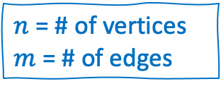
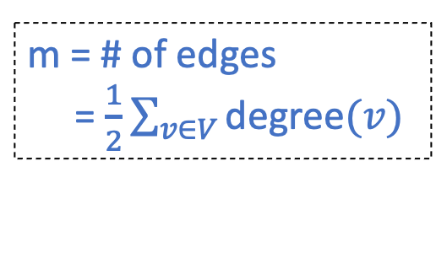
Bellman-Ford (takeaways)
Running time is O(mn)
For each of n rounds, update m edges.
Works fine with negative edges.
Does not work with negative cycles.
But it can detect negative cycles!
For i=0,…,n-1:
For u in V:
For v in u.neighbors:

Slide 14
Pop Quiz! 😱
What are the differences between Dijkstra and Bellman-Ford?

Slide 15
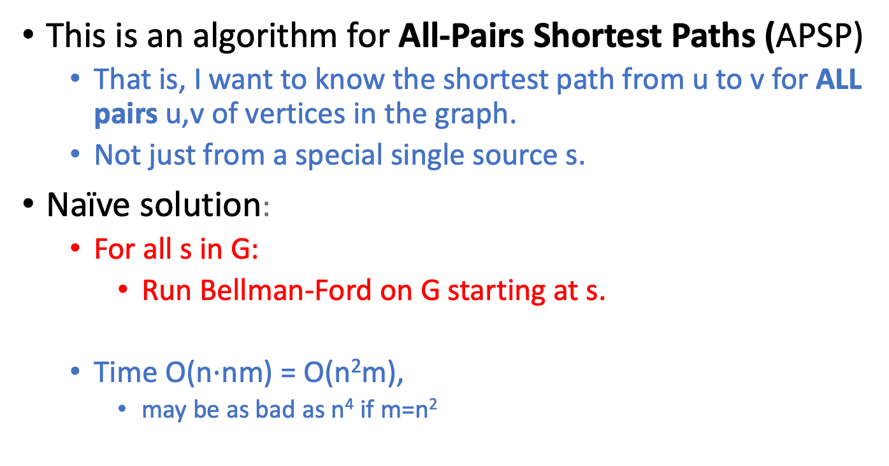
Floyd-Warshall algorithm (motivation)
Can we do better?

Slide 16
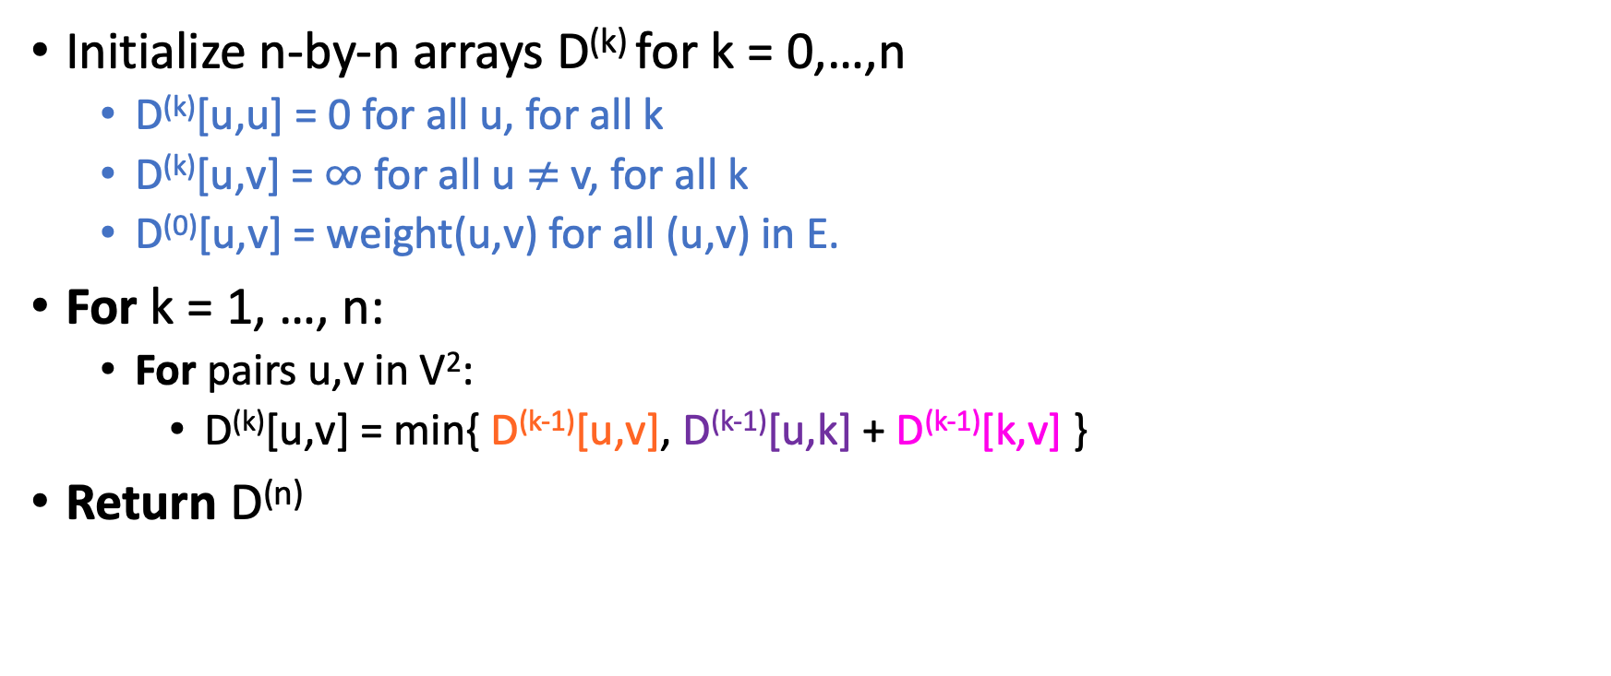
Floyd-Warshall algorithm
The base case checks out: the only path through zero other vertices are edges directly from u to v.
D^{(k)}[u,v] := length of shortest path between u and v that only pass through vertices 1,2,...,k in G

Slide 17
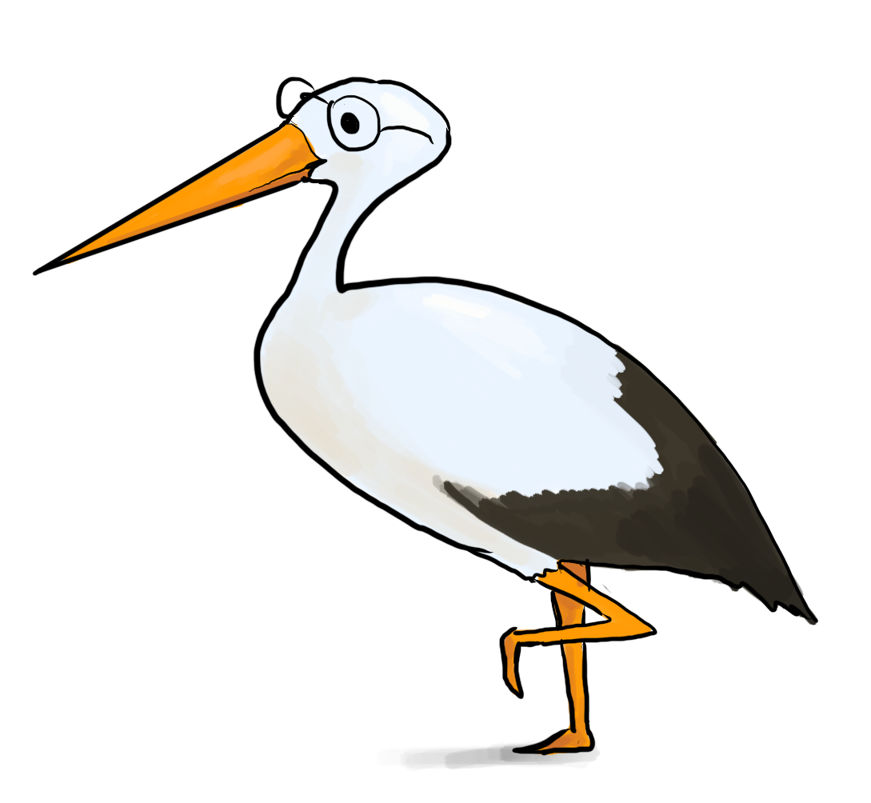
Floyd-Warshall algorithm (analysis)
Theorem:
If there are no negative cycles in a weighted directed graph G, then the Floyd-Warshall algorithm, running on G, returns a matrix D^{(n)} so that:
D^{(n)}[u,v] = distance between u and v in G.
Running time: O(n³)
Better than running Bellman-Ford n times!
Storage:
Need to store two n-by-n arrays, and the original graph.
Work out the details of a proof!
As with Bellman-Ford, we don’t really need to store all n of the D^{(k)}.

Slide 18
B-F and F-W are examples of DYNAMIC PROGRAMMING!!

Slide 19
This is a great transition to…

Slide 20
What is dynamic programming?
It is an algorithm design paradigm
(like divide-and-conquer is an algorithm design paradigm)
Usually it is for solving optimization problems
Most x given constraint y
Examples:
(Fibonacci numbers aren’t an optimization problem, but they are a good example…)
Knapsack
Longest-Common Subsequence
Graph Algorithms! (which ones?)

Slide 21
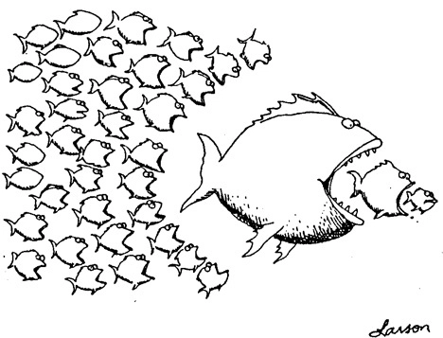
Bottom up approach
Solve the small problems first
fill in F[0],F[1]
Then bigger problems
fill in F[2]
…
Then bigger problems
fill in F[n-1]
Then finally solve the real problem.
fill in F[n]

Slide 22

Top down approach
Think of it like a recursive algorithm.
To solve the big problem:
Recurse to solve smaller problems
Those recurse to solve smaller problems
etc..
The difference from divide and conquer:
Memoization
Keep track of what small problems you’ve already solved to prevent re-solving the same problem twice.

Slide 23
Quick check-in!
Which is iterative? Which is recursive? What do we use to improve the recursive one?

Slide 24
Ok cool…how do I get these cool DP solutions?
Notes:
Notes for Will:

Slide 25
Recipe for applying Dynamic Programming
Step 1: Identify optimal substructure.
Step 2: Find a recursive formulation for the length of the longest common subsequence.
Step 3: Use dynamic programming to find the length of the longest common subsequence.
Step 4: If needed, keep track of some additional info so that the algorithm from Step 3 can find the actual LCS.

Slide 26
What are some subproblems and recursive formulations we’ve seen?
Notes:
Notes for Will:

Slide 27
Practice: # of paths
You have an nxn grid where each cell is 0 (free) or 1 (obstacle)
A robot starts at the top-left (0,0) and wants to make it to (n-1, n-1)
It can move down one space OR right one space BUT it can’t go through an obstacle
Compute the number of unique paths from start to finish that avoid obstacles
Specifically, what are our subproblems? What is the recurrence? Base cases?

Slide 28
Greedy Algorithms

Slide 29
Intuition
Let me just pick what’s best in this current moment (very short-sighted)!

Slide 30
Sub-problem graph view
Divide-and-conquer:
Big problem
sub-problem
sub-problem
sub-sub-problem
sub-sub-problem
sub-sub-problem
sub-sub-problem
sub-sub-problem

Slide 31
Sub-problem graph view
Dynamic Programming:
Big problem
sub-problem
sub-problem
sub-problem
sub-sub-problem
sub-sub-problem
sub-sub-problem
sub-sub-problem

Slide 32
Sub-problem graph view
Greedy algorithms:
Big problem
Not only is there optimal sub-structure:
optimal solutions to a problem are made up from optimal solutions of sub-problems
but each problem depends on only one sub-problem.
sub-problem
sub-sub-problem

Slide 33
When does this not work?

Slide 34
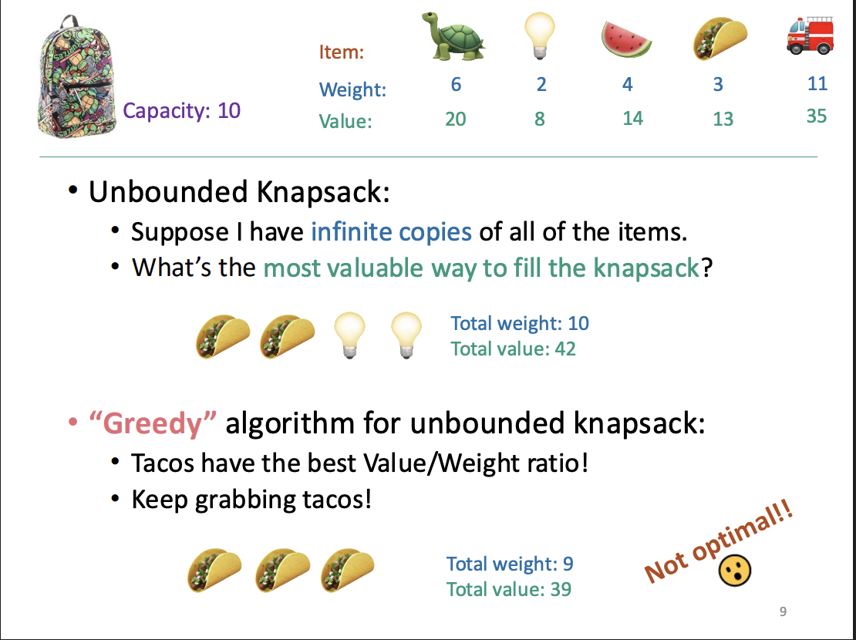

Slide 35
When DOES this work?
How do we show that???

Slide 36

Common strategy for greedy algorithms
Make a series of choices.
Show that, at each step, our choice won’t rule out all optimal solutions at the end of the day.
After we’ve made all our choices, there is an optimal solution we haven’t ruled out, so we must have found one.

Slide 37

Common strategy (formally) for greedy algorithms
“Success” here means “finding an optimal solution.”
Inductive Hypothesis:
After greedy choice t, you haven’t ruled out success.
Base case:
Success is possible before you make any choices.
Inductive step:
If you haven’t ruled out success after choice t, then you won’t rule out success after choice t+1.
Conclusion:
If you reach the end of the algorithm and haven’t ruled out success then you must have succeeded.

Slide 38
Common strategy for showing we don’t rule out success
Suppose that you’re on track to make an optimal solution T*.
Eg, after you’ve picked activity i, you’re still on track.
Suppose that T* disagrees with your next greedy choice.
Eg, it doesn’t involve activity k.
Manipulate T* in order to make a solution T that’s not worse but that agrees with your greedy choice.
Eg, swap whatever activity T* did pick next with activity k.

Slide 39
Uhhh… what does that mean?
Let’s see an example!

Slide 40
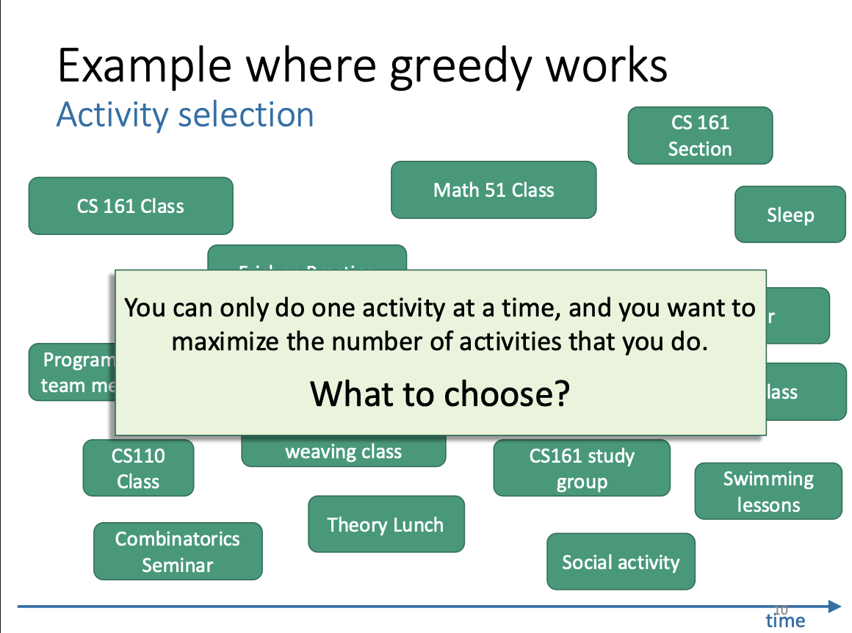

Slide 41
Activity selection
a_{i}
Input:
Activities a₁, a₂, …, a_{n}
Start times s₁, s₂, …, s_{n}
Finish times f₁, f₂, …, f_{n}
Output:
A way to maximize the number of activities you can do today.
s_{i}
f_{i}
time

Slide 42
Greedy algorithm
a₅
a₁
a₃
a₇
a₄
a₂
a₆
time
Pick activity you can add with the smallest finish time.
Repeat.

Slide 43
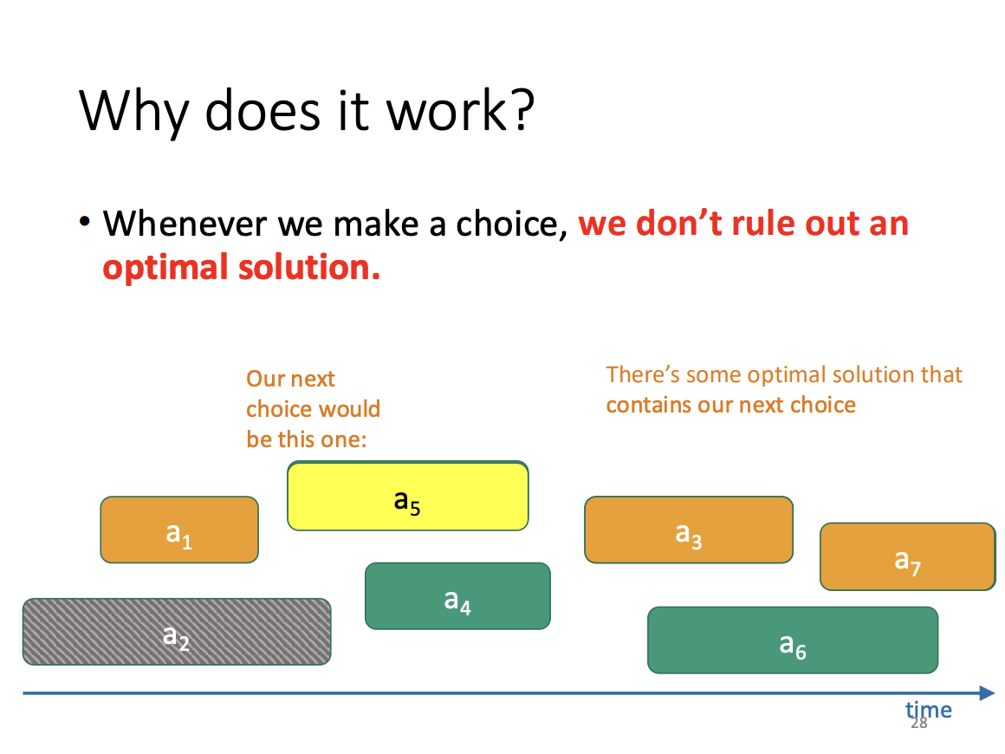

Slide 44
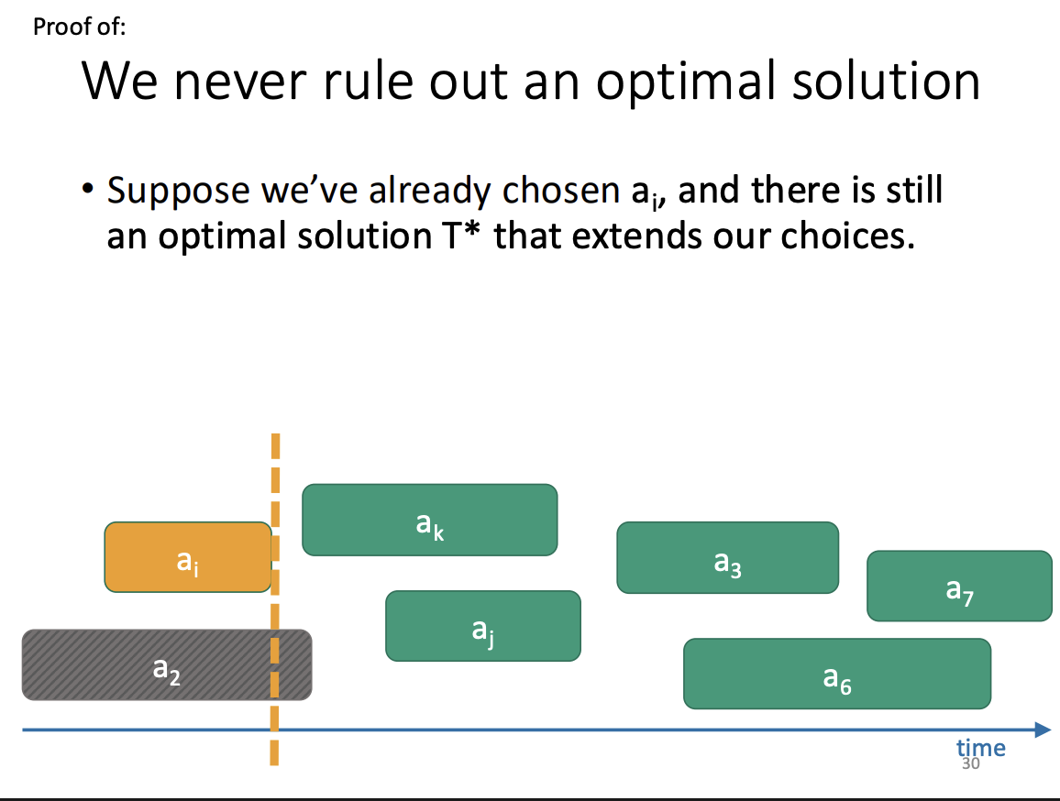

Slide 45
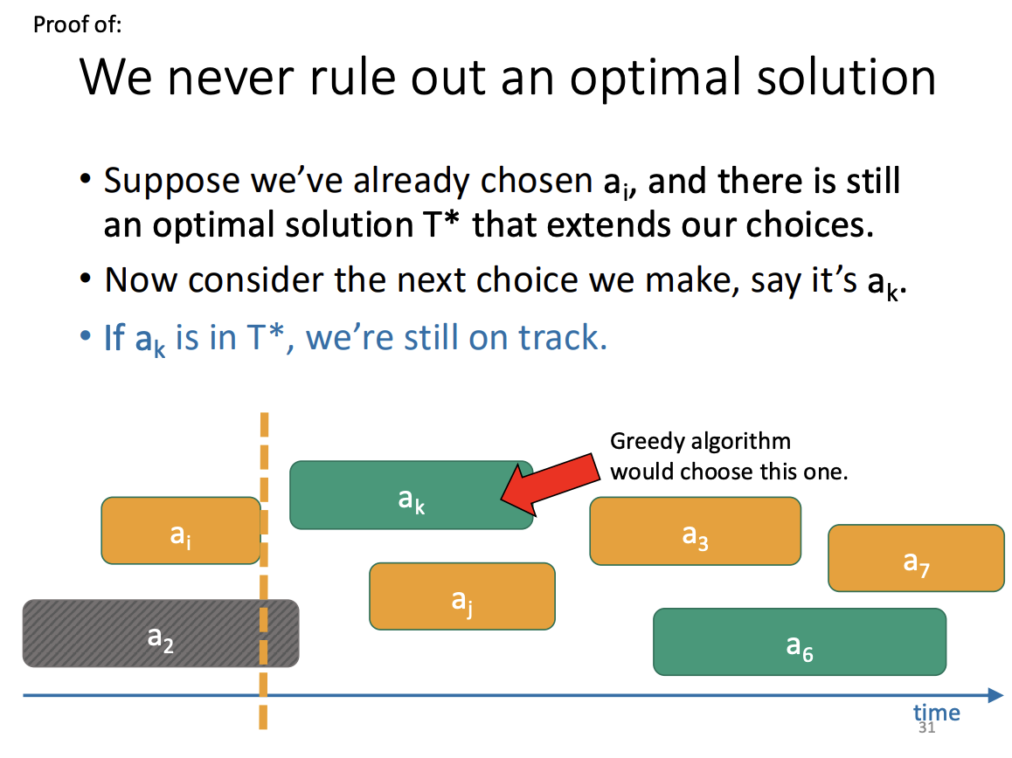

Slide 46
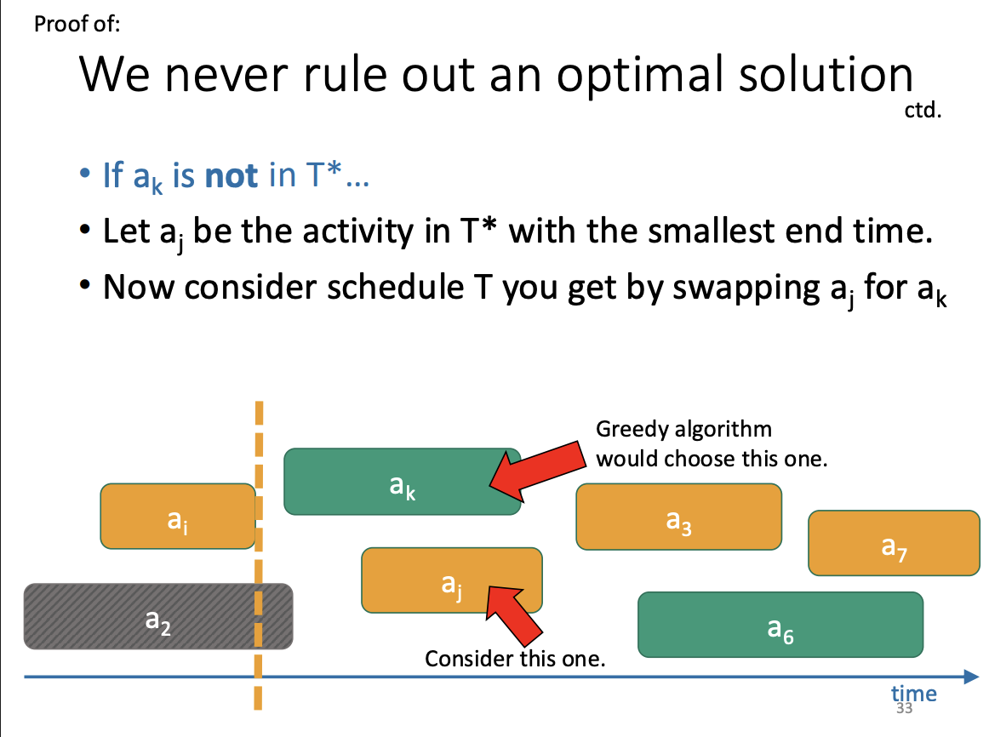

Slide 47
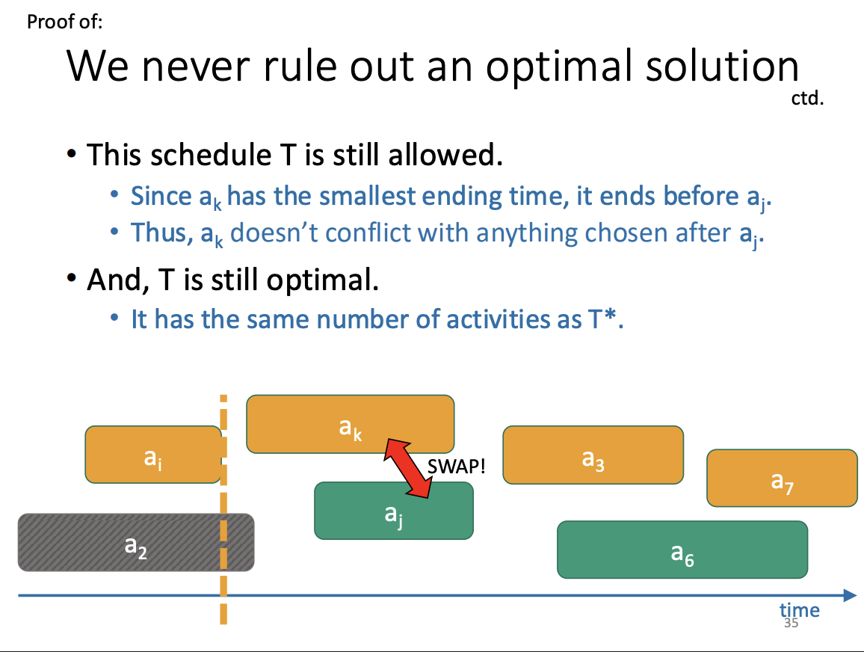

Slide 48
Common strategy (formally) for greedy algorithms
“Success” here means “finding an optimal solution.”
Inductive Hypothesis:
After greedy choice t, you haven’t ruled out success.
Base case:
Success is possible before you make any choices.
Inductive step:
✅✅✅✅✅✅✅✅✅ If you haven’t ruled out success after choice t, then you won’t rule out success after choice t+1.
Conclusion:
If you reach the end of the algorithm and haven’t ruled out success then you must have succeeded.

Slide 49
Minimum Spanning Trees

Slide 50
Minimum Spanning Tree Say we have an undirected weighted graph
8
7
This is a minimum spanning tree.
B
C
D
It has cost 37
4
9
2
11
4
A
I
14
E
7
6
8
10
1
2
H
G
F
minimum
of minimal cost
A spanning tree is a tree that connects all of the vertices.

Slide 51

Algorithms for Minimum Spanning Tree Plan 1: Start growing a tree, greedily add the shortest edge we can to grow the tree.
8
7
B
C
D
4
9
2
11
4
A
I
14
E
7
6
8
10
1
2
H
G
F

Slide 52
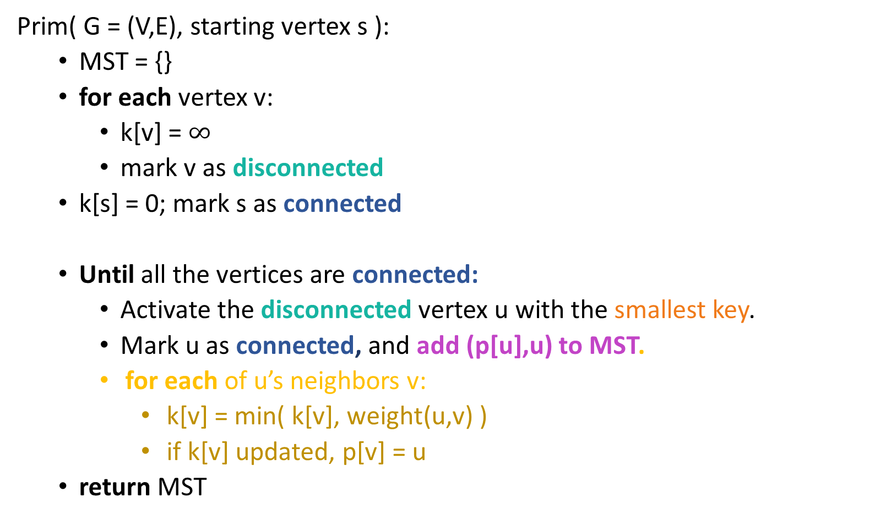
Prim’s Algorithm

Slide 53
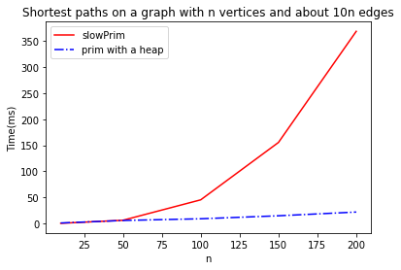
Prim’s Runtime
Exactly the same as Dijkstra: O(nlogn + m) with a Fibonacci heap!

Slide 54
Idea 2 what if we just always take the cheapest edge? whether or not it’s connected to what we have so far?
That won’t cause a cycle
8
7
B
C
D
4
9
2
11
4
A
I
14
E
7
6
8
10
1
2
H
G
F

Slide 55
Union-find data structure also called disjoint-set data structure
Used for storing collections of sets
Supports:
makeSet(u): create a set {u}
find(u): return the set that u is in
union(u,v): merge the set that u is in with the set that v is in.
makeSet(x)
makeSet(y)
makeSet(z)
union(x,y)
find(x)
x
y
z

Slide 56
Kruskal’s algorithm
kruskal(G = (V,E)):
Sort E by weight in non-decreasing order
MST = {} // initialize an empty tree
for v in V:
makeSet(v) // put each vertex in its own tree in the forest
for (u,v) in E: // go through the edges in sorted order
if find(u) != find(v): // if u and v are not in the same tree
add (u,v) to MST
union(u,v) // merge u’s tree with v’s tree
return MST

Slide 57
Compare and contrast
Prim might be a better idea on dense graphs if you can’t radixSort edge weights
Prim:
Grows a tree.
Time O(mlog(n)) with a red-black tree
Time O(m + nlog(n)) with a Fibonacci heap
Kruskal:
Grows a forest.
Time O(mlog(n)) with a union-find data structure
If you can do radixSort on the edge weights, close to O(m)
Kruskal might be a better idea on sparse graphs if you can radixSort edge weights

Slide 58
min-cut max-flow

Slide 59
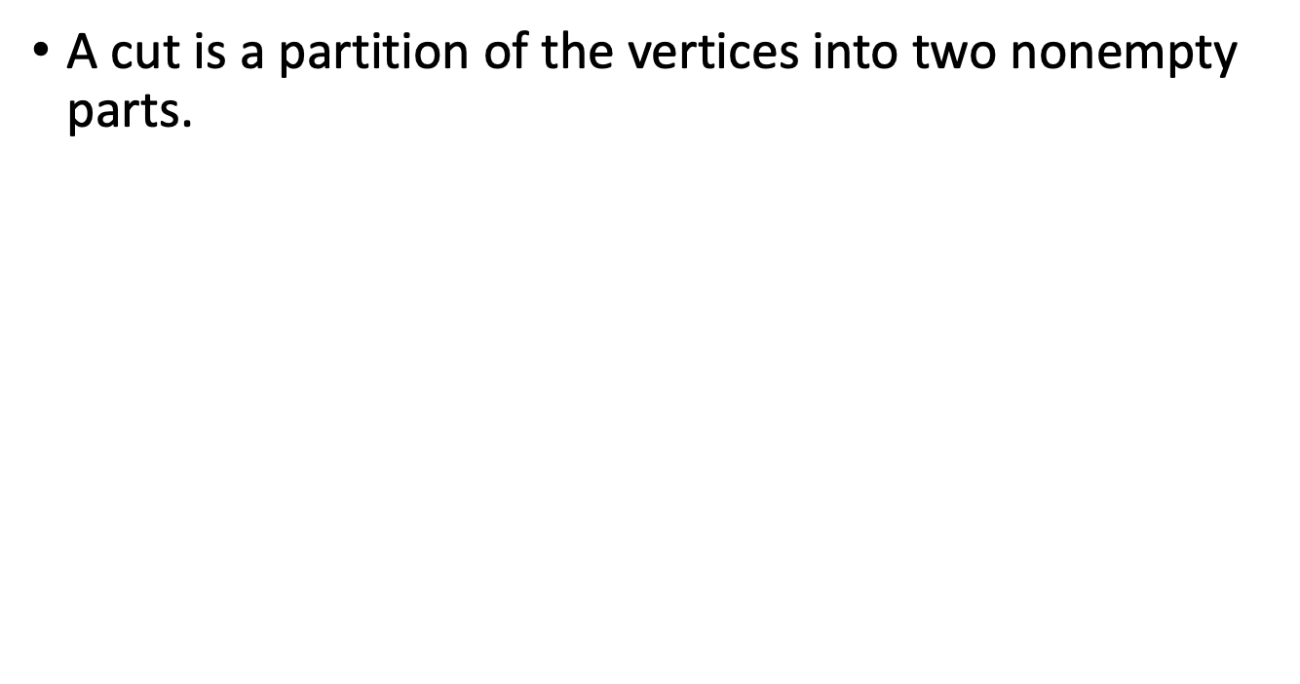
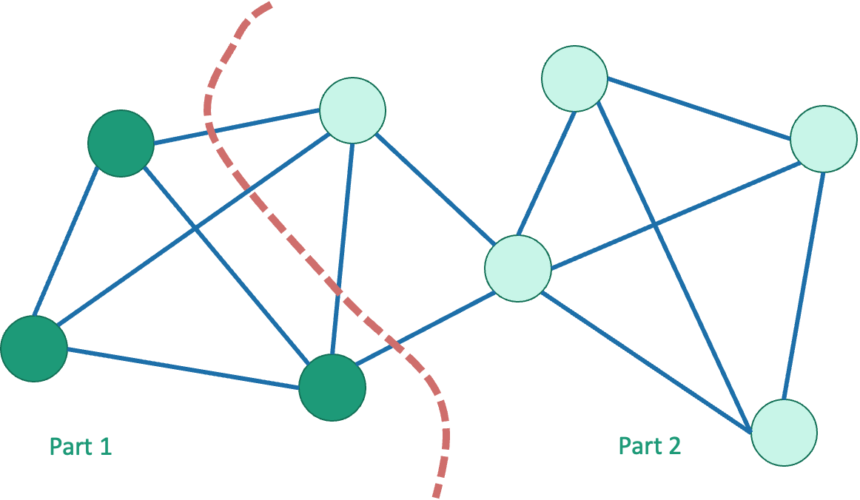
Cuts in graphs

Slide 60
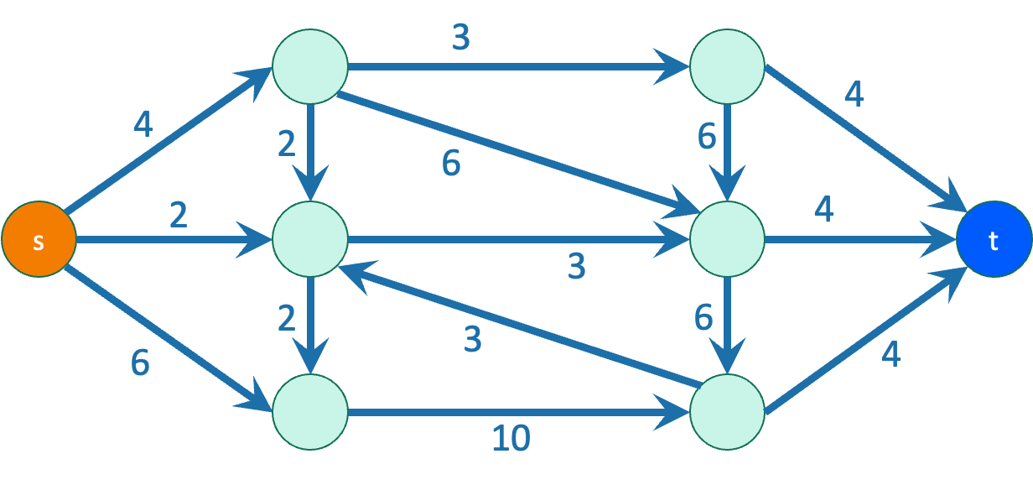
s-t Cuts
Graphs are directed and edges have “capacities” (weights)
We have a special “source” vertex s and “sink” vertex t.
s has only outgoing edges*
t has only incoming edges*
s and t are on different sides of the cut
*at least for this class

Slide 61
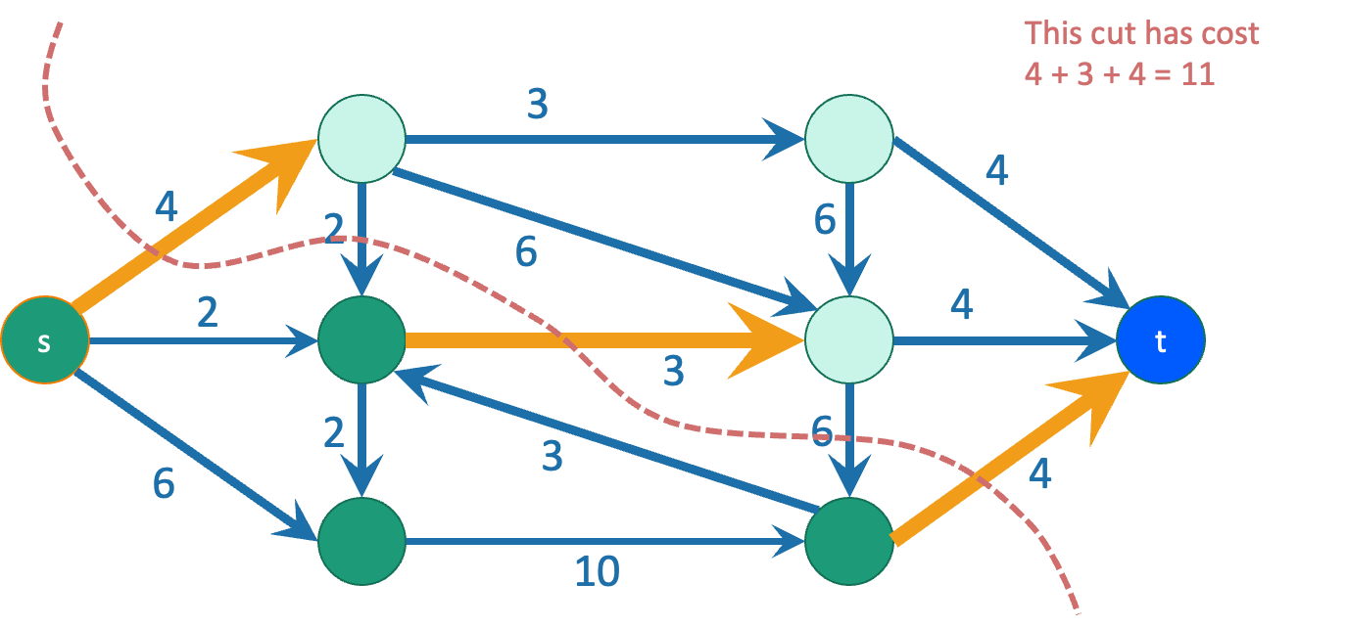
A minimum s-t cut is a cut which separates s from t with minimum capacity.
Question: how do we find a minimum s-t cut?

Slide 62
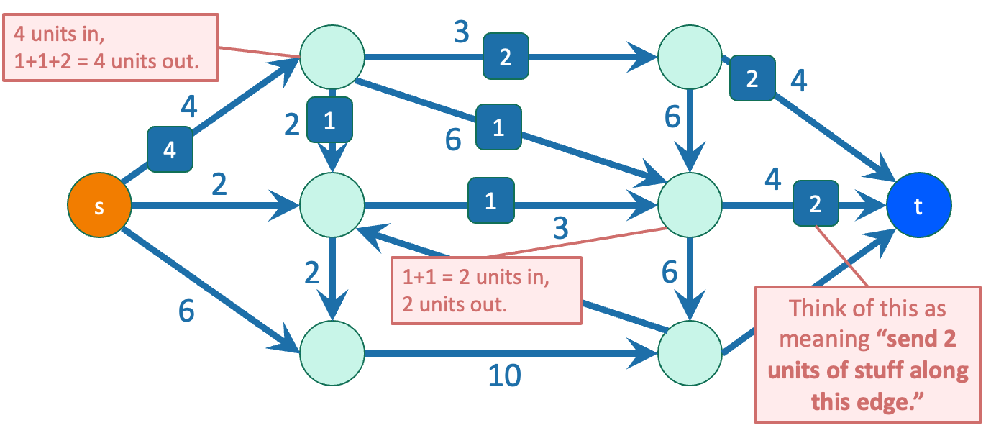
Flows
flow
In addition to a capacity, each edge has a
(unmarked edges in the picture have flow 0)
The flow on an edge must be less than or equal to its capacity.
At each vertex other than s and t, the incoming flows must equal the outgoing flows.

Slide 63
But what is a “flow,” really?
Think of s as a “water source” and t as a “water sink”
Each edge is a pipe, and the capacity is the amount of water that can flow through the edge
Clearly, for each pipe, as much water comes in must go out!
Some pipes will be the “bottleneck” pipes… could these be related to the min-cut somehow?

Slide 64
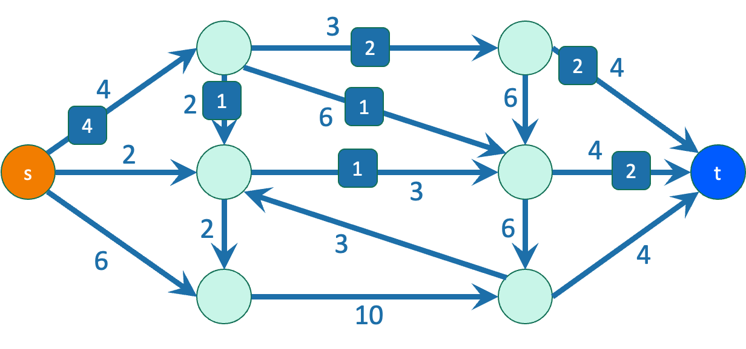
Flows
Because of conservation of flows at vertices,
stuff you put in
=
stuff you take out.
The value of a flow is:
The amount of stuff coming out of s
The amount of stuff flowing into t
These are the same!
The value of this flow is 4.

Slide 65
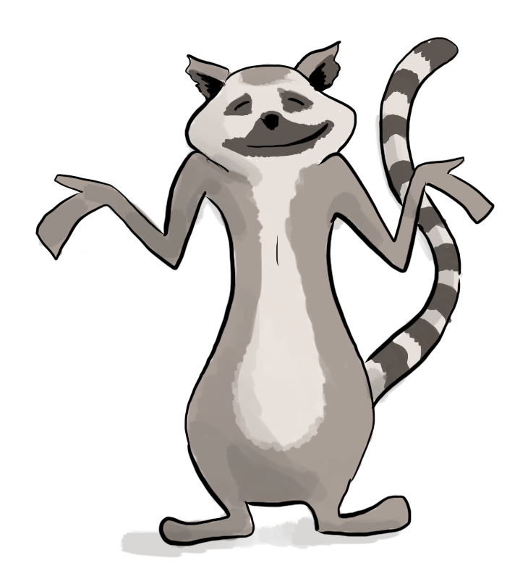
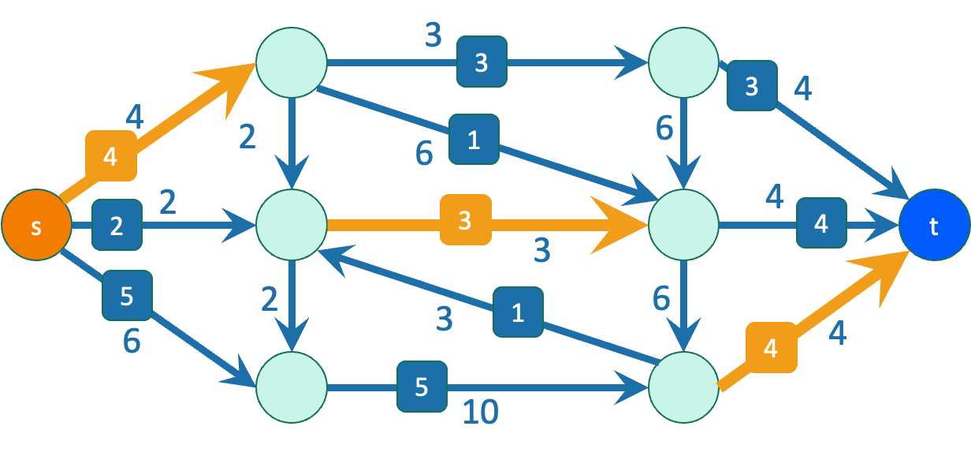
Theorem Max-flow min-cut theorem
The value of a max flow from s to t
is equal to
the capacity of a min s-t cut.
Intuition: in a max flow, the min cut better fill up, and this is the bottleneck.

Slide 66
Max-flow min-cut in water pipes
What does the max-flow min-cut theorem mean in the context of our water pipes example before?
Max-flow = maximum amount of water we can send
Min-cut = the minimum capacity of pipes, which when removed, completely disconnects the water source and sink (i.e., no water flows)
Intuitively makes sense!

Slide 67
Ford-Fulkerson algorithm
Outline of algorithm:
Start with zero flow
While we haven’t found the max flow:
Find a way to send more from s to t
Original graph:
a
2
2
s
2
t
2
b
2
Iteration 3: optimal flow!
Iteration 2: increase the flow again:
a
increased flow on this edge
a
2
2
2
0
2
2
decreased flow on this edge
2
2
0
2
s
2
t
2
t
s
2
2
2
2
b
2
2
0
b
2

Slide 68
2 key ideas
In order to increase total flow, we decreased flow on some edges
Decreasing flow in one direction = increasing flow in the opposite direction
= “sending back” this flow
Iteration 3: optimal flow!
Iteration 2: increase the flow again:
a
increased flow on this edge
a
2
2
2
0
2
2
decreased flow on this edge
2
2
0
2
s
2
t
2
t
s
2
2
2
2
b
2
2
0
b
2

Slide 69

Why residual graphs?
Let’s think of a greedy idea for finding flows:
Pick an arbitrary augmenting path, and push the maximum flow you can through this path
Keep repeating this until no paths exist!
We reach a “blocking” flow: no more paths exist, even though the flow is not optimal… what to do?
Reference: https://cs.stackexchange.com/a/71505

Slide 70

Why residual graphs?
Fix this issue by allowing “undo” operations!
Akin to reversing our previous decision in a greedy algorithm
Encoding these operations is the main goal of a residual graph
Reference: https://cs.stackexchange.com/a/71505

Slide 71


What is a residual graph?
Stores how much flow can be pushed through an edge
Having the reverse edge capacities = current flow represents that the current flow can be “undone!”
Reference: https://cs.stackexchange.com/a/71505

Slide 72
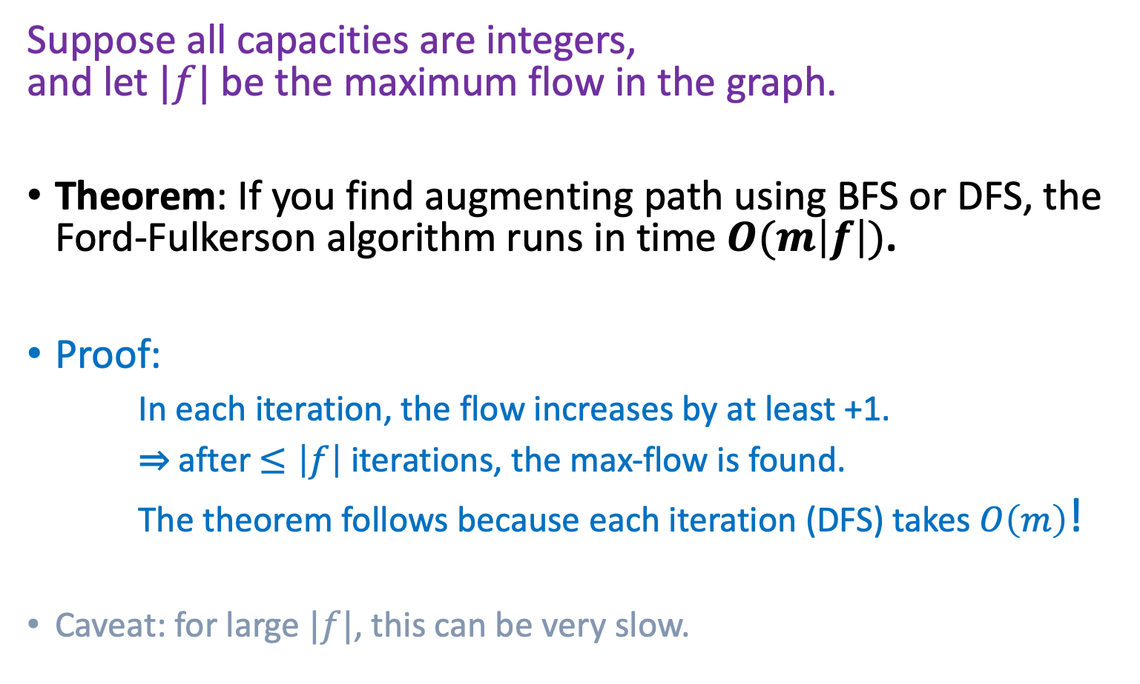
Time complexity of max flow?

Slide 73
How not to pick the augmenting path
a
Choose a really big number C.
C
C
0
0
0
1
t
s
C
0
C
0
b
a
C
C
1
t
s
C
C
b

Slide 74
How not to pick the augmenting path
a
Choose a really big number C.
C
C
0
0
0
1
t
s
C
0
C
0
b
a
C
C
1
t
s
C
C
b

Slide 75
How not to pick the augmenting path
a
Choose a really big number C.
C
C
1
0
1
1
t
s
C
1
C
0
b
a
1
C
C-1
1
The edge (b,a) disappeared from the residual graph!
t
s
1
C
C-1
b

Slide 76
How not to pick the augmenting path
a
Choose a really big number C.
C
C
1
0
1
1
t
s
C
1
C
0
b
a
1
C
C-1
1
t
s
1
C
C-1
b

Slide 77
How not to pick the augmenting path
a
Choose a really big number C.
C
C
1
1
0
1
t
s
C
1
C
1
b
a
1
1
C-1
C-1
The edge (b,a) re-appeared in the residual graph!
1
t
s
1
1
b
C-1
C-1

Slide 78
How not to pick the augmenting path
a
Choose a really big number C.
C
C
1
1
0
1
t
s
C
1
C
1
b
a
1
1
C-1
C-1
1
t
s
1
1
b
C-1
C-1

Slide 79
How not to pick the augmenting path
a
Choose a really big number C.
C
C
2
1
1
1
t
s
C
2
C
1
b
a
2
1
C-1
C-2
1
The edge (b,a) disappeared from the residual graph!
t
s
2
1
b
C-1
C-2

Slide 80
How not to pick the augmenting path
a
Choose a really big number C.
C
C
2
This will go on for C steps, adding flow along (b,a) and then subtracting it again.
1
1
1
t
s
C
2
C
1
b
a
2
1
C-1
C-2
1
The edge (b,a) disappeared from the residual graph!
t
s
2
1
b
C-1
C-2

Slide 81
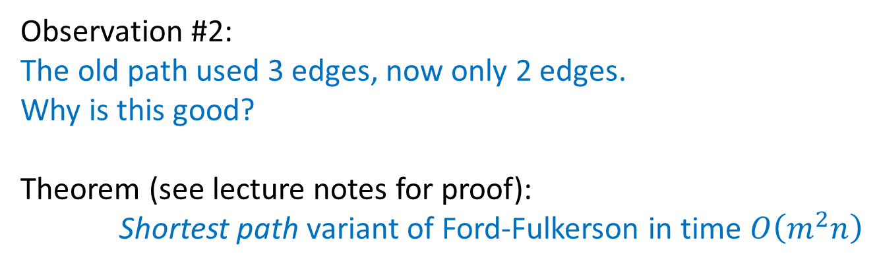
So how should we pick the path?
a
C
In this example, red/blue paths would have been much better!
What about in a general graph?
C
1
t
s
C
C
b
Notes:
Shortest path proof idea: use the distance of the shortest path from s to t (aka how many vertices there are between them) to get an upper-bound for # iterations until t is no longer reachable from s

Slide 82
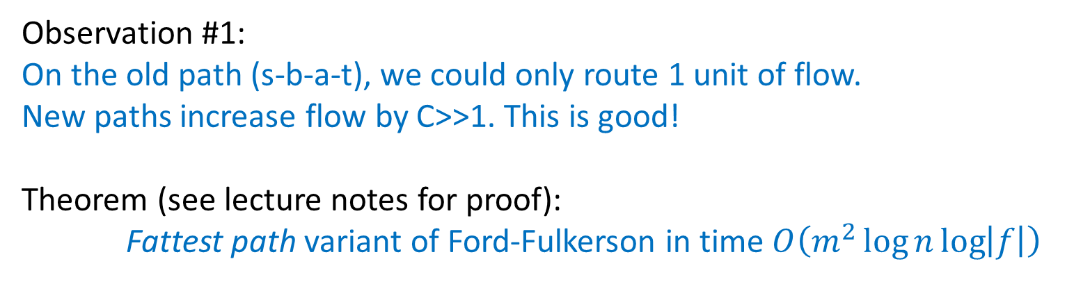
So how should we pick the path?
a
C
In this example, red/blue paths would have been much better!
What about in a general graph?
C
1
t
s
C
C
b
Notes:
Fattest path proof idea: use the min edge on the fattest path (aka the flow of the augmenting path) to get an upper-bound for # iterations until the max flow is reached

Slide 83
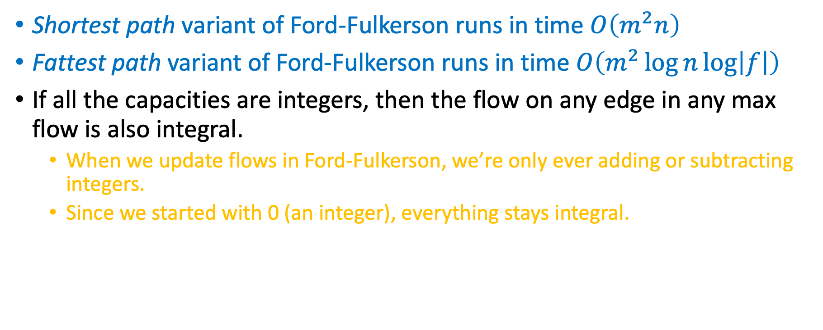
Ford Fulkerson additional notes!
Notes:
Take CS261 if you want to learn more!

Slide 84
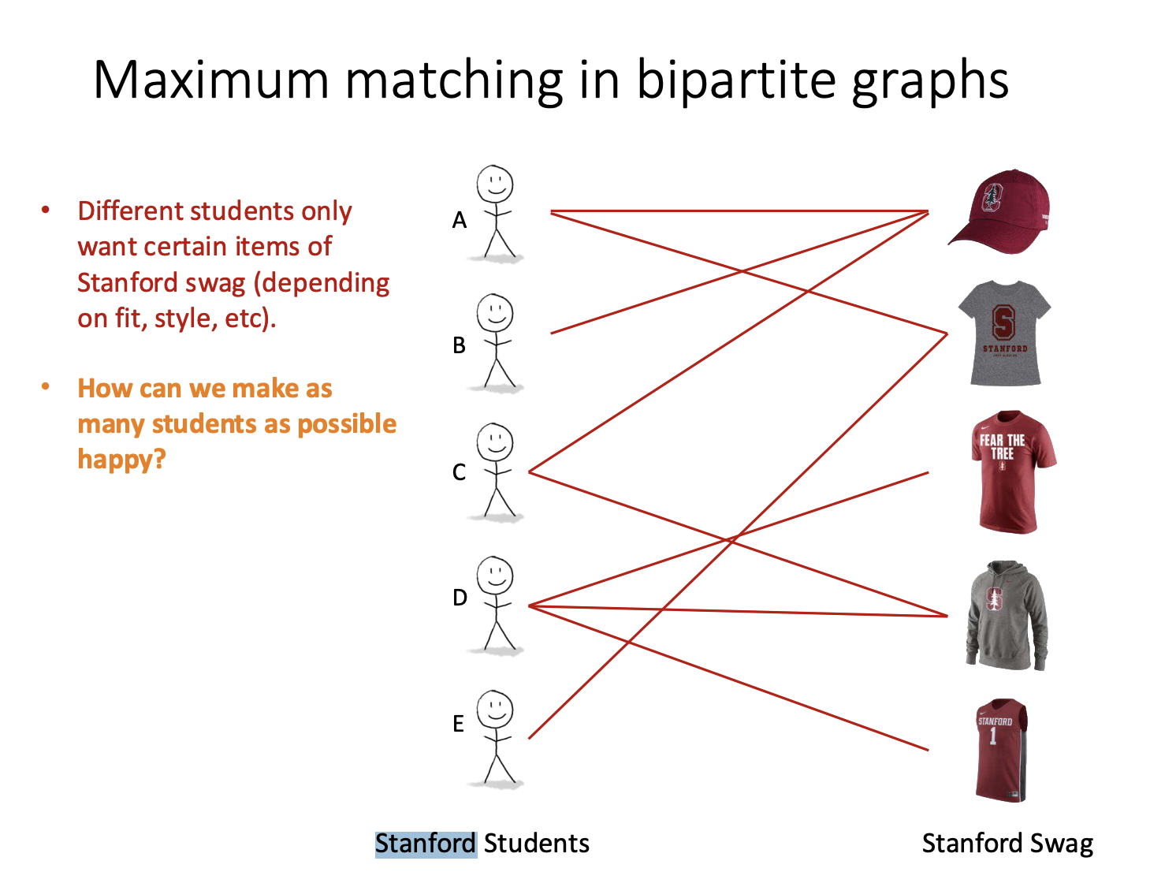

Slide 85
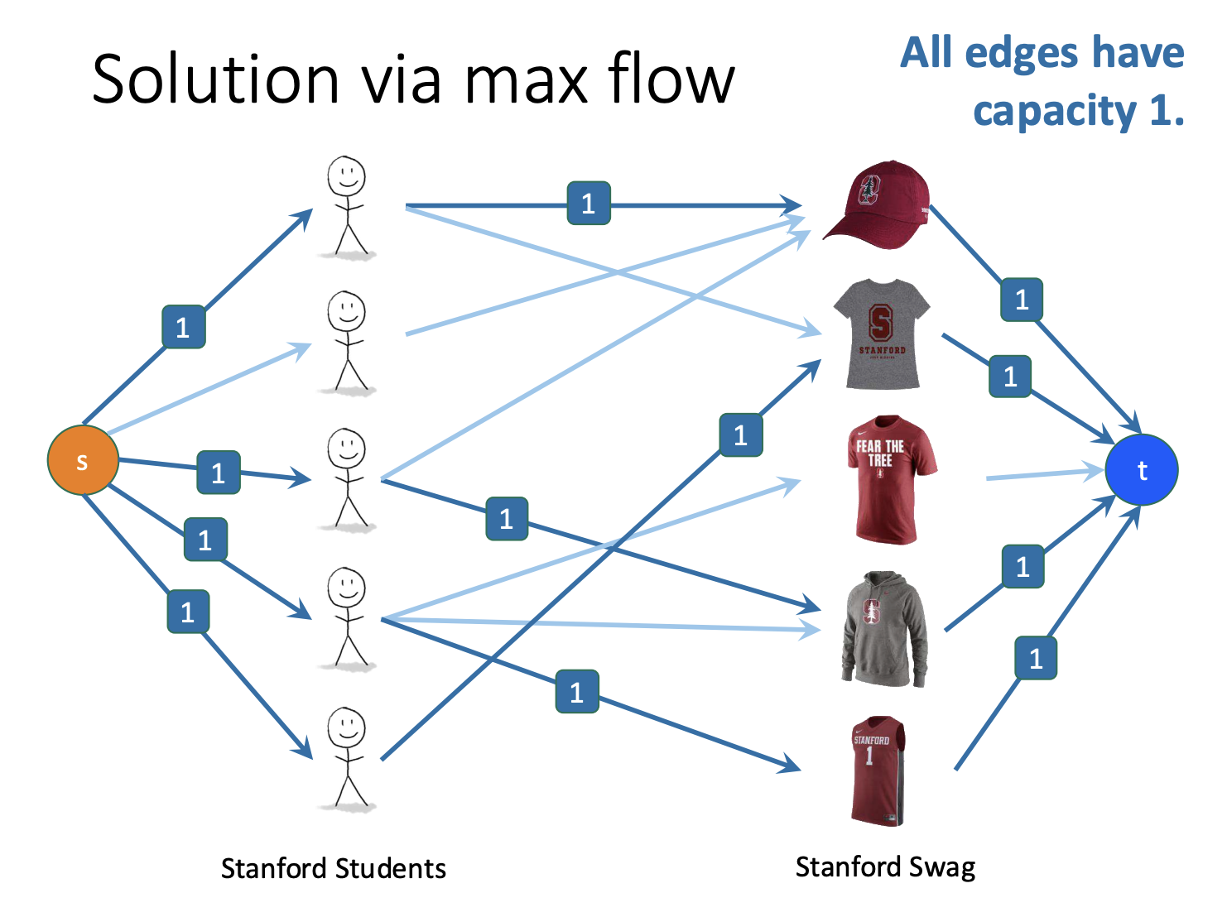

Slide 86
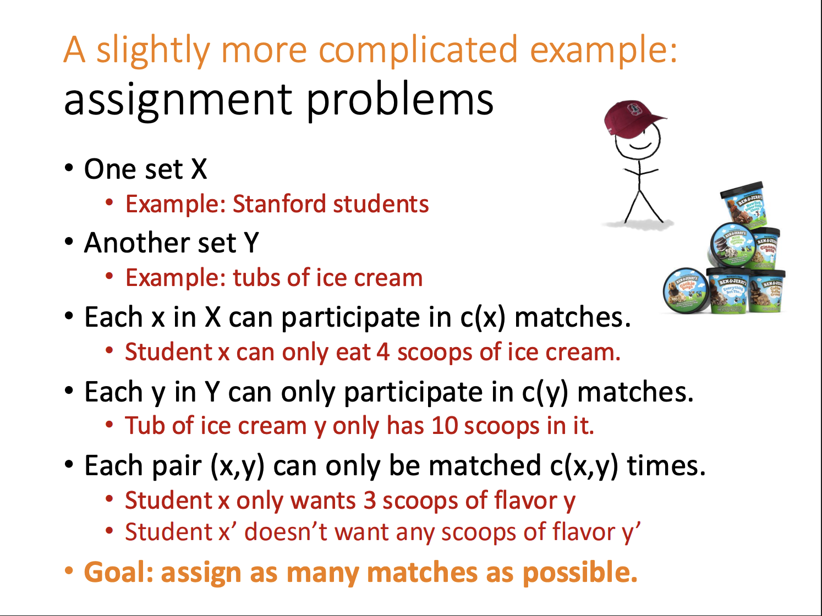

Slide 87
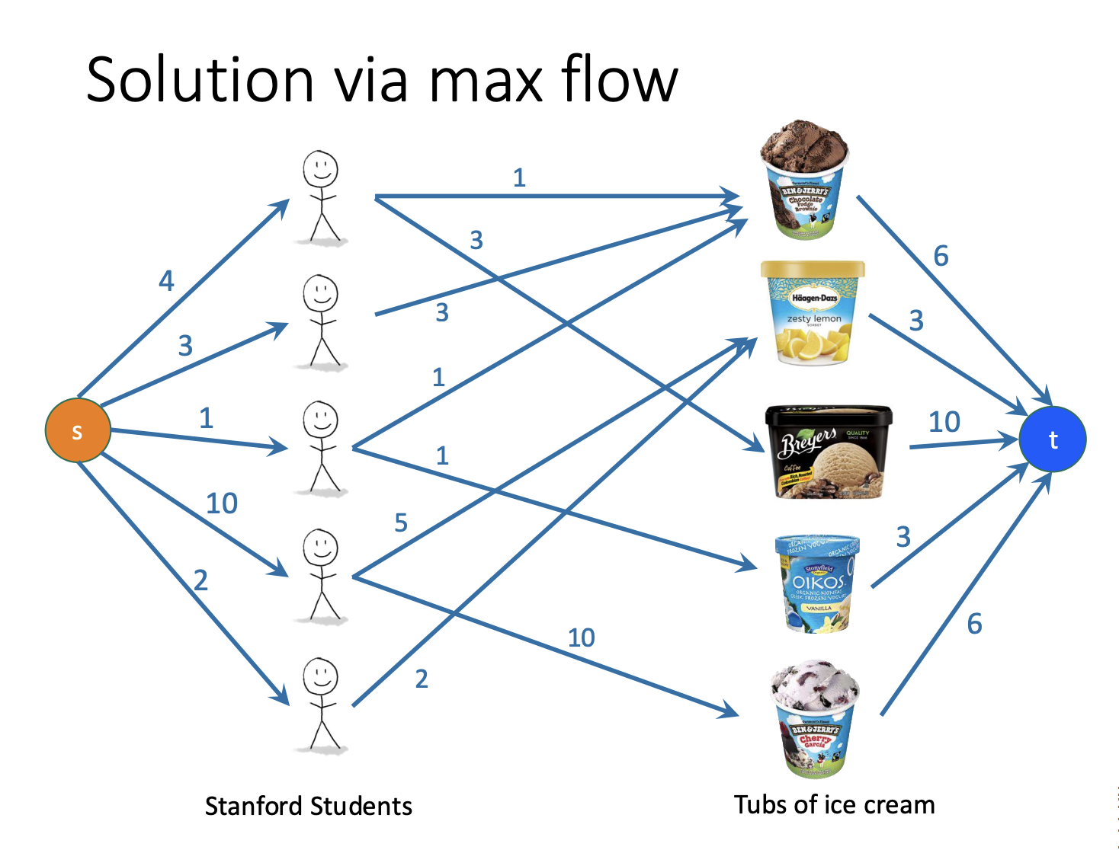

Slide 88
Practice: Project Team Matching
There are X students and Y project topics
Each student has the capacity for f(X) projects and g(X, Y) indicates if student X is interested in project Y (1 or 0)
The projects can take on a max number of students, let’s call this h(Y)
How do we design a graph that maximizes assignments?

