Slide 1
Lecture 3
Recurrence relations and how to solve them!

Slide 2
Announcements
Homework 1 is due today by midnight
Homework 2 will be released today (still solo)
Office hours:
Online:
Click sign up on Queuestatus
Connect to the Zoom meeting (you’ll go to the waiting room)
The CA will let you into the Zoom room when it’s your turn
In-person:
Queuestatus NOT used for in-person OHs (just show up)
Default location: Huang basement (unless the calendar says otherwise)

Slide 3
EthiCS
Homework 2 will have EthiCS questions.
The first pre-recorded video is available now.
As a reminder, you are responsible for watching them.
They are fair game for exams.

Slide 4
Last time….
Sorting: InsertionSort and MergeSort
What does it mean to work and be fast?
Worst-Case Analysis
Big-Oh Notation
Analyzing correctness of iterative + recursive algs
Induction!
Analyzing running time of recursive algorithms
By drawing out a tree and adding up all the work done.

Slide 5
Today
Recurrence Relations!
How do we calculate the runtime of a recursive algorithm?
The Master Theorem
A useful theorem so we don’t have to answer this question from scratch each time.
The Substitution Method
A different way to solve recurrence relations, more generally applicable than the Master Method.

Slide 6
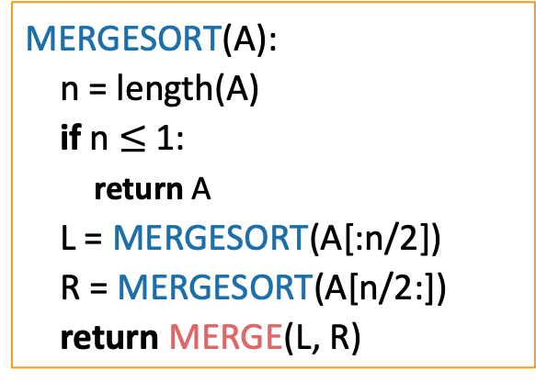
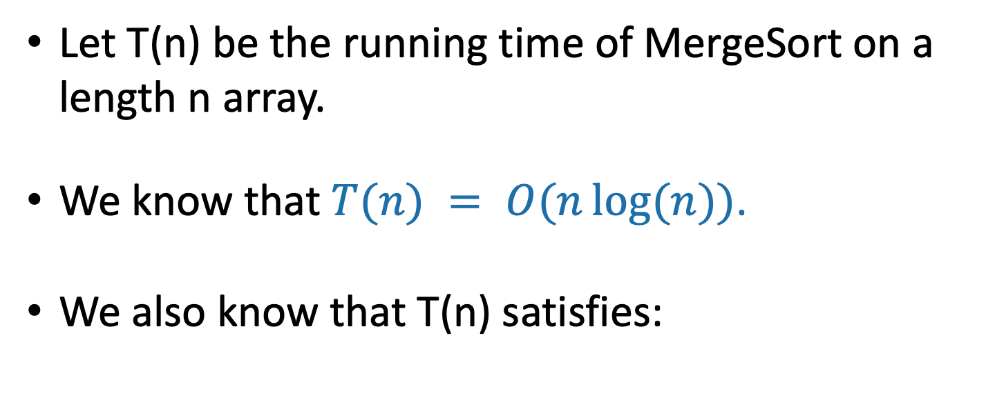
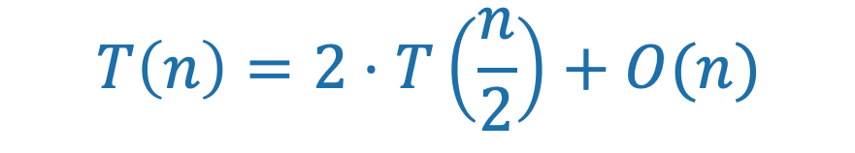
Running time of MergeSort
Let T(n) be the running time of MergeSort on a length n array.
We know that $T(n) = O(n\log{(n)})$.
We also know that T(n) satisfies:
MERGESORT(A):
n = length(A)
if n $≤$ 1:
return A
L = MERGESORT(A[:n/2])
R = MERGESORT(A[n/2:])
return MERGE(L, R)
$$T\left(n\right)=2⋅T\left(\frac{n}{2}\right)+O(n)$$

Slide 7
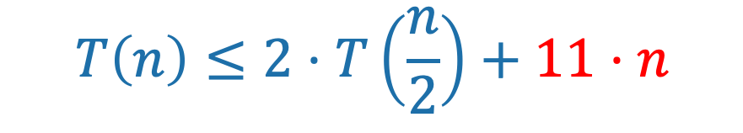
Running time of MergeSort
Let T(n) be the running time of MergeSort on a length n array.
We know that $T(n) = O(n\log{(n)})$.
We also know that T(n) satisfies:
MERGESORT(A):
n = length(A)
if n $≤$ 1:
return A
L = MERGESORT(A[:n/2])
R = MERGESORT(A[n/2:])
return MERGE(L, R)
$$T\left(n\right)≤2⋅T\left(\frac{n}{2}\right)+11⋅n$$
Last time we showed that the time to run MERGE on a problem of size n is O(n). For concreteness, let’s say that it’s at most 11n operations.

Slide 8

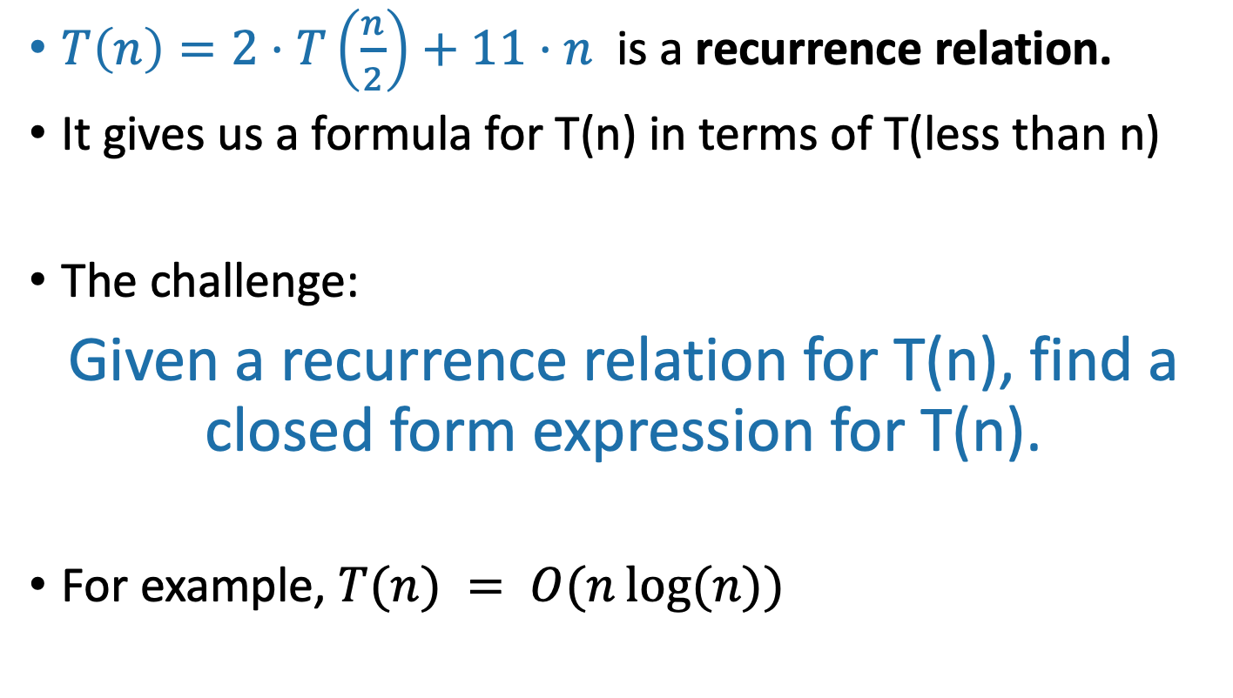
Recurrence Relations
Note (read after class):
$T\left(n\right)≤2⋅T\left(\frac{n}{2}\right)+11⋅n$ (with a $≤$) is also a recurrence relation. A recurrence relation with an “=“ exactly defines a function; a recurrence relation with an inequality only bounds it.
$T\left(n\right)=2⋅T\left(\frac{n}{2}\right)+11⋅n$ is a recurrence relation.
It gives us a formula for T(n) in terms of T(less than n)
The challenge:
Given a recurrence relation for T(n), find a closed form expression for T(n).
For example, $T(n) = O(n\log{(n)})$

Slide 9
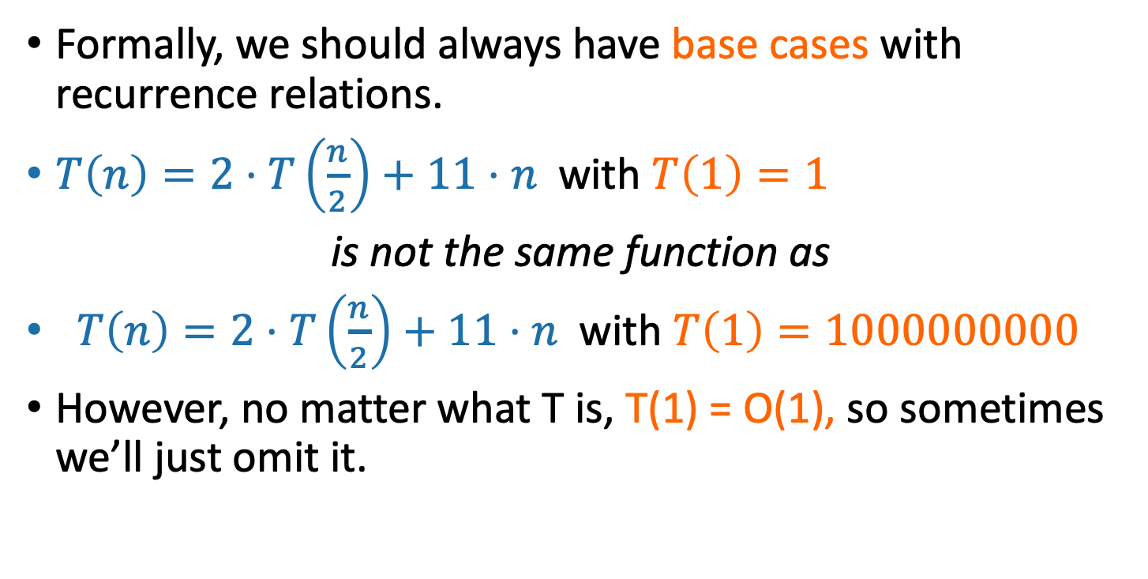
Technicalities I Base Cases
Plucky the Pedantic Penguin
Formally, we should always have base cases with recurrence relations.
$T\left(n\right)=2⋅T\left(\frac{n}{2}\right)+11⋅n$with $T\left(1\right)=1$
is not the same function as
$T\left(n\right)=2⋅T\left(\frac{n}{2}\right)+11⋅n$with $T\left(1\right)=1000000000$
However, no matter what T is, T(1) = O(1), so sometimes we’ll just omit it.
Why does T(1) = O(1)?
Siggi the Studious Stork

Slide 10
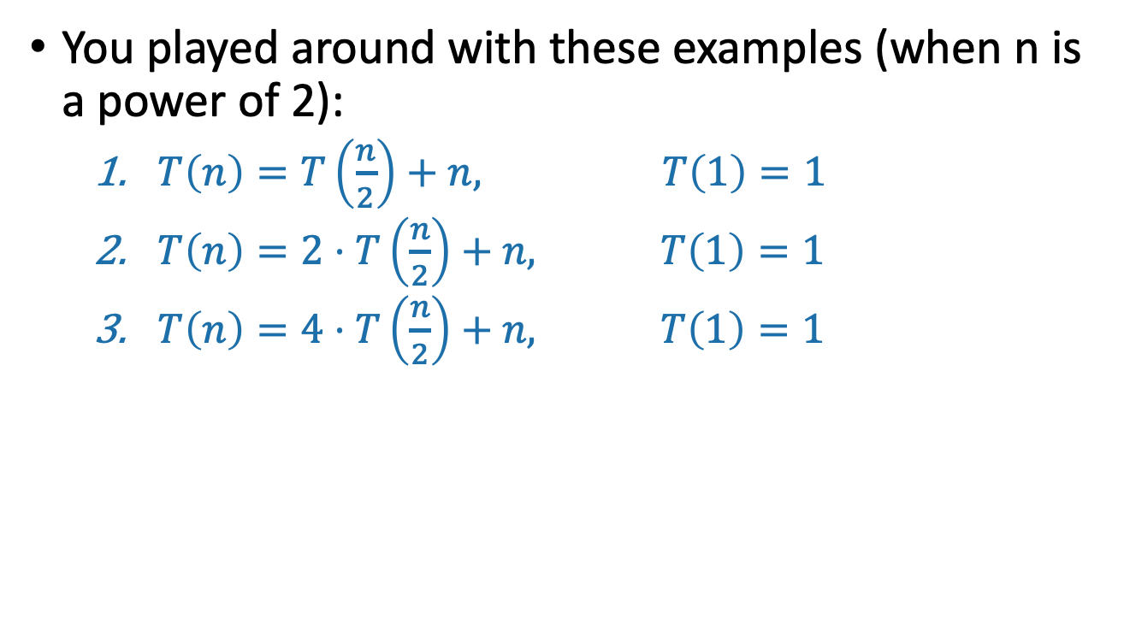
On your pre-lecture exercise
You played around with these examples (when n is a power of 2):
$T\left(n\right)=T\left(\frac{n}{2}\right)+n, T\left(1\right)=1$
$T\left(n\right)=2⋅T\left(\frac{n}{2}\right)+n, T\left(1\right)=1$
$T\left(n\right)=4⋅T\left(\frac{n}{2}\right)+n, T\left(1\right)=1$

Slide 11
One approach for all of these
Size n
The “tree” approach from last time.
Add up all the work done at all the sub-problems.
n/2
n/2
n/4
n/4
n/4
n/4
…
n/2^{t}
n/2^{t}
n/2^{t}
n/2^{t}
n/2^{t}
n/2^{t}
…
(Size 1)

Slide 12

Pre-lecture exercise
(when n is a power of 2):
$T\left(n\right)=T\left(\frac{n}{2}\right)+n, T\left(1\right)=1$
$T\left(n\right)=2⋅T\left(\frac{n}{2}\right)+n, T\left(1\right)=1$
$T\left(n\right)=4⋅T\left(\frac{n}{2}\right)+n, T\left(1\right)=1$

Slide 13
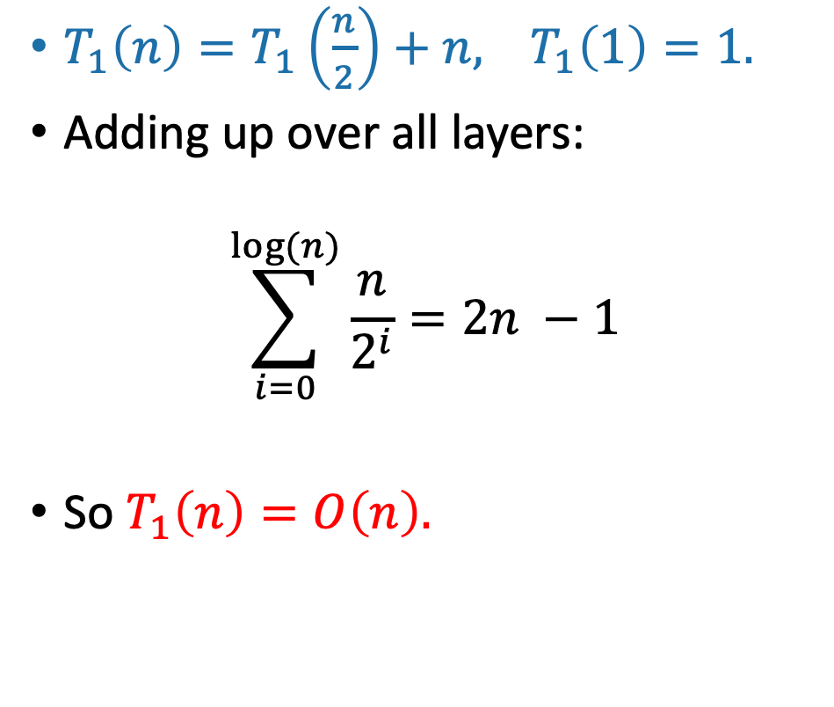
Solutions to pre-lecture exercise (1)
Contribution at this layer:
$T_{1}\left(n\right)=T_{1}\left(\frac{n}{2}\right)+n,$ $T_{1}\left(1\right)=1.$
Adding up over all layers:
$$\sum_{i=0}^{log⁡(n)}{\frac{n}{2^{i}}=2n −1}$$
So $T_{1}\left(n\right)=O\left(n\right).$
Size n
n
n/2
n/2
n/4
n/4
…
n/2^{t}
n/2^{t}
…
1
(Size 1)

Slide 14
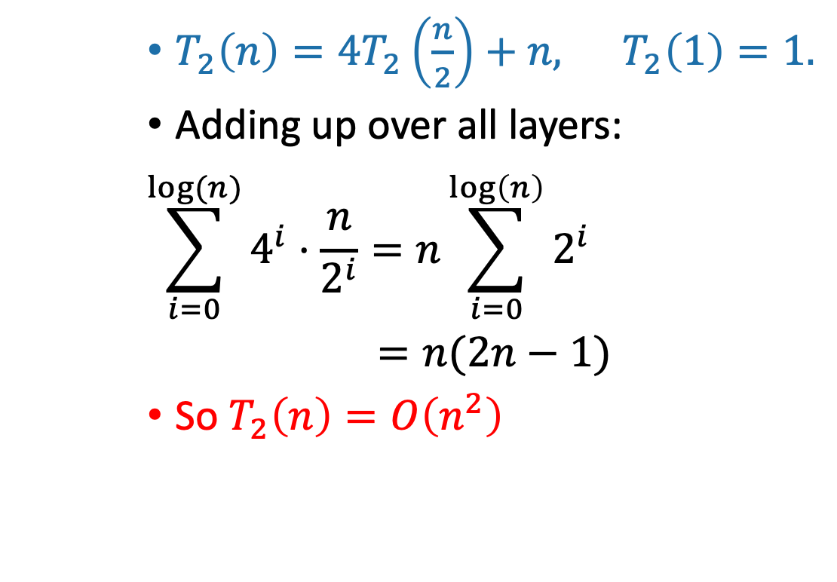
Solutions to pre-lecture exercise (2)
$T_{2}\left(n\right)={4T}_{2}\left(\frac{n}{2}\right)+n,$ $T_{2}\left(1\right)=1.$
Adding up over all layers:
$$\sum_{i=0}^{log⁡(n)}{4^{i}⋅\frac{n}{2^{i}}=n\sum_{i=0}^{\log\left(n\right)}{2^{i}}}$$
$=n(2n−1)$
So $T_{2}\left(n\right)=O\left(n^{2}\right)$
Contribution at this layer:
Size n
n
4x
n/2
2n
16x
n/4
4n
…
4^{t} x
n/2^{t}
2^{t}n
…
n² x
n²
(Size 1)

Slide 15
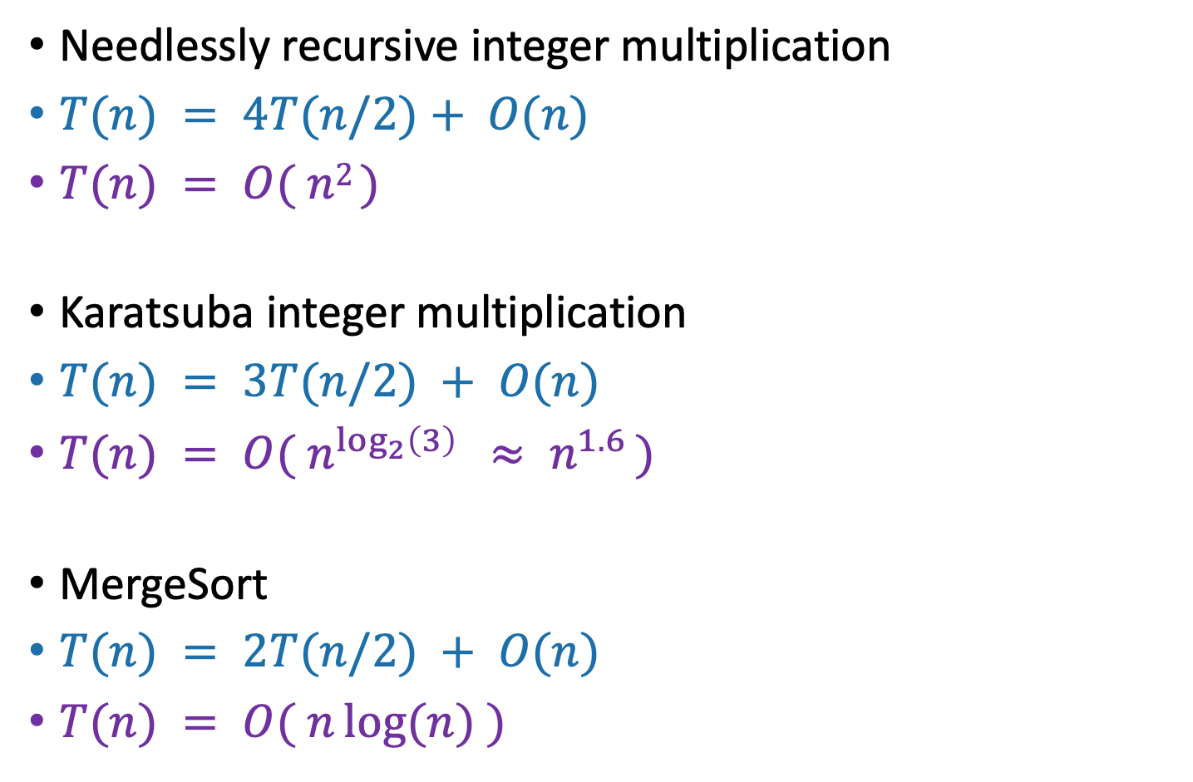
More examples
T(n) = time to solve a problem of size n.
Needlessly recursive integer multiplication
$T(n) = 4T(n/2)+ O(n)$
$T(n) = O( n2 )$
Karatsuba integer multiplication
$T(n) = 3T(n/2) + O(n)$
$T(n) = O( n^{\log_{2}\left(3\right)} ≈ n^{1.6} )$
MergeSort
$T(n) = 2T(n/2) + O(n)$
$T(n) = O( n\log{(n)} )$
This is similar to T₂ from the pre-lecture exercise.
What’s the pattern?!?!?!?!

Slide 16
The master theorem
A useful formula it is.
Know why it works you should.
A formula for many recurrence relations.
We’ll see an example next lecture where it won’t work.
Proof: “Generalized” tree method.
Jedi master Yoda

Slide 17
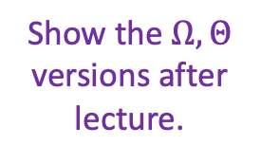


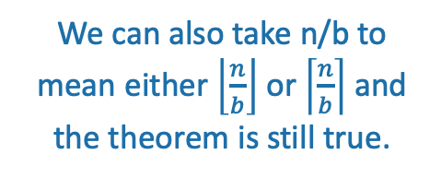
The master theorem
We can also take n/b to mean either $\left\lfloor \frac{n}{b}\right\rfloor$ or $\left\lceil \frac{n}{b}\right\rceil$ and the theorem is still true.
Suppose that $a≥1,b>1,and d$ are constants (independent of n).
Suppose $T\left(n\right)=a⋅T\left(\frac{n}{b}\right)+O\left(n^{d}\right)$. Then
$$T\left(n\right)= \left\{\begin{aligned}O\left(n^{d}\log\left(n\right)\right) if a=b^{d} \\ O\left(n^{d}\right) if a<b^{d} \\ O\left(n^{\log_{b}\left(a\right)}\right) if a>b^{d}\end{aligned}\right.$$
Show the $Ω,Θ$ versions after lecture.
Three parameters:
a : number of subproblems
b : factor by which input size shrinks
d : need to do n^{d} work to create all the subproblems and combine their solutions.
Many symbols those are….

Slide 18
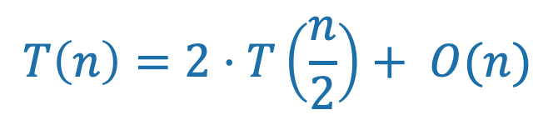
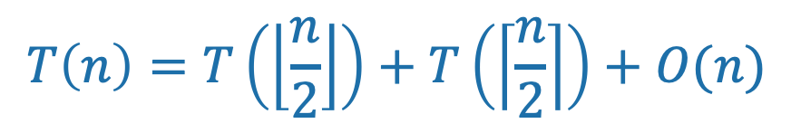
Technicalities II Integer division
Plucky the Pedantic Penguin
If n is odd, I can’t break it up into two problems of size n/2.
However (see CLRS, Section 4.6.2 for details), one can show that the Master theorem works fine if you pretend that what you have is:
From now on we’ll mostly ignore floors and ceilings in recurrence relations.
$$T\left(n\right)=T\left(\left\lfloor \frac{n}{2}\right\rfloor \right)+T\left(\left\lceil \frac{n}{2}\right\rceil \right)+O(n)$$
$$T\left(n\right)=2⋅T\left(\frac{n}{2}\right)+ O(n)$$

Slide 19
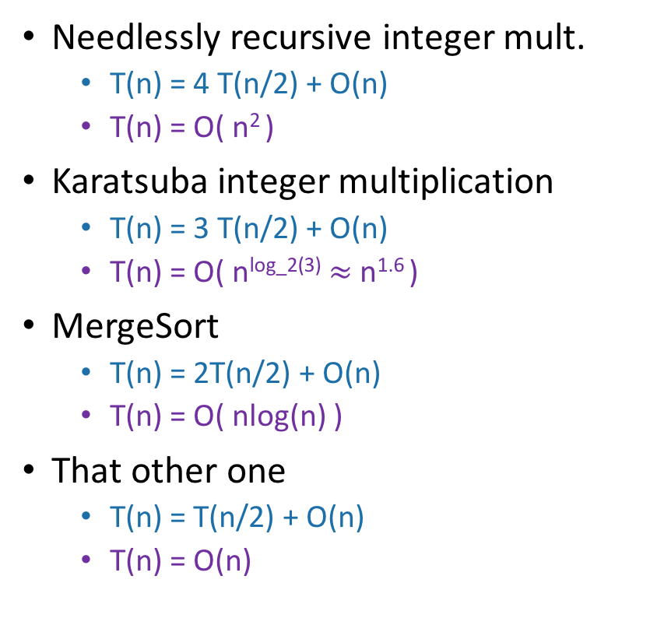
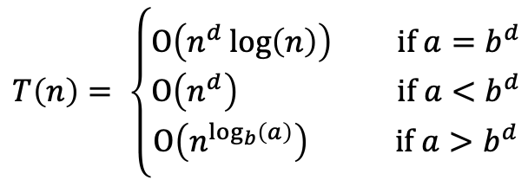

Examples
$T\left(n\right)=a⋅T\left(\frac{n}{b}\right)+O\left(n^{d}\right)$.
$$T\left(n\right)= \left\{\begin{aligned}O\left(n^{d}\log\left(n\right)\right) if a=b^{d} \\ O\left(n^{d}\right) if a<b^{d} \\ O\left(n^{\log_{b}\left(a\right)}\right) if a>b^{d}\end{aligned}\right.$$
Needlessly recursive integer mult.
T(n) = 4 T(n/2) + O(n)
T(n) = O( n² )
Karatsuba integer multiplication
T(n) = 3 T(n/2) + O(n)
T(n) = O( n^{log_2(3)} $≈$ n^{1.6} )
MergeSort
T(n) = 2T(n/2) + O(n)
T(n) = O( nlog(n) )
That other one
T(n) = T(n/2) + O(n)
T(n) = O(n)
✓
a = 4
b = 2
d = 1
a > b^{d}
✓
a = 3
b = 2
d = 1
a > b^{d}
✓
a = 2
b = 2
d = 1
a = b^{d}
✓
a = 1
b = 2
d = 1
a < b^{d}

Slide 20

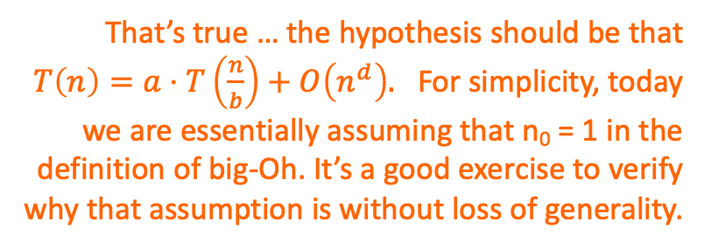
Proof of the master theorem
We’ll do the same recursion tree thing we did for MergeSort, but be more careful.
Suppose that $T\left(n\right)≤a⋅T\left(\frac{n}{b}\right)+c⋅n^{d}$.
Hang on! The hypothesis of the Master Theorem was that the extra work at each level was O(n^{d}), but we’re writing cn^{d}…
That’s true … the hypothesis should be that $T\left(n\right)=a⋅T\left(\frac{n}{b}\right)+O\left(n^{d}\right).$ For simplicity, today we are essentially assuming that n₀ = 1 in the definition of big-Oh. It’s a good exercise to verify why that assumption is without loss of generality.
Plucky the
Pedantic Penguin
Siggi the Studious Stork

Slide 21
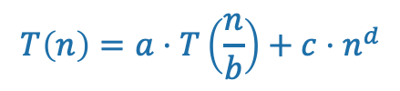
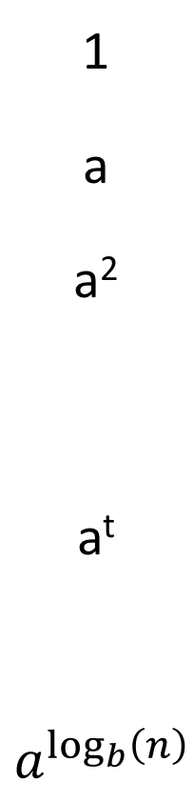
Recursion tree
$$T\left(n\right)=a⋅T\left(\frac{n}{b}\right)+c{⋅n}^{d}$$
Amount of work at this level
Size of each
problem
#
problems
Level
Size n
0
1
a
a²
a^{t}
$$a^{\log_{b}\left(n\right)}$$
n
n/b
n/b²
n/b^{t}
1
n/b
n/b
n/b
1
n/b²
n/b²
n/b²
n/b²
2
n/b²
n/b²
n/b²
…
n/b^{t}
n/b^{t}
n/b^{t}
n/b^{t}
n/b^{t}
n/b^{t}
t
…
…
log_{b}(n)
(Size 1)

Slide 22

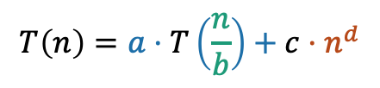
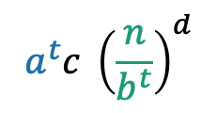
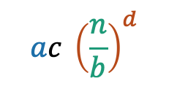
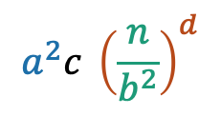

Recursion tree
$$T\left(n\right)=a⋅T\left(\frac{n}{b}\right)+c{⋅n}^{d}$$
Amount of work at this level
Help me fill this in! How much work at each level?
1 minutes: think How much work total?
1 minute: share (wait)
Size of each
problem
#
problems
Level
Size n
$$c⋅nd$$
0
1
a
a²
a^{t}
$$a^{\log_{b}\left(n\right)}$$
n
n/b
n/b²
n/b^{t}
1
$$ac {\left(\frac{n}{b}\right)}^{d}$$
n/b
n/b
n/b
1
n/b²
n/b²
n/b²
$$a^{2}c {\left(\frac{n}{b^{2}}\right)}^{d}$$
n/b²
2
n/b²
n/b²
n/b²
…
n/b^{t}
n/b^{t}
n/b^{t}
n/b^{t}
n/b^{t}
n/b^{t}
t
$$a^{t}c {\left(\frac{n}{b^{t}}\right)}^{d}$$
…
…
log_{b}(n)
$$a^{\log_{b}\left(n\right)}c$$
(Size 1)
(Let’s pretend that the base case is T(1) = c for convenience).

Slide 23


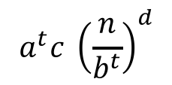
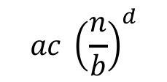
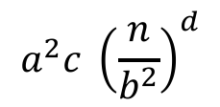

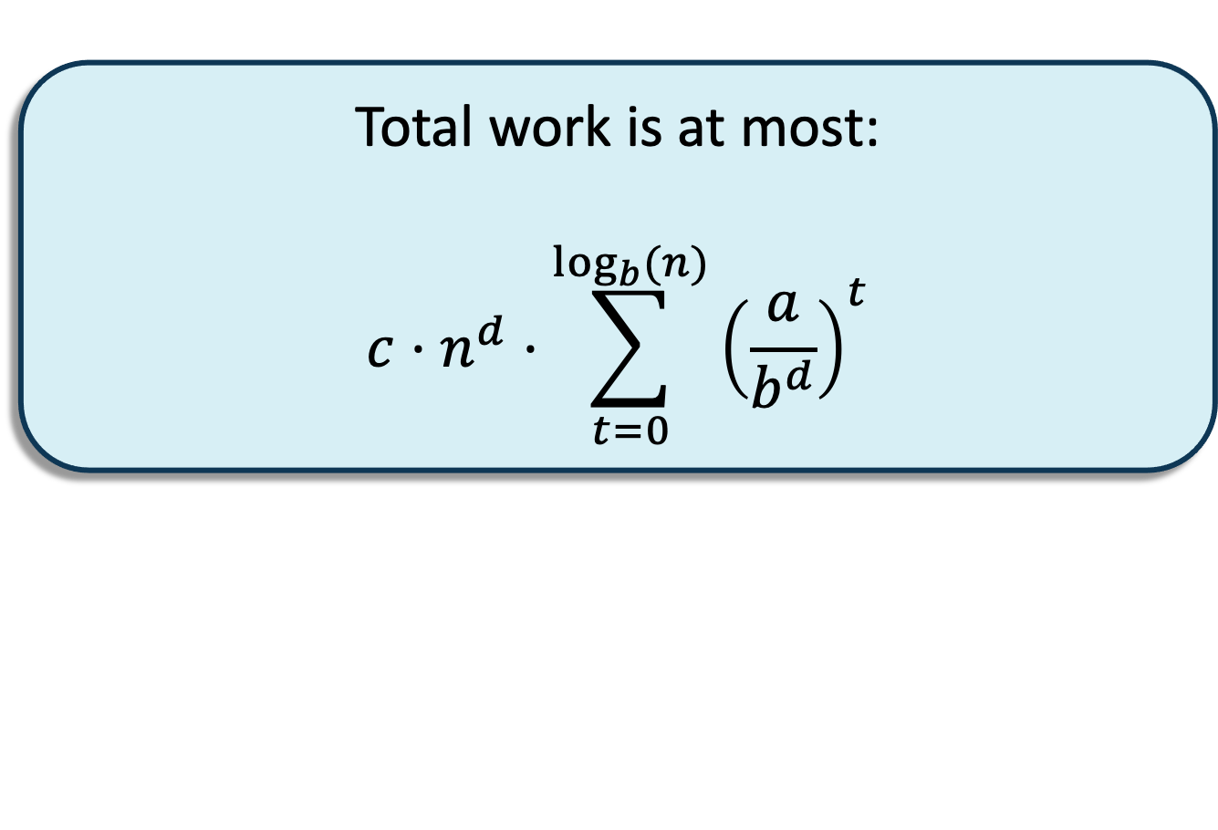
Recursion tree
$$T\left(n\right)=a⋅T\left(\frac{n}{b}\right)+c{⋅n}^{d}$$
Amount of work at this level
Size of each
problem
#
problems
Level
Size n
$$c⋅nd$$
0
1
a
a²
a^{t}
$$a^{\log_{b}\left(n\right)}$$
n
n/b
n/b²
n/b^{t}
1
$$ac {\left(\frac{n}{b}\right)}^{d}$$
n/b
n/b
n/b
1
Total work is at most:
$$c⋅n^{d}⋅\sum_{t=0}^{\log_{b}{(n)}}{{\left(\frac{a}{b^{d}}\right)}^{t}}$$
n/b²
n/b²
n/b²
$$a^{2}c {\left(\frac{n}{b^{2}}\right)}^{d}$$
n/b²
2
n/b²
n/b²
n/b²
…
n/b^{t}
n/b^{t}
n/b^{t}
n/b^{t}
n/b^{t}
n/b^{t}
t
$$a^{t}c {\left(\frac{n}{b^{t}}\right)}^{d}$$
…
…
log_{b}(n)
$$a^{\log_{b}\left(n\right)}c$$
(Let’s pretend that the base case isT(1) = c for convenience).
(Size 1)

Slide 24
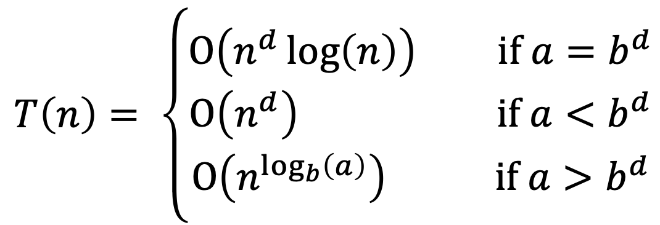
Now let’s check all the cases
$$T\left(n\right)= \left\{\begin{aligned}O\left(n^{d}\log\left(n\right)\right) if a=b^{d} \\ O\left(n^{d}\right) if a<b^{d} \\ O\left(n^{\log_{b}\left(a\right)}\right) if a>b^{d}\end{aligned}\right.$$

Slide 25
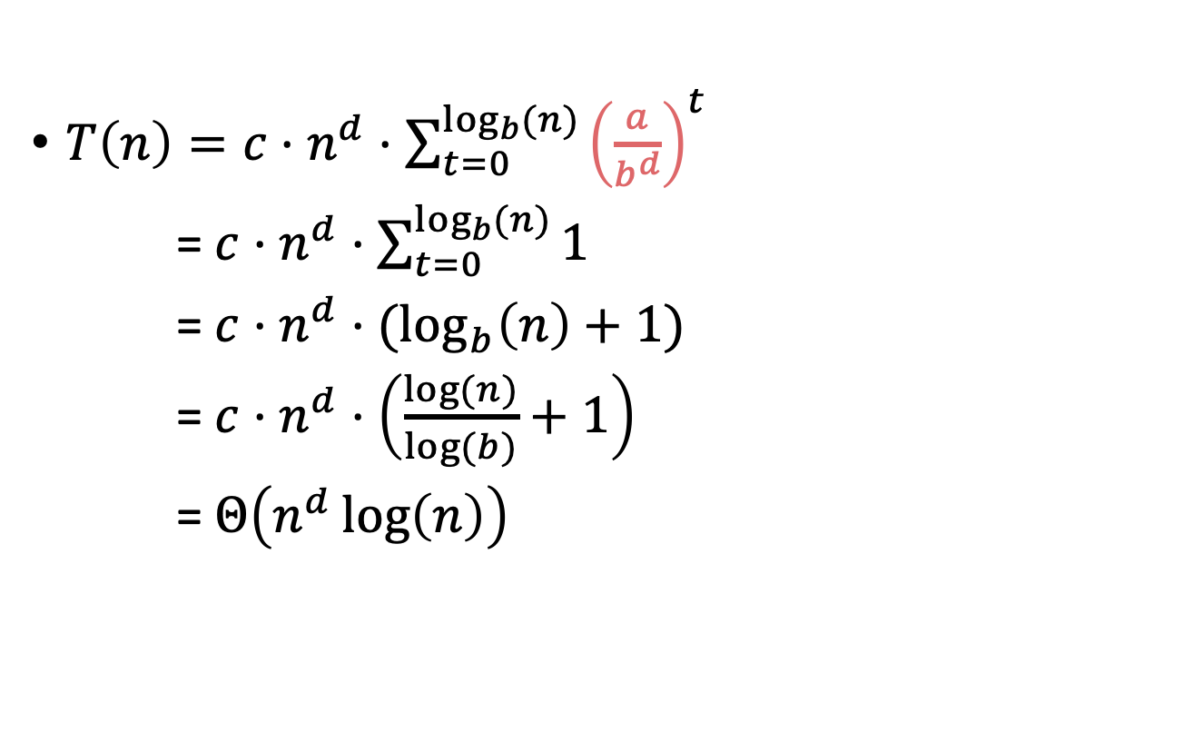


Case 1: $a=b^{d}$
$$T\left(n\right)= \left\{\begin{aligned}O\left(n^{d}\log\left(n\right)\right) if a=b^{d} \\ O\left(n^{d}\right) if a<b^{d} \\ O\left(n^{\log_{b}\left(a\right)}\right) if a>b^{d}\end{aligned}\right.$$
$T\left(n\right)=c⋅n^{d}⋅\sum_{t=0}^{\log_{b}{(n)}}{{\left(\frac{a}{b^{d}}\right)}^{t}}$
= $c⋅n^{d}⋅\sum_{t=0}^{\log_{b}{(n)}}{1}$
= $c⋅n^{d}⋅(\log_{b}\left(n\right)+1)$
= $c⋅n^{d}⋅\left(\frac{log⁡(n)}{log⁡(b)}+1\right)$
= $Θ\left(n^{d}\log\left(n\right)\right)$
Equal to 1!

Slide 26
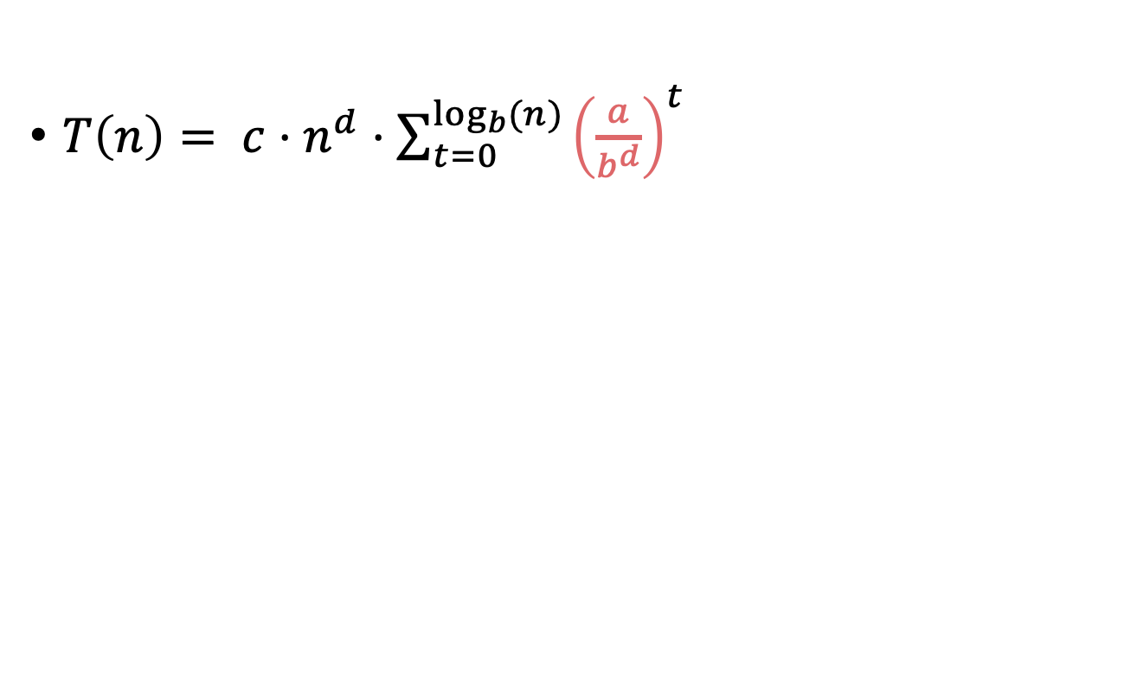

Case 2: $a<b^{d}$
$$T\left(n\right)= \left\{\begin{aligned}O\left(n^{d}\log\left(n\right)\right) if a=b^{d} \\ O\left(n^{d}\right) if a<b^{d} \\ O\left(n^{\log_{b}\left(a\right)}\right) if a>b^{d}\end{aligned}\right.$$
$T\left(n\right)= c⋅n^{d}⋅\sum_{t=0}^{\log_{b}{(n)}}{{\left(\frac{a}{b^{d}}\right)}^{t}}$
Less than 1!

Slide 27
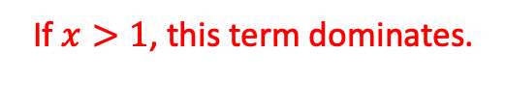

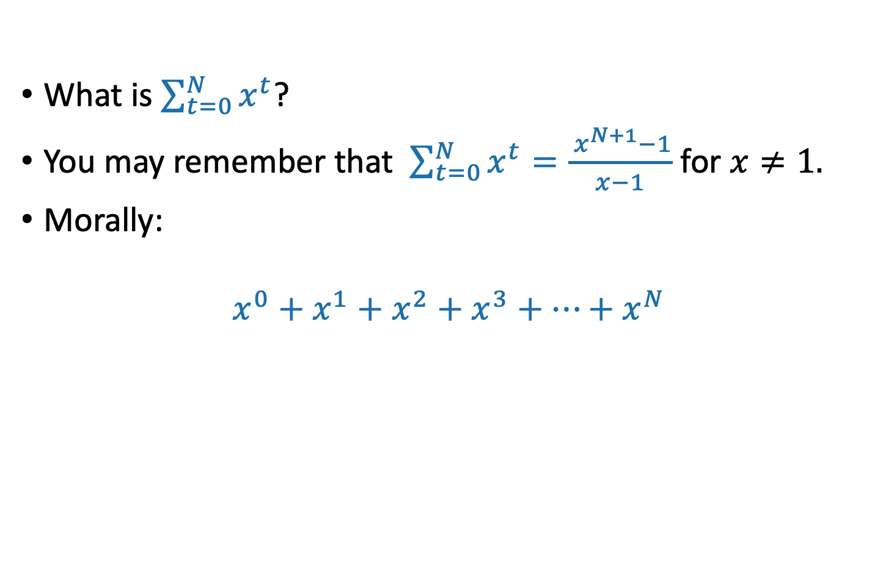
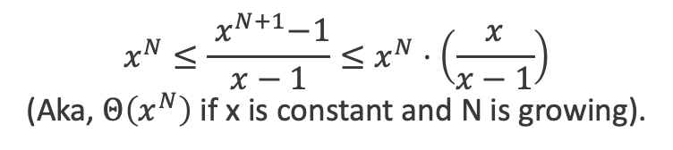
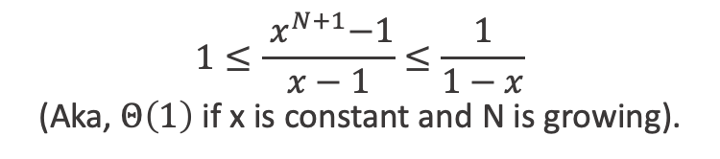
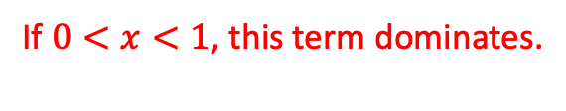
Aside: Geometric sums
What is $\sum_{t=0}^{N}{x^{t}}$?
You may remember that $\sum_{t=0}^{N}{x^{t}}=\frac{{ x}^{N+1}−1}{x−1}$ for $x≠1.$
Morally:
$$x^{0}+x^{1}+x^{2}+x^{3}+⋯+x^{N}$$
If $0<x<1$, this term dominates.
(If $x=1$, all terms the same)
If $x>1$, this term dominates.
$$1≤\frac{{ x}^{N+1}−1}{x−1}≤\frac{1}{1−x}$$
(Aka, $Θ\left(1\right)$ if x is constant and N is growing).
$$x^{N}≤\frac{{ x}^{N+1}−1}{x−1}≤x^{N}⋅\left(\frac{x}{x−1}\right)$$
(Aka, $Θ\left(x^{N}\right)$ if x is constant and N is growing).

Slide 28
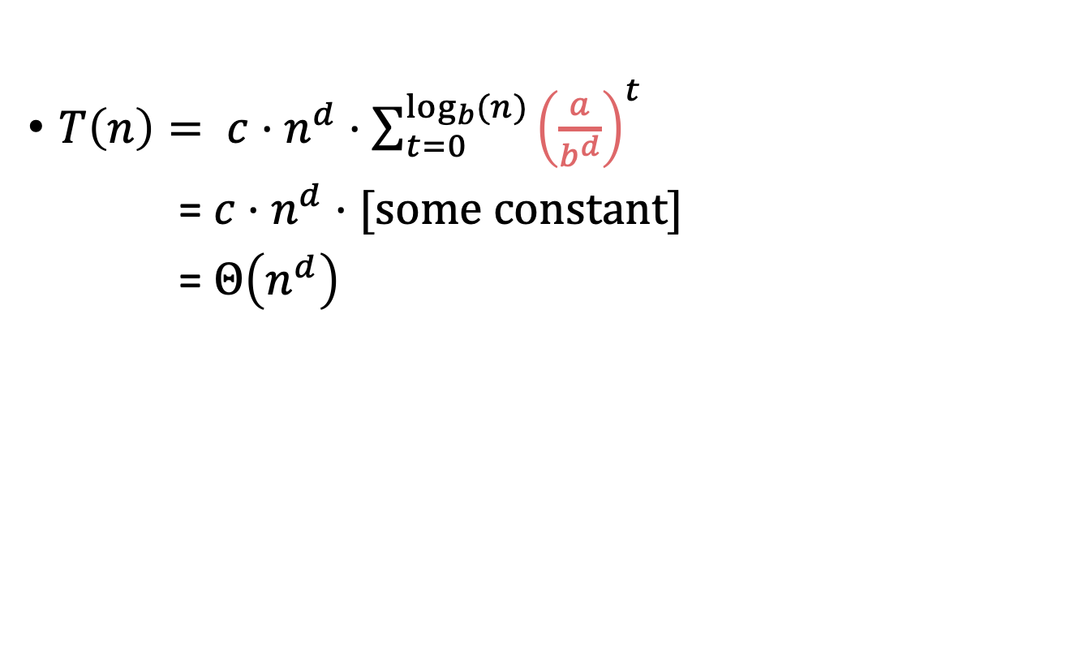
Case 2: $a<b^{d}$
$$T\left(n\right)= \left\{\begin{aligned}O\left(n^{d}\log\left(n\right)\right) if a=b^{d} \\ O\left(n^{d}\right) if a<b^{d} \\ O\left(n^{\log_{b}\left(a\right)}\right) if a>b^{d}\end{aligned}\right.$$
$T\left(n\right)= c⋅n^{d}⋅\sum_{t=0}^{\log_{b}{(n)}}{{\left(\frac{a}{b^{d}}\right)}^{t}}$
= $c⋅n^{d}⋅[some constant]$
= $Θ\left(n^{d}\right)$
Less than 1!

Slide 29


Case 3: $a>b^{d}$
$$T\left(n\right)= \left\{\begin{aligned}O\left(n^{d}\log\left(n\right)\right) if a=b^{d} \\ O\left(n^{d}\right) if a<b^{d} \\ O\left(n^{\log_{b}\left(a\right)}\right) if a>b^{d}\end{aligned}\right.$$
$T\left(n\right)= c⋅n^{d}⋅\sum_{t=0}^{\log_{b}{(n)}}{{\left(\frac{a}{b^{d}}\right)}^{t}}$
= $Θ\left(n^{d}{\left(\frac{a}{b^{d}}\right)}^{\log_{b}{(n)}}\right)$
=$Θ\left(n^{\log_{b}{(a)}}\right)$
Larger than 1!
Convince yourself that this step is legit!
We’ll do this step on the board!

Slide 30
Now let’s check all the cases
$$T\left(n\right)= \left\{\begin{aligned}O\left(n^{d}\log\left(n\right)\right) if a=b^{d} \\ O\left(n^{d}\right) if a<b^{d} \\ O\left(n^{\log_{b}\left(a\right)}\right) if a>b^{d}\end{aligned}\right.$$

Slide 31
Even more generally, for T(n) = aT(n/b) + f(n)…
SLIDE SKIPPED IN CLASS
[From CLRS – you won’t need to know this fancier version for this class unless you want to.]
Figure out how to adapt the proof we gave to prove this more general version!
Ollie the Over-Achieving Ostrich

Slide 32


Understanding the Master Theorem
Let $a≥1,b>1,and d$ be constants.
Suppose $T\left(n\right)=a⋅T\left(\frac{n}{b}\right)+O\left(n^{d}\right)$. Then
$$T\left(n\right)= \left\{\begin{aligned}O\left(n^{d}\log\left(n\right)\right) if a=b^{d} \\ O\left(n^{d}\right) if a<b^{d} \\ O\left(n^{\log_{b}\left(a\right)}\right) if a>b^{d}\end{aligned}\right.$$
What do these three cases mean?

Slide 33
The eternal struggle
Branching causes the number of problems to explode!
The most work is at the bottom of the tree!
The problems lower in the tree are smaller! The most work is at the top of the tree!

Slide 34

Consider our three warm-ups
$T\left(n\right)=T\left(\frac{n}{2}\right)+n$
$T\left(n\right)=2⋅T\left(\frac{n}{2}\right)+n$
$T\left(n\right)=4⋅T\left(\frac{n}{2}\right)+n$

Slide 35
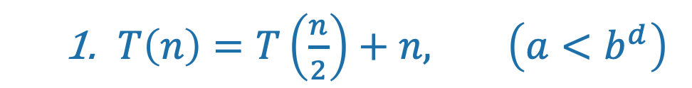
First example: tall and skinny tree
$T\left(n\right)=T\left(\frac{n}{2}\right)+n, \left(a<b^{d}\right)$
Size n
The amount of work done at the top (the biggest problem) swamps the amount of work done anywhere else.
T(n) = O( work at top ) = O(n)
n/2
n/4
n/2^{t}
WINNER
Most work at the top of the tree!
1

Slide 36
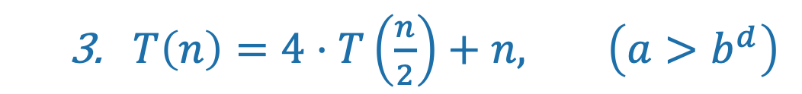
Third example: bushy tree
WINNER
$T\left(n\right)=4⋅T\left(\frac{n}{2}\right)+n, \left(a>b^{d}\right)$
Size n
Most work at the bottom of the tree!
n/2
n/2
n/2
n/2
There are a HUGE number of leaves, and the total work is dominated by the time to do work at these leaves.
T(n) = O( work at bottom ) = O( 4^{depth of tree} ) = O(n²)
1
1
1
1
1
1
1
1
1
1
1
1
1
1
1
1
1
1
1
1
1
1
1
1
1
1
1
1
1
1
1
1
1
1
1
1
1
1
1
1
1
1
1
1
1
1
1
1
1
1
1
1
1
1
1
1
1
1
1
1
1
1
1

Slide 37
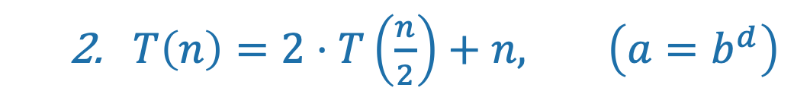
Second example: just right
$T\left(n\right)=2⋅T\left(\frac{n}{2}\right)+n, \left(a=b^{d}\right)$
Size n
The branching just balances out the amount of work.
n/2
n/2
The same amount of work is done at every level.
n/4
n/4
n/4
n/4
T(n) = (number of levels) * (work per level)
= log(n) * O(n) = O(n log(n))
TIE!
1
1
1
1
1
1
1
1
1
1

Slide 38
What have we learned?
The “Master Method” makes our lives easier.
But it’s basically just codifying a calculation we could do from scratch if we wanted to.

Slide 39
The Substitution Method
Another way to solve recurrence relations.
More general than the master method.
Step 1: Generate a guess at the correct answer.
Step 2: Try to prove that your guess is correct.
(Step 3: Profit.)

Slide 40
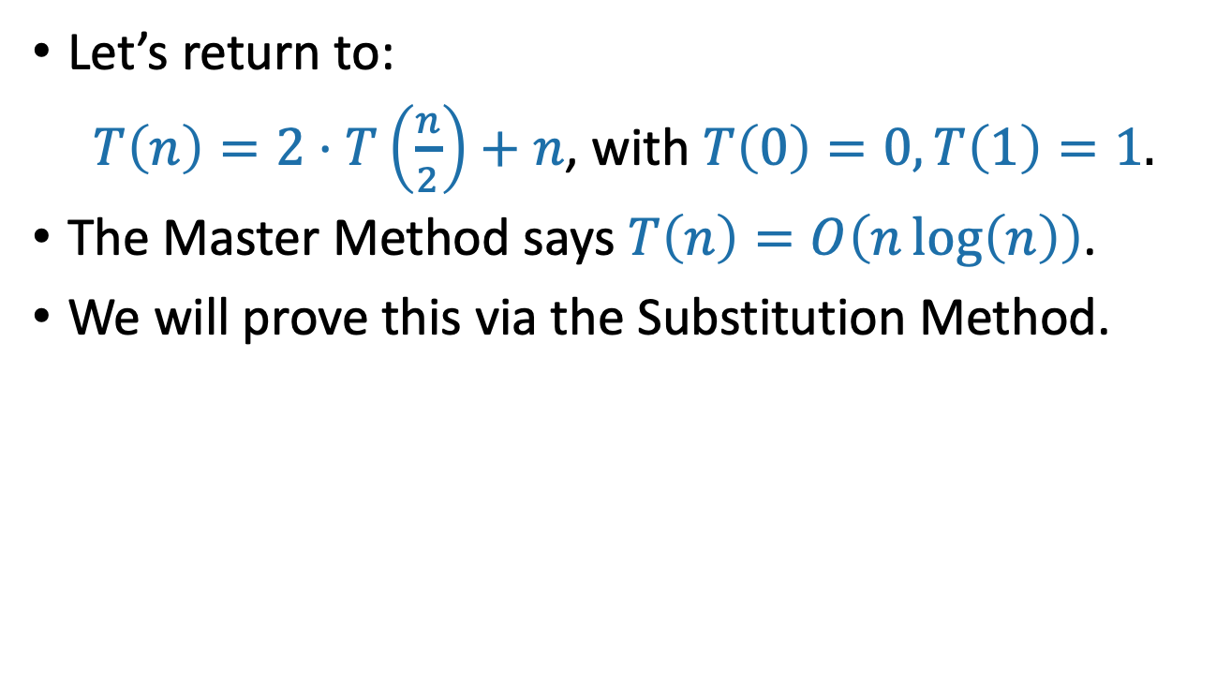
The Substitution Method first example
Let’s return to:
$T\left(n\right)=2⋅T\left(\frac{n}{2}\right)+n$, with $T\left(0\right)=0, T\left(1\right)=1.$
The Master Method says $T\left(n\right)=O\left(n\log\left(n\right)\right)$.
We will prove this via the Substitution Method.

Slide 41





Step 1: Guess the answer
$T\left(n\right)=2⋅T\left(\frac{n}{2}\right)+n$, with $T\left(1\right)=1.$
You can guess the answer however you want: meta-reasoning, a little bird told you, wishful thinking, etc. One useful way is to try to “unroll” the recursion, like we’re doing here.
$T\left(n\right)=2⋅T\left(\frac{n}{2}\right)+n$
$T\left(n\right)=2⋅\left(2⋅T\left(\frac{n}{4}\right)+\frac{n}{2}\right)+n$
$T\left(n\right)=4⋅T\left(\frac{n}{4}\right)+2n$
$T\left(n\right)=4⋅\left(2⋅T\left(\frac{n}{8}\right)+\frac{n}{4}\right)+2n$
$T\left(n\right)=8⋅T\left(\frac{n}{8}\right)+3n$
…
Expand $T\left(\frac{n}{2}\right)$
Simplify
Expand $T\left(\frac{n}{4}\right)$
Simplify
Guessing the pattern: $T\left(n\right)=2^{t}⋅T\left(\frac{n}{2^{t}}\right)+t⋅n$
Plug in $t=\log\left(n\right),$ and get
$$T\left(n\right)=n⋅T\left(1\right)+\log\left(n\right)⋅n=n\left(\log\left(n\right)+1\right)$$

Slide 42

Step 2: Prove the guess is correct.
$T\left(n\right)=2⋅T\left(\frac{n}{2}\right)+n$, with $T\left(1\right)=1.$
Inductive Hypothesis: $T\left(n\right)=n\left(\log\left(n\right)+1\right)$.
Base Case (n=1): $T\left(1\right)=1=1⋅\left(\log\left(1\right)+1\right)$
Inductive Step:
Assume Inductive Hyp. for $1≤n<k$:
Suppose that $T\left(n\right)=n\left(\log\left(n\right)+1\right)$ for all $1≤n<k.$
Prove Inductive Hyp. for n=k:
$T\left(k\right)=2⋅T\left(\frac{k}{2}\right)+k$ by definition
$T\left(k\right)=2⋅\left(\frac{k}{2}\left(\log\left(\frac{k}{2}\right)+1\right)\right)+k$ by induction.
$T\left(k\right)=k\left(\log\left(k\right)+1\right)$ by simplifying.
So Inductive Hyp. holds for n=k.
Conclusion: For all $n≥1,$ $T\left(n\right)=n\left(\log\left(n\right)+1\right)$
We’re being sloppy here about floors and ceilings…what would you need to do to be less sloppy?

Slide 43

Step 3: Profit
Pretend like you never did Step 1, and just write down:
Theorem: $T\left(n\right)=O(n\log\left(n\right))$
Proof: [Whatever you wrote in Step 2]

Slide 44
What have we learned?
The substitution method is a different way of solving recurrence relations.
Step 1: Guess the answer.
Step 2: Prove your guess is correct.
Step 3: Profit.
We’ll get more practice with the substitution method next lecture!

Slide 45

Another example (if time)
(If not time, that’s okay; we’ll see these ideas in Lecture 4)
$T\left(n\right)=2⋅T\left(\frac{n}{2}\right)+32⋅n$
$T\left(2\right)=2$
Step 1: Guess: $O(n\log\left(n\right))$ (divine inspiration).
But I don’t have such a precise guess about the form for the $O(n log⁡(n))$ …
That is, what’s the leading constant?
Can I still do Step 2?

Slide 46

Aside: What’s wrong with this?
This is NOT CORRECT!!!
Inductive Hypothesis: $T\left(n\right)=O(n\log\left(n\right))$
Base case: $T\left(2\right)=2=O\left(1\right)=O(2\log\left(2\right))$
Inductive Step:
Suppose that $T\left(n\right)=O(n\log\left(n\right))$ for n < k.
Then $T\left(k\right)=2⋅T\left(\frac{k}{2}\right)+32⋅k$ by definition
So $T\left(k\right)=2⋅O\left(\frac{k}{2}\log\left(\frac{k}{2}\right)\right)+32⋅k$ by induction
But that’s $T\left(k\right)=O\left(k\log\left(k\right)\right)$, so the I.H. holds for n=k.
Conclusion:
By induction, $T\left(n\right)=O(n\log\left(n\right))$ for all n.
Plucky the
Pedantic Penguin
Figure out what’s wrong here!!!
Siggi the Studious Stork

Slide 47

Aside: What’s wrong with this?
Red flag: We can use the same reasoning to prove that T(n) = O(n), which is not true!
This slide skipped in class
This is NOT CORRECT!!!
Inductive Hypothesis: $T\left(n\right)=O\left(n\right)$
Base case: $T\left(2\right)=2=O\left(1\right)=O(2)$
Inductive Step:
Suppose that $T\left(n\right)=O(n)$ for n < k.
Then $T\left(k\right)=2⋅T\left(\frac{k}{2}\right)+32⋅k$ by definition
So $T\left(k\right)=2⋅O\left(\frac{k}{2}\right)+32⋅k$ by induction
But that’s $T\left(k\right)=O\left(k\right)$, so the I.H. holds for n=k.
Conclusion:
By induction, $T\left(n\right)=O\left(n\right)$ for all n.
Plucky the
Pedantic Penguin
The problem is that this doesn’t make any sense. We can’t have
“T(n) = O(n) for n < k,”
since the def. of big-Oh needs to hold for all n.

Slide 48
Another example (if time)
(If no time, that’s okay; we’ll see these ideas in Lecture 4)
$T\left(n\right)=2⋅T\left(\frac{n}{2}\right)+32⋅n$
$T\left(2\right)=2$
Step 1: Guess: $O(n\log\left(n\right))$ (divine inspiration).
But I don’t have such a precise guess about the form for the $O(n log⁡(n))$ …
That is, what’s the leading constant?
Can I still do Step 2?

Slide 49


Step 2: Prove it, working backwards to figure out the constant
Guess: $T\left(n\right)≤C⋅n\log\left(n\right)$ for some constant C TBD.
Inductive Hypothesis (for $n≥2)$ : $T\left(n\right)≤C⋅n\log\left(n\right)$
Base case: $T\left(2\right)=2≤C⋅2\log\left(2\right)$ as long as $C≥1$
Inductive Step:
$$T\left(n\right)=2⋅T\left(\frac{n}{2}\right)+32⋅n$$
$$T\left(2\right)=2$$

Slide 50


Inductive step
Inductive Hypothesis: $T\left(n\right)≤C⋅n\log\left(n\right)$
Assume that the inductive hypothesis holds for n<k.
$T\left(k\right)=2T\left(\frac{k}{2}\right)+32k$
$≤2C\frac{k}{2}log\left(\frac{k}{2}\right)+32k$
$=k\left(C⋅\log\left(k\right)+32 −C\right)$
$≤k\left(C⋅\log{(k)}\right)$ as long as $C≥32$.
Then the inductive hypothesis holds for n=k.
$$T\left(n\right)=2⋅T\left(\frac{n}{2}\right)+32⋅n$$
$$T\left(2\right)=2$$

Slide 51

Step 2: Prove it, working backwards to figure out the constant
Guess: $T\left(n\right)≤C⋅n\log\left(n\right)$ for some constant C TBD.
Inductive Hypothesis (for $n≥2$): $T\left(n\right)≤C⋅n\log\left(n\right)$
Base case: $T\left(2\right)=2≤C⋅2\log\left(2\right)$ as long as $C≥1$
Inductive step: Works as long as $C≥32$
So choose $C=32$.
Conclusion: $T\left(n\right)≤32⋅n\log\left(n\right)$
$$T\left(n\right)=2⋅T\left(\frac{n}{2}\right)+32⋅n$$
$$T\left(2\right)=2$$

Slide 52

Step 3: Profit.
Theorem: $T\left(n\right)=O(n\log\left(n\right))$
Proof:
Inductive Hypothesis: $T\left(n\right)≤32⋅n\log\left(n\right)$
Base case: $T\left(2\right)=2≤32⋅2\log\left(2\right)$ is true.
Inductive step:
Assume Inductive Hyp. for n<k.
$T(k)=2T\left(\frac{k}{2}\right)+32k$
$≤2⋅32⋅\frac{k}{2}log\left(\frac{k}{2}\right)+32k$
$=k\left(32⋅\log\left(k\right)+32 −32\right)$
$=32⋅k log⁡(k)$
This establishes inductive hyp. for n=k.
Conclusion: $T\left(n\right)≤32⋅n\log\left(n\right)$ for all $n≥2$.
By the definition of big-Oh, with $n_{0}=2$ and $c=32$, this implies that $T\left(n\right)=O(n\log\left(n\right))$
By the def. of T(k)
By induction

Slide 53
Why two methods?
Sometimes the Substitution Method works where the Master Method does not.
More on this next time!

Slide 54
Next Time
What happens if the sub-problems are different sizes?
And when might that happen?
BEFORE Next Time
Pre-lecture 4 exercises!

