Slide 1
CS 161 - Section 2
CA : [Name of the CA]

Slide 2
Section 2 agenda
Recurrence Relations
Master Theorem
Substitution Method
Space Complexity

Slide 3
Recurrence Relations

Slide 4
Recurrence Relations
We explored the power of Divide and Conquer
breaking a big problem into a collection of smaller problems
combining solutions
We usually perform this breaking recursively until a base case is reached

Slide 5
Recurrence Relations
Advantage: smaller problems are easier to solve!
Disadvantage: how do we reason about runtime?
Might only know runtime of subproblems relative to the bigger problem
We can know “subproblems can be solved twice as fast as the big problem” but won’t know what the big problem runtime is

Slide 6
Recurrence Relations
T(n) = 2*T(n/2) + O(n)
we break down the problem runtime T(n) into what we call a “recurrence relation”
T(n) = 2*T(n/2) + O(n)
T(n) = 2*[2*T(n/4) + O(n)] + O(n)
T(n) = 2*[2*[2*T(n/8) + O(n)]+ O(n)] + O(n)

Slide 7
Recurrence Relations
When do we stop the recursive definition for T(n)?
Don’t know properties of n
Don’t know the exact levels of recursion
We resort to solving the recurrence relation directly!
Two methods:
Master Method
2. Substitution Method

Slide 8
Recurrence Relations
“Master Theorem” Method:
Closed form solution!
Easily applicable with knowledge of how the subproblems are formed
Doesn’t always work :(
Substitution Method:
Generalized method to solve recurrence relations
Requires more manual math
Always works! :D

Slide 9
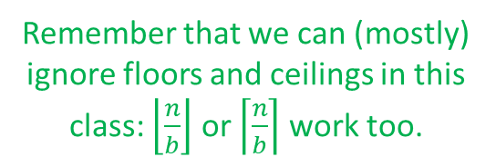
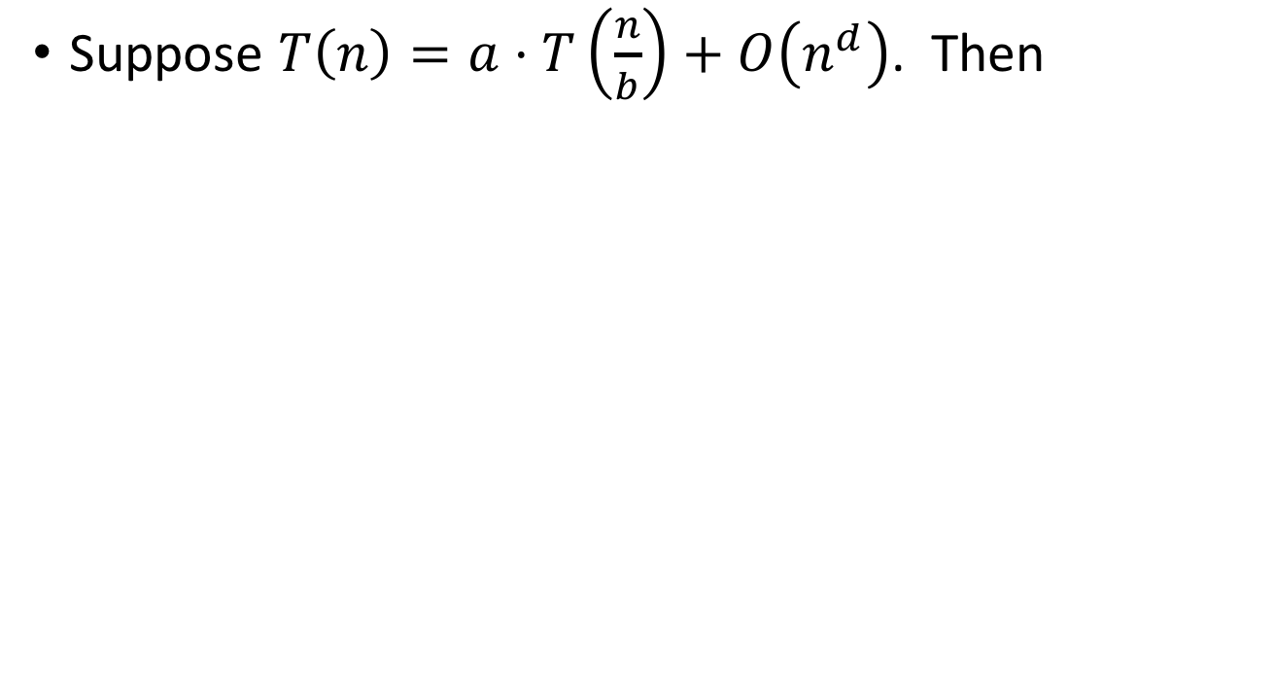
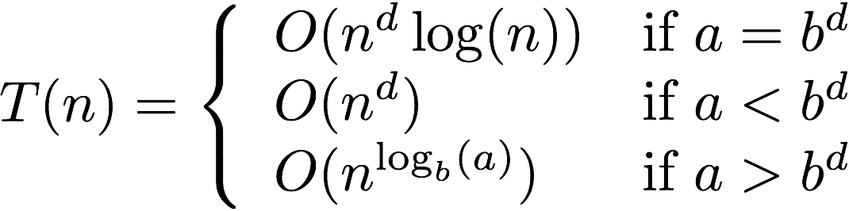
The Master Method
Three parameters:
a : number of subproblems
b : factor by which input size shrinks
d : need to do n^{d} work to create all the subproblems and combine their solutions.
Requires all subproblems to be the same size!

Slide 10
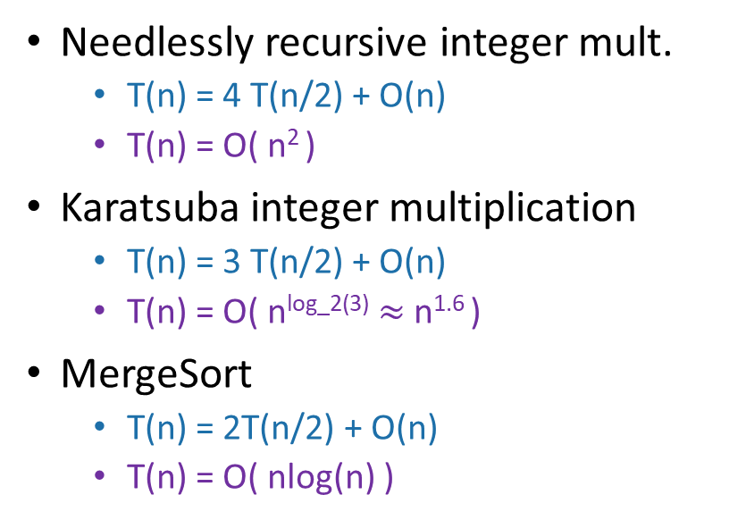
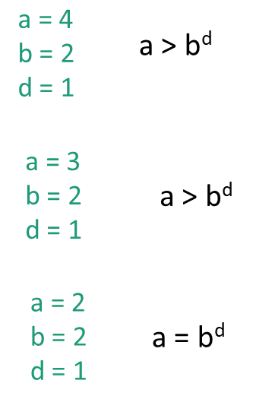

Slide 11
The Substitution Method
The Master Theorem is extremely convenient, but is in reality just a closed form solution to a calculation that could be made by hand
Substitution is the generalized procedure to solve any recurrence relation, even in cases when Master Theorem fails
Soon we will explore when MT fails

Slide 12
The Substitution Method
Guess what the answer is.
Try a few levels of recursion and see if you spot a pattern
Formally prove that that’s what the answer is.
Often using induction
From MT we know T(n) = 2*T(n/2) + n = O(n logn)
How do we show it without the MT?

Slide 13
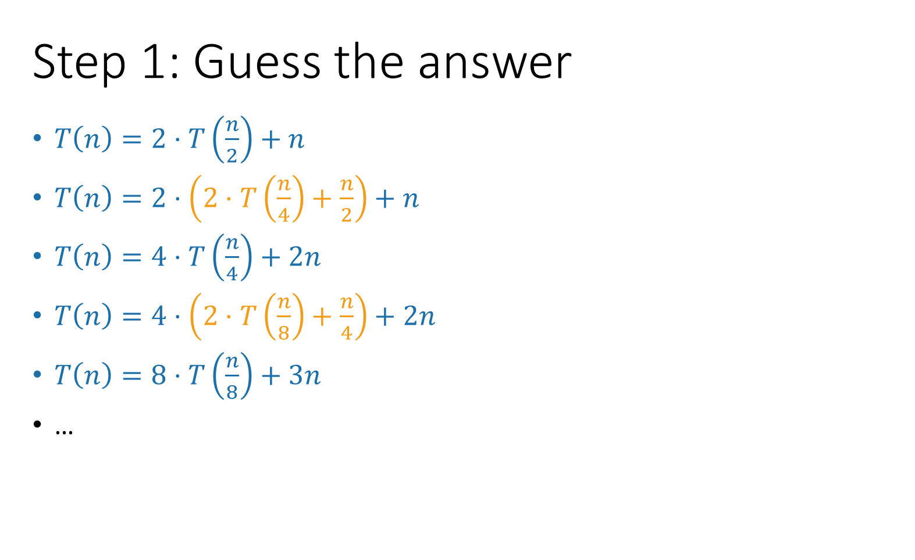
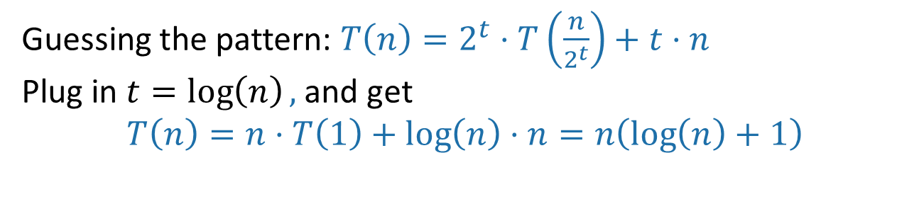
number of levels

Slide 14
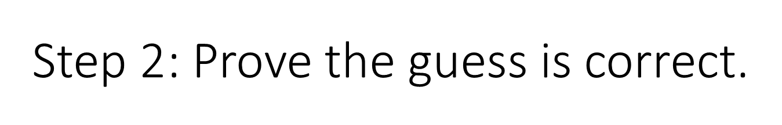
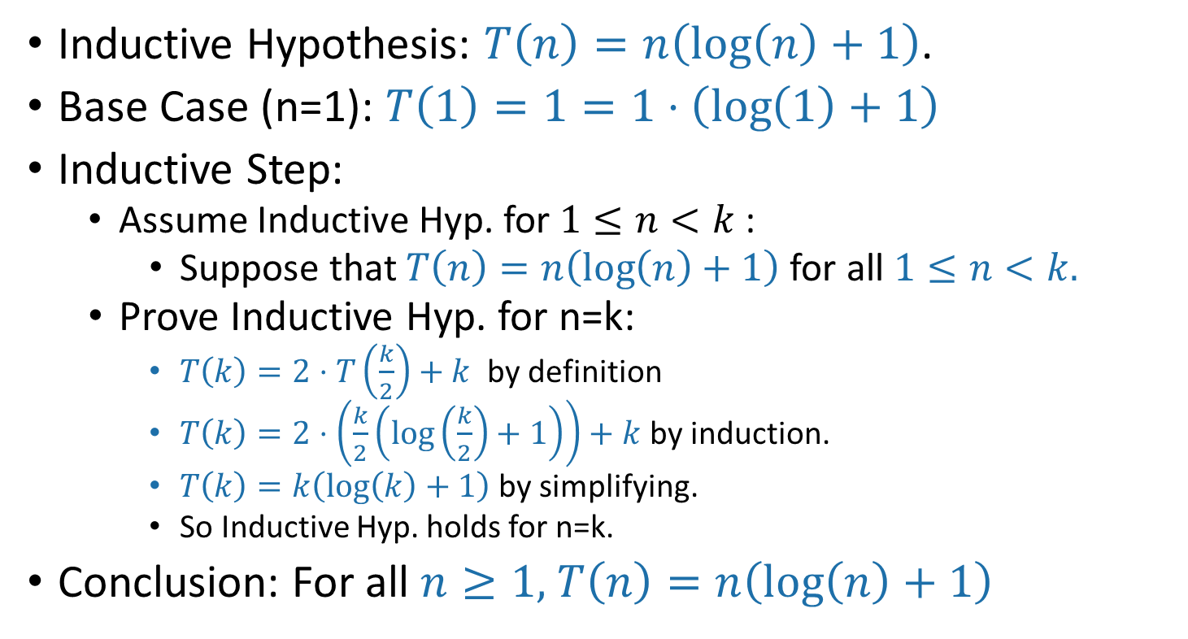

Slide 15
Space Complexity

Slide 16
Warm-up
How many bits do you need to store a number between 1 and n?
Answer is log(n), since k bits can represent all numbers between 1 and 2^{k}
How many digits do you need to represent that same number?
log₁₀(n)
What about base-r digits?
log_{r}(n)
Keep this in the back of your mind for Week 3!

Slide 17
Space complexity of an algorithm
Definition: the space complexity of an algorithm is how much memory the algorithm needs to run, excluding the input and output.
Expressed as a function of input size
Could vary based on language, compiler, etc. 🡪 Big-O notation!

Slide 18
Example: Insertion Sort
def InsertionSort(A):
for i in range(1,len(A)):
current = A[i]
j = i-1
while j >= 0 and A[j] > current:
A[j+1] = A[j]
j -= 1
A[j+1] = current
4
6
3
8
5
3
4
6
8
5
Input: array of size n
All operations are done in-place 🡪 no extra space needed
Space complexity = O(1)

Slide 19
Example: Merge sort
6
4
3
8
1
5
2
7
6
4
3
8
1
5
2
7
3
4
6
8
1
2
5
7
MERGE!
1
2
3
4
5
6
7
8

Slide 20
Example: Merge sort
Merging two arrays of size k/2 into a new array of size k requires extra space of size k
The top level of merge sort needs space n, so merge sort has space complexity O(n)
Merge sort has log(n) levels of merges, why is it not n log(n)?
Can we do better?

Slide 21
In-place merging
3
4
6
8
1
2
5
7
If the left element is smaller, move the left pointer to the right.
If the right element is smaller, move it to the position of the left element and shift everything in between to the right. Then move both pointers to the right.
Now requires no extra space 🡪 space complexity is O(1)!

Slide 22
In-place merging
What happened to time complexity?
“Shift everything to the right” is O(n), in the worst case we need to do it O(n) times
This merge takes time O(n²)!
Often there is a trade-off between time and space complexity.
In what situations is having a small space complexity more important?

Slide 23
Recap
Space complexity = amount of extra space needed to run an algorithm, excluding the input and output
Often there is a trade-off between time and space complexity.
Next time: an algorithm that is both in-place and runs in time O(n log(n))!

