Slide 1
CS 161 Review Section
Dynamic Programming!

Slide 2
Agenda
DP Definition and Recipe
DP Tips and Tricks
DP Practice

Slide 3
Dynamic Programming Definition
DP is an algorithmic strategy revolving around "not repeating work for subproblems"
Look for DP whenever you see anything about a "shortest path," a "longest subsequence," a "most profit," – optimization problems that have natural subproblems

Slide 4
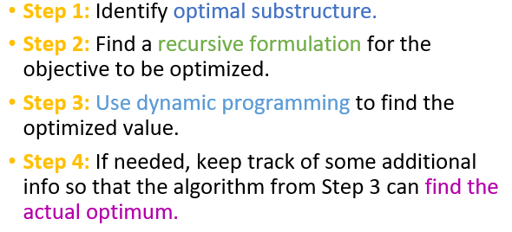
Dynamic Programming Recipe

Slide 5
Problem-Solving Tips for DP
Implementation is usually fairly simple -- 1-3 nested for loops, typically, in this class
Make sure you figure out a reasonable initial value for your array: usually 0, -\infty, or +\infty
When the runtime is given to you, you know what those loops should be. (i.e. O(nk) runtime means you iterate 1-n and 1-k)
Recurrence is often a MAX or a MIN over all the choices you can make (usually the innermost for-loop, when the number of choices is greater than constant).

Slide 6
Problem-Solving Tips for DP
If a problem asks for a recurrence relation, explicitly give a formula!
Don’t forget the base cases; if you can’t figure out the base cases, think about which subproblems will “fall out of range” of your recurrence relation
If you can’t figure out the recurrence relation, draw small problems out, see what choices you are making to determine the solution, and then repeat, building off of your smaller problems to create larger ones

Slide 7
Problem-Solving Tips for Finding the Recurrence
DP recurrence is all about "laying out the choices" or “the cases”
Ex) Green duck could choose to dance in the leftmost or the rightmost square
Once we've laid out the choices, pick the "best" one
Ex) If it is the green duck’s move, the best choice is the one that maximizes our score
Ex) If it is the white duck’s move, the best choice is the one that minimizes the green duck’s score

Slide 8
Runtime of DP
Usually O(|entries|*(amount of work it takes to fill out an entry))

Slide 9
Example Problems for DP:
Lecture 13 (Longest Common Subsequence) +
Lecture 13 (Knapsack Problem) +
Lecture 13 (Independent Set Problem)
Section 7 (Encoding)
Section 7 (Knight Moves)*
Section 7 (String Cutting) +
HW 7 (Making Change)
HW 7 (Smartphone Stress Testing)
HW 6 (Plucky’s Commuting Plans)*
HW 6 (Duck Dance Off)*
HW 6 (Most Reliable Path)*
W2024 Final (Optimal Matrix Multiplication)

