Slide 1
Section 1
CA : [Name of the CA]

Slide 2
Section 1 agenda
Good/bad pseudocode examples
Review Karatsuba integer multiplication
Review MergeSort & InsertionSort
Review big-Oh notation
Practice in groups

Slide 3

What is pseudocode?

Slide 4

What is a pseudocode
Pseudocode is a plain language clear description of the steps in an algorithm.
Pseudocode often uses structural conventions of a normal programming language, but is intended for human reading rather than machine reading.
We’re about to see some high-level guidelines for writing pseudocode, but remember to aim for maximum clarity rather than adhering to any specific rules

Slide 5
What is a good pseudocode?

Slide 6




Example: Light Bulbs and Lost Socket
Siggi used to have n pairs of light bulbs and their matching sockets with distinct sizes such that each light bulb would only match exactly one of the n sockets and vice versa.
But Siggi lost all their sockets while they were moving from one dorm room to another. Lucky found a socket in the hallway and gave it to Siggi with the hopes that it’s one of the lost sockets.
Siggi is extremely organized, so they have already ordered their light bulbs based on their base sizes from small to big. Help Siggi find the matching light bulb with the found socket.

Slide 7
Sample Pseudocodes

Slide 8
find_matching_light_bulb (LightBulbs, Socket)
search the light bulbs and return the matching lightbulb with the socket

Slide 9


Clear description of the steps
find_matching_light_bulb (LightBulbs, Socket)
search the light bulbs and return the matching lightbulb with the socket
find_matching_light_bulb (lightBulbs, socket)
for lightBulb in lightBulbs:
if lightBulb and socket match: return lightBulb
return no matching light bulb found

Slide 10
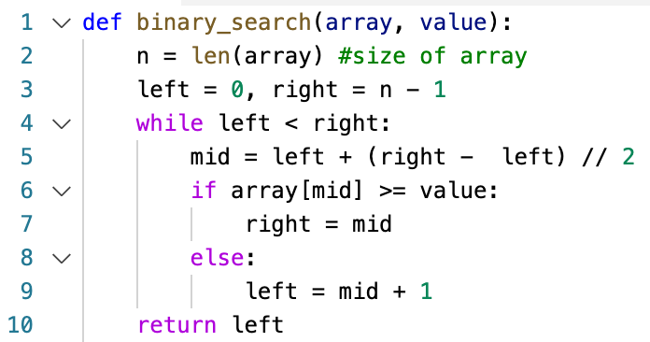
Using the algorithms covered during the lectures without their pseudocode
For the sake of this example, assume the following implementation of binary search was given in the lecture.

Slide 11
Using the algorithms covered during the lectures without their pseudocode
find_matching_light_bulb (LightBulbs, Socket)
run binary_search to find the matching light bulb.

Slide 12
You can use the algorithms covered during the lectures without their pseudocode, but make sure to specify their inputs and other details clearly.
find_matching_light_bulb (LightBulbs, Socket)
run binary_search to find the matching light bulb.
find_matching_light_bulb (lightBulbs, socket)
ind=modified_binary_search(lightBulbs,
socket)
if lightBulbs[ind] matches with socket:
return lightBulbs[ind]
else:
return no matching light bulb found
Modified_binary_search is binary_search, but we change line 6 to: if array[mid]’s lightBulb size is greater than or equal to socket’s size

Slide 13
Make the Pseudocode as simple as possible
find_matching_light_bulb (lightBulbs, socket)
if the 1st light bulb matches the socket:
return the first light bulb
if the 2nd light bulb matches the socket:
return the 2nd light bulb
if the 3rd light bulb matches the socket:
return the 3rd light bulb
.
.
.
if the nth light bulb matches the socket:
return the nth light bulb
return no matching light bulb found

Slide 14
Make the Pseudocode as simple as possible
find_matching_light_bulb (lightBulbs, socket)
if the 1st light bulb matches the socket:
return the first light bulb
if the 2nd light bulb matches the socket:
return the 2nd light bulb
if the 3rd light bulb matches the socket:
return the 3rd light bulb
.
.
.
if the nth light bulb matches the socket:
return the nth light bulb
return no matching light bulb found
find_matching_light_bulb (lightBulbs, socket)
for lightBulb in lightBulbs:
if lightBulb and socket match: return lightBulb
return no matching light bulb found

Slide 15
Divide-and-Conquer

Slide 16
Divide and conquer
[Lecture 1: Slide 66]
Break problem up into smaller (easier) sub-problems
Big problem
Smaller problem
Smaller problem
Yet smaller problem
Yet smaller problem
Yet smaller problem
Yet smaller problem

Slide 17

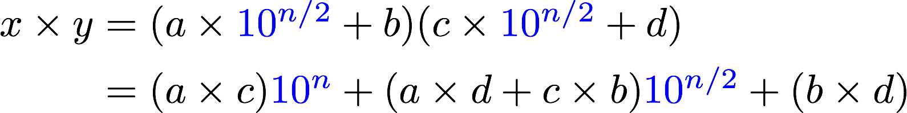
Divide and conquer for multiplication
Suppose n is even
Break up an n-digit integer:
1
2
3
4
One n-digit multiply
Four (n/2)-digit multiplies

Slide 18
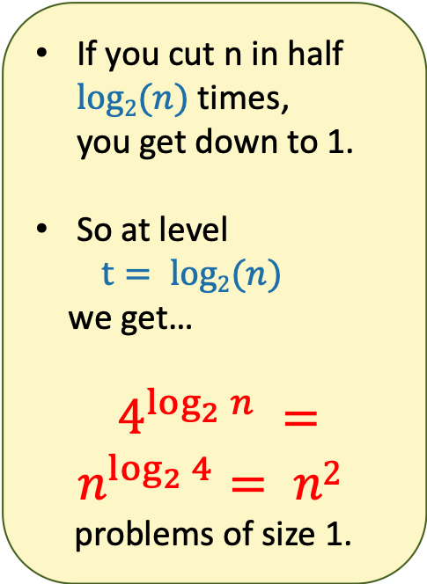

There are n² 1-digit problems
1 problem
of size n
4 problems
of size n/2
…
4^{t} problems
of size n/2^{t}
Note: this is just a cartoon – I’m not going to draw all 4^{t} circles!
…
____ problems
of size 1

Slide 19
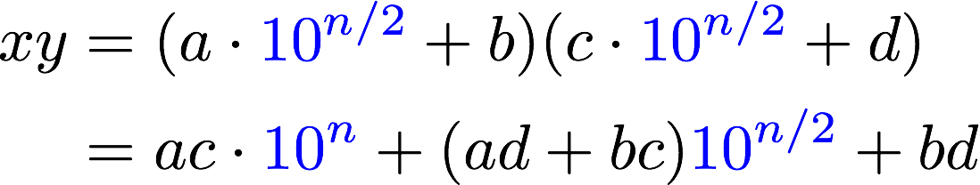

Do Better: Karatsuba integer multiplication
Recursively compute these THREE things:
ac
bd
(a+b)(c+d)
ad + bc = (a+b)(c+d) - ac - bd
Assemble the product:

Slide 20
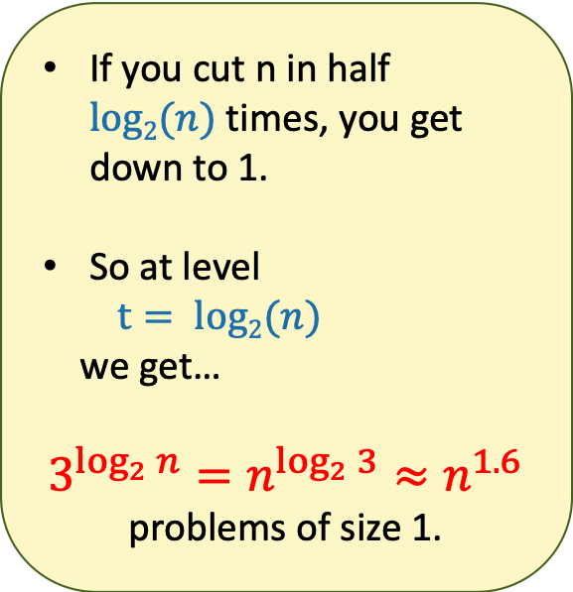


What’s the running time?
1 problem
of size n
3 problems
of size n/2
…
3^{t} problems
of size n/2^{t}
Note: this is just a cartoon – I’m not going to draw all 3^{t} circles!
…
We aren’t accounting for the work at the higher levels! But we’ll see later that this turns out to be okay.
____ problems
of size 1

Slide 21
MergeSort
A divide and conquer algorithm for sorting an array
Big problem
Smaller problem
Smaller problem
Yet smaller problem
Yet smaller problem
Yet smaller problem
Yet smaller problem

Slide 22
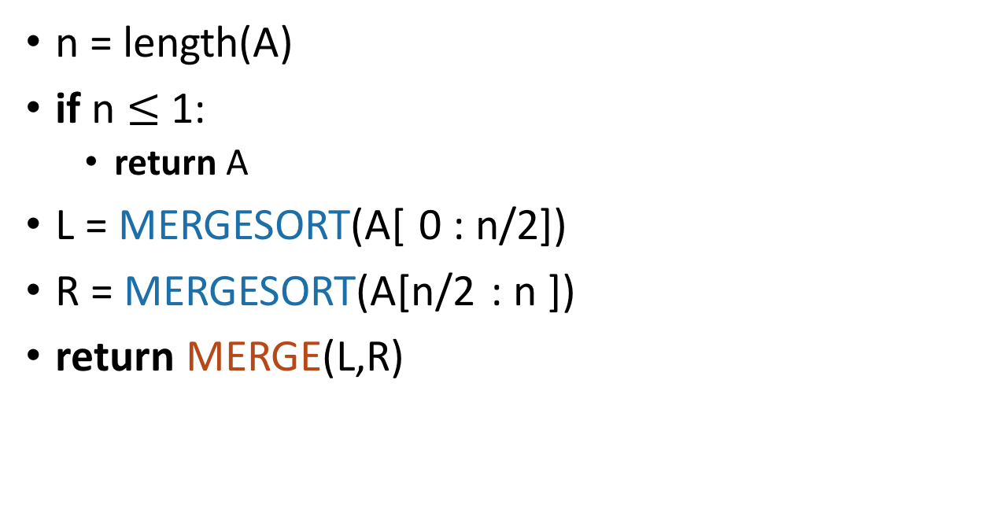
MergeSort Pseudocode
[Lecture 2: Slide 64]
MERGESORT(A):
If A has length 1,
It is already sorted!
Sort the left half
Sort the right half
Merge the two halves
Notes:
Okay, this pseudo-code is actually pretty intuitive, it's follows our english description.
(Question to ponder: what if we wanted to do this in-place?)

Slide 23
Merge sort in pictures
6
4
3
8
1
5
2
7
6
4
3
8
1
5
2
7
6
4
3
8
1
5
2
7
6
4
3
8
1
5
2
7
This array of length 1 is sorted!

Slide 24
Merge sort in pictures
Sorted sequence!
1
2
3
4
5
6
7
8
Merge!
3
4
6
8
1
2
5
7
Merge!
Merge!
4
6
3
8
1
5
2
7
Merge!
Merge!
Merge!
Merge!
6
4
3
8
1
5
2
7
A bunch of sorted lists of length 1 (in the order of the original sequence).
Notes:
Here's a different way of looking at merge sort. Let's take the same example, and think about it in terms of what order the MERGE calls happen in (instead of what order the recursive calls happen in)

Slide 25

InsertionSort
An algorithm that builds up the final sorted array by inserting (& sorting) one item at a time
Similar to how you would sort a hand of playing cards

Slide 26
InsertionSort example
[Lecture 2: Slide 14]
6
4
3
8
5
Start by moving A[1] toward the beginning of the list until you find something smaller (or can’t go any further):
Then move A[3]:
6
4
3
8
5
3
4
6
8
5
4
6
3
8
5
3
4
6
8
5
Then move A[2]:
Then move A[4]:
4
6
3
8
5
3
4
6
8
5
3
4
6
8
5
3
4
5
6
8
Then we are done!

Slide 27
Insertion Sort (the actual algorithm)
def InsertionSort(A):
for i in range(1,len(A)):
current = A[i]
j = i-1
while j >= 0 and A[j] > current:
A[j+1] = A[j]
j -= 1
A[j+1] = current
4
6
3
8
5
3
4
6
8
5
Remember our two questions:
Does it work? (Proof by induction)
Is it fast?

Slide 28
Asymptotic analysis
Aka big-Oh notation

Slide 29
In this class we will use…
Big-Oh notation!
Gives us a meaningful way to talk about the running time of an algorithm, independent of programming language, computing platform, etc., without having to count all the operations.
Notes:
O means order – as in “order of magnitude”

Slide 30
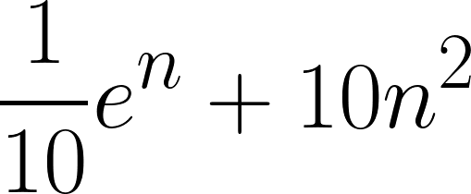

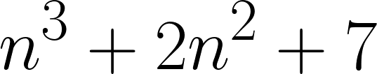
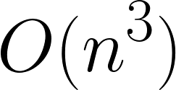
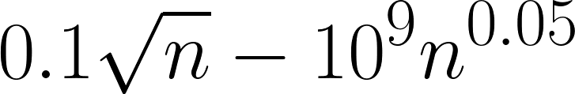

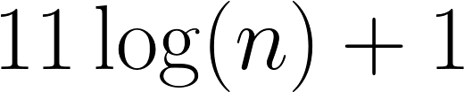
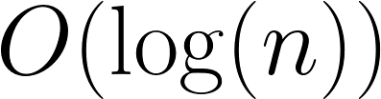
Main idea:
Focus on how the runtime scales with n (the input size).
Some examples…
(Only pay attention to the largest function of n that appears.)
Number of operations | Asymptotic Running Time
We say this algorithm is “asymptotically faster” than the others.

Slide 31

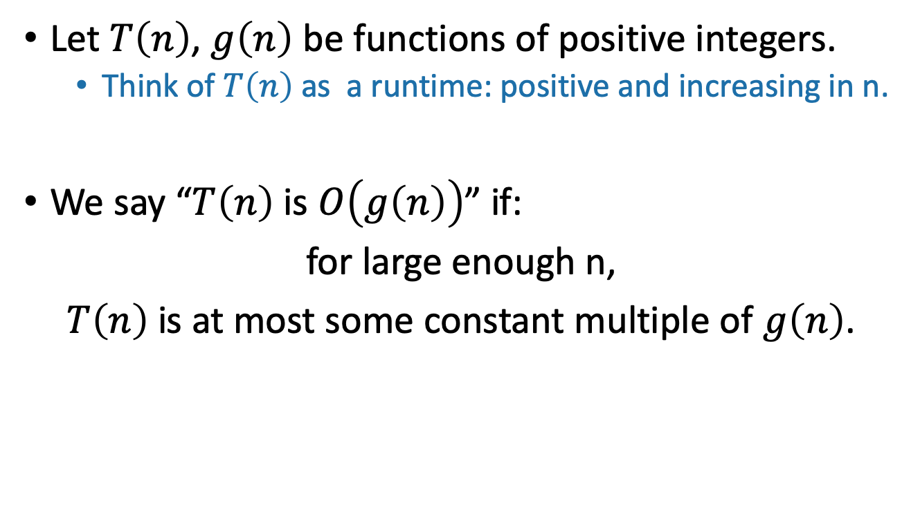
Informal definition for O(…)
pronounced “big-oh of …” or sometimes “oh of …”
Here, “constant” means “some number that doesn’t depend on n.”

Slide 32
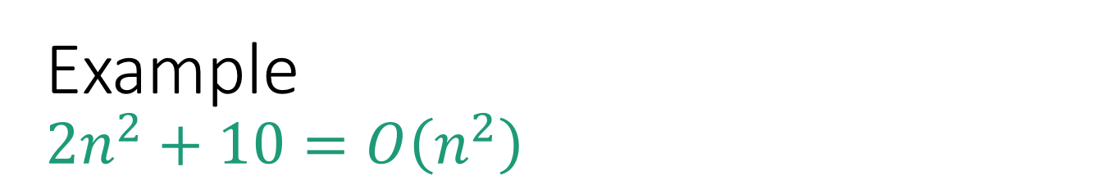
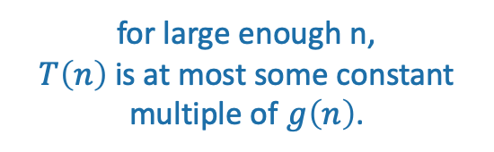
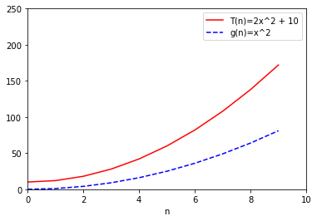
T(n) = 2n² + 10
g(n) = n²

Slide 33
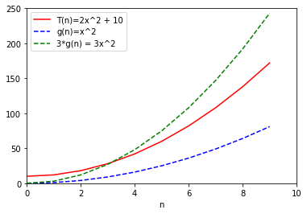
3g(n) = 3n²
T(n) = 2n² + 10
g(n) = n²

Slide 34
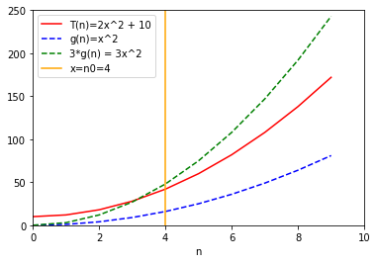
n₀=4
3g(n) = 3n²
T(n) = 2n² + 10
g(n) = n²

Slide 35

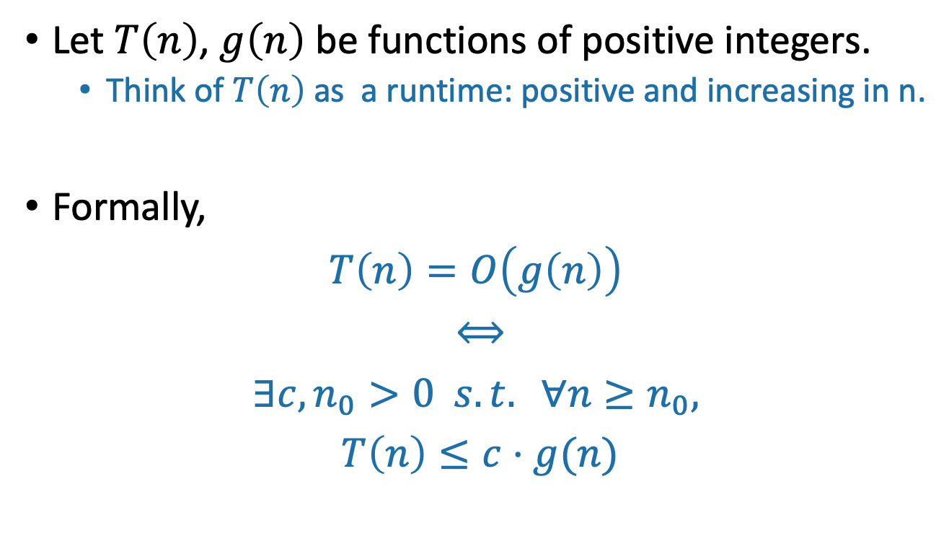
Formal definition of O(…)
“If and only if”
“For all”
“There exists”
“such that”

Slide 36
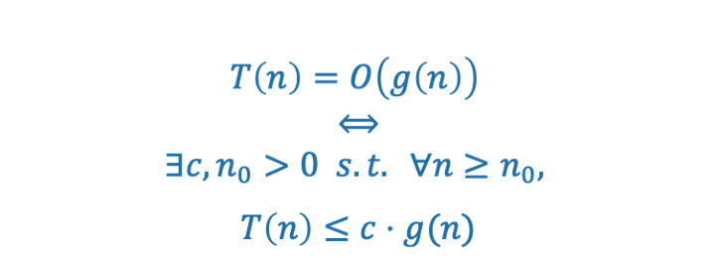
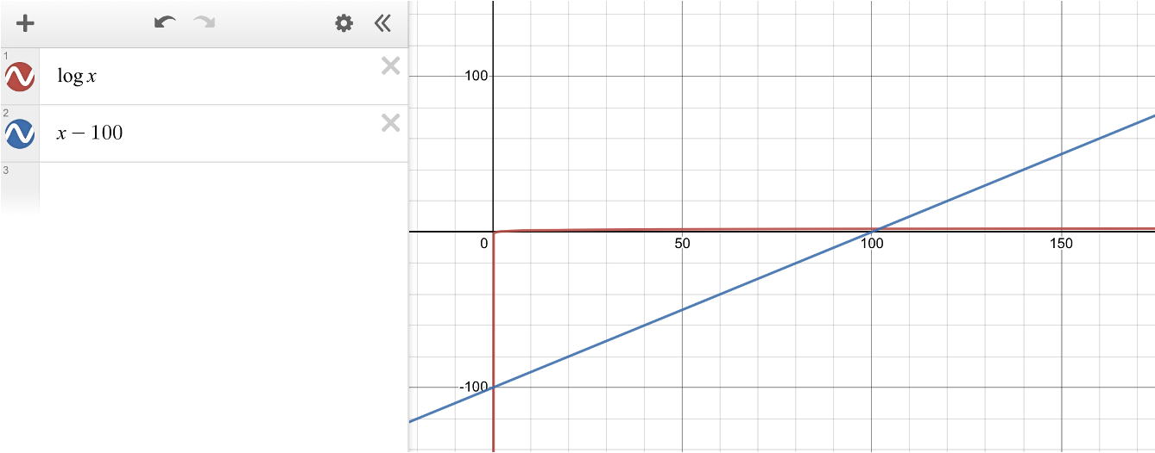
Why does n_0 matter?
E.g. log(x) is O(x – 100), but x-100 starts off smaller
We only care about asymptotic behavior, so we will look at the two functions at a later point
Smaller terms in functions do not matter for big-O!

Slide 37
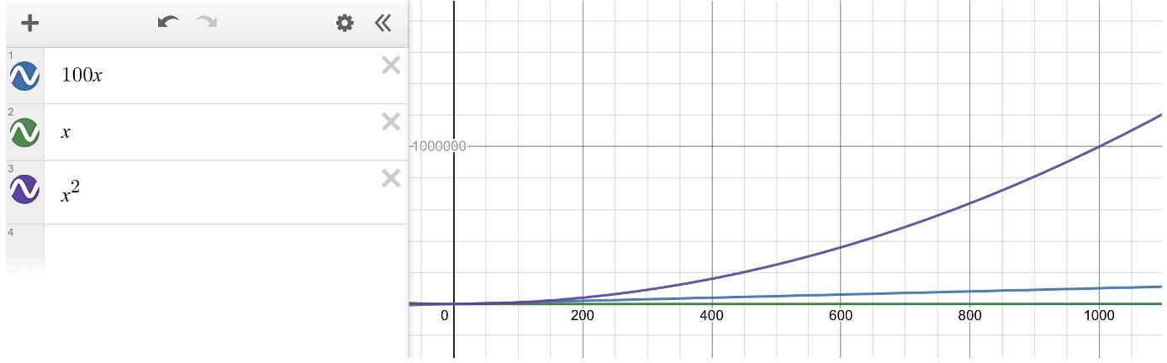
Why does c matter?
E.g. 100x is O(x), but x is always smaller
Functions that “grow at the same rate” (e.g. linear) are big-O of each other, so we can multiply them by constants to compensate
Coefficients in functions do not matter for big-O!

Slide 38
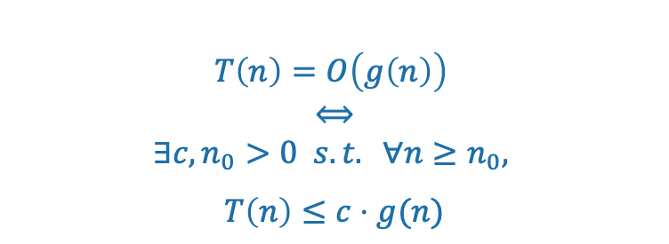
T(n) = 2n² + 10
g(n) = n²

Slide 39
3g(n) = 3n²
(c=3)
T(n) = 2n² + 10
g(n) = n²

Slide 40
n₀=4
3g(n) = 3n²
(c=3)
T(n) = 2n² + 10
g(n) = n²

Slide 41

n₀=4
Formally:
Choose c = 3
Choose n₀ = 4
Then:
3g(n) = 3n²
T(n) = 2n² + 10
g(n) = n²

Slide 42
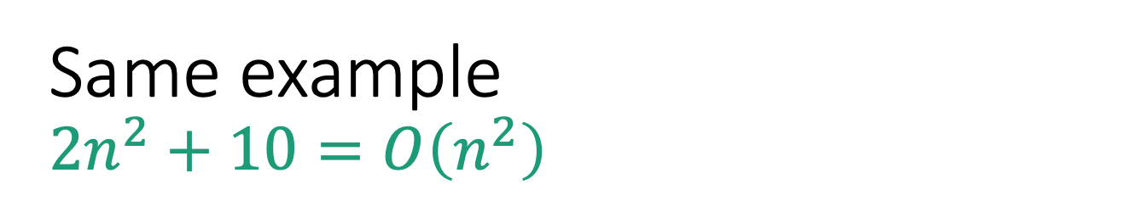
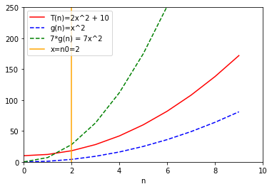

Formally:
Choose c = 7
Choose n₀ = 2
Then:
7g(n) = 7n²
T(n) = 2n² + 10
g(n) = n²
There is not a “correct” choice of c and n₀
n₀=2

Slide 43
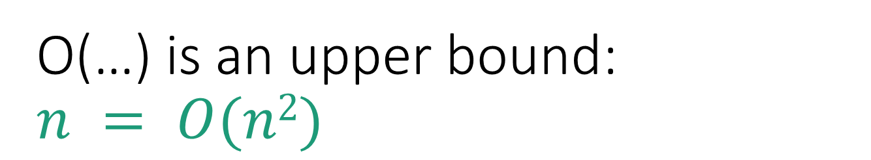
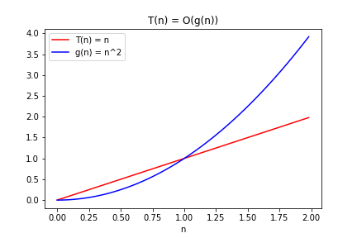
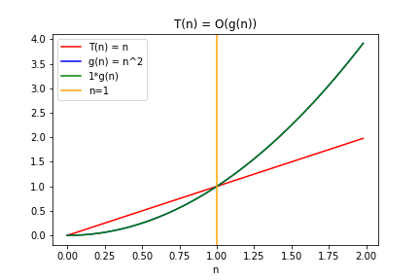

g(n) = n²
Choose c = 1
Choose n₀ = 1
Then
T(n) = n

Slide 44
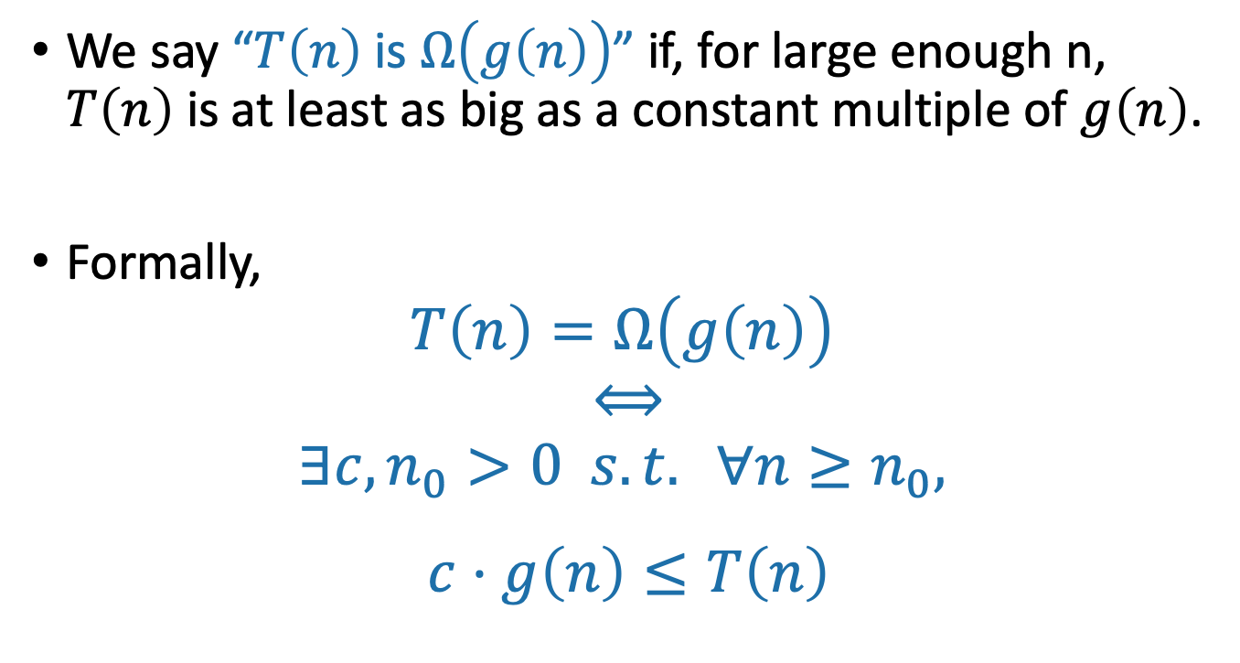
Ω(…) means a lower bound
Switched these!!

Slide 45


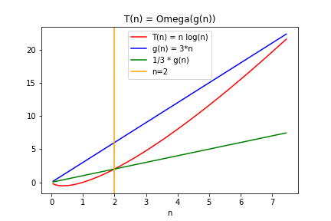
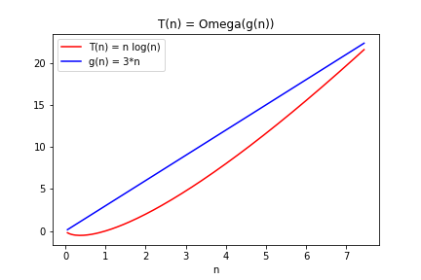
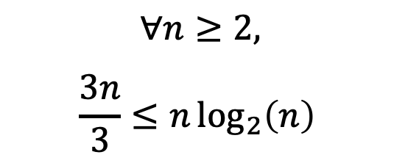
g(n) = 3n
Choose c = 1/3
Choose n₀ = 2
Then
T(n) = nlog(n)
g(n)/3 = n

Slide 46
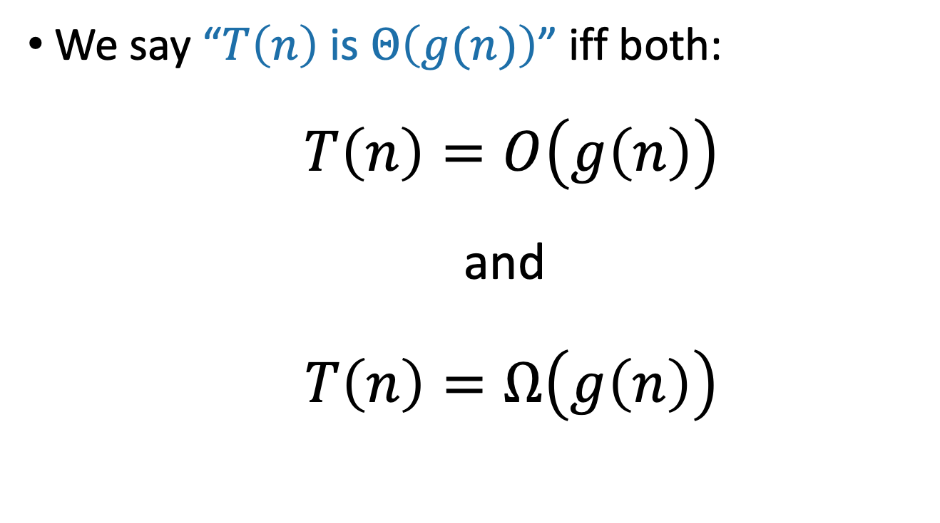
Θ(…) means both!

Slide 47

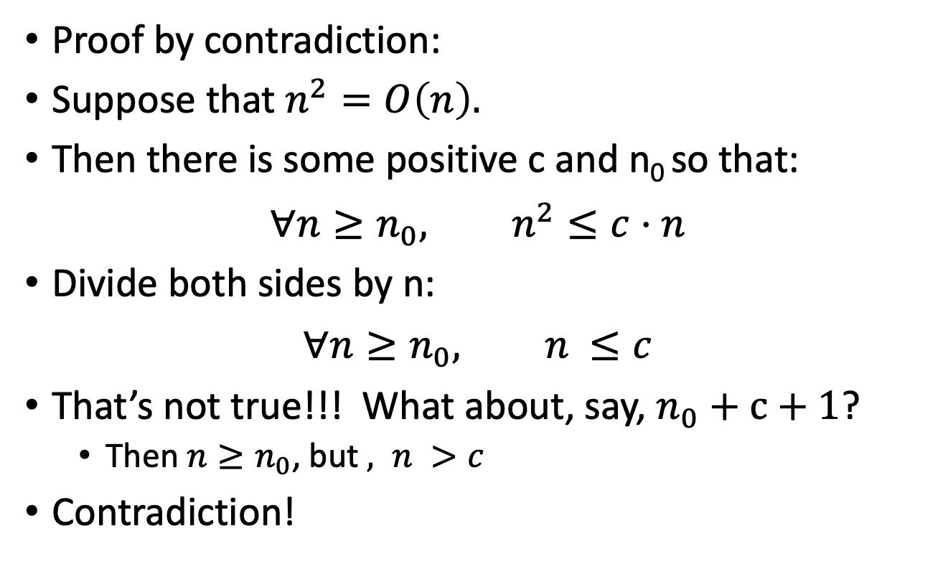

Slide 48
Take-away from examples
To prove T(n) = O(g(n)), you have to come up with c and n₀ so that the definition is satisfied.
To prove T(n) is NOT O(g(n)), one way is proof by contradiction:
Suppose (to get a contradiction) that someone gives you a c and an n₀ so that the definition is satisfied.
Show that this someone must by lying to you by deriving a contradiction.

Slide 49
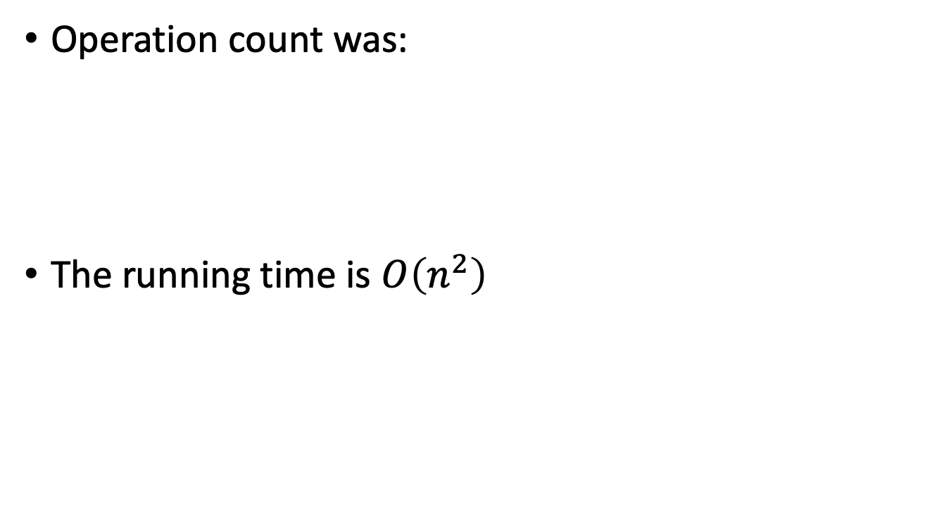
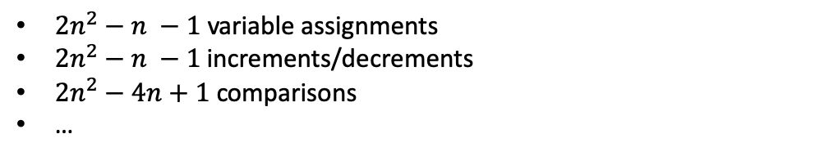
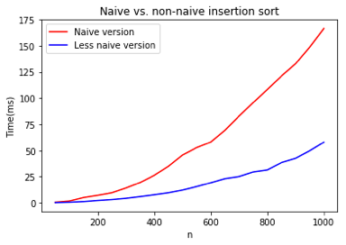

Back to Insertion Sort
Go back to the pseudocode and convince yourself of this!
Seems plausible

Slide 50
Merge Sort: running time
Size n
Level 0
n/2
n/2
Level 1
n/4
n/4
n/4
n/4
sub-problem each takes O(n/2^{t})
…
Level t
2^{t} subproblems at level t.
n/2^{t}
n/2^{t}
n/2^{t}
n/2^{t}
n/2^{t}
n/2^{t}
…
(Size 1)
Level log(n)

Slide 51
Total runtime…
O(n) steps per level, at every level
log(n) + 1 levels
O( n log(n) ) total!
Asymptotically better than Insertion Sort!

Slide 52
Any questions?

