Slide 1
CS 161 - Section 2
CA : [Name of the CA]

Slide 2
Section 2 agenda
Recurrence Relations
Master Theorem
Substitution Method
Select
Space Complexity

Slide 3
Recurrence Relations

Slide 4
Recurrence Relations
We explored the power of Divide and Conquer
breaking a big problem into a collection of smaller problems
combining solutions
We usually perform this breaking recursively until a base case is reached

Slide 5
Recurrence Relations
Advantage: smaller problems are easier to solve!
Disadvantage: how do we reason about runtime?
Might only know runtime of subproblems relative to the bigger problem
We can know “subproblems can be solved twice as fast as the big problem” but won’t know what the big problem runtime is

Slide 6
Recurrence Relations
T(n) = 2*T(n/2) + O(n)
we break down the problem runtime T(n) into what we call a “recurrence relation”
T(n) = 2*T(n/2) + O(n)
T(n) = 2*[2*T(n/4) + O(n)] + O(n)
T(n) = 2*[2*[2*T(n/8) + O(n)]+ O(n)] + O(n)

Slide 7
Recurrence Relations
When do we stop the recursive definition for T(n)?
Don’t know properties of n
Don’t know the exact levels of recursion
We resort to solving the recurrence relation directly!
Two methods:
Master Method
2. Substitution Method

Slide 8
Recurrence Relations
“Master Theorem” Method:
Closed form solution!
Easily applicable with knowledge of how the subproblems are formed
Doesn’t always work :(
Substitution Method:
Generalized method to solve recurrence relations
Requires more manual math
Always works! :D

Slide 9
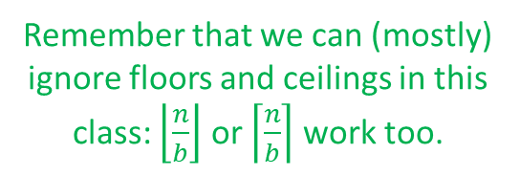
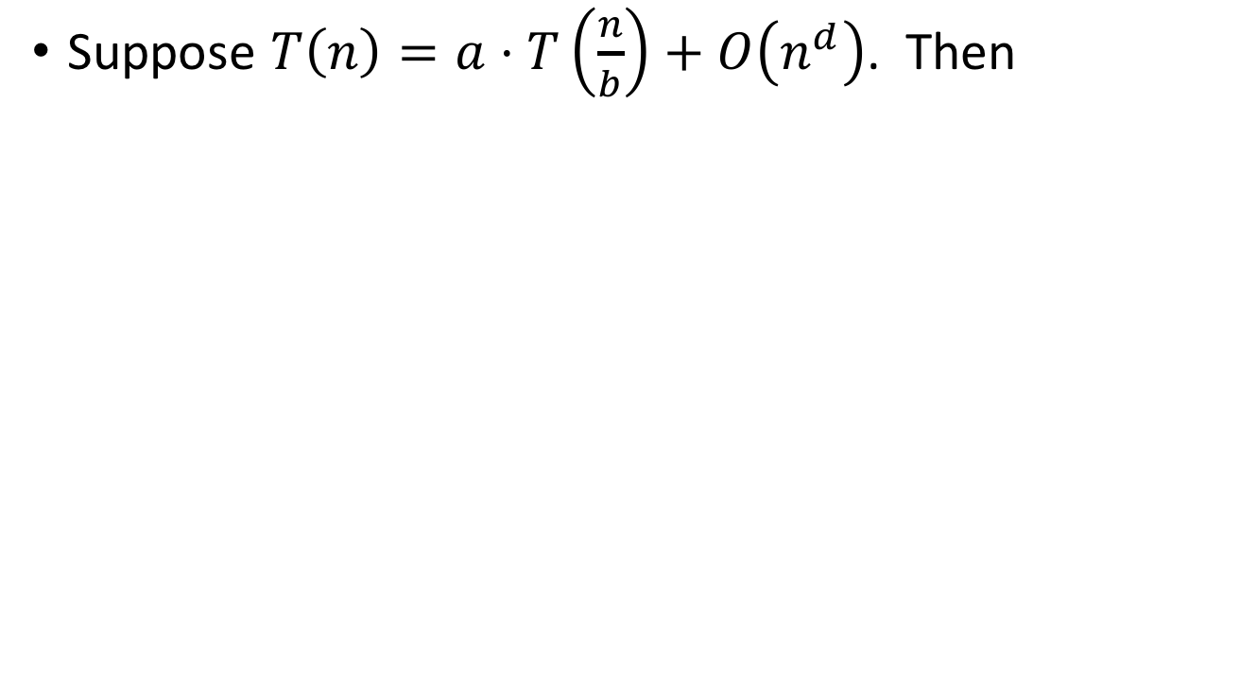
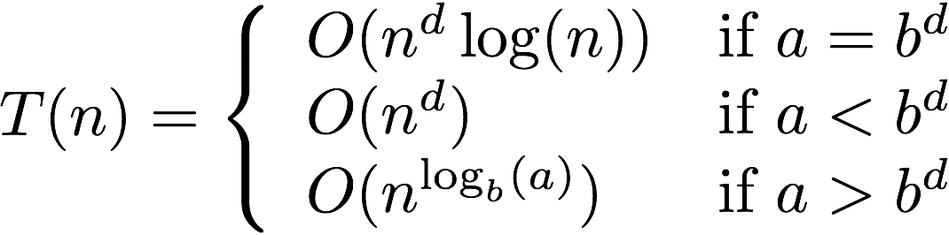
The Master Method
Three parameters:
a : number of subproblems
b : factor by which input size shrinks
d : need to do n^{d} work to create all the subproblems and combine their solutions.
Requires all subproblems to be the same size!

Slide 10
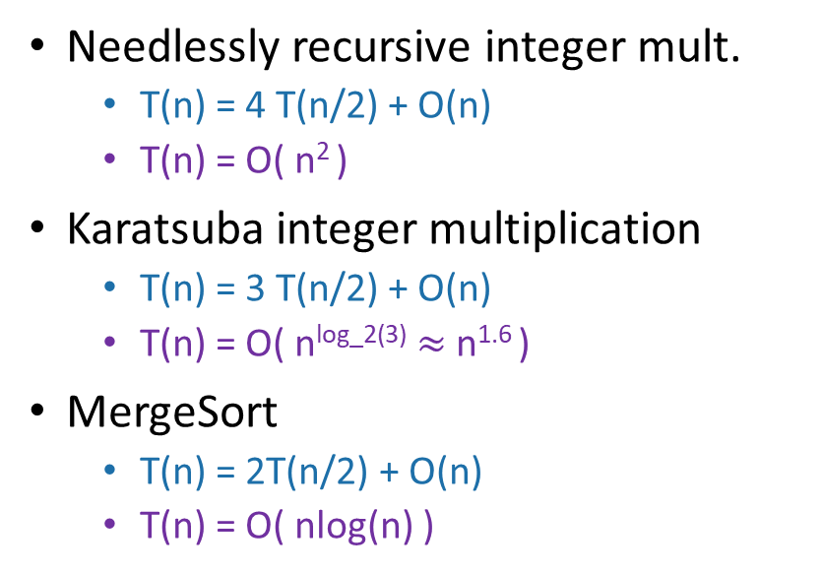
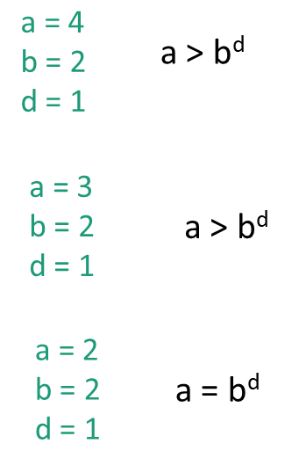

Slide 11
The Substitution Method
The Master Theorem is extremely convenient, but is in reality just a closed form solution to a calculation that could be made by hand
Substitution is the generalized procedure to solve any recurrence relation, even in cases when Master Theorem fails
Soon we will explore when MT fails

Slide 12
The Substitution Method
Guess what the answer is.
Try a few levels of recursion and see if you spot a pattern
Formally prove that that’s what the answer is.
Often using induction
From MT we know T(n) = 2*T(n/2) + n = O(n logn)
How do we show it without the MT?

Slide 13
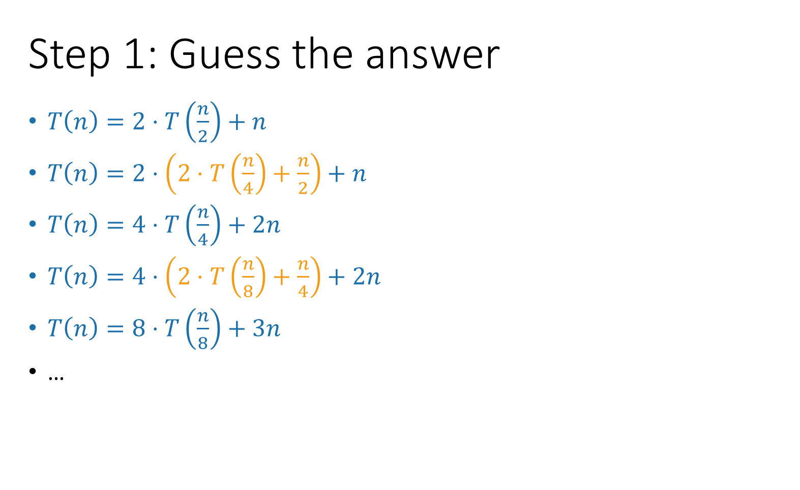
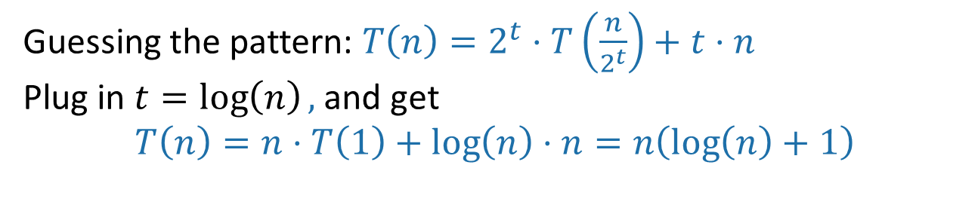
number of levels

Slide 14
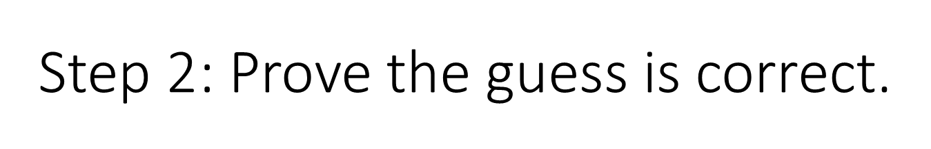
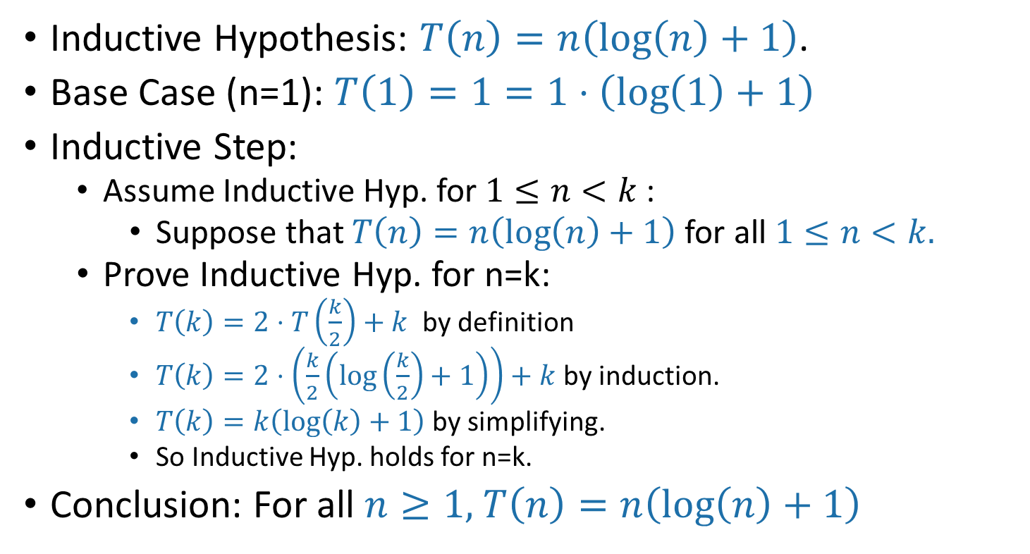

Slide 15
Select Algorithm

Slide 16
Main idea: Divide and Conquer
Merge sort – divide and conquer algorithm for sorting an array
SELECT – divide and conquer algorithm for finding the kth smallest element of an array
Big problem
Smaller problem
Smaller problem
Yet smaller problem
Yet smaller problem
Yet smaller problem
Yet smaller problem

Slide 17
SELECT
getPivot(A) returns some pivot for us.
Partition(A,p) splits up A into L, A[p], R.
Select(A, k):
If len(A) == 1:
Return A[0]
p = getPivot(A)
L, pivotVal, R = Partition(A,p)
if len(L) == k-1:
return pivotVal
Else if len(L) > k-1:
return Select(L, k)
Else if len(L) < k-1:
return Select(R, k – len(L) – 1)
Base Case: If A is a single element, this is our answer
Case 1: We got lucky and found exactly the k’th smallest value!
Case 2: The k’th smallest value is in the first part of the list
Case 3: The k’th smallest value is in the second part of the list

Slide 18
Partitioning
Say we want to find SELECT(A, k)
6
3
1
4
2
pivot
9
8
L = array with things smaller than A[pivot]
R = array with things larger than A[pivot]
If k = 5 = len(L) + 1:
We should return A[pivot]
If k < 5:
We should return SELECT(L, k)
If k > 5:
We should return SELECT(R, k – 5)
Partitioning like this takes time O(n) since we don’t care about sorting each half.

Slide 19
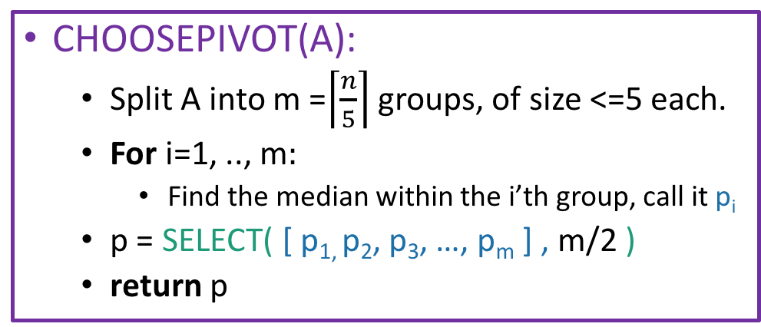
Choosing the pivot
This takes time O(1), for each group, since each group has size 5. So that’s O(m)=O(n) total in the for loop.
1
8
9
3
15
5
9
1
3
4
12
2
1
5
20
15
13
2
4
6
12
1
15
22
3
8
4
5
6
12
Pivot is SELECT( , 3 ) = 6:
1
8
9
3
15
5
9
1
3
4
12
2
1
5
20
15
13
2
4
6
12
1
15
22
3
PARTITION around that 6:
6
1
3
5
1
3
4
2
1
2
4
1
3
5
8
9
15
9
12
20
15
13
12
15
22
This part is L
This part is R: it’s almost the same size as L.

Slide 20
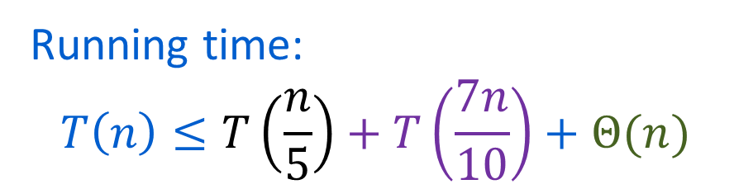
SELECT
getPivot(A) returns some pivot for us.
How?? Median of sub-medians!
Partition(A,p) splits up A into L, A[p], R.
Select(A,k):
If len(A) <= 50:
A = MergeSort(A)
Return A[k-1]
p = getPivot(A)
L, pivotVal, R = Partition(A,p)
if len(L) == k-1:
return pivotVal
Else if len(L) > k-1:
return Select(L, k)
Else if len(L) < k-1:
return Select(R, k – len(L) – 1)
Base Case: If the len(A) = O(1), then any sorting algorithm runs in time O(1).
Case 1: We got lucky and found exactly the k’th smallest value!
Case 2: The k’th smallest value is in the first part of the list
Case 3: The k’th smallest value is in the second part of the list

Slide 21
Why 70%/30% split worst case?
The most lopsided split that can happen after partitioning around the median of medians is 70/30.
102
104
106
108
17
22
27
101
103
105
107
16
21
26
At least ⅗ of each group is <= the group’s median.
3
6
9
12
15
20
25
2
5
8
11
14
19
24
1
4
7
10
13
18
23
If we group into groups of 5 and sort by the groups’ medians, the gray stuff (at least ⅗ * ½ = 3/10) all lies in one side of the partition.
At least ½ of the groups have medians <= pivot

Slide 22
Space Complexity

Slide 23
Warm-up
How many bits do you need to store a number between 1 and n?
Answer is log(n), since k bits can represent all numbers between 1 and 2^{k}
How many digits do you need to represent that same number?
log₁₀(n)
What about base-r digits?
log_{r}(n)
Keep this in the back of your mind for Week 3!

Slide 24
Space complexity of an algorithm
Definition: the space complexity of an algorithm is how much memory the algorithm needs to run, excluding the input and output.
Expressed as a function of input size
Could vary based on language, compiler, etc. Big-O notation!

Slide 25
Example: Insertion Sort
def InsertionSort(A):
for i in range(1,len(A)):
current = A[i]
j = i-1
while j >= 0 and A[j] > current:
A[j+1] = A[j]
j -= 1
A[j+1] = current
4
6
3
8
5
3
4
6
8
5
Input: array of size n
All operations are done in-place. No extra space needed
Space complexity = O(1)

Slide 26
Example: Merge sort
6
4
3
8
1
5
2
7
6
4
3
8
1
5
2
7
3
4
6
8
1
2
5
7
MERGE!
1
2
3
4
5
6
7
8

Slide 27
Example: Merge sort
Merging two arrays of size k/2 into a new array of size k requires extra space of size k
The top level of merge sort needs space n, so merge sort has space complexity O(n)
Merge sort has log(n) levels of merges, why is it not n log(n)?
Can we do better?

Slide 28
In-place merging
3
4
6
8
1
2
5
7
If the left element is smaller, move the left pointer to the right.
If the right element is smaller, move it to the position of the left element and shift everything in between to the right. Then move both pointers to the right.
Now requires no extra space => space complexity is O(1)!

Slide 29
In-place merging
What happened to time complexity?
“Shift everything to the right” is O(n), in the worst case we need to do it O(n) times
This merge takes time O(n²)!
Often there is a trade-off between time and space complexity.
In what situations is having a small space complexity more important?

Slide 30
Recap
Space complexity = amount of extra space needed to run an algorithm, excluding the input and output
Often there is a trade-off between time and space complexity.

