Slide 1
CS 161 - Section 3
CA : [Name of the CA]

Slide 2
Section 3 agenda
Review:
Halfway to the midterm, progress check (Kahoot!)
Randomized Algorithms
Quick Sort
Handout

Slide 3
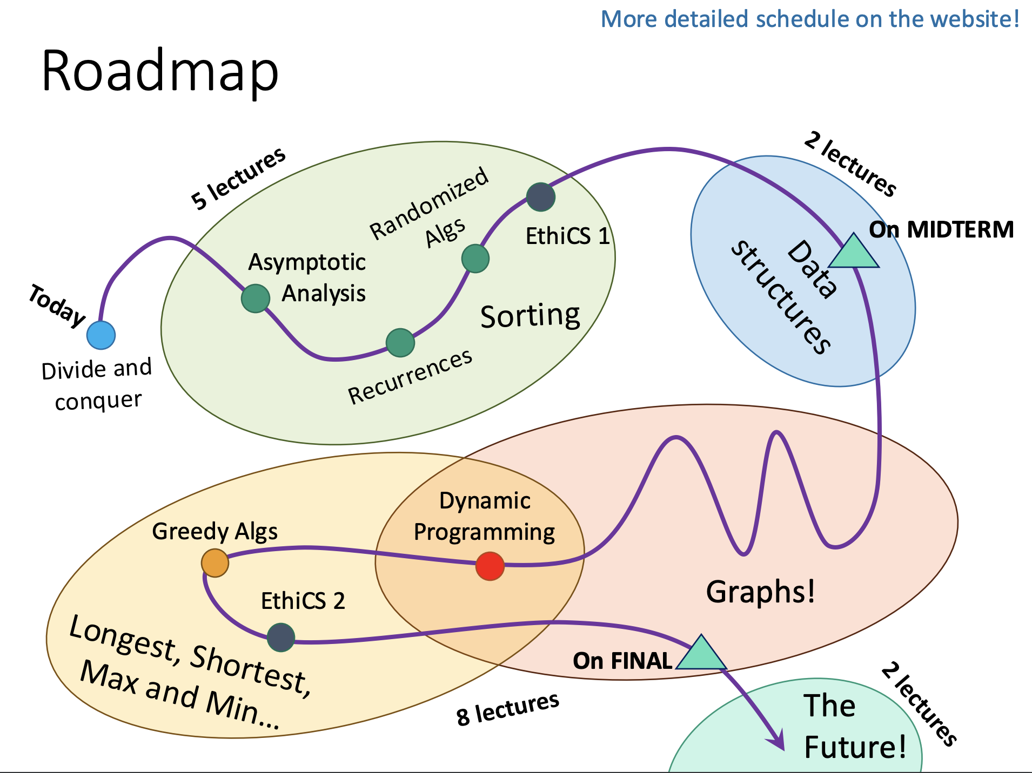
We are here!

Slide 4
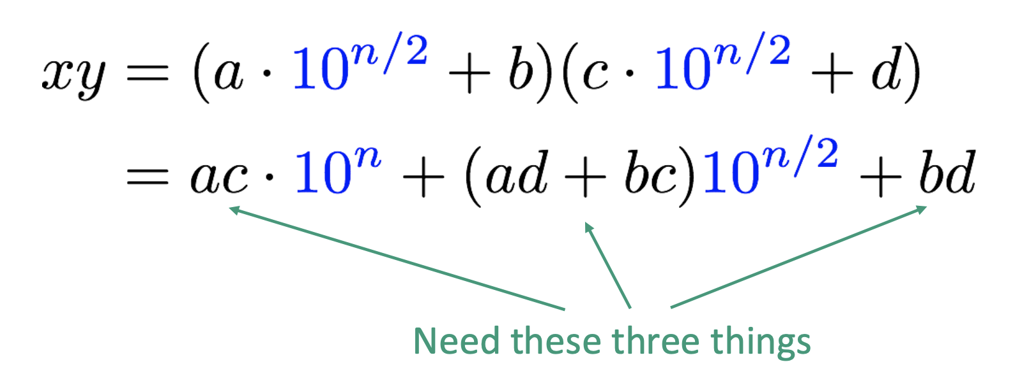
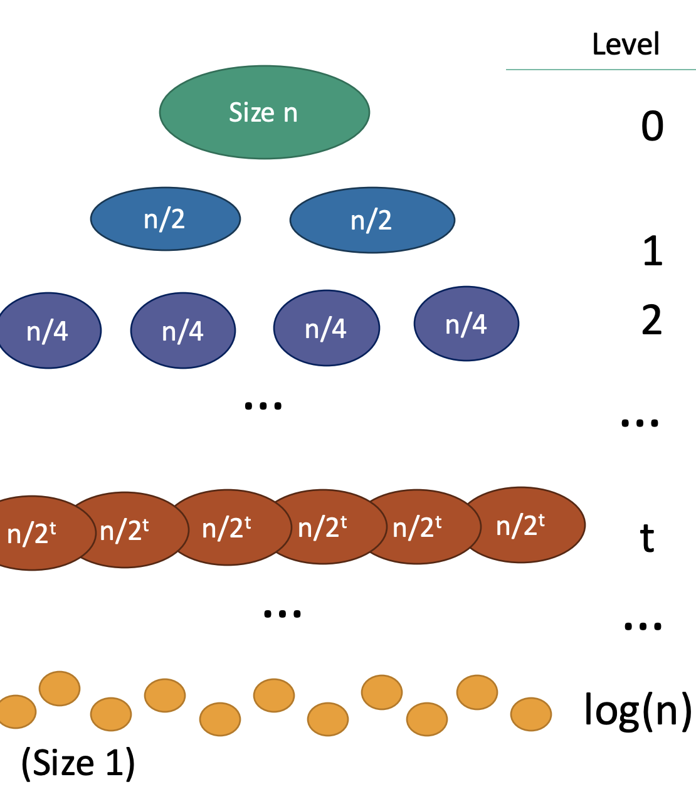
Lectures 1-4 Review
Lecture 1:
Divide and Conquer
Karatsuba
Lecture 2:
Sorting: Does it work / is it fast?
InsertionSort
Big O/Omega/Theta
MergeSort
Recursion Tree Analysis

Slide 5
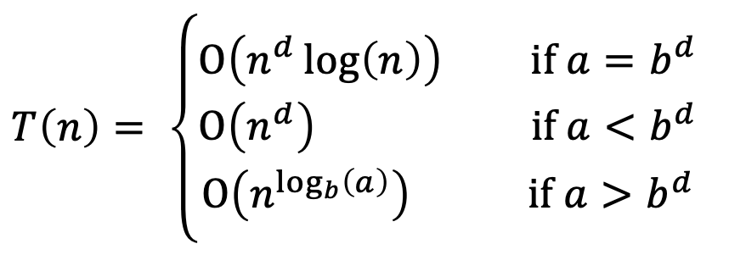
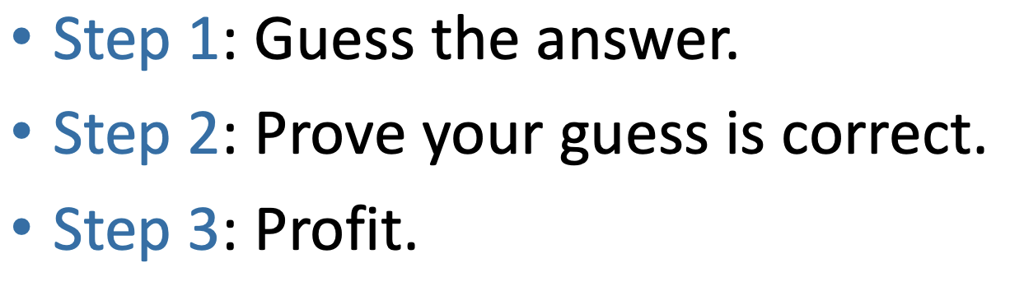
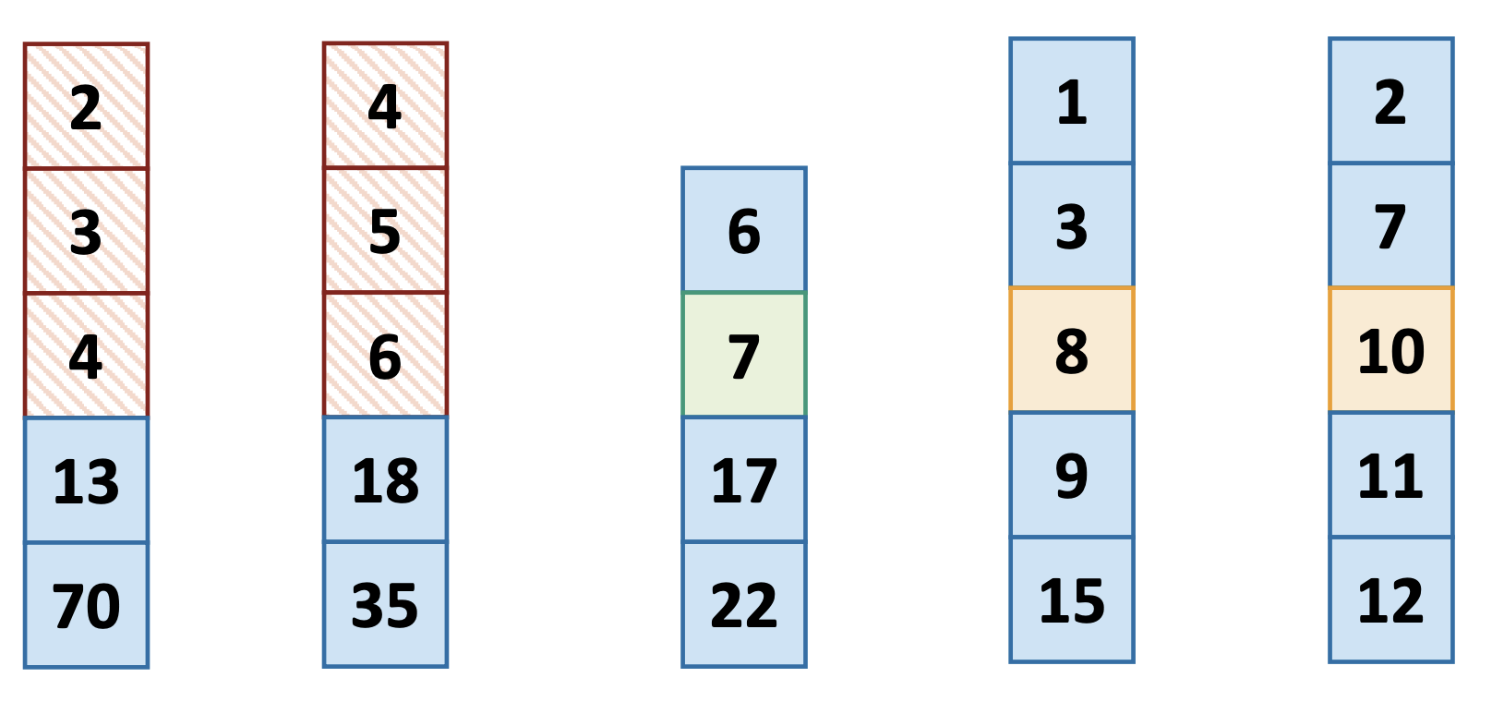
Lectures 1-4 Review
Lecture 3:
Recurrence Relations
Master Theorem
Geometric Series
Substitution Method
Lecture 4:
k-SELECT
Pivot matters
Median of Medians

Slide 6

Lectures 1-5 Kahoot
https://create.kahoot.it/share/section-3-fun/83bd9a91-ddfc-4c0d-9c3e-bd2443a43036

Slide 7

Randomized Algorithms

Slide 8
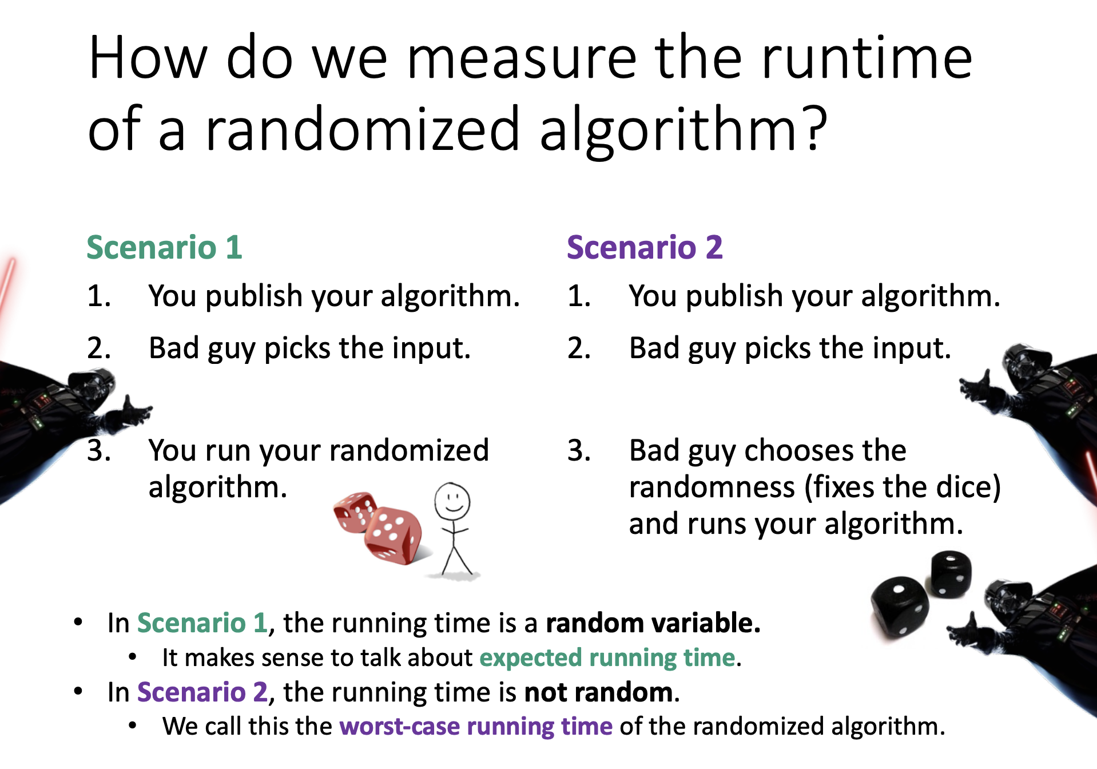

Slide 9
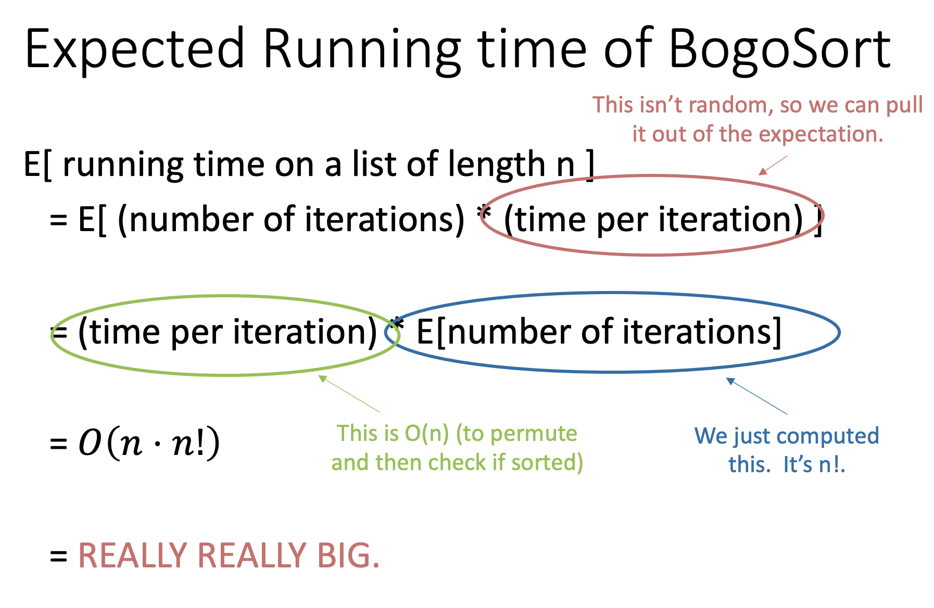
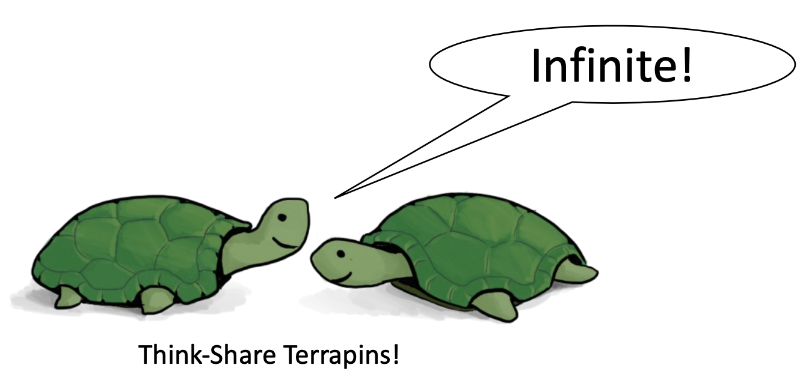

Slide 10
A Better Randomized Algorithm
SELECT – divide and conquer algorithm for finding the kth smallest element of an array
Quick Sort (NEW) – divide and conquer algorithm for sorting an array
Big problem
Smaller problem
Smaller problem
Yet smaller problem
Yet smaller problem
Yet smaller problem
Yet smaller problem

Slide 11
SELECT Recap
getPivot(A) returns some pivot for us.
Partition(A,p) splits up A into L (elements <= A[p]), A[p], R (elements > A[p])
Partition takes time O(n) since we don’t care about sorting each half
Select(A,k):
If len(A) <= 50:
A = MergeSort(A)
Return A[k-1]
p = getPivot(A)
L, pivotVal, R = Partition(A,p)
if len(L) == k-1:
return pivotVal
Else if len(L) > k-1:
return Select(L, k)
Else if len(L) < k-1:
return Select(R, k – len(L) – 1)
Base Case: If the len(A) = O(1), then any sorting algorithm runs in time O(1).
Case 1: We got lucky and found exactly the k’th smallest value!
Case 2: The k’th smallest value is in the first part of the list
Case 3: The k’th smallest value is in the second part of the list

Slide 12
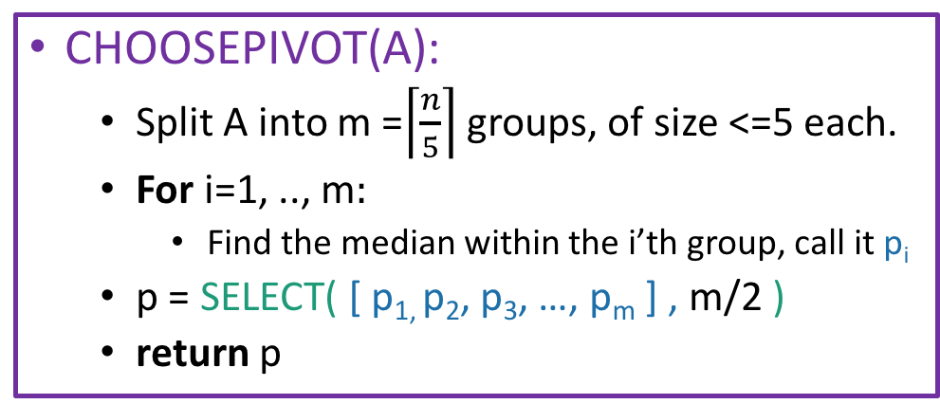
Choosing the pivot
8
This takes time O(1), for each group, since each group has size 5. So that’s O(m)=O(n) total in the for loop.
4
5
9
1
3
4
12
2
1
5
20
12
1
15
22
3
1
8
9
3
15
5
15
13
2
4
6
6
8
4
5
6
12
Pivot is SELECT( , 3 ) = 6:
12
12
2
1
5
20
6
1
8
9
3
15
5
9
1
3
4
15
13
2
4
12
1
15
22
3
PARTITION around that 6:
6
1
3
5
1
3
4
2
1
2
4
1
3
5
8
9
15
9
12
20
15
13
12
15
22
This part is L
This part is R: it’s almost the same size as L.

Slide 13
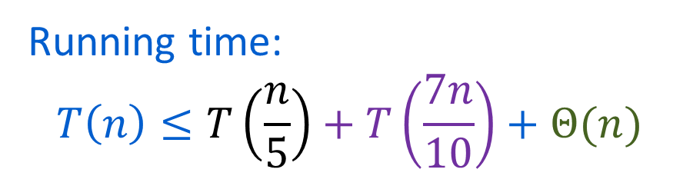
SELECT
getPivot(A) returns some pivot for us.
How?? Median of sub-medians!
Partition(A,p) splits up A into L, A[p], R.
Select(A,k):
If len(A) <= 50:
A = MergeSort(A)
Return A[k-1]
p = getPivot(A)
L, pivotVal, R = Partition(A,p)
if len(L) == k-1:
return pivotVal
Else if len(L) > k-1:
return Select(L, k)
Else if len(L) < k-1:
return Select(R, k – len(L) – 1)
Base Case: If the len(A) = O(1), then any sorting algorithm runs in time O(1).
Case 1: We got lucky and found exactly the k’th smallest value!
Case 2: The k’th smallest value is in the first part of the list
Case 3: The k’th smallest value is in the second part of the list

Slide 14
Why 70%/30% split worst case?
The most lopsided split that can happen after partitioning around the median of medians is 70/30.
102
104
106
108
17
22
27
101
103
105
107
16
21
26
At least ⅗ of each group is <= the group’s median.
3
6
9
12
15
20
25
2
5
8
11
14
19
24
1
4
7
10
13
18
23
If we group into groups of 5 and sort by the groups’ medians, the gray stuff (at least ⅗ * ½ = 3/10) all lies in one side of the partition.
At least ½ of the groups have medians <= pivot

Slide 15
Quick Sort

Slide 16
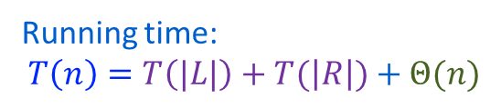
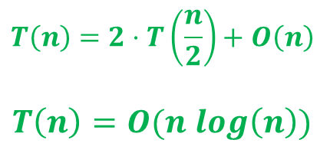
QuickSort
QuickSort(A):
If len(A) <= 1:
return
Pick pivot x with pivot
PARTITION the rest of A into:
L (less than x) and
R (greater than x)
Rearrange A as [L, x, R]
QuickSort(L)
QuickSort(R)

Slide 17
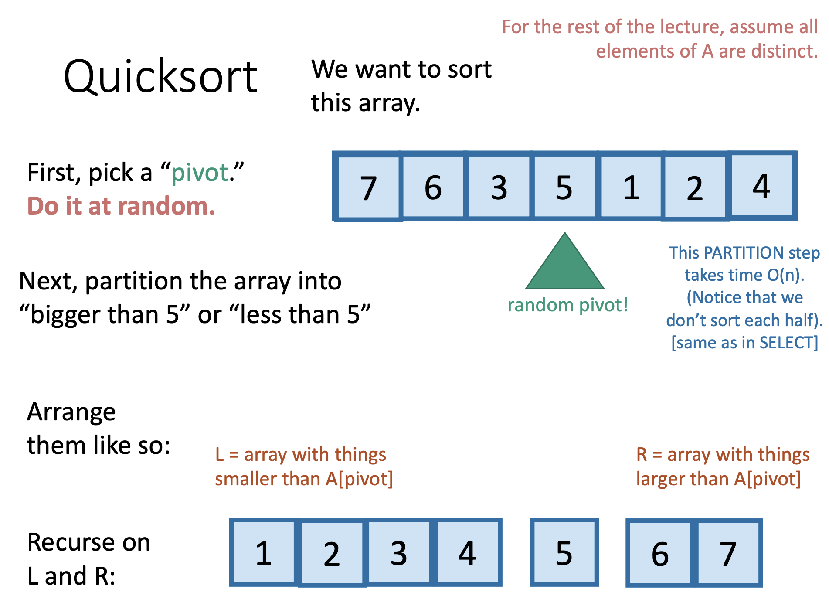

Slide 18
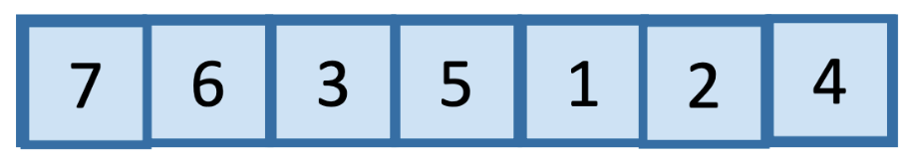

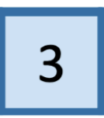
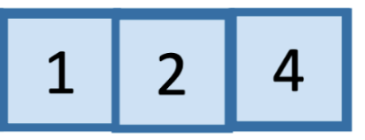
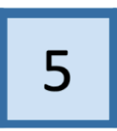
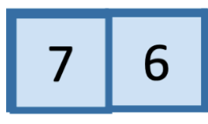
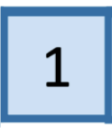
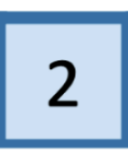
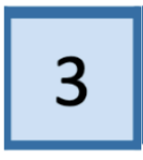
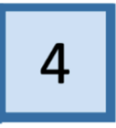
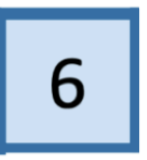
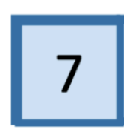
L
Pivot
R

Slide 19

L
Pivot
R

Slide 20
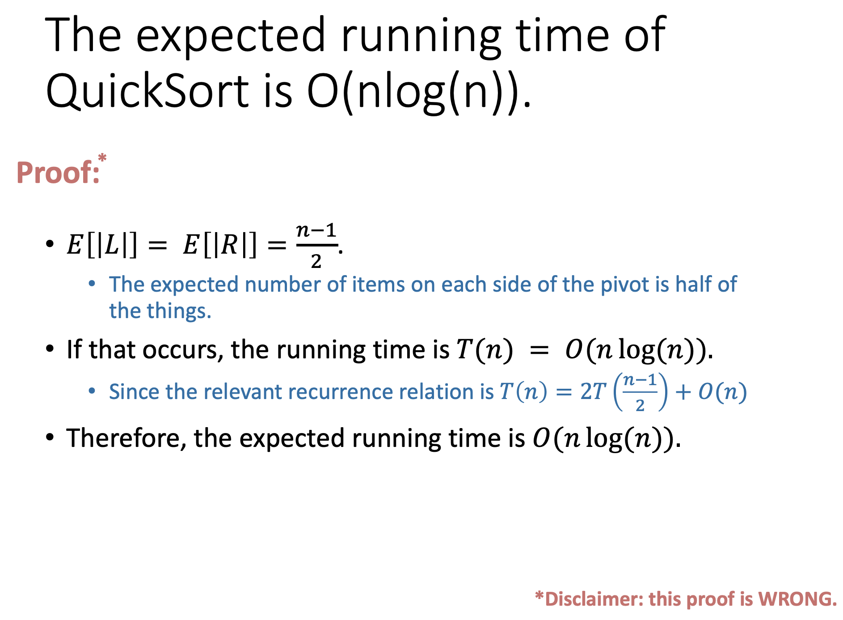


Slide 21
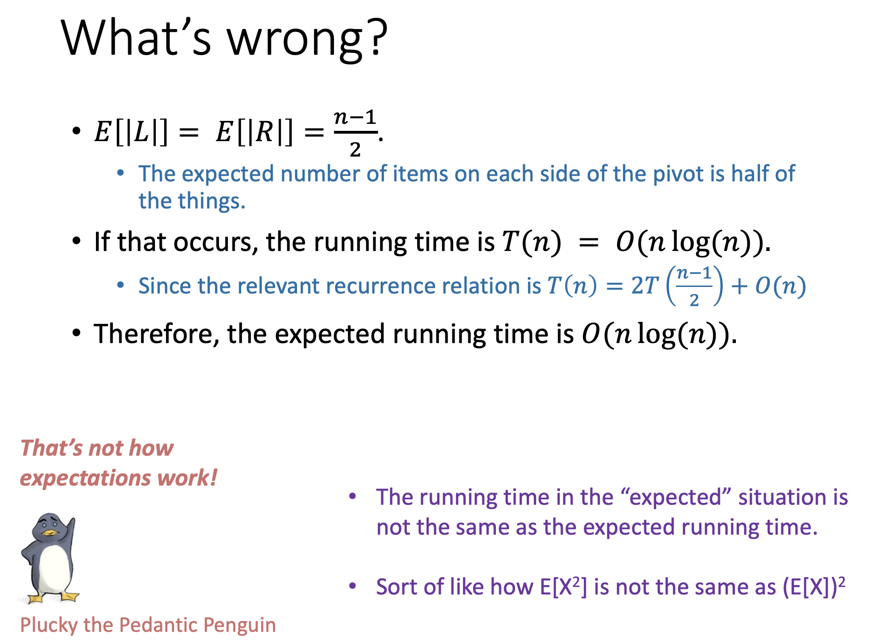


Slide 22
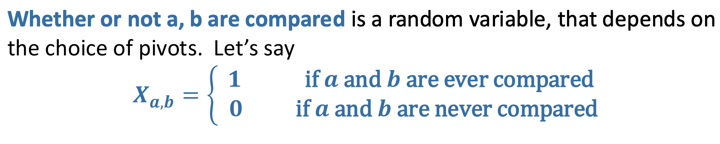
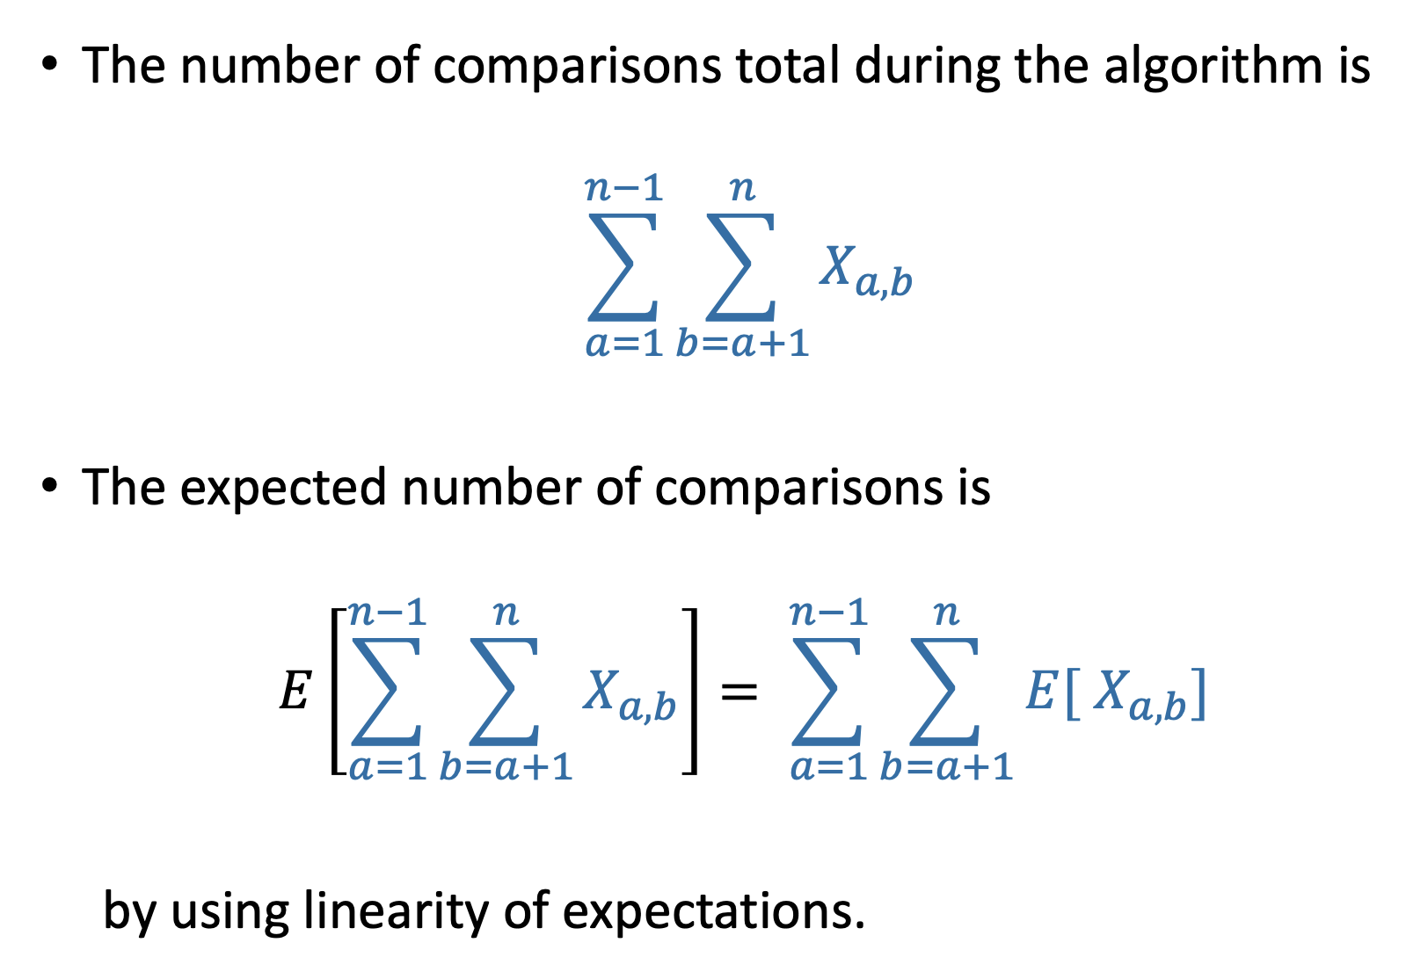
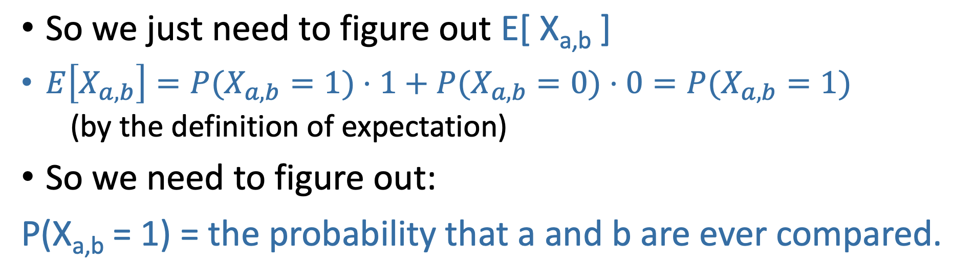
Instead, let’s count comparisons

Slide 23
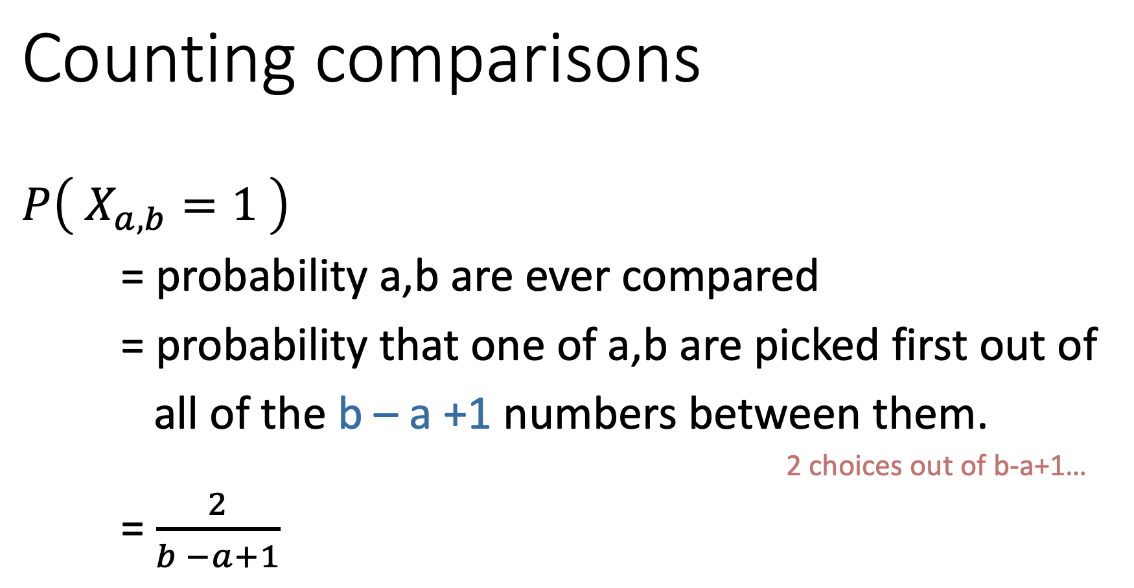
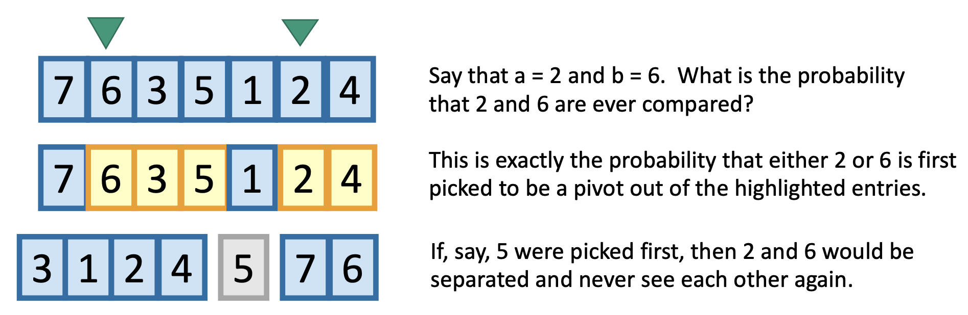

Slide 24
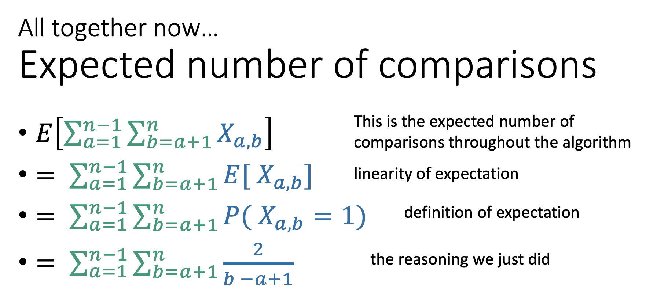
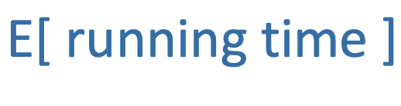

So

Slide 25
Space complexity of QuickSort
Definition: the space complexity of an algorithm is how much memory the algorithm needs to run, excluding the input and output.

Slide 26
Space complexity of QuickSort
Recall the Naïve memory complexity of Quick Sort is O(n logn)
Why? Think about storing an ordering of n elements for log(n) levels
We can improve it to O(n)
Why? Can use a single array to represent the ordering and update at each level
Can we do even better?
Let these happy Hungarians show you the answer!
https://www.youtube.com/watch?v=ywWBy6J5gz8&ab_channel=AlgoRythmics

Slide 27

Dance Demonstration
https://www.youtube.com/watch?v=ywWBy6J5gz8

Slide 28
In-Place [O(1) memory!] Partition for Quick Sort
Pivot
8
7
1
3
5
6
4
Choose it randomly, then swap it with the last one, so it’s at the end.
8
7
1
3
5
6
4
Initialize and
Swap!
Step forward.
1
7
8
3
5
6
4
When sees something smaller than the pivot, swap the things ahead of the bars and increment both bars.
1
3
8
7
5
6
4
1
3
8
7
5
6
4
Repeat till the end, then put the pivot in the right place.
1
3
4
7
5
6
8

Slide 29
Quick Sort vs Merge Sort
 | QuickSort (random pivot) | MergeSort (deterministic)
Running time | Worst-case: O(n²) Expected: O(n log(n)) | Worst-case: O(n log(n))
In-Place? (With O(1) extra memory) | Yes, can be implemented in-place (relatively) easily | Not as easily since you’d have to sacrifice stability and runtime, but it can be done
Stable? | No | Yes
stable sorting algorithms sort identical elements in the same order as they appear in the input

Slide 30
Quick Sort vs Merge Sort
Which one would you use for a small array?
Given the small size it mostly does not matter. At this scale the difference will be in the order of ns or µs, so the only way to be sure which is better is to write implementations and test it in practice. In fact, insertion sort can often be the fastest for very small arrays.
Which one would you use for an array with millions of elements?
Because for large n the Law of Large Numbers kicks in, we can reasonably expect both algorithms to run in O(n log n). It then becomes a choice between stability and memory overhead.
Which one would you use in a security-critical situation?
We value the predictability and consistency of a deterministic algorithm in these situations, so merge sort would be preferred. Some pitfalls of quicksort are:
Randomized algorithms are harder to log, debug, and reproduce than deterministic algorithms.
If an adversary can guess which seed you start with, they may be able to craft a worst-case n^2 input!

Slide 31
Handout!

Slide 32


Handout Problem 2 - Adaptivity
Algorithm
1
5
9
2
3
3
1
?
4
8
5
8
5
2
6
8
8
9
8
6
8
4
9
5
9

Slide 33
Handout Problem 2 - Adaptivity
Algorithm
1
5
9
2
3
3
1
4
8
5
8
Step 1
Step 2
Step 3
…
Step K
5
2
6
8
8
9
8
6
8
4
9
5
9

Slide 34




Handout Problem 2 - Adaptivity
Algorithm
1
5
9
2
3
Stage 1
Stage 2
Stage 3
…
Stage K
3
1
4
8
5
Step 1
Step 1
Step 1
Step 1
5
8
2
Step 2
Step 2
Step 2
Step 2
6
8
…
…
…
…
8
9
8
6
8
4
9
5
9

Slide 35


Adaptivity Example – Insertion Sort
Insertion Sort
Step 1
Step 2
Step 3
Step K
5
1
9
5
5
5
…
1
3
3
9
9
3
2
5
1
3
3
9
3
9
1
1
1
4

Slide 36
Adaptivity Example – Insertion Sort
Insertion Sort
Stage 1
Stage 2
Stage 3
5
1
9
5
5
3
3
3
9
9
5
5
1
3
3
9
9
1
1
1

Slide 37
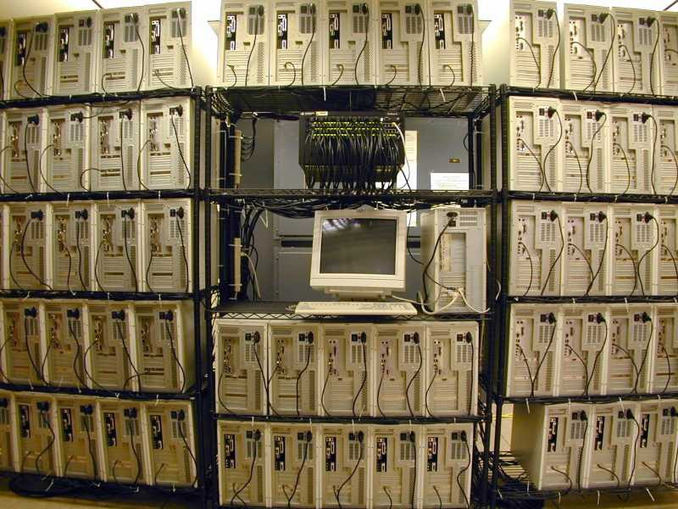
Why Adaptivity?
Long history of parallel computing dating as far back as the 60s
Adaptivity is a great model for understanding the parallel capabilities algorithms

Slide 38
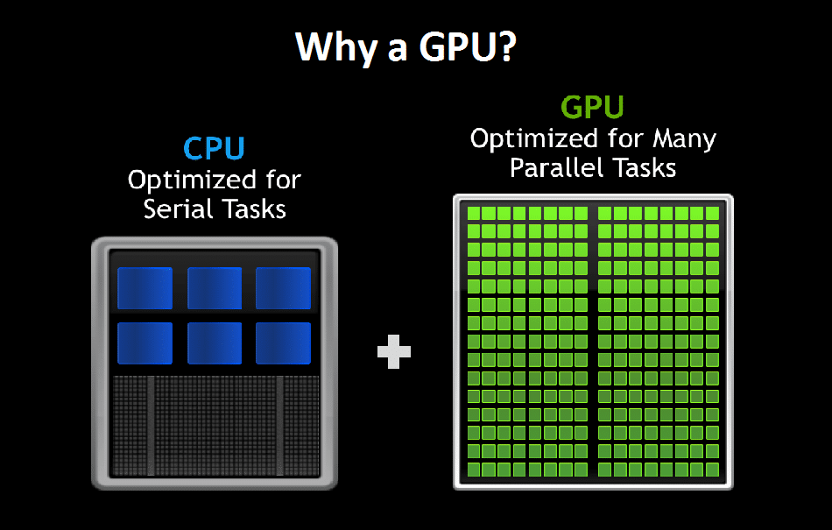
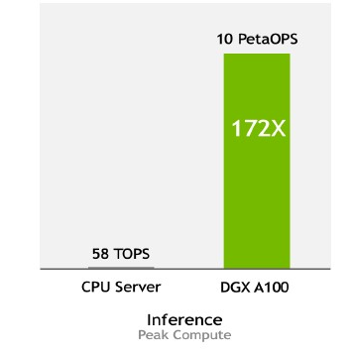
Why Adaptivity?
Large Language Model Inference

