Slide 1
CS161 Section 4
[CA Name]

Slide 2
Agenda
Recap Lecture
Comparison based sorting
Lower-bound on performance
Non-comparison based sorting
Bucket sort, radix sort
Tree data-structures
Heaps, binary trees, red-black trees
Handout

Slide 3
Comparison Based Sorting

Slide 4
Comparison-Based Sorting Algorithms
Intuition:
You want to sort an array of items
You can’t access items’ values directly: you can only compare two items and find out which is bigger or smaller
Examples:
MergeSort
InsertionSort
QuickSort

Slide 5
Lower bound of Ω(n log(n))
Theorem:
Any deterministic comparison-based sorting algorithm must take Ω(n log(n)) steps.
Any randomized comparison-based sorting algorithm must take Ω(n log(n)) steps in expectation.

Slide 6
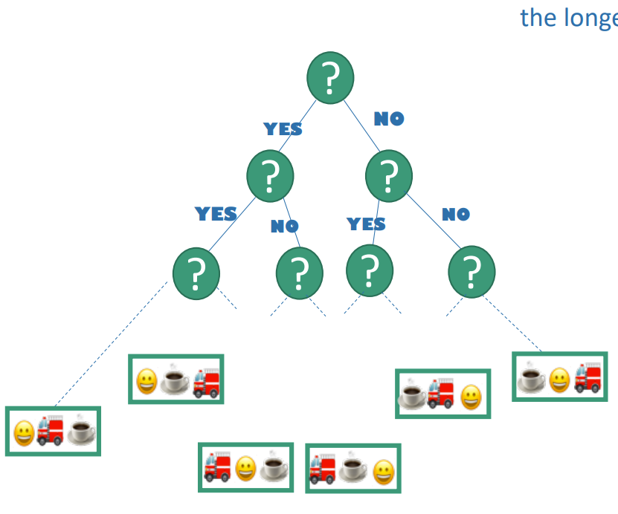
Lower bound of Ω(n log(n))
Proof Recap:
Any deterministic comparison-based algorithm can be represented as a decision tree with n! leaves.
The worst-case running time is at least the depth of the decision tree.
All decision trees with n! leaves have depth Ω(n log(n)).
So any comparison-based sorting algorithm must have worst-case running time at least Ω(n log(n)).

Slide 7
Non-Comparison Based Sorting

Slide 8
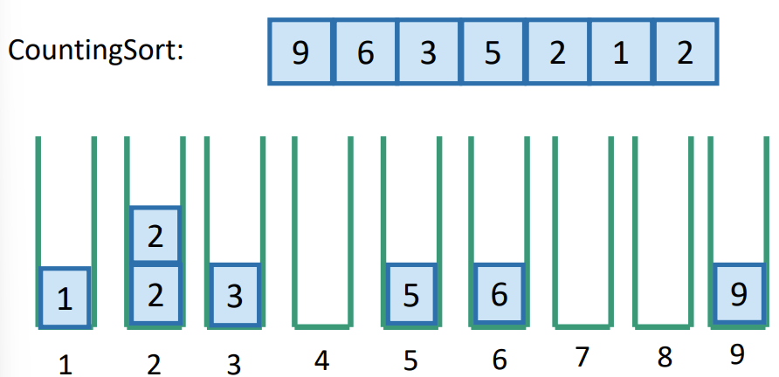
CountingSort
Implement the buckets as FIFO linked lists
Sorted in time O(n)
Why does this perform better than our lower bound on sorting?
Answer: It’s not comparison based!

Slide 9
RadixSort
Assumptions of CountingSort:
Assume we can evaluate the items directly, not just by comparison
Assume we know what values show up ahead of time
Assume there are not too many such values
Idea:
CountingSort on the least-significant digit first, then the next least-significant, and so on
Now we can sort integers up to size M
Can use less space than CountingSort!

Slide 10
Step1: CountingSort - least significant digit
21 | 345 | 13 | 101 | 50 | 234 | 1
1
101
50
21
13
234
345
0 1 2 3 4 5 6 7 8 9
50 | 21 | 101 | 1 | 13 | 234 | 345

Slide 11
Step2: CountingSort 2nd least significant digit
50 | 21 | 101 | 1 | 13 | 234 | 345
1
101
13
21
234
345
50
0 1 2 3 4 5 6 7 8 9
101 | 1 | 13 | 21 | 234 | 345 | 50

Slide 12
Step3: CountingSort 3rd least significant digit
101 | 1 | 13 | 21 | 234 | 345 | 50
50
21
13
1
101
234
345
0 1 2 3 4 5 6 7 8 9
1 | 13 | 21 | 50 | 101 | 234 | 345

Slide 13
RadixSort Running Time
Say we want to sort:
N integers, maximum size U – 1, in base r
Number of iterations:
d = ceil(log_r(U))
Time per iteration:
Initialize r buckets, put n items into them
O(n + r) total time
Total time
O(d * (n + r)) = O( ceil(log_r(U)) * (n + r))

Slide 14
Tree Data Structures

Slide 15
Heap
Definition:
A complete binary tree such that:
Every descendant of a node has key larger than that node
1
2
5
4
3
8
7

Slide 16
INSERT in a Heap
1
Example: insert 4.5
INSERT(key):
\\ insert to bottom of heap:
x = new_node()*
x.key = key
\\ ”bubble” up
While x.key < parent(x.key)
Swap keys of x and parent(x)
X = parent(x)
2
5
4
3
7
nil

Slide 17
EXTRACT-MIN in a Heap
1
EXTRACT-MIN():
x = root
min = x.key
\\ replace root w/last element
y = pointer to last node*
x.key = y.key
delete(y)
\\ ”bubble” down
While true
If left(x).key < x.key, right(x).key
Swap keys of x and left(x)
X = left(x)
Else-if right(x).key < x.key
Swap keys of x and right(x)
X = right(x)
Else
Return min
2
5
8
7
9

Slide 18
Complexity of Heap Operations
How long do these take?
INSERT / EXTRACT-MIN
O(1) for each swap up the tree
O(1) for each swap down the tree
In total: O(height) = O(log(n)) (equal since we are in a complete binary tree!)

Slide 19

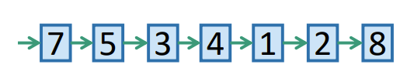
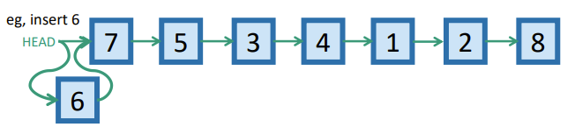
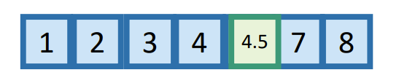
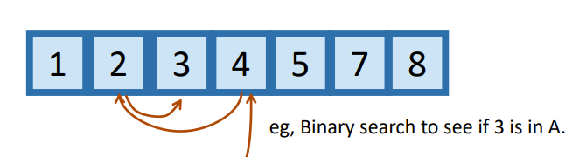
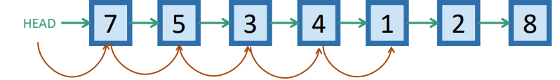
Data Structure Performance
SORTED ARRAYs
LINKED LISTS
O(n) INSERT/DELETE
Find relevant element, then move elements in the array (e.g. insert 4.5)
O(1) INSERT
Not necessarily sorted, can just add to HEAD
O(logn) SEARCH
Can use binary search (e.g. see if 3 is in A)
O(n) SEARCH/DELETE
Not necessarily sorted, so need to check each element. Can delete it by manipulating pointers once it’s found!

Slide 20
Binary Search Trees
Definition:
A binary tree such that:
Every LEFT descendent of a node has a key LESS than that node
Every RIGHT descendant of a node has a key LARGER than that node
5
3
7
2
4
8
1

Slide 21
SEARCH in a Binary Search Tree
5
Example: search for 4
3
7
How long does this take?
O(length of longest path) = O(height) = O(n)
2
4
8
1

Slide 22
INSERT/DELETE in Binary Search Tree
INSERT(key):
x = SEARCH(key)
INSERT a new node with desired key at x
DELETE(key):
x = SEARCH(key)
If x.key == key:
…delete x … (O(1))
What is the runtime for these operations?
SEARCH is the upper bound → O(n)

Slide 23
Red-Black Trees (Self-Balancing)
Idea:
Keep the tree relatively balanced
Rules:
Every node is red or black
Root node is a black node
NIL children count as black nodes
Children of red nodes are black nodes
For all nodes x:
All paths from x to NIL’s have the same number of black nodes on them
Notes:
TODO: add tree illustration

Slide 24
Red-Black Tree Examples
This is not a valid red-black tree because property 4 (children of a red node are black) is not satisfied
This is a valid red-black tree: all properties are satisfied (can you see why?)
5
5
3
7
3
7
2
2
1

Slide 25
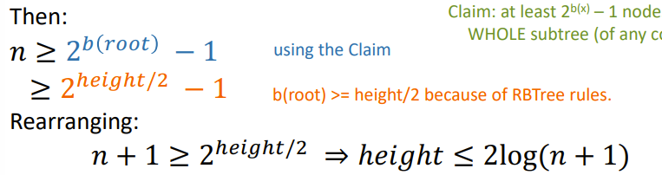
Red-Black Tree Height
The height of a RB-tree with n non-NIL nodes is at most 2log(n+1)
Define b(x) to be the number of black nodes in any path from x to NIL
Claim:
There are at least 2^{b(x)} – 1 non-NIL nodes in the subtree underneath x
Notes:
Should we show the proof for this?

Slide 26
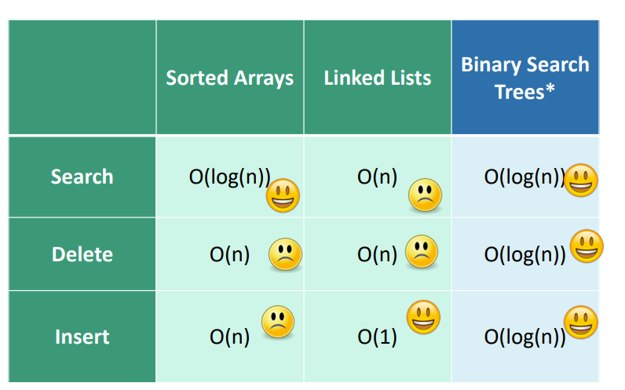
Running Time Comparison

Slide 27
Handout ☺

