Slide 1
CS 161 Section 5
CA: [name of CA]

Slide 2
Today’s Agenda
Recap
Hashing
Graph
DFS
BFS
Midterm
Handout

Slide 3
Hashing

Slide 4
This is a hash table (with chaining)
For demonstration purposes only!
This is a terrible hash function! Don’t use this!
Array of n buckets.
Each bucket stores a linked list.
We can insert into a linked list in time O(1)
To find something in the linked list takes time O(length(list)).
h:U → {1,…,n} can be any function:
but in this example for concreteness we let h(x) = least significant digit of x.
INSERT:
1
2
22
13
22
43
9
3
13
43
SEARCH 43:
…
Scan through all the elements in bucket h(43) = 3.
9
9
n buckets (say n=9)

Slide 5
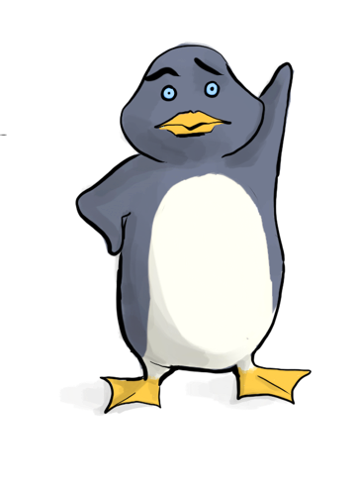
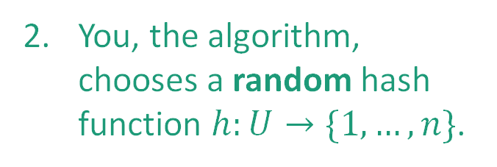

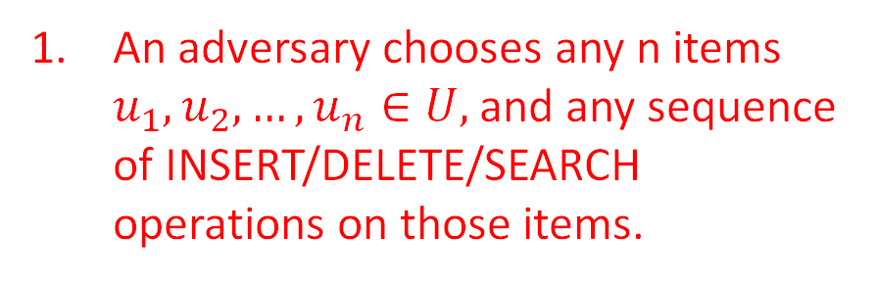
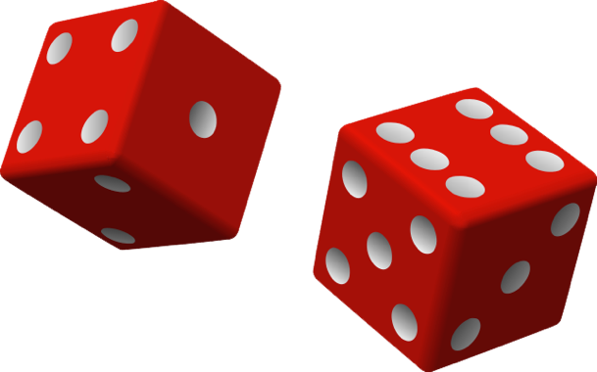

The game
What does random mean here? Uniformly random?
Plucky the pedantic penguin
HASH IT OUT
#hashpuns
13
22
43
92
7
1
43
INSERT 13, INSERT 22, INSERT 43, INSERT 92, INSERT 7, SEARCH 43, DELETE 92, SEARCH 7, INSERT 92
22
2
3
13
u_{j}
…
u_{k}
7
u_{i}
n
92

Slide 6
What if we have lots of collisions?
Solution: Randomness

Slide 7

Example
Universe U
h
n buckets
Say that h is uniformly random.
That means that h(1) is a uniformly random number between 1 and n.
h(2) is also a uniformly random number between 1 and n, independent of h(1).
h(3) is also a uniformly random number between 1 and n, independent of h(1), h(2).
…
h(n) is also a uniformly random number between 1 and n, independent of h(1), h(2), …, h(n-1).

Slide 8
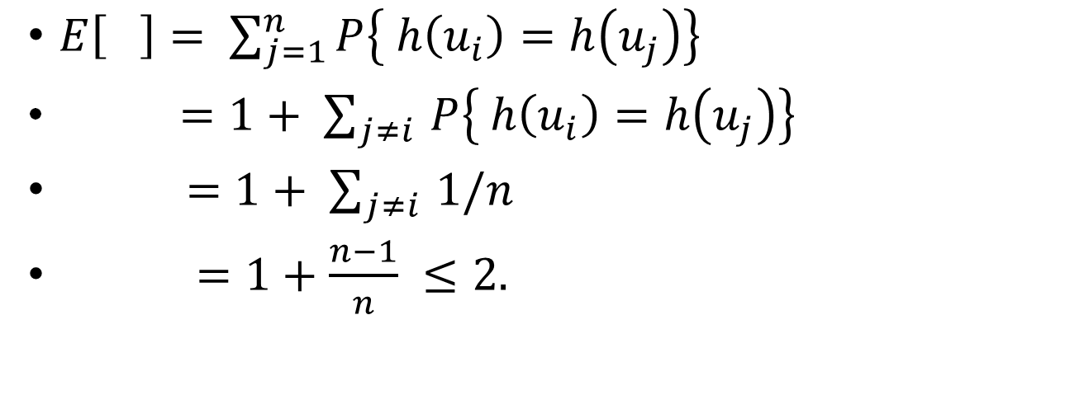

Expected number of items in u_{i}’s bucket?
h is uniformly random
That’s what we wanted.
Universe U
h
u_{k}
u_{i}
n buckets
u_{j}
u_{i}
u_{j}
COLLISION!

Slide 9
Expected number of items in u_{i}’s bucket?
All that we needed was that this is 1/n
Universe U
h
u_{k}
u_{i}
n buckets
u_{j}
u_{i}
u_{j}
COLLISION!

Slide 10
From the previous slide: How to pick Hash function with low collision?
Solution: Universal Hash Family

Slide 11
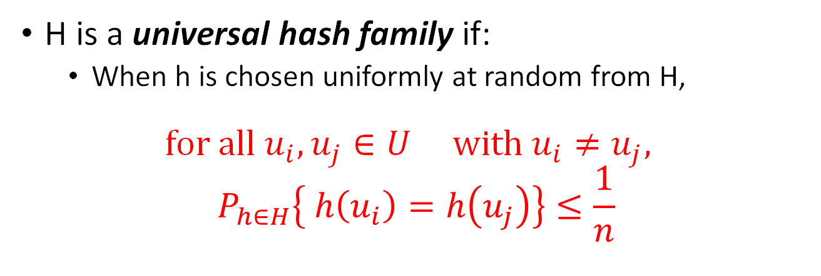
Universal hash family Let’s compare this definition with "All that we needed"
E.g. The family of all hash functions h:U->[n] is a universal hash family as we showed earlier

Slide 12
But We Also Need a Small Hash Family!
Remember that after we select the hash function, we need to store the hash function for search/delete.
What will happen if we did not remember the hash function?
With a smaller hash family it’s easier to remember which function from the family we’re using.
The set of all hash functions contains n^{U} functions. So to store the index of a function, we need log(n^{U})=Ulog(n) bits ☹.

Slide 13
We need Ulog(n) bits to store an arbitrary hash function h:U -> {1,…,n}
Say that this elephant-shaped blob represents the set of all hash functions.
It has size n^{U}. (Really big!)
To remember an arbitrary function from this set, we need log(n^{U}) = Ulog(n) bits.
All of the hash functions
h:U →{1,…,n}

Slide 14
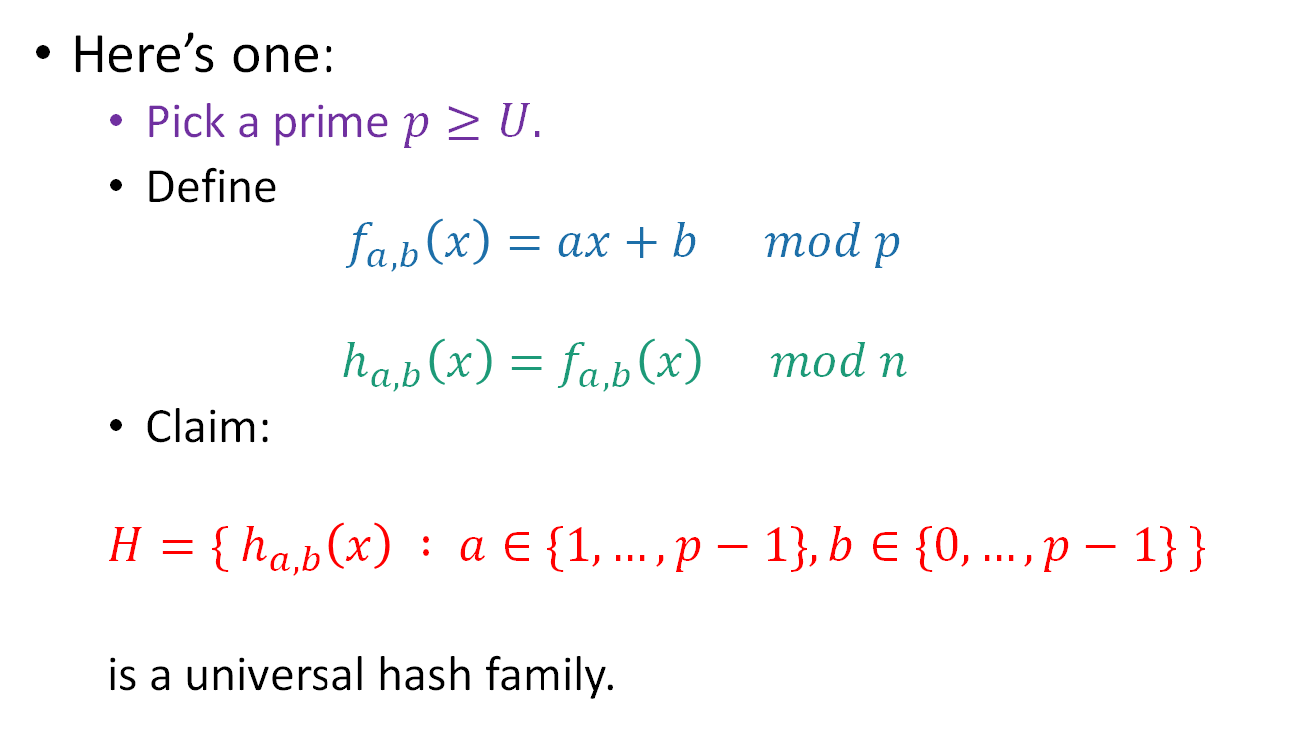
An example of small universal hash family
??

Slide 15
So the whole scheme will be
Choose a and b at random and form the function h_{a,b}
We can store h in space O(log(U)) since we just need to store a and b.
u₁
u_{k}
Probably these buckets will be pretty balanced.
u_{i}
u_{j}
h_{a,b}
n buckets
u_{i}
Universe U

Slide 16
Conclusion:
We can build a hash table that supports INSERT/DELETE/SEARCH in O(1) expected time,
if we know that only n items are ever going to show up, where n is waaaayyyyyy less than the size U of the universe.
The space to implement this hash table is
O(n log(U)) bits.
O(n) buckets
O(n) items with log(U) bits per item
O(log(U)) to store the hash fn.
U is waaayyyyyy bigger than n, but log(U) probably isn’t.

Slide 17
Running times (in a perfect world…)
 | Sorted Arrays | Linked Lists | Heaps | Red-Black Binary Search Trees | Hash Table
Search | O(log(n)) | O(n) | O(n) | O(log(n)) | O(1)
Delete | O(n) | Search +O(1) | Search +O(log(n)) | O(log(n)) | O(1)
Insert | O(n) | O(1) | O(log(n)) | O(log(n)) | O(1)
Extract-min | O(1) | O(n) | O(log(n)) | O(log(n)) | O(n)
In expectation!

Slide 18
Graph (DFS and BFS)

Slide 19
Graph
Definition: A graph G = (V,E) consists of two things: A collection V of vertices and a collection E of edges.
Two ways to explore a graph that we’ve covered in class: DFS and BFS
Also…
- Stack: first in, last out
- Queue: first in, first out

Slide 20
BFS (More detail than you’ve seen in class)
BFS(G, v)
Input: graph G = (V, E); node v in V, edge e in E
Output:
Array visited: V -> {True, False}
Queue Q of vertices. Initialize with start vertex v.
While Q is non-empty: # keep looping as we have unexplored vertices
Pop u from queue Q # u is the vertex currently explored
If not visited[u]: # only work on vertices we have not explored
visited[u] = True
for (u, v) in E: #push every neighbor of u into queue
Push v onto queue Q
What if we used a stack instead of a queue?
It becomes DFS (iterative implementation)!

Slide 21
Example BFS
A
B
C
D
E
F
Notes:
Skip this example if time does not allow

Slide 22
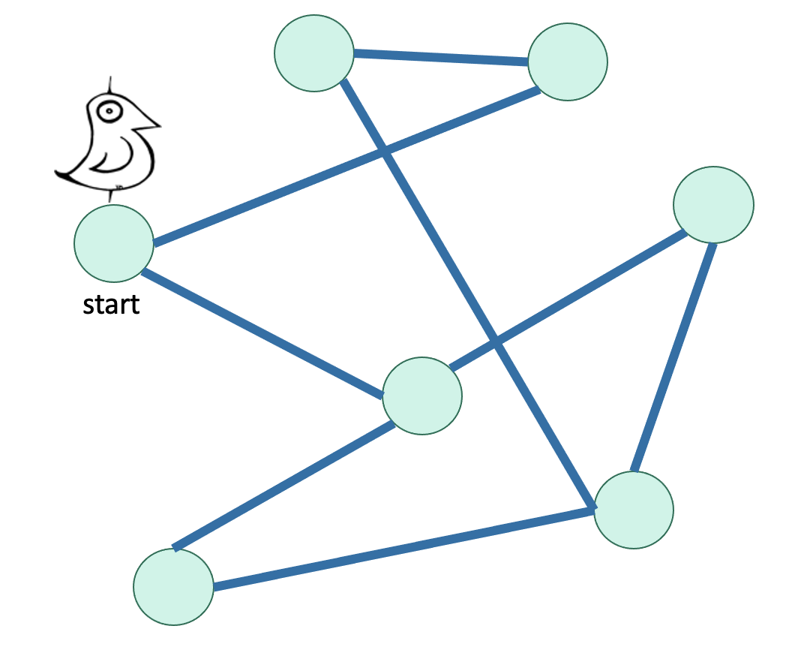
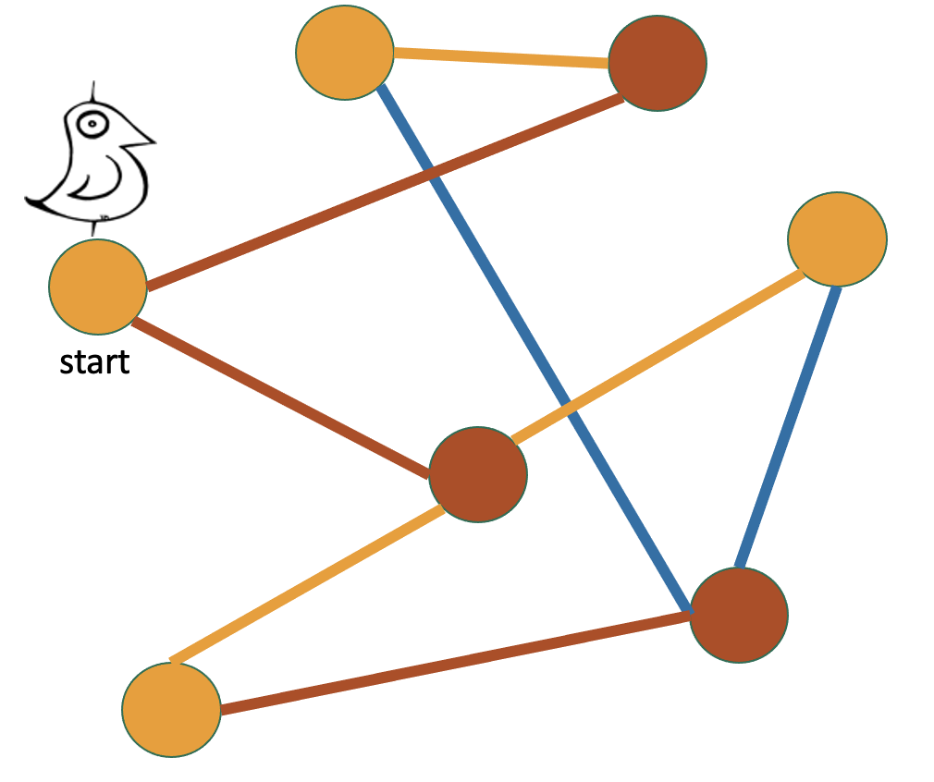
What can we do with BFS?
Find all vertices reachable from the start vertex
Find the shortest paths from a vertex to all the others in unweighted graph
Check if a graph is bipartite graph.
Color the levels of the BFS tree in alternating colors.
If you never color two connected nodes the same color, then it is bipartite.
Otherwise, it’s not.

Slide 23
DFS
DFS(w, currentTime):
w.startTime = currentTime
currentTime ++
Mark w as in progress.
for v in w.neighbors:
if v is unvisited:
currentTime = DFS(v, currentTime)
currentTime ++
w.finishTime = currentTime
Mark w as all done
return currentTime

Slide 24
Example DFS (we sort edges in alphabetical order)
A
B
C
Start: 1
D
E
F
Notes:
Skip this example if time does not allow

Slide 25
Example DFS (we sort edges in alphabetical order)
A
B
C
Start: 1
D
E
F
Start : 2

Slide 26
Example DFS (we sort edges in alphabetical order)
A
B
C
Start: 1
Start : 3
D
E
F
Start : 2

Slide 27
Example DFS (we sort edges in alphabetical order)
A
B
C
Start: 1
Start : 3
Start : 4
D
E
F
Start : 2

Slide 28
Example DFS (we sort edges in alphabetical order)
A
B
C
Start: 1
Start : 3
Start : 4
Finish : 5
D
E
F
Start : 2

Slide 29
Example DFS (we sort edges in alphabetical order)
A
B
C
Start: 1
Start : 3
Start : 4
Finish : 5
D
E
F
Start : 2
Start : 6

Slide 30
Example DFS (we sort edges in alphabetical order)
A
B
C
Start: 1
Start : 3
Start : 4
Finish : 5
D
E
F
Start : 2
Start : 6
Start : 7

Slide 31
Example DFS (we sort edges in alphabetical order)
A
B
C
Start: 1
Start : 3
Start : 4
Finish : 5
D
E
F
Start : 2
Start : 6
Start : 7
Finish : 8

Slide 32
Example DFS (we sort edges in alphabetical order)
A
B
C
Start: 1
Start : 3
Start : 4
Finish: 12
Finish: 10
Finish : 5
D
E
F
Start : 2
Start : 6
Start : 7
Finish : 11
Finish : 9
Finish : 8

Slide 33
Relation in DFS tree and start/finish time
If u is v’s ancestor: start(u) < start(v) < finish(v) < finish(u)
If u is v’s descendant: start(v) < start(u) < finish(u) < finish(v)
If u is v’s cousin and v is visited first: start(v) < finish(v) < start(u) < finish(u)
Note that startTime and finishTime never interleave: start(v) < start(u) < finish(v) < finish(u) will never happen
Notes:
V is sandwiched by u
U is sandwiched by v
They do not overlap
Interleave never happens

Slide 34
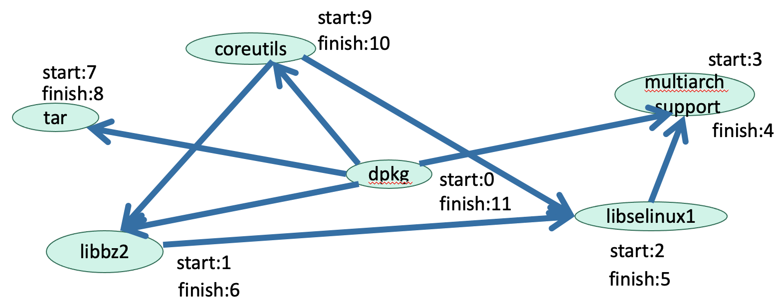
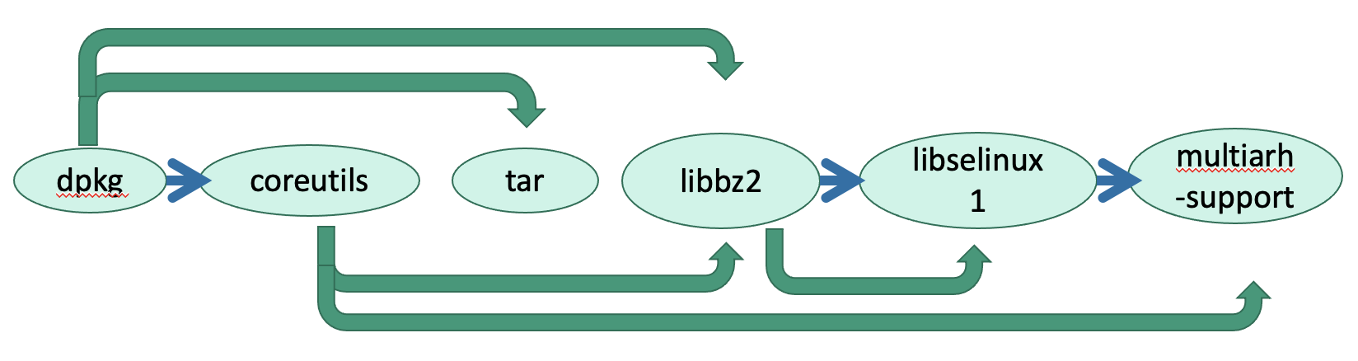
What can we do with DFS?
Find all vertices reachable from the start vertex
Check if a graph is bipartite graph. (Similar to the method based on BFS. Will go over this in the handout)
Topological sort for directed graph without any cycle (DAG)
In reverse order of finishing time in DFS!
Both algorithms run in O(|V| + |E|).

Slide 35
Midterm

Slide 36
Midterm
Midterm on Wednesday, Feb 12 (6pm-9pm)
Covers up to (and including) lecture 7
Questions?

Slide 37
Handout

