Slide 1
CS161 Section 6
[CA Name]

Slide 2
Agenda
Recap (strongly connected components, shortest path)
Kosaraju's algorithm (SCC)
Dijkstra’s algorithm (shortest path)
Bellman-Ford, Floyd-Warshall (dynamic-programming shortest path algorithms)
2) Handout

Slide 3
Strongly connected components (SCC)

Slide 4
Strongly vs Weakly Connected Components
Please do not confuse them!
"connected" means any vertex is reachable from any other vertex
Undirected graphs (Weakly) connected Components (CC)
Directed graphs Strongly Connected Components (SCC)
Find with BFS/DFS
Find with Kosaraju's algorithm (DFS)

Slide 5
Algorithm
[Kosaraju's algorithm]
Running time: O(n + m)
(This is basically “PretendTopoSort”)
Run DFS.
Choose starting vertices in any order.
Order vertices by reverse finishing times.
Reverse all the edges in the graph.
Do DFS again to create a new DFS forest.
(Using the reverse-finish-time order from the first DFS run.)
The SCCs are the different trees in the new DFS forest.
(This doesn’t change SCCs)

Slide 6






Example

Slide 7

Example
Start:0
Start with an arbitrary vertex and do DFS.

Slide 8
Example
Start:0
Start:1
Start with an arbitrary vertex and do DFS.

Slide 9
Example
Start:0
Start:1
Start:2
Start with an arbitrary vertex and do DFS.

Slide 10
Example
Start:0
Start:1
Start:2
Start with an arbitrary vertex and do DFS.
Start:3

Slide 11
Example
Start:0
Start:1
Start:2
Start with an arbitrary vertex and do DFS.
Start:3
Finish:4

Slide 12
Example
Start:0
Start:1
Start:2
Finish:5
Start with an arbitrary vertex and do DFS.
Start:3
Finish:4

Slide 13
Example
Start:0
Start:1
Start:2
Finish:5
Start with an arbitrary vertex and do DFS.
Start:3
Finish:4

Slide 14
Example
Start:0
Start:1
Start:2
Finish:5
Start:7
Start with an arbitrary vertex and do DFS.
Start:3
Finish:4

Slide 15
Example
Start:0
Start:1
Start:2
Finish:5
Start:7
Finish:8
Start with an arbitrary vertex and do DFS.
Start:3
Finish:4

Slide 16
Example
Start:0
Start:1
Finish:9
Start:2
Finish:5
Start:7
Finish:8
Start with an arbitrary vertex and do DFS.
Start:3
Finish:4

Slide 17
Example
Start:0
Finish:10
Start:1
Finish:9
Start:2
Finish:5
Start:7
Finish:8
Start with an arbitrary vertex and do DFS.
Start:3
Finish:4

Slide 18
Example
Start:0
Finish:10
Start:1
Finish:9
Start:2
Finish:5
Start:7
Finish:8
Start with an arbitrary vertex and do DFS.
Repeat until done.
Start:3
Finish:4

Slide 19

Example
Start:0
Finish:10
Start:1
Finish:9
Start:11
Finish:12
Start:2
Finish:5
Start:7
Finish:8
Start with an arbitrary vertex and do DFS.
Repeat until done.
Start:3
Finish:4

Slide 20
Example
Start:0
Finish:10
Start:1
Finish:9
Start:11
Finish:12
Start:2
Finish:5
Start:7
Finish:8
Reverse all the edges.
Start:3
Finish:4

Slide 21
Example
Start:0
Finish:10
Start:1
Finish:9
Start:11
Finish:12
Start:2
Finish:5
Start:7
Finish:8
Reverse all the edges.
Start:3
Finish:4

Slide 22
Example
Start:0
Finish:10
Start:1
Finish:9
Start:11
Finish:12
Start:2
Finish:5
Start:7
Finish:8
Do DFS again, but this time, start with the vertices with the largest finish time.
Start:3
Finish:4

Slide 23

Example
Start:0
Finish:10
Start:1
Finish:9
Start:11
Finish:12
Start:2
Finish:5
Start:7
Finish:8
Do DFS again, but this time, start with the vertices with the largest finish time.
Start:3
Finish:4

Slide 24
Example
Start:0
Finish:10
Start:1
Finish:9
Start:11
Finish:12
Start:2
Finish:5
Start:7
Finish:8
This is one DFS tree in the DFS forest!
Do DFS again, but this time, start with the vertices with the largest finish time.
Start:3
Finish:4

Slide 25
Example
Start:0
Finish:10
Start:1
Finish:9
Start:11
Finish:12
Start:2
Finish:5
Start:7
Finish:8
This is one DFS tree in the DFS forest!
Do DFS again, but this time, start with the vertices with the largest finish time.
Start:3
Finish:4

Slide 26
Example
Start:0
Finish:10
Start:1
Finish:9
Start:11
Finish:12
Start:2
Finish:5
Start:7
Finish:8
This is one DFS tree in the DFS forest!
Do DFS again, but this time, start with the vertices with the largest finish time.
Start:3
Finish:4

Slide 27
Example
Start:0
Finish:10
Start:1
Finish:9
Start:11
Finish:12
Start:2
Finish:5
Start:7
Finish:8
This is one DFS tree in the DFS forest!
Do DFS again, but this time, start with the vertices with the largest finish time.
Start:3
Finish:4

Slide 28
Example
Start:0
Finish:10
Start:1
Finish:9
Start:11
Finish:12
Start:2
Finish:5
Start:7
Finish:8
This is one DFS tree in the DFS forest!
Do DFS again, but this time, start with the vertices with the largest finish time.
Start:3
Finish:4
Notice that I’m not changing the start and finish times – I’m keeping them from the first run.

Slide 29
Example
Start:0
Finish:10
Start:1
Finish:9
Start:11
Finish:12
Start:2
Finish:5
Start:7
Finish:8
This is one DFS tree in the DFS forest!
Do DFS again, but this time, start with the vertices with the largest finish time.
Start:3
Finish:4
Notice that I’m not changing the start and finish times – I’m keeping them from the first run.

Slide 30
Example
Start:0
Finish:10
Start:1
Finish:9
Start:11
Finish:12
Start:2
Finish:5
Start:7
Finish:8
This is one DFS tree in the DFS forest!
Do DFS again, but this time, start with the vertices with the largest finish time.
Start:3
Finish:4
Notice that I’m not changing the start and finish times – I’m keeping them from the first run.

Slide 31
Example
Start:0
Finish:10
Start:1
Finish:9
Start:11
Finish:12
Start:2
Finish:5
Start:7
Finish:8
This is one DFS tree in the DFS forest!
Do DFS again, but this time, start with the vertices with the largest finish time.
Start:3
Finish:4
Notice that I’m not changing the start and finish times – I’m keeping them from the first run.

Slide 32
Example
Here’s another DFS tree in the DFS forest!
Start:0
Finish:10
Start:1
Finish:9
Start:11
Finish:12
Start:2
Finish:5
Start:7
Finish:8
This is one DFS tree in the DFS forest!
Do DFS again, but this time, start with the vertices with the largest finish time.
Start:3
Finish:4

Slide 33
Example
Here’s another DFS tree in the DFS forest!
Start:0
Finish:10
Start:1
Finish:9
Start:11
Finish:12
Start:2
Finish:5
Start:7
Finish:8
This is one DFS tree in the DFS forest!
Do DFS again, but this time, start with the vertices with the largest finish time.
Start:3
Finish:4

Slide 34
Example
Here’s another DFS tree in the DFS forest!
Start:0
Finish:10
Start:1
Finish:9
Start:11
Finish:12
Start:2
Finish:5
Start:7
Finish:8
This is one DFS tree in the DFS forest!
Do DFS again, but this time, start with the vertices with the largest finish time.
Start:3
Finish:4

Slide 35
Example
Here’s another DFS tree in the DFS forest!
Start:0
Finish:10
Start:1
Finish:9
Start:11
Finish:12
Start:2
Finish:5
Start:7
Finish:8
This is one DFS tree in the DFS forest!
Do DFS again, but this time, start with the vertices with the largest finish time.
Start:3
Finish:4

Slide 36
Example
Here’s another DFS tree in the DFS forest!
Start:0
Finish:10
Start:1
Finish:9
Start:11
Finish:12
Start:2
Finish:5
Start:7
Finish:8
This is one DFS tree in the DFS forest!
Do DFS again, but this time, start with the vertices with the largest finish time.
Start:3
Finish:4

Slide 37
Example
Here’s another DFS tree in the DFS forest!
Start:0
Finish:10
Start:1
Finish:9
Start:11
Finish:12
Start:2
Finish:5
Start:7
Finish:8
This is one DFS tree in the DFS forest!
Do DFS again, but this time, start with the vertices with the largest finish time.
Start:3
Finish:4

Slide 38
Example
Here’s another DFS tree in the DFS forest!
Start:0
Finish:10
Start:1
Finish:9
Start:11
Finish:12
Start:2
Finish:5
Start:7
Finish:8
This is one DFS tree in the DFS forest!
The last DFS tree!
Do DFS again, but this time, start with the vertices with the largest finish time.
Start:3
Finish:4

Slide 39
Example
Here’s another DFS tree in the DFS forest!
Start:0
Finish:10
Start:1
Finish:9
Start:11
Finish:12
Start:2
Finish:5
Start:7
Finish:8
This is one DFS tree in the DFS forest!
The last DFS tree!
Do DFS again, but this time, start with the vertices with the largest finish time.
Start:3
Finish:4
IT WORKED!

Slide 40
Why this algorithm works
Example graph:

Slide 41
The first DFS essentially does a toposort of strongly connected components
For this example, let's say toposort gives the following order of SCCs
1
3
2
Note: There's no edge from higher-indexed component to lower-indexed component because otherwise it won't be a proper toposort
4
Notes:
The first DFS orders the vertices by their finish time, which implies a topological order of SCCs (one can think of each SCC as a big vertex whose finish time is the largest finish time of vertices in that SCC, and then order the SCCs by their finish time).

Slide 42
Reversing all edges makes higher-indexed component unreachable from lower-indexed component
1
3
2
4
Notes:
Because the indices of the SCCs correspond to a topological order (as we explained in previous slide), there's no edge from higher-indexed SCC to lower-indexed SCC, and thus, after reversing all edges, there's no edge from lower-indexed SCC to higher-indexed SCC.

Slide 43
Now another DFS on this graph (starting from lower-indexed vertex to higher-indexed vertex) can identify all the components
1
3
2
4
Notes:
DFS starting from any vertex in lower-indexed SCC will visit all vertices in that SCC, but cannot reach higher-indexed SCC (as we explained in previous slide).

Slide 44
Shortest path in graphs

Slide 45
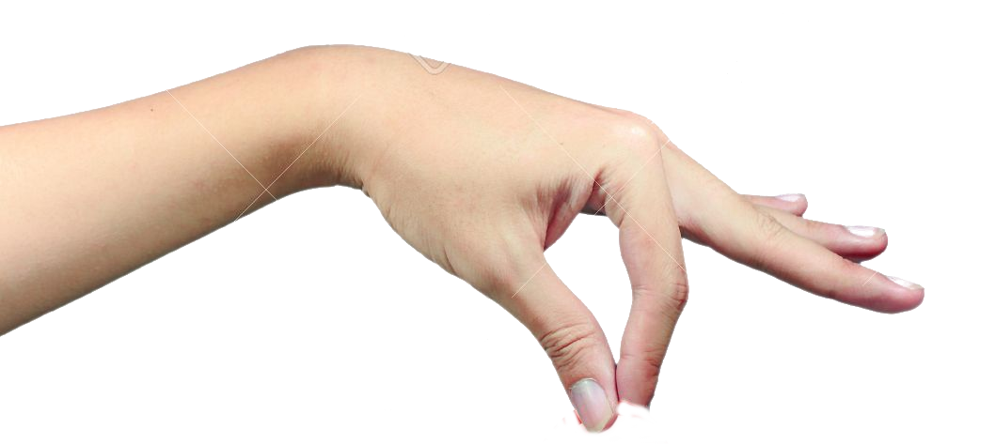
Dijkstra's algorithm visual intuition
YOINK!
Stanford
Portland
New Orleans
Nashville
Las Vegas
Mexico City

Slide 46
Dijkstra's algorithm visual intuition
YOINK!
This creates a tree!
Stanford
The highlighted + fully stretched edges along this tree are the shortest paths!
8
10
Las Vegas
Portland
25
30
Nashville
Mexico City
7
New Orleans

Slide 47
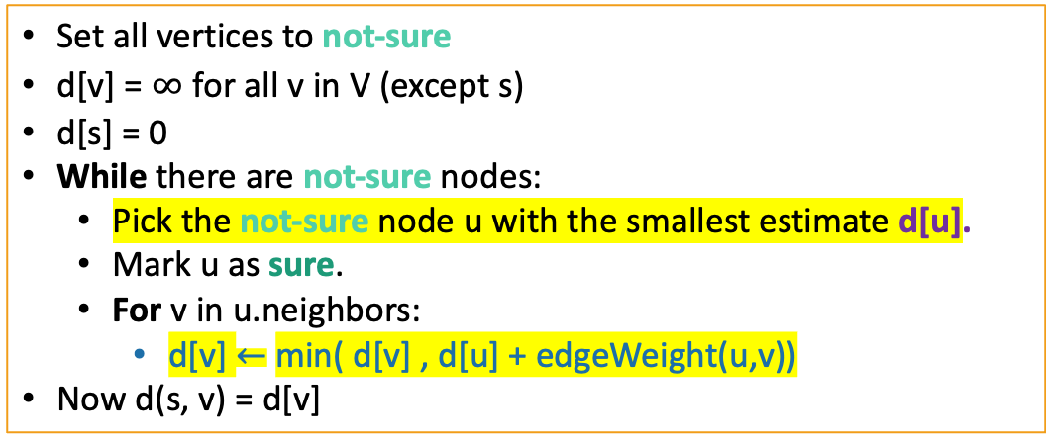
Dijkstra Pseudocode
Dijkstra(G,s):
Shouldn’t be used on graphs with negative edges!
Runtime? Will need to use Fibonacci heaps
to make the highlighted operations run faster!
Notes:
Feel free to skip if time does not allow for it, but emphasize that the algorithm shouldn’t be used on graphs with negative edges!!

Slide 48
Need to use Fibonacci Heap to implement fastest Dijkstra
* - amortized time
 | Sorted Arrays | Linked Lists | Binary Heap | Fibonacci Heap | Red-Black Trees
Search | O(log(n)) | O(n) | O(n) | O(n) | O(log(n))
Delete | O(n) | Search +O(1) | Search +O(log(n)) | Search +O(log(n))* | O(log(n))
Insert | O(n) | O(1) | O(log(n)) | O(1) | O(log(n))
Extract-min | O(1) | O(n) | O(log(n)) | O(log(n))* | O(log(n))
Decrease-key | O(n) | Search +O(1) | Search +O(log(n) | O(1)* | O(log(n)
Notes:
Emphasize that students don’t need to know the implementation details of the Fibonacci heap

Slide 49
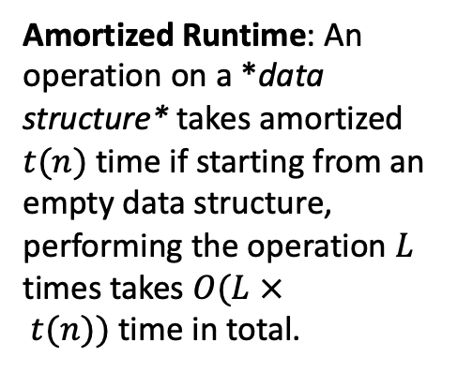
Amortized Analysis
0000
0001
0010
0011
0100
0101
0110
0111
1000
1001
1010
1011
1100
1101
1110
1111
Example:
Incrementing a binary counter n times.
Say that flipping a bit is costly.
Some steps are very expensive (worst case takes 4 flips).
Many are very cheap.
Amortized over all the inputs, it turns out to be cheaper than worst case.
2n for all n increments = 2 flips per increment (amortized).
1 2 1 3 1 2 1 4 1 2 1 3 1 2 1
Notes:
Another example: expanding arrays when they’re full

Slide 50
Dijkstra with Fibonacci Heap
T(extractMin) = O(log(n)) (amortized time*)
T(decreaseKey) = O(1) (amortized time*)
See CS166 for more! (or CLRS)
Running time of Dijkstra
O(n( T(extractMin) ) + m T(decreaseKey))
O(nlog(n) + m)
*This means that any sequence of d extractMin calls takes time at most O(dlog(n)). But a few of the d may take longer than O(log(n)) and some may take less time..

Slide 51
Shortest path (dynamic programming)

Slide 52
What is dynamic programming?
It is an algorithm design paradigm
like divide-and-conquer is an algorithm design paradigm
Usually it is for solving optimization problems
e.g., shortest path, more examples in next week's lecture
Usually it models the objective of the problem as a function (e.g., f[i]) that depend on some state variable (e.g., i ≤ n), such that function value at some state (e.g., f[n]) is the optimum we're searching for, and it uses some recurrence relation (e.g., f[i]=f[i-1]+f[i-2]) to infer the optimum (f[n] in this example)

Slide 53
Bellman-Ford (main idea)
For any vertex u,
d^{i}(s,u) := length of shortest path from s (source) to u that uses ⩽ i edges
Initialization:
d⁰(s,s) = 0 and d⁰(s,u) = infinity for every other u ≠ s
Recursive formulation:
d^{i+1}(s,v) = min_{u} d^{i}(s,u) + w(u,v)

Slide 54
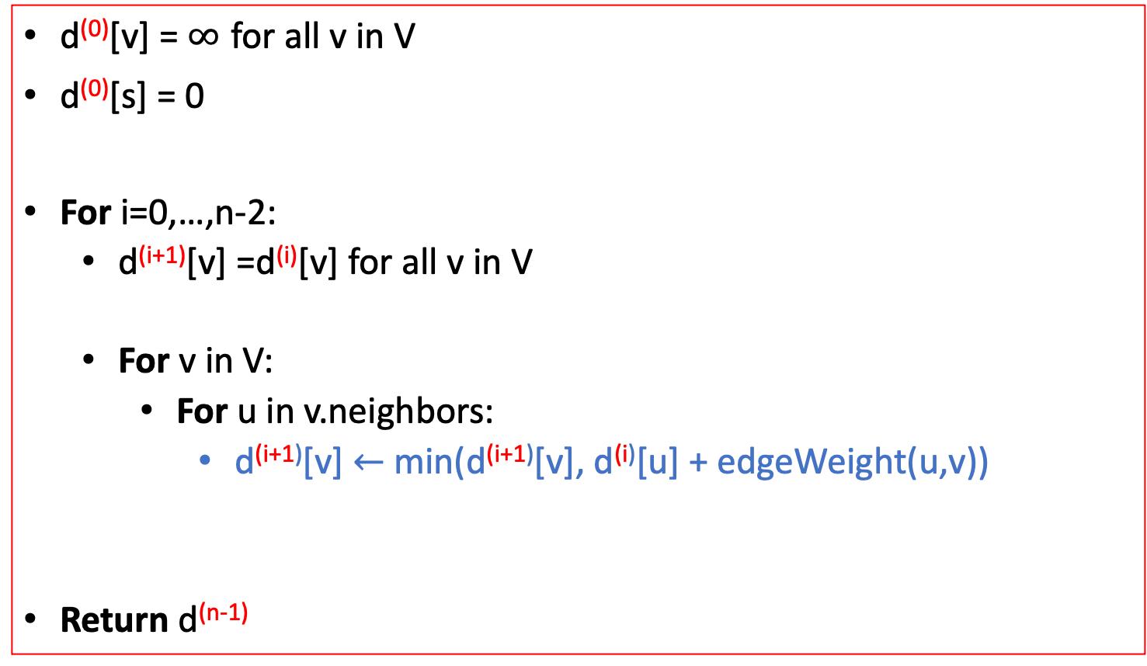
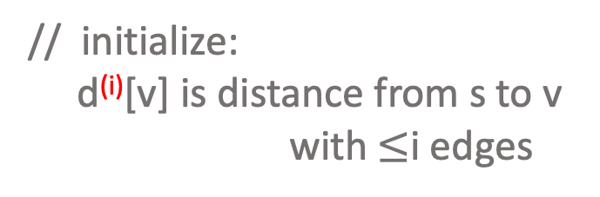
Bellman-Ford (algorithm)
Bellman-Ford(G,s):
// baseline distance: v doesn’t need (i+1)^{th} edge
// found a better path through u
Notes:
Compare the recurrence relation of BF with Dijkstra

Slide 55






Bellman-Ford (implementation)
Don’t actually keep all n arrays around.
Just keep two at a time: “last round” and “this round”
Point Reyes
Yellowstone
Stanford
S.F.
Yosemite
d⁽⁰⁾
0
d⁽¹⁾
0
1
-3
d⁽²⁾
0
-5
2
7
-3
d⁽³⁾
-4
-5
-4
6
-3
Only need these two in order to compute d⁽⁴⁾
d⁽⁴⁾
-4
-5
-4
6
-7

Slide 56
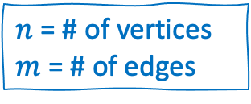
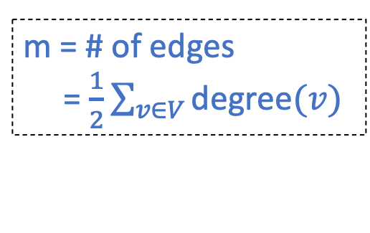
Bellman-Ford (takeaways)
Running time is O(mn)
For each of n rounds, update m edges.
Works fine with negative edges.
Does not work with negative cycles.
But it can detect negative cycles!
For i=0,…,n-1:
For u in V:
For v in u.neighbors:

Slide 57
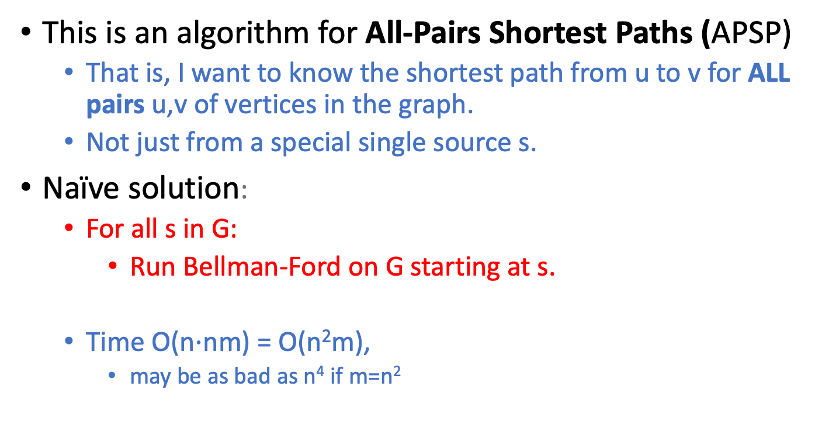
Floyd-Warshall algorithm (motivation)
Can we do better?

Slide 58
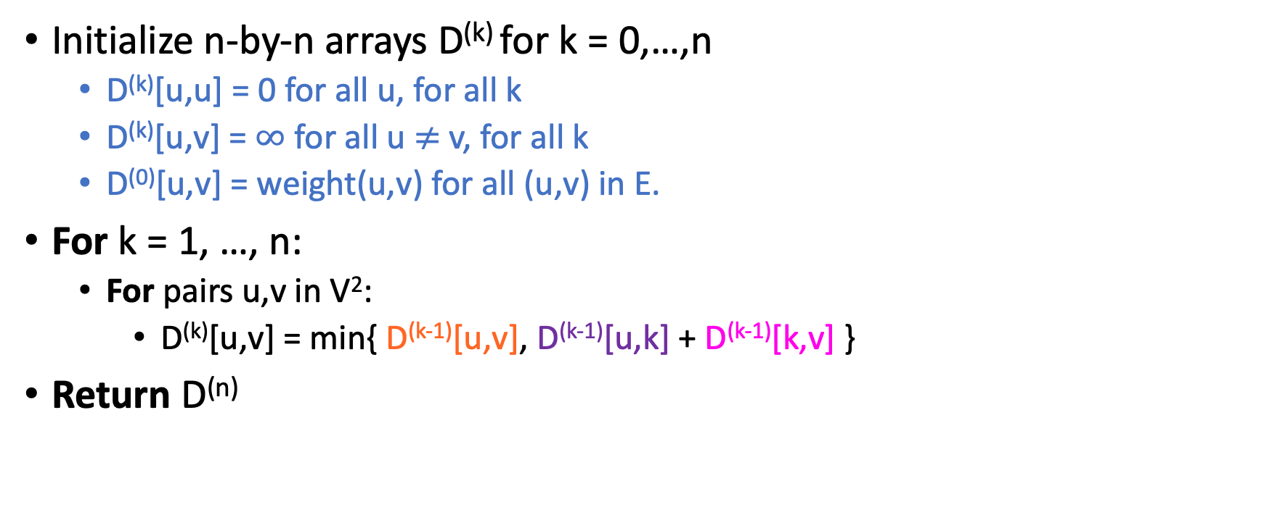
Floyd-Warshall algorithm
The base case checks out: the only path through zero other vertices are edges directly from u to v.
D^{(k)}[u,v] := length of shortest path between u and v that only pass through vertices 1,2,...,k in G

Slide 59
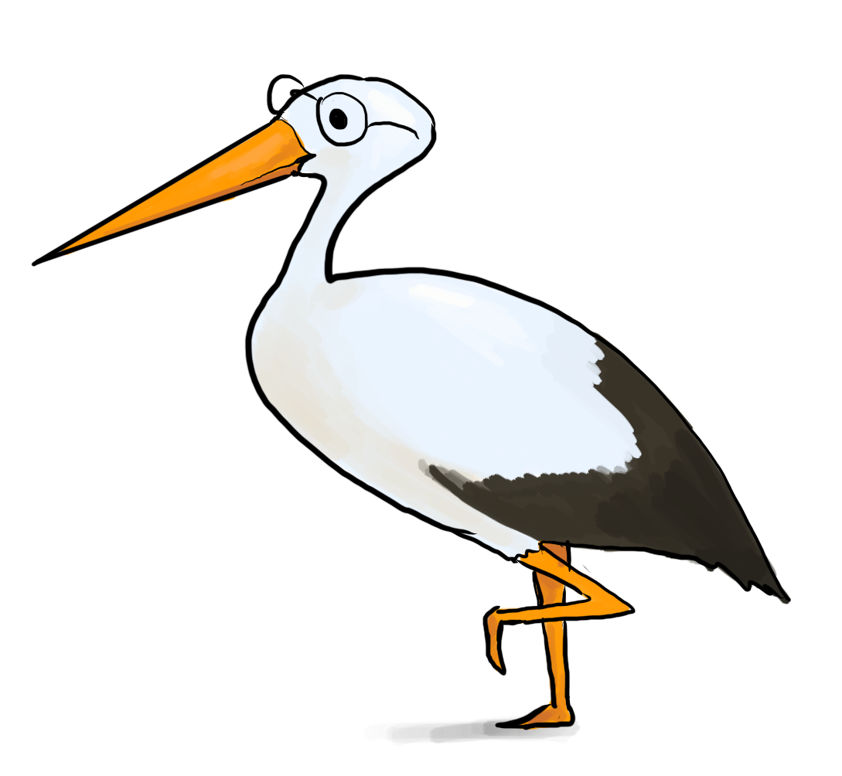
Floyd-Warshall algorithm (analysis)
Theorem:
If there are no negative cycles in a weighted directed graph G, then the Floyd-Warshall algorithm, running on G, returns a matrix D^{(n)} so that:
D^{(n)}[u,v] = distance between u and v in G.
Running time: O(n³)
Better than running Bellman-Ford n times!
Storage:
Need to store two n-by-n arrays, and the original graph.
Work out the details of a proof!
As with Bellman-Ford, we don’t really need to store all n of the D^{(k)}.

Slide 60
Handout

