Slide 1
CS 161 – Section 7
CA: [Name of CA]

Slide 2
Agenda
Dynamic Programming
Greedy Algorithms
Activity selection
Scheduling
Huffman Encoding

Slide 3
Dynamic Programming

Slide 4
What is dynamic programming?
It is an algorithm design paradigm
like divide-and-conquer is an algorithm design paradigm.
Usually it is for solving optimization problems
eg, shortest path, or longest common subsequence
(Fibonacci numbers aren’t an optimization problem, but they are a good example…)

Slide 5
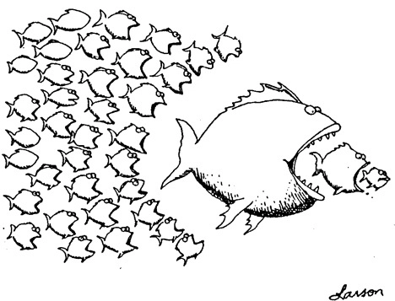
Bottom up approach
For Fibonacci:
Solve the small problems first
fill in F[0],F[1]
Then bigger problems
fill in F[2]
…
Then bigger problems
fill in F[n-1]
Then finally solve the real problem.
fill in F[n]

Slide 6

Top down approach
Think of it like a recursive algorithm.
To solve the big problem:
Recurse to solve smaller problems
Those recurse to solve smaller problems
etc..
The difference from divide and conquer:
Memo-ization
Keep track of what small problems you’ve already solved to prevent re-solving the same problem twice.

Slide 7

What have we learned?
Dynamic programming:
Paradigm in algorithm design.
Uses optimal substructure
Uses overlapping subproblems
Can be implemented bottom-up or top-down.
It’s a fancy name for a pretty common-sense idea:
Don’t duplicate work if you don’t have to!

Slide 8
Longest Common Subsequence
Subsequence:
BDFH is a subsequence of ABCDEFGH
If X and Y are sequences, a common subsequence is a sequence which is a subsequence of both.
BDFH is a common subsequence of ABCDEFGH and of ABDFGHI
A longest common subsequence…
…is a common subsequence that is longest.
The longest common subsequence of ABCDEFGH and ABDFGHI is ABDFGH.

Slide 9
Recipe for applying Dynamic Programming
Step 1: Identify optimal substructure.
Step 2: Find a recursive formulation for the length of the longest common subsequence.
Step 3: Use dynamic programming to find the length of the longest common subsequence.
Step 4: If needed, keep track of some additional info so that the algorithm from Step 3 can find the actual LCS.

Slide 10
Step 1: Optimal substructure
Prefixes:
X
A
C
G
G
T
Y
A
C
G
C
T
T
A
Notation: denote this prefix ACGC by Y₄
Our sub-problems will be finding LCS’s of prefixes to X and Y.
Let C[i,j] = length_of_LCS( X_{i}, Y_{j} )

Slide 11
Recipe for applying Dynamic Programming
Step 1: Identify optimal substructure.
Step 2: Find a recursive formulation for the length of the longest common subsequence.
Step 3: Use dynamic programming to find the length of the longest common subsequence.
Step 4: If needed, keep track of some additional info so that the algorithm from Step 3 can find the actual LCS.

Slide 12
Goal
Write C[i,j] in terms of the solutions to smaller sub-problems
i
X_{i}
A
C
G
G
A
j
Y_{j}
A
C
G
C
T
T
A
C[i,j] = length_of_LCS( X_{i}, Y_{j} )

Slide 13
Two cases
Our sub-problems will be finding LCS’s of prefixes to X and Y.
Let C[i,j] = length_of_LCS( X_{i}, Y_{j} )
Case 1: X[i] = Y[j]
i
These are the same
X_{i}
A
C
G
G
A
j
Y_{j}
A
C
G
C
T
T
A
Then C[i,j] = 1 + C[i-1,j-1].
because LCS(X_{i},Y_{j}) = LCS(X_{i-1},Y_{j-1}) followed by
A

Slide 14
Two cases
Our sub-problems will be finding LCS’s of prefixes to X and Y.
Let C[i,j] = length_of_LCS( X_{i}, Y_{j} )
Case 2: X[i] != Y[j]
i
These are not the same
X_{i}
A
C
G
G
T
j
Y_{j}
A
C
G
C
T
T
A
Then C[i,j] = max{ C[i-1,j], C[i,j-1] }.
either LCS(X_{i},Y_{j}) = LCS(X_{i-1},Y_{j}) and is not involved,
or LCS(X_{i},Y_{j}) = LCS(X_{i},Y_{j-1}) and is not involved,
(maybe both are not involved, that’s covered by the “or”).
T
A

Slide 15
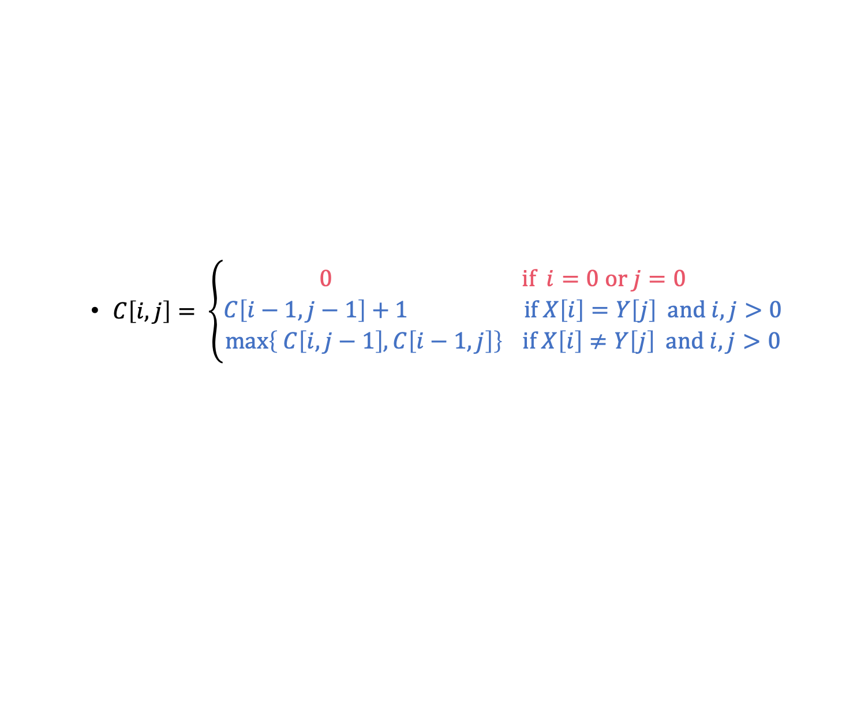
Recursive formulation of the optimal solution
X₀
Y_{j}
A
C
G
C
T
T
A
Case 0
Case 1
Case 2
X_{i}
A
C
G
G
A
X_{i}
A
C
G
G
T
Y_{j}
A
C
G
C
T
T
A
Y_{j}
A
C
G
C
T
T
A

Slide 16
Recipe for applying Dynamic Programming
Step 1: Identify optimal substructure.
Step 2: Find a recursive formulation for the length of the longest common subsequence.
Step 3: Use dynamic programming to find the length of the longest common subsequence.
Step 4: If needed, keep track of some additional info so that the algorithm from Step 3 can find the actual LCS.

Slide 17
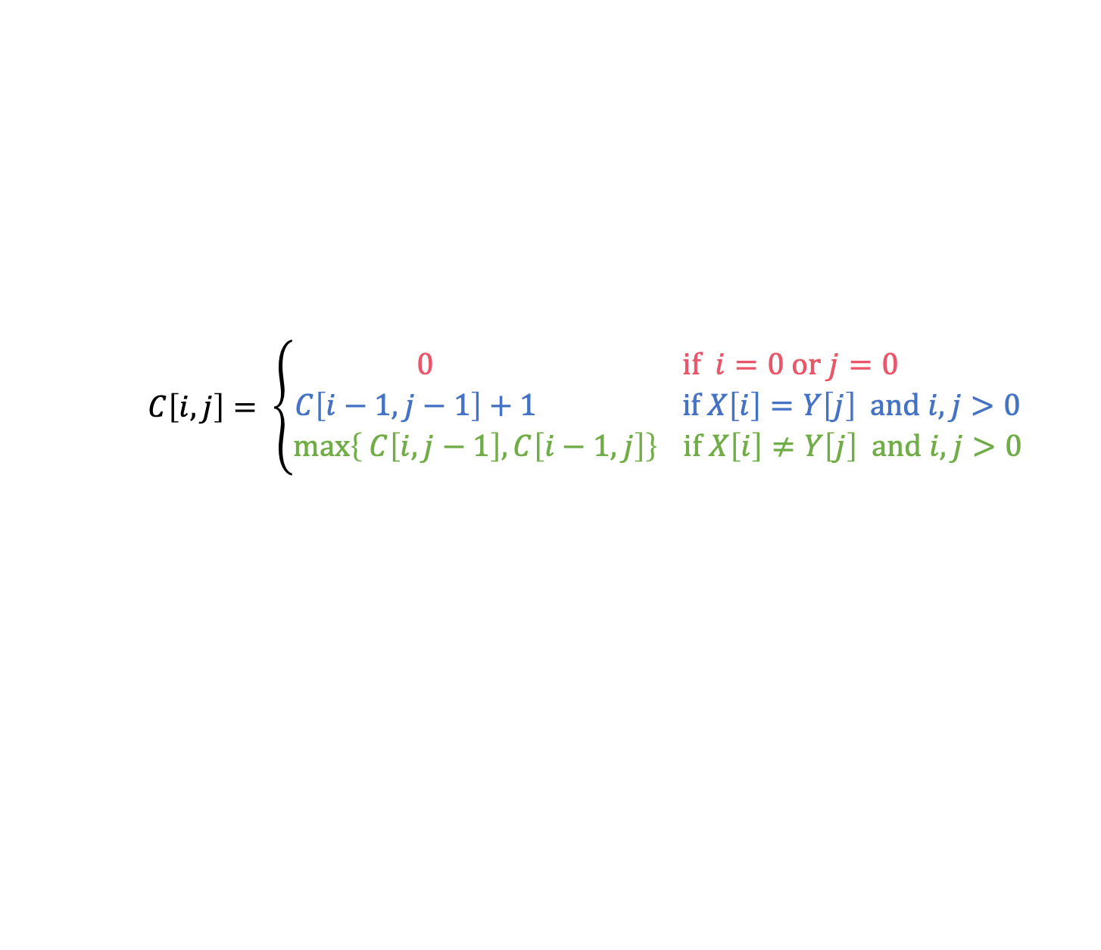
LCS DP OMG BBQ
LCS(X, Y):
C[i,0] = C[0,j] = 0 for all i = 1,…,m, j=1,…n.
For i = 1,…,m and j = 1,…,n:
If X[i] = Y[j]:
C[i,j] = C[i-1,j-1] + 1
Else:
C[i,j] = max{ C[i,j-1], C[i-1,j] }
Running time: O(nm)

Slide 18
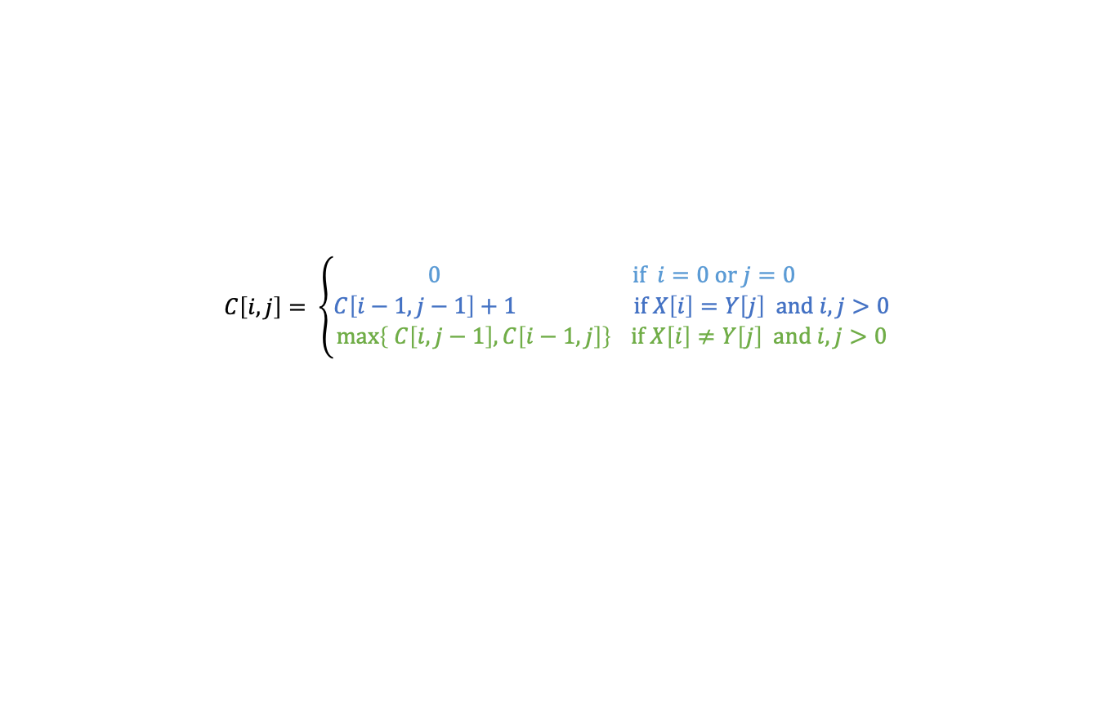
Example
X
A
C
G
G
A
Y
A
C
T
G
Y
A
C
T
G
0
0
0
0
0
A
0
C
0
X
G
0
G
0
A
0

Slide 19
Example
X
A
C
G
G
A
Y
A
C
T
G
Y
A
C
T
G
0
0
0
0
0
0
0
0
0
0
0
So the LCS of X and Y has length 3.
A
0
1
1
1
1
0
C
0
1
2
2
2
X
0
G
0
1
2
2
3
0
G
0
1
2
2
3
0
A
0
1
2
2
3

Slide 20
Recipe for applying Dynamic Programming
Step 1: Identify optimal substructure.
Step 2: Find a recursive formulation for the length of the longest common subsequence.
Step 3: Use dynamic programming to find the length of the longest common subsequence.
Step 4: If needed, keep track of some additional info so that the algorithm from Step 3 can find the actual LCS.

Slide 21
Finding an LCS
See lecture notes for pseudocode
Takes time O(mn) to fill the table
Takes time O(n + m) on top of that to recover the LCS
We walk up and left in an n-by-m array
We can only do that for n + m steps.
Altogether, we can find LCS(X,Y) in time O(mn).

Slide 22
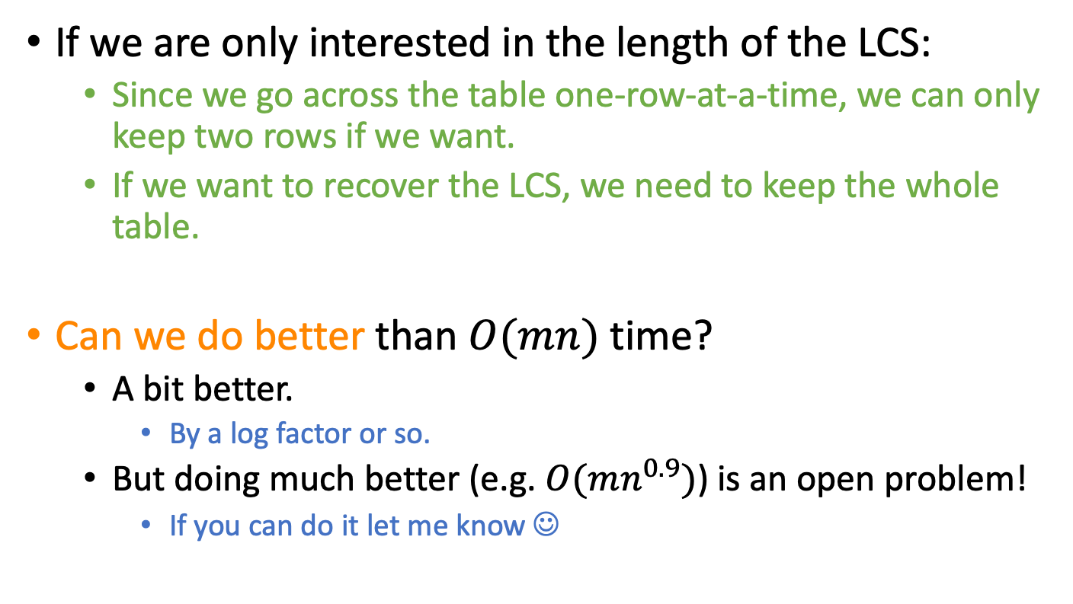
Time and Space complexity

Slide 23
What have we learned?
We can find LCS(X,Y) in time O(nm)
if |Y|=n, |X|=m
We went through the steps of coming up with a dynamic programming algorithm.
We kept a 2-dimensional table, breaking down the problem by decrementing the length of X and Y.

Slide 24
Greedy Algorithms

Slide 25
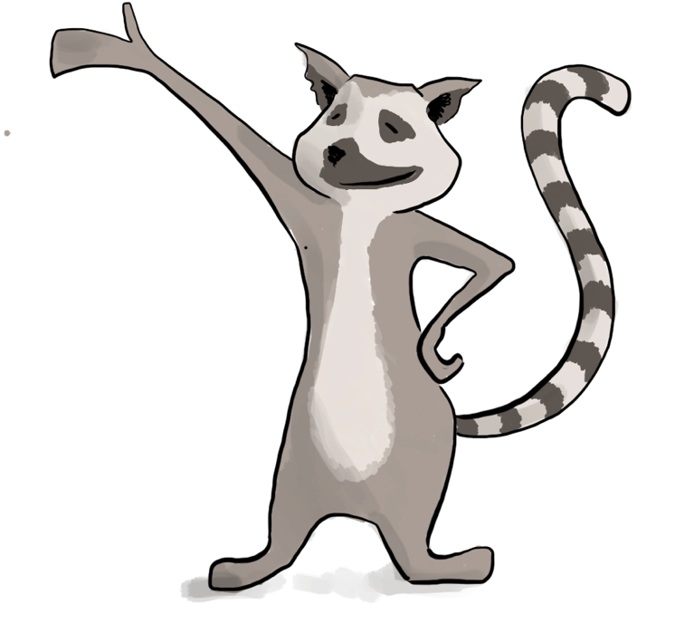
Common strategy for greedy algorithms
Make a series of choices.
Show that, at each step, our choice won’t rule out all optimal solutions at the end of the day.
After we’ve made all our choices, there is an optimal solution we haven’t ruled out, so we must have found one.

Slide 26

Common strategy (formally) for greedy algorithms
“Success” here means “finding an optimal solution.”
Inductive Hypothesis:
After greedy choice t, you haven’t ruled out success.
Base case:
Success is possible before you make any choices.
Inductive step:
If you haven’t ruled out success after choice t, then you won’t rule out success after choice t+1.
Conclusion:
If you reach the end of the algorithm and haven’t ruled out success then you must have succeeded.

Slide 27
Common strategy for showing we don’t rule out success
Suppose that you’re on track to make an optimal solution T*.
Eg, after you’ve picked activity i, you’re still on track.
Suppose that T* disagrees with your next greedy choice.
Eg, it doesn’t involve activity k.
Manipulate T* in order to make a solution T that’s not worse but that agrees with your greedy choice.
Eg, swap whatever activity T* did pick next with activity k.

Slide 28
Sub-problem graph view
Divide-and-conquer:
Big problem
sub-problem
sub-problem
sub-sub-problem
sub-sub-problem
sub-sub-problem
sub-sub-problem
sub-sub-problem

Slide 29
Sub-problem graph view
Dynamic Programming:
Big problem
sub-problem
sub-problem
sub-problem
sub-sub-problem
sub-sub-problem
sub-sub-problem
sub-sub-problem

Slide 30
Sub-problem graph view
Greedy algorithms:
Big problem
Not only is there optimal sub-structure:
optimal solutions to a problem are made up from optimal solutions of sub-problems
but each problem depends on only one sub-problem.
sub-problem
sub-sub-problem

Slide 31
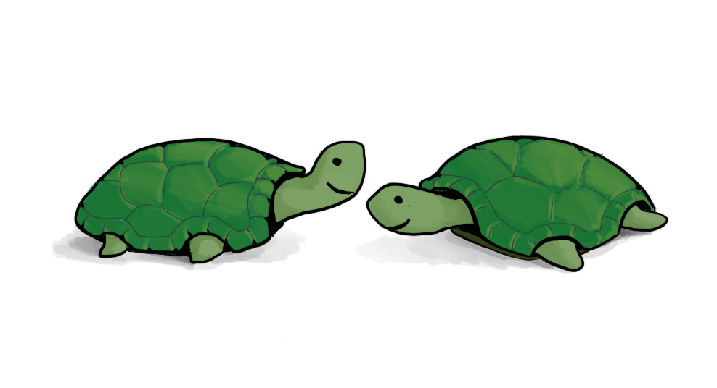
Social Activity selection
a_{i}
Input:
Activities a₁, a₂, …, a_{n}
Start times s₁, s₂, …, s_{n}
Finish times f₁, f₂, …, f_{n}
Output:
A way to maximize the number of activities you can do today.
s_{i}
f_{i}
time
In what order should you greedily add activities?
Think-pair-share!

Slide 32
Greedy algorithm
a₅
a₁
a₃
a₇
a₄
a₂
a₆
time
Pick activity you can add with the smallest finish time.
Repeat.

Slide 33
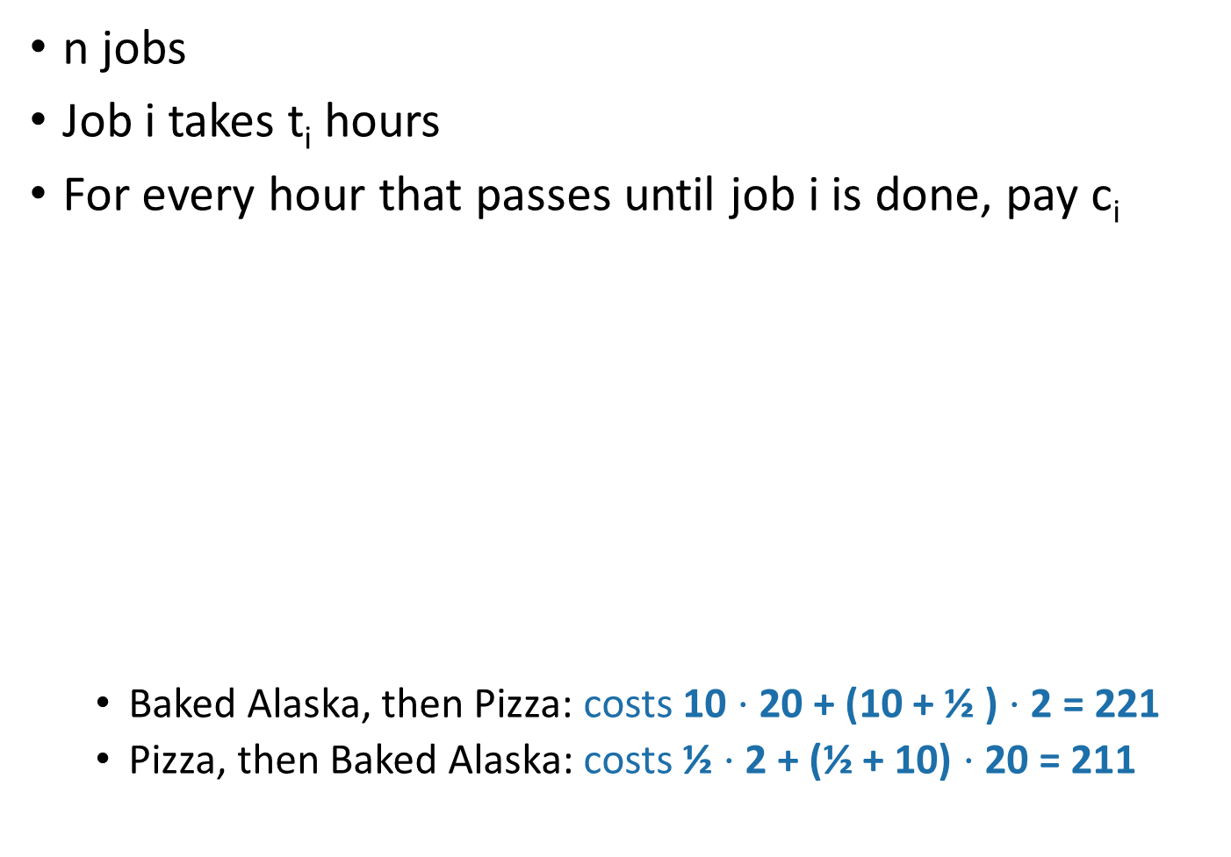
Scheduling
10 hours prep time
Cost: 20 units per hour until it’s done.
Baked Alaska for Table 1 (VIP guest)
Pizza for Table 4
Cost: 2 units per hour until it’s done.
½ hours prep time

Slide 34
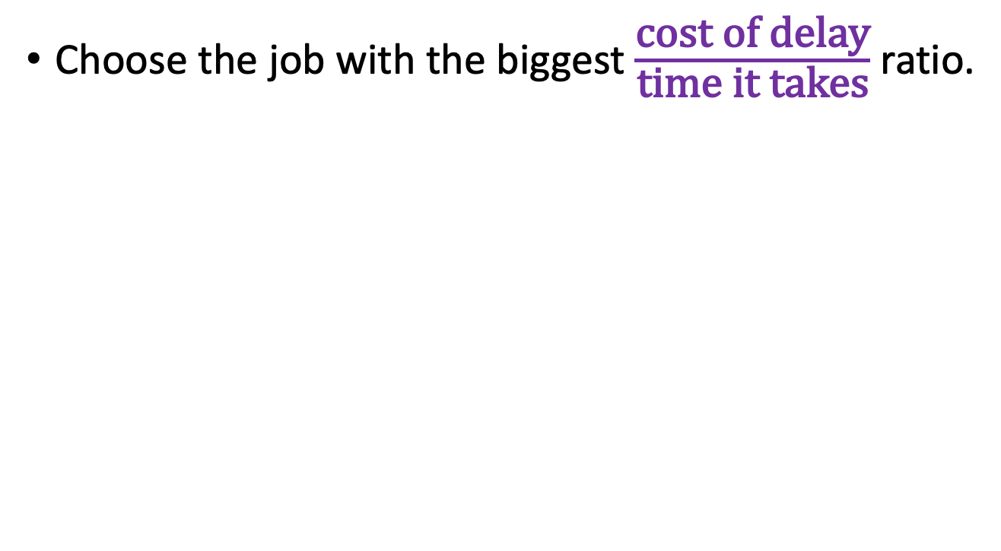
Greedy algorithm

Slide 35
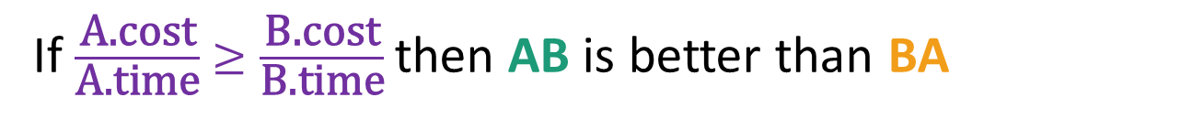
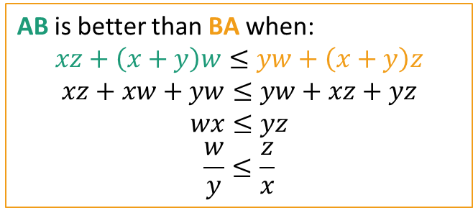
Claim 1:
Job B
Job A
Job A
Job B
Proof: we just did this…

Slide 36
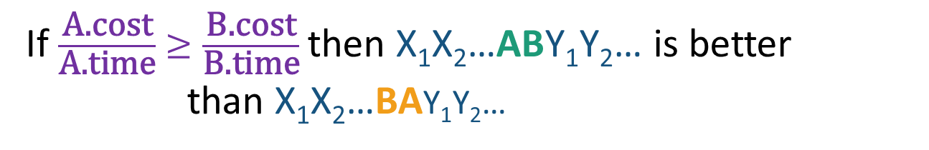
Claim 2:
X₁
X₂
X₃
Job B
Job A
Y₁
Y₂
X₁
X₂
X₃
Job A
Job B
Y₁
Y₂
Proof: Other jobs wait the same amount of time!
(And we know AB is better than BA by Claim 1)

Slide 37
Huffman Encoding
ASCII is pretty wasteful for English sentences. If e shows up so often, we should have a more parsimonious way of representing it!
everyday english sentence
01100101 01110110 01100101 01110010 01111001 01100100 01100001 01111001 00100000 01100101 01101110 01100111 01101100 01101001 01110011 01101000 00100000 01110011 01100101 01101110 01110100 01100101 01101110 01100011 01100101
qwertyui_opasdfg+hjklzxcv
01110001 01110111 01100101 01110010 01110100 01111001 01110101 01101001 01011111 01101111 01110000 01100001 01110011 01100100 01100110 01100111 00101011 01101000 01101010 01101011 01101100 01111010 01111000 01100011 01110110

Slide 38
Suppose we have some distribution on characters
For simplicity, let’s go with this made-up example
How to encode them as efficiently as possible?
45
Percentage
A
16
D
13
B
12
9
C
E
5
F
Letter

Slide 39
Solution greedily build subtrees, starting with the infrequent letters
14
0
1
A: 45
B:13
C:12
D: 16
E:9
F:5

Slide 40
Solution greedily build subtrees, starting with the infrequent letters
25
14
0
1
0
1
A: 45
B:13
C:12
D: 16
E:9
F:5

Slide 41
Solution greedily build subtrees, starting with the infrequent letters
30
1
25
14
0
0
1
0
1
A: 45
B:13
C:12
D: 16
E:9
F:5

Slide 42
Solution greedily build subtrees, starting with the infrequent letters
55
1
30
0
1
25
14
0
0
1
0
1
A: 45
B:13
C:12
D: 16
E:9
F:5

Slide 43
Solution greedily build subtrees, starting with the infrequent letters
100
1
55
1
30
0
0
1
25
14
0
0
1
0
1
A: 45
B:13
C:12
D: 16
E:9
F:5

Slide 44
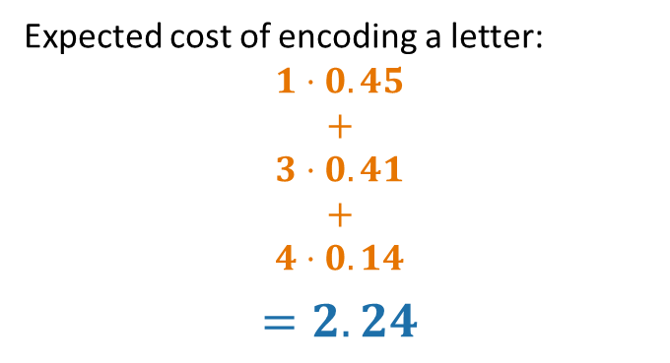
Solution greedily build subtrees, starting with the infrequent letters
100
0
1
55
A: 45
0
1
0
30
25
0
0
1
1
C:12
D: 16
14
B:13
101
110
0
1
100
E:9
F:5
1110
1111

Slide 45
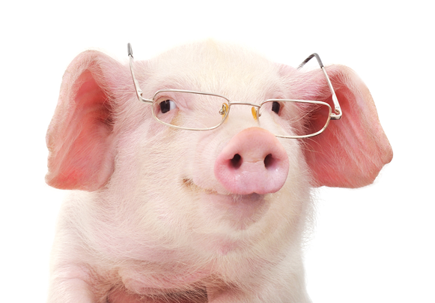
Recap
Greedy algorithms!
Often easy to write down
But may be hard to come up with and hard to justify
The natural greedy algorithm may not always be correct.
A problem is a good candidate for a greedy algorithm if:
it has optimal substructure
that optimal substructure is REALLY NICE
solutions depend on just one other sub-problem.

Slide 46
Thank you

